Slide 1
The Word Identification Strategy
By B. Keith Lenz, Jean B. Schumaker, Donald D. Deshler, and Victoria Beals
Teaching PowerPoint developed by FL SPDG SIM Project to support teachers in implementing The Word Identification Strategy
Notes:
***Please note, this presentation is intentionally very plain, so that teachers can add their own design to the slides.

Slide 2
Stage 1: Pretest and Make Commitments
Notes:
Pg. 12

Slide 3
Pretest
Purpose is to figure out how well you can:
  Identify prefixes and suffixes (or the beginning and ending parts of words)
  Pronounce the words you are reading
  Understand the material you read
Parts of the Pretest
  Prefix/Suffix Test
  Oral reading test
  Comprehension test
Notes:
Pg. 12 Instructor Manual

Slide 4
Student's Name:
Key
Oral Reading Test percentage of words pronounced correctly
Comprehension Test percentage of correct answers
Word Identification Progress Chart
GOAL-SETTING SECTION
Stage 3
Stage 4
Stage 5
Stage 6
Stage 7
Stage 8
Goal Date:
Date Completed:
MOR
100
90
80
70
MC
60
50
40
Percentage Score
30
20
10
0
1
2
3
4
5
6
7
8
9
10
1
2
3
4
5
6
7
8
9
10
1
2
3
4
5
Pre-
Controlled Practice
Advanced Practice
Post-
Maint.
test
Attempts
Atempts
test
Probes
Key:
Percentage of Words Correct
MOR = Mastery Level for Oral Reading = 99%
Percentage of Answers Correct
MC = Mastery Level for Comprehension = 60%
Notes:
Chart Pretest score – page 15, If students do not receive an 80% on the Prefix/Suffix Test, do the Prefix/suffix Lessons in Appendix C (pg. 17 & pg. 112)

Slide 5
The Success Formula
The Word Identification Strategy
+
Effort
=
SUCCESS
Notes:
Pg. 16 Instructor Manual

Slide 6
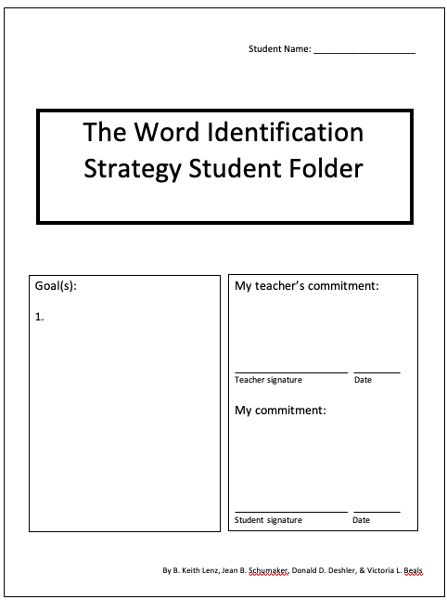
Notes:
Set long term goal and make commitments – pg. 17 Instructor Manual

Slide 7
Prefix/Suffix Lessons
For students who did not meet mastery criteria on the Prefix/Suffix Test
Notes:
Mastery criteria for the Prefix/Suffix test is 80% or higher.
Pg. 112 Instructor Manual

Slide 8
Part 1: Prefixes
Essential Questions
What is a prefix?
How are prefixes identified?
Can I pronounce the common prefixes?
Notes:
Pg. 113– student objectives have been translated into questions.

Slide 9
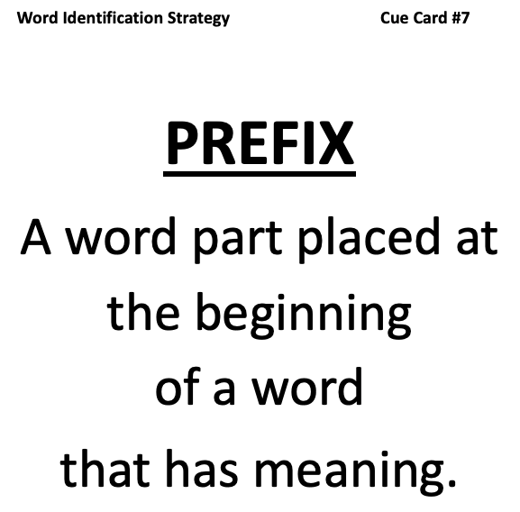

Slide 10
Notes:
Pg. 113

Slide 11
Prefixes within prefixes
Some prefixes are included in other prefixes
Examples:
co is included in con
On your prefix list, draw a box around prefixes that are contained in other prefixes
Example:
ex is included in extra
Notes:
Pg. 114

Slide 12
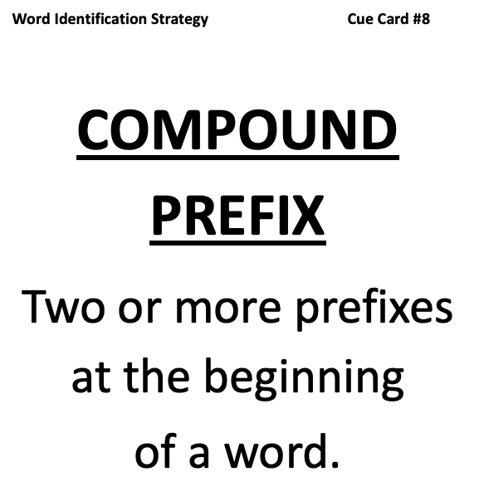

Slide 13
Compound Prefixes
unrelenting
Notes:
Pg. 114

Slide 14
Practice isolating prefixes
Notes:
Pg. 115

Slide 15
Notes:
Pg. 115

Slide 16
Practice reading prefixes aloud
Notes:
Pg. 115

Slide 17
Part 1: Suffixes
Essential Questions
What is a suffix?
How are suffixed identified?
Can I pronounce the common suffixes?
Notes:
Pg. 116– student objectives have been translated into questions.

Slide 18
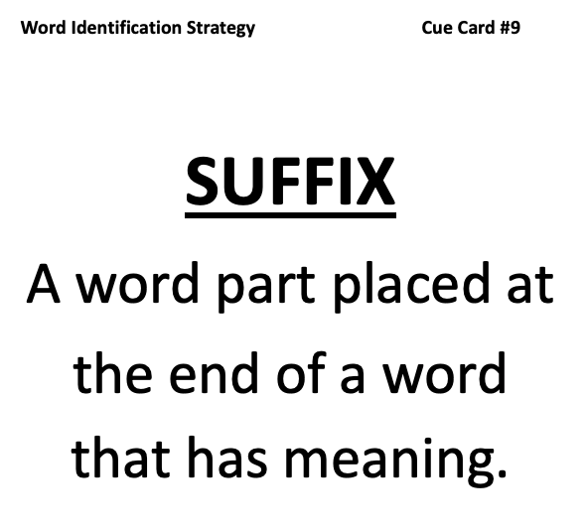
Notes:
Pg. 116

Slide 19
Notes:
Pg. 116

Slide 20
Suffixes within suffixes
Some suffixes also function as the last letter in other suffixes
Examples:
“s” and “y”
On your suffix list, draw a box around suffixes that you don’t want to separate until you have looked for other suffixes.
Notes:
Pg. 117

Slide 21
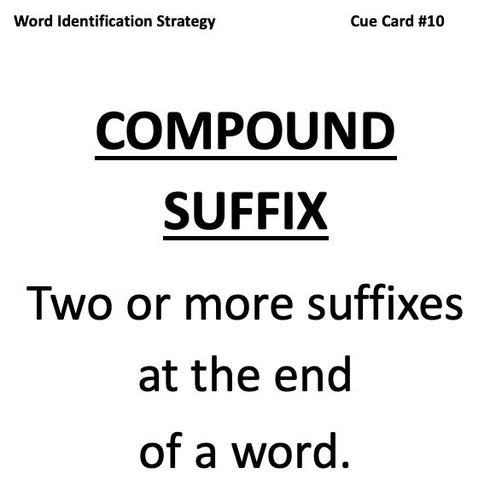
Notes:
Pg. 117

Slide 22

Compound Suffixes
helplessness
help less ness
Notes:
Pg. 117

Slide 23
Practice separating suffixes
Notes:
Pg. 118

Slide 24
Notes:
Pg. 118

Slide 25
Practice reading suffixes aloud
Notes:
Pg. 118

Slide 26
Stage 2: Describe
Notes:
Pg. 19

Slide 27
Describe Essential Questions
What is the meaning of “dissect”?
What are the steps of the Word Identification Strategy?
Where would you use the Word Identification Strategy?
What are the benefits of using the strategy?
Notes:
Pg. 19– student objectives have been translated into questions.

Slide 28
What does “dissect” mean?
Notes:
Pg. 20

Slide 29
Results we can expect from using the Word Identification Strategy
 | Before Mastery | After Mastery
Number of errors | 20 | 3
Percentage of comprehension questions correct | 40% | 70%
Notes:
Pg. 21 “Before they began using the Word Identification Strategy, students were making about 20 errors while reading a passage containing 400 words. As a result, they could only answer about 40% of the questions about the passage correctly. After they mastered the strategy, they only make about 3 errors, and they could answer correctly 70% of the questions about the passages they were reading.”

Slide 30
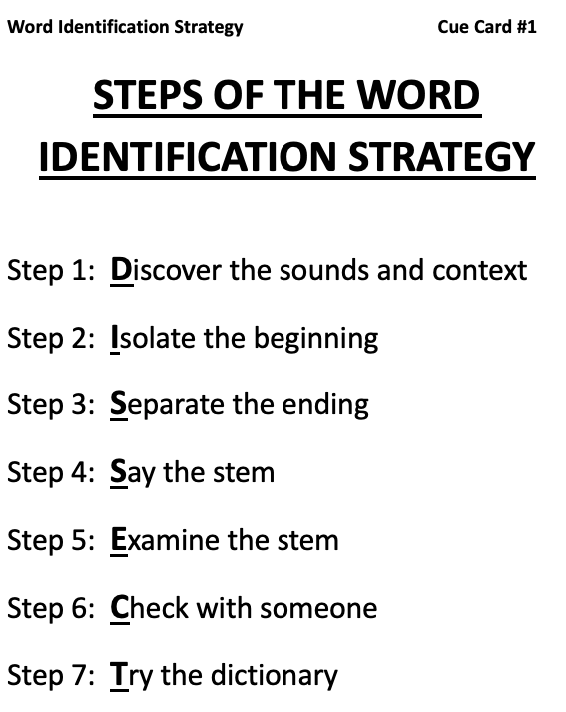
Notes:
Pg. 22

Slide 31
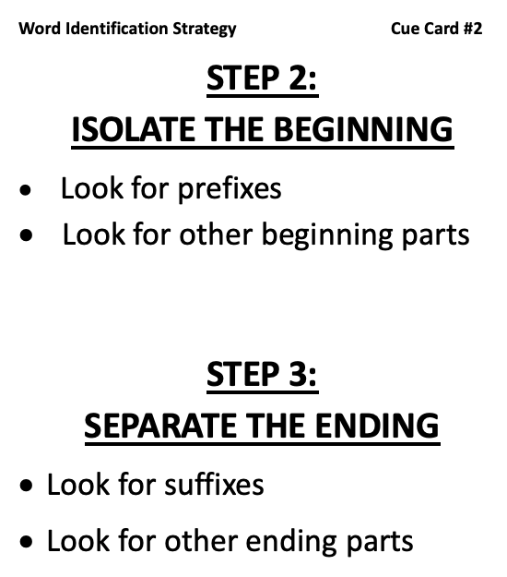
Notes:
Pg. 23

Slide 32
Isolate the beginning
impenetrable
extract
Notes:
Pg. 23

Slide 33
Separate the ending
odorless
Notes:
Pg. 25

Slide 34
Stem
The stem of a word is what is left after you take away the beginning and the ending of a word. If there is no beginning or ending, the whole word is the stem.
unfairly
Notes:
Pg. 25

Slide 35
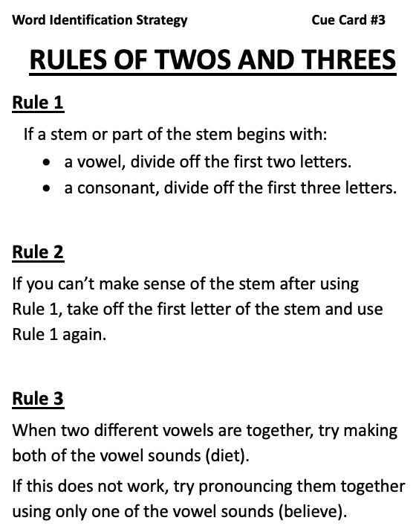
Notes:
Pg. 26

Slide 36
Rule 1
alternator
Rule 2
scandal
Rule 3
diet
Notes:
Pg 26, pg. 27, pg. 28

Slide 37
Notes:
Pg. 28…Answer key on pg. 132

Slide 38
Practice
macadam adjective mercantile
parsimony participate insurgency
Funicular herbivore remedial
Notes:
Pg. 31

Slide 39
Student's Name:
Word Identification Progress Chart
Set goals
GOAL-SETTING SECTION
Stage 3
Stage 4
Stage 5
Stage 6
Stage 7
Stage 8
Goal Date:
Date Completed:
MOR
100
90
80
70
MC
60
50
40
Percentage Score
30
20
10
0
1
2
3
4
5
6
7
8
9
10
1
2
3
4
5
6
7
8
9
10
1
2
3
4
5
Pre-
Controlled Practice
Advanced Practice
Post-
Maint.
test
Attempts
Atempts
test
Probes
Key:
Percentage of Words Correct
MOR = Mastery Level for Oral Reading = 99%
Percentage of Answers Correct
MC = Mastery Level for Comprehension = 60%
Notes:
Pg. 32

Slide 40
Exit Ticket
What was the main idea of today’s lesson?
What did you learn today?
What confused you about the lesson?
What do you still need to know?
How will this lesson help you in your future life?
Notes:
Instructor manual pg. 32

Slide 41
Stage 3: Model
Notes:
Pg. 34

Slide 42
Review of previous information
What is the meaning of “dissect”?
What are the steps of the Word Identification Strategy?
What do “beginning” and “ending” refer to?
What are the Rules of Twos and Threes?
When should you “check with someone”?
Where would you use the Word Identification Strategy?
What are the benefits of using the strategy?

Slide 43
Model Essential Questions
What are the thinking processes involved in using the Word Identification Strategy?
Notes:
Pg. 35

Slide 44
Notes:
Pg. 36

Slide 46
Exit Ticket
What did you witness today?
What did you learn today?
What confused you about the lesson?
What do you still need to know?
How will this lesson help you in your future life?
Notes:
Instructor manual pg. 39

Slide 47
Student's Name:
Word Identification Progress Chart
Stage 3 Completion Date
GOAL-SETTING SECTION
Stage 3
Stage 4
Stage 5
Stage 6
Stage 7
Stage 8
Goal Date:
Date Completed:
MOR
100
90
80
70
MC
60
50
40
Percentage Score
30
20
10
0
1
2
3
4
5
6
7
8
9
10
1
2
3
4
5
6
7
8
9
10
1
2
3
4
5
Pre-
Controlled Practice
Advanced Practice
Post-
Maint.
test
Attempts
Atempts
test
Probes
Key:
Percentage of Words Correct
MOR = Mastery Level for Oral Reading = 99%
Percentage of Answers Correct
MC = Mastery Level for Comprehension = 60%
Notes:
Pg. 40

Slide 48
Stage 4: Verbal Practice
Notes:
Pg. 41

Slide 49
Review of previous information
What are the steps of the Word Identification Strategy?
What is the mnemonic for remembering the steps?
What do “beginning” and “ending” refer to?
What are the Rules of Twos and Threes?
When should you “check with someone”?
When and where would you use the Word Identification Strategy?
What are the benefits of being able to read well?
Notes:
Pg. 42

Slide 51
Student's Name:
Word Identification Progress Chart
Stage 4 Completion Date
GOAL-SETTING SECTION
Stage 3
Stage 4
Stage 5
Stage 6
Stage 7
Stage 8
Goal Date:
Date Completed:
MOR
100
90
80
70
MC
60
50
40
Percentage Score
30
20
10
0
1
2
3
4
5
6
7
8
9
10
1
2
3
4
5
6
7
8
9
10
1
2
3
4
5
Pre-
Controlled Practice
Advanced Practice
Post-
Maint.
test
Attempts
Atempts
test
Probes
Key:
Percentage of Words Correct
MOR = Mastery Level for Oral Reading = 99%
Percentage of Answers Correct
MC = Mastery Level for Comprehension = 60%
Notes:
Pg. 40

Slide 52
Stage 5: Controlled Practice and Feedback
Notes:
Pg. 47

Slide 53
Review of previous information
What are the definitions of: prefix, suffix, beginning, ending, and stem?
What are the steps of the Word Identification Strategy?
What is the mnemonic for remembering the steps?
What do “beginning” and “ending” refer to?
What are the Rules of Twos and Threes?
When should you “check with someone”?
When and where would you use the Word Identification Strategy?
What are the benefits of being a strategic reader?
Notes:
Pg. 42

Slide 56
Activities
Read your assigned passage using the DISSECT steps into ______________. (where you will capture student oral responses) – Mastery is 99% or higher
Take Comprehension test – mastery is 60% or higher
Develop fluency in using the strategy over time
Plot your scores on the Progress Chart
Notes:
Pg. 51

Slide 57
Student's Name:
Word Identification Progress Chart
GOAL-SETTING SECTION
Stage 3
Stage 4
Stage 5
Stage 6
Stage 7
Stage 8
Goal Date:
Date Completed:
MOR
100
90
80
70
MC
60
50
40
Percentage Score
30
20
10
Plot scores for controlled practice attempts
0
1
2
3
4
5
6
7
8
9
10
1
2
3
4
5
6
7
8
9
10
1
2
3
4
5
Pre-
Controlled Practice
Advanced Practice
Post-
Maint.
test
Attempts
Atempts
test
Probes
Key:
Percentage of Words Correct
MOR = Mastery Level for Oral Reading = 99%
Percentage of Answers Correct
MC = Mastery Level for Comprehension = 60%
Notes:
Pg. 52

Slide 58
Student's Name:
Word Identification Progress Chart
Stage 5 Completion Date
GOAL-SETTING SECTION
Stage 3
Stage 4
Stage 5
Stage 6
Stage 7
Stage 8
Goal Date:
Date Completed:
MOR
100
90
80
70
MC
60
50
40
Percentage Score
30
20
10
0
1
2
3
4
5
6
7
8
9
10
1
2
3
4
5
6
7
8
9
10
1
2
3
4
5
Pre-
Controlled Practice
Advanced Practice
Post-
Maint.
test
Attempts
Atempts
test
Probes
Key:
Percentage of Words Correct
MOR = Mastery Level for Oral Reading = 99%
Percentage of Answers Correct
MC = Mastery Level for Comprehension = 60%
Notes:
Pg. 52

Slide 59
Stage 6: Advanced Practice and Feedback
Notes:
Pg. 56

Slide 60
Review of previous information
What are the definitions of: prefix, suffix, beginning, ending, and stem?
What are the steps of the Word Identification Strategy?
What is the mnemonic for remembering the steps?
What do “beginning” and “ending” refer to?
What are the Rules of Twos and Threes?
When should you “check with someone”?
When and where would you use the Word Identification Strategy?
What are the benefits of being a strategic reader?
Notes:
Pg. 57

Slide 61
Advanced Practice
Essential Question
How do I use the Word Identification Strategy on materials written at my grade level?

Slide 62
Notes:
Pg. 57

Slide 64
Activities
Read your assigned passage using the DISSECT steps into ______________. (where you will capture student oral responses) – Mastery is 99% or higher
Take Comprehension test – mastery is 60% or higher
Develop fluency in using the strategy over time
Plot your scores on the Progress Chart
Notes:
Pg. 58

Slide 65
Student's Name:
Word Identification Progress Chart
GOAL-SETTING SECTION
Stage 3
Stage 4
Stage 5
Stage 6
Stage 7
Stage 8
Goal Date:
Date Completed:
MOR
100
90
80
70
MC
60
50
40
Percentage Score
30
20
10
Plot scores for advanced practice attempts
0
1
2
3
4
5
6
7
8
9
10
1
2
3
4
5
6
7
8
9
10
1
2
3
4
5
Pre-
Controlled Practice
Advanced Practice
Post-
Maint.
test
Attempts
Atempts
test
Probes
Key:
Percentage of Words Correct
MOR = Mastery Level for Oral Reading = 99%
Percentage of Answers Correct
MC = Mastery Level for Comprehension = 60%
Notes:
Pg. 58

Slide 66
Student's Name:
Word Identification Progress Chart
Stage 6 Completion Date
GOAL-SETTING SECTION
Stage 3
Stage 4
Stage 5
Stage 6
Stage 7
Stage 8
Goal Date:
Date Completed:
MOR
100
90
80
70
MC
60
50
40
Percentage Score
30
20
10
0
1
2
3
4
5
6
7
8
9
10
1
2
3
4
5
6
7
8
9
10
1
2
3
4
5
Pre-
Controlled Practice
Advanced Practice
Post-
Maint.
test
Attempts
Atempts
test
Probes
Key:
Percentage of Words Correct
MOR = Mastery Level for Oral Reading = 99%
Percentage of Answers Correct
MC = Mastery Level for Comprehension = 60%
Notes:
Pg. 58

Slide 67
Stage 7: Posttest and Make Commitments
Notes:
Pg. 56

Slide 68
Posttest
Essential Question
Have I mastered the use of the Word Identification Strategy?

Slide 69
Student's Name:
Word Identification Progress Chart
GOAL-SETTING SECTION
Stage 3
Stage 4
Stage 5
Stage 6
Stage 7
Stage 8
Goal Date:
Date Completed:
MOR
100
90
80
70
MC
60
50
40
Percentage Score
30
20
10
Plot score for Posttest
0
1
2
3
4
5
6
7
8
9
10
1
2
3
4
5
6
7
8
9
10
1
2
3
4
5
Pre-
Controlled Practice
Advanced Practice
Post-
Maint.
test
Attempts
Atempts
test
Probes
Key:
Percentage of Words Correct
MOR = Mastery Level for Oral Reading = 99%
Percentage of Answers Correct
MC = Mastery Level for Comprehension = 60%
Notes:
Pg. 61

Slide 70
Goal Completed!
How will you celebrate your success?
Notes:
Pg. 62

Slide 71
What does “generalization” mean to you?
What would be the benefits of generalizing this strategy?

Slide 72
New Goal to use the Word ID Strategy
Notes:
Pg. 62

Slide 73
Student's Name:
Word Identification Progress Chart
Stage 7 Completion Date
GOAL-SETTING SECTION
Stage 3
Stage 4
Stage 5
Stage 6
Stage 7
Stage 8
Goal Date:
Date Completed:
MOR
100
90
80
70
MC
60
50
40
Percentage Score
30
20
10
0
1
2
3
4
5
6
7
8
9
10
1
2
3
4
5
6
7
8
9
10
1
2
3
4
5
Pre-
Controlled Practice
Advanced Practice
Post-
Maint.
test
Attempts
Atempts
test
Probes
Key:
Percentage of Words Correct
MOR = Mastery Level for Oral Reading = 99%
Percentage of Answers Correct
MC = Mastery Level for Comprehension = 60%
Notes:
Pg. 61

Slide 74
Stage 8 : Generalization
Orientation Phase
Notes:
Pg. 64

Slide 75
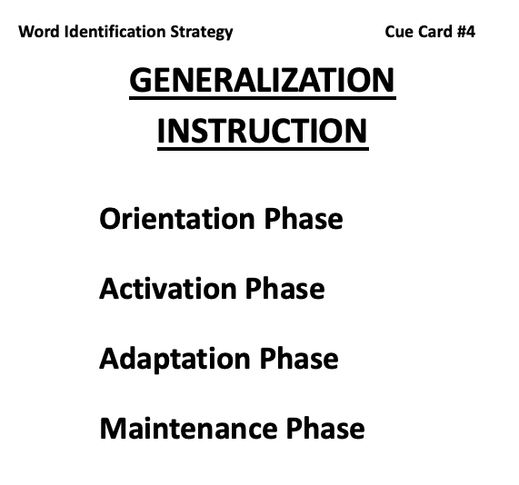
Notes:
Pg. 65

Slide 76
The Success Formula
The Word Identification Strategy
+
Effort
=
SUCCESS
Notes:
Pg. 65 Instructor Manual

Slide 77
Cues for Using the Word Identification Strategy
Notes:
Pg. 66

Slide 78
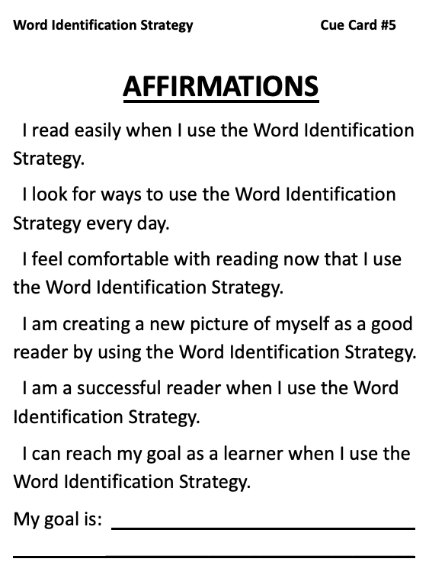
Notes:
Pg. 67

Slide 79
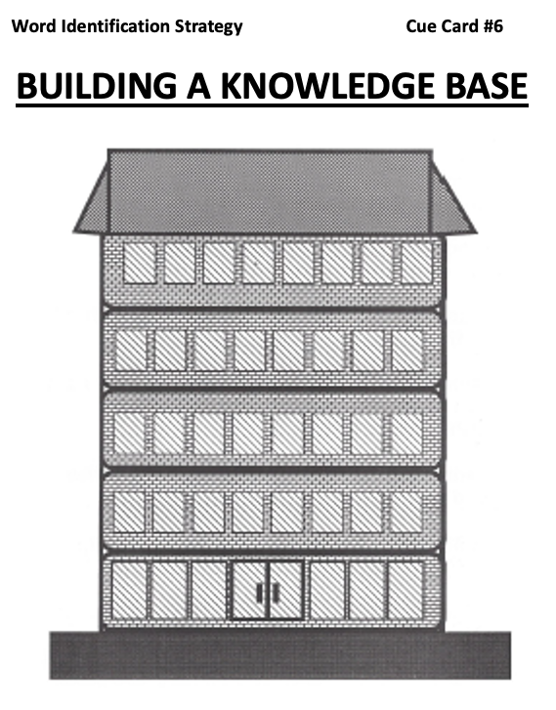

Slide 80
Stage 8 : Generalization
Activation Phase
Notes:
Pg. 70

Slide 81
Notes:
Pg. 71

Slide 82
Notes:
Pg. 71

Slide 84
Stage 8 : Generalization
Adaptation Phase
Notes:
Pg. 75

Slide 85
Notes:
Pg. 75

Slide 86
Using clues from context
Breaking into parts
Using resources
Notes:
Pg. 76

Slide 87
Stage 8 : Generalization
Maintenance Phase
Notes:
Pg. 75

Slide 88
Notes:
Pg. 81

Slide 89
Student's Name:
Word Identification Progress Chart
GOAL-SETTING SECTION
Stage 3
Stage 4
Stage 5
Stage 6
Stage 7
Stage 8
Goal Date:
Date Completed:
MOR
100
90
80
70
MC
60
50
40
Percentage Score
30
20
10
0
1
2
3
4
5
6
7
8
9
10
1
2
3
4
5
6
7
8
9
10
1
2
3
4
5
Select dates for maintenance probes
Pre-
Controlled Practice
Advanced Practice
Post-
Maint.
test
Attempts
Atempts
test
Probes
Key:
Percentage of Words Correct
MOR = Mastery Level for Oral Reading = 99%
Percentage of Answers Correct
MC = Mastery Level for Comprehension = 60%
Notes:
Pg. 82

