Slide 1
Why Word Mapping Today
Monica L. Harris, Ph.D.
Grand Valley State University

Slide 2


Agenda
Importance of Teaching the WM Strategy
How to use WM in Inclusive Settings
Q & A
This Photo by Unknown Author is licensed under CC BY-SA

Slide 3

Why MA & Roots are Important…..
  Reports on Adolescent Literacy supporting Morphological Awareness (MA)
  Standards/CCSS with MA as focus from disciplines

Slide 4
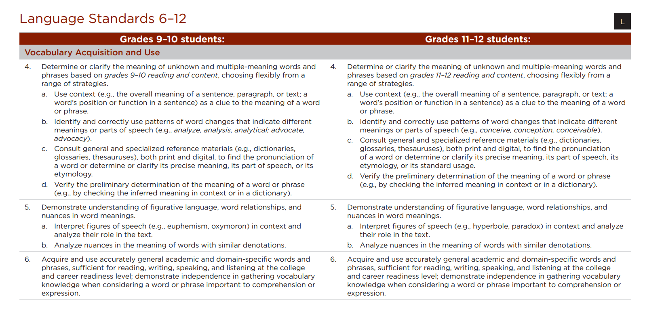
Notes:
Taken from The Common Core State Standards – Language Arts & Literacy in Social Studies/History, Science and Technical Studies

Slide 5
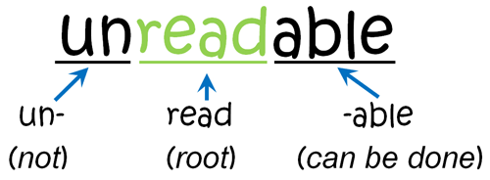
Research on Morphological Awareness (MA)
Morphology in the 21st Century!
  Students with Disabilities (Harris et al., 2011)
  English Language Learners (Goodman, 2013)
  Subject/Discipline Areas (Ganz, 2008; Marzano, 2011)

Slide 6
Frequently Asked Questions
Do you have any “Tips” for dissecting words?
How to embed in daily instruction?
How to choose the terms to use?
Any additional activities to engage students in practice & feedback?

Slide 7
Tips for “Deconstructing” Words
Look for words or known parts within the term.
  “un-” “healthy”
Bite off the biggest chunk!
  “anthrop” (instead of only an-) “-ology”
  “divers(e)” (instead of only di-) “-ity”
At times, the prefix/root/suffix “sequence” will not be used; not all words have all parts.
  ex- port port port -er trans- port (a)-tion
Word parts may have more than one meaning – must “play” with meanings to make prediction.
  dis- (not, apart or away) ease
At times, there will be “extra” letters left between word parts; connector vowels.
  morph (o)-logy trans- port (a)-tion

Slide 8
Word Map
Word
unhealthy
Prefix
Root
Suffix
M Step
A Step
P Step
S Step
un
healthy
Meaning
Meaning
Meaning
not
well-being
Prediction
Not well
Definition
Not healthy or being well.

Slide 9
Word Map
Word
anthropologist
Prefix
Root
Suffix
M Step
A Step
P Step
S Step
anthrop
(o)log/ist
Meaning
Meaning
Meaning
man; human
study of/one who
Prediction
one who studies man or humans
Definition
One who studies anthropology or human culture.

Slide 10
Word Map
Word
port
Prefix
Root
Suffix
M Step
A Step
P Step
S Step
im-
ex-
port
-er
Meaning
Meaning
Meaning
into
out of
to carry
more or one who
Prediction
Start with suffix, go to the root and add or change with the prefix
Definition

Slide 11
Word Map
Word
transportation
Prefix
Root
Suffix
M Step
A Step
P Step
S Step
trans
port
(at) ion
Meaning
Meaning
Meaning
across
to carry
act, result, or state of
Prediction
The act or state of carry across something
Definition
The act of transporting or being carried across.

Slide 12
2. How to Embed WM into Your Instruction
  High Frequency Affix List – Targeted Word Part List in WMS manual (p. X)
  Prefixes, Suffixes, & Roots in the Disciplines (Marzano’s work)
  Teach explicitly, as an essential part of your daily/weekly routine (Archer & Hughes, 2011)
Notes:
Word Mapping instruction for inclusive settings

Slide 13
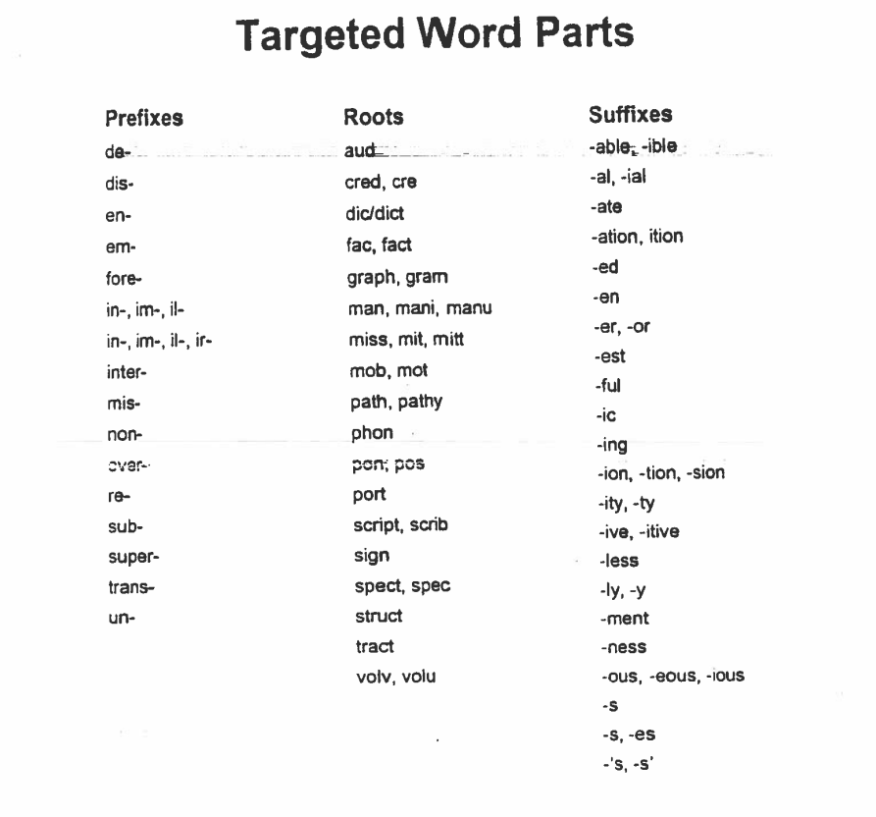
Manual – p. ?

Slide 14
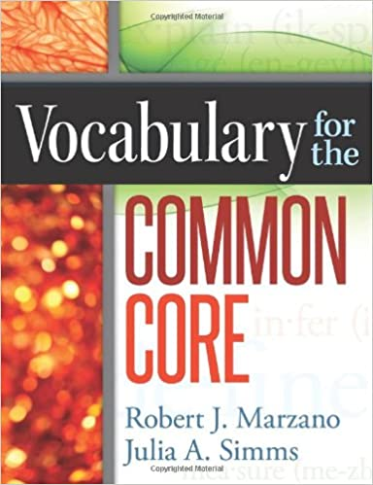
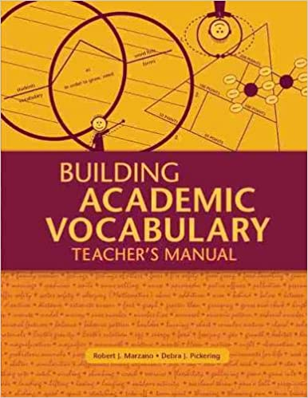
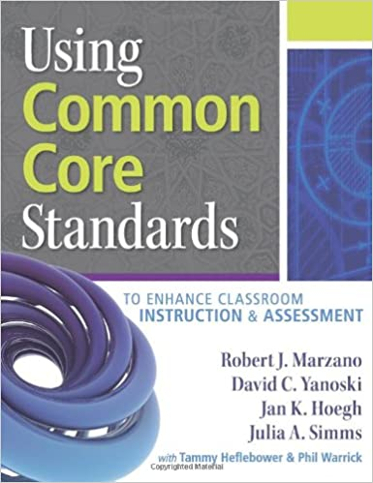
Marzano!

Slide 15

Explicit Instruction
I do it
We do it
You do it

Slide 16

#3 - How do I know which vocabulary terms to choose?

Slide 17
Tiered Words (Beck et al., 2004)
Tier 1 | Tier 2* | Tier 3*
Very basic; sight words For example, house food happy | High frequency words; “utility” words For example, variable incredible representative | Content specific; contextual For example, polynomial exoskeleton circumference
* A balance of Tier 2 & 3 words must be used in the content areas
Notes:
When considering WMS, ask yourself if a term lends itself to using word parts or etymology to memorize the word; all other terms can be used with LINCS

Slide 18
#4 – Additional Activities & Resources
Focus on High Frequency Words & Parts
  Find high frequency roots from the disciplines to use (Marzano stuff)
Use Cooperative Learning & Peer Assisted Learning practices
  Morphologists as Word Detectives

Slide 19
Role Cards (Kagan & Kagan, 2009)
Notes:
Role Cards (Kagan & Kagan, 2009)

Slide 20

This Photo by Unknown Author is licensed under CC BY

