Slide 1
SIM Network Webinar on the Sentence Writing Strategies Manuals Revisions
Jocelyn Washburn, Ph.D.
Director of Professional Development
KUCRL
May 1, 2024

Slide 2
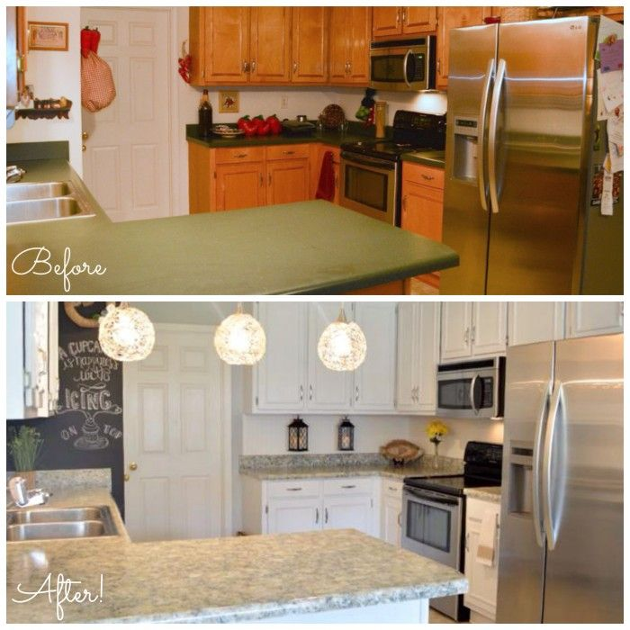
Major Revisions to Proficiency in SW
Minor Revisions to Fundamentals in SW
Notes:
The Prof in SW Instructor’s Manual is now a 2nd Edition, published in 2024, but the Fund in SW manual is only a revision with a new 2023 copyright date.

Slide 3
Acknowledgements and Many Thanks
Peony Allen for her copy editing for the revisions and transferring the prior file to a new editable file (no small feat).
Dana McCaleb for her review of the prior PSW manuals to identify locations for Student Lessons Volume 2 revisions and make suggested language updates.
Jocelyn Washburn for checking content revisions, writing scripts teachers to refer to the Student Lessons Volume 2, and editing prior scripts to accommodate the new scripts.
Debbie Higginbotham for her review of the prior FSW manuals to identify scoring errors.
Rosanne Arvin for providing updated Progress Charts.
Jean Schumaker for final review and approval of edits and revisions.

Slide 4
Changes in Both Manuals
Revision Where to Check Explanation

Slide 5
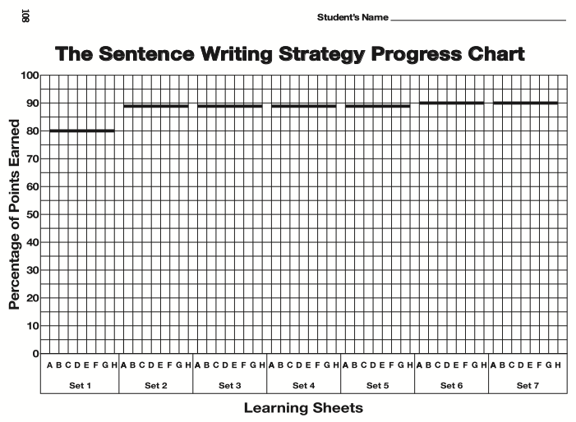
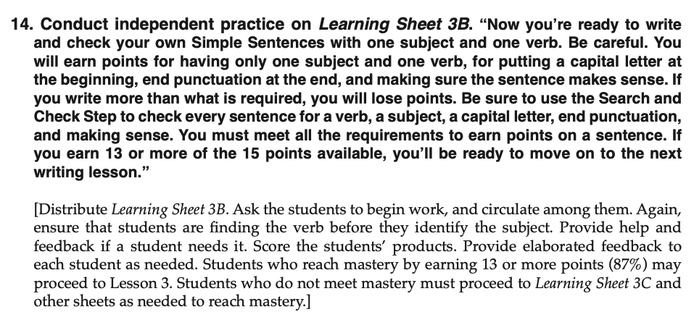
Mastery Percentages and Points Alignment Fundamentals in the Sentence Writing Instructor’s Manual
Lesson 2, p. 23

Slide 6
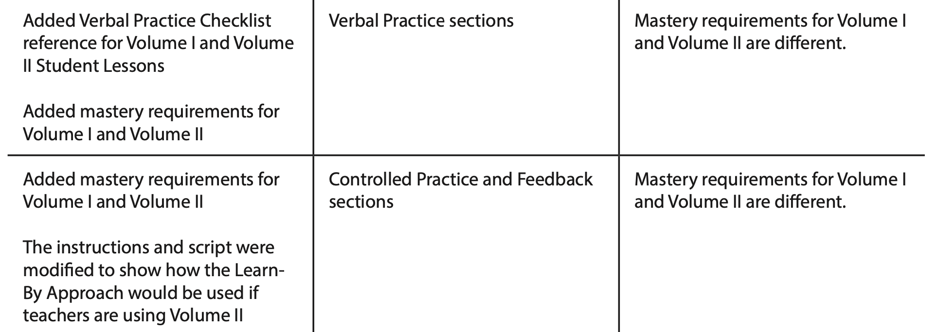
Mastery Requirements for Volume I and II Proficiency in the Sentence Writing Instructor’s Manual
Revision Where to Check Explanation
Volume I: 90%
Volume II: 80%
Volume I: 90%
Volume II: 85%
Notes:
Verbal Practice
Volume I: 90%
Volume II: 80%
Controlled Practice
Volume I: 90%
Volume II: 85%

Slide 7
Additional Progress Charts for Volume II

Slide 8
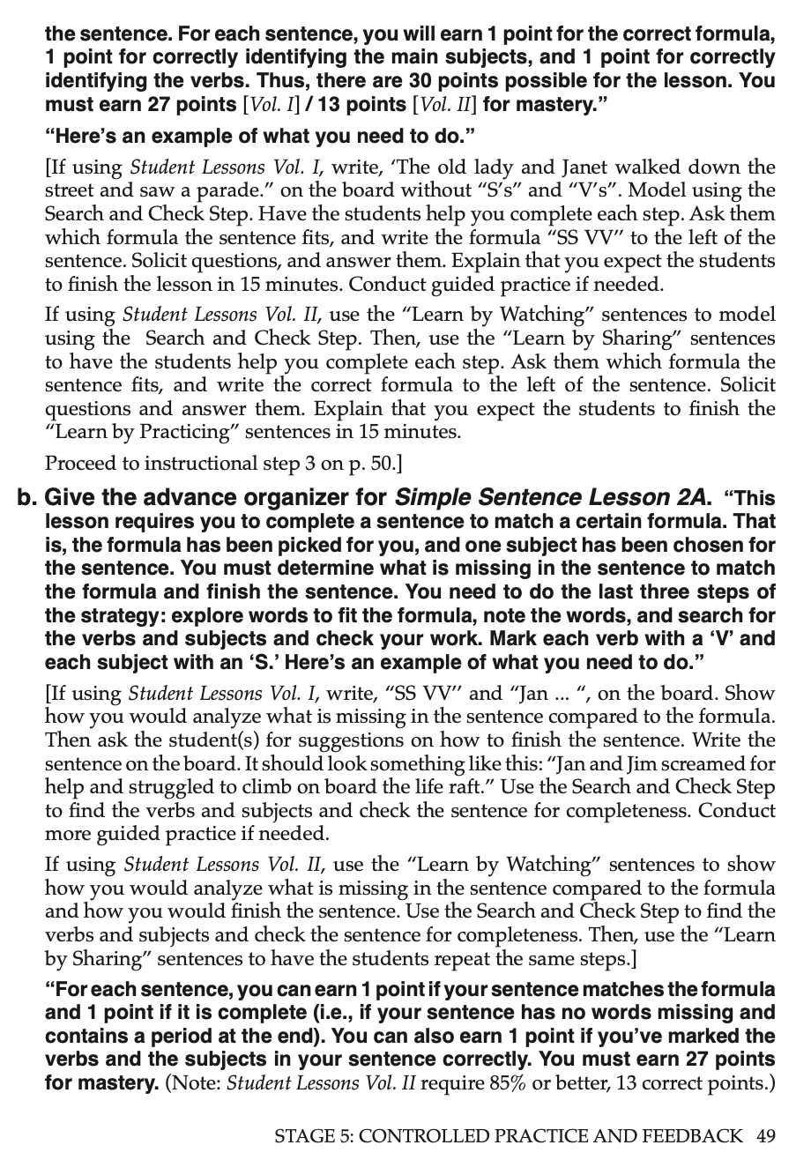
Scripts in Controlled Practice & Feedback for Volume I and II Proficiency in the Sentence Writing Instructor’s Manual

Slide 9
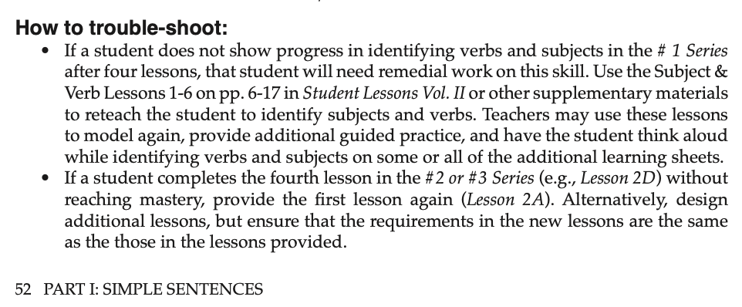
S & V in Student Lesson Volume 2
The existence of the S and V learning Sheets in Volume II was confusing for teachers. When they would get to Controlled Practice, they would start there rather than with Learning Sheet 1A.

Slide 10
Name Changes Proficiency in the Sentence Writing Instructor’s Manual
Notes:
Also, we changed the sentence in Step 1 to “Miguel won an award”
(Cue Card 4, p. 156)
We wanted the sentence to read more positively.

Slide 11
Verb-Subject Identification Procedure
Step 1: Look for the action or state-of-being word to find the verb.
Example: Miguel won an award.
Step 2: Ask yourself "Who or what (verb)?” to find the subject
Example: Mae is an astronaut.
Cue Card #4
University of Kansas | Center for Research on Learning

Slide 12
Example Set I
1. Ava went to the pool.
2. Travis is a very nice guy.
3. Cakes lined the store window.
4. I love chocolate ice cream.
5. Bikes are very expensive.
6. Dad is strict.
7. Bananas taste good.
8. Kara has a son named Jackson.
9. Raccoons raid our garbage can every night.
10. Flowers are in bloom everywhere.

Slide 13
Other Language & Context Revisions
“IEP file”
Junior high to middle school
They/them when gender is not apparent (APA 7 Rule)
“remedial” to “intervention” class
Notes:
“IEP File” Removed from various locations in Generalization Stage and on Page 15, Step 10 - IEP regulations might interfere with teachers doing this.

Slide 14
Important Resources for Your PD
For Proficiency in Sentence Writing:
2024 Updated Presenter Slides in SIMville
2024 Cue Card Slides in SIMville
PSW Page in SIMville

Slide 15
Let’s Talk!
How will these revised manuals affect your work?
What are your next steps?
What other resources do we need to support you with these revisions?
What else?

