Slide 1
The Visual Imagery Strategy
By Jean B. Schumaker, Donald D. Deshler,
Alice Zemitzsch, and Michael M. Warner
Teaching PowerPoint developed by FL SPDG SIM Project to support teachers in implementing The Word Identification Strategy
Notes:
***Please note, this presentation is intentionally very plain, so that teachers can add their own design to the slides.

Slide 2
Stage 1: Pretest and Make Commitments
Notes:
Pg. 12

Slide 3
Pretest
Purpose is to figure out how well you can understand the material you read and remember it.
Parts of the Pretest
  Visual Imagery Test
  Comprehension test
Notes:
Pg. 13 Instructor Manual

Slide 4
Key
Visual Imagery Test percentage correct
Comprehension Test percentage of correct answers
Plot Pre-test scores
Notes:
Chart Pretest score – page 15

Slide 5
The Success Formula
The Visual Imagery Strategy
+
Effort
=
SUCCESS
Notes:
Pg. 15 Instructor Manual

Slide 6
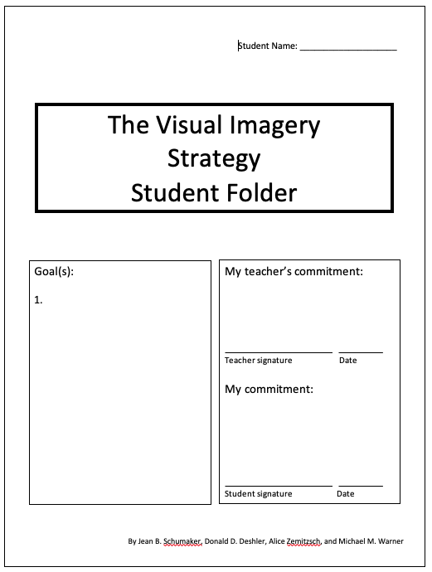
Notes:
Set long term goal and make commitments – pg. 16 Instructor Manual

Slide 7
Stage 2: Describe
Notes:
Pg. 18

Slide 8
Describe Essential Questions
Why would learning the Visual Imagery Strategy be helpful?
What results can we expect from using the Visual Imagery Strategy?
What are the steps of the Visual Imagery Strategy?
Where could you use the Visual Imagery Strategy?
Notes:
Pg. 18– student objectives have been translated into questions.

Slide 9
What does “visual” mean?
What does “imagery” or “image” mean?
Notes:
Pg. 19

Slide 10
Discussion Questions
What is “reading”?
Why do we read?
Why might we want to store the information in our brains?
Notes:
Pg. 20

Slide 11
Discussion Questions
How would understanding and information better help you in school?
How would it help you outside of school?
What are some situations where it would be important to understand and remember information?
Notes:
Pg. 20

Slide 12
Results we can expect from using the Visual Imagery Strategy
 | Before Mastery | After Mastery
Percentage of comprehension questions correct | 35% | 86%
Notes:
Pg. 22

Slide 13
Notes:
Pg. 23

Slide 14
Notes:
Pg. 23

Slide 15
Notes:
Pg. 24

Slide 16
Notes:
Pg. 23

Slide 17
What is a “scene”?
Notes:
Pg. 24

Slide 18
Notes:
Pg. 26 – practice creating scenes

Slide 19
Notes:
Pg. 26

Slide 20
Notes:
Pg. 27 – practice entering lots of details

Slide 21
Notes:
Pg. 27

Slide 22
Notes:
Pg. 27

Slide 23
Notes:
Pg. 28

Slide 24
Notes:
Pg. 28

Slide 25
Notes:
Pg. 28

Slide 26
Notes:
Pg. 29

Slide 27
Notes:
Pg. 29

Slide 28
Notes:
Pg. 30

Slide 29
Notes:
Pg. 30

Slide 30
Set goals
Notes:
Pg. 31

Slide 31
Exit Ticket
What was the main idea of today’s lesson?
What did you learn today?
What confused you about the lesson?
What do you still need to know?
How will this lesson help you in your future life?
Notes:
Instructor manual pg. 31

Slide 32
Stage 2 Completion Date
Notes:
Pg. 32

Slide 33
Stage 3: Model
Notes:
Pg. 33

Slide 34
Review of previous information
What is the meaning of “image”?
What are the steps of the Visual Imagery Strategy?
What is the reason for creating a scene?
What is the reason for entering lots of details?
What is the reason for describing the image to yourself?
What do you need to describe to yourself?
What are the reasons for checking your image?
What are the benefits of using the Visual Imagery Strategy?
Where can you use the strategy?
Notes:
Pg. 34

Slide 35
Model Essential Questions
What are the thinking processes involved when using the Visual Imagery Strategy?
Notes:
Pg. 35

Slide 36
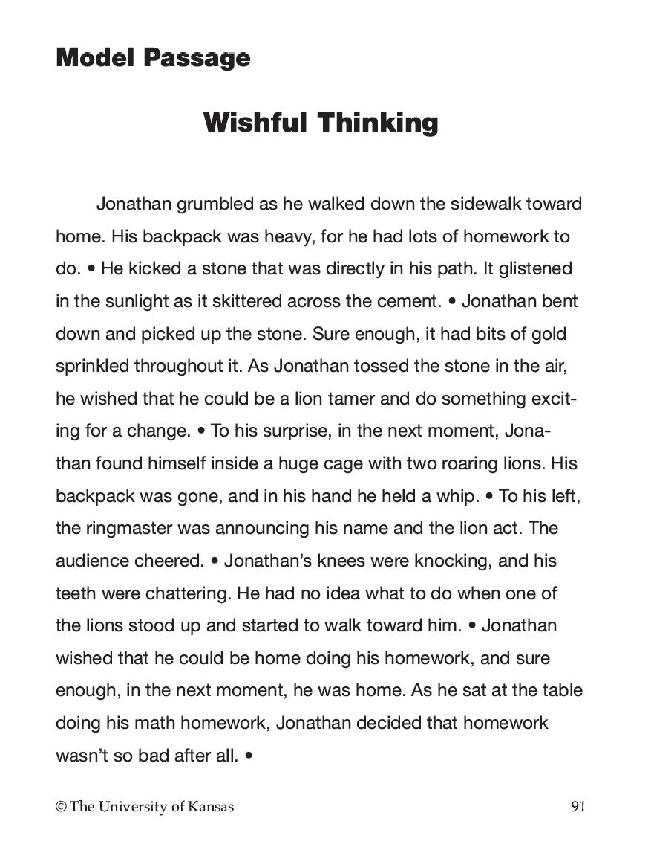
Notes:
Pg. 35

Slide 37
Exit Ticket
What did you watch today?
What did you learn today?
What confused you about the lesson?
What do you still need to know?
How will this lesson help you in your future life?
Notes:
Instructor manual pg. 38

Slide 38
Stage 3 Completion Date
Notes:
Pg. 39

Slide 39
Stage 4: Verbal Practice
Notes:
Pg. 40

Slide 40
Review of previous information
What is the purpose of reading?
What are the benefits of being able to read well?
When and where would you use the Visual Imagery Strategy?
What are the steps of the Visual Imagery Strategy?
What is the mnemonic for remembering the steps?
What are the requirements for a good image statement?
Notes:
Pg. 41

Slide 42
Stage 4 Completion Date
Notes:
Pg. 45

Slide 43
Stage 5: Controlled Practice and Feedback
Notes:
Pg. 47

Slide 44
Review of previous information
What is the purpose of reading?
What are the benefits of being a strategic reader?
What are the steps of the Visual Imagery Strategy?
What are the parts of the image to be named?
What are the requirements for a good image statement?
When and where would you use the Visual Imagery Strategy?
What are the benefits to using the Visual Imagery Strategy?
Notes:
Pg. 48

Slide 47
Pairs/Group Practice Activities
Read assigned passage using the SCENE steps
  stop after every three sentences to describe and evaluate images
  record how well your partners do on the group score sheet.
Take Comprehension test
Develop fluency in using the strategy over time
Notes:
Pg. 50 – please note, additional instruction in pairs or group practice expectations may need to be added to this section, based on the needs of students.

Slide 48
Independent Practice Activities
Read assigned passage using the SCENE steps Mastery is 80% or higher
Take Comprehension test – mastery is 80% or higher
Develop fluency in using the strategy over time
Plot your scores on the Progress Chart
Notes:
Pg. 51

Slide 49
Plot scores for controlled practice attempts
Notes:
Pg. 51

Slide 50
Stage 5 Completion Date
Notes:
Pg. 53

Slide 51
Stage 6: Advanced Practice and Feedback
Notes:
Pg. 54

Slide 52
Review of previous information
What is the purpose of reading?
What are the benefits of being a strategic reader?
What are the steps of the Visual Imagery Strategy?
What are the parts of the image to be named?
What are the requirements for a good image statement?
When and where would you use the Visual Imagery Strategy?
What are the benefits to using the Visual Imagery Strategy?
Notes:
Pg. 55

Slide 53
Advanced Practice
Essential Question
How do I use the Visual Imagery Strategy on materials written at a more difficult level?
Notes:
Pg. 55

Slide 54
Independent Practice Activities
Read assigned passage using the SCENE steps Mastery is 80% or higher
Take Comprehension test – mastery is 80% or higher
Develop fluency in using the strategy over time
Plot your scores on the Progress Chart
Notes:
Pg. 51

Slide 56
Plot scores for advanced practice attempts
Notes:
Pg. 56

Slide 57
Stage 6 Completion Date
Notes:
Pg. 56

Slide 58
Stage 7: Posttest and Make Commitments
Notes:
Pg. 58

Slide 59
Posttest
Essential Question
Have I mastered the use of the Visual Imagery Strategy?

Slide 60
Posttest
Purpose is to figure out how well you can understand the material you read and remember it now that you have learned to use the Visual Imagery Strategy
Parts of the Posttest
  Visual Imagery Test
  Comprehension test
Notes:
Pg. 13 Instructor Manual

Slide 61
Plot score for Posttest
Notes:
Pg. 60

Slide 62
Goal Completed!
How will you celebrate your success?
Notes:
Pg. 60

Slide 63
What does “generalization” mean to you?
What would be the benefits of generalizing this strategy?
Notes:
Pg.60

Slide 64
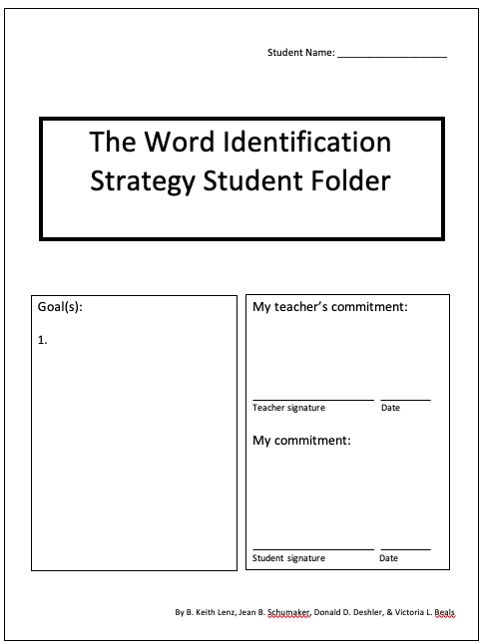
New Goal to use the Visual Imagery Strategy
Notes:
Pg. 61

Slide 65
Stage 7 Completion Date
Notes:
Pg. 61

Slide 66
Stage 8 : Generalization
Orientation Phase
Notes:
Pg. 62

Slide 67
Notes:
Pg. 63

Slide 68
The Success Formula
The Visual Imagery Strategy
+
Effort
=
SUCCESS
Notes:
Pg. 63 Instructor Manual

Slide 69
Cues for Using the Visual Imagery Strategy
Notes:
Pg. 65

Slide 70
Notes:
Pg. 65

Slide 71
Notes:
Pg. 66

Slide 72
Stage 8 : Generalization
Activation Phase
Notes:
Pg. 68

Slide 73
Notes:
Pg. 69

Slide 74
Notes:
Pg. 69

Slide 75
Notes:
Pg. 70

Slide 76
Stage 8 : Generalization
Adaptation Phase
Notes:
Pg. 73

Slide 77
Notes:
Pg. 73

Slide 78
Deciding and taking in information
Transforming
Checking
Notes:
Pg. 74

Slide 79
Practicing making adaptations
Notes:
Pg. 77

Slide 80
Stage 8 : Generalization
Maintenance Phase
Notes:
Pg. 79

Slide 81
Set maintenance goal and maintenance dates
Notes:
Pg. 81

