Slide 1
The Self-Questioning Strategy
By Jean B. Schumaker, Donald D. Deshler, Susan M. Nolan and Gordon R. Alley
Teaching PowerPoint developed by FL SPDG SIM Project to support teachers in implementing The Self-Questioning Strategy
***Please note, this presentation is intentionally very plain, so that teachers can add their own design to the slides.
Notes:
***Please note, this presentation is intentionally very plain, so that teachers can add their own design to the slides.

Slide 2
Stage 1
Pretest and Make Commitments
Notes:
Pg. 12

Slide 3
Pretest
Purpose – to determine how well you can create questions, make predictions, and find answers while you read which increases your understanding and ability to remember what you have read.
Part 1 – how well do you create questions, make predictions and find answers while you read grade level passages?
Part 2 – how well do you remember and understand reading passages on your grade level?
Notes:
Instructional Manual pg. 13

Slide 4
Pretest Part 1
You may have a different passage from your neighbor based on your grade level.
When you come to a dot
  What questions come to your mind about what you have read?
  What do you predict the answers to those questions will be?
  As you read, what answers do you find?
Examples:
Questions | Predictions | Answers
1. What does the girl look like? | She has brown hair and eyes. | She is blond with curly hair and blue eyes.
2. Where does she live? | She lives in an apartment. | She lives in a trailer.
Notes:
These directions will change based on how you plan to collect the information orally or written
Pg. 14

Slide 5
Pretest part 2
You will take a comprehension quiz to determine how well you understand and remember the passage you read during the last class.
Notes:
Pg. 15

Slide 6
Chart Pre-test Scores
Notes:
Pg. 15

Slide 7
Success Formula
Self-Questioning Strategy
+
Effort
=
Success
Notes:
Pg. 16

Slide 8
Notes:
Pg. 17

Slide 9
Stage 2
Describe
Notes:
Pg. 19

Slide 10
Essential Questions
How will learning the Self-Questioning strategy help me?
Where will I be able to use the strategy?
What results can I expect from using the Self—Questioning Strategy?
What are the steps of the Self-Questioning Strategy?
Notes:
Outcomes have been translated into essential questions for the lesson pg. 19

Slide 11
Definitions review
Self
Questioning
Predictions
Answers
Notes:
Pg. 20

Slide 12
How is using the Self-Questioning Strategy like playing the game “Clue”?

Slide 13
Grade-level Comprehension Quiz Results
Before Instruction | After Instruction
46% | 86%
Notes:
Pg. 23

Slide 14
Self-Questioning Strategy
Cue Card #1
SELF-QUESTIONING STRATEGY STEPS
Step 1: A ttend to clues as you
read
Step 2: S aysome questions
Step 3: Keep predictions in mind
Step 4: Identify the answers
Step 5: Talk about the answers
© The University of Kansas
Notes:
Pg. 24

Slide 15
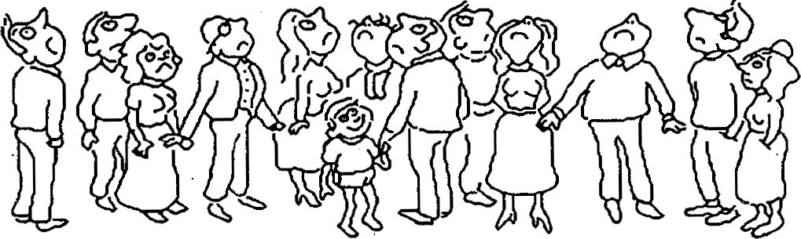
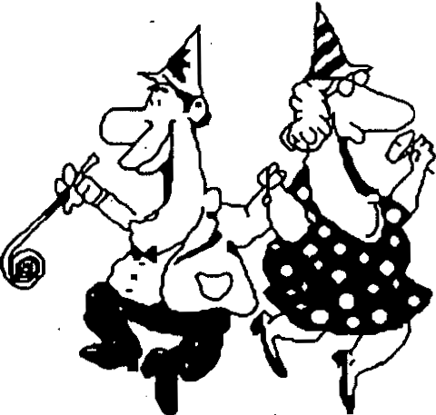
Self-Questioning Strategy Cue Card #2
WHAT DO YOU WONDER?
Titles
"Mountain Madness"
"Partners in Grime"
"Miracle at Midnight"
.
.
"Invisible Again"
Pictures
© The University of Kansas
Notes:
Pg. 25

Slide 16
Self-Questioning Strategy
CueCard#3
ATTEND TO CLUES
The pilgrims had tough lives.
Our national anthem is The Star-Spangled Banner.
The boy wandered aimlessly among the trees.
Kathy's mother sent her to the store.
Two new toys have become available for teenagers.
The mission ran into a major problem.
© The University of Kansas
Notes:
Pg. 26

Slide 17
Self-Questioning Strategy
Cue Card #1
SELF-QUESTIONING STRATEGY STEPS
Step 1: A ttend to clues as you
read
Step 2: S aysome questions
Step 3: Keep predictions in mind
Step 4: Identify the answers
Step 5: Talk about the answers
© The University of Kansas
Notes:
Pg. 27

Slide 18




Self-Questioning Strategy
Cue Card #4
SEVEN TYPES OF QUESTIONS
. . .
Who
What When
Where
Y
Why
Which
H
How
© The University of Kansas
Notes:
Pg. 27

Slide 19
Self-Questioning Strategy
CueCard#3
ATTEND TO CLUES
The pilgrims had tough lives.
Our national anthem is The Star-Spangled Banner.
The boy wandered aimlessly among the trees.
Kathy's mother sent her to the store.
Two new toys have become available for teenagers.
The mission ran into a major problem.
© The University of Kansas
Notes:
Pg. 29

Slide 20
Self Questioning Strategy
Cue Card #5
EXAMPLE QUESTIONS
Who
Who will solve the mystery? Who is coming to vistt?
Who burned the books? Who started the rumor?
What is this about?
What kind of animal made that footprint? What is the girl's name? ·
What will happen next?
What
When
When will the package be found?
When will the boy become visible again?
When will she get some help?
When did the pilgrims first meet the Indians?
Where are the jewels hidden? Where will they go next?
Where did he go when he disappeared? Where are Sarah's friends?
Why did they do this?
Why did the coach kick her off the team? Why is the flqwer blooming at night?
Why are the scarecrows ·moving?
Which way did she go? Which game ·will they win? Which dog survived ?
Which name di.d he choose?
How will they solve this problem?
How many steps are there?
How are they· going to work it out? How much time is left?
Where
Why
Which
How
Notes:
Pg. 29

Slide 21
Self-Questioning Strategy
Cue Card #1
SELF-QUESTIONING STRATEGY STEPS
Step 1: A ttend to clues as you
read
Step 2: S aysome questions
Step 3: Keep predictions in mind
Step 4: Identify the answers
Step 5: Talk about the answers
© The University of Kansas
Notes:
Pg. 29

Slide 22
Self-Questioning Strategy
CueCard#6
EXAMPLE QUESTIONS & PREDICTIONS
Q: What does the man look like?
P: He is tall, with brown hair and a
mustache.
Q: When will the boy be found? P: In three days.
Q: Where is the dog hiding?
P: In the woods.
Q: Why didn't she show up?
P: She had homework to do.
©The University of Kansas
103
Notes:
Pg. 30

Slide 23
Self-Questioning Strategy
Cue Card #1
SELF-QUESTIONING STRATEGY STEPS
Step 1: A ttend to clues as you
read
Step 2: S aysome questions
Step 3: Keep predictions in mind
Step 4: Identify the answers
Step 5: Talk about the answers
© The University of Kansas
Notes:
Pg. 30

Slide 24
Self-Questioning Strategy
Cue Card #1
SELF-QUESTIONING STRATEGY STEPS
Step 1: A ttend to clues as you
read
Step 2: S aysome questions
Step 3: Keep predictions in mind
Step 4: Identify the answers
Step 5: Talk about the answers
© The University of Kansas
Notes:
Pg. 31

Slide 25
Self-Questioning Strategy
Cue Card#7
IDENTIFYING AND TALKING ABOUT ANSWERS
Q: What does Rebecca look like?
P: She has long black hair and dark eyes.
Rebecca looked very much like her mother. She had long, curly blond hair and blue eyes. She was short but very slim and trim. She looked like an athlete.
Q: Why did Tim hide his art work?
P: He wants to give it to his mother as a gift.
Tim was happy that his mother did not see his picture. He knew that she would be upset if he was drawing when he was supposed to be doing his homework.
Q: Which choice will Ryan make: will he quit the team or stay on it?
P: He'll quit the team.
Ryan took a long walk. As he walked, he thought about his options. If he stayed on the team, he knew he'd be sitting on the bench during games. He thought about how he might learn new skills if he kept going to practice. He also thought about how much fun practices were. He decided to stay on the team.
©The University of Kansas
Notes:
Pg. 31

Slide 26
Self-Questioning · Strategy
Cue Card #8
SELF-QUESTIONING STRATEGY STEP SEQUENCE
Step 1: Attend to clues as you read
Step 4: Identify the
answers
Step 1: Attendto Clues
as you read
Step 2: Say some questions
Step 5: Talk about the answers
Step 3: Keep predictions in mind
-'
and
Notes:
Pg. 31

Slide 27
Self-Questioning ·Strategy
Cue Card #9
REQUIREMENTS FOR QUESTIONS, PREDICTIONS, AND ANSWERS
Use complete statements
  Subject
  Verb
Use accurate statements
Include new information
Make sense
© The University of Kansas

Slide 28
Comprehension Check
What are the steps of the Self-Questioning Strategy?
What is the mnemonic that helps us remember the steps?
What are the types of questions?
What is a prediction?
What are the requirements for questions, predictions, and answers?
When should we use the Self-Questioning Strategy?
Notes:
Pg. 33

Slide 29
Set goal dates
Notes:
Pg. 33

Slide 30
Exit Ticket
What was the main idea of today’s lesson?
What did you learn today?
What confused you about the lesson?
What do you still need to know?
How will this lesson help you in your future life?
Notes:
Pg. 35

Slide 31
Stage 3
Model
Notes:
Pg. 36

Slide 32
Review of Previous Content
What are the steps of the Self-Questioning Strategy?
What is the reason for asking questions?
What is the reason for making predictions?
What is the reason for talking about the answers?
What are the seven types of questions?
What are the benefits of using the Self-Questioning Strategy?
Where can you use this strategy?
Notes:
Pg. 37

Slide 33
Essential Questions
What do I think about as I am using the steps of the Self-Questioning Strategy?
Notes:
Pg. 36

Slide 34
.'•
Model Passage 1
Chocolate Moose? •
Moose may not be made of chocolate, and they are not cooled by a refrigerator like the popular desert "Chocolate Mousse." They are dark brown, and they do live where the weather is cold.• Moose can be found living in the mountains in western Canada and northwestern United States. They can live in these parts of the North American continent because their large bodies can keep them warm for a long time.•In fact, they are the biggest deer in the world. They can stand 8 feet tall at the shoulders, and they can weigh almost a ton.•
Something special about the moose is his antlers. Male
moose antlers can weigh as much as 80 pounds and can
measure 7 feet from one tip to the other. • Male moose can grow new pairs of antlers in 4 or 5 months. After a new pair of antlers has been worn for about 6 months, they fall off,
and a new pair starts growing.•Moose use their antlers to protect themselves from enemies. • They also use them to
cool their bodies. Blood moving through the antlers gets cooled by the air. Then this cooled blood cools off the rest of the body.•
Something else that is special about moose is their diet. Moose are strict vegetarians! Even though they have huge bodies, they eat only plants.• Moose live near water. In the spring and summer, they often eat plant that grow under the water. •Most of the time, they can reach the plants by sticking their heads under the water. Sometimes, though, when they see some plants that look delicious, they dive under the water completely and swim to the bottom for an underwater meal.•
Notes:
Pg. 38

Slide 35
Exit Ticket
What did you watch today?
What did you learn today?
What confused you about the lesson?
What do you still need to know?
How will this lesson help you in your future life?
Notes:
Pg. 40

Slide 36
Record Stage 3 completion date
Notes:
Pg. 41

Slide 37
Stage 4
Verbal Practice
Notes:
Pg. 42

Slide 38
Review of Previous Content
What is the purpose of reading?
What are the benefits of reading well?
Where and when should we use the Self-Questioning Strategy?
What are the steps of the Self-Questioning Strategy?
What is the mnemonic for remembering the steps?
What are the W and H questions?
What are the requirements for questions, predictions and answers?
Notes:
Pg. 43

Slide 39
Essential Questions
Have I memorized the steps of the Self-Questioning Strategy?
Why is memorizing them important?
Notes:
Pg. 43

Slide 40

Student's Name:
Self-Questioning Verbal Practice Checklist
Attempts
1
2
3
4
5
6
Describe Strategy
In own words:
Strategy Steps:
Attend to clues
Say some questions
Keep predictions in
mind
Identify the answer
Talk about the
answer
Questions:
Percent Correct
Date
%
%
%
%
%
%
Notes:
Pg. 47

Slide 41
Record Stage 4 completion date
Notes:
Pg. 48

Slide 42
Stage 5
Controlled Practice and Feedback
Notes:
Pg. 49

Slide 43
Review of Previous Content
What is the purpose of reading?
What does it mean to be a strategic learner?
What are the steps of the Self-Questioning Strategy?
What are the seven types of questions and their symbols?
Where and when should we use the Self-Questioning Strategy?
What are the benefits of using the Self-Questioning Strategy?
Notes:
Pg. 50

Slide 44
Essential Questions
How do I use the Self-Questioning Strategy with materials written at my reading level?
Notes:
Pg. 51

Slide 45
SELF-QUESTIONING
Name:
ASSIGNMENT SHEET
Controlled Practice
Advanced Practice
Generalization
Date
Reading Selection
Place
Comments
Assigned

Slide 46
Record Controlled Practice Attempts
Notes:
Pg. 55

Slide 47
Record Stage 5 completion date
Notes:
Pg. 55

Slide 48
Stage 6
Advanced Practice and Feedback
Notes:
Pg. 57

Slide 49
Review of Previous Content
What is the purpose of reading?
What does it mean to be a strategic learner?
What are the steps of the Self-Questioning Strategy?
What are the seven types of questions and their symbols?
What are the requirements of good questions, predictions, and answers?
Where and when should we use the Self-Questioning Strategy?
What are the benefits of using the Self-Questioning Strategy?
Notes:
Pg. 58

Slide 50
Essential Questions
How do I use the Self-Questioning Strategy with materials written at my grade level?
Notes:
Pg. 51

Slide 51
SELF-QUESTIONING
Name:
ASSIGNMENT SHEET
Controlled Practice
Advanced Practice
Generalization
Date
Reading Selection
Place
Comments
Assigned

Slide 52
Record Advanced Practice Attempts
Notes:
Pg. 59

Slide 53
Record Stage 7 completion date
Notes:
Pg. 59

Slide 54
Stage 7
Posttest and Make Commitments
Notes:
Pg. 61

Slide 55
Posttest
Purpose – to determine how well you can create questions, make predictions, and find answers while you read which increases your understanding and ability to remember what you have read.
Part 1 – how well do you create questions, make predictions and find answers while you read grade level passages?
Part 2 – how well do you remember and understand reading passages on your grade level?
Notes:
Instructional Manual pg. 62

Slide 56
Record Post test score
Notes:
Pg. 63

Slide 57
Goal Completed!
Commitment to Generalize
Notes:
Pg. 64

Slide 58
Stage 8: Generalization
Phase I: Orientation
Notes:
Pg. 66

Slide 59
Essential Questions
What are some circumstances and situations in which the Self-Questioning Strategy can be used?
Notes:
Pg. 67 Instructor Manual – student objectives have been translated into questions.

Slide 60
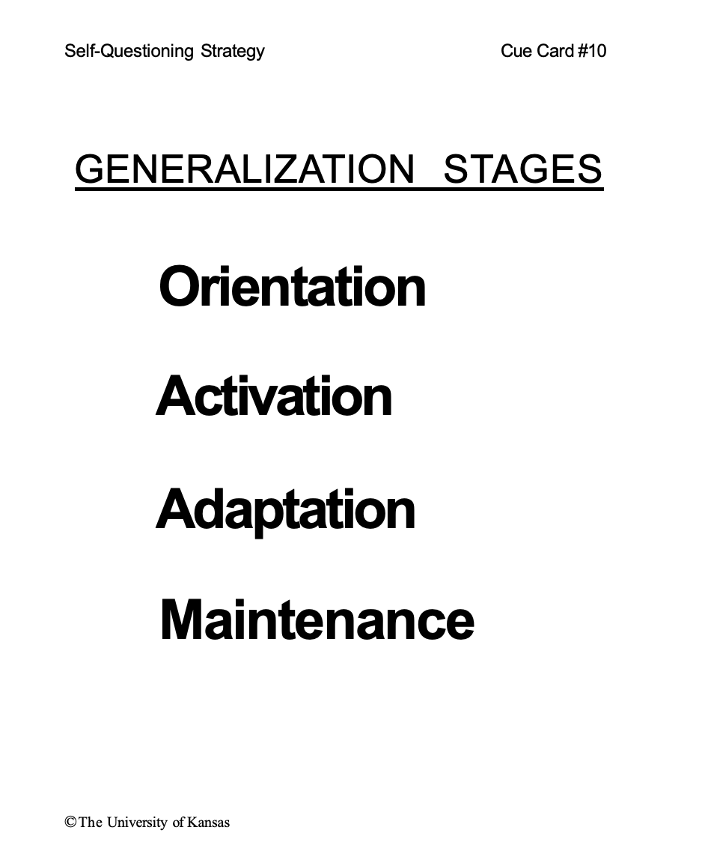
© The University of Kansas
Notes:
Pg. 67

Slide 61
The Self-Questioning Strategy
+
Effort
=
Success
Notes:
Pg.67

Slide 62
AFFIRMATIONS
Self-Questioning Strategy Cue Card #11
Using the Self-Questioning Strategy helps me be a great reader.
Using the Self-Questioning Strategy makes me want to read more.
Using the Self-Questioning Strategy helps me remember new information.
I am a good reader when I use the strategies I know.
I am a strategic learner.
I am growing as a learner every day as I
learn how to use strategies better and better.
I can reach my goal as a learner when I use the Self-Questioning Strategy.
(My Goal is: .)
©The University of Kansas
Notes:
Pg. 69

Slide 63
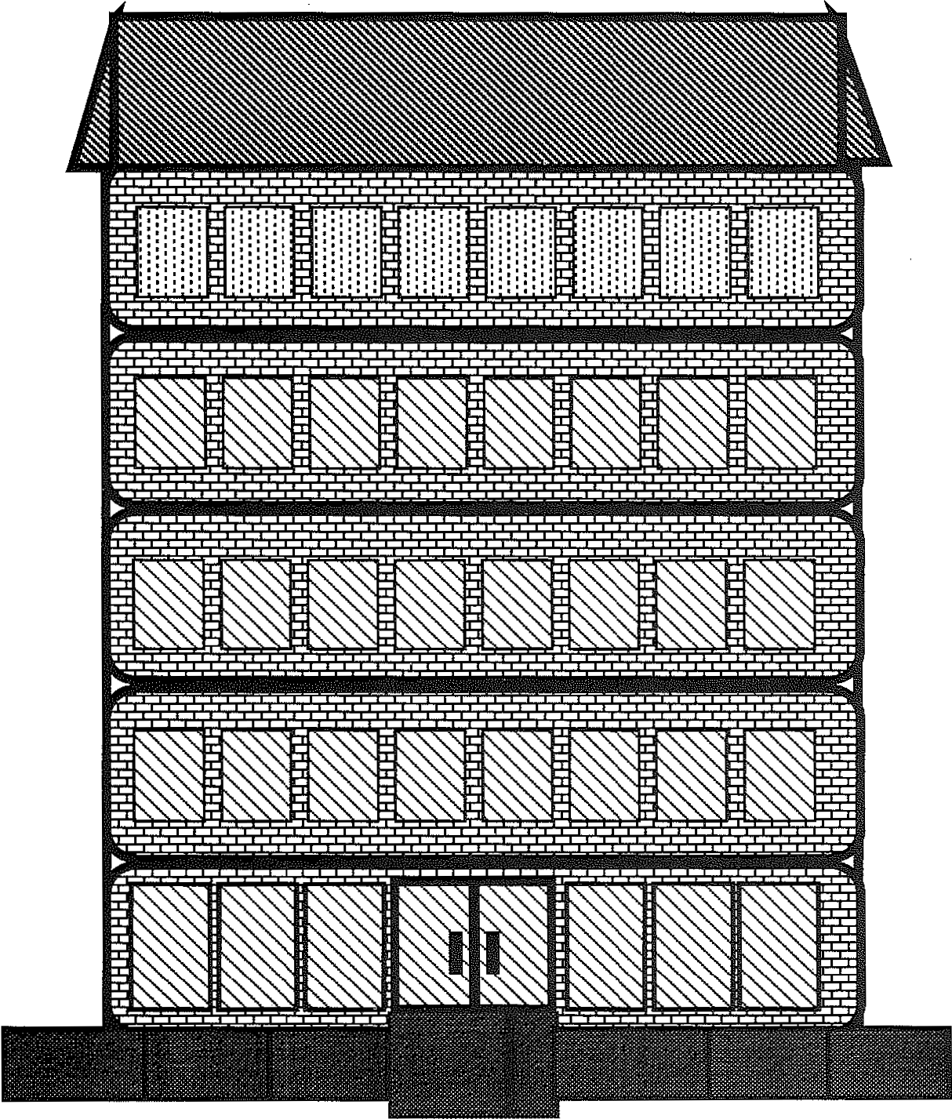
Self-Questioning Strategy
Cue Card #12
BUILDING A KNOWLEDGE BASE
153
Notes:
Pg.70

Slide 64
© The University of Kansas
Notes:
Pg. 71

Slide 65
Stage 8: Generalization
Phase II: Activation
Notes:
Pg. 72

Slide 66
Essential Questions
How do I apply the Self-Questioning Strategy to a variety of materials in different settings?
Notes:
Pg. 73 Instructor Manual – student objectives have been translated into questions.

Slide 67
© The University of Kansas
Notes:
Pg. 73

Slide 68
Notes:
Pg. 73

Slide 69
SELF-QUESTIONING
Name:
ASSIGNMENT SHEET
Controlled Practice
Advanced Practice
Generalization
Date
Reading Selection
Place
Comments
Assigned
Notes:
Pg. 74

Slide 70
Stage 8: Generalization
Phase III: Adaptation
Notes:
Pg. 77

Slide 71
Essential Questions
How do I adapt parts of the Self-Questioning Strategy to a variety of materials in different settings?
Notes:
Pg. 77 Instructor Manual – student objectives have been translated into questions.

Slide 72
© The University of Kansas
Notes:
Pg. 73

Slide 73
Self-Questioning Strategy
Cue Card #1
SELF-QUESTIONING STRATEGY STEPS
Step 1: A ttend to clues as you
read
Step 2: S aysome questions
Step 3: Keep predictions in mind
Step 4: Identify the answers
Step 5: Talk about the answers
Looking for clues
Question-asking
Predicting
Taking-in information
Transforming
© The University of Kansas
Notes:
Pg. 78

Slide 75
Stage 8: Generalization
Phase IV: Maintenance
Notes:
Pg. 96

Slide 76
Essential Questions
How do I remember to keep using the Self-Questioning Strategy?
Notes:
Pg. 84 Instructor Manual – student objectives have been translated into questions.

Slide 77
© The University of Kansas
Notes:
Pg. 85

Slide 78
Create Maintenance Plan on the back
Notes:
Pg. 86

