Slide 1



The Self-Advocacy Strategy
For enhancing student motivation & self-determination
Searching,
Solving,
Soaring!
An Education & Transition Planning Process
Revised by A.K Van Reusen & A. Chambers, 2016

Slide 2
Purpose
To explain, model, and practice the Self-Advocacy Strategy for enhancing student motivation and self-determination.
Learn
Plan
Succeed!
Think
Practice
Provide
Notes:
Example objectives
At the end of this lesson, you will be able to:
Save files to the team Web server.
Move files to different locations on the team Web server.
Share files on the team Web server.

Slide 3
The Five Objectives of this presentation
Objective One: Explain the Self-Advocacy Strategy and the link between intrinsic motivation, self-determination, learning, and self advocacy.
Intrinsic Motivation
Self-Determination
Learning
Self-Advocacy
Notes:
How presentation will benefit audience: Adult learners are more interested in a subject if they know how or why it is important to them.
Presenter’s level of expertise in the subject: Briefly state your credentials in this area, or explain why participants should listen to you.

Slide 4

Objectives
Objective Two: State Rationales for teaching the Self-Advocacy Strategy to Students.
Rationale
Self-Advocacy
Success
I am the
“I”
in IEP!

Slide 5
Objectives
Objective Three: Describe and Model the instructional sequence for teaching the Self-Advocacy Strategy.
Describe
Model
Self-Advocacy Strategy

Slide 6

Objectives
Objective Four:
  Score performance during group and individual practice.
  Score performance during education and/or training planning conferences.

Slide 7

Objectives
Objective Five: Implement the Self-Advocacy Strategy.

Slide 8

Agenda
Self-Advocacy Strategy Overview
Review Materials
Step-by-Step Group & Individual Practice
Scoring Practice
Discussion: Incorporating the Self-Advocacy Strategy into Educational Planning Meetings (e.g., IEP & ITP)
Problem Solving
Planning for Implementation
Notes:
Lesson descriptions should be brief.

Slide 9


The Self-Advocacy Strategy: Background
The Self-Advocacy Strategy

Slide 10

Self-Advocacy: Defined
One’s ability to:
  Effectively communicate, negotiate, or assert one’s own interests, desires, needs, and rights.
  Make informed decisions and take responsibility for those decisions.
Notes:
Opportunities to learn and use decision-making and self-advocacy skills can help prepare students to become contributing and productive participants in society.

Slide 11
Why teach the Self-Advocacy Strategy?
Helping
Involving
Teaching
Connecting
Efforts to enhance student intrinsic motivation, self-determination, and responsibility in the learning process may need to be directed in a multifold approach that includes:
Helping students determine the direction of their lives
Involving students in setting their education and transition goals
Teaching students how to advocate for their learning needs and desired outcomes
Connecting instruction with students’ interests and preferences for learning
Notes:
Helping students determine the direction of their lives
Involving students in setting their education and transition goals
Teaching students how to advocate for their learning needs and desired outcomes
Connecting instruction with students’ interest and preferences for learning

Slide 12
The Link between Intrinsic Motivation, Self-
Determination, Learning, and Self-Advocacy
Intrinsic motivation has been described as an important energizer of human behavior that is thought to be based on an individual's need for competence and self-determination (i.e., internal control).
1
People are described as "intrinsically motivated" when they complete activities or exhibit behaviors because of an inner desire to succeed or to act competent and make appropriate choices based on personal needs (i.e., self-determination). 2
Notes:
1-Boggiano, A. K., Shields, A., Barrett, M., Kellam, T., Thompson, E., Simons, J., & Katz, P. (1992). The role of motivational orientation. Motivation and Emotion, 16 271-296.
2- Cameron, J., & Pierce, W. D. (1994). Reinforcement, reward, and intrinsic motivation: A meta analysis. Review of Educational Research, 64, 363-423.
3- Deci, E. L., & Ryan, R. M. (1985). Intrinsic motivation and self-determination in human behavior. New York: Plenum
4- Stipek, D. (1993). Motivation to learn: From theory to practice (2nd edition). (pp. 292 pages). Needham Heights, MA: Allyn & Bacon.

Slide 13
The Link between Intrinsic Motivation, Self-
Determination, Learning, and Self-Advocacy
Intrinsic Motivation and Self-determination are believed to have a critical role in the human ability to understand and regulate one's own behavior and actions. 1
Students who have positive self-perceptions and perceive that they have choice and control over their learning abilities, opportunities, and tasks are more willing and likely to work successfully with adults in their environments. 2
Notes:
Deci, E. L., & Ryan, R. M. (1985). Intrinsic motivation and self-determination in human behavior. New York: Plenum
Mithaug, D. E. (1996). Equal opportunity theory. Newbury Park, CA: Sage Publications
Spaulding S. L, 1992, “Motivation in the classroom”. McGraw-Hill Inc.
Zimmerman, B. J., & Bandura, A. (1994). Impact of self-regulatory influence on writing course attainment.
American Educational Research Journal, 31, 845-862.
2 - (Brown, 1988; Chapman, 1988; Schunk & Swartz, 1993)

Slide 14
The Link between Intrinsic Motivation, Self-
Determination, Learning, and Self-Advocacy
Self-determination has been defined as the attitudes and abilities necessary to act as the primary causal agent in one's life and to make choices and decisions regarding one's quality of life, free from external influences or interferences.
Self-determination is thought to be predicated upon the individual acquisition and use of specific skills, behaviors, and attitudes that are learned across the life span and associated primarily with reaching adulthood and fulfilling adult roles. 1
Notes:
1 Wehmeyer, M. L. (1996). Self-determination as an educational outcome: Why is it important to children, youth and adults with disabilities? In D. J. Sands & M. L. Wehmeyer (Eds.), Self-determination across the life span: Independence and choice for people with disabilities (pp. 15-34). Baltimore: Paul H. Brookes.
Wehmeyer, M., & Schwartz, M. (1997). Self-determination and positive adult outcomes: A follow-up study of
youth with mental retardation or learning disabilities. Exceptional Children, 63(2), 245-255.

Slide 15
The Link between Intrinsic Motivation, Self-
Determination, Learning, and Self-Advocacy
The essential characteristics of self-determined behavior are thought to emerge on the basis of the development or acquisition of a set of complex components or elements that provide a theoretical framework to direct instructional activities.
According to Wehmeyer (2001) these include the development of:
Choice-making skills
Decision-making skills
Problem-solving skills
Goal-setting and attainment skills
Self-management skills
Independence, risk-taking, and safety skills
Self-advocacy and leadership skills
Internal locus of control
Positive attributions of efficacy and outcome expectancy
Self-awareness
Self-knowledge

Slide 16
What Does Effective Self-Advocacy Require?
It requires…
  Effective communication skills and behaviors
  Assertiveness in stating needs and wants
  Assertiveness in stating rights
  Taking responsibility
  Determining needed supports
  Pursuing needed supports
  Obtaining and evaluating needed supports
  Conducting one’s own affairs
…and opportunities at:
  School, Class and Home
  And In:
  Work, Community and Relationships

Slide 17
The Self-Advocacy Strategy: Introduction
The Self-Advocacy Strategy

Slide 18
Student Participation and Rationale:
Philosophical Underpinnings
of the Strategies Instructional Approach
Rationales for Teaching the Strategy
Purposes of the Strategy
How Will Students Participate?
Participation (Pertinent) Setting Goals

Slide 19
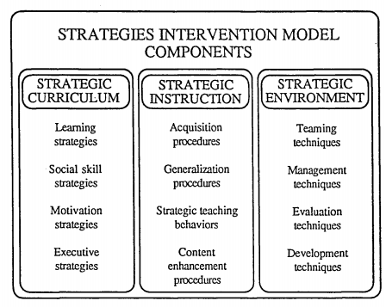
The Self-Advocacy Strategy
STRATEGIC INSTRUCTION COMPONENTS
Is a component of the Strategies Instructional Approach.
It focuses on student motivation and self-determination in the learning process.

Slide 20
Strategies Instructional Approach
Curriculum Components
Task-Specific Learning Strategies
Executive Strategies
Social Skills Strategies
Transition Strategies
Motivation Strategies
SAo #10

Slide 21
The Self-Advocacy Strategy is comprised of motivation and transition strategies that enable students to learn other strategies (e.g. Learning Strategies and Social Skill Strategies).

Slide 22
Philosophical Underpinnings of the Strategies Instructional Approach
Most adolescents can learn to be successful in mainstream settings.
The role of the SUPPORT-CLASS teacher is to teach low-achieving (LA) adolescents STRATEGIES that will enable them to be independent learners and performers.
The role of the CONTENT teacher is to deliver subject-matter information in a manner that can be understood and remembered by LA adolescents.
Adolescents should have a MAJOR VOICE in DECISIONS about what strategies and skills they are to learn and how fast they are to learn these strategies and skills.
SAo #5

Slide 23
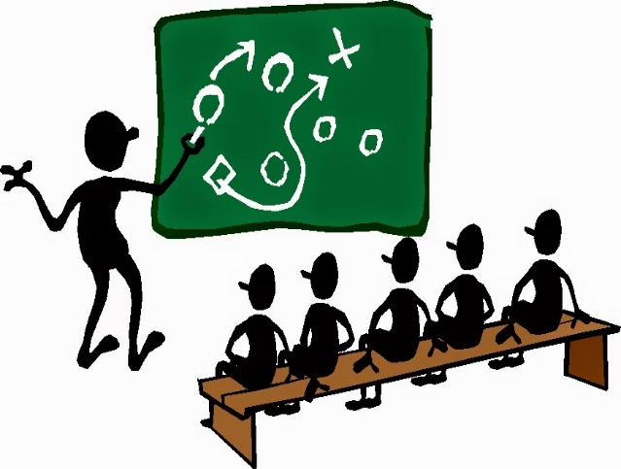
Rationales for Teaching the Strategy
The Self Advocacy Strategy:
  Makes students active participants in decision making about their education and transition into adulthood.
  Provides students with a sense of control over the learning and development process and over the direction of their future.
  Provides students with a set of communication skills which can be used in a variety of settings and circumstances.
SAo #4

Slide 24

Purposes of the Strategy
To teach students:
  How to focus their attention on their strengths as well as their areas to improve or learn
  The skills which will allow them to take an active role in decision making
  A way of getting organized before a conference or meeting
  Techniques for effectively communicating their education and transition strengths, areas to improve or learn, and goals
SAo #2

Slide 25


How Will Students Participate?
Students will:
  Identify their strengths, areas to improve or learn, goals, and choices for learning or needed accommodations
  Participate in education and/or transition planning conferences by:
    Stating their strengths, areas to improve or learn, and choices for learning or accommodations
    Exhibiting appropriate social and communication skills
    Responding to and asking questions of others
    Stating their goals
SAo #3

Slide 26

Participation & Goal Setting
Student participation in:
  Education and/or *transition planning conferences
  Classes, clubs, meetings, and school activities
  Job interviews, locating and using services and resources
  Meetings with teachers, counselors, administrators, and employers
  The community at large
  *See Slide 85 for more information on Transition Planning (Click on *transition planning conferences during the presentation.)
SAo #1

Slide 27
Important Terms and Concepts in Facilitating Student Motivation
Choice and Control
Generalization
Decision-Making
Goal Structures
Attributions
Motives
Motivation
SAo #6

Slide 28
Concepts Included in the Self-Advocacy Strategy
Nonverbal and verbal behaviors necessary for good communication
Social skills
Self-talk
Planning
Active versus passive listening
Accepting criticism and feedback
Conversation skills
Making informed decisions
Questioning
Getting information
Becoming a self-advocate
Self-awareness skills
Negotiation
Accepting responsibility
SAo #7

Slide 29
Being In Control
What is it?
How does it apply to students?
What can I do to encourage it?
SAo #8

Slide 30
Results
Average percentage of goals appearing
on IEPs specified by students
during IEP Conferences
SAo #9

Slide 31
Instruction for Education Planning Conferences
The Self-Advocacy Strategy

Slide 32
Selecting the Students
Students who are:
Expected to participate in decision making about their educational goals
Willing to set goals and take steps to improve themselves
SAo #12

Slide 33
Instructional Sequence
Stage 1:
Orient and Obtain Commitment to Learn
Stage 2:
Describe
Stage 3:
Model and Prepare
Yes
Mastery
No
Stage 4:
Verbal Rehearsal
Yes
Mastery
No
Stage 5:
Group Practice and Feedback
Education Planning
Conference
Yes
Mastery
No
Stage 6:
Individual Practice and Feedback
Generalization to other settings
Yes
Mastery
No
SAo #11

Slide 34
Instructor’s Manual Contents
Instructional Methods
Stage 1: Orient and Obtain Commitment
Stage 2: Describe
Stage 3: Model and Prepare*
Stage 4: Verbal Practice
Stage 5: Group Practice and Feedback*
Stage 6: Individual Practice and Feedback
Stage 7: Generalization
Part I: Preparing for and Conducting the Planning Conference
Part II: Preparing for Other Uses of the Strategy
Part III: Preparing for Subsequent Conferences
Appendix A: Evaluation Guidelines
Appendix B: Instructional Materials
Appendix C: Education and Transition Conference Probe Question Guides
*Separate stages for Education or Transition Planning Conferences
SAo #13

Slide 35
Student Folder Contents
Front Cover: Progress Chart
Eventual Contents: Cue Cards, Inventory Sheet, Worksheets, Skill Lists, Verbal Practice Checklist, Individual Mastery Checklist
SAo #14

Slide 36
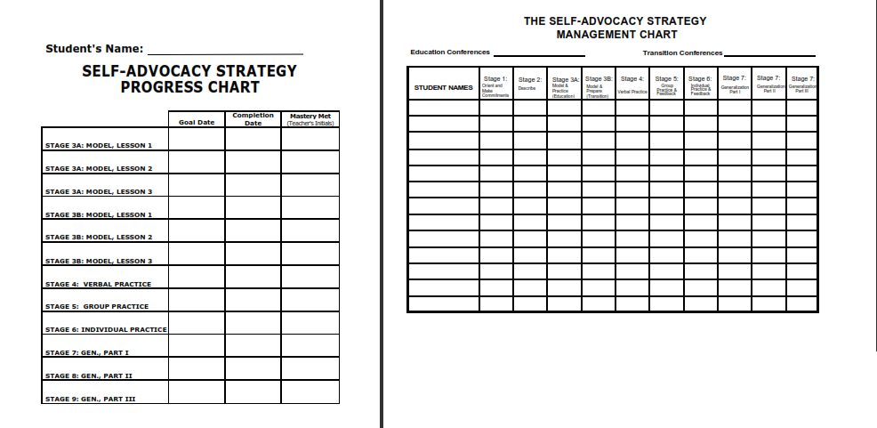
Progress and Management Charts
SAo #15 & 16

Slide 37
Stage 1: Orient and Obtain Commitment to Learn
The Self-Advocacy Strategy

Slide 38
Stage 1: Orient and Obtain Commitment to Learn
Define key terms
Provide examples of student actions
Provide rationales for conferences
Explain information to be shared
Introduce the success Formula
Make commitments

Slide 39
Stage 2: Describe & Define
The Self-Advocacy Strategy

Slide 40
Stage 2: Describe
Define terms
Describe Educational Planning Conferences
OR Describe Transition Planning Conferences
Introduce the Self-Advocacy Strategy
Describe the “SHARE” Behaviors

Slide 41

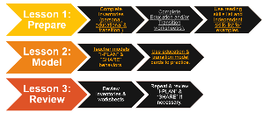
The “S.H.A.R.E.” Behaviors
Sit up Straight
Have a pleasant tone of voice
Activate your thinking
  Tell yourself to:
  Pay attention, Participate, Compare ideas
Relax
  Don’t look uptight
  Stay Calm
Engage in Eye communication

Slide 42
Describe
Define terms
Describe Educational Planning Conferences
Introduce the Self-Advocacy Strategy
Describe the “SHARE” Behaviors
Describe the “I PLAN” Steps

Slide 43
Steps of the Self-Advocacy Strategy (I PLAN)
Step 1: Inventory your
Strengths
Areas to improve or learn
Goals
Choices for learning accommodations
Step 2: Provide inventory information
Step 3: Listen and Respond
Step 4: Ask questions
Step 5: Name your goals

Slide 44
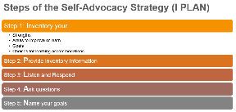
I PLAN (Inventory)
Step 1. Inventory your
Strengths
Areas to improve or learn
Goals
Choices for learning or accommodations
When: Before the conference
How: Think about the inventory areas
Complete a worksheet.
Make your inventory.

Slide 45
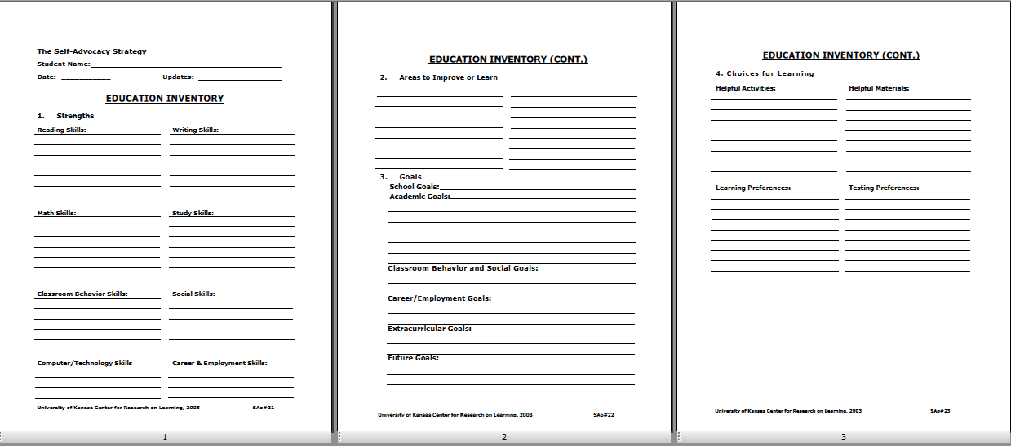
I PLAN (Inventory)

Slide 46
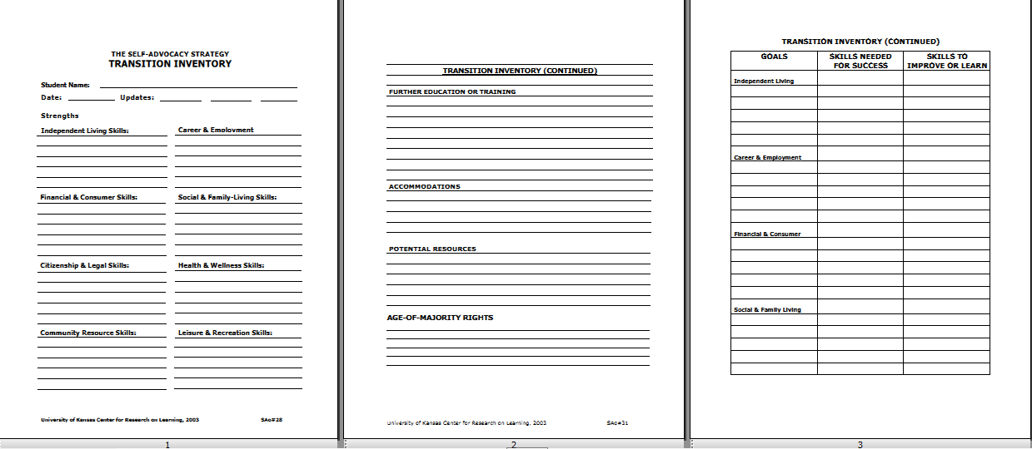
I PLAN (Inventory)

Slide 47
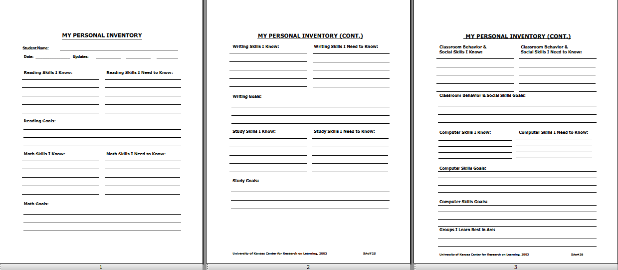
I PLAN (Inventory)

Slide 48
I PLAN (Provide)
Step 2: Provide your inventory information.
When: The discussion centers on your:
Strengths
Areas to improve or learn
Goals
Choices for learning or accommodations
How: Use the “SHARE” Behaviors.
Use your inventory.
Make complete statements.

Slide 49
I PLAN (Listen)
Step 3: Listen and respond.
When: Listen when:
Someone is making a statement
Someone is asking a question
Respond when:
Someone asks you a question
You have information to add
How: Be an active listener.
Use head nods
Paraphrase to yourself
Ask yourself questions
Use the “SHARE” Behaviors

Slide 50
I PLAN (Ask)
Step 4: Ask questions.
When: You need information
You don’t understand what people are saying
How: Use the “SHARE” Behaviors.
Use “W” questions: Who, What, When, Where, Why, Which, or How
Ask complete questions
Ask one question at a time

Slide 51
I PLAN (Name)
Step 5: Name your goals.
When: Near the end of the conference
How: Use the “SHARE” Behaviors.
For each goal, tell:
What you want to do
When you want to complete it

Slide 52
Stage 3: Model and Prepare for the Education and/or Transition Planning Conferences.
The Self-Advocacy Strategy

Slide 53
Stage 3: Model and Prepare for the Education and/or Transition Planning Conferences.
Lesson 1: Prepare
Complete Inventories (personal, educational & transition)
Complete Education and/or Transition worksheet(s).
Use reading skills list and independent skills list for examples.
Lesson 2: Model
Teacher models “I-PLAN” & “SHARE” Behaviors.
Use education & transition model cards to practice.
Lesson 3: Review
Review inventories & worksheets
Repeat & review “I-PLAN” & “SHARE” if necessary.

Slide 54
For Education Planning Conferences
See pp. 45-68 in the manual
Model filling in half of the Inventory sections
Students fill in half of their Inventories (Less. 1)
Teacher and students role-play (Lesson 2)
Teacher and students fill in remaining Inventory sections (Lesson 3)

Slide 55
I PLAN (Inventory)

Slide 56
For Transition Planning Conferences
See pp. 69-86 in the manual
Model filling in the Inventory sections
Students fill their Inventories (Lesson 1)
Teacher and students role-play (Lesson 2)

Slide 57
I PLAN (Inventory)

Slide 58
I PLAN (Inventory)

Slide 59
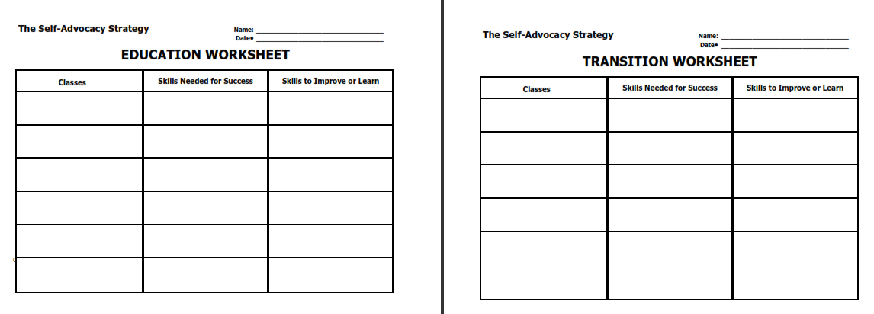
Education and Transition Worksheet(s)

Slide 60
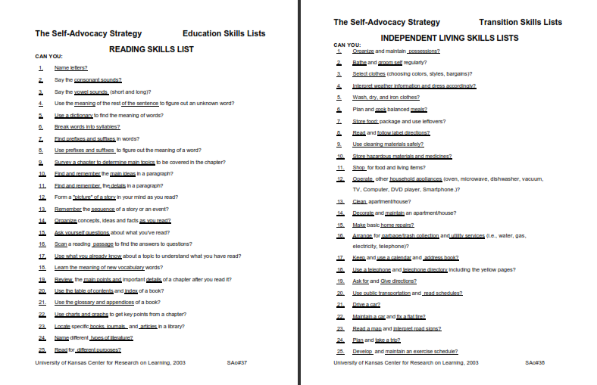
Reading and Independent Skills Worksheet(s)

Slide 61
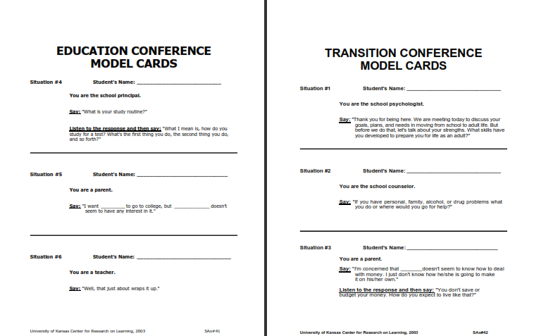
Educational and Transitional Modeling Card(s)

Slide 62
Choices for Learning: Helpful Activities
The activities I learn best from are:
a. reading
b. listening
c. taking notes
d. watching
e. discussing
f. writing reports
g. making goal reports
h. working math problems
i. working on lab projects
k. working on shop projects
l. (other)___________________
Materials and equipment that help me learn are:
a. flash cards
b. dictionary
c. calculator
d. computer
e. games
f. voice recorder
g. films/videos
h. keyboard/word processor
i. charts
j. shop tools
k. (other)_____________________
SAo #37

Slide 63

Choices for Learning: Learning Preferences
1. I learn best when I work:
a. by myself
b. by myself with a teacher
c. with a tutor
d. with another student
e. (other)_____________________

Slide 64

Choices for Learning: Learning Preferences
2. I learn best in the following groups:
a. large groups for lectures
b. medium groups (3-6 people)
c. small groups (2-3 people)
d. with one other person
e. on my own
f. (other) ______________________

Slide 65

Choices for Learning: Learning Preferences
3. When taking tests, I do best on:
a. multiple-choice, true-false, or matching tests
b. short answer or essay tests
c. open note or open book tests
d. take-home test
e. when I answer out loud (oral tests)
f. (other) ______________________

Slide 66
Stage 4: Verbal Practice
The Self-Advocacy Strategy

Slide 67
Stage 4: Verbal Practice
Conduct the Verbal Elaboration Exercise
Conduct Verbal Practice for the “IPLAN” Steps
Conduct Verbal Practice for the “SHARE” Behaviors
Administer quizzes (oral or written)

Slide 68
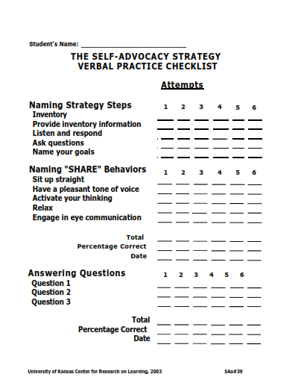
Verbal Practice Checklist
SAo #39

Slide 69
Stage 5: Group Practice & Feedback
The Self-Advocacy Strategy

Slide 70
Stage 5: Group Practice & Feedback
Answer the question: What happens at an education planning conference?

Slide 71
What happens at an Education-Planning Conference?
Conference Beginning
Discussion of Learning Progress
Discussion of Goals
Discussion of Services
Conference Conclusion
SAo #40-41

Slide 72

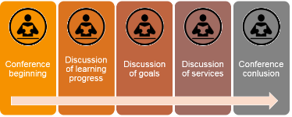
What happens at an Education-Planning Conference?
Introductions are made.
The conference purpose is explained.
Legal rights are explained.
Conference Beginning

Slide 73
What happens at an education planning conference?
What happens at an Education-Planning Conference?
The student’s school progress, including progress toward graduation, is reviewed.
The student’s test performance is described.
The meaning of test results is explained.
The student’s strengths and areas to improve or learn are discussed.
The student’s questions are answered.
The student’s ideas are considered.
Discussion of Learning Progress

Slide 74
What happens at an Education-Planning Conference?
Education goals are suggested.
Agreement is reached.
Goal statements are written.
Conference beginning
Discussion of Goals

Slide 75
What happens at an Education-Planning Conference?
Available options and classroom placements are described and discussed.
Options are considered.
Service statements are written.
Conference beginning
Discussion of Services

Slide 76
What happens at an Education-Planning Conference?
The education plan is summarized.
Responsibilities are specified.
A review date is set.
Conference beginning
Conference Conclusion

Slide 77
Stage 5: Group Practice & Feedback

Slide 78
What happens at a Transition-Planning Conference?
Conference Beginning
Discussion of Transition Progress
Discussion of Goals
Discussion of Resources, Services, & Accommodations
Conference Conclusion
SAo #42-43

Slide 79

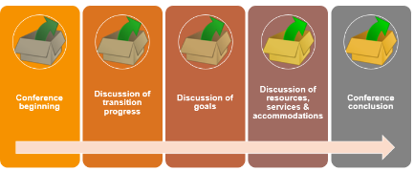
What happens at a Transition-Planning Conference?
Introductions are made.
The conference purpose is explained.
Legal rights are explained.
Conference Beginning

Slide 80

What happens at a Transition-Planning Conference?
The student’s progress toward graduation is reviewed.
The student’s performance is described.
The student’s transition needs are discussed.
The student’s transition strengths and areas to improve or learn are discussed.
The student’s questions are answered.
The student’s ideas are considered.
Conference beginning
Discussion of Transition Progress

Slide 81

What happens at a Transition-Planning Conference?
Transition goals are suggested.
Agreement is reached.
Goal statements are written.
Conference beginning
Discussion of Goals

Slide 82

What happens at a Transition-Planning Conference?
Available resources and services are identified.
Needed accommodations are specified.
Transition service statements are written.
Conference beginning
Discussion of Resources, Services & Accommodations

Slide 83

What happens at a Transition-Planning Conference?
Your transition plan is summarized.
Responsibilities are specified.
A review date is set.
Conference beginning
Conference Conclusion

Slide 84
Stage 5: Group Practice & Feedback
Explain what students should do.
Introduce the group-practice activity.
Conduct the group-practice activity.
Provide feedback.
Notes:
(Use the Simulated Conference Guide, pp. 188-191 or pp.192-195 to prompt participant responses and use a Group Practice Score Sheet pp. 196 to record participant responses. Allow approximately 20-30 minutes depending upon the number of participants.)

Slide 85
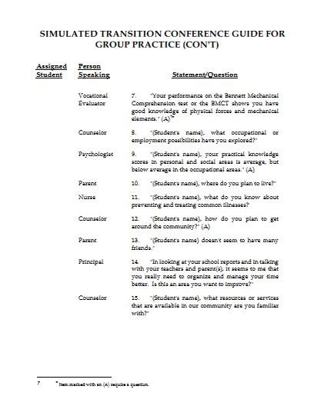
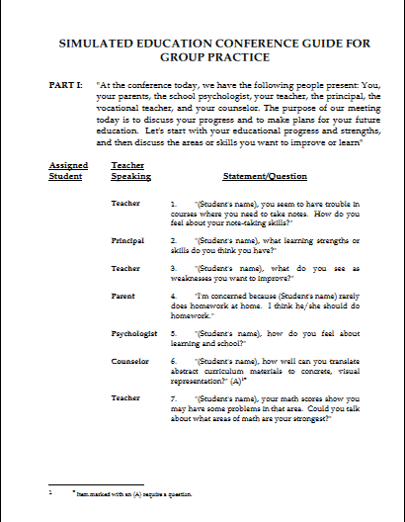
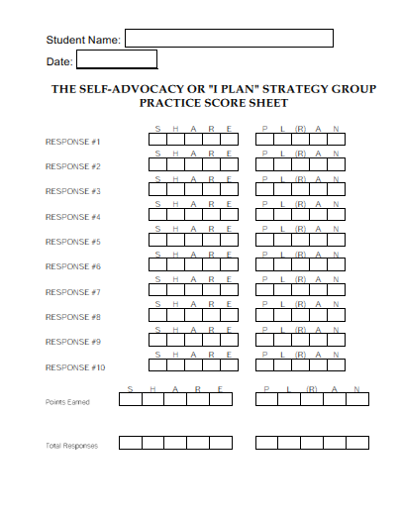
Simulated Conference Guide(s)
Education conference.
Transition conference.
Group Practice score sheet.
Education conference individual mastery checklist.
Transition conference individual mastery checklist.

Slide 86
Stage 6: Individual Practice and Feedback
The Self-Advocacy Strategy

Slide 87
Stage 6: Individual Practice and Feedback
Conduct a simulated conference.
Provide feedback.
Address questions and concerns.

Slide 88
Elaborated Feedback
Provide positive feedback (at least 3 statements)
Provide corrective feedback
Explain a kind of error
Review the pertinent concept
Make suggestions on how to behave in the future
Provide corrective feedback (cont.)
Provide a model
Have the student practice
Have the student paraphrase
Have the student write a goal

Slide 89
Stage 7: Generalization
The Self-Advocacy Strategy

Slide 90
Stage 7: Generalization, Part 1
Preparing for & Conducting the Conference
Review the strategy.
Review the Inventory.
Conduct a warm-up session.
Answer questions and concerns.
Conduct the conference.
Provide feedback.

Slide 91
Stage 7: Generalization, Part II
Preparing for Other Strategy Uses
Discuss other situations.
Discuss adapting the strategy.
Explain how to use you as a resource.
Direct students to set up meetings.

Slide 92
Stage 7: Generalization, Part III
Preparing for Subsequent Conferences
Review student progress.
Review the strategy.
Have the students update their inventories.
Conduct a simulated conference.
Answer questions and concerns.
Provide feedback.

Slide 93
Considerations for Deciding to Teach
the Self-Advocacy Strategy
The desire to:
  Enhance learner motivation, independence, and personal responsibility for learning and development.
The willingness to:
  Create and maintain environments that provide learners and others with opportunities for success.
  Recognize differences often exist in individual perceptions of education and transition needs, goals, ability levels, and motivations and in valuing and accommodating those differences.
  Provide students with opportunities to determine their learning and development needs, and accommodate those needs with choices.

Slide 94

Implementation of Self-Advocacy Strategy Instruction
Which students will this be ideal for?
Where will you be implementing the strategy?
When do you plan on implementing the strategy?
How will you be managing your resources from the manual?
Who will be on your support team?
Graphic from Bang2Write

Slide 95

More about Transition Services
P.L. 101-476 [34 CFR 300.43 (a)] [20 U.S.C. 1401(34)]
A coordinated set of activities for a child with a disability that:
Is designed to be within a results-oriented process.
Focuses on improving the academic and functional achievement of the child.
- which, in turn, will -
Facilitate the child’s movement from school to post-school activities*.
Is based upon the individual child’s needs, takes into account the child’s preferences and interests.
Includes instruction, related services, community experiences, the development of employment and other post-school adult living objectives, and, if appropriate, acquisition of daily-living skills and functional vocational evaluation.

Slide 96
Post-School Activities
P.L. 101-476 [34 CFR 300.43 (a)] [20 U.S.C. 1401(34)]
  Postsecondary Education
  Vocational Education
  Integrated Employment (Including Supported Employment)
  Continuing And Adult Education
  Adult Services
  Independent Living
  Community Participation

Slide 97
Transition Services
A Breakdown of IDEA Legislation (2007)
Coordinated Set of Activities Based upon:
The individual student's needs
The student's preferences and interests
Instruction, community experiences for employment
Adult-living goals
Acquisition of daily-living skills
Vocational evaluation

Slide 98
Transition Services
A Breakdown of IDEA Legislation (2007)
Designed within an outcome-oriented process which focuses on:
The transition from school to adult life
Integrated employment
Vocational training
Community and adult education
Adult services
Independent living or community participation

Slide 99
Transition Service Planning Areas
Further Education or Training
Employment/Vocational Training
Financial
Independent Living/Living Options
Leisure/Recreation
Legal
Medical/Dental
Personal/Family Relationships
Transportation
Utilize State and Community Resources

Slide 100
Legal Emancipation
Age of Majority
The circumstances under which a person becomes free of parents’/guardians’ care, responsibility, and control.
The age at which a person is granted by law all the rights and responsibilities of an adult. In most states, this is 18.
Age of Majority = Legal age

Slide 101




Definition of Recreation
"Recreation is often defined as a diversion from work, a retooling of energy for work, or as a positive and socially acceptable leisure activity" (p. 2).

Slide 102




Areas of Recreation
Social: Banquets, dancing, dining
Cultural: Arts and crafts, dance, drama, literary, reading, puzzles, music
Sport: Educational, recreational, fitness, entertainment, professional
Special Events: Pageants, parades, festivals
INTRO SAo #12

Slide 103
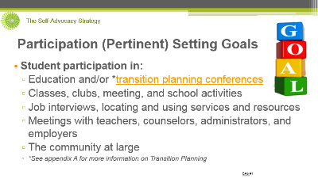

Definition of Leisure
Click here to return to:
Participation (Pertinent) Setting Goals
"The word leisure is derived from the Latin word licere which means to be free, and is closely related to the French word loisir, to be permitted. The essence of leisure appears to be freedom. Freedom in terms of time. Leisure is a time in an individual's life apart from earning a living or biological self-maintenance. Leisure, then is a time span in which there is freedom of choice and lack of compulsion" (p. 2).
INTRO SAo #13

