Slide 1

Introduction to a New Intervention for Teaching Multiplication with Regrouping
Margaret M. Flores, Ph.D., BCBA-D
Auburn University
Bradley J. Kaffar, Ph.D.
St. Cloud State University

Slide 2
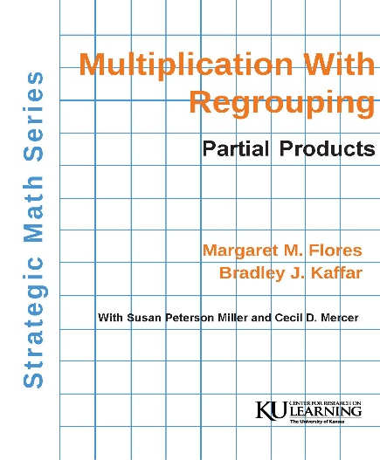
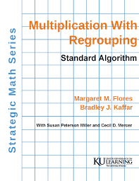
Purpose of the Intervention Program
Teach multiplication with regrouping with emphasis on the mathematical practices infused throughout the Numbers and Operations mathematics standards in most states
  Manual for teaching Partial Products Algorithm
  Manual for teaching the Standard Algorithm

Slide 3
Purpose (continued)
Build students’ sense of numbers and understanding of the multiplication operation
  Making numbers and physically showing operations with base-ten blocks, and drawings
Build students’ understanding of the operation in the context of real-life situations
  Each lesson presents computation problems with words, laying foundation for word problems
  After mastery of multiplication with regrouping, students differentiate between addition, subtraction, and multiplication within word problems
    allows students to engage in mathematical practices

Slide 4
The intervention is for students who demonstrate error patterns below.
 | 2 |  |  |  | 3
 | 2 | 4 |  |  | 2 | 5 |  |  | 3 | 4 |  |  | 2 | 4 |  | 3 | 3
x | 3 | 6 |  | x | 1 | 7 |  | x | 2 | 3 |  | x | 1 | 6 |  | x | 6
8 4 |  |  |  |  | 7 | 5 |  | 1 2 |  |  |  | 2 4 |  |  |  | 1, 8 1 8
 |  |  |  |  |  |  |  |  |  | 9 |  |  | 1 | 2
 |  |  |  |  |  |  |  |  |  | 8 |  |  |  | 4
 |  |  |  |  |  |  |  | + |  | 6 |  | + | 1 | 2
 |  |  |  |  |  |  |  |  | 3 | 5 |  |  | 5 | 2
Lack of number sense
  multi-digit numbers are not just separate numerals, but each one has a different value (42 is 4 tens and 2 ones rather than a 4 and 2)
Students attempt to memorize steps within a algorithm without a sense of numbers or understanding meaning of the operation

Slide 5
Pre-requisite Skills
Mastery of basic multiplication facts (zero through five)
  problems in manual intentionally developed so that students who have not mastered facts involving larger numbers can be successful (e.g., 8x7 or 6x9)
  Mastery of addition and subtraction involving regrouping
Field-testing has shown that deficits in these areas will significantly interfere with student learning
Manuals within the Strategic Math Series can be used to remediate
  Multiplication Facts 0 to 81 (Miller & Mercer, 1993)
  Addition With Regrouping (Miller, Kaffar, & Mercer, 2011)
  Subtraction With Regrouping (Miller, Kaffar, & Mercer, 2011)

Slide 6
Field Testing
Students in public elementary and middle schools
  students with disabilities
  students at-risk for failure who received the intervention within MTSS
Four studies conducted using single case designs (Flores, Hinton, & Strozier, 2014; Flores, Schweck, Hinton, 2014; Flores & Hinton, in press; Flores & Milton, in preparation)
Three with larger groups of students and the results were analyzed using statistical methods
  Compared Multiplication With Regrouping with a Direct Instruction intervention program (Flores, Kaffar, Hinton, in press).
  One group, pre-test and post test (Flores & Franklin, 2014; Flores, in preparation)

Slide 7
Instructional Sequence
Phase | Purpose | Lessons | Mastery Criteria
Phase 1 | Pretest and Commitment with Learning Contract | Pretest Lesson
Phase 2 | Teach multiplication with regrouping at the concrete level | Lessons 1-4 | 100% 2/2 ind. practice items
Phase 3 | Teach multiplication with regrouping at the representational level | Lessons 5-8 | 100% 2/2 ind. practice items
Phase 4 | Teach RENAME Strategy applied to multiplication with regrouping | Lesson 9 | 100% accuracy
Phase 5 | Teach multiplication with regrouping at the abstract level | Lesson 10 | 80% 4/5 ind. practice items
Phase 6 | Teach FAST RENAME Strategy for solving word problems | Lesson 11 | 100% accuracy
Phase 7 | Teach computation and problem solving at the abstract level, differentiating between operations within word problems. Teacher guidance fades. | Lessons 12-15 | 85% 6/7 ind. practice items
 |  | Lessons 16-18 | 87% 7/8 ind. practice items
Phase 8 | Post-test | Post-test Lesson

Slide 8
Concrete Level Instruction (Lessons 1-4)
Teach multiplication with regrouping using base-ten blocks
Materials: multiplication mat, base-ten blocks, learning sheets
Problems presented using words, translated into multiplication problems, problem solved using base-ten blocks and mat
Examples (Lesson 3):
There are 15 bags of candy and 24 candies in each bag. How many pieces of candy all together? | There are 23 students and each completes 24 assignments each week. How many assignments were completed?
__ groups of __ __ x __ 15 x 24 | __ groups of __ __ x __ 23 x 24

Slide 9
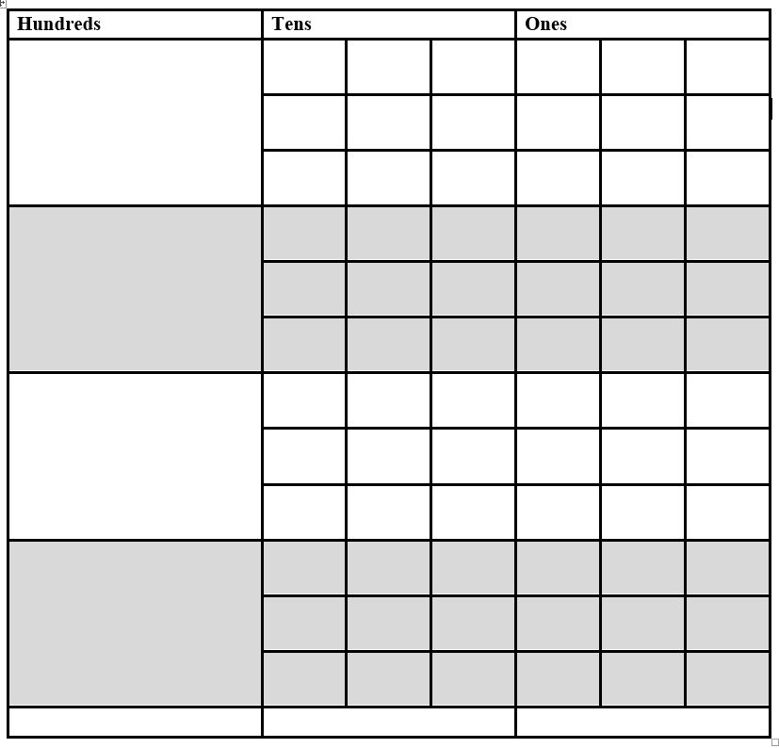
Representational Level Instruction (Lessons 5-8)
Teach multiplication with regrouping using drawings
Materials: learning sheets that include multiplication table
Problems presented using words, no prompts for translation, problem solved using drawings
Example (Lesson 7):
There are 14 shelves of books, 24 books on each shelf. How many books altogether? | Hundreds | Tens |  |  | Ones
14 x 24

Slide 10
RENAME Strategy
Bridge between representational and abstract phases
Simple generalizable strategy that assists students in remembering procedures for each algorithm
Teach strategy within context using problems
Students memorize strategy before moving to abstract level and using the RENAME strategy to solve problems.

Slide 11
RENAME Strategy for Each Algorithm
Partial Products
Read the problem.
Examine the ones column of the multiplier to make equations
Note the ones partial products.
Address the tens column of the multiplier to make equations.
Mark the tens partial products.
Examine the columns, add, and check.
Standard Algorithm
Read the problem.
Examine the ones column. (10 or more go next door.)
Note the ones.
Address the tens column. (10 or more go next door.)
Mark the tens.
Examine the columns, begin again, or add and check.

Slide 12
Beginning Abstract Instruction (Lesson 10)
Solve multiplication word problems and computation problems using RENAME
Examples (Lesson 10):
There 35 classes with 25 students in each class. How many students in all?
35 x 25

Slide 13
FAST RENAME Strategy
Simple generalizable strategy that assists students in thinking about how to solve a word problem
Teach strategy within context of solving different word problems
Students memorize FAST strategy
Find what you are solving for.
Ask yourself, “What are the parts of the problem?”
Set up the numbers.
Tie down the sign.

Slide 14
Abstract Instruction, Fluency, Differentiation Between Operations in Word Problems (Lessons 12-18)
Solve word problems that require addition, subtraction, or multiplication with regrouping
Solve computation problems using multiplication with regrouping
Teacher modeling and guidance faded until all items are independent practice in lessons 16-18
Examples (Lesson 14)
There are 14 boys in the class and 17 girls in the class. How many students are in the class? Write and solve. | There are 12 football teams and each team has 36 players. How many players in all? Write and solve. | There are 42 students on soccer teams. There are 56 students on hockey teams. How many more students are on hockey teams?

Slide 15
Fluency
Regrouping Rate Assessments: administer after students complete lesson 12
  3 versions (A, B, C), administer by rotating versions across lessons
  2-minute timed multiplication with regrouping assessment
  To assess retention from previous session, administer before lessons
  Fluency defined as 30 correct digits written
    What is a correct digit?
 |  | 1
 |  | 2 | 5
 | x | 1 | 3
 | 1 | 7 | 5 | 2 correct digits
+ | 2 | 5 | 0 | 3 correct digits
 | 3 | 2 | 5 | 3 correct digits

Slide 16
Practice Games
Beginning with Lesson 17, the last lesson activity is “Game Practice”
  supplemental practice in which students compete with each other in solving computation problems
    Example Object of game is to be first to complete problems correctly; use dice to determine how many problems are completed within a student’s turn
      Roll numbers 1-5, complete one problem
      Roll double sixes, can complete 2 problems
      Roll one six, lose turn

Slide 17
Intervention Summary
18 lessons that teach multiplication with options of using partial products or standard algorithms
Emphasis on understanding the operation and its application to real-life situations
Lesson sequence
Concrete |  | Representational |  | Abstract
Problem solving using base-ten blocks | > | Problem solving using drawings | > | Problem solving using numbers only | > | Computation fluency and discrimination between operations within word problems

