Slide 1
Addition Within 20: CRA-Integrated
Margaret M. Flores, PhD, BCBA-D, Bradley J. Kaffar, PhD

Slide 2
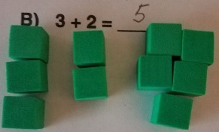
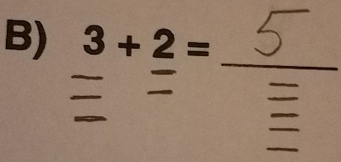
What is CRA?
Mathematics instruction presented in a sequence of phases
  Solve problems using objects (concrete)
  Solve problems using pictures and/or drawings (representational)
  Solve problems using numbers and symbols (abstract)
3 + 2 = 5

Slide 3
Why use CRA interventions?
Provides foundational conceptual understanding
Students learn mathematical language, numbers, operations, and concepts through explicit hands-on experiences

Slide 4

Why use CRA interventions?
  Concrete: students have visual and hands-on experience
    Example: addition (+) means that amounts are joined and the equal sign (= or ____) means that amounts on both sides are the same or equal
      Student physically makes 2 amounts (make numbers, count)
      Student combines and makes one group on the other side of the equal sign
      Student counts the amounts on each side of equal sign to ensure both are equal or the same amount

Slide 5
Why use CRA interventions?
  Representational: students continue to have visual experiences solving problems, but making their own drawings or using pictures moves them away from a dependence on manipulatives
      Draw 2 amounts (make numbers, count)
      Combine and draw one group on the other side of the equal sign
      Count the amounts on each side of equal sign to ensure both are equal or the same amount

Slide 6
Why use CRA interventions?
  Abstract: students solve problems using just numbers, symbols, and procedures
    HOWEVER, students likely understand why procedures are used
  Emphasis on fluency

Slide 7
CRA-Integrated Instruction (CRA-I)
Instruction begins with both concrete and representational activities at the same time to solve abstract problems
Concrete activities fade from instruction
  Abstract problems solved with pictures and drawings
Representational activities fade from instruction
  Problems solved using numbers and symbols (abstract)

Slide 8
Use of High Leverage Practices
CRA-I sequence scaffolds instruction for students who struggle, providing systematically more complex instruction across lessons as students achieve mastery
Lessons taught with explicit instruction
  Advance Organizer
  Describe and Model
  Guided Practice
  Independent Practice
  Post Organizer

Slide 9
Content Addressed by Addition Within 20
  Conceptual understanding of addition
    Including application through word problems
  Conceptual understanding of equal sign
  Connection between addition and subtraction with missing addend problems
  Understanding of place value and magnitude
  Understanding of commutative property
  Reasoning and processes for solving problems using different strategies

Slide 10
Who needs this intervention?
Students who are not fluent in addition facts with sums between 10 and 20.
Students who may have memorized some addition facts, but do not show an understanding of the operation or show enough flexibility within numbers to solve unknown addition problems mentally
Students who make the following errors:
  Complete addition problems with sums of one less than the actual answer (8 + 6 = 13).
  Leave answers blank.
  Write one of the addends as the sum (4 + 7 = 7).

Slide 11
Field Testing
Second grade students receiving multi-tiered systems of support
  Beginning second grade student who had received tier three services during first grade mastered addition facts
  Second grade teacher used program with students receiving tier two intervention
    Five students demonstrated increased fluency and showed mastery of addition and number concepts

Slide 12
Instructional Sequence
Phase | Purpose | Lessons | Mastery Criteria
Phase 1 | Pretest(s) | Pretest Lesson | 80% accuracy
Phase 2 | Teach addition at concrete level and representational level using base-ten blocks, number lines, and drawings | Lessons 1-3 | 100% accuracy
Phase 3 | Teach addition at the representational level using number lines, and drawings | Lessons 4-5 | 100% accuracy
Phase 4 | Teach strategy-use to solve addition problems at the representational level using number lines, and drawings | Lesson 6-7 | 100% accuracy
Phase 5 | Teach FACTS strategy for solving addition problems | Lesson 8 | 100% accuracy in identifying steps
Phase 6 | Teach addition at abstract level using FACTS strategy and numbers only | Lessons 9-12 | 100% accuracy
Phase 7 | Posttest(s) | Posttest Lesson | 90% accuracy

Slide 13
Progress Monitoring Options in Manual
Addition Accuracy (untimed)
  pretest and posttest
Addition Conceptual Understanding (untimed)
  pretest and posttest
  strategy-use, magnitude, missing addend
Word Problems (untimed)
  pretest and posttest
  discrimination between addition and missing addend (subtraction) problems
Addition Fluency (one-minute)
  pretest and posttest

Slide 14
Supplemental Lessons
The design of the manual was intentionally brief.
  Conducive for use within MTSS, completed within 4 weeks
Some students may not achieve mastery and/or fluency after 12 lessons.
  Eight supplemental lessons for use as needed

Slide 15


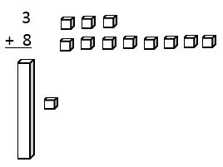

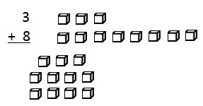
Lesson One: Solve each problem using objects and number line.
Using Objects
Count total, notice ones and tens. Exchange blocks. Write answer, noting ones and tens .
Discuss equal sign and the amount on either side of the equal line
Discuss the order of numbers in making the sum (commutative property)
Make each number
Make whole group (meaning of addition and equal sign)

Slide 16
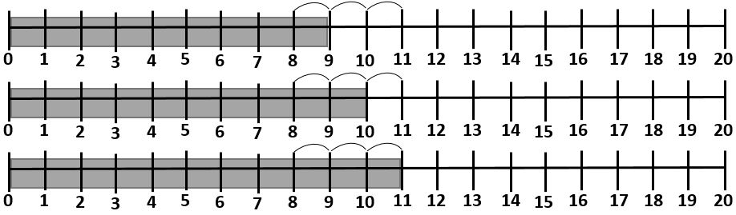

Lesson One
Solve using number line
Draw and show the counting-on process
Discuss the ones and tens in the sum.
The answer has _1_ ten _1_ one.
Discuss sum’s proximity to 10 and 20 (magnitude)
Is the answer closer to 10 or 20? __10__
Make number (largest) on number line
Draw representations, showing how the other number combines

Slide 17

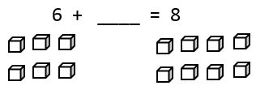


Addition Within 20 – Missing Addend (beginning lesson 2)
Solve each problem using objects and number line
Using objects
Make the first addend and sum
Add objects until the amount on left side is equal to amount on right side.
6 + __2__ = 8

Slide 18
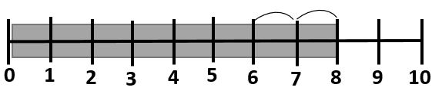
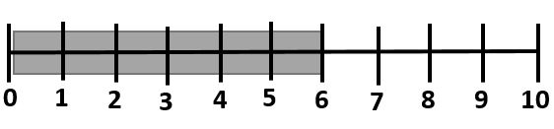
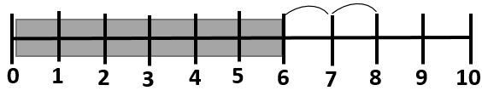
Addition Within 20 – Missing Addend (beginning lesson 2)
Solve each problem using objects and number line
Using number line
Make given addend on number line
Draw representations, showing an increase to the sum
Shade difference and count to find the missing addend.
Discuss another way to solve using subtraction
Write a different number sentence using the same numbers. 8 – 6 = __2___

Slide 19
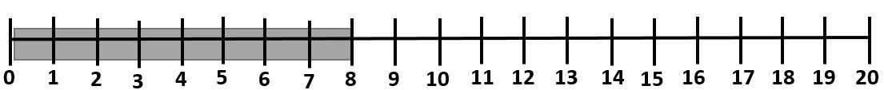
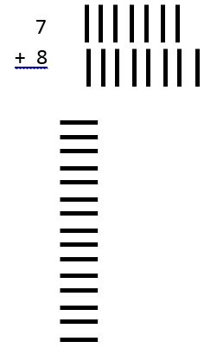
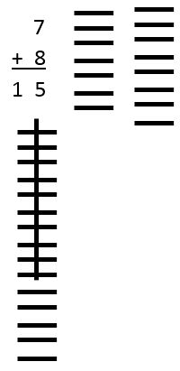
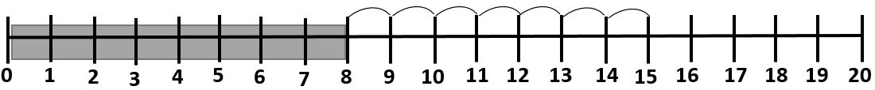
Addition Within 20 – Fade Objects: (Lessons 4-5)
Draw numbers and sum
Make ten and discuss number of tens and ones in sum
Make larger number on number line
Draw representations, showing how the other number combines
Draw and show the counting-on process
Discuss the sum’s proximity to 10 & 20

Slide 20
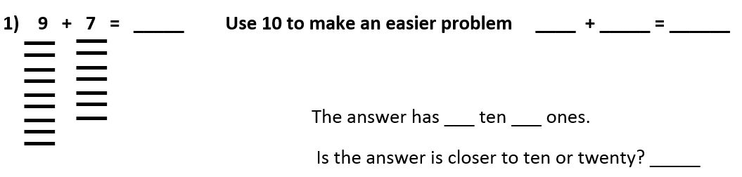
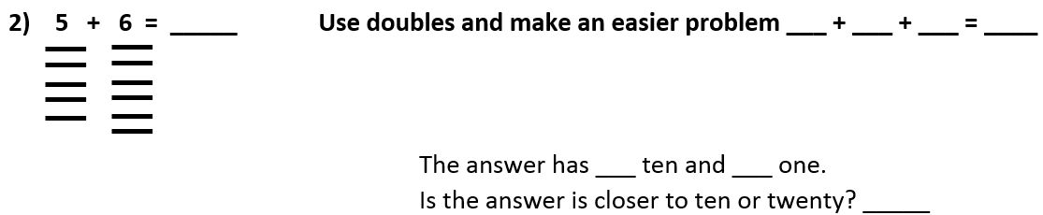
Addition Within 20: Explicitly Teach How to Use Strategies to Solve Problems (Lessons 6-7)
Lesson Examples

Slide 21
Addition Within 20: Mnemonic Strategy (Lesson 8)
Focus on the problem (Look at sign and numbers; ask, “Do I know the answer?” If not, choose strategy )
Another problem (doubles plus one, use of ten)
Count on (count on to the larger number)
Tallies (draw the problem using tallies)
Solve the problem (use strategy and write the answer)

Slide 22
Addition Within 20: Abstract Instruction (lessons 9-12)
Students solve computation problems and word problems using FACTS strategy
  Focus on computation and fluency

Slide 23
Fluency Activities and Games
Lessons 9-12 include instructions for fluency building
Teacher-led Activities
  Make/acquire 5-6 flashcards with completed equation on one side and equation without answer on other.
  Present the student(s) with the whole equation, including the answer and read the equation.
  Then, turn the flashcard over and ask the student to tell you the answer. Continue for 2-3 rounds.
  Present equations without answers. Ask the students to respond, but only if they know answer.
    If not, ask them to wait for you to show them the answer.
  When presenting flashcards, give students about four seconds before you show them the answer on the other side of the flashcard.
  After students master facts, add a few more to the pool
This activity can be a game if you assign points. If the students answer correctly from memory, they earn two points. If the student answers correctly after the teacher gives the answer, the student earns one point. If the student answers incorrectly, the teacher earns a point.

Slide 24
Fluency Activities and Games
Lessons 9-12 include instructions for fluency building
Dice Games for Students
Give students sheets with unknown facts written on them. Students roll dice before they complete each problem. The dice determine whether they can complete the problem or not.
  Each of the different types of games involve the use of either one or two dice.
  Several different games from which to choose.
  If you cannot supervise while students play, provide them with a calculator to check their work.

Slide 25
Summary of Addition Within 20
Compact intervention that addresses multiple numbers and operations standards
Intended for brief explicit intervention
Although brief, includes high leverage practices
  Explicit instruction
  Scaffolding with the CRA-I sequence
Lesson Sequence
Concrete,
Representational, &
Abstract: Build
understanding
Representational
& Abstract:
Build conceptual
understanding.
Abstract:
Build procedural
knowledge & fluency
FACTS:
Build procedural
knowledge

Slide 26
Questions?
Contact Information:
mflores@auburn.edu bjkaffar@stcloudstate.edu

