Slide 1
Word Mapping Made Easy: How to ‘Map” in Content Area Classrooms
SIM Conference 2016
July 13th – 15th, 2016
Monica L. Harris, Ph.D.
harrismo@gvsu.edu

Slide 2

Agenda
Essential Components of Vocabulary Instruction
Explicit Instruction
  Tiered Words
  Word Choice
  Strategy Choice
Tips for “Deconstructing” Words
Word mapping in the Classroom

Slide 3
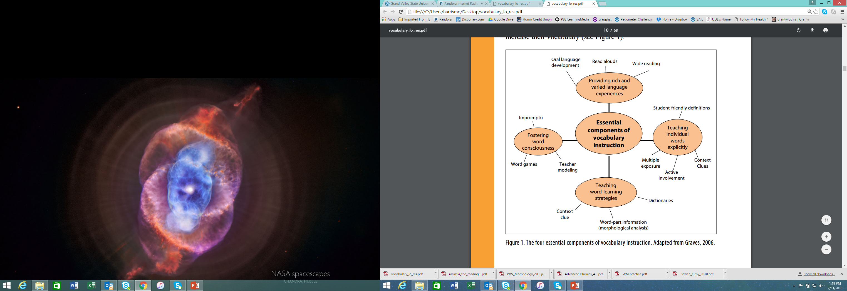

Slide 4
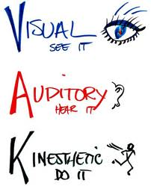
Inclusive Environments
Multiple modalities should be used in both instruction and learning.
Pressley & Woloshyn (1995)

Slide 5

Inclusive Environments
Emphasis on words that are useful for content learning and will open doors to more learning.
Attention should be given to generative words that have parts found in many other words (e.g., word families, roots, etc.).
Learning the shared (high frequency) morphemes leads to more word learning.
Biemiller (2001)

Slide 6

Inclusive Environments
Students must develop independent strategies for word learning and the ability to use context, morphology and reference tools.
Fisher & Blachowicz (2005)

Slide 7

Inclusive Environments
Instruction should emphasize the connectedness in which words are related to topics and categories of meaning (e.g., synonyms, antonyms, examples, non-examples, etc.)
Blachowicz & Fisher (2003)

Slide 8
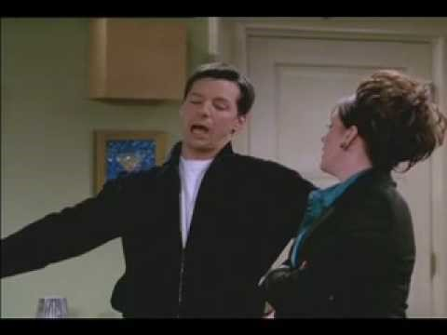
A Vocabulary Lesson

Slide 9
Explicit Instruction

Slide 10
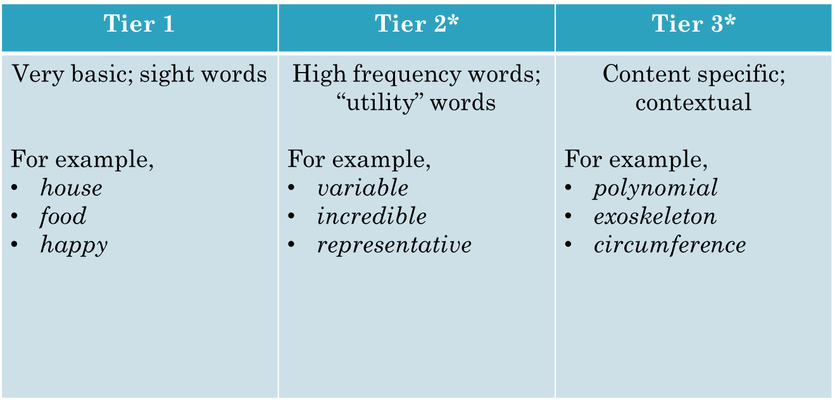
Word Choice
Beck, McKeown, & Kucan (2004)

Slide 11
Word Choice: Eliminate Tier 1 terms
representation
weathering
geomorphology
Mt. Vesuvius
convergent
divergent
dome
plate tectonics
eruption
igneous
mudslides
orogeny
dormant
erosion
volcanoes
epicenter
Crater Lake
viscosity
geoscience
earthquakes

Slide 12
How Best to Explicitly Teach?
LINCS (Ellis, 1992)
  Word Specific approach
  Recall definition via visual/auditory memory device
Word Mapping (Harris, Schumaker, & Deshler, 2008)
  Generative approach
  Predicting meaning based on word parts

Slide 13
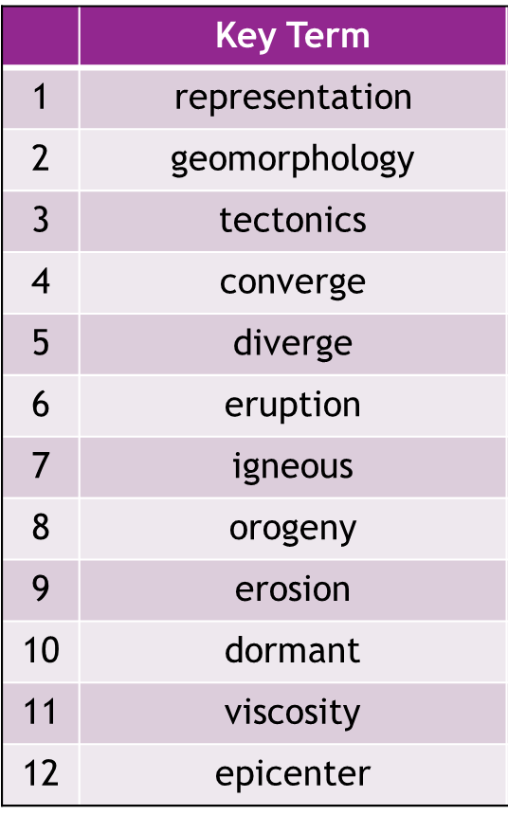
Decide which strategy to use: WM or LINCS

Slide 14
Vocabulary: Geomorphology Unit
 | Key Term | Tier 2 | Tier 3
1 | representation | X
2 | geomorphology |  | X
3 | tectonics |  | X
4 | converge | X
5 | diverge | X
6 | eruption | X
7 | igneous |  | X
8 | orogeny |  | X
9 | erosion |  | X
10 | dormant | X
11 | viscosity |  | X
12 | epicenter |  | X
WM
VL
Notes:
With a partner decide which of the Tier 2 & 3 terms lend themselves to using etymology (Word Mapping) or word-specific definitions.

Slide 15
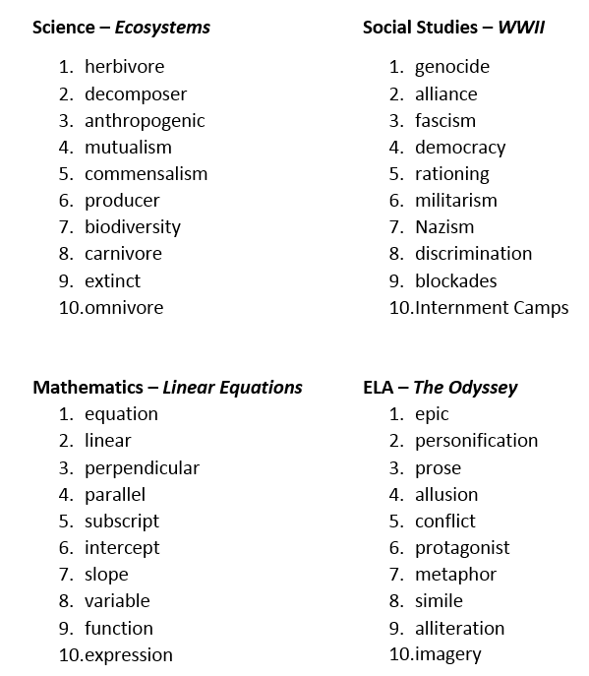
Domain Specific Vocabulary:
MAPS vs. LINCing
Notes:
Controlled Practice with content area terms. Decide if terms are Tier 2 or 3.
Then ask which would be WM terms and LINCS words.

Slide 16
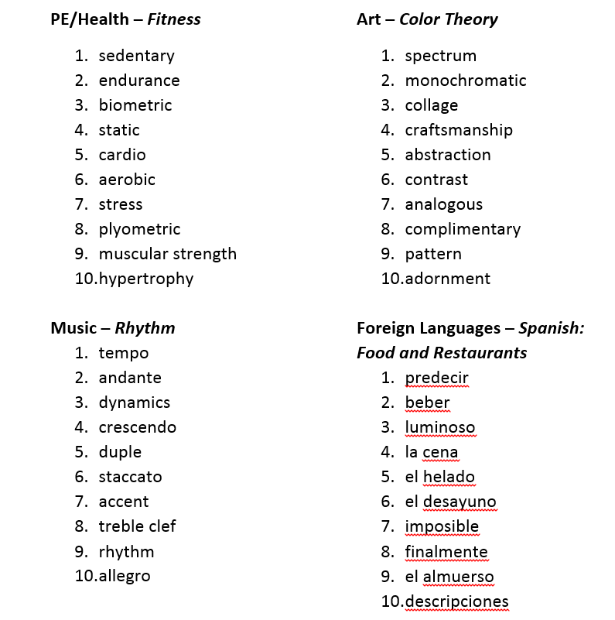

Slide 17
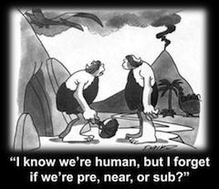

Slide 18
Tips for “Deconstructing” Words
Look for words or known parts within the term.
  un- healthy
Bite off the biggest chunk!
  diversity (instead of only diverse)
Word parts may have more than one meaning – must “play” with meanings to make prediction.
  dis- ease
At times, the prefix/root/suffix “sequence” will not be used; not all words have all parts.
  port or dia- meter
At times, there will be “extra” letters left between word parts.
  associat(e) -ive

Slide 19
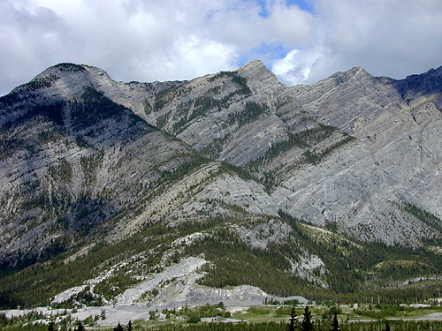
Sedimentary Rocks
Sedimentary rocks can be categorized into three groups based on sediment type. Most sedimentary rocks are formed by the lithification of weathered rock debris that has been physically transported and deposited.

Slide 20
The FRAME Routine
Key Topic
Formation of Rocks
is about…
The processes that form the different types of rocks.
Main idea
Main idea
Main idea
Metamorphic
Igneous
Sedimentary
Essential details
Essential details
Essential details
Metamorphism
Cooling Magma
Deposition
Pressure and Temperature
Molecular Rearrangement
Layering
Physical and Chemical Change
Intrusive and Extrusive
Law of Superposition
Exposed by Uplift and erosion
Earths crust is made up of 95% igneous rocks
Fossils
So What? (What’s important to understand about this?)
These rock types are formed in the rock cycle and that cycle is driven by plate tectonics.

Slide 21
Sedimentary Rocks
Sedimentary rocks can be categorized into three groups based on sediment type. Most sedimentary rocks are formed by the lithification of weathered rock debris that has been physically transported and deposited.

Slide 23
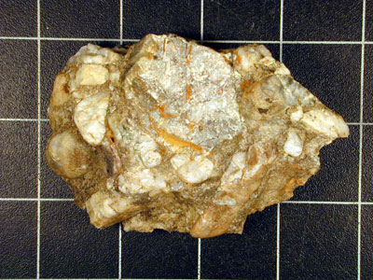
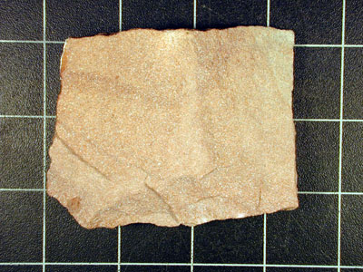
During the transport process, the particles that make up these rocks often become rounded due to abrasion or can become highly sorted. Examples of this type of sedimentary rock include conglomerate and sandstone.

Slide 24
Word Mapping: Classroom Activities
Teacher Nudges (adapted from Martinez & Roser, 2003)
  When might you…?
  How might you…?
  Why might you…?
Be a Word Detective (Baumann, Font, Edwards, & Boland, 1989)
Role Cards (Kagan & Kagan, 2009)
Pick a Morpheme

Slide 25
Be a Word Detective (Baumann et al., 1989)
Use context clues
Break the word apart
  M - Map out the parts
  A - Attack the meaning
Put word back together
  P – Predict the words meaning
Reread text
  S – See if you’re correct!

Slide 26
Role Cards (Kagan & Kagan, 2009)

Slide 27
Pick a Morpheme
Assign a targeted morpheme (affix or root).
Put students in pairs (or teams). Have them work independently to list as many words as they can with the morpheme, along with the definition (they cannot use a dictionary).
When time is up, have teams share their lists. Consult a dictionary if any definitions are disputed.
The team that has compiled the longest list of words (with correct definitions) wins!

Slide 28
The Goal…
Choose words for instruction carefully, focusing on content specific and generative words as part of a shared knowledge base (e.g., word-specific or etymology approaches).
Both general vocabulary knowledge and specific text-based vocabulary should receive attention (e.g., Tier 2 & 3 terms).
Meanings must be made explicit through vocabulary activities: demonstrations, discussion, usage, further discussion, and refinement (e.g., multi-modal instruction)

Slide 29

Websites:
William & Mary – School of Education
Florida Center for Reading Research

Slide 30
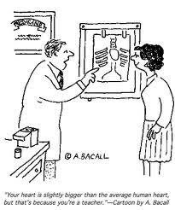
Thank You!
“Your heart is slightly bigger than the average human heart, but that’s because you are a teacher.”

