Slide 1
The Star Writer Program: Proficiency in Paragraph Writing
Jean Schumaker
January, 2015

Slide 2
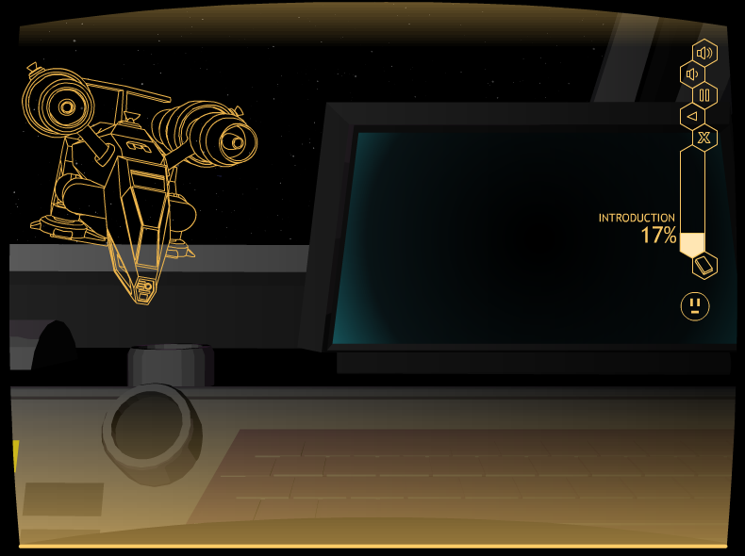
Matt: Insert a cool slide of the space ship or something showing the space theme

Slide 3
TODAY’S GOALS
To familiarize you with:
The Star Writer Program content for teaching advanced paragraph writing skills
The program structure
Your role as a teacher
The instructor’s guide
How to get organized
The research

Slide 4
Parts of the Star Writer program
Fundamentals of Paragraph Writing
Proficiency in Paragraph Writing
Fundamentals in Theme Writing
Proficiency in Theme Writing

Slide 5
Fundamentals in Paragraph-writing
Introduction
Lesson 1: Complete Sentences
Lesson 2: Topic Sentences
Lesson 3: Planning a Paragraph
Lesson 4: Detail Sentences
Lesson 5: Clincher Sentences

Slide 6
CONTENT OF THE PROGRAM
Parts I, II, III of the Paragraph Writing Strategy Program
The program builds across the lessons so that students are writing whole paragraphs in Lesson 5

Slide 7
THE INTRODUCTION
Introduces the purpose
Provides navigation instructions
Begins the plot
Provides an overview of the lessons

Slide 8
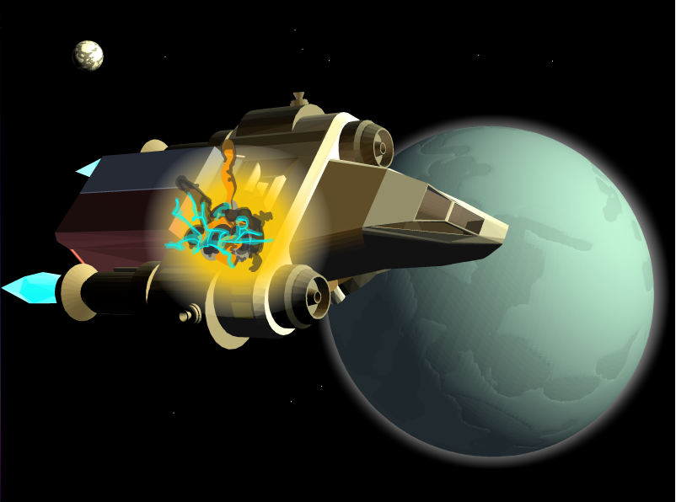

Slide 9
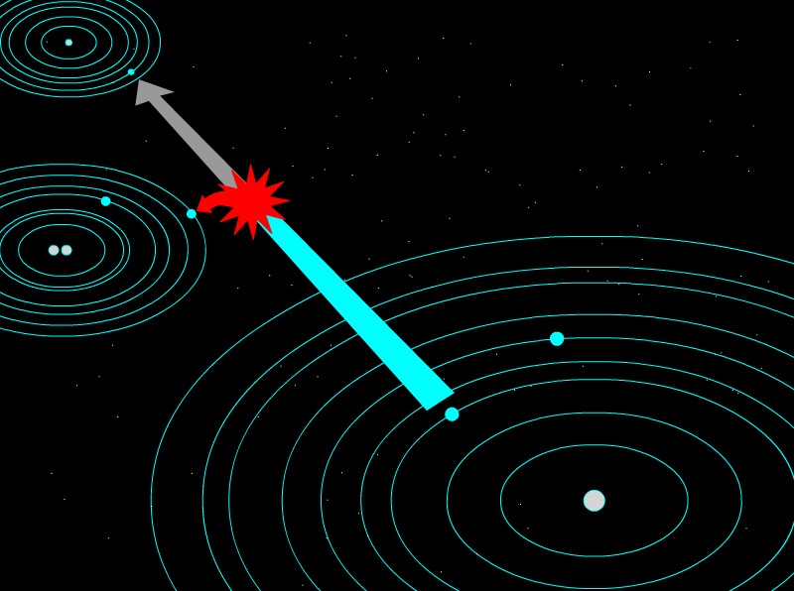

Slide 10
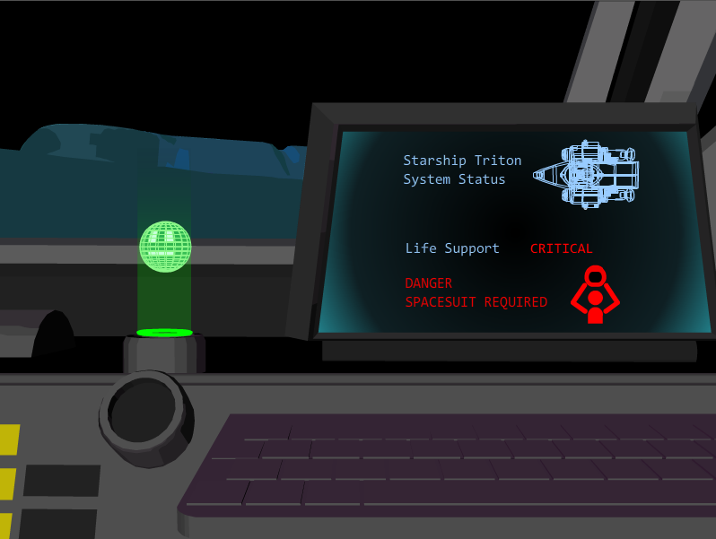

Slide 11
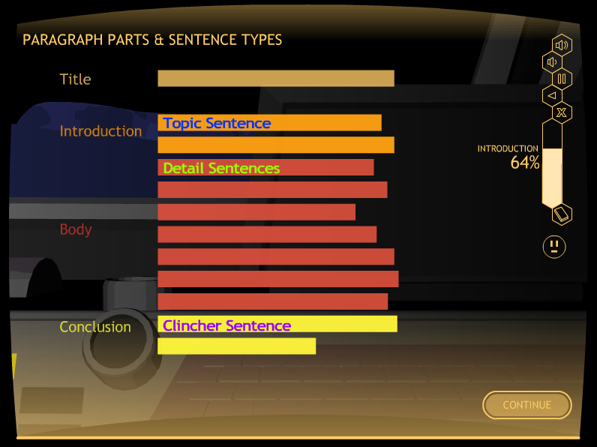

Slide 12
The Lessons
Lesson 1: Complete Sentences
Lesson 2: Topic Sentence
Lesson 3: Planning a Paragraph
Lesson 4: Detail Sentences
Lesson 5: Clincher Sentences

Slide 13
LESSON STRUCTURE
            Learn It
            Watch It
            Study It
            Practice It

Slide 14
End Goal: Mastery of basic paragraph-writing skills

Slide 15
Parts of the Star Writer program
Fundamentals of Paragraph Writing
Proficiency in Paragraph Writing
Fundamentals in Theme Writing
Proficiency in Theme Writing

Slide 16
Proficiency in
Paragraph writing
Introduction
Lesson 1: Instructive Paragraphs
Lesson 2: Narrative Paragraphs
Lesson 3: Persuasive Paragraphs
Lesson 4: Informative Paragraphs
Lesson 5: Descriptive Paragraphs

Slide 17
CONTENT OF THE PROGRAM
Part IV of the Paragraph Writing Strategy Program

Slide 18
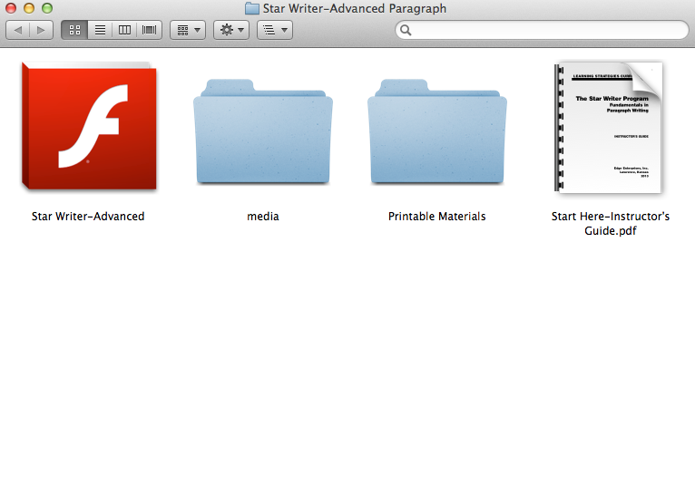

Slide 19
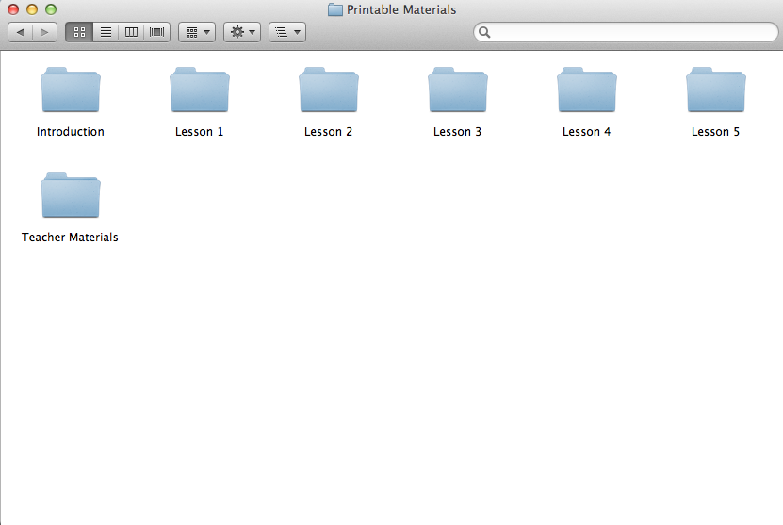

Slide 20
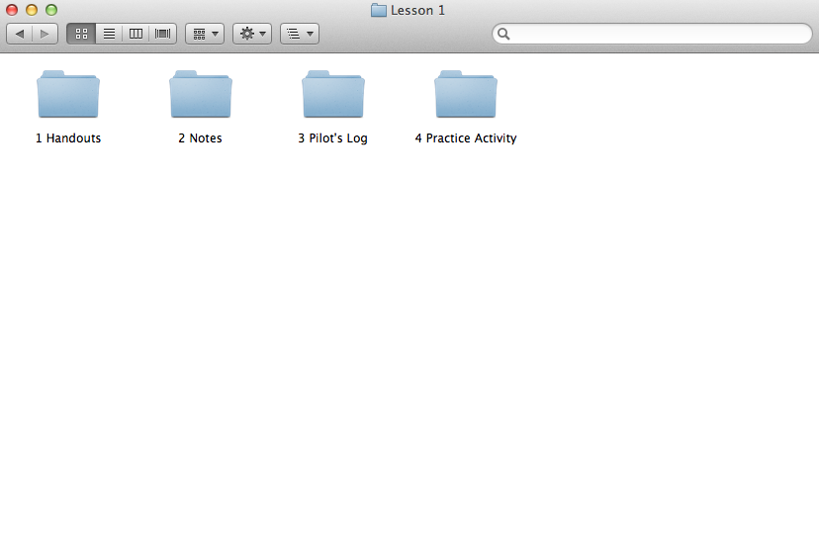

Slide 22
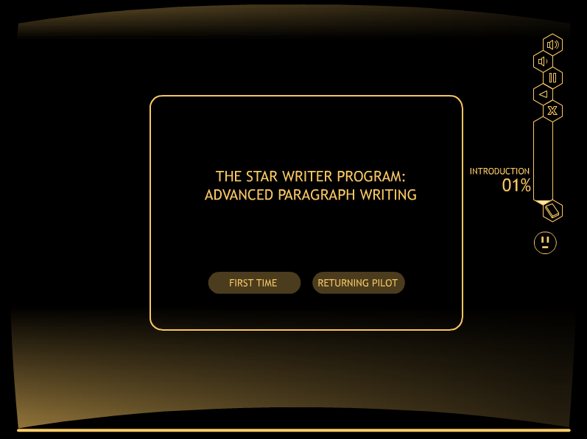
ADD second round of slides

Slide 23
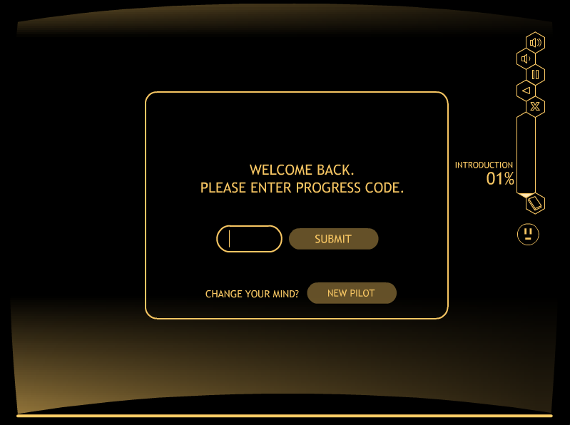
ADD second round of slides

Slide 24
INTRODUCTION

Slide 25
INTRODUCTION
Introduces the purpose
Provides navigation instructions
Begins the plot
Provides an overview of the lessons

Slide 26
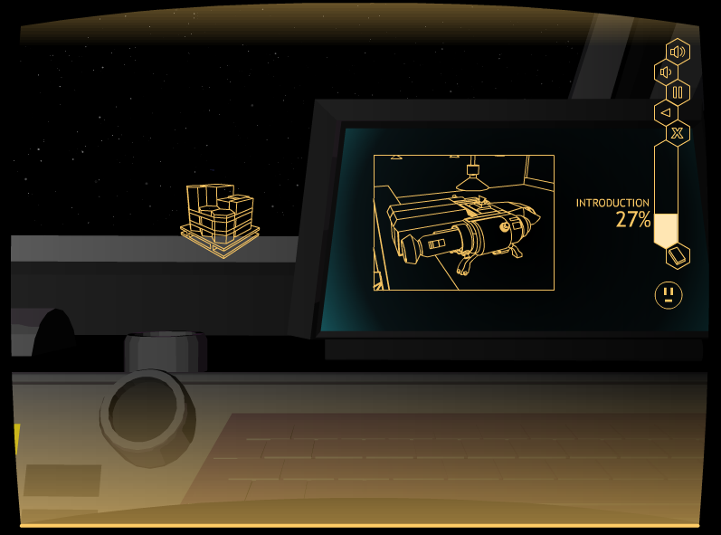
ADD second round of slides

Slide 27
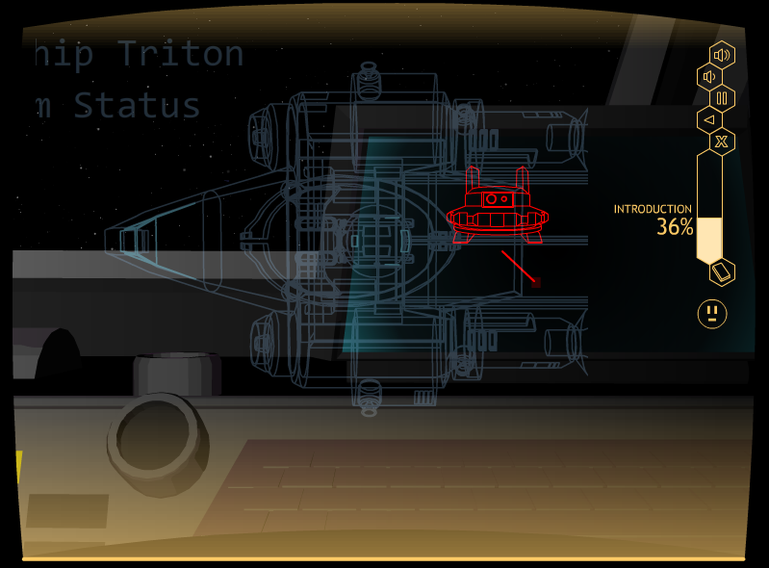
Matt: Insert a slide showing the space theme

Slide 28
NAVIGATION
Navigating through the program is the same as in the Fundamentals of Paragraph Writing Program

Slide 29
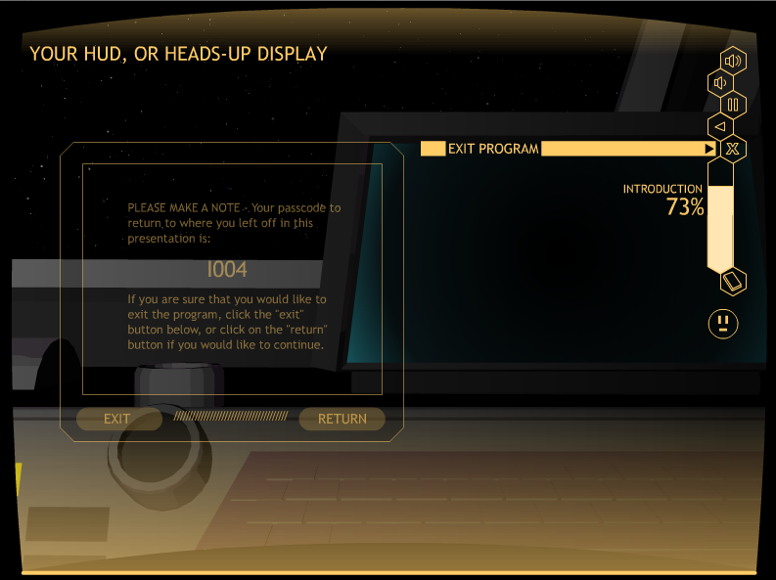

Slide 30
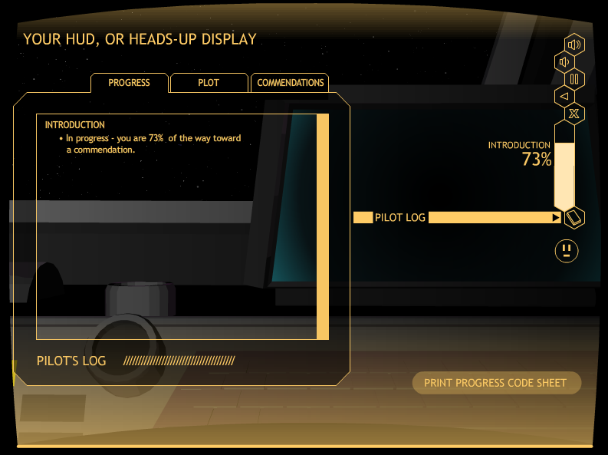

Slide 31
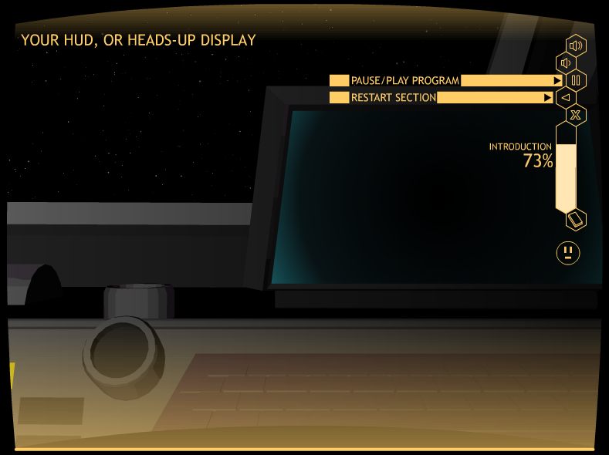

Slide 32
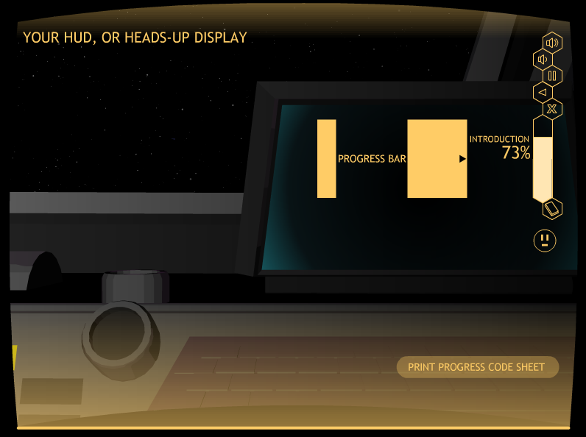

Slide 33
Lesson 1: instructive paragraphs

Slide 34
LESSON STRUCTURE
            Learn It
            Watch It
            Study It
            Practice It

Slide 35
EACH LESSON
Purpose and parts of the paragraph
Specifics about the paragraph type
Demonstration of filling in a Paragraph Diagram
Demonstration of writing the type of paragraph
Verbal Practice activities
Practice activities

Slide 36
Purpose
An Instructive Paragraph:
• Explains how to do something
• Is organized in steps

Slide 37
Each step
Covers one part of the process
Must be in the order to be followed in completing the process

Slide 38
INstructive PARAGRAPH
Title: Names the job to be explained
Topic Sentence: Explains that a set of steps will be described
Lead-off Detail Sentences: Each introduces a new step
Follow-up Detail Sentences: Each provides more information about the step
Clincher Sentence: Sums up the steps and tells that the job is done

Slide 39
OTHER key POINTS
Time transitions
Second-person point of view
Present tense

Slide 40
EXAMPLE LEARN IT SCREEN

Slide 41
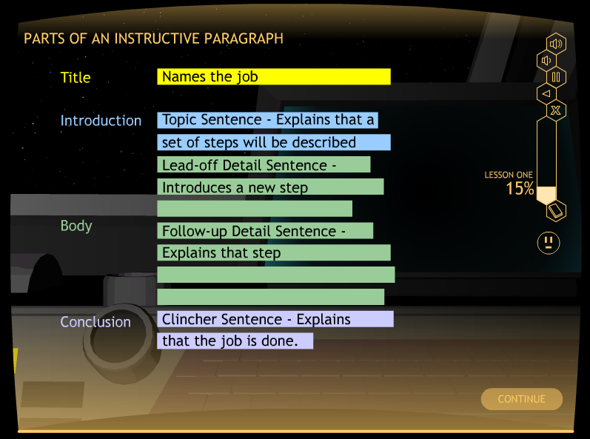
Matt: Add the slide from LS 1, Row 5
Matt: Insert

Slide 42
WatcH It

Slide 43
Matt: Please insert in here the diagram for the Watch It

Slide 44
ADD second round of slides

Slide 45
ADD second round of slides

Slide 46
Let’s watch it
Go to A007
Stop at the end of the demo

Slide 47
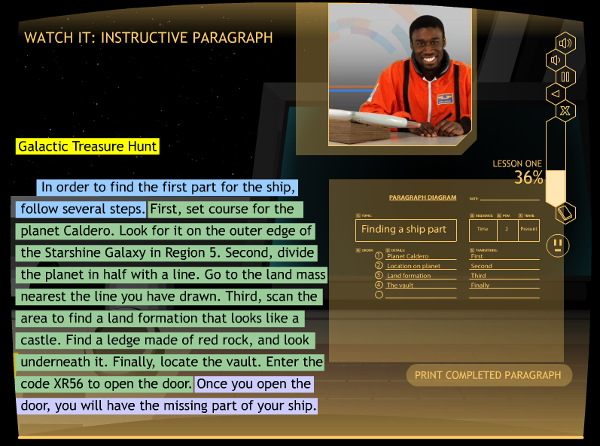
Matt: Insert the Watch It screen that shows the Instructive paragraph

Slide 48
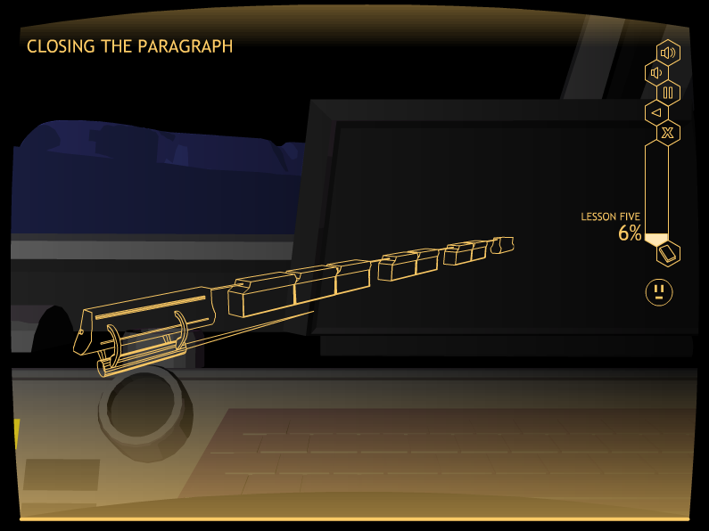
Matt: Please put in here the slide with the galactic train on it from the beginning paragraph CD. It should have all the cars.

Slide 49
EXAMPLE STUDY IT SCREEN

Slide 50
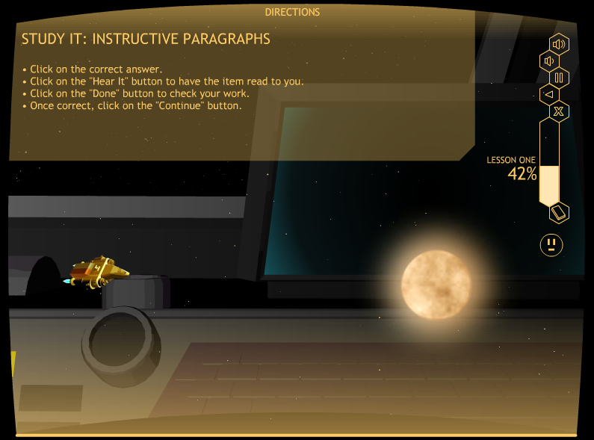
Matt: Add a picturesque Study it screen Here

Slide 51
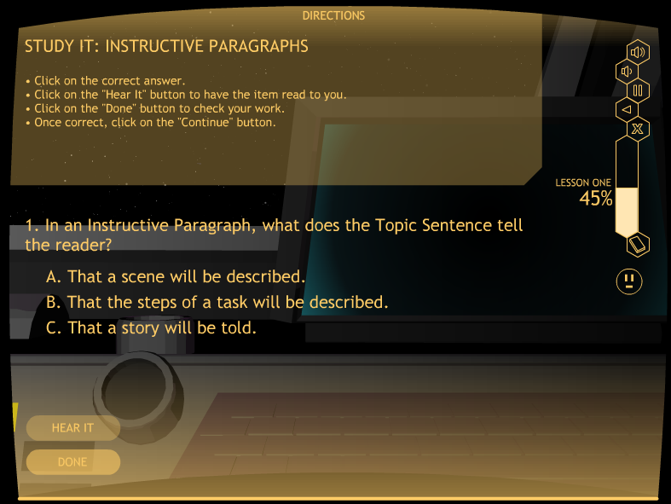
Matt: Please put in here a slide from the Study It section that shows a question with multiple choice answers. Maybe Row 15?

Slide 52
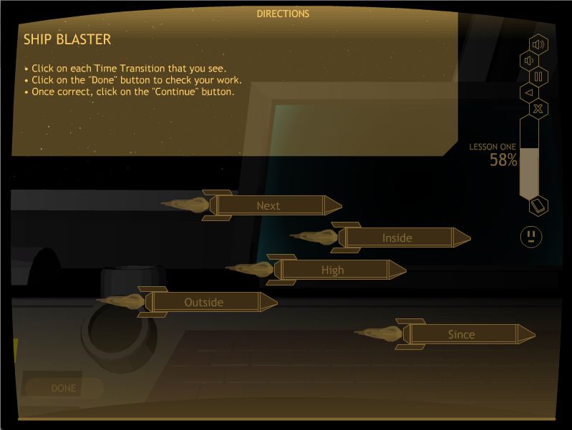
Matt: Please put the instructions screen for the Ship Blaster activity in here. Is it row 19?

Slide 53
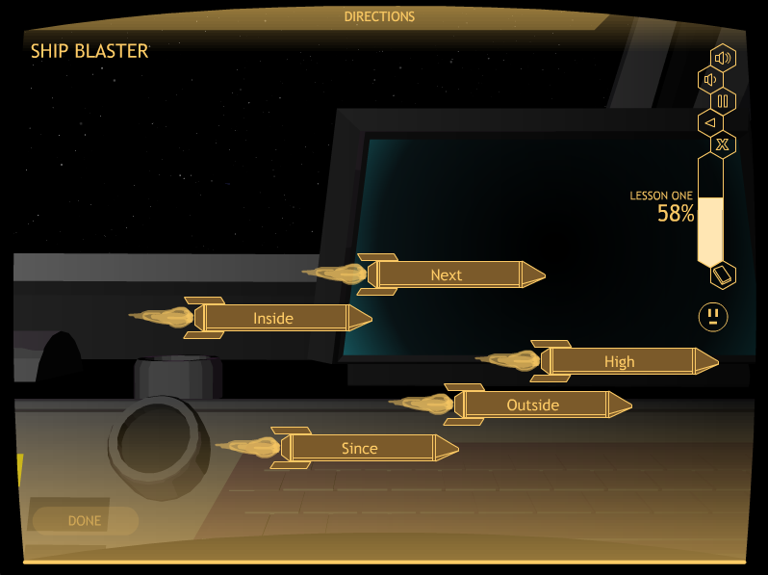
Matt: Insert a space slide

Slide 54
Let’s study it
Go to A019
Stop after answering the questions

Slide 55
The practice sequence
Student practices planning a paragraph
Teacher scores the paragraph diagram
Student practices writing a paragraph with prompts
Teacher scores the prompted paragraph
Student practices writing a paragraph independently (no prompts)
Teacher scores the independent paragraph
Student reaches mastery and progresses to the next lesson

Slide 56
PRACTICE Planning

Slide 57
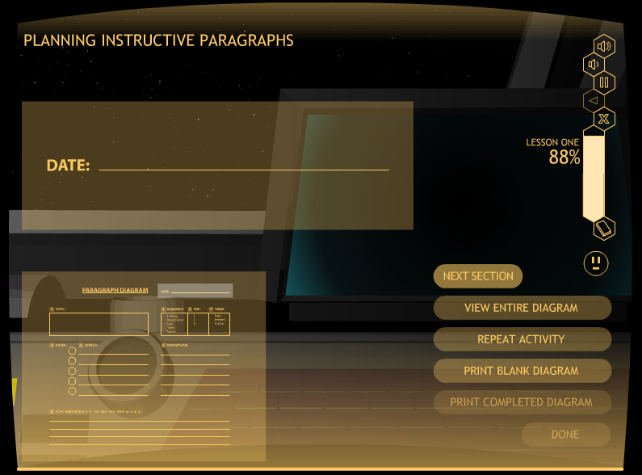
Matt: Add the paragraph diagram screen here

Slide 58
Let’s practice it
Go to A029
Stop after filling in the diagram

Slide 59
PRACTICE writing

Slide 60
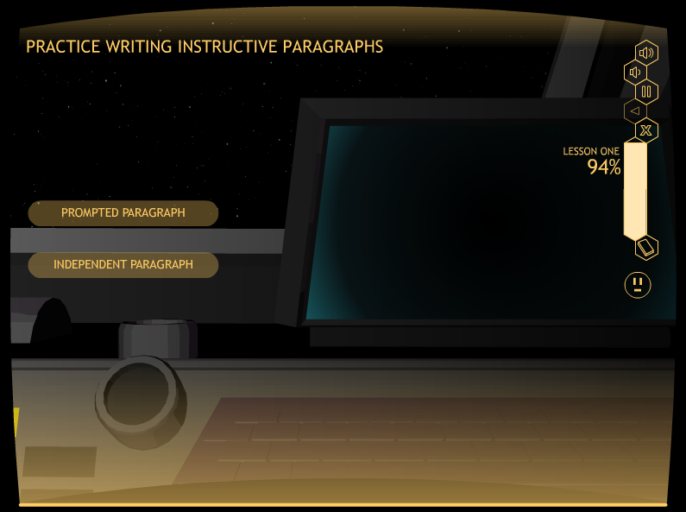
Matt: add the prompted and independent button screen here

Slide 61
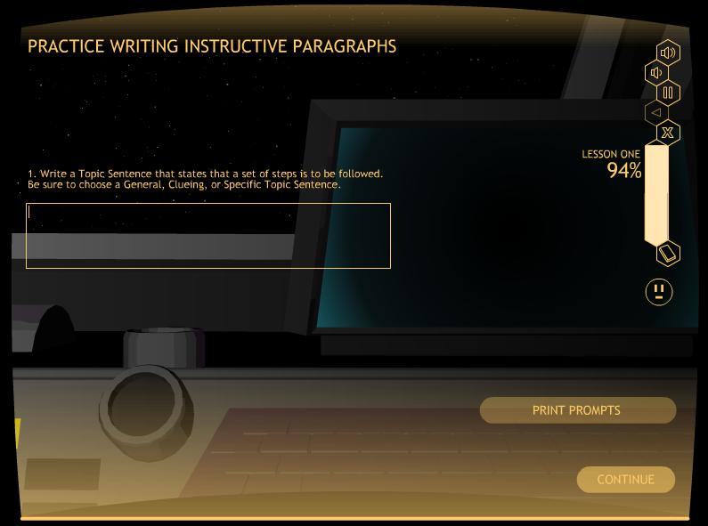
Matt: Add a Prompt screen here—Topic sentence

Slide 62
Let’s practice it
Go to A031
Stop after editing your paragraph

Slide 63
Matt: add the prompted and independent button screen here

Slide 64
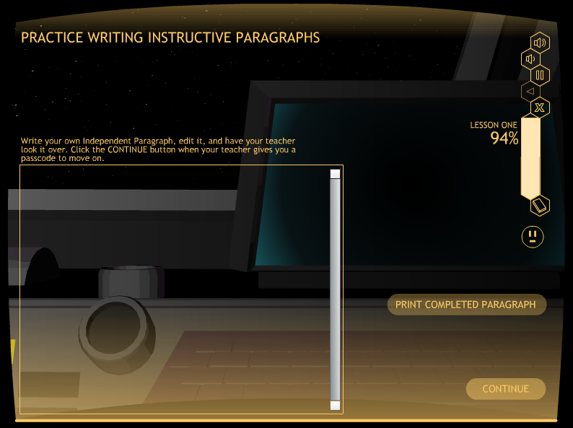
Matt: Add the independent paragraph screen here

Slide 65
Lesson 2:
Narrative paragraphs

Slide 66
Learn IT

Slide 67
Purpose
A Narrative Paragraph:
• Tells a story
• Is organized in events

Slide 68
Each event
Is an activity or happening
Must be in chronological order
Can involve the writer
Can involve others

Slide 69
OTHER KEY POINTS
Time transitions
First-person point of view (if about the writer)
Third-person point of view (if about others)
Past tense

Slide 70
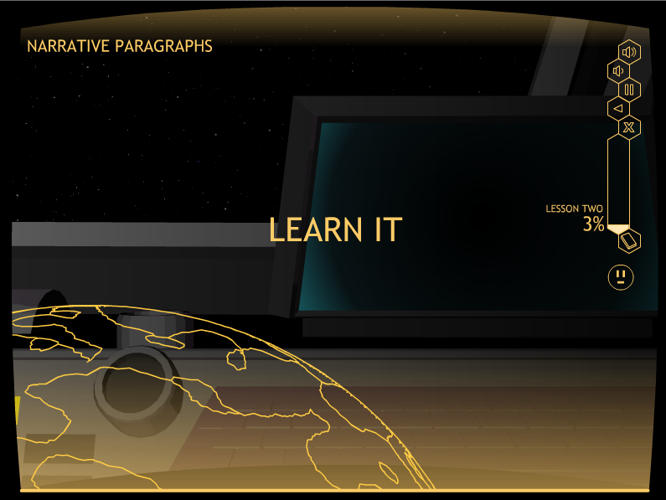
Matt: Add a good picture from Narrative lesson here

Slide 71
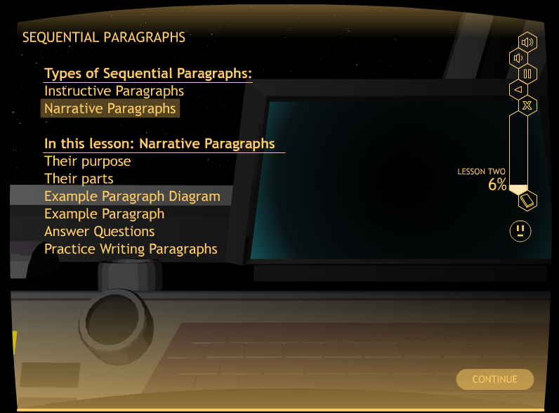
Matt: Add a good picture from Narrative lesson here

Slide 72
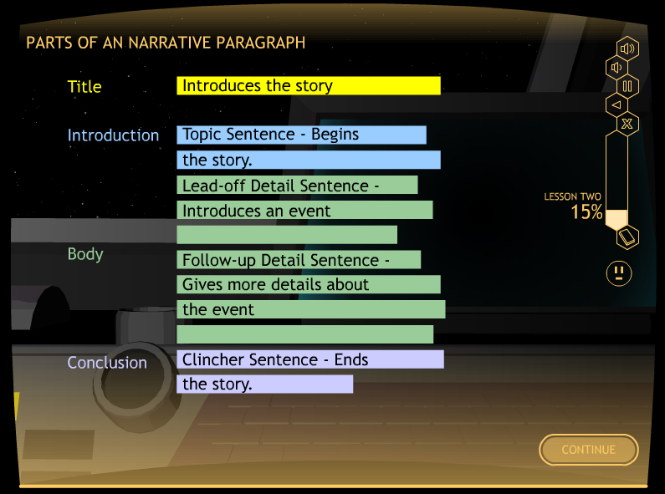
Matt: Add a good picture from Narrative lesson here

Slide 73
narrative PARAGRAPH
Title: Introduces the story
Topic Sentence: Begins the story
Lead-off Detail Sentences: Each introduces a new event
Follow-up Detail Sentences: Each provides more information about the event
Clincher Sentence: Ends the story

Slide 74
WATCH IT

Slide 75
Matt: Please put in here the diagram for the Watch It

Slide 76
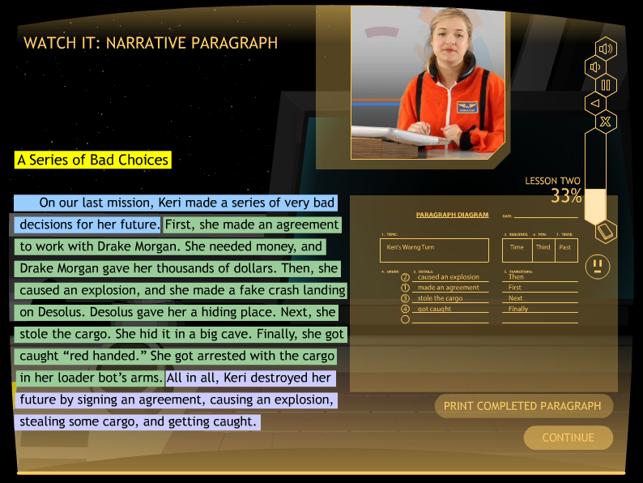
MATT: PLEASE PUT IN HERE A SLIDE WITH THE PILOT SHOWING AS MUCH OF THE PARAGRAPH AS POSSIBLE.

Slide 77
Let’s watch it
Go to B011
Stop at the end of the demo

Slide 78
Study It

Slide 79
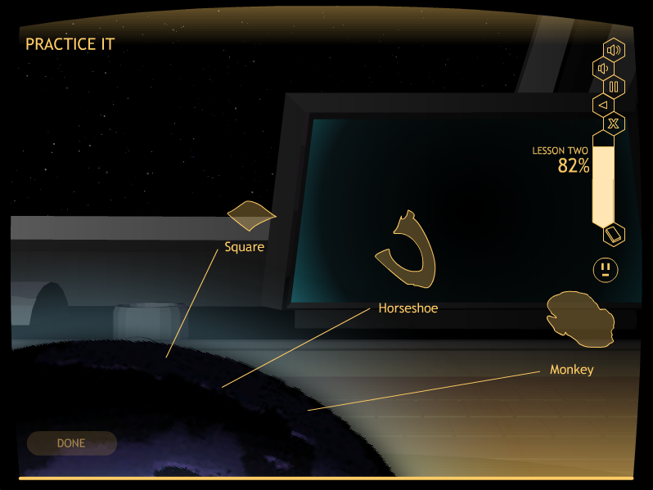
Matt: Please put a colorful study it slide in here from narrative paragraphs

Slide 80
The practice sequence
Student practices planning a paragraph
Teacher scores the paragraph diagram
Student practices writing a paragraph with prompts
Teacher scores the prompted paragraph
Student practices writing a paragraph independently (no prompts)
Teacher scores the independent paragraph
Student reaches mastery and progresses to the next lesson

Slide 81
Lesson 3:
Persuasive paragraphs

Slide 82
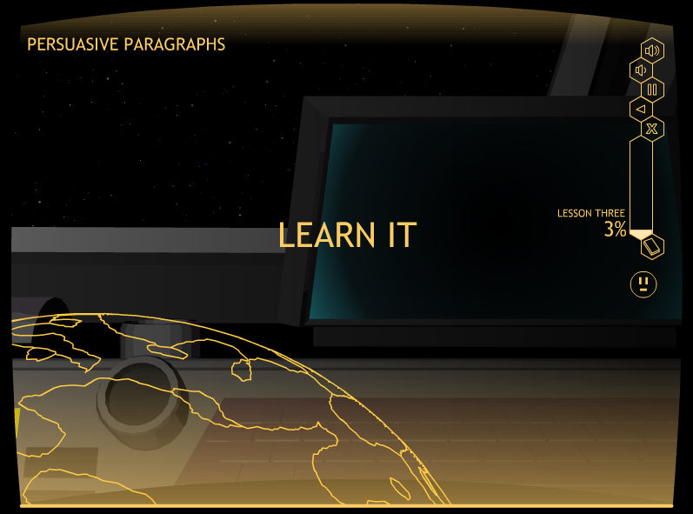
Matt: Add a good picture from Persuasive lesson here

Slide 83
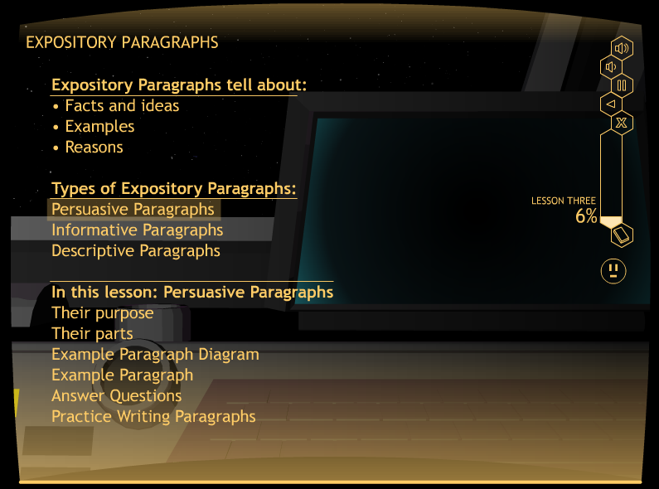
Matt: Add a good picture from Persuasive lesson here

Slide 84
Purpose
A Persuasive Paragraph:
• Convinces the reader to do or believe something
• Is organized with reasons

Slide 85
Each REASON
Explains why to do or believe something
Relate to the reader’s goals
Are in an order that is the writer’s choice

Slide 86
OTHER KEY POINTS
Importance or Linking transitions
Second-person point of view (if talking directly to the reader)
Third-person point of view (if talking about reasons)
Future tense

Slide 87
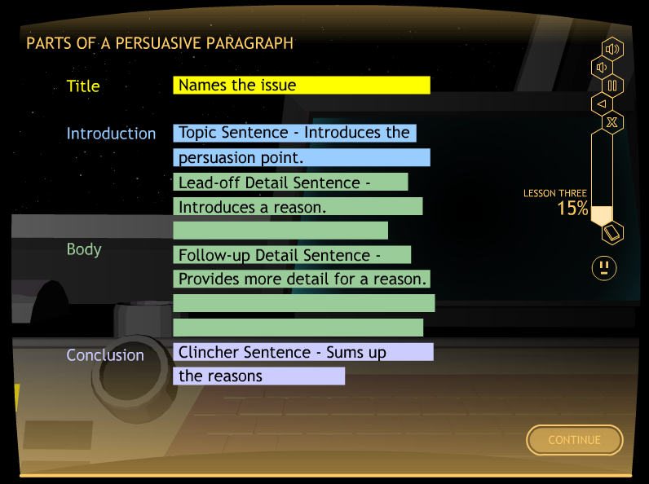
Matt: Add a good picture from Persuasive lesson here

Slide 88
PERSUASIVE PARAGRAPH
Title: Names the issue
Topic Sentence: Introduces the persuasion point
Lead-off Detail Sentences: Each introduces a new reason
Follow-up Detail Sentences: Each provides more information about the reason
Clincher Sentence: Sums up the reasons

Slide 89
WATCH IT

Slide 90
Matt: Please put in here the diagram for the Watch It

Slide 91
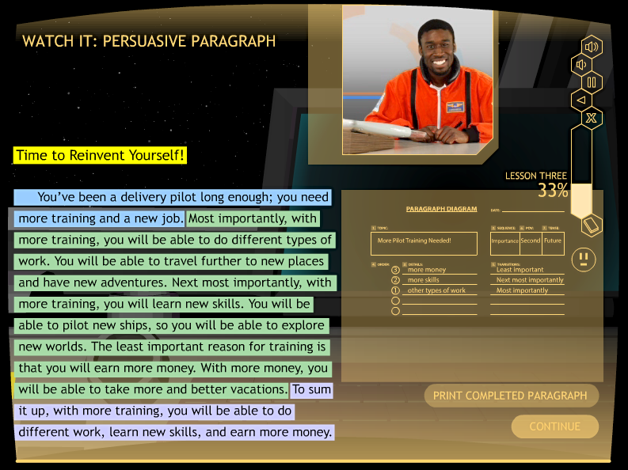
MATT: PLEASE PUT IN HERE A SLIDE WITH THE PILOT SHOWING THE whole PARAGRAPH .

Slide 92
Let’s watch it
Go to C011
Stop at the end of the demo

Slide 93
Study It

Slide 94
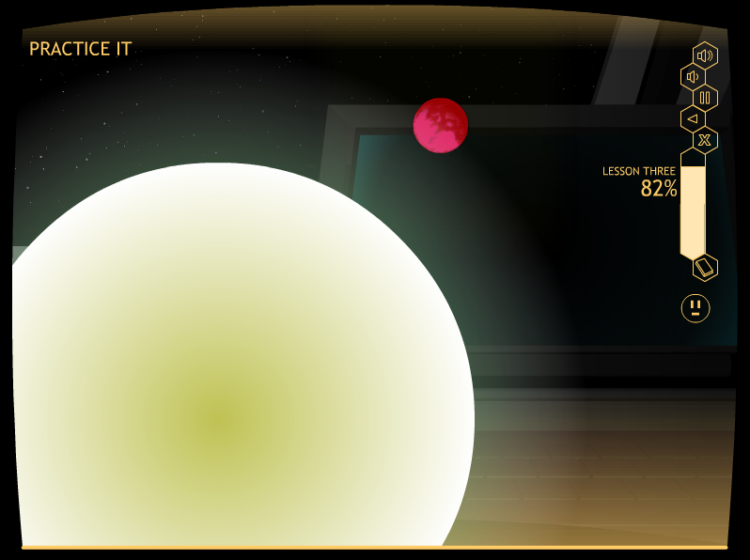
Matt: Please put a colorful study it slide in here from persuasive paragraphs

Slide 95
The practice sequence
Student practices planning a paragraph
Teacher scores the paragraph diagram
Student practices writing a paragraph with prompts
Teacher scores the prompted paragraph
Student practices writing a paragraph independently (no prompts)
Teacher scores the independent paragraph
Student reaches mastery and progresses to the next lesson

Slide 96
Lesson 4:
Informative paragraphs

Slide 97
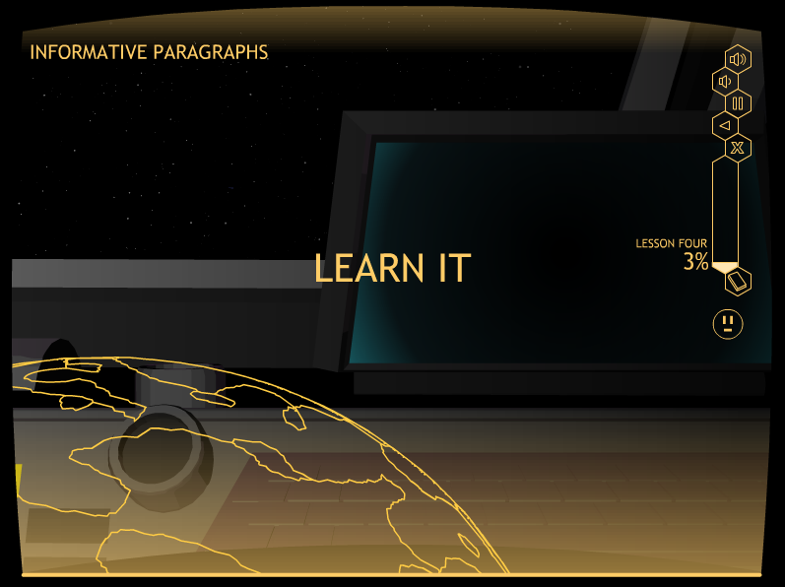
Matt: Add a good picture from Informative lesson here

Slide 98
Purpose
An Informative Paragraph:
• Teaches the reader about something
• Provides facts and information
• Is organized logically with facts

Slide 99
Each fact
Is actual and current
Is gathered from your or someone else’s knowledge
Is in an order with other facts that is logical

Slide 100
OTHER KEY POINTS
Importance or Linking transitions
Third-person point of view
Present or past tense

Slide 101
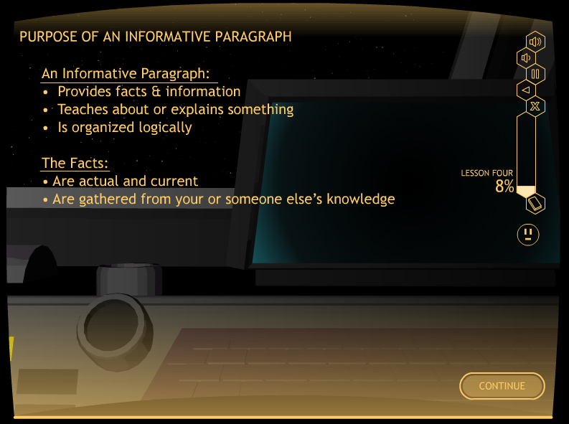
Matt: Add a good picture from Informative lesson here

Slide 102
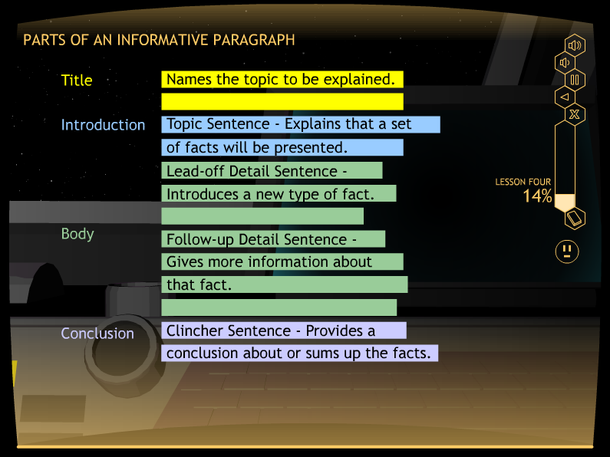
Matt: Add a good picture from Informative lesson here

Slide 103
INFORMATIVE PARAGRAPHS
Title: Names the topic to be explained
Topic Sentence: Explains that a set of facts will be presented
Lead-off Detail Sentences: Each introduces a new fact
Follow-up Detail Sentences: Each provides more information about the fact
Clincher Sentence: Sums up the facts

Slide 104
WATCH IT

Slide 105
Matt: Please put in here the diagram for the Watch It related to Informative paragraphs

Slide 106
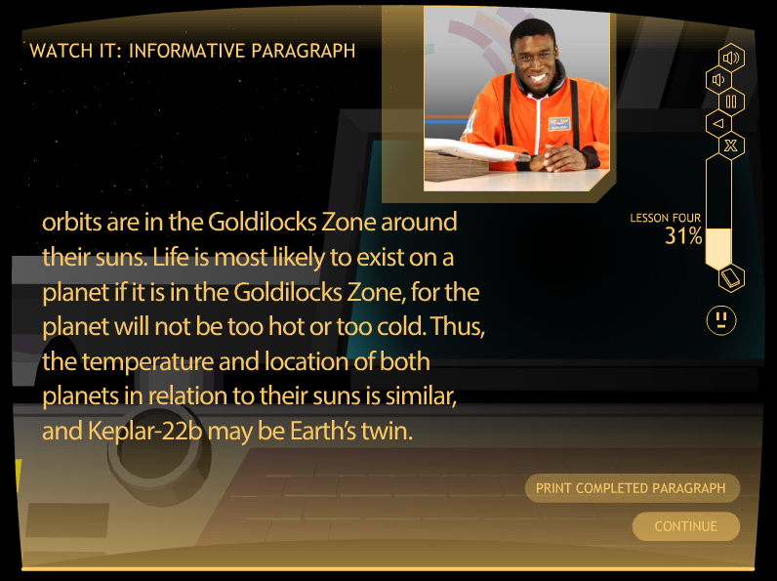
MATT: PLEASE PUT IN HERE A SLIDE WITH THE PILOT SHOWING the informative PARAGRAPH.

Slide 107
Let’s watch it
Go to D011
Stop at the end of the demo

Slide 108
Study It

Slide 109
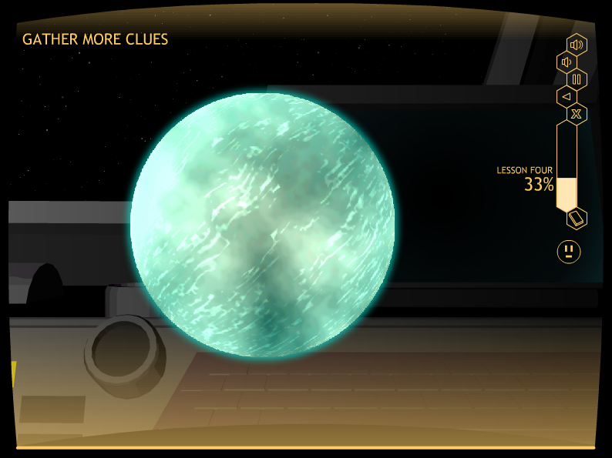
Matt: Please put a colorful study it slide in here from informative paragraphs

Slide 110
PRACTICE IT

Slide 111
What’s special about this lesson?
Students need content about which they can write an Informative Paragraph.
The program provides video clips that they can watch and use for writing their paragraphs.
Four video clips are included.

Slide 112
The Videoclips
Are short
Are organized around main ideas and details
Have text on the screen to aid note taking

Slide 113
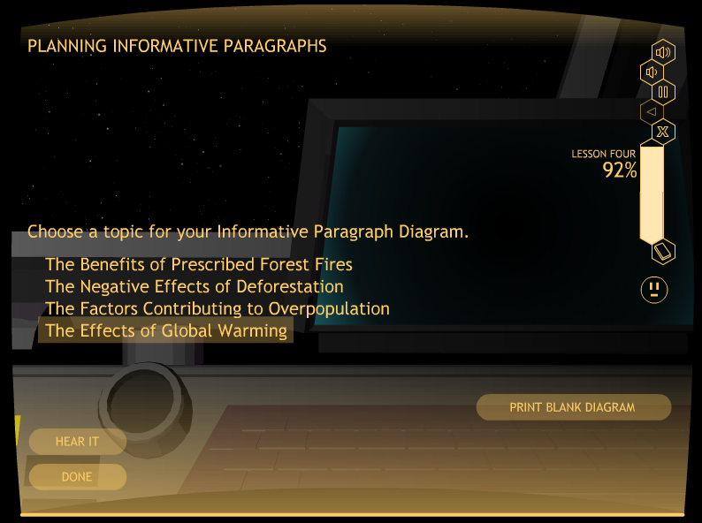
Matt– Please put in here the slide where the students choose one of the videoclips. It shows the titles or topics of the clips. I think it’s row 33

Slide 114
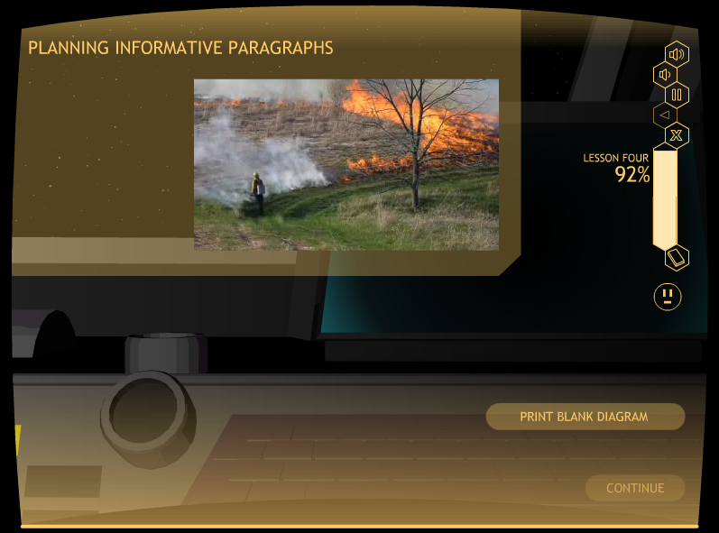
Matt: Insert a good slide showing the video clip playing in the video box

Slide 115
Let’s Watch one!
Go to D033
Stop after watching the video clip

Slide 116
The practice sequence
Student watches a video clip and takes notes
Student practices planning a paragraph
Teacher scores the paragraph diagram
Student practices writing a paragraph with prompts
Teacher scores the prompted paragraph
Student practices writing a paragraph independently (no prompts)
Teacher scores the independent paragraph
Student reaches mastery and progresses to the next lesson

Slide 117
Lesson 5:
Descriptive paragraphs

Slide 118

Matt; Add a good picture from the descriptive lesson here

Slide 119
Purpose
A Descriptive Paragraph:
• Paints a picture with words
• Describes what can be seen, heard, or felt
• Is organized according to features
or parts

Slide 120
Each feature
Is a part of what is being described
Is described with adjectives and adverbs as well as nouns
Is in an order that is logical in relation to other parts

Slide 121
OTHER KEY POINTS
Space Transitions (for places)
Linking or Importance Transitions (for people, places, & things)
Usually third-person point of view
Any tense

Slide 122
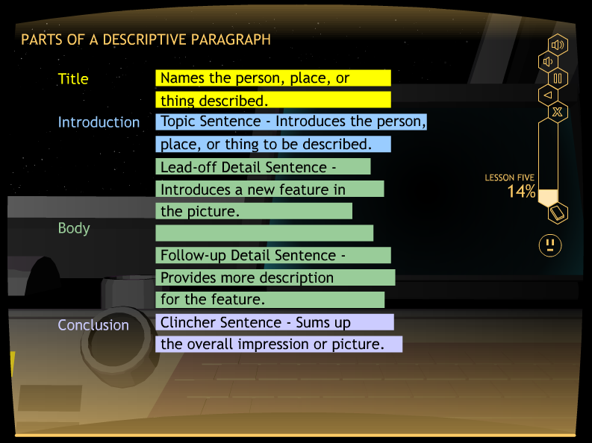
Matt; Add a good picture from the descriptive lesson here

Slide 123
DESCRIPTIVE PARAGRAPH
Title: Names the person, place, or thing to be described
Topic Sentence: Introduces the person, place, or thing
Lead-off Detail Sentences: Each introduces a new feature of the person, place, or thing
Follow-up Detail Sentences: Each provides more information about the feature
Clincher Sentence: Sums up the features and gives and overall impression

Slide 124
WATCH IT

Slide 125
Matt: Please put in here the diagram for the Watch It related to descriptive paragraphs

Slide 126
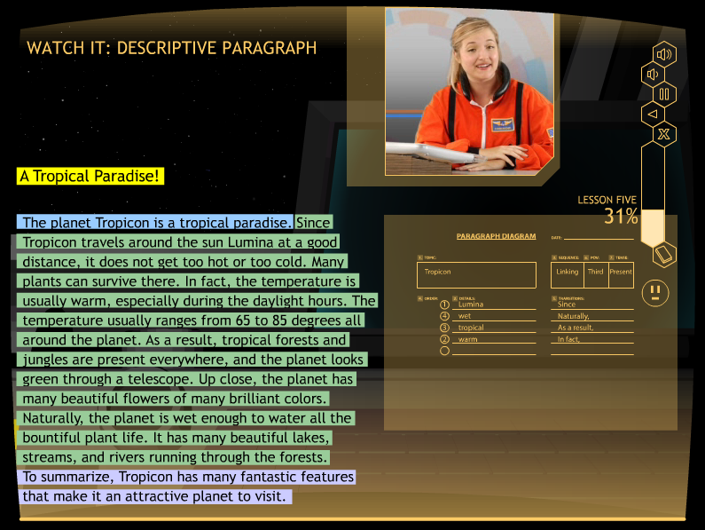
MATT: PLEASE PUT IN HERE A SLIDE WITH THE PILOT SHOWING the descriptive PARAGRAPH on the screen.

Slide 127
Let’s watch it
Go to E011
Stop at the end of the demo

Slide 128
Study It

Slide 129
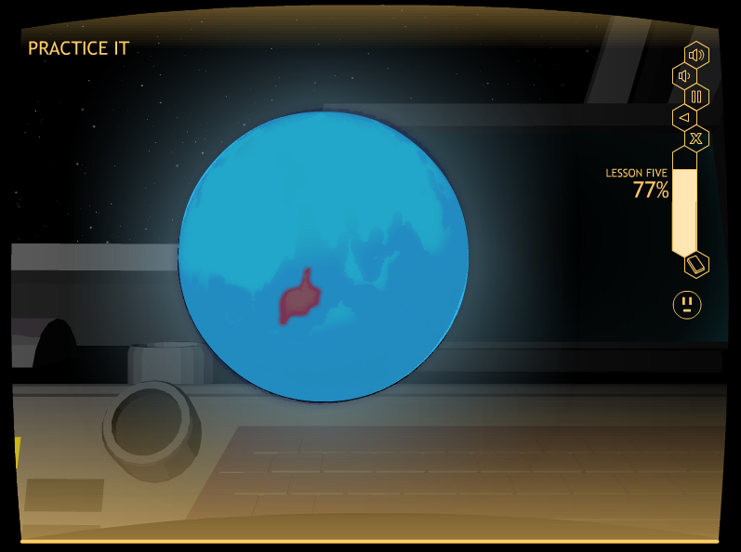
Matt: Please put a colorful study it slide in here from descriptive paragraphs

Slide 130
Study DETAILS
Control-group design with randomly selected groups
Plus a normative group

Slide 131
More Study Details
STRUGGLING WRITERS
Junior high writing group = 24 students
Junior high reading group = 17 students
Senior-high writing group = 18 students
Senior-high reading group = 18 students
NORMAL LEARNERS
• Junior-high group = 24 students
• Senior-high group = 21 students

Slide 132
Persuasive paragraph organization
On the Persuasive Paragraph Test, experimental students made statistically significant gains on a measure of paragraph organization:
Junior-high students – 42% to 85% of the points
Senior-high students – 31% to 85% of the points
• Control students made no gains

Slide 133
Persuasive Paragraph planning
• On the Persuasive Paragraph Test, experimental students made statistically significant gains on a measure of paragraph planning:
Junior High – 12% to 96% of the points
Senior High – 10% to 100% of the points
• Control Students made no gains

Slide 134
Narrative paragraph organization
On the Narrative Paragraph Test, experimental students made statistically significant gains on a measure of paragraph organization:
Junior-high students – 46% to 81% of the points
Senior-high students – 36% to 86% of the points
• Control students made no gains

Slide 135
Narrative Paragraph planning
• On the Narrative Paragraph Test, experimental students made statistically significant gains on a measure of paragraph planning:
Junior High – 8% to 92% of the points
Senior High – 6% to 100% of the points
• Control Students made no gains

Slide 136
Results summary
All experimental group students met mastery on the sentence writing and paragraph writing skills.
All experimental group students made statistically significant and socially significant gains on all measures of sentence writing, paragraph planning, and paragraph organization.
The control students made no gains on any measures of writing.

Slide 137
Results summary (continued)
There were no significant differences between the experimental junior-high and senior-high students’ scores on the posttests while controlling for the pretest scores. (Junior-high and senior-high students learned equally well from the program.)
There were significant differences between the experimental and control students’ posttest scores while controlling for the pretest scores, with very large effect sizes for each measure.
The experimental students’ mean posttest scores exceeded the mean end-of-year scores of the normal students.

Slide 138
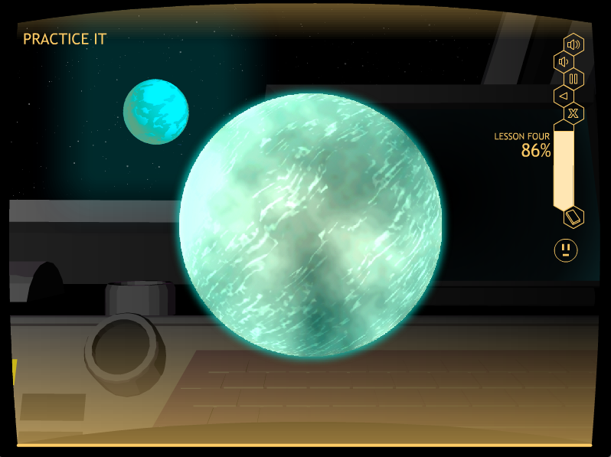
Matt: Please put a colorful slide here to end it

Slide 139
For more information about the Star Writer Program and strategic instruction, contact:
Edge Enterprises, Inc.
785-749-1473
www.edgeenterprisesinc.com
708 W. 9th St.
Lawrence, KS 66044

