Slide 1
Proficiency in the Sentence Writing Strategy
By Jean B. Schumaker with Jan B. Sheldon
Teaching PowerPoint developed by FL SPDG SIM Project to support teachers in implementing The Proficiency in Sentence Writing Strategy
***Please note, this presentation is intentionally very plain, so that teachers can add their own design to the slides.
Notes:
***Please note, this presentation is intentionally very plain, so that teachers can add their own design to the slides.

Slide 2
Pretest
Purpose – to figure out the quality and kinds of sentences you can write
Notes:
Pg. 14 Instructor Manual

Slide 3
Pretest Directions
Choose one of the topics from the list on the next slide and write at least six sentences about it.
Write the topic, your name and the date at the top of your paper.
Use different types of sentences if you can.
  Simple sentence
  Compound sentence
  Complex sentence
  Compound-complex sentence
Notes:
Pg. 14 Instructor Manual

Slide 4
Pretest Topic List
My Favorite Meal
Summer Activities
The Best Things About School
Life as a Teenager
The Best Place to Live
My Favorite Sport
The Best Job in the World
My New Year’s Resolutions
Notes:
Pg. 152 Instructor Manual

Slide 5
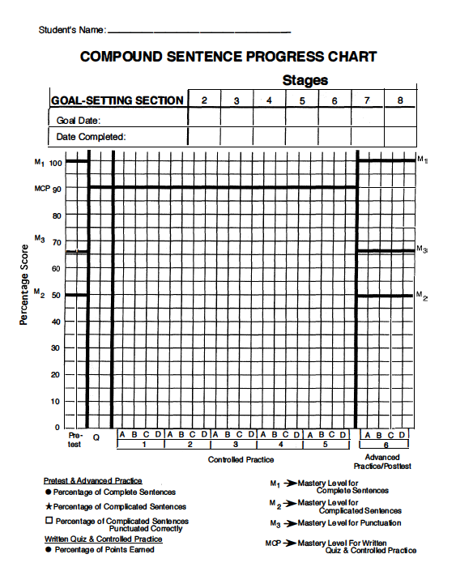
Notes:
Pg. 15

Slide 6
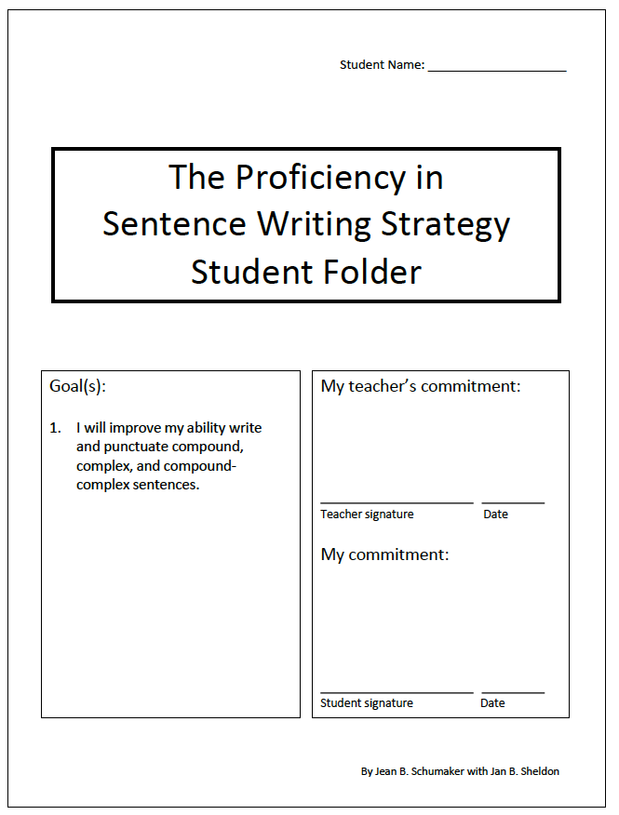
Notes:
Set long term goal and make commitments – pg. 15Instructor Manual

Slide 7
Part II: Compound Sentences
Stage 2: Describe
Notes:
Pg. 57 (Starting with Compound Sentences assumes that the students have completed the Fundamentals in the Sentence Writing Strategy. If they have not, begin with Part 1: Simple Sentences.

Slide 8
Essential Questions
Why do good writers vary the sentence structures they use?
What are the requirements for compound sentences?
What are the formulas that can be used to write compound sentences?
How can we use the PENS steps to write compound sentences?
Notes:
Pg. 57 Instructor Manual – student objectives have been translated into questions.

Slide 9
Review of Simple Sentences
What is the definition for a verb?
What is the definition for an action verb?
What are some examples of action verbs?
What is the definition for a linking verb?
What are some examples of linking verbs?
What is the definition for a subject?
What are some examples of subjects?
What is the definition of an adjective?
What are some examples of adjectives?
What is the definition of a prepositional phrase?
What are some examples of prepositions and prepositional phrases?
What is the definition for an infinitive?
What are some examples of infinitives?
What are the PENS steps?
What are the four parts of the Search and Check step?
Notes:
From Fundamentals in the Sentence Writing Strategy

Slide 10
Discussion Question
Why might you want to make your writing interesting?
Notes:
Instructor manual pg. 58

Slide 11
Set goal dates
Notes:
Pg. 58

Slide 12
Notes:
Pg. 59

Slide 13
Notes:
Pg. 59

Slide 14
Notes:
Pg. 60

Slide 15
Notes:
Pg. 61

Slide 16
Notes:
Pg.61

Slide 17
Notes:
Pg 62

Slide 18
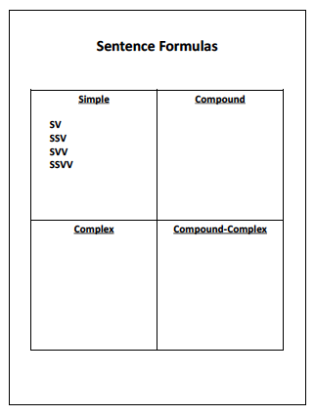
I,cI
I:I
Notes:
Pg. 62

Slide 19
Notes:
Pg. 63

Slide 20
Mark date completed for stage 2
Notes:
Pg. 58

Slide 21
Part II: Compound Sentences
Stage 3: Model
Notes:
Pg. 65

Slide 22
Essential Questions
How can we use the PENS steps to write compound sentences?
Notes:
Pg. 65 Instructor Manual – student objectives have been translated into questions.

Slide 23
Review of Previous Content
What is the definition for a simple sentence?
What is the definition for a compound sentence?
What is the definition for an independent clause?
What are the steps of the Sentence Writing Strategy?
What are the two kinds of compound sentences?
What are some examples of coordinating conjunctions?
Where and when can you use the Sentence Writing Strategy?
How can using the strategy help you?
Notes:
Pg. 65

Slide 24
Notes:
Pg. 66

Slide 25
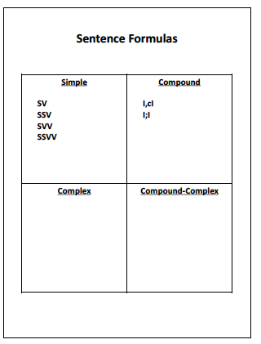
Notes:
Pg. 66

Slide 26
Mark date completed for stage 3
Notes:
Pg. 67

Slide 27
Part II: Compound Sentences
Stage 4: Verbal Practice
Notes:
Pg. 68

Slide 28
Essential Questions
Have I memorized the requirements for a compound sentence?
Have I memorized the steps of the Sentence Writing Strategy?
Notes:
Pg. 68 Instructor Manual – student objectives have been translated into questions.

Slide 29
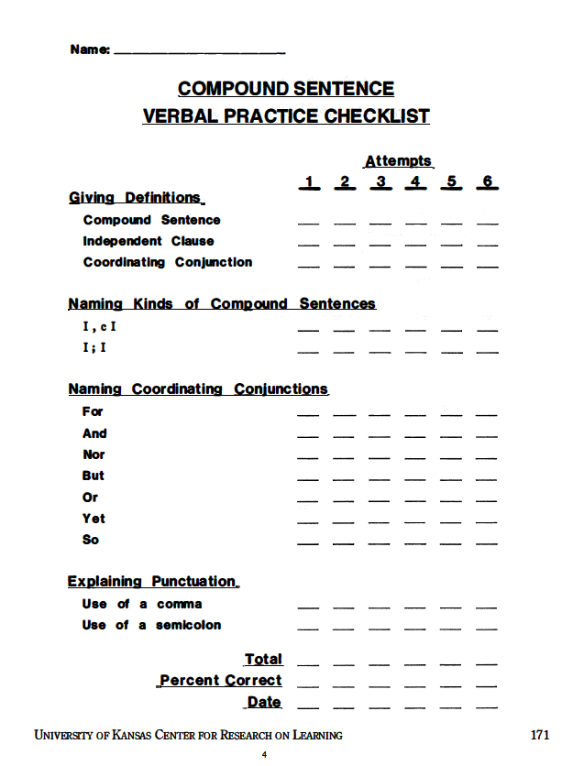
Notes:
Pg. 70

Slide 30
Notes:
Pg. 70 The quizzes are not in the Skeleton student folder. Digital copies for printing can be found in the Student Materials flash drive under Compound Sentences.

Slide 31
Mark date completed for stage 4
Chart Compound Sentences Quiz Score
Notes:
Pg. 70

Slide 32
Part II: Compound Sentences
Stage 5: Controlled Practice and Feedback
Notes:
Pg. 71

Slide 33
Essential Questions
Can I write and check two types of compound sentences?
Can I write and check sentences that include simple and compound?
Notes:
Pg. 71 Instructor Manual – student objectives have been translated into questions.

Slide 34
Review of Previous Content
What is the definition for a simple sentence?
What is the definition for a compound sentence?
What is the definition for an independent clause?
What are the steps of the Sentence Writing Strategy?
What are the two kinds of compound sentences?
What are some examples of coordinating conjunctions?
When and why would you use the Sentence Writing Strategy?
Notes:
Pg. 71

Slide 35
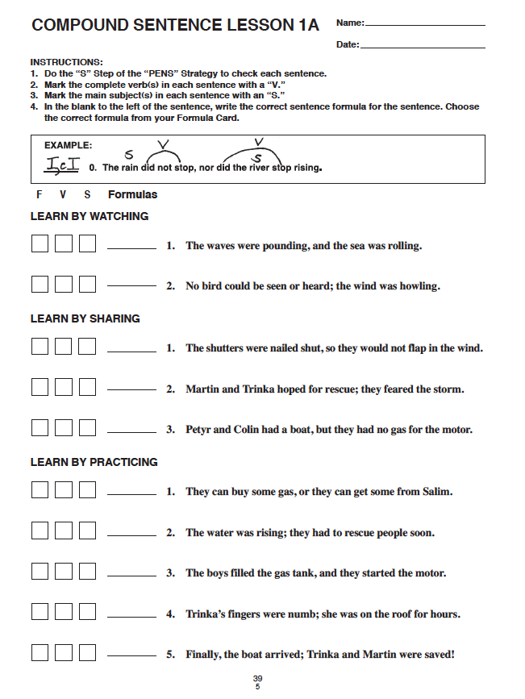
Notes:
Pg. 72

Slide 36
Chart Controlled Practice Series 1 scores

Slide 37
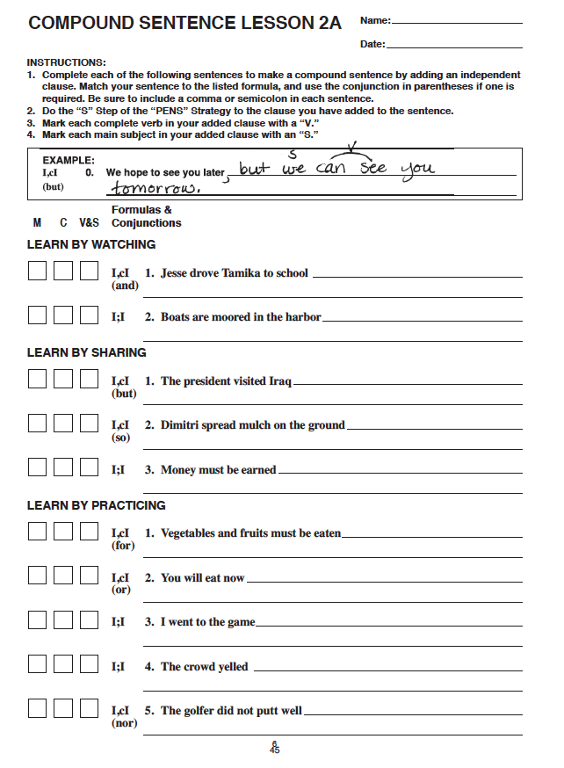
Notes:
Pg. 72

Slide 38
Chart Controlled Practice Series 2 scores

Slide 39
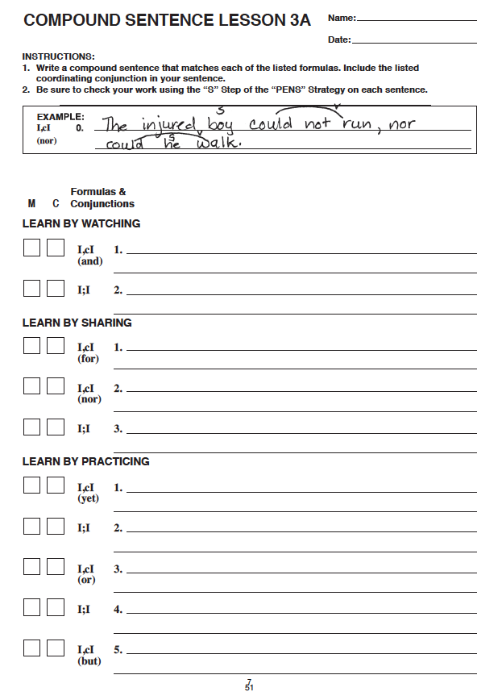
Notes:
Pg. 73

Slide 40
Chart Controlled Practice Series 3 scores

Slide 41
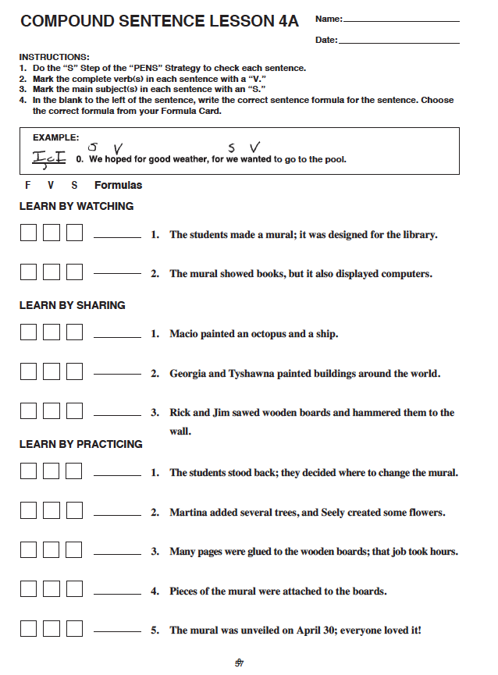
Notes:
Pg. 73

Slide 42
Chart Controlled Practice Series 4 scores

Slide 43
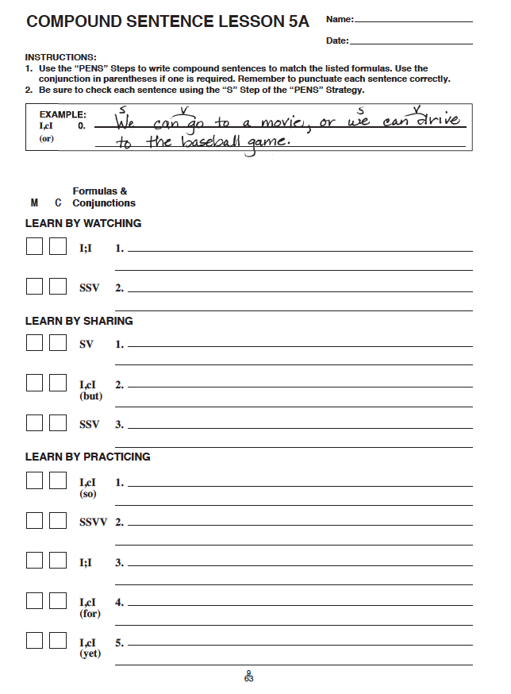
Notes:
Pg. 73

Slide 44
Mark date completed for stage 5
Chart Controlled Practice Series 5 scores

Slide 45
Part II: Compound Sentences
Stage 6: Advanced Practice/Post-test and Feedback
Notes:
Pg. 75

Slide 46
Essential Questions
Can I write simple and compound sentences on grade-level assignments?
Notes:
Pg. 75 Instructor Manual – student objectives have been translated into questions.

Slide 47
Review of Previous Content
What is the definition for a simple sentence?
What is the definition for a compound sentence?
What is the definition for an independent clause?
What are the steps of the Sentence Writing Strategy?
What are the two kinds of compound sentences?
What are some examples of coordinating conjunctions?
When and why would you use the Sentence Writing Strategy?
Notes:
Pg. 871

Slide 48
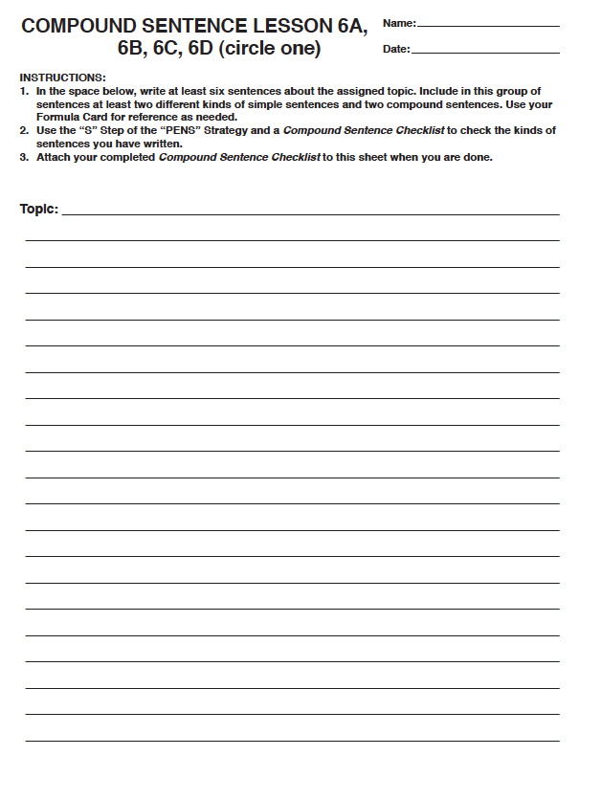
Notes:
Pg. 76

Slide 49
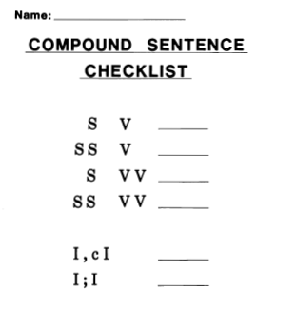
Notes:
Pg. 76

Slide 50
Mark date completed for stage 6
Chart Controlled Practice Series 6 scores

Slide 51
Part III: Complex Sentences
Stage 2: Describe
Notes:
Pg. 77

Slide 52
Essential Questions
What are the requirements for complex sentences?
What are the formulas that can be used to write complex sentences?
How can we use the PENS steps to write complex sentences?
Notes:
Pg. 77 Instructor Manual – student objectives have been translated into questions.

Slide 53
Review of Previous Content
What is the definition for a simple sentence?
What is the definition for a compound sentence?
What is the definition for an independent clause?
What are the steps of the Sentence Writing Strategy?
What are the two kinds of compound sentences?
What are some examples of coordinating conjunctions?
When and why would you use the Sentence Writing Strategy?
Notes:
Pg. 77

Slide 54
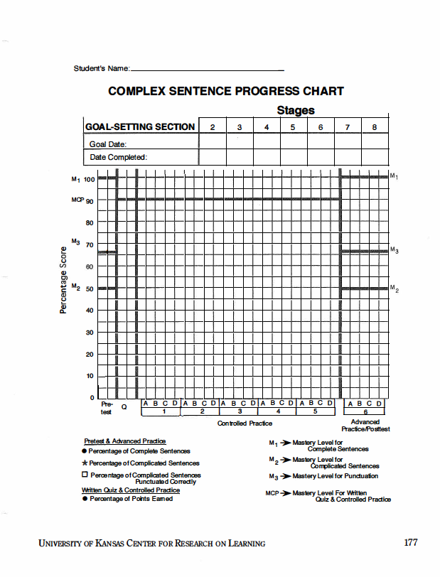
Set goal dates for each stage
Notes:
Pg. 78

Slide 55
Notes:
Pg. 78

Slide 56
Notes:
Pg. 79

Slide 57
Notes:
Pg. 80

Slide 58
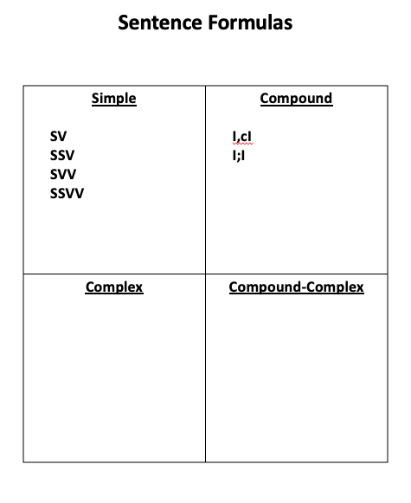
ID
D, I
Notes:
Pg. 871

Slide 59
Notes:
Pg. 81

Slide 60
Mark date completed for Stage 2
Notes:
Pg. 78

Slide 61
Part III: Complex Sentences
Stage 3: Model
Notes:
Pg. 83

Slide 62
Essential Questions
What are the thought processes involved as I use the Sentence Writing Strategy to write complex sentences?
Notes:
Pg. 83 Instructor Manual – student objectives have been translated into questions.

Slide 63
Review of Previous Content
What is the definition for a simple sentence?
What is the definition for a compound sentence?
What is the definition for a complex sentence?
What is the definition for an independent clause?
What is the definition for a dependent clause?
What are the steps of the Sentence Writing Strategy?
What are the four kinds of simple sentences?
What are the two kinds of compound sentences?
What are the two kinds of complex sentences?
Where would you use the Sentence Writing Strategy and how does it help you?
Notes:
Pg. 83

Slide 64
Notes:
Pg. 81

Slide 65
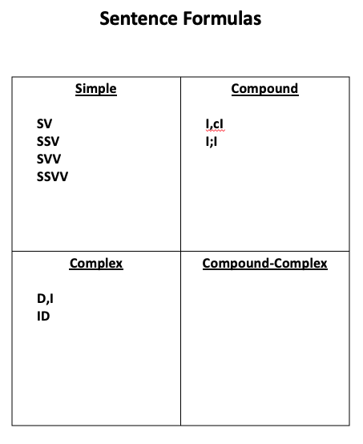

Slide 66
Mark date completed for Stage 3
Notes:
Pg. 78

Slide 67
Part III: Complex Sentences
Stage 4: Verbal Practice
Notes:
Pg. 86

Slide 68
Essential Questions
Have I memorized the requirements for a complex sentence?
Have I memorized the steps of the Sentence Writing Strategy?
Notes:
Pg. 86 Instructor Manual – student objectives have been translated into questions.

Slide 69
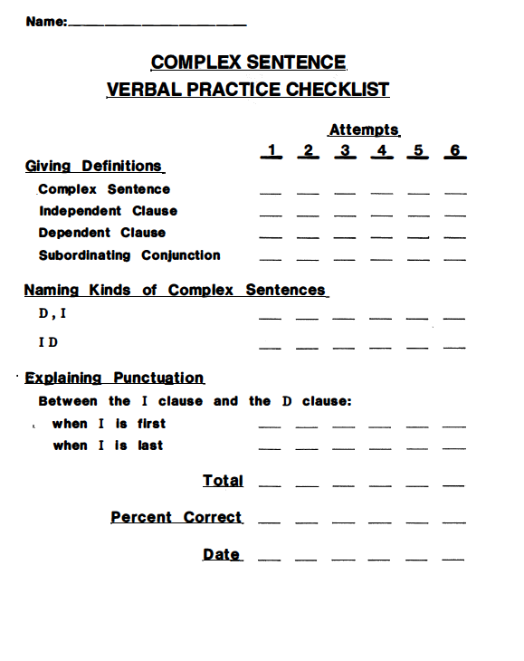
Notes:
Pg. 88

Slide 70
Notes:
Pg. 88 The quizzes are not in the Skeleton student folder. Digital copies for printing can be found in the Student Materials flash drive under Compound Sentences.

Slide 71
Mark date completed for Stage 4
Chart Complex Sentences Quiz Score
Notes:
Pg. 88

Slide 72
Part III: Complex Sentences
Stage 5: Controlled Practice and Feedback
Notes:
Pg. 89

Slide 73
Essential Questions
Can I write and check two types of complex sentences?
Can I write and check sentences that include simple, compound, and complex?
Notes:
Pg. 89 Instructor Manual – student objectives have been translated into questions.

Slide 74
Review of Previous Content
What is the definition for a simple sentence?
What is the definition for a compound sentence?
What is the definition for a complex sentence?
What is the definition for an independent clause?
What is the definition for a dependent clause?
What are the steps of the Sentence Writing Strategy?
What are the four kinds of simple sentences?
What are the two kinds of compound sentences?
What are the two kinds of complex sentences?
Where would you use the Sentence Writing Strategy and how does it help you?
Notes:
Pg. 89

Slide 75
Notes:
Pg. 90

Slide 76
Chart Complex Sentences Series 1 Scores
Notes:
Pg. 88

Slide 77
Notes:
Pg. 90

Slide 78
Chart Complex Sentences Series 2 Scores
Notes:
Pg. 90

Slide 80
Chart Complex Sentences Series 3 Scores
Notes:
Pg. 91

Slide 81
Notes:
Pg. 91

Slide 82
Chart Complex Sentences Series 4 Scores
Notes:
Pg. 91

Slide 83
Notes:
Pg. 91

Slide 84
Mark date completed for Stage 5
Chart Complex Sentences Series 5 Scores
Notes:
Pg. 92

Slide 85
Part III: Complex Sentences
Stage 6: Advanced Practice/Post-test and Feedback
Notes:
Pg. 93

Slide 86
Essential Questions
Can I write simple, compound, and complex sentences on grade-level assignments?
Notes:
Pg. 93 Instructor Manual – student objectives have been translated into questions.

Slide 87
Review of Previous Content
What is the definition for a simple sentence?
What is the definition for a compound sentence?
What is the definition for a complex sentence?
What is the definition for an independent clause?
What is the definition for a dependent clause?
What are the steps of the Sentence Writing Strategy?
What are the four kinds of simple sentences?
What are the two kinds of compound sentences?
What are the two kinds of complex sentences?
Where would you use the Sentence Writing Strategy and how does it help you?
Notes:
Pg. 93

Slide 88
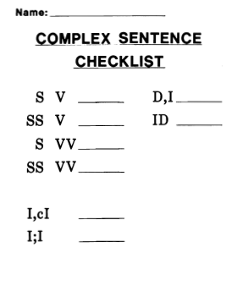
Notes:
Pg. 94

Slide 90
Mark date completed for Stage 6
Chart Complex Sentences Series 6 Scores
Notes:
Pg. 94

Slide 91
Part IV: Compound-Complex Sentences
Stage 2: Describe
Notes:
Pg. 95

Slide 92
Essential Questions
What are the requirements for compound-complex sentences?
What are the formulas that can be used to write compound-complex sentences?
How can we use the PENS steps to write compound-complex sentences?
Notes:
Pg. 95 Instructor Manual – student objectives have been translated into questions.

Slide 93
Review of Previous Content
What is the definition for a simple sentence?
What is the definition for a compound sentence?
What is the definition for a complex sentence?
What is the definition for an independent clause?
What is the definition for a dependent clause?
What are the steps of the Sentence Writing Strategy?
What are the four kinds of simple sentences?
What are the two kinds of compound sentences?
What are the two kinds of complex sentences?
Where would you use the Sentence Writing Strategy and how does it help you?
Notes:
Pg. 95

Slide 94
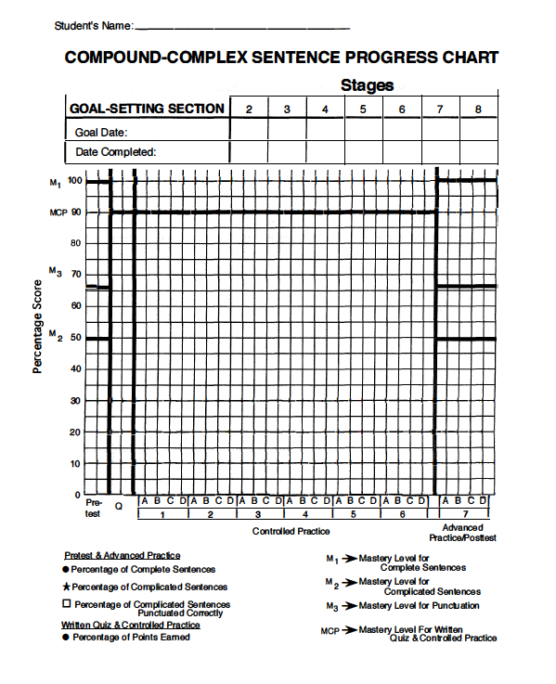
Set goal dates for each stage
Notes:
Pg. 96

Slide 95
Notes:
Pg. 97

Slide 96
Notes:
Pg. 98

Slide 97
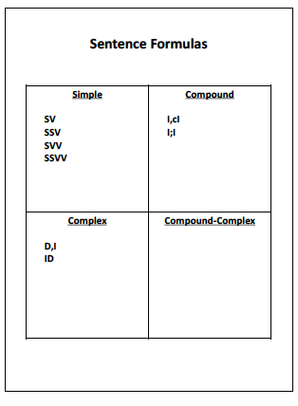
D, I, cI
D, I; I
ID, cI
ID;I
I,cID
I;ID
Notes:
Pg. 100

Slide 98
Notes:
Pg. 81

Slide 99
Mark date completed for stage 2
Notes:
Pg. 101

Slide 100
Part IV: Compound-Complex Sentences
Stage 3: Model
Notes:
Pg. 102

Slide 101
Essential Questions
What are the thought processes involved as I use the Sentence Writing Strategy to write compound-complex sentences?
Notes:
Pg. 102 Instructor Manual – student objectives have been translated into questions.

Slide 102
Review of Previous Content
What is the definition for a simple sentence?
What is the definition for a compound sentence?
What is the definition for a complex sentence?
What is the definition for an independent clause?
What is the definition for a dependent clause?
What are the steps of the Sentence Writing Strategy?
What are the four kinds of simple sentences?
What are the two kinds of compound sentences?
What are the two kinds of complex sentences?
What are the six kinds of compound-complex sentences?
Where would you use the Sentence Writing Strategy and how does it help you?
Notes:
Pg. 102

Slide 103
Notes:
Pg. 103

Slide 104
D, I, cI
D, I;I
ID, cI
ID;I
I,cID
I;ID
Notes:
Pg. 103

Slide 105
Mark date completed for stage 3
Notes:
Pg. 101

Slide 106
Part IV: Compound-Complex Sentences
Stage 4: Verbal Practice
Notes:
Pg. 105

Slide 107
Essential Questions
Have I memorized the requirements for compound-complex sentences?
Have I memorized the steps of the Sentence Writing Strategy?
Notes:
Pg. 105 Instructor Manual – student objectives have been translated into questions.

Slide 108
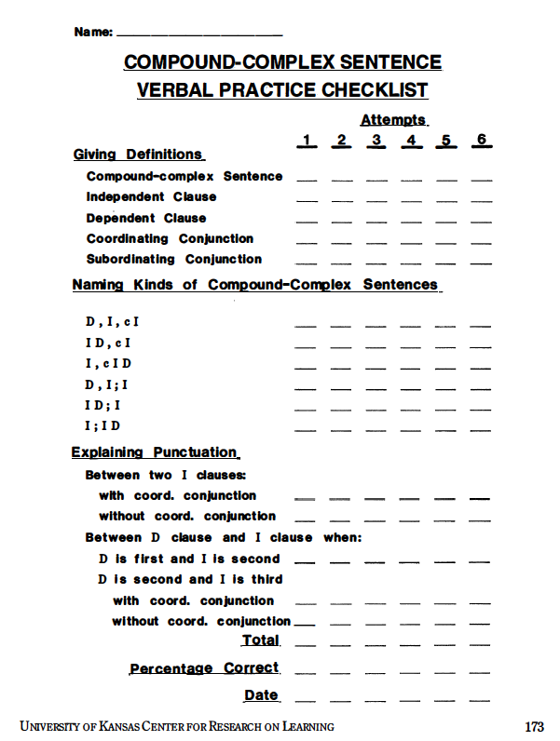
Notes:
Pg. 107

Slide 109
Notes:
Pg. 107 The quizzes are not in the Skeleton student folder. Digital copies for printing can be found in the Student Materials flash drive under Compound Sentences.

Slide 110
Mark date completed for stage 4
Chart Compound-Complex Quiz Score
Notes:
Pg. 107

Slide 111
Part IV: Compound-Complex Sentences
Stage 5: Controlled Practice and Feedback
Notes:
Pg. 109

Slide 112
Essential Questions
Can I write and check six types of compound-complex sentences?
Can I write and check sentences that include simple, compound, complex, and compound-complex?
Notes:
Pg. 109 Instructor Manual – student objectives have been translated into questions.

Slide 113
Review of Previous Content
What is the definition for a simple sentence?
What is the definition for a compound sentence?
What is the definition for a complex sentence?
What is the definition for an independent clause?
What is the definition for a dependent clause?
What are the steps of the Sentence Writing Strategy?
What are the four kinds of simple sentences?
What are the two kinds of compound sentences?
What are the two kinds of complex sentences?
What are the six kinds of compound-complex sentences?
Where would you use the Sentence Writing Strategy and how does it help you?
Notes:
Pg. 110

Slide 114
Notes:
Pg. 1102

Slide 115
Chart Compound-Complex Series 1 Score(s)
Notes:
Pg. 107

Slide 116
Notes:
Pg. 110

Slide 117
Chart Compound-Complex Series 2 Score(s)
Notes:
Pg. 111

Slide 118
Notes:
Pg. 111

Slide 119
Chart Compound-Complex Series 3 Score(s)
Notes:
Pg. 111

Slide 121
Chart Compound-Complex Series 4 Score(s)
Notes:
Pg. 111

Slide 122
Notes:
Pg. 112

Slide 123
Chart Compound-Complex Series 5 Score(s)
Notes:
Pg. 112

Slide 124
Notes:
Pg. 112

Slide 125
Mark date completed for stage 5
Chart Compound-Complex Series 6 Score(s)
Notes:
Pg. 113

Slide 126
Part IV: Compound-Complex Sentences
Stage 6: Advanced Practice/Post-test and Feedback
Notes:
Pg. 114

Slide 127
Essential Questions
Can I write simple, compound, complex, and compound-complex sentences on grade-level assignments?
Notes:
Pg. 114 Instructor Manual – student objectives have been translated into questions.

Slide 128
Review of Previous Content
What is the definition for a simple sentence?
What is the definition for a compound sentence?
What is the definition for a complex sentence?
What is the definition for an independent clause?
What is the definition for a dependent clause?
What are the steps of the Sentence Writing Strategy?
What are the four kinds of simple sentences?
What are the two kinds of compound sentences?
What are the two kinds of complex sentences?
What are the six kinds of compound-complex sentences?
Where would you use the Sentence Writing Strategy and how does it help you?
Notes:
Pg. 114

Slide 130
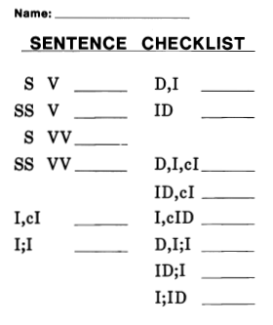
Notes:
Pg. 115

Slide 131
Mark date completed for stage 6
Chart Compound-Complex Series 7 Score(s)
Notes:
Pg. 113

Slide 132
Stage 7: Make Commitments for Generalization
Notes:
Pg. 117

Slide 133

Master of Sentence Writing
Generalization Goal
Notes:
Celebrate progress and set goal for generalization– pg. 117 Instructor Manual

Slide 134
Mark date completed for stage 7
Notes:
Pg. 113

Slide 135
Stage 8: Generalization
Phase I: Orientation
Notes:
Pg. 119

Slide 136
Essential Questions
What are some situations and circumstances in which I can use the Sentence Writing Strategy?
Notes:
Pg. 119 Instructor Manual – student objectives have been translated into questions.

Slide 137
Course 1 Name:
Course 2 Name:
Course 3 Name:
Course 4 Name:
Course 5 Name:
Course 6 Name:
Kinds of class requirements in which sentence writing is necessary
Cues to listen for to determine whether or not you will need to use the Sentence Writing Strategy.
Notes:
Pg. 120

Slide 138
Notes:
Pg. 120

Slide 139
Stage 8: Generalization
Phase II: Activation
Notes:
Pg. 122

Slide 140
Essential Questions
Can I use the Sentence Writing Strategy in a variety of settings?
Notes:
Pg. 122 Instructor Manual – student objectives have been translated into questions.

Slide 141
Notes:
Pg. 123

Slide 142
Notes:
Pg. 124

Slide 143
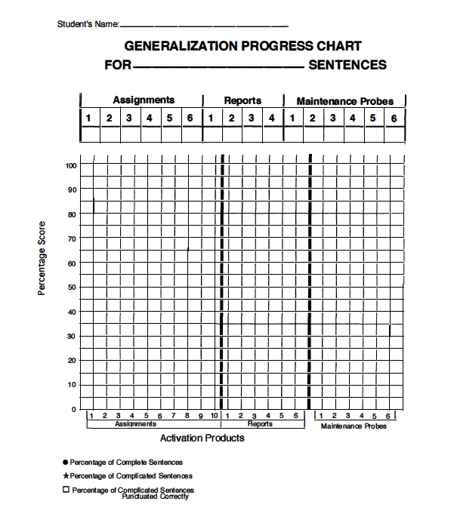
Notes:
Pg. 125

Slide 144
Stage 8: Generalization
Phase III: Adaptation
Notes:
Pg. 128

Slide 145
Essential Questions
What are the four mental functions that learners perform when they use the Sentence Writing Strategy?
When and how can I adapt parts of the Sentence Writing Strategy?
Notes:
Pg. 128 Instructor Manual – student objectives have been translated into questions.

Slide 146
Using Formulas
Planning
Writing
Checking
Notes:
Pg. 129

Slide 147
Creating new sentence formulas
Notes:
Pg. 130

Slide 148
Creating other types of formulas
Notes:
Pg. 130

Slide 149
Planning
Notes:
Pg. 131

Slide 150
Checking
Notes:
Pg. 131

Slide 151
Notes:
Pg. 133

Slide 152
Stage 8: Generalization
Phase IV: Maintenance
Notes:
Pg. 134

Slide 153
Essential Questions
How will I remember to use the Sentence Writing Strategy?
How will I be sure that I am continuing to use it correctly?
Notes:
Pg. 134 Instructor Manual – student objectives have been translated into questions.

Slide 154
Review of Previous Content
What is the definition for a simple sentence?
What is the definition for a compound sentence?
What is the definition for a complex sentence?
What is the definition for an independent clause?
What is the definition for a dependent clause?
What are the steps of the Sentence Writing Strategy?
What are the four kinds of simple sentences?
What are the two kinds of compound sentences?
What are the two kinds of complex sentences?
What are the six kinds of compound-complex sentences?
Where would you use the Sentence Writing Strategy and how does it help you?
Notes:
Pg. 135

Slide 155
Notes:
Pg. 135

