Slide 1
Possible Selves Nurturing Student Motivation 2nd Edition
By Michael Hock, Jean Schumaker, and Donald Deshler
with Tonya Eberhart and Nhan Nguyen
Teaching PowerPoint developed by the FL SPDG SIM Project to support teachers in implementing Possible Selves
***Please note, this presentation is intentionally very plain, so that teachers can add their own design to the slides.

Slide 2
Lesson 1
What are Possible Selves and why are they important?
Notes:
Instructor Manual 2nd edition pg. 11

Slide 3
Lesson 1 Essential Questions
What does ”Possible Selves” mean?
What is the Possible Selves Program?
What is a personal mission statement and how is it related to my Possible Self?
How can participating in the Possible Selves Program help me?
Notes:
Student objectives have been translated into Essential Questions.
Pg. 11

Slide 4
Possible Selves
Notes:
Pg. 13

Slide 5
Possible selves are ideas about what you might become in the future.
Notes:
Pg. 13

Slide 6
Notes:
Pg. 14

Slide 7
Notes:
Pg. 15

Slide 8
Notes:
Pg. 15

Slide 9
Notes:
2.1, pg. 16

Slide 10
Personal Mission Statement
What do you want to be?
What do you want to be like?
What do you want to do?
Notes:
Pg. 16

Slide 11
Example Mission Statements
The mission of Florida's K-20 education system is to increase the proficiency of all students within one seamless efficient system, by allowing them the opportunity to expand their knowledge and skills through learning opportunities and research valued by students, parents and communities.
Notes:
2.2 pg. 17

Slide 12
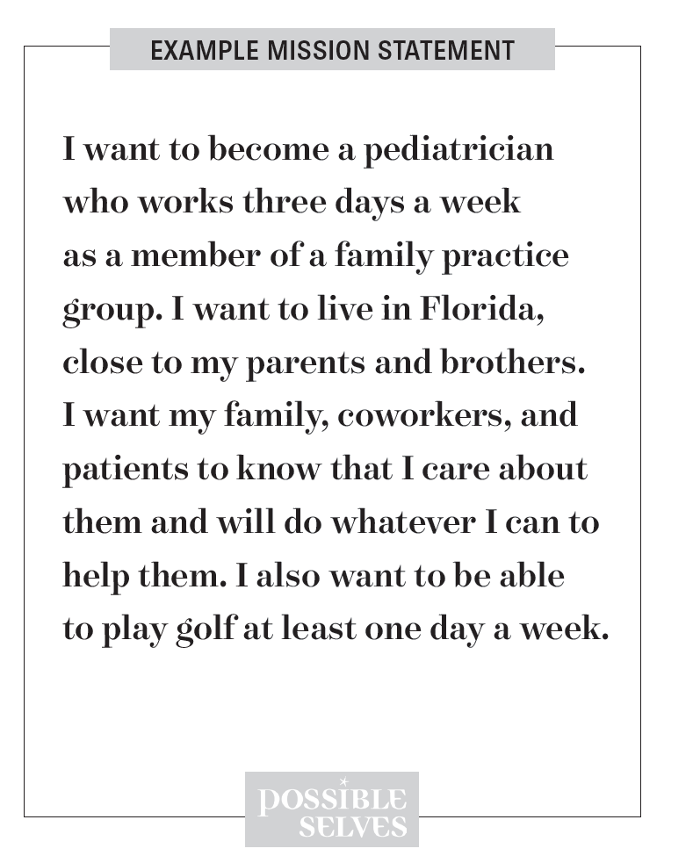

Slide 13
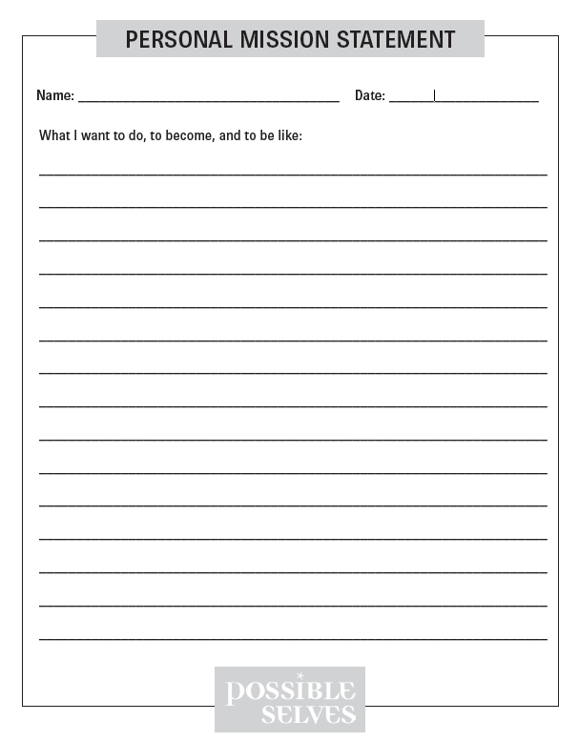
Notes:
Pg. 17

Slide 14
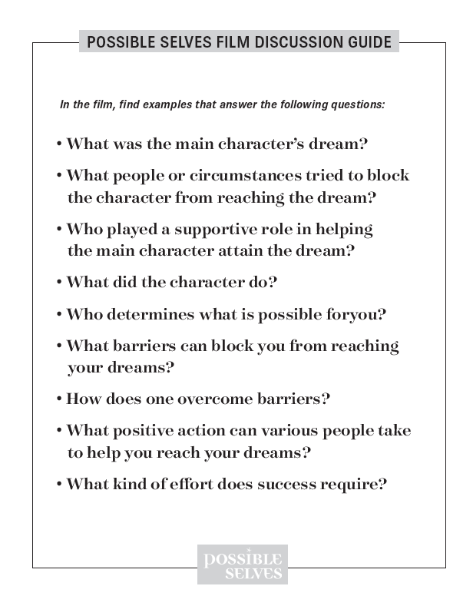
Notes:
Pg. 17

Slide 15
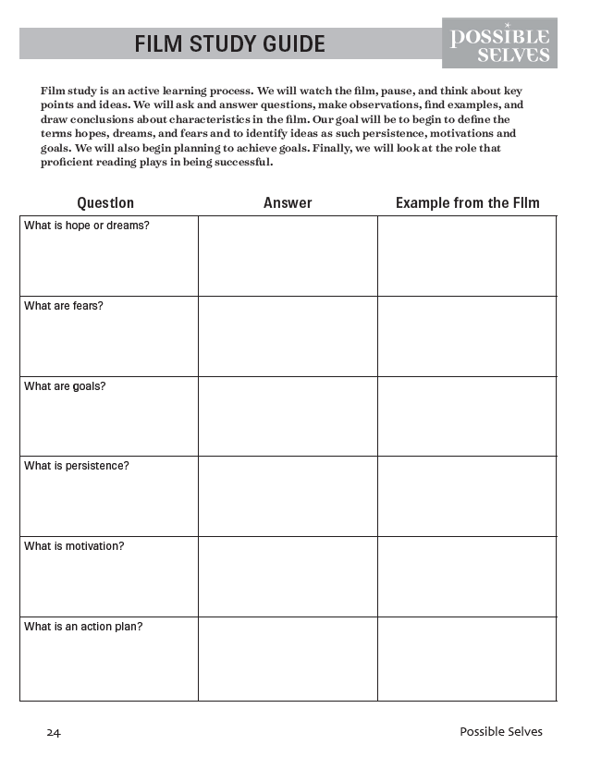
Notes:
Pg. 17

Slide 16
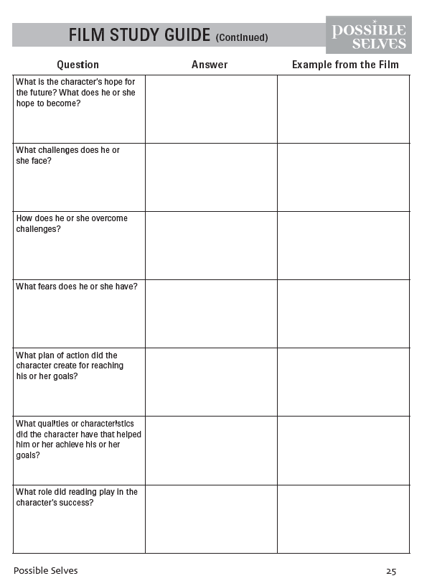
Notes:
Pg. 17

Slide 17
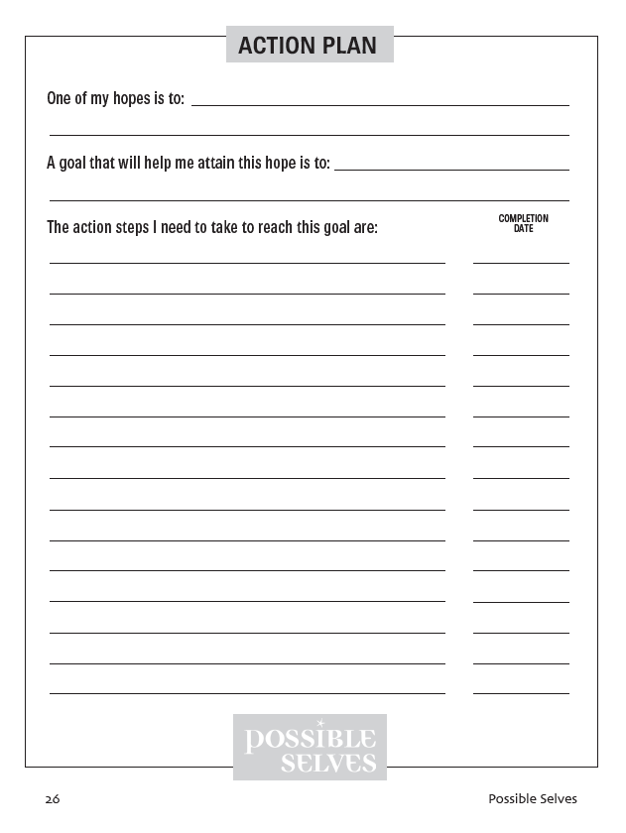
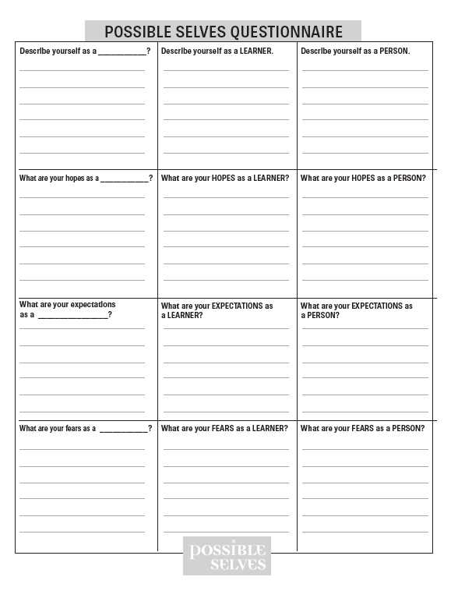
Front cover
Back cover
Inside front cover
Inside back cover
Notes:
Pg. 18, 4

Slide 18
HOPE + EFFORT + MENTOR = SUCCESS
Notes:
Pg. 18

Slide 19
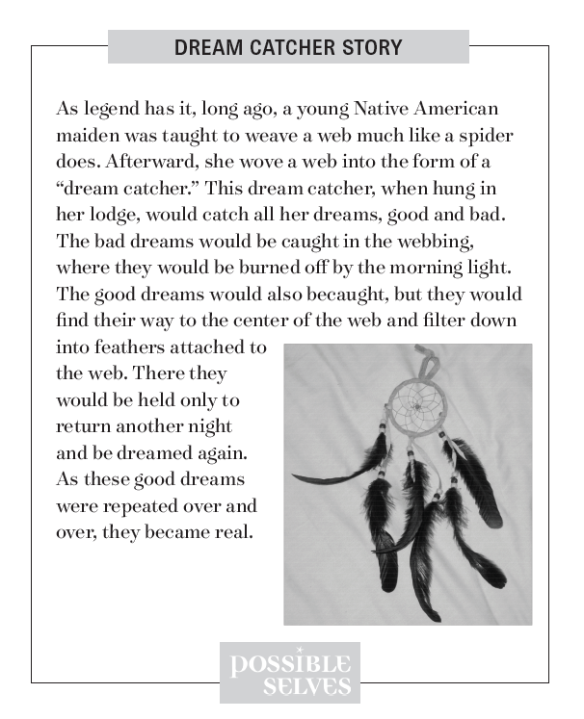
Notes:
Pg. 19

Slide 20
Notes:
5.2 pg. 19

Slide 21
Notes:
Pg. 20

Slide 23
Lesson 2
Discovering strengths and interests
Notes:
Instructor Manual pg. 35

Slide 24
Lesson 2 Essential Questions
What are my strengths and interests?
What would I like have based on my strengths and interests?
Notes:
Student objectives have been translated into Essential Questions.
Pg. 35

Slide 25
Notes:
Pg. 36

Slide 26
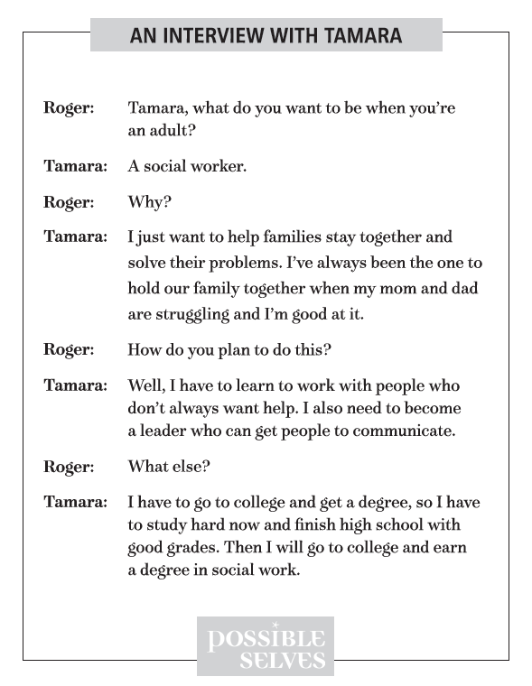
Notes:
1.2 Pg. 37

Slide 27
Strengths, Interests, and Dreams Brainstorm
Notes:
Pg. 37

Slide 28
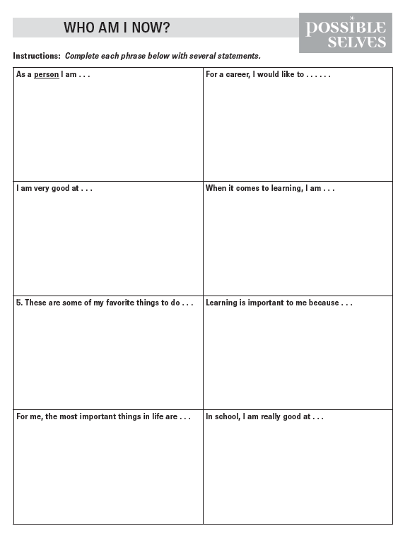
Notes:
Pg. 38

Slide 29
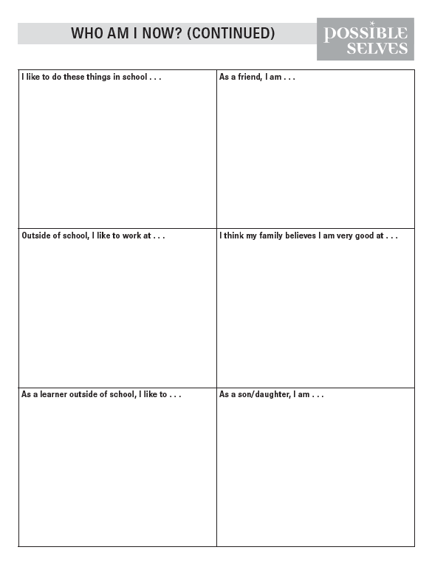
Notes:
Pg. 38

Slide 30
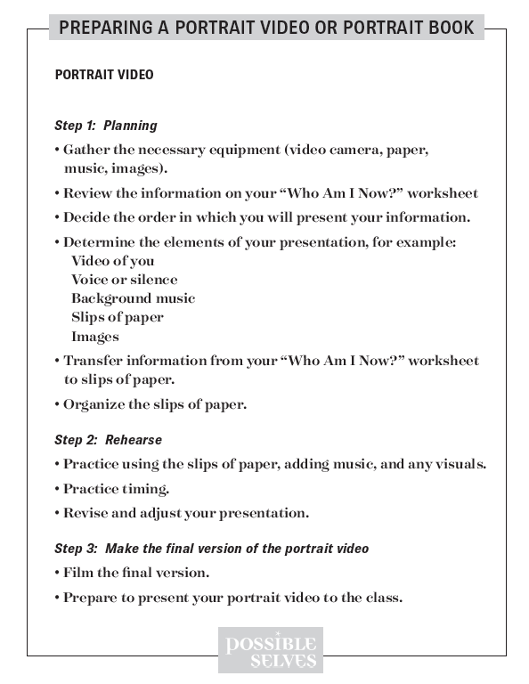
Notes:
Pg. 39

Slide 31
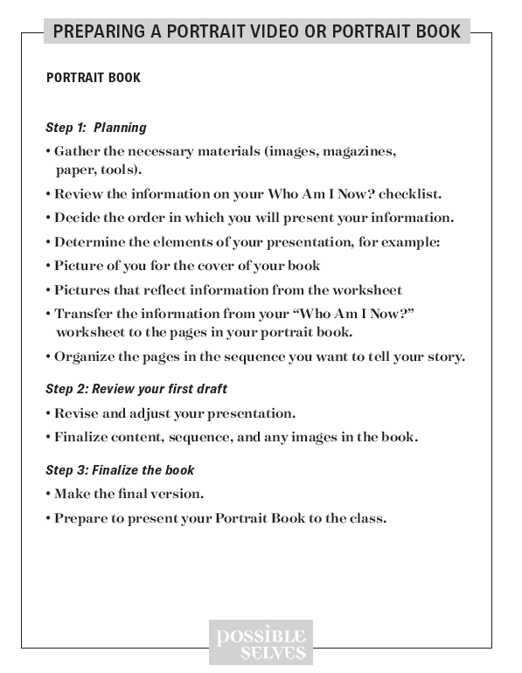
Notes:
Pg. 39

Slide 32
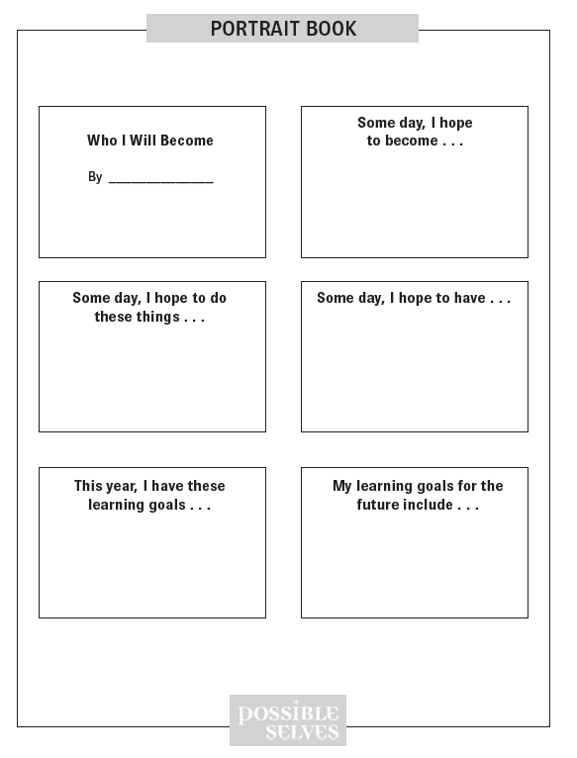
Notes:
Pg. 39

Slide 33
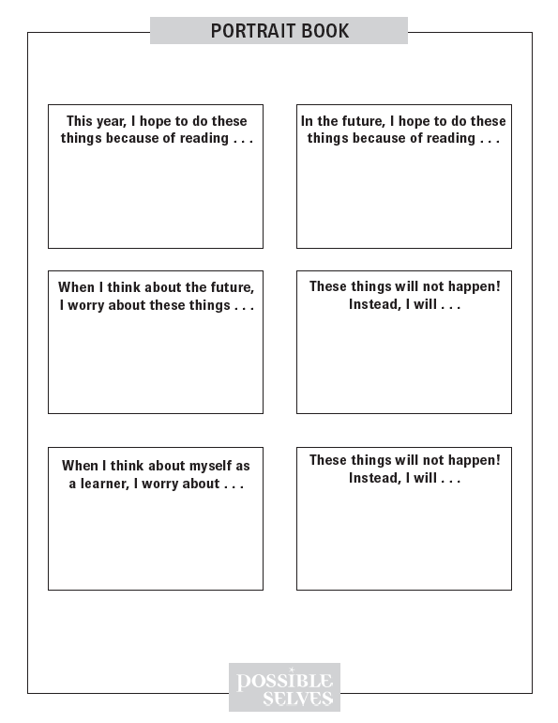
Notes:
Pg. 39

Slide 34
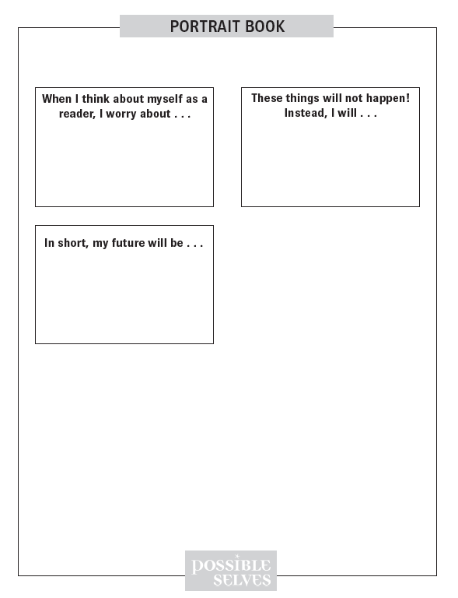
Notes:
Pg. 39

Slide 35
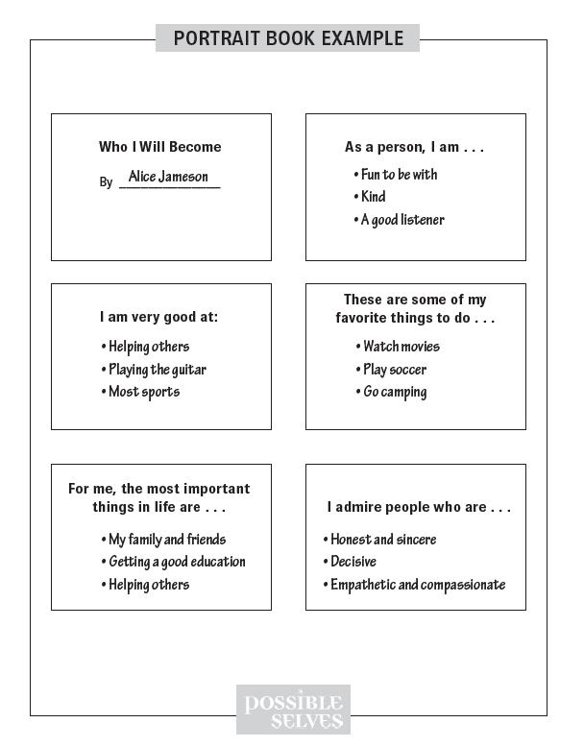
Notes:
Pg. 39

Slide 36
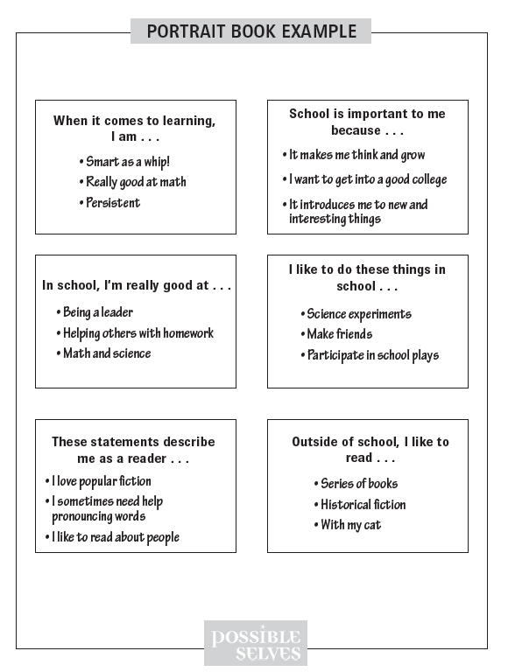
Notes:
Pg. 39

Slide 37
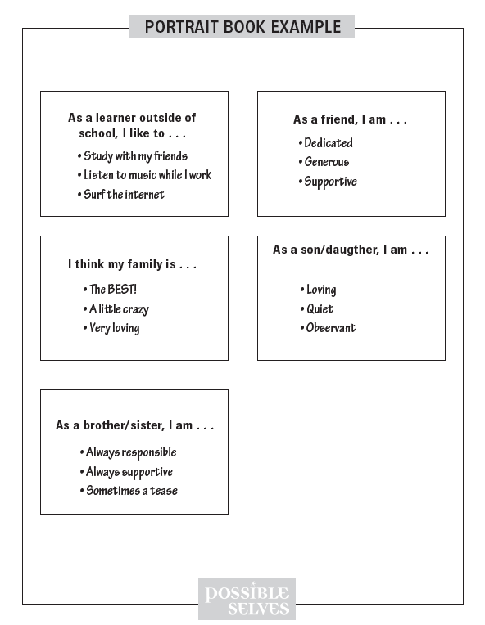
Notes:
Pg. 39

Slide 38
Lesson 3
Thinking about hopes, expectations, and fears
Notes:
Instructor Manual pg. 53

Slide 39
Lesson 3 Essential Questions
What are my hopes, expectations and fears?
What are my strengths as a learner, a person, and a worker?
Notes:
Student objectives have been translated into Essential Questions.
Pg. 53

Slide 40
Notes:
Pg. 54

Slide 41
Hope
Notes:
Pg. 55

Slide 42
Expectation
Notes:
Pg. 55

Slide 43
Fear
Notes:
Pg. 55

Slide 44
Individual strength
Notes:
Pg. 55

Slide 45
Learner
Notes:
Pg. 55

Slide 46
Person
Notes:
Pg. 55

Slide 47
Worker
Notes:
Pg. 55

Slide 48
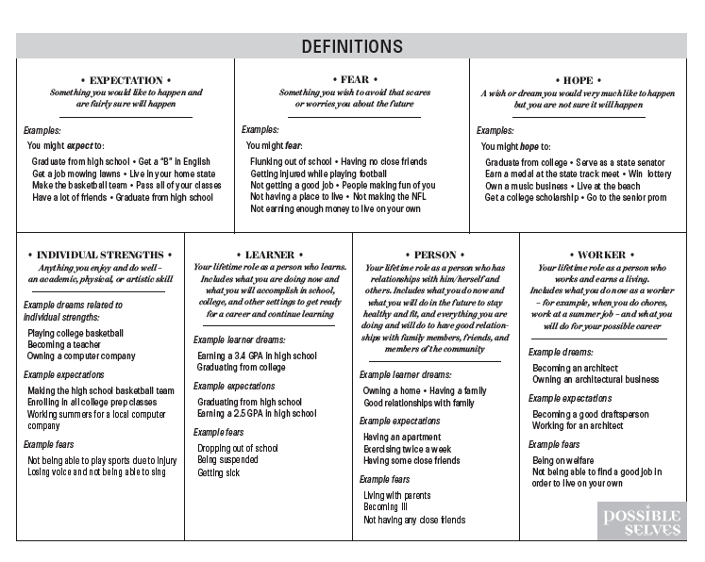
Notes:
Pg. 55

Slide 49
Notes:
1.2 pg. 55

Slide 50
Lesson 4
Sketching me and my possible selves
Notes:
Instructor Manual pg. 62

Slide 51
Lesson 4 Essential Questions
How can I graphically portray my current hopes, expectations, and fears?
Notes:
Student objectives have been translated into Essential Questions.
Pg. 62

Slide 52
Notes:
Pg. 64

Slide 53
Notes:
1.2 pg. 64

Slide 54
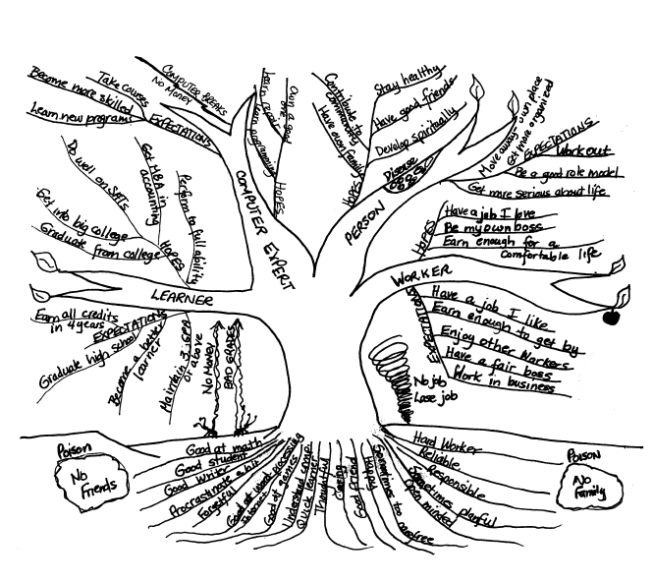
Notes:
Pg. 64

Slide 55
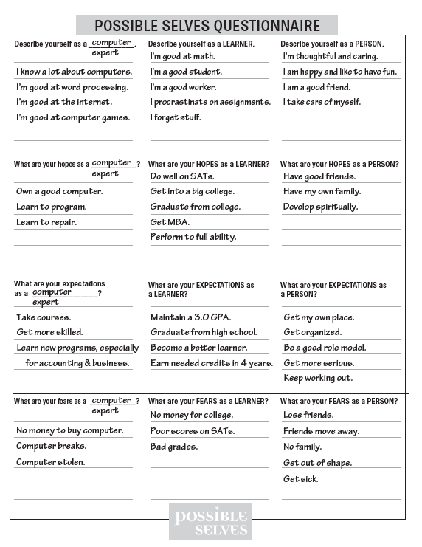
Notes:
Pg. 31

Slide 56
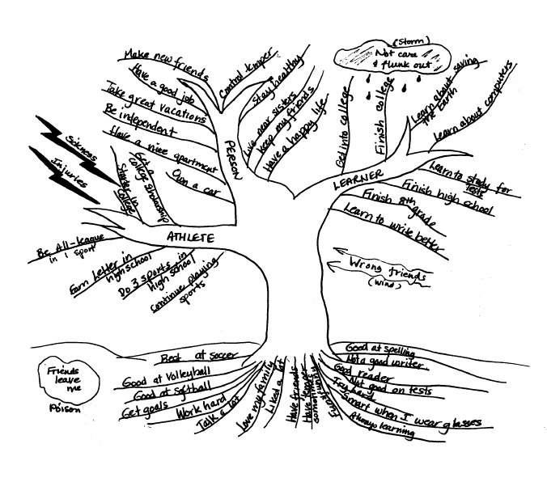
Notes:
Pg. 64

Slide 57
Lesson 5
Reflecting on goals
Notes:
Instructor Manual pg. 74

Slide 58
Lesson 5 Essential Questions
What are my current strengths and needs
How can I use what I know about my current strengths and needs to develop short and long term goals?
Will my goals help me create my hoped-for possible self?
Which of my goals will I make a priority?
Notes:
Student objectives have been translated into Essential Questions.
Pg. 74

Slide 59
Notes:
Pg. 75

Slide 60
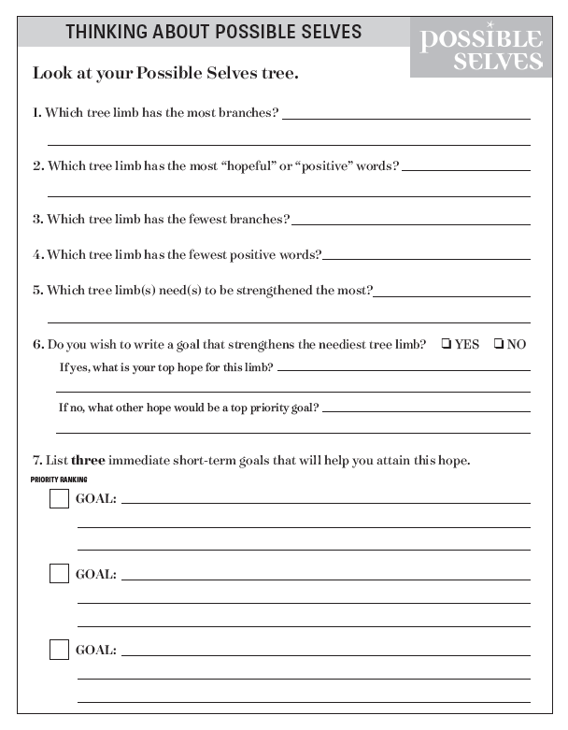
Notes:
Pg. 75

Slide 61
Notes:
Pg. 76

Slide 62
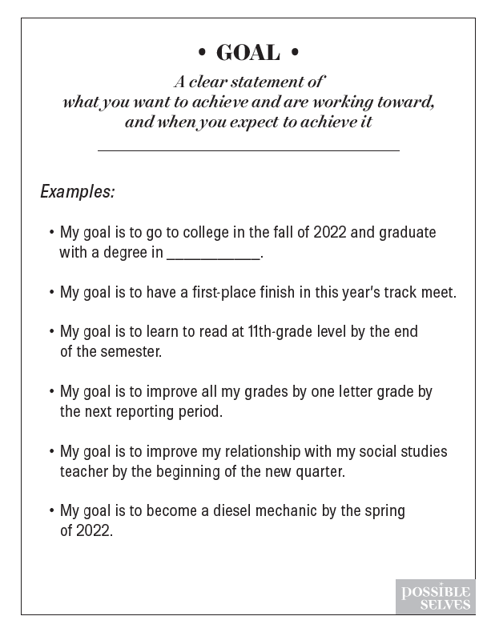
Notes:
Pg. 77

Slide 63
Lesson 6
Planning ways to reach goals
Notes:
Instructor Manual pg. 82

Slide 64
Lesson 6 Essential Questions
How do I develop an action plan for reaching my goals?
Notes:
Student objectives have been translated into Essential Questions.
Pg. 82

Slide 65
Notes:
Pg. 83

Slide 66
Notes:
Pg. 83

Slide 67
Action plan
A plan that contains the specific actions that a person takes to reach a goal.
Action
Anything a person does, including thinking and moving.
Notes:
Pg. 83

Slide 68
Actions
Examples of Mental Actions
Examples of Physical Actions
Planning
Making a decision
Gathering information
Mowing lawns
Writing a letter
Taking a class
Notes:
Pg. 84

Slide 69
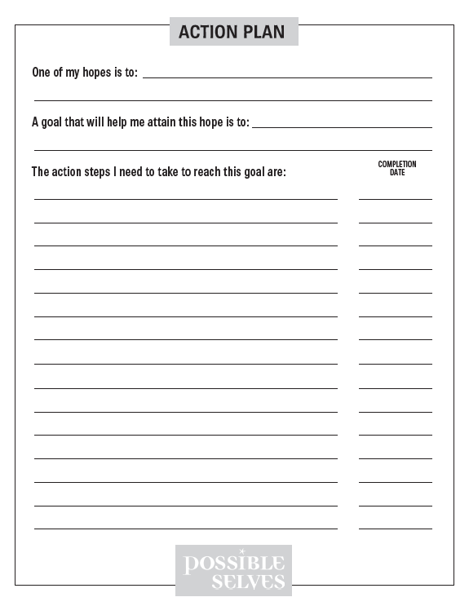
Notes:
2.1 Pg. 84

Slide 70
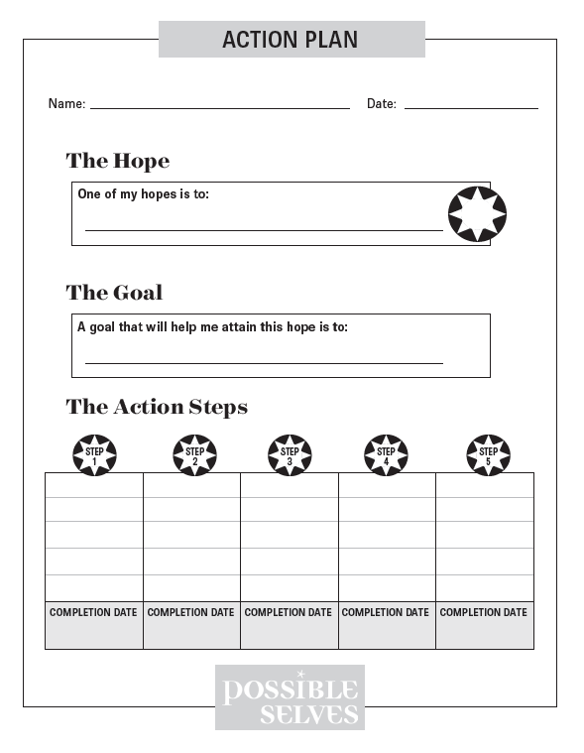
Notes:
2.1 Pg. 84

Slide 71
Notes:
Pg. 86

Slide 72
Notes:
Blank for Guided Practice

Slide 73
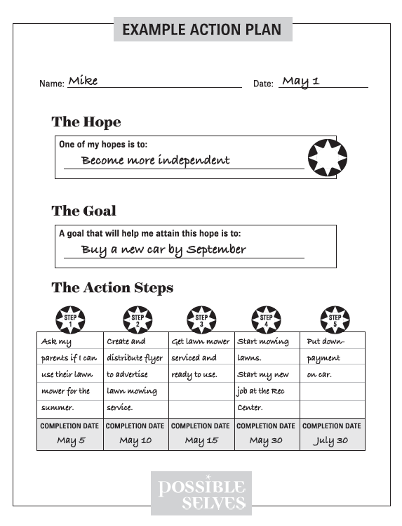
Notes:
Sample for teacher as a guide for guided practice.

Slide 74
Lesson 7
Working to reach goals
Notes:
Instructor Manual pg. 93

Slide 75
Lesson 7 Essential Questions
What progress can I predict on my action plans?
What are additional Action Plans that I should create in order to reach my goals?
Notes:
Student objectives have been translated into Essential Questions.
Pg. 93

Slide 76
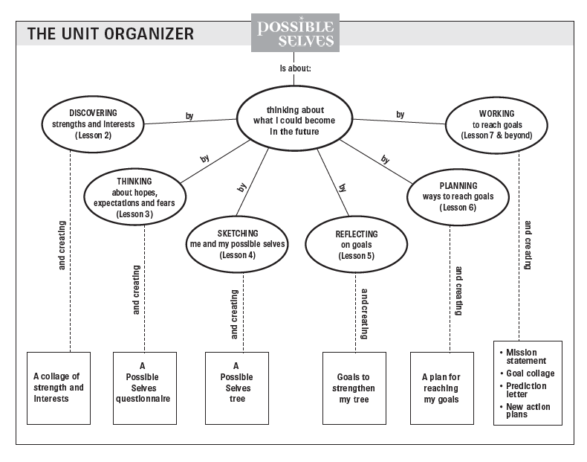
Notes:
Pg. 96

Slide 77
Prediction letter
Notes:
Pg. 96

Slide 78
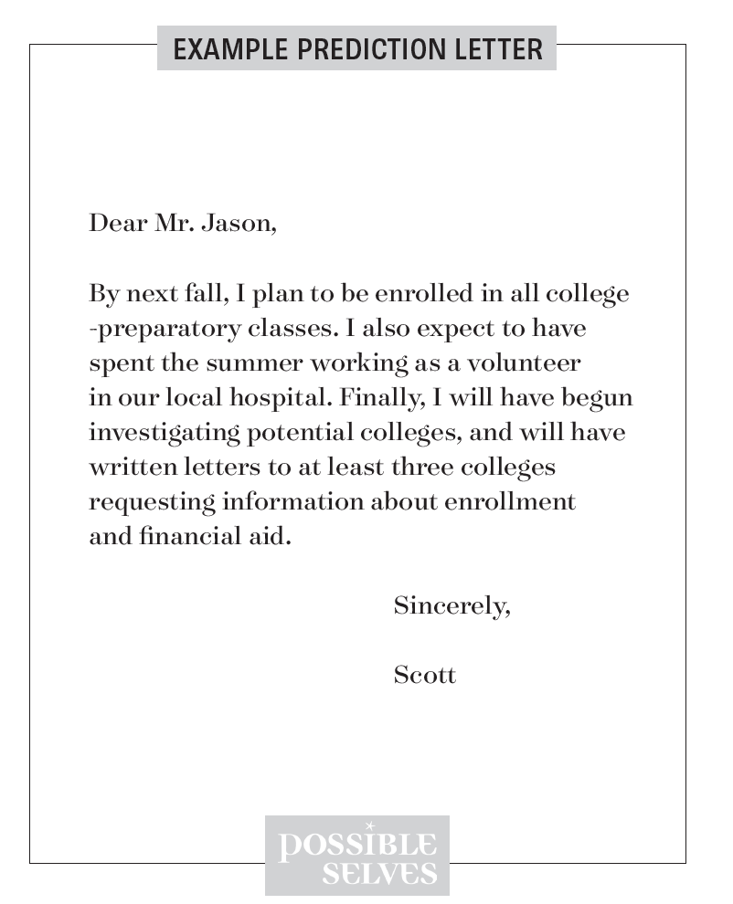
Notes:
Pg. 96

Slide 79
Notes:
Pg. 97

Slide 80
New Action Plans
For priority goals #2 and #3 (from Thinking About Possible Selves forms)
Notes:
Pg. 97

Slide 81
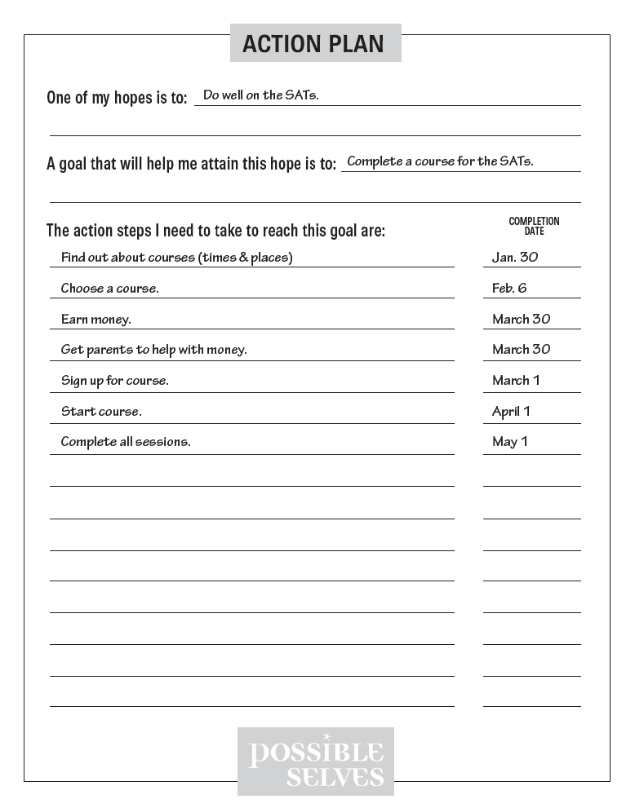

Slide 82
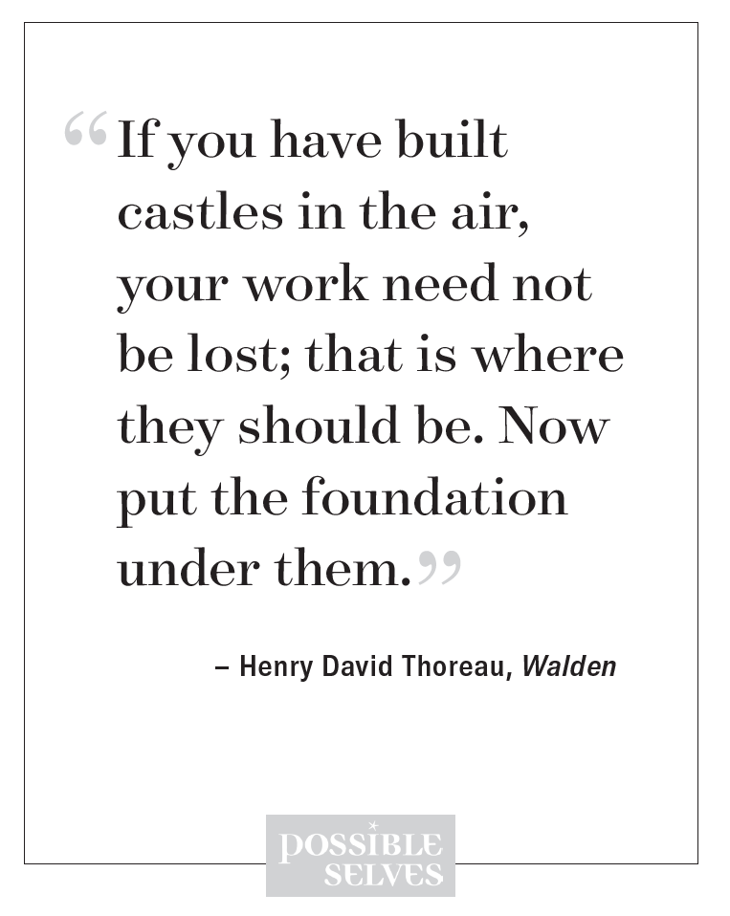

Slide 83
How Am I Doing?
Notes:
Pg. 98

Slide 84
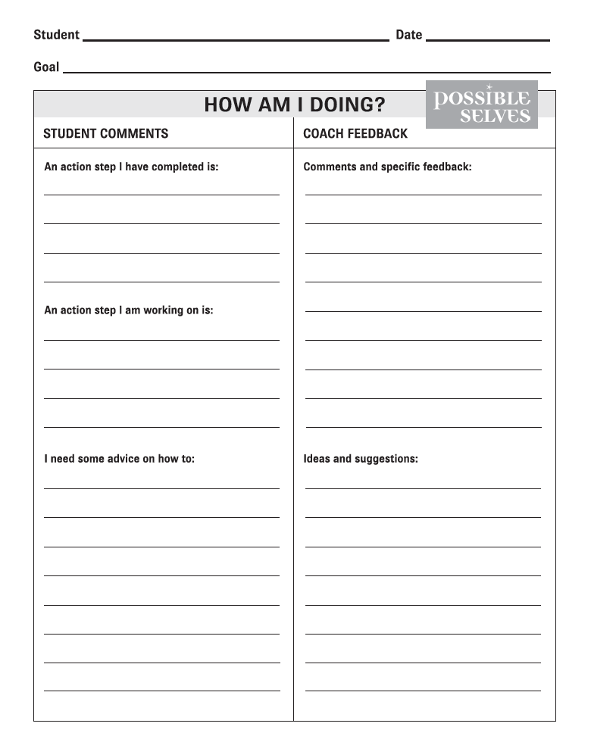
Notes:
Pg. 99

Slide 85
Extra Blank Templates

Slide 89
Notes:
Pg. 14

Slide 90
