Slide 1
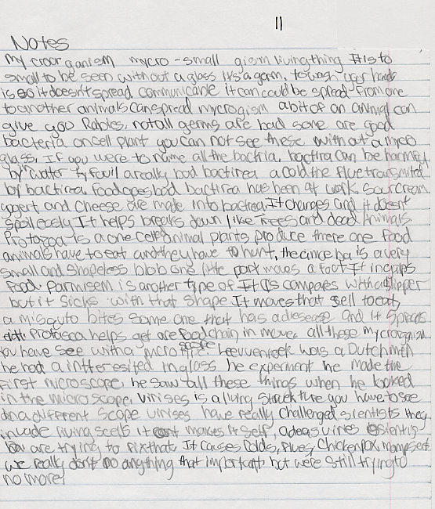
Notes:
BEFORE learning L & N

Slide 2
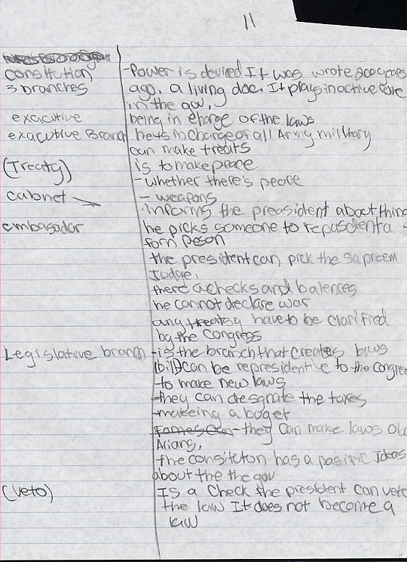
Notes:
AFTER Learning L & N

Slide 3
Before-After Notes for 1 Student with a Language Disability

Slide 4
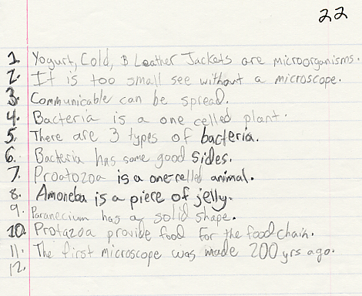
Notes:
BEFORE learning L & N

Slide 5
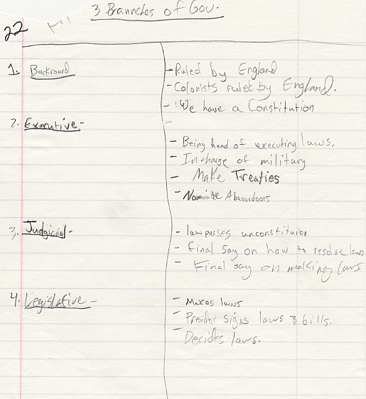
Notes:
AFTER learning L & N

Slide 6
Guided Practice Examples for Transforming & Sorting Information (Lessons 2 & 3)

Slide 7
Note in the Following Student Examples:
Abbreviations used
Symbols used
Key words used to shorten information
Spacing

Slide 8
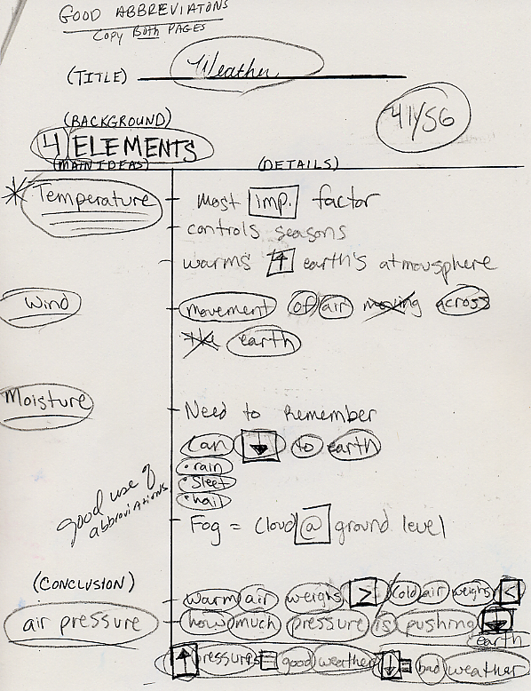

Slide 9
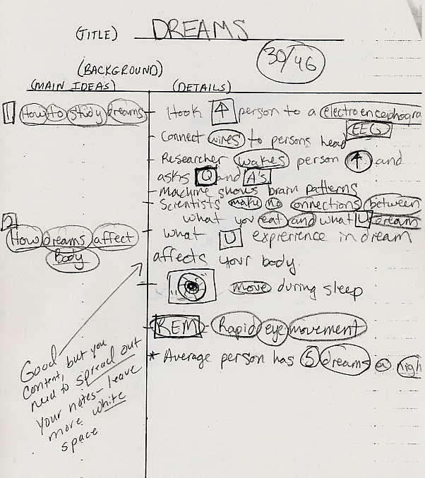

Slide 10
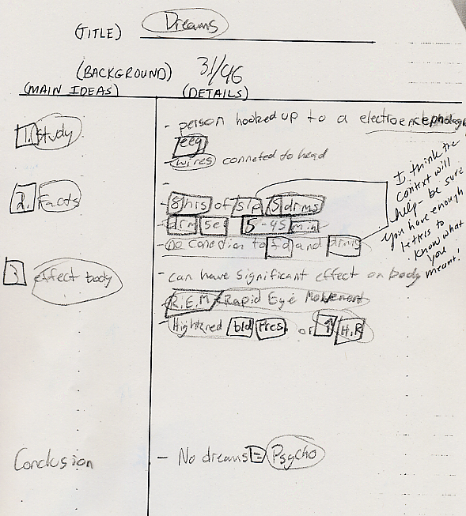

Slide 11
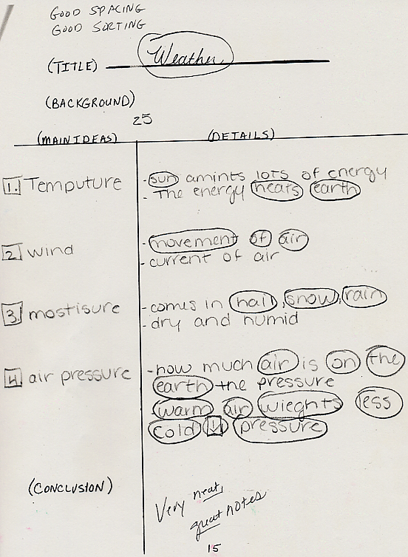

Slide 12
Guided Practice Examples for Drawing a Diagram (Lesson 4)

Slide 13
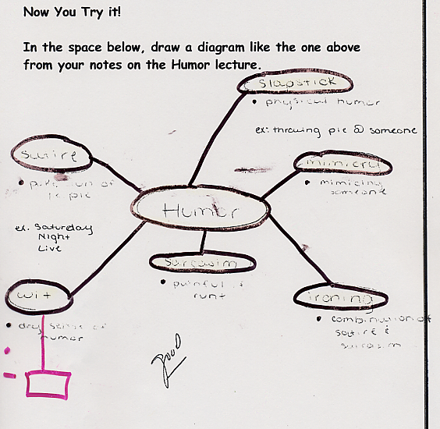

Slide 14
