Slide 1
Listening and Note-Taking Student Examples
Gwen C. Berry, Ph.D.

Slide 2
2001 High School Study
Two 9th grade general education social studies classrooms (inclusive classrooms)
23 of 57 students with disabilities
20 students with LD
1 student with OHD
1 student with speech/language disability
1 student with emotional/behavioral disability

Slide 3
2001 High School Study
Strategy taught in 1 week’s time period
(5, 50 -minute class periods)
Strategy taught in large-group, inclusive setting
Describe, model, practice, format used
Students scored their own practices

Slide 4
Before-After Notes for 2 Students without Disabilities

Slide 5
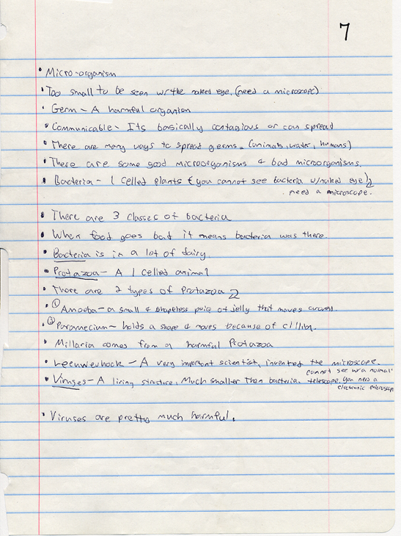
Notes:
BEFORE learning L & N

Slide 6
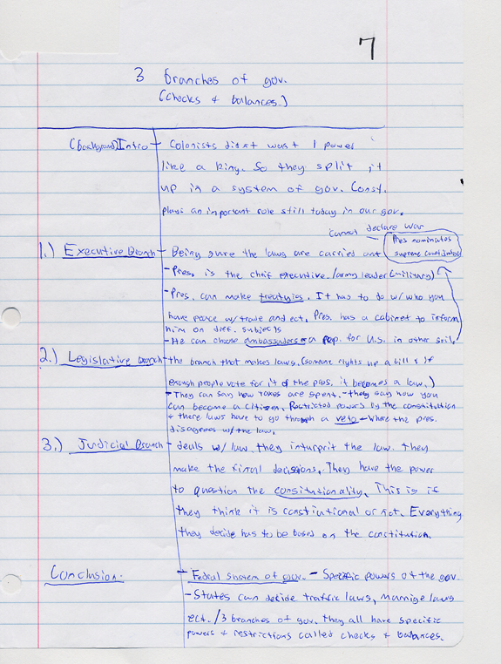
Notes:
After learning L & N

Slide 7
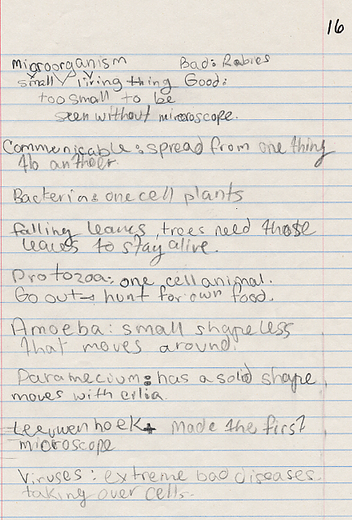
Notes:
Before learning L & N

Slide 8
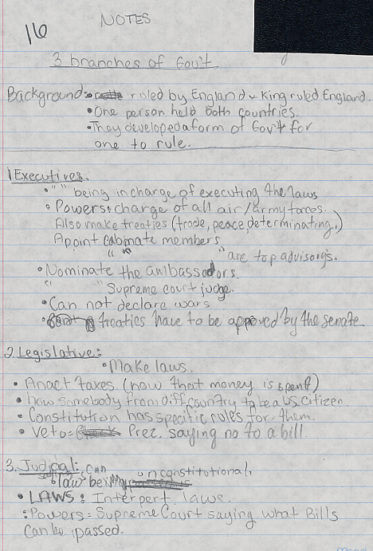
Notes:
AFTER learning L & N

Slide 9
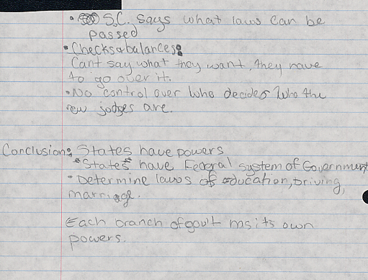

Slide 10
Before-After Notes for 2 Students with Learning Disabilities

Slide 11
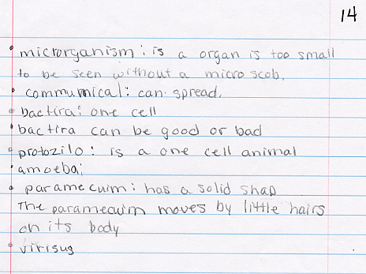
Notes:
BEFORE learning L & N

Slide 12
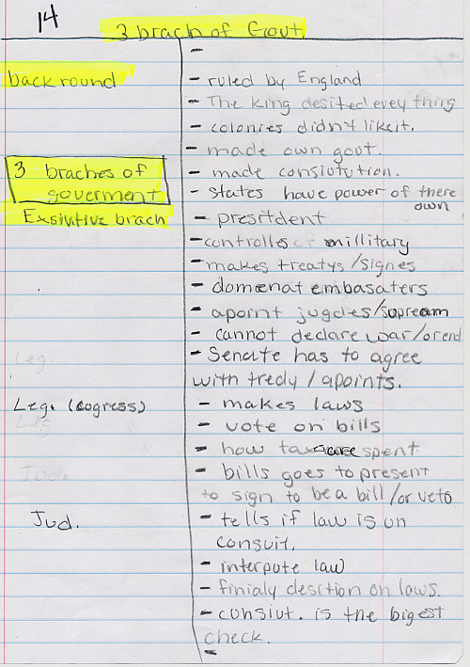
Notes:
AFTER Learning L & N

Slide 13
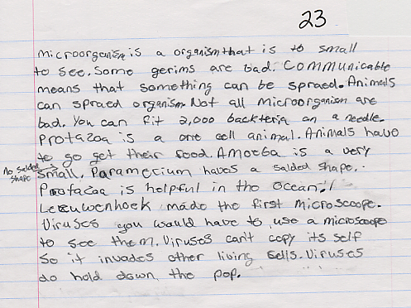
Notes:
BEFORE Learning L & N

Slide 14
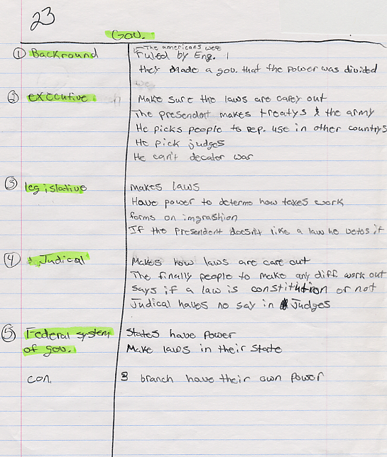
Notes:
AFTER learning L & N

Slide 15
Before-After Notes for 1 Student with ADHD

