Slide 1
The Paragraph Writing Strategy
By Anita Friede, M.A.
National SIM Professional Developer

Slide 2
Learning Strategies Curriculum
Acquisition
Word Identification
Paraphrasing
Self-Questioning
Visual Imagery
Word Mapping
Inference
Storage
FIRST-Letter Mnemonic
Paired Associates
LINCS Vocabulary
Listening & Note-Taking
Expression of Competence
Sentence Writing
Paragraph Writing
Error Monitoring
Theme Writing
Assignment Completion
Test-Taking
Essay Test Taking
EDIT

Slide 3
The purpose of the strategy instruction
To teach students to write well-organized paragraphs that include:
Topic, Detail, and Clincher Sentences
a consistent point of view
consistency in tense throughout
logically sequenced ideas
appropriate transitions between ideas

Slide 4
Range of Intensity
Of Instruction
Construct
independently
Direct Instruction

Slide 5
What does direct instruction look like? It is explicit, systematic, and structured. We call it: The Stages of Acquisition and Generalization

Slide 6
Stages of Acquisition and Generalization
1 – Pretest and make commitments
2 – Describe the strategy
3 – Model
4 – Verbal Rehearsal
5 – Controlled Practice and Feedback
6 – Advanced Practice and Feedback
7 – Posttest and make commitments
8 – Generalization

Slide 7
The Art and Science of Teaching
The Center for Research on Learning at The University of Kansas has given you the science,
You
must create the art!

Slide 8
Pretest Sample
Assignment: Describe someone.
Eric is very special to me. One reason he is special is that he makes me laugh. You can always trust him. I have known Eric since I was six years old. We lived down the block and played together. His grandma was friends with my grandma. I can’t wait until Saturday because we are going to Great Adventure together. We are going to go on a million rides.

Slide 9
Posttest Sample
Assignment: Describe someone.
My Special Friend
Eric is very special to me. One reason Eric is special is that he is my best friend; he is always there for me. When I am upset, he listens and helps me solve my problems. In fact, Eric can always find a way to make me smile; he lifts my spirits when I am down. Another reason he is special is that he always shows me respect. He never forgets my feelings, and he often puts my feelings first. A third reason Eric is special is that he is a very kind person, and he spreads his kindness generously. He is always doing favors for people without being asked. To summarize, Eric is special because he is always there for me, respects my feelings, and is very kind.

Slide 10
Steps for Writing a Paragraph
Set up a diagram
Create the title
Reveal the topic
Iron out the details
Bind it together with a clincher
Edit your work
Plan
Execute
Evaluate

Slide 11
Steps for Writing a Topic, Detail, and Clincher Sentence
Pick a formula and a sentence type
Explore words to fit the sentence type
Note the words
Search and check
Plan
Execute
Evaluate

Slide 12
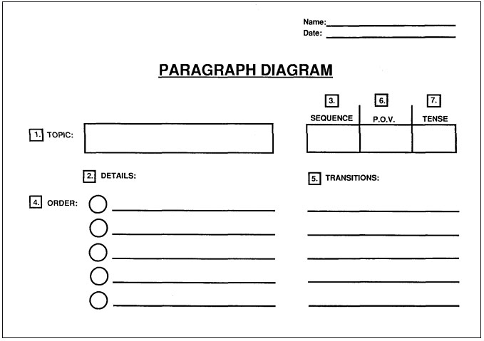

Slide 13
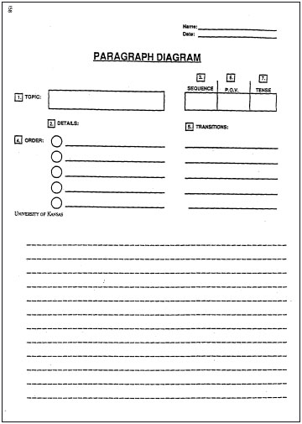

Slide 14
Sentence Types Used in Paragraphs
Paragraph Part Sentence Type
Introduction Topic Sentence
Body Detail Sentences
Conclusion Clincher Sentence
Cue Card #3

Slide 15
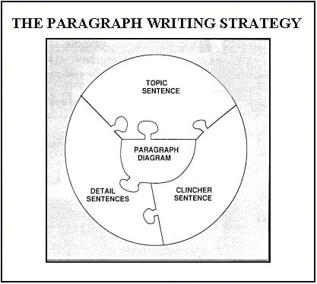
The Paragraph Writing Strategy

Slide 16
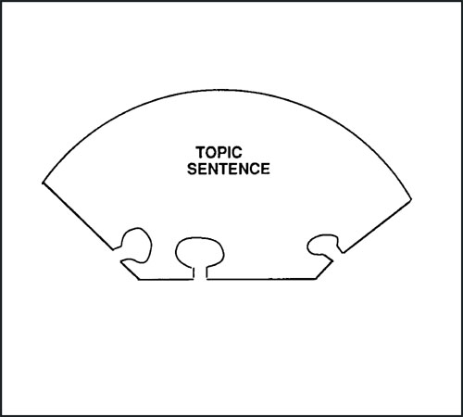
Topic Sentence
Is usually the first sentence
Introduces the main idea
Sometimes introduces the details
Cue Cards #5 & #6

Slide 17
Types of Topic Sentences
General Topic Sentences
Clueing Topic Sentences
Specific Topic Sentences
Cue Card #7

Slide 18
General Topic Sentence
Names the main idea
of the paragraph
Cue Card #8

Slide 19
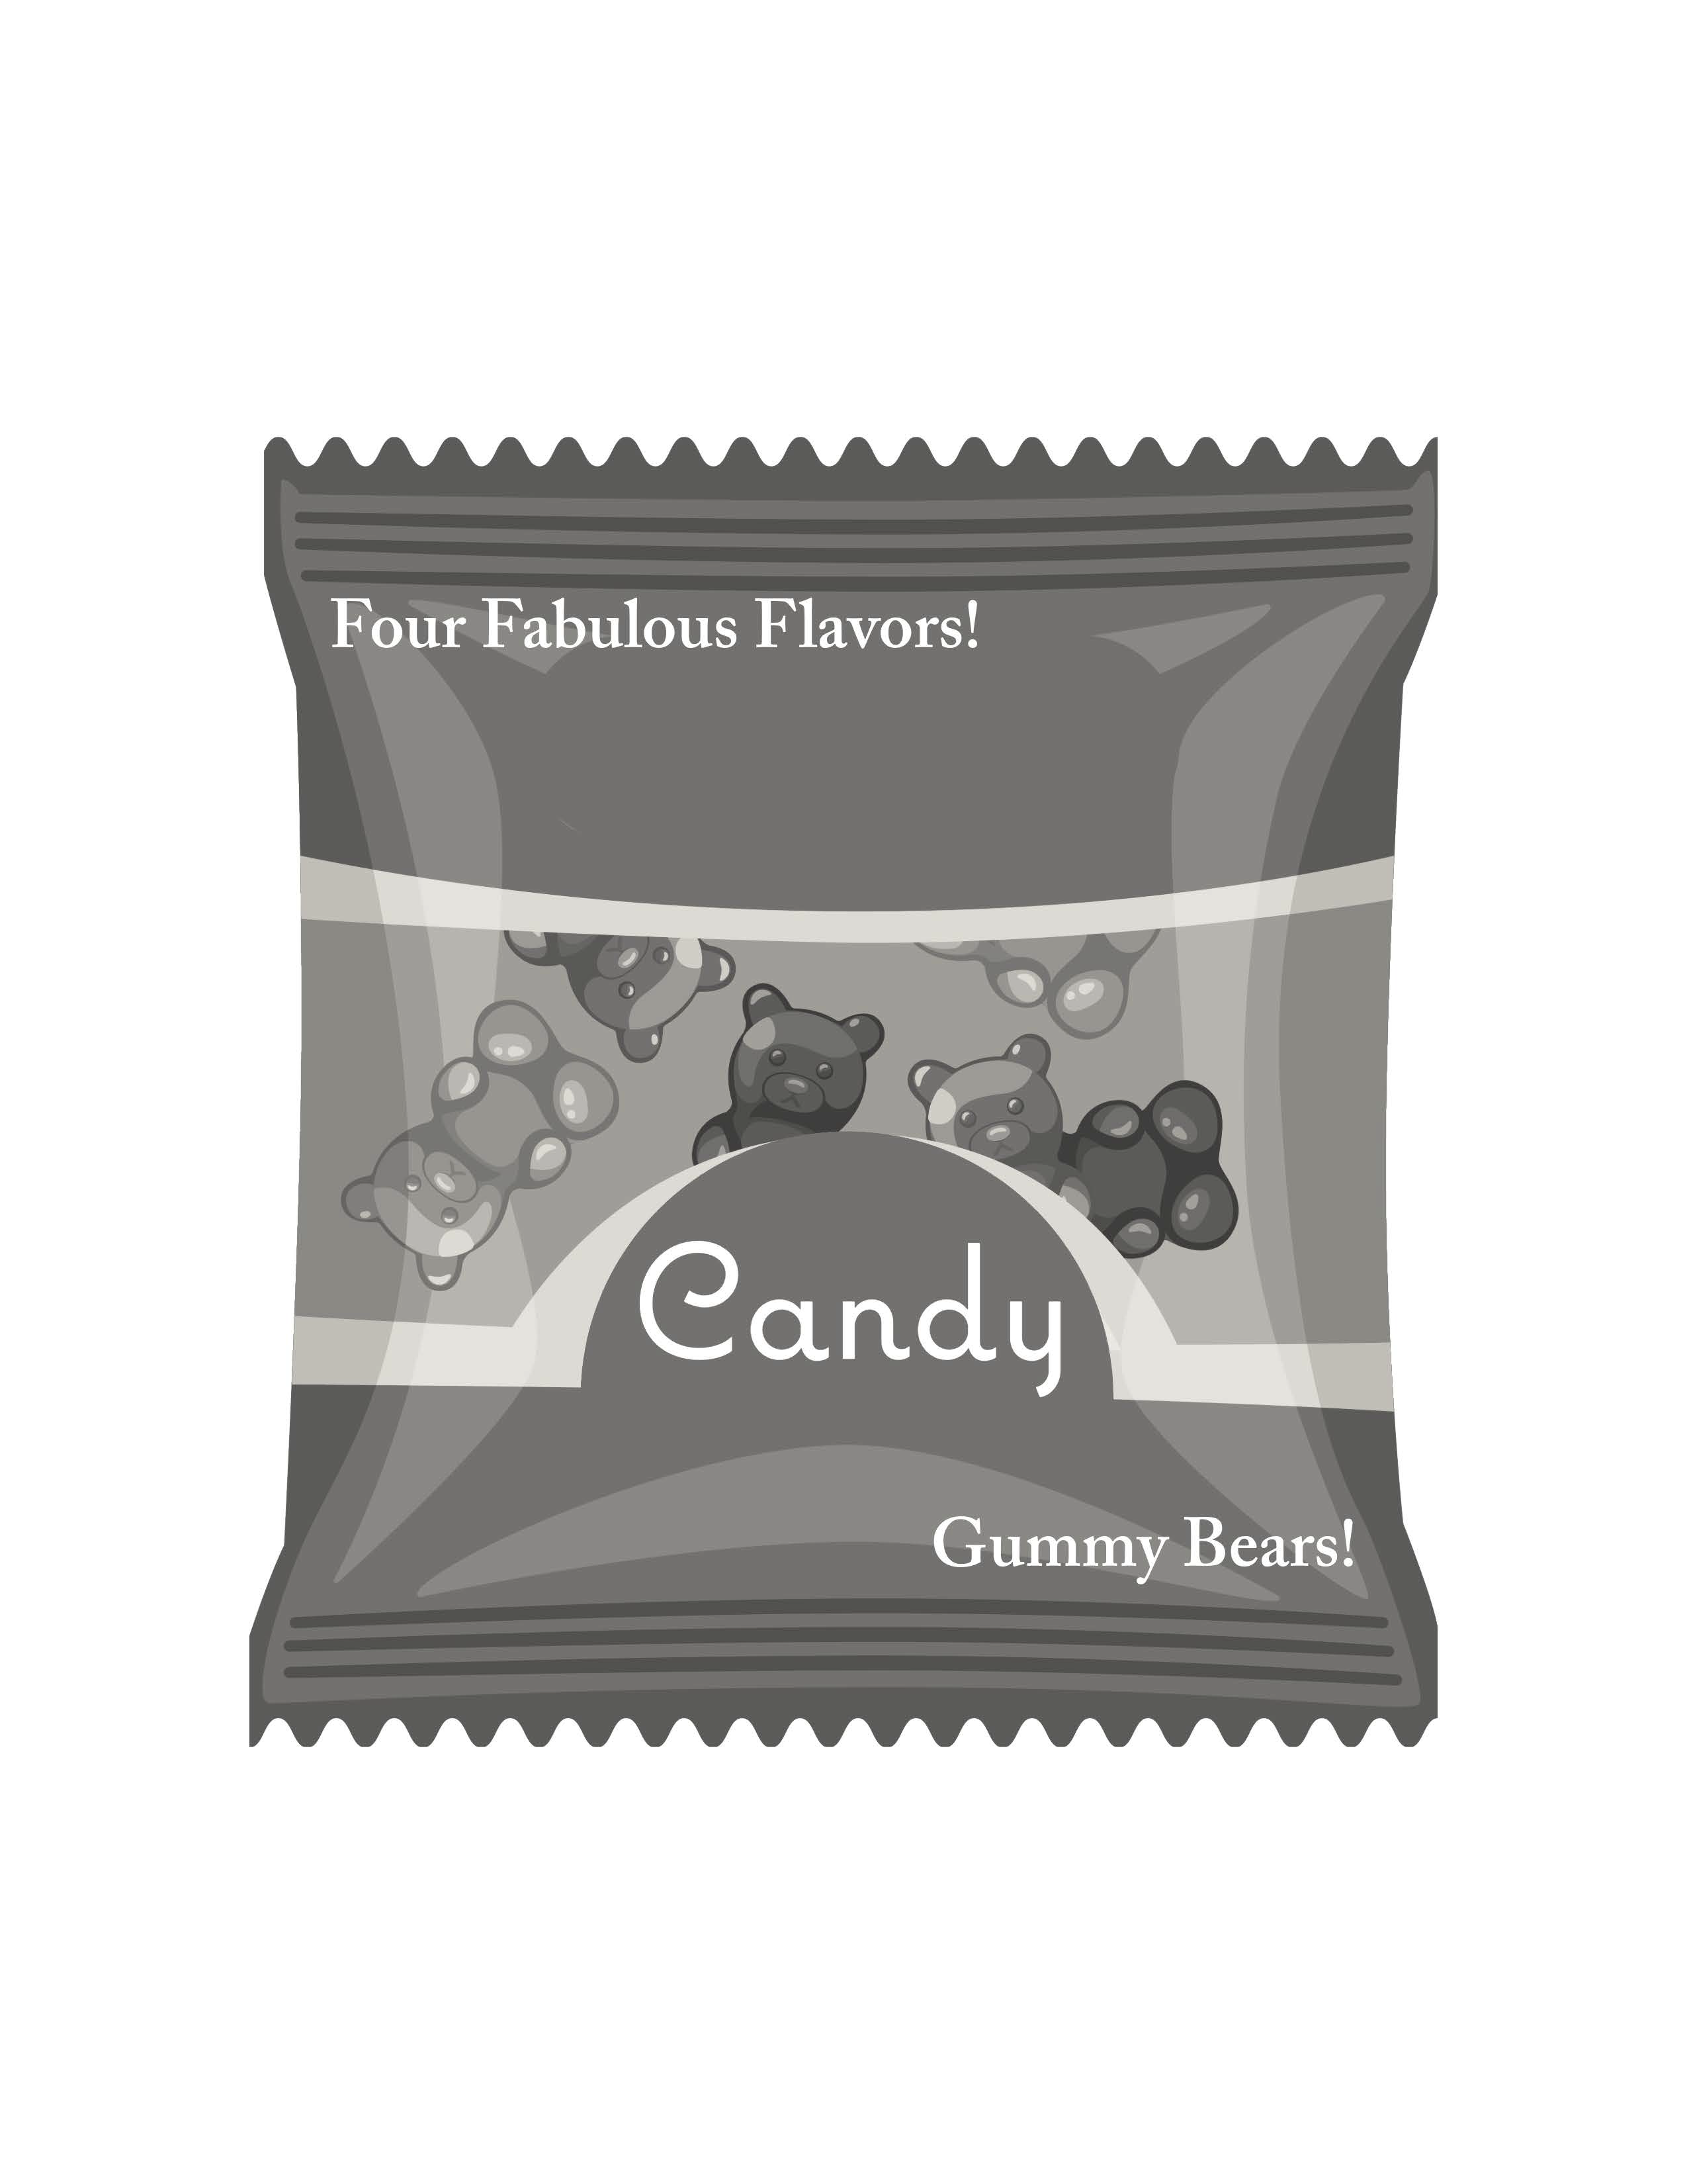
General Topic Sentence
Cue Card #9

Slide 20
Examples of General Topic Sentences
The hot trend in advertising these days is to hire real, live stars.
Not much is left of a town known as Nora, Nebraska.
Democracy is thriving at Hillsboro High School.
Cue Card #10

Slide 21
Examples of General Topic Sentences
Mr. James is my favorite teacher.
I went to Hawaii on vacation.
We are going to fix up our house.

Slide 22
Clueing Topic Sentence
Names the main idea of the paragraph
Gives a clue about the details
Cue Card #11

Slide 23
Clue Words
Many Various Differences
Several Classes Similarities
A number of Categories Advantages
Number (“Three”) Groups Disadvantages
Kinds Steps Jobs
Types Stages Uses
Parts Ways Causes
Elements Roles Effects
Pieces Features Reasons
Members Examples Sources
Divisions Characteristics Products
Components Functions Variety
Different Assortment
Cue Card #12

Slide 24
Examples of Clueing Topic Sentences
The four seasons spice up our lives.
Tents come in a variety of shapes and sizes.
The citizens of Lawrence have several reasons for building a new high school.
Jesse Flynn is my best friend because of his many fine characteristics.
Cue Card #13

Slide 25
Examples of Clueing Topic Sentences
Mr. James is my favorite teacher for three reasons.
I did several exciting things when I went to Hawaii on vacation.
We need to do a variety of projects to fix up our house.

Slide 26
Clueing Topic Sentence
Cue Card #14

Slide 27
Specific Topic Sentence
Names the main idea
Names the specific details
to be covered
Cue Card #15

Slide 28
Specific Topic Sentence
Cue Card #16

Slide 29
Examples of Specific Topic Sentences
Air pollution is caused by vehicles and industries.
Charles Darwin lived an interesting life as an explorer, writer, and scientist.
Diseases caused by vitamin deficiencies are beri beri, pellagra, scurvy, and rickets.
Cue Card #17

Slide 30
Examples of Specific Topic Sentences
Mr. James is my favorite teacher because he is funny, interesting, and very fair.
When I went to Hawaii on vacation I surfed, went swimming, and skydived.
We are going to fix up our house by putting on a new roof, painting the inside, and buying all new carpets.

Slide 31
Steps for Writing a Topic Sentence
Pick a sentence type and a formula.
Explore words to fit the sentence type.
Note the words.
Search and check.
Cue Card #18

Slide 32

Let me model the strategy for writing Topic Sentences

Slide 33
How can we teach students to write a Topic Sentence?

Slide 34
Teaching Topic Sentences
PWS Student Lesson: pages_____________.
The worksheets are _________.
There are ____ worksheets for each type of worksheet. They are labeled
___________. Mastery is ____%. Once students master a worksheet, do
______ have the student’s continue at that level. It is ______________.
PWS Instructor’s Manual: Pages___________ Cue Cards______________
Stage Purpose Teacher’s Behavior Student Behavior
Describe
Model
Verbal Rehearsal
Controlled Practice

Slide 36
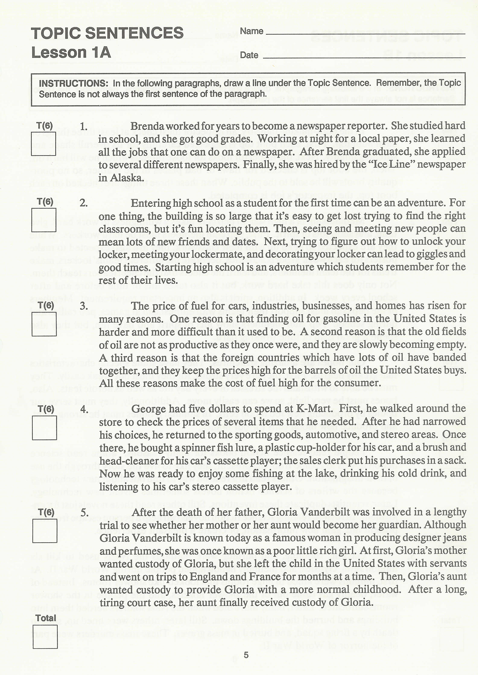
Topic Sentences
Lesson 1A
SL p.5

Slide 37
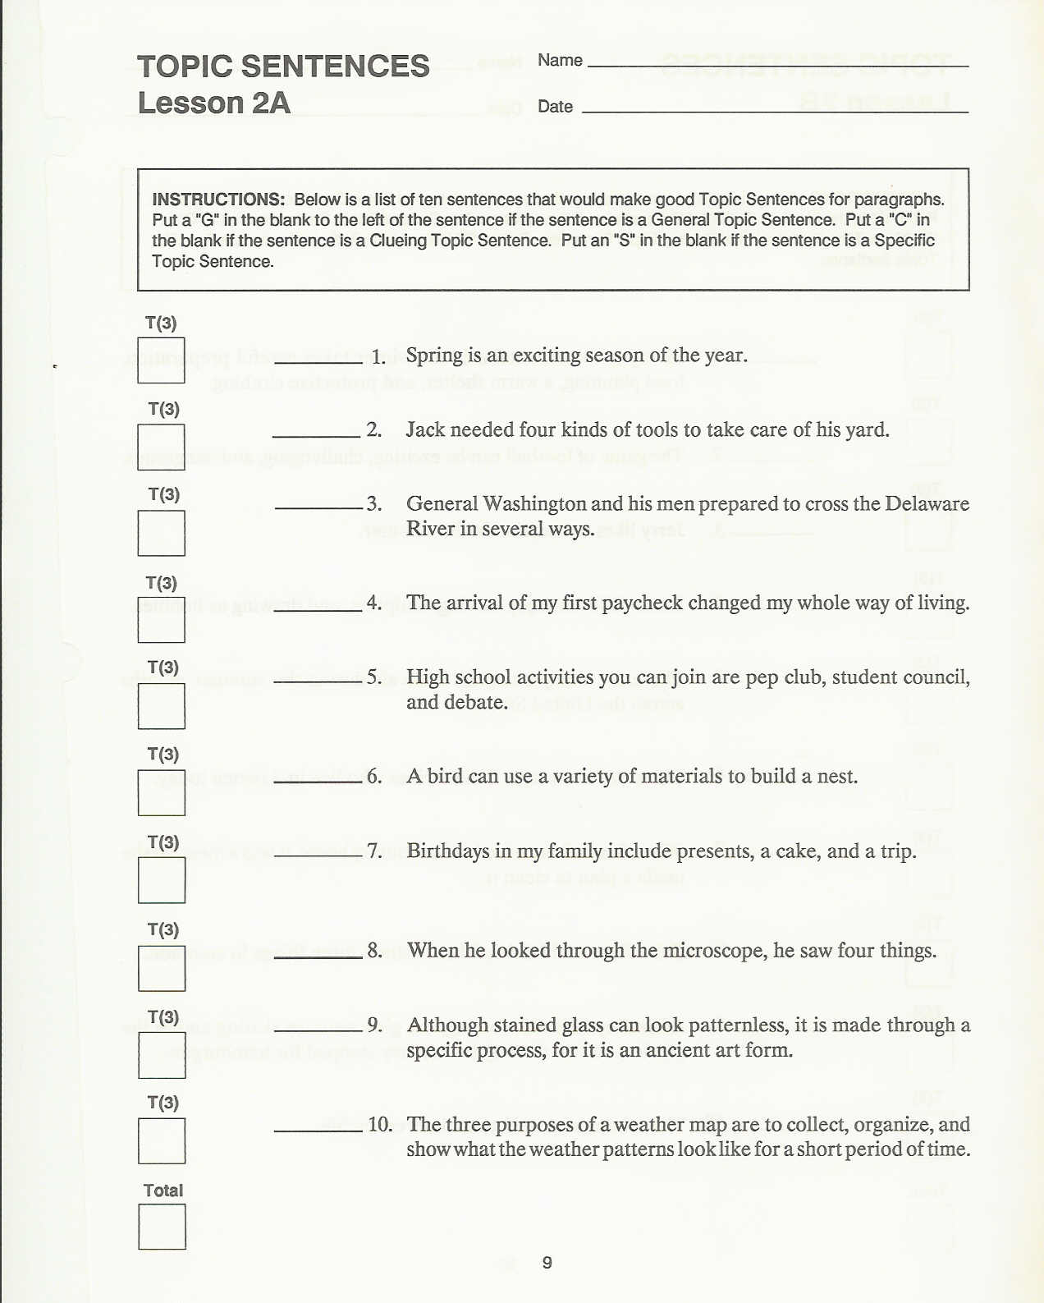
Topic Sentences
Lesson 2A
SL p.9

Slide 38
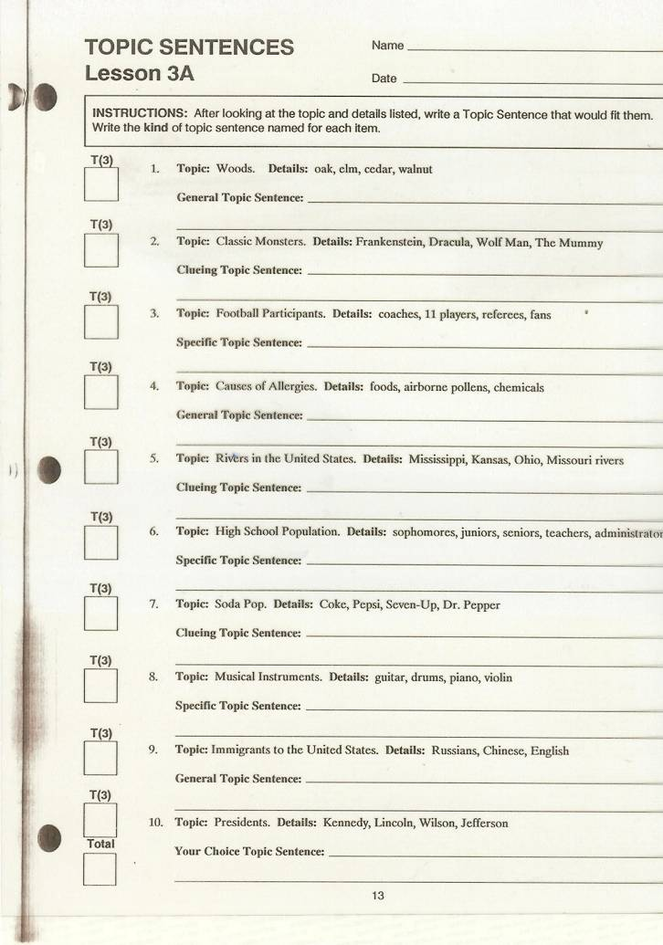
Topic Sentences
Lesson 3A
SL p.13

Slide 39
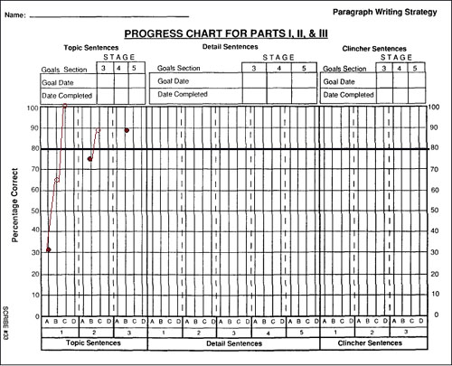
P 348

Slide 40
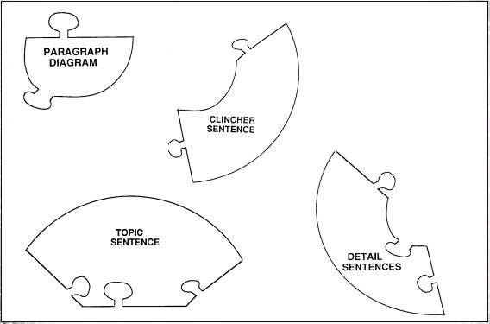
Detail Sentence
Discusses one of the details in the paragraph
Sometimes shows the relationship between a detail and the rest of the paragraph
Cue Cards #19/20

Slide 41
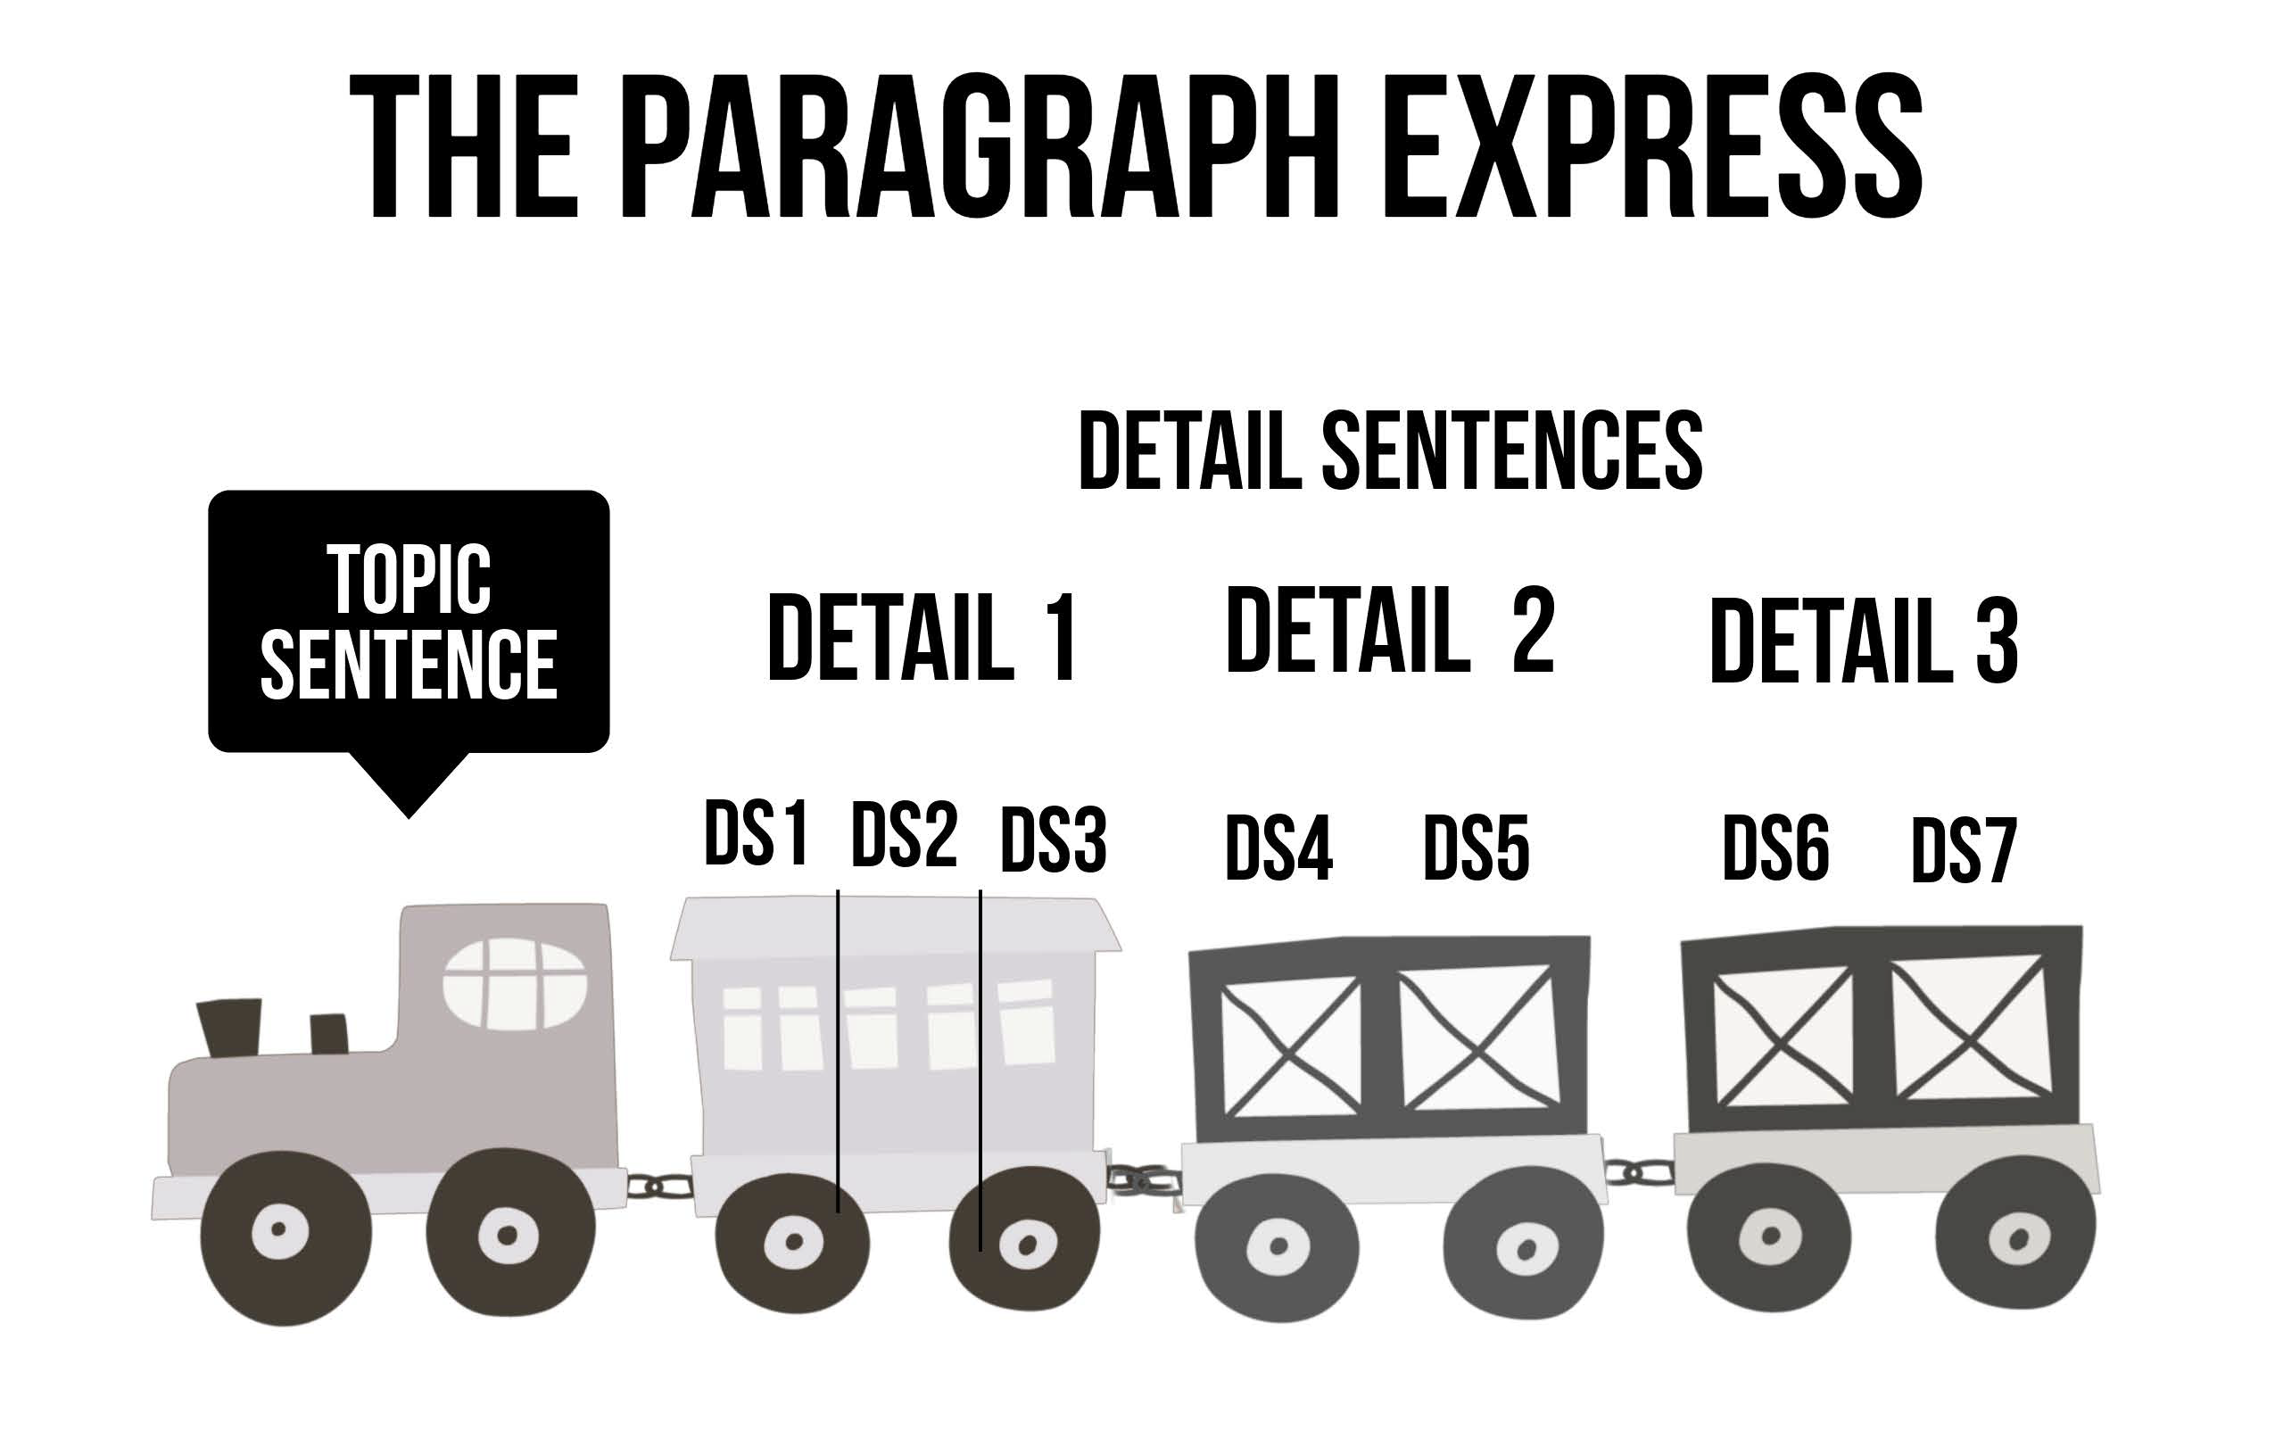
The Paragraph Express
Cue Card #21

Slide 42
Transition
Signals the introduction of a new detail.
Shows the relationship between the detail and the rest of the paragraph.
Cue Card #22

Slide 43
Types of Detail Sentences
Lead-off Sentences
Follow-up Sentences
Cue Card #23

Slide 44
Lead-off Sentence
Introduces a new detail
Contains a transition
Follow-up Sentence
Provides more information
about the detail.

Slide 45
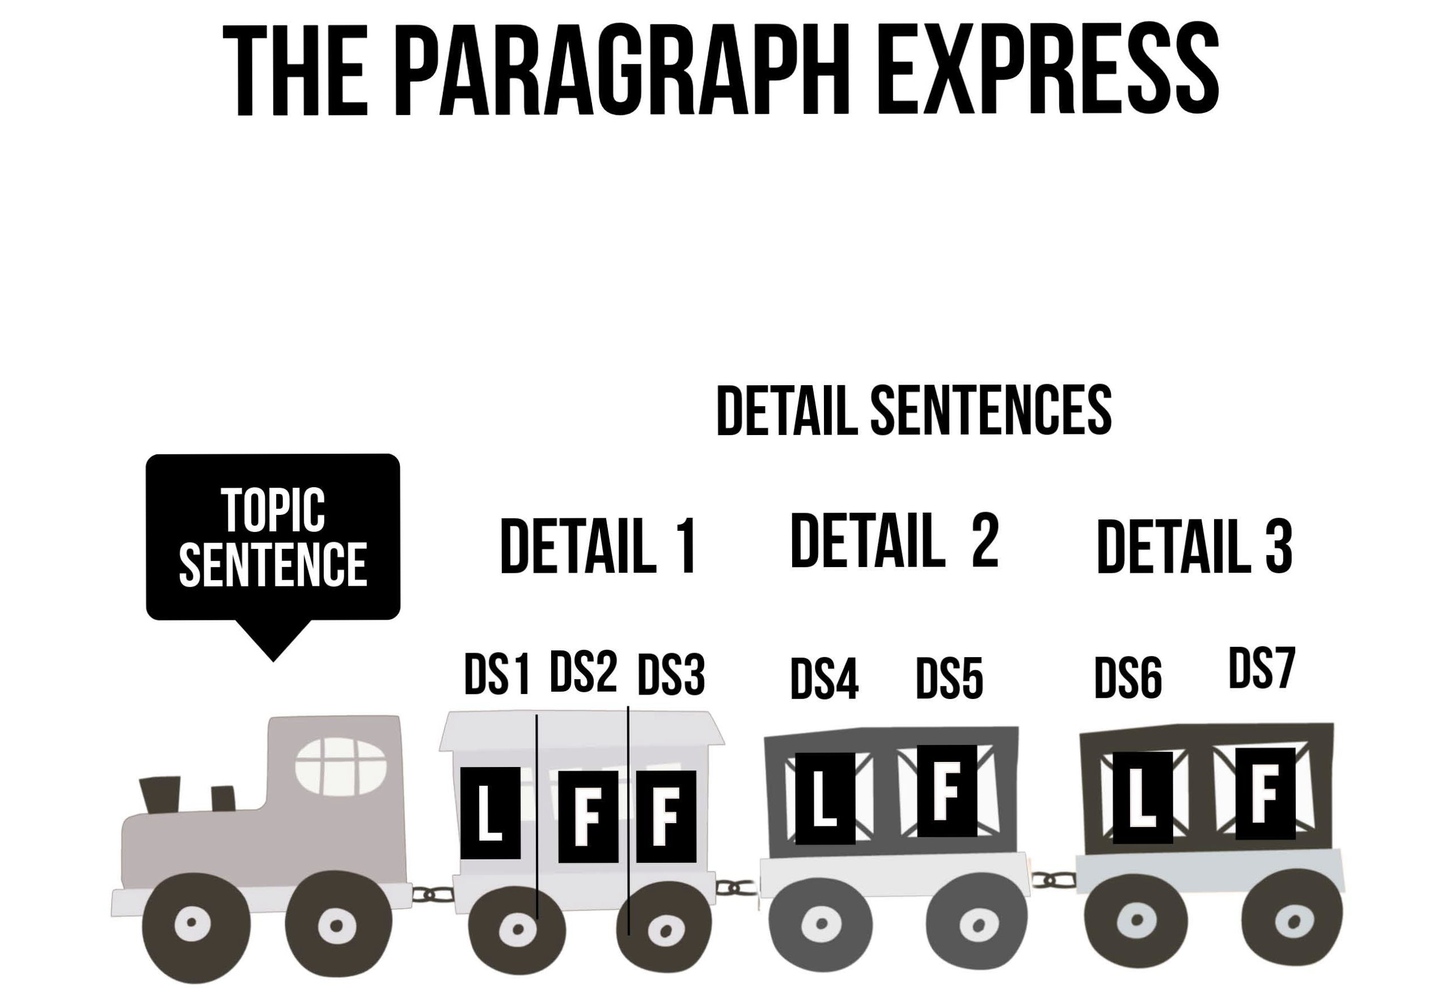
The Paragraph Express
Cue Card #26

Slide 46
Example Detail Sentences
Topic sentence: Turtles could not survive without their
marvelous shells.
Detail sentences:
Most importantly, turtles’ shells serve as the base for their skeletons. Their backbones and ribs are attached to the flat bony plates of their shells. This skeleton provides shape for their bodies. Somewhat importantly, turtles’ shells serve as their portable homes. Turtles can live anywhere because they carry their homes with them. This is important for turtles since they move so slowly. Finally, turtles’ shells are important because the shells protect turtles from their enemies. Turtles who are in danger can pull their heads and legs into their hard shells to protect themselves from animals who might try to eat them.
Cue Card #27

Slide 47
Requirements for a Detail Sentence
Each Detail Sentence must:
Contain related information,
Be in a logical sequence with other sentences,
Include a transition if it introduces a new detail,
Be written from the same point of view as the other sentences, and
Be written in the same tense as the other sentences.
Cue Card #28

Slide 48
Requirements for a Detail Sentence
Each Detail Sentence must:
Contain related information,
Be in a logical sequence with other sentences,
Include a transition if it introduces a new detail,
Be written from the same point of view as the other sentences, and
Be written in the same tense as the other sentences.
Cue Card #28

Slide 49
Detail Sentence Sequences
Size Sequence
When details are larger/smaller than each other
Time Sequence
When some details occur before others in time
Space Sequence
When details are arranged in space in relation to each other
Importance Sequence
When some details are more important than others
Chain-Link Sequence
When details are related in pairs or not related in any of the above sequences
Cue Card #29

Slide 50
Transitions Chart
Size Transitions
The largest Larger than The smallest The small-sized The tallest
The next largest Equal to The next smallest The medium-sized The shortest
The smallest Smaller than The largest The large-sized
Time Transitions
First, Now At the beginning of Before By this time Thereafter,
Then, Soon In the middle of In the meantime At the same time, Presently
Next, Then At the end of During At that instant, After a short time
At last, Later Meanwhile After Soon thereafter, Immediately,
Afterwards Simultaneously,
First, In the morning, Yesterday, The first
Second, Before noon, Today, A more recent
Third, In the afternoon, Tomorrow, The most recent
Finally, In the evening, The day after tomorrow,
In the past, The next day, This year, The earliest
In the present, Two weeks later, Next year, The next earliest
In the future, Six months later, In the next few years, The most recent
Cue Card #30

Slide 51
Transitions Chart (cont.)
Space Transitions
Behind On the edge of Beside In front West of High
Over Toward Around Facing East of Against
Under Throughout Near back of North of Alongside
Below To the right of Side by side In the center South of Ahead of
Beneath To the left of Close to Inside At the Here
Low down On top of Next to Outside In There
On the bottom At the top Down At the end of On Beyond
On the corner By Up Between Above Farther on
Importance Transitions
The best The most important The first The best
The next best Equally important More important than The next best
The least best The next most important Most important The worst
The least important

Slide 52
Transitions Chart (cont.)
Chain-Link Transitions
On the one hand, One example of In the first place, In other words The first
On the other hand, For instance, In the second place, In fact, The second
Another example, In the third place, Also, The third
Again, A further example,
Besides, For example,
Moreover, For another example, One Because First,
Another Since Second,
Still another A further As third,
In addition, Further, Still, Specifically,
In the same way, Furthermore, While More specifically,
In fact, Instead In particular,
The opposite of _ is_ Additionally,
On the contrary side Lastly, The last Indeed, As a result,
To the contrary, Similar to _ is_ Last Although Consequently,
In contrast, Another similar _ is_ Even though Naturally,
In spite of Likewise, Nevertheless, Even if After all,
Despite the Similarly, Nonetheless,
A dissimilar _ is_
Concluding Transitions
To conclude, In summary, To sum up, As you can see,
In conclusion, In sum, To summarize, As a result,
In brief, Thus, Finally,
In short, Therefore,

Slide 53
Student Lessons on Transitions
Pretest/Posttest, pages 93-96
Lessons 1A-1D, pages 97-100
Lessons 2A-2D, pages 101-104
Lessons 3A-3D, page 105

Slide 54
Lead-off Sentence
Introduces a new detail
Contains a transition
Follow-up Sentence
Provides more information
about the detail.

Slide 55
Initially…
Eventually...

Slide 56
Requirements for a Detail Sentence
Each Detail Sentence must:
Contain related information,
Be in a logical sequence with other sentences,
Include a transition if it introduces a new detail,
Be written from the same point of view as the other sentences, and
Be written in the same tense as the other sentences.
Cue Card #28

Slide 57
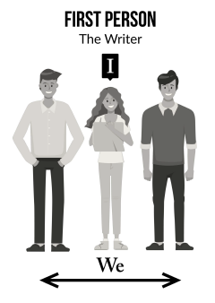
Example Sentences Written in First Person Point of View
I went to the beach for a vacation with several friends.
We sunbathed, fished, watched the surfers, and swam.
I have solved a number of mysteries lately.
We recently moved to the country from the city; we love our new home.
Cue Cards #31 & 32

Slide 58

Example Sentences Written in Second Person Point of View
You should be sure to pack light when you go backpacking.
You will have a good trip if you are aware of some safety tips.
Never take heavy objects like extra shoes or cast-iron fry pans on a backpacking trip.
Cue Cards #31 & 33

Slide 59
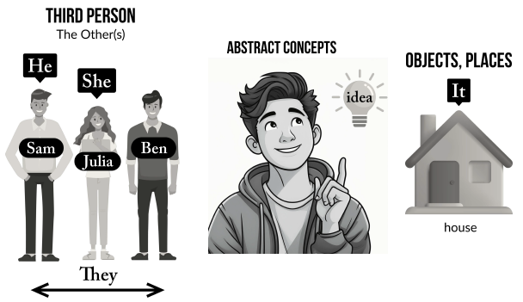
Example Sentences Written in Third Person Point of View
The boys went to a movie and then to a dance; they enjoyed themselves.
Scott, Chris, and Wallis became the best of friends.
The garden was filled with many fragrant and colorful flowers.
Cue Cards #31 & 34

Slide 60
Point of View Chart
First Person
Second Person
Third Person
I
We
He The house
She One idea
It Mimi, Tom,
They Joe
You
You (understood)
Subjects
Sometimes
in rest of
sentence
Him Themselves
Her Itself
Them His
Himself Hers
Herself Their
Theirs
Me Us
My Our
Mine Ours
Myself Ourselves
Your
Yours
Yourself
Yourselves
Cue Card #35

Slide 61
What Point of View?
My house is brown and white, and it has a big porch on the front.
Your photograph of the mountains is beautiful.
You can come over to my house tomorrow night.
Yesterday, I visited my best friend and his brother.
My sister’s family includes her husband, her daughter, and her two sons.
Cue Card #36

Slide 62
Student Lessons on Point of View
Pretest/Posttest, pages 65-68
Lessons 1A-1D, pages 69-72
Lessons 2A-2D, pages 73-76
Lessons 3A-3D, page 77

Slide 63
Requirements for a Detail Sentence
Each Detail Sentence must:
Contain related information,
Be in a logical sequence with other sentences,
Include a transition if it introduces a new detail,
Be written from the same point of view as the other sentences, and
Be written in the same tense as the other sentences.
Cue Card #28

Slide 64
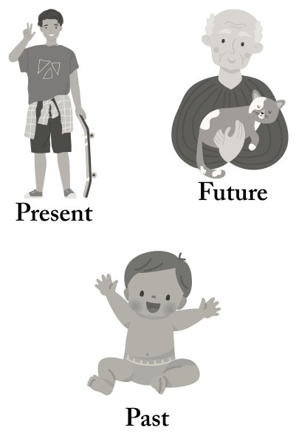
Tense Chart
Tense Verb
Past painted
was painting
had painted
Present is painting
paints
Future will paint
shall paint
Cue Card #37/8

Slide 65
Example Sentences for Tense
Past
Yesterday, the sun rose at 5:30 a.m.
On her vacation, Kathy swam in the ocean every day, and she ran along the beach each evening.
Present
The sun is rising early this morning.
Kathy loves to swim in the ocean.
Future
Tomorrow, we will watch the sun rise.
Next summer, Kathy will swim in the ocean again, and she will stay fit.
Cue Card #39

Slide 66
Student Lessons on Tense
Pretest/Posttest, pages 79-82
Lessons 1A-1D, pages 83-86
Lessons 2A-2D, pages 87-90
Lessons 3A-3D, page 91

Slide 67
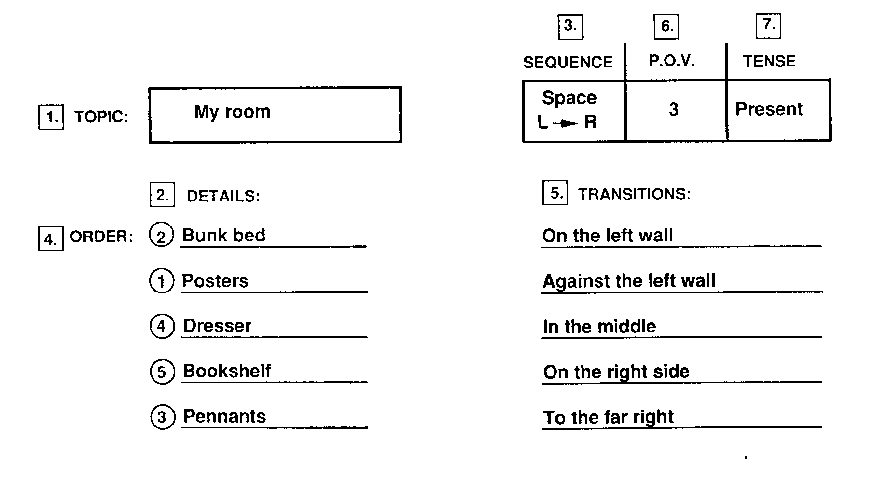
A Finished Paragraph Diagram
Cue Card #40

Slide 68
Steps for Writing a Detail Sentence
Pick a sentence type
Explore words to fit the sentence type
Note the words
Search and check
Cue Card #41

Slide 69
Let me model the strategy

Slide 70
How do we teach students to write a Detail Sentence?

Slide 71
Teaching Detail Sentences
PWS Student Lessons: pages_____________.
The worksheets are _________.
There are ____ worksheets for each type of worksheet. They are labeled
___________. Mastery is ____%. Once students master a worksheet, do
______ have the students continue at that level. It is ______________.
PWS Instructor’s Manual: Pages___________ Cue Cards______________
Stage Purpose Teacher’s Behavior Student Behavior
Describe
Model
Verbal Rehearsal
Controlled Practice

Slide 73
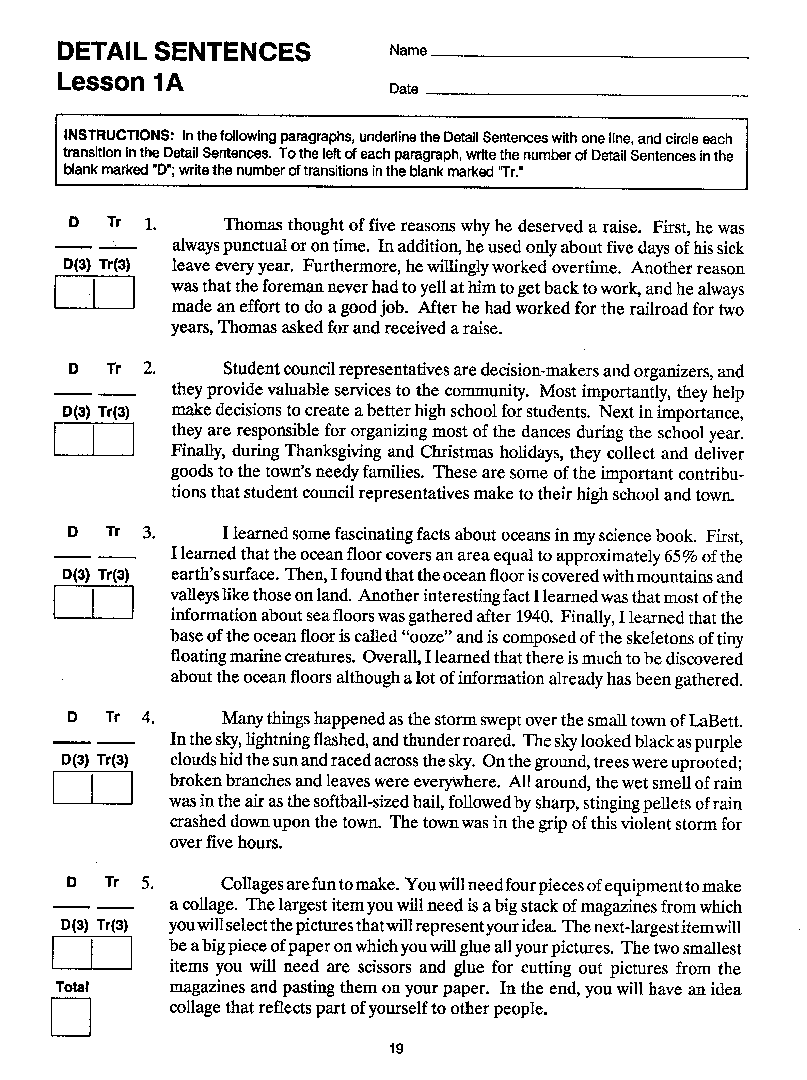
Detail Sentences
Lesson 1A
SL p.19

Slide 74
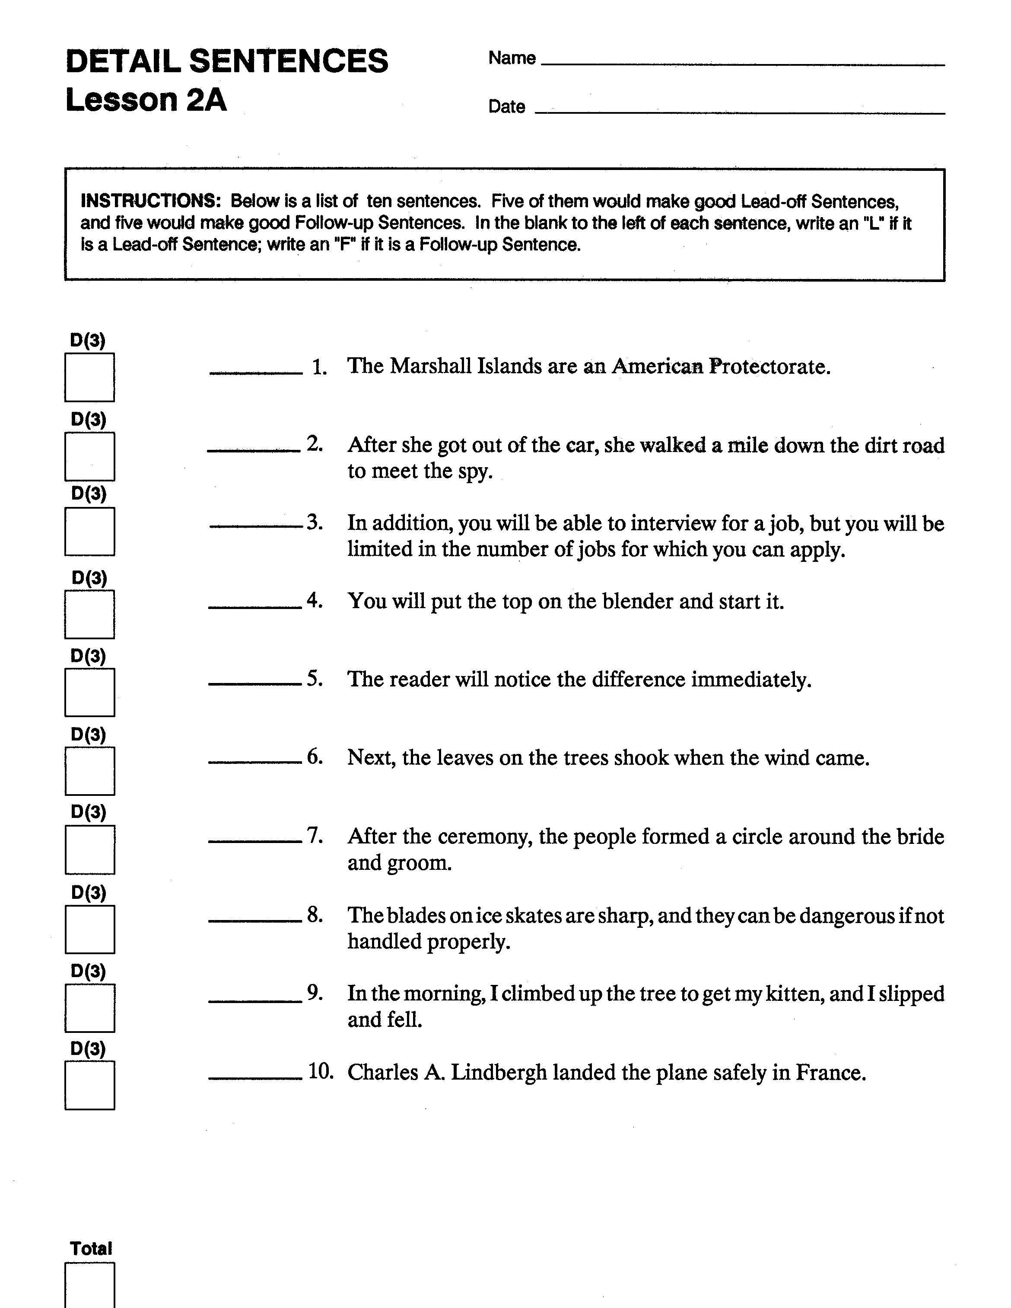
Detail Sentences
Lesson 2A
SL p.23

Slide 75
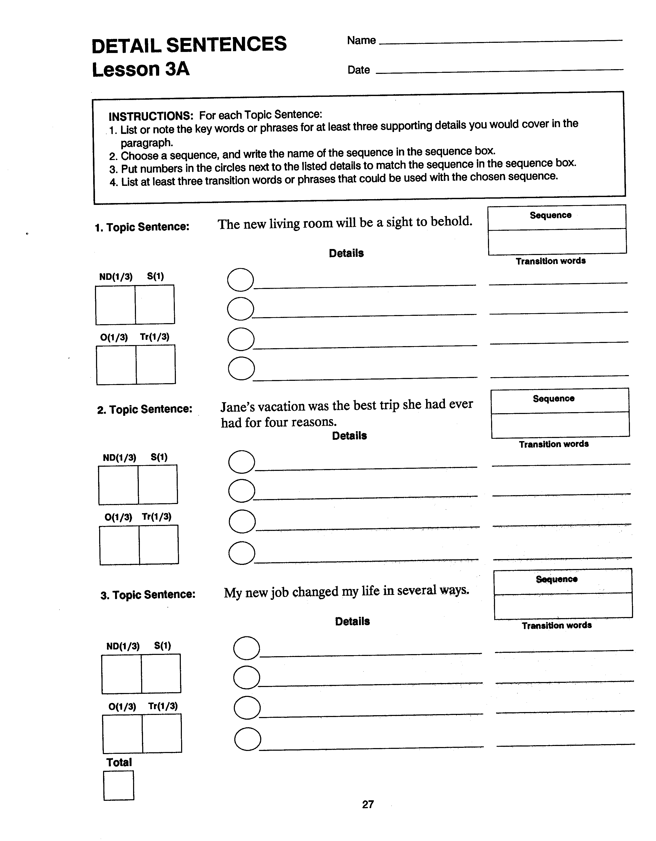
Detail Sentences
Lesson 3A
SL p.27

Slide 76
space
sofa
2
across
3
rug
under
1
fireplace
on the North wall
4
hutch
on the back wall

Slide 77
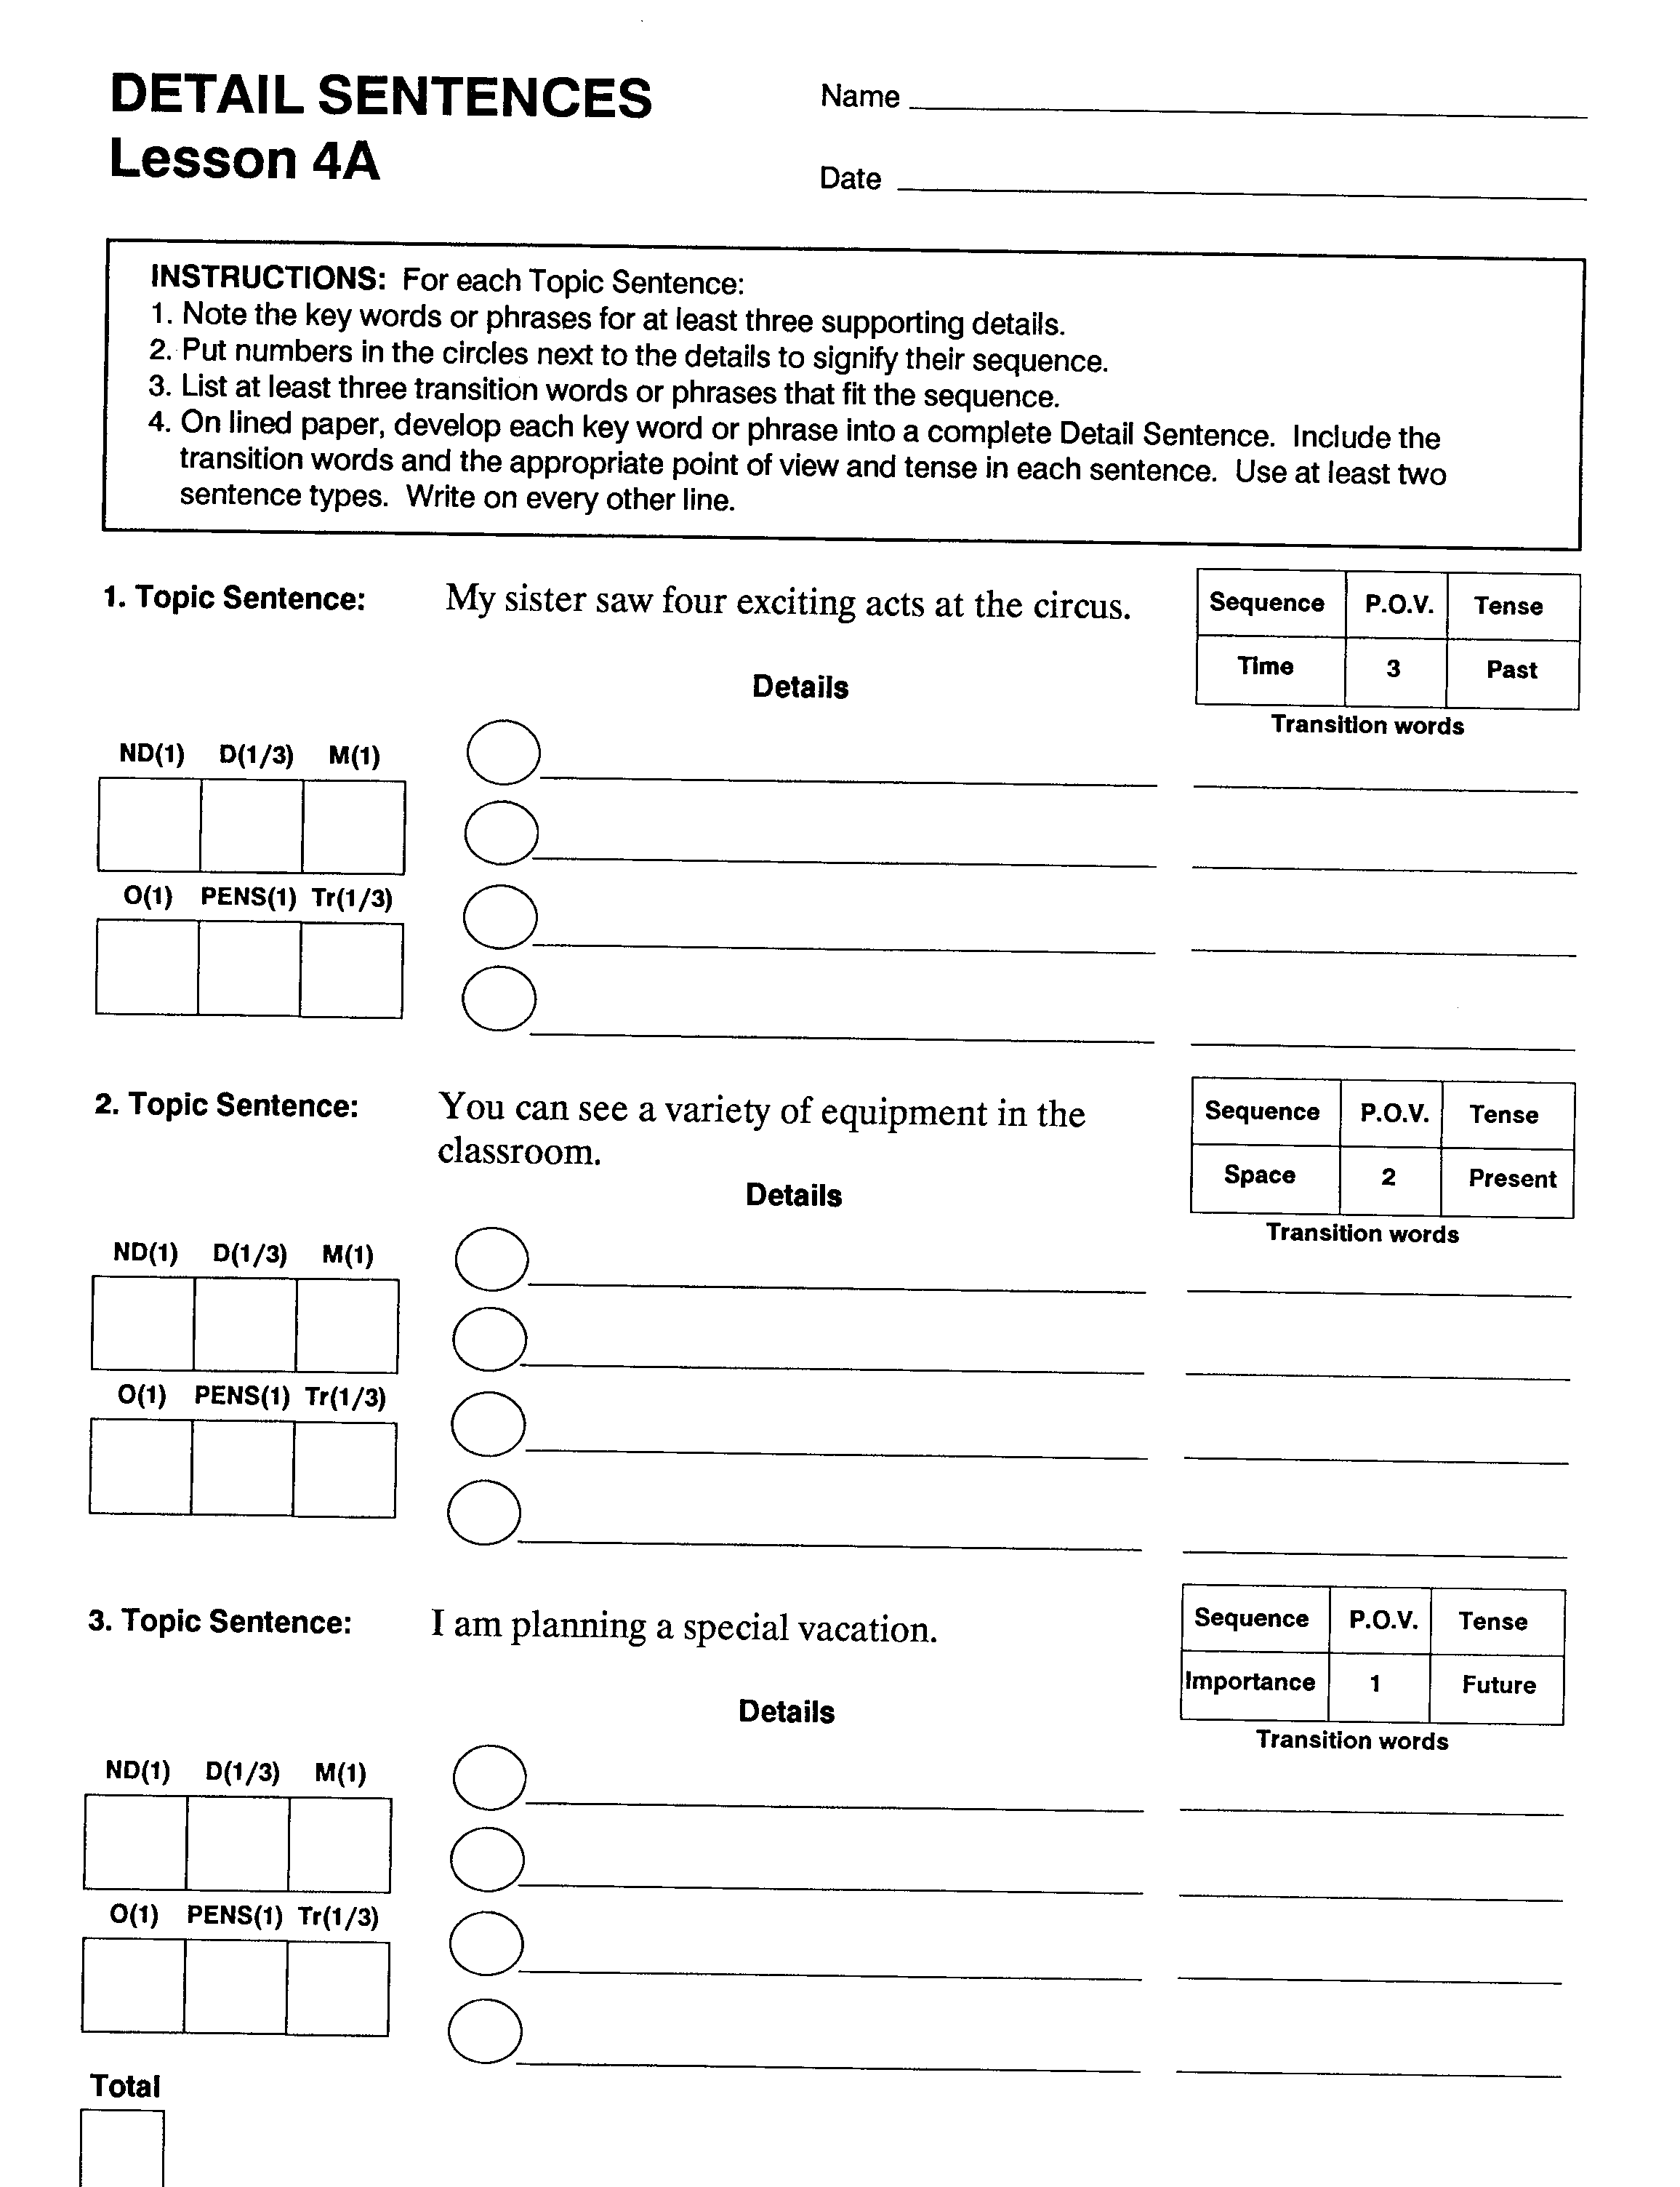
Detail Sentences
Lesson 4A
SL p.31

Slide 78
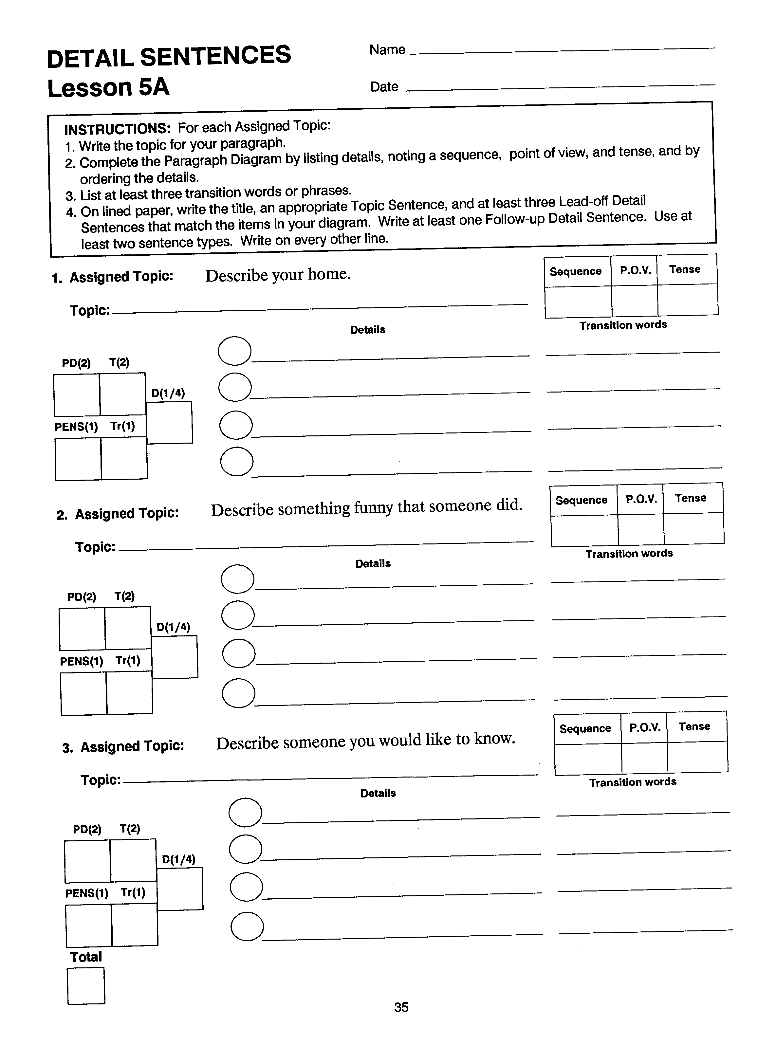
Detail Sentences
Lesson 5A
SL p.35

Slide 79
Clincher Sentence
Is the last sentence in the paragraph
Closes the paragraph
Names the main idea of the paragraph
Sometimes summarizes or names the details of the paragraph
Is different from the Topic Sentence
Cue Card #43

Slide 80
Concluding Transitions
Words that tell the reader
that the paragraph is finished.
Cue Card #46

Slide 81
Types of Clincher Sentences
General Clincher Sentence
Clueing Clincher Sentence
Specific Clincher Sentence
Cue Card #47

Slide 82
General Clincher Sentence
Summarizes the main idea
of the paragraph.
Makes the reader think more
about the topic
Cue Card #48

Slide 83
Example General Clincher Sentences
In summary, these car models are my favorites.
To summarize, these are my favorite car models; what are yours?
In conclusion, when life gives you lemons, make lemonade.
Thus, if a person has approval from others, he may be less happy than if he has his own approval.
To conclude, this woman had many qualities that people should imitate daily.
Cue Card #49

Slide 84
Clueing Clincher Sentence
Names the main idea
Ties the details together with a clue word
Cue Card #51

Slide 85
Example Clueing Clincher Sentences
In sum, these four events served as the spark that ignited the war.
To conclude, life can deal you many cards; it’s how you play them that counts.
In other words, several issues need to be considered before a person accepts a job offer.
In conclusion, plenty of serious reasons exist for staying away from drugs; ignoring them can endanger one’s health and life.
Cue Card #53

Slide 86
Specific Clincher Sentence
Names the main idea
Names the specific details that were covered in the paragraph
Names the details in the order in which they were discussed
Cue Card #54

Slide 87
Example Specific Clincher Sentences
As you can see, making a snowman involves rolling the parts of his body, stacking the parts, and creating his face and clothes.
In effect, the people followed a clear course: they wrote a petition, held rallies, demanded a vote, and caused the law to be changed.
In summary, the environment is in danger because of our vehicles, our mountains of waste, and our lack of attention to nature’s need to replenish itself.
Cue Card #56

Slide 88
Steps for Writing a Clincher Sentence
Pick a sentence type.
Explore words to fit the sentence type.
Note the words.
Search and check.
Cue Card #57

Slide 89
How do we teach students to write Clincher Sentences?

Slide 90
Teaching Clincher Sentences
PWS Student Lesson: pages_____________.
The worksheets are _________.
There are ____ worksheets for each type of worksheet. They are labeled
___________. Mastery is ____%. Once students master a worksheet, do
______ have the students continue at that level. It is ______________.
PWS Instructor’s Manual: Pages___________ Cue Cards______________
Stage Purpose Teacher’s Behavior Student Behavior
Describe
Model
Verbal Rehearsal
Controlled Practice

Slide 92
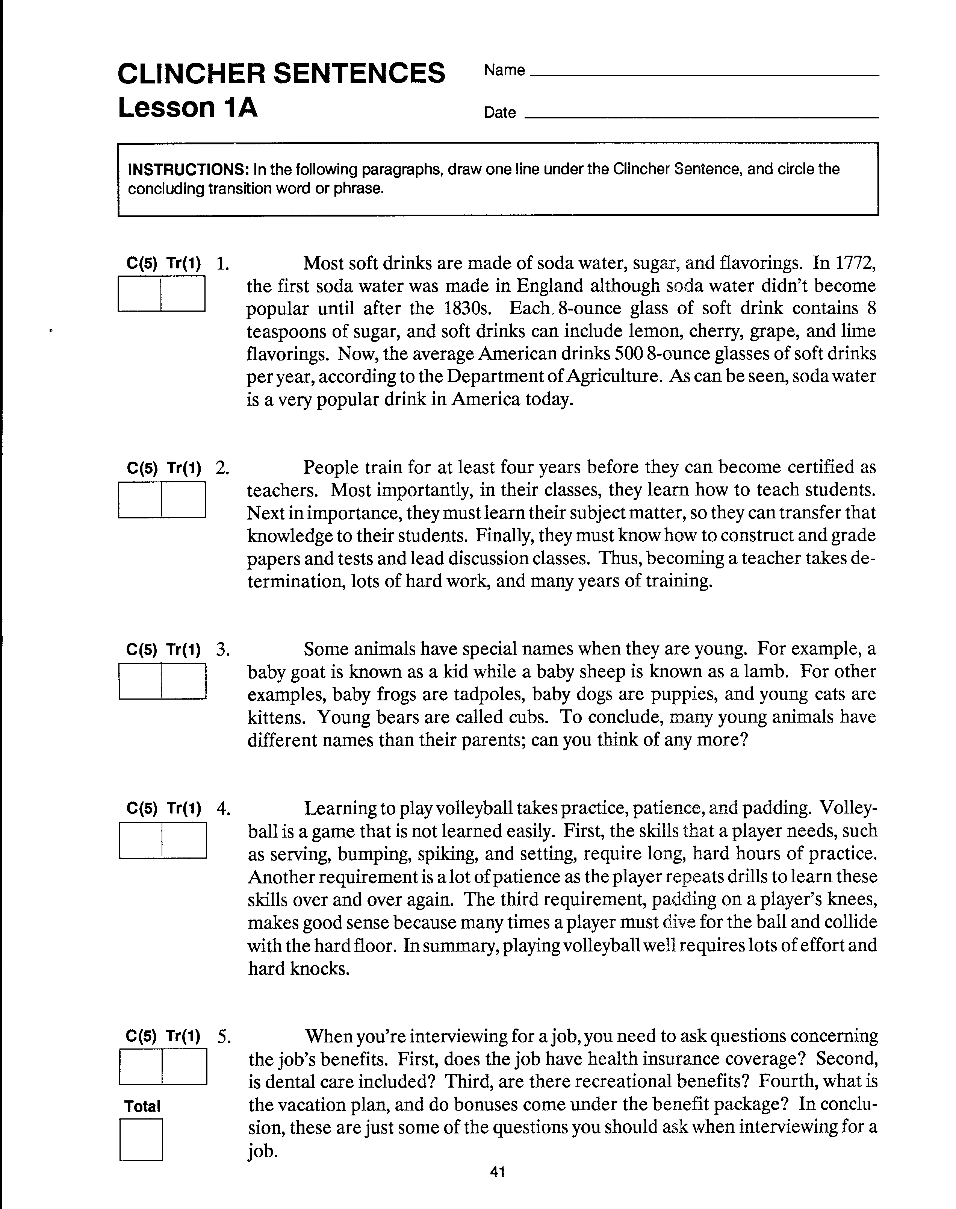
Clincher Sentences Lesson 1A
SL p.41

Slide 93
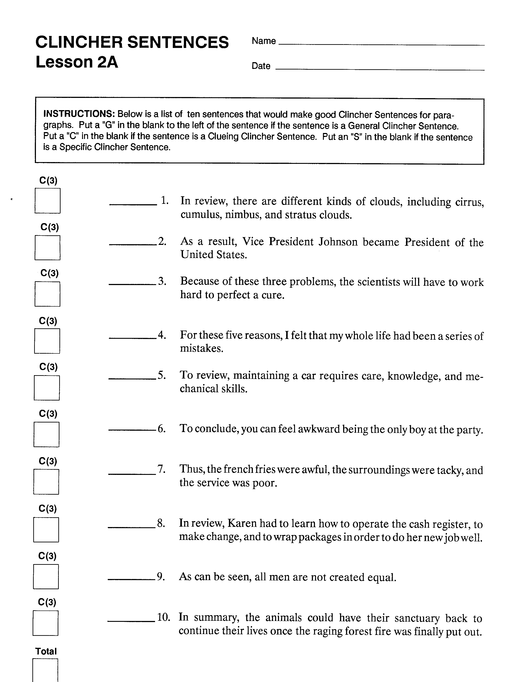
Clincher Sentences Lesson 2A
SL p.45

Slide 94
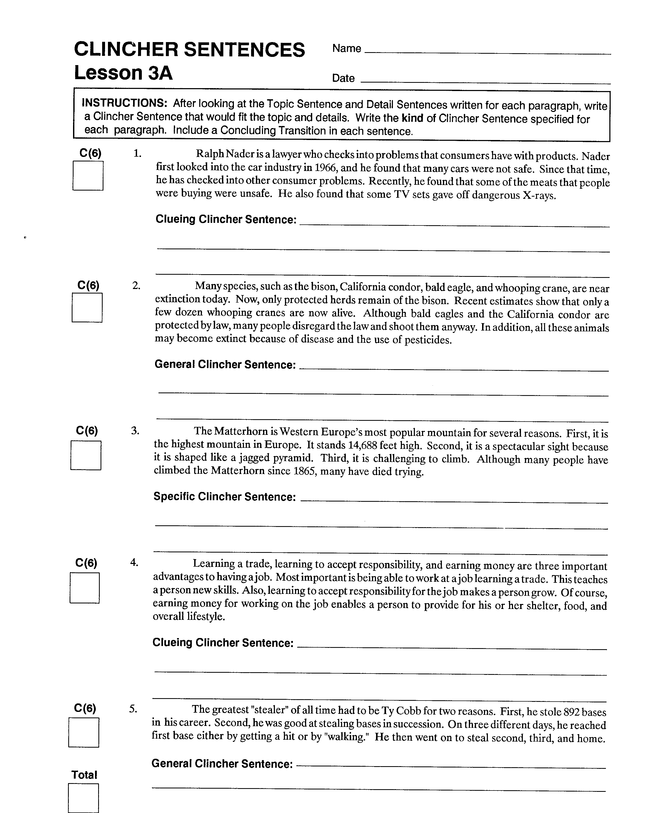
Clincher Sentences Lesson 3A
SL p.49

Slide 95
Clincher Sentences
Model Paragraph 3
How the dinosaurs died out is one of the greatest mysteries of all time. Some scientists think that a giant meteor from outer space hit the earth about 65 million years ago. Its impact could have caused many changes on the earth that might have killed the dinosaurs. For example, the meteor’s impact might have raised tons of dirt and dust into the atmosphere so that sunlight could not reach the earth, or it might have started the eruptions of many volcanoes or created tidal waves. Other scientists theorize that when flowering plants appeared in the world, the plant-eating dinosaurs could not digest these plants and died. In turn, the meat-eating dinosaurs also starved because there were no plant-eating dinosaurs left to eat. Still other scientists propose that a strange disease wiped out the dinosaurs. Finally, other scientists think that the climate of the world became too cold for the dinosaurs’ survival.

Slide 96
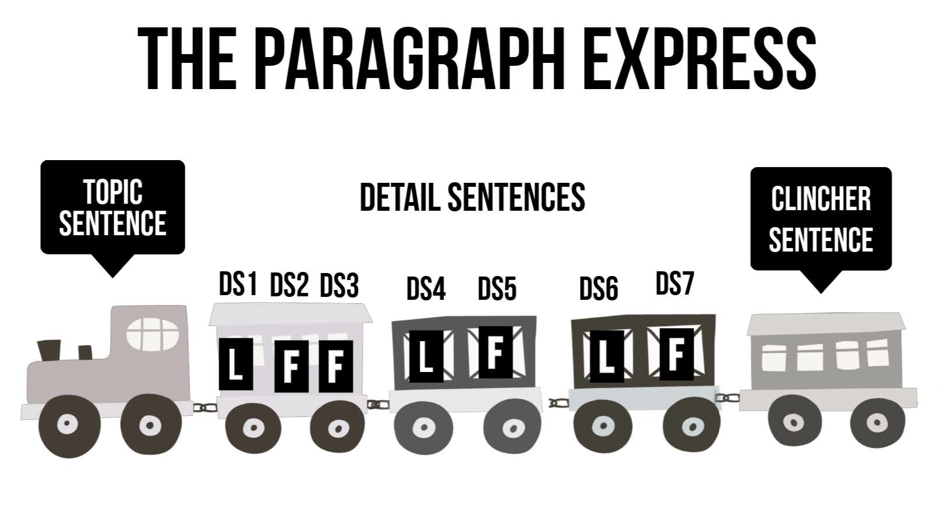
The Paragraph Express

Slide 97
Putting it all together…

Slide 98
Example Paragraph
Nonviolent protest has been a major force in the world. In the late 1940s and early 1950s, Mahatma Ghandi and his followers used nonviolent protest to gain independence for India from Britain. For the first time in decades, Indians had their own country. In the 1960s, Martin Luther King and his followers used nonviolent protest to gain rights for Blacks in America. Through nonviolent protest, they obtained rights that had been denied to them since the slaves had been freed, such as the right to sit anywhere on a bus, eat in any restaurant, and vote in elections. Thus, nonviolent protest has been successfully used by oppressed people to gain independence from other nations; it has also been used to gain personal rights and freedoms.

Slide 99
In the example paragraph…
1. Is the Topic Sentence a General, Specific, or Clueing Topic Sentence?
2. What are the two Lead-off Detail Sentences?
3. What are the two transitions that begin those two Detail Sentences?
4. Is the Clincher Sentence a General, Clueing, or Specific Topic Sentence?
5. What is the concluding transition?
6. What is the tense?
7. What is the point of view?

Slide 100
Steps for Writing a Paragraph
Set up a diagram.
Create the title
Reveal the topic.
Iron out the details.
Bind it together with a clincher.
Edit your work.

Slide 101
A Finished Paragraph Diagram

Slide 102
Steps for Writing a Paragraph
Set up a diagram.
Create the title
Reveal the topic using PENS.
Iron out the details using PENS.
Bind it together with a clincher using PENS.
Edit your work.

Slide 103
Paragraph Checklist
Name: ________________________
Do I have. . .
_____ a title?
_____ a Topic Sentence that fits the details?
_____ at least 6 Detail Sentences?
_____ a Clincher Sentence that is different from the Topic
Sentence?
Have I used. . .
_____ a variety of sentence types (Simple, Compound,
Complex, Compound-Complex)?
_____ the same point of view throughout?
_____ the same tense throughout?
_____ the correct paragraph format?
_____ at least three transitions and a Concluding Transition?

Slide 104
The Paragraph Writing Strategy

Slide 105
Whole Paragraph
SCRIBE is now introduced.
PWS Instructor’s Manual: Pages___________ Cue Cards____________
Stage Purpose Teacher’s Behavior Student’s Behavior
Describe
Model
Verbal Rehearsal
Advanced Practice

Slide 106
Types of Paragraphs
Sequential Paragraph
Step-by-Step Paragraph
Narrative Paragraph
Descriptive Paragraph
Expository Paragraph
Facts Paragraph
Reasons Paragraph
Examples Paragraph
Compare and Contrast Paragraph
Compare Paragraph
Contrast Paragraph
Compare and Contrast Paragraph

Slide 107
Book Walk

Slide 108
The Paragraph Writing Strategy Instructor’s Manual
Registration of Training
Table of contents
Introduction
Instructional Sequence
Evaluation Guidelines
Instructional Material

Slide 109
Stages of Acquisition and Generalization
1 – Pretest and Make Commitments p.18-62
2 – Describe the strategy
3 – Model
4 – Verbal Practice
5 – Controlled Practice and Feedback
6 – Advanced Practice and Feedback p. 157-217
7 – Posttest and Make Commitments p. 218
8 – Generalization p.223
.

Slide 110
Organization of each chapter
What your goal is
What you need
How to prepare
How much time to allow
What to do
What to require for mastery
Where to go from here
How to trouble-shoot

Slide 111
Paragraph Topic List
My Favorite Sport
The Problems of Old Age
The Life of a Teenager
The Perfect Job
The “MUSTS” for a Healthy Body
The Best Season of the Year

Slide 112
Scoring Guidelines

Slide 113
Paragraph Topic List
My Favorite Sport
The Problems of Old Age
The Life of a Teenager
The Perfect Job
The “MUSTS” for a Healthy Body
The Best Season of the Year

Slide 114
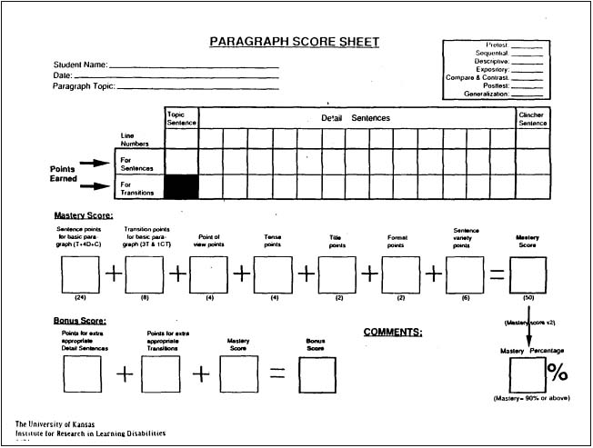
Paragraph Score Sheet

Slide 116
How can we use the Paragraph Writing Strategy to write an essay?

Slide 117
Example #1: Social Studies Document Based Question

Slide 118
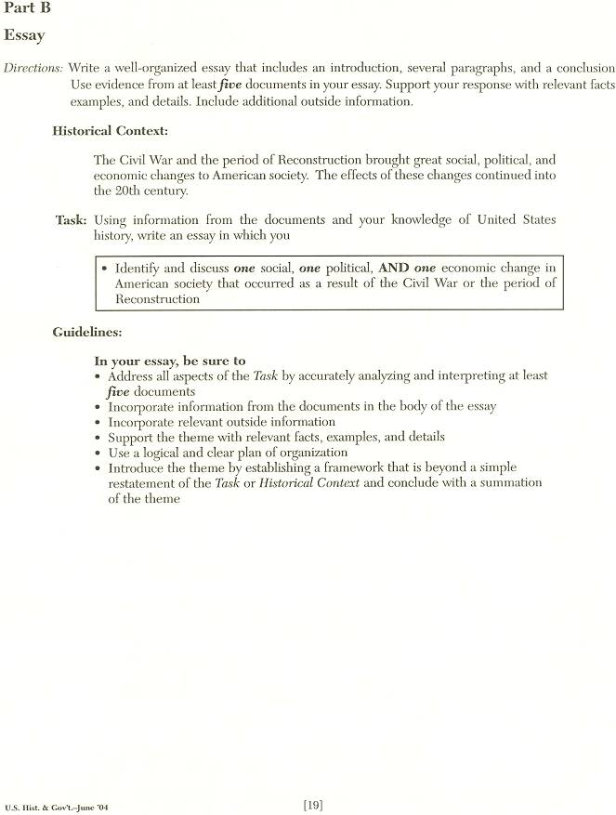

Slide 119
General Topic Sentence
An important change that occurred as a result of the Civil War and Reconstruction was that the South experienced a huge growth of industry. According to Document #5, the iron, mining, timber, coal, and fertilizer industries all developed by leaps and bounds after the war. This was a huge contrast with the economy of the United States before the war. At that time, the North was known for its industry and the South for its agriculture. In fact, it was that lack of manufacturing in the South that gave them a disadvantage in fighting the war. According to Document #4, however, many African-Americans did not participate in the new economic opportunities offered by the growing industries because they often became tenant farmers and lived on the same land they had lived on when they were slaves. Many others worked as sharecroppers renting a plot of land and giving the landowner a share of the crops. Usually, after paying the landlord, there was little or nothing left for the tenant farmer to keep. These tenant workers and sharecroppers were little better off than slaves.
1st Lead-off with transition
Follow-ups containing background knowledge
2ndLead-off with transition
Follow-ups containing background knowledge

Slide 120
General Topic Sentence
An important change that occurred as a result of the Civil War and Reconstruction was that the South experienced a huge growth of industry. For example, the iron, mining, timber, coal, and fertilizer industries all developed by leaps and bounds after the war. This was a huge contrast with the economy of the United States before the war. At that time, the North was known for its industry and the South for its agriculture. In fact, it was that lack of manufacturing in the South that gave them a disadvantage in fighting the war. In contrast, many African-Americans did not participate in the new economic opportunities offered by the growing industries because they often became tenant farmers and lived on the same land they had lived on when they were slaves. Many others worked as sharecroppers renting a plot of land and giving the landowner a share of the crops. Usually, after paying the landlord, there was little or nothing left for the tenant farmer to keep. These tenant workers and sharecroppers were little better off than slaves.
1st Lead-off with transition
Follow-ups containing background knowledge
2ndLead-off with transition
Follow-ups containing background knowledge

Slide 126
Example #3: Essay for English Grade 11 NYS Assessment (See Handout)

Slide 130
