Slide 1
The Paragraph Writing Strategy
By Jean B. Schumaker and Karen Lyerla
Teaching powerpoint developed by FL SPDG SIM Project to support teachers in implementing The Paragraph Writing Strategy
Notes:
***Please note, this presentation is intentionally very plain, so that teachers can add their own design to the slides.

Slide 2
Pretest
Purpose – to figure out how you are currently organizing and writing paragraphs.
Notes:
Pg. 14 Instructor Manual

Slide 3
Pretest Directions
Choose one of the topics from the list on the next slide
Make notes about it on one of the sheets of paper
On the second sheet of paper write your name and the date at the top.
Then write your paragraph on the lines below.
You must write at least 6 sentences for your paragraph.
Use different types of sentences if you can.
Notes:
Pg. 14 Instructor Manual

Slide 4
Pretest Topic List
My Favorite Sport
The Problems of Old Age
The Life of a Teenager
The Perfect Job
The “Musts” for a Healthy Body
The Best Season of the Year
Notes:
Pg. 264 Instructor Manual

Slide 5
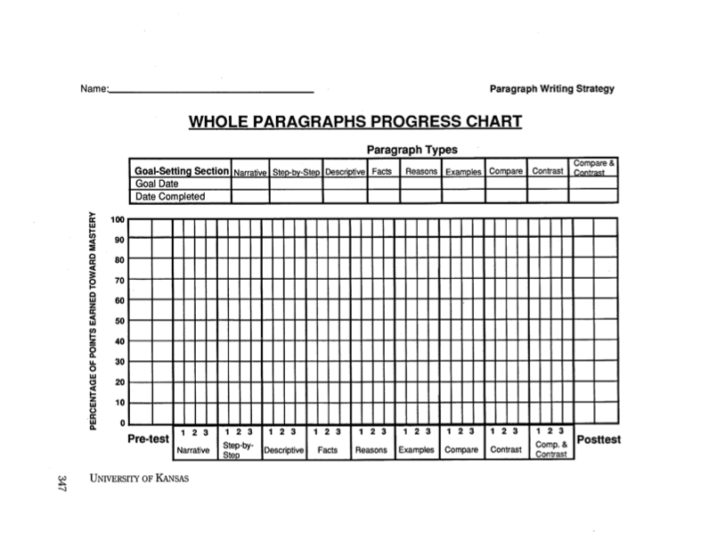
Notes:
Chart Pretest score

Slide 6
The Success Formula
The Paragraph Writing Strategy
+
Effort
=
SUCCESS
Notes:
Pg. 15 Instructor Manual

Slide 7
Notes:
Set long term goal and make commitments – pg. 16 Instructor Manual

Slide 8
Lesson 1 Essential Questions
What are the benefits of learning the Paragraph Writing Strategy?
Where might we use the Paragraph Writing Strategy?
What kind of results can we expect from using the strategy?
What is a Topic Sentence?
What are the different types of Topic Sentences?
What are the steps for writing Topic Sentences?
Notes:
Pg. 18 Instructor Manual – student objectives have been translated into questions.

Slide 9
Discussion Questions
What is writing, and why do we do it?
When is writing necessary?
If you could clearly communicate all of your ideas and knowledge in writing, how would you feel?
Being able to write well empowers you. It gives you control in a major realm of life…communication.
Writing is an empowerment tool.
Notes:
Instructor manual pg. 19

Slide 10
Discussion Questions
What does being a ”master writer” mean to you?
Listen to this quote, what does a master know?
Notes:
Instructor manual pg. 20

Slide 11
”To master anything, you must know the rules, how they function, how to use them, and what you want them to do for you. Master skiers do not make up their own rules; they discover what works in skiing. They become one with their skis, the mountain, and the snow. A true master skier loses herself in the skiing as a master dances loses himself in the dance. The effort disappears, and what is left is the experience of effortlessness…..A master through his/her dedication loses separate identity and becomes the experience of cosmic energy in motion. It takes effort to become effortless.”
-Terry Cole Whitaker
Notes:
Instructor manual dedication page

Slide 12
The Paragraph Writing Strategy, if used appropriately can help you become personally powerful in a major way that you interact with others: through your writing, it can enable you to become a master writer.
Notes:
Instructor manual pg. 21

Slide 13
Brainstorm
Situations where it’s necessary to write several sentences that are related on one topic.
Notes:
Instructor manual pg. 21

Slide 14
Discussion Questions
What will be the benefits of using the Paragraph Writing Strategy in school?
What will be the benefits of using the Paragraph Writing Strategy in employment situations?

Slide 15
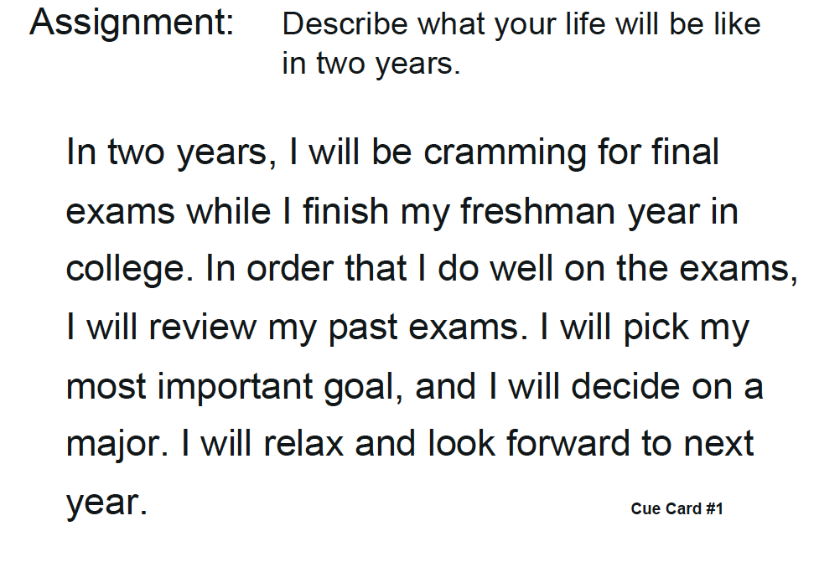
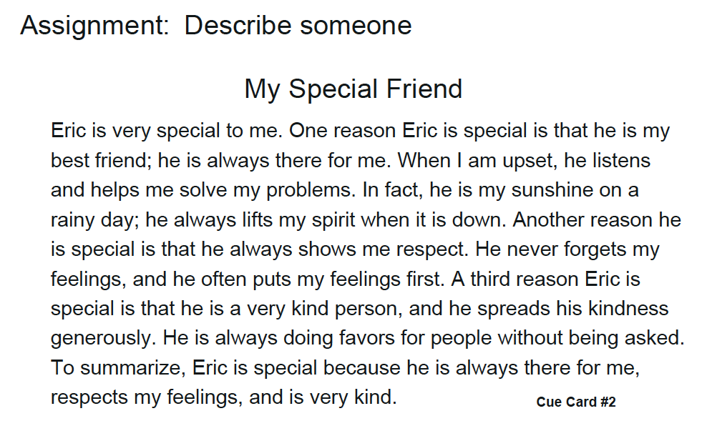
Results you can expect
Pretest Sample
Practice Sample
Notes:
Instructor manual, pg. 22

Slide 16
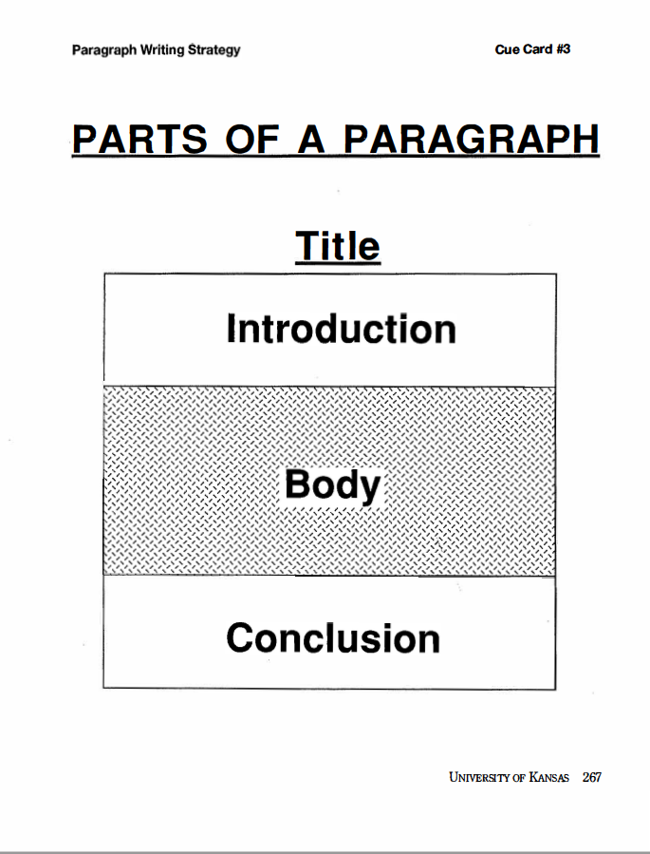
Notes:
Instructor Manual pg. 24

Slide 17
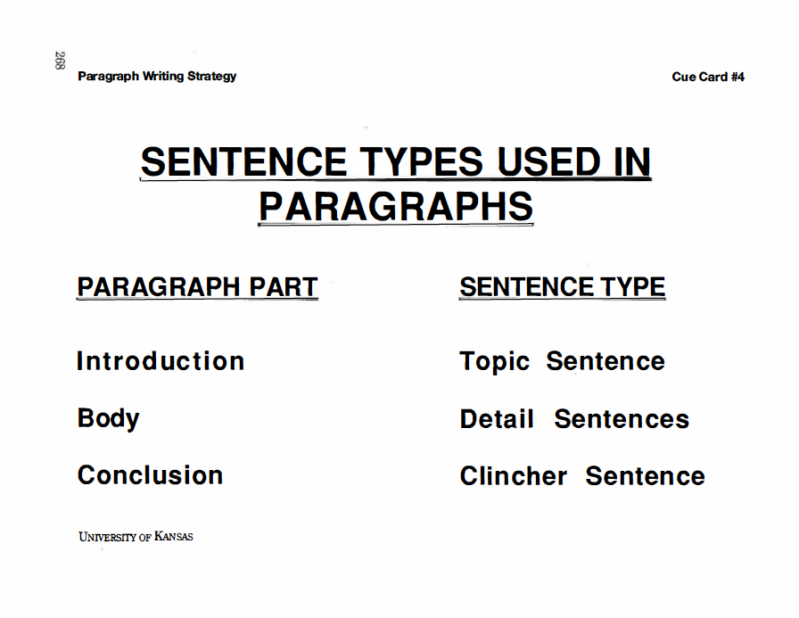
Notes:
Instructor Manual pg. 24

Slide 18
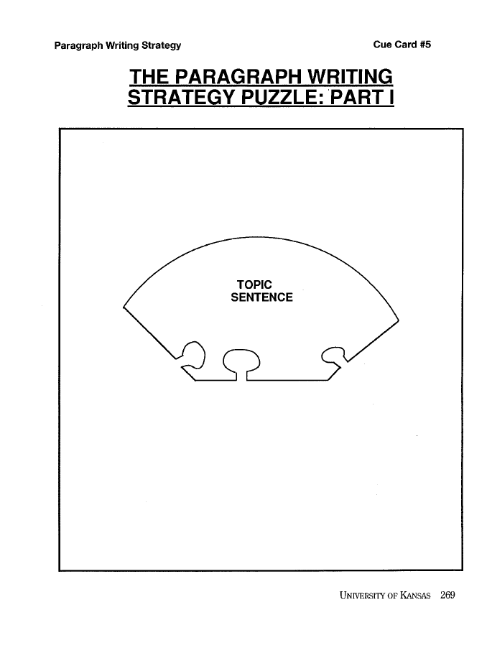
Notes:
Instructor Manual pg. 25

Slide 19
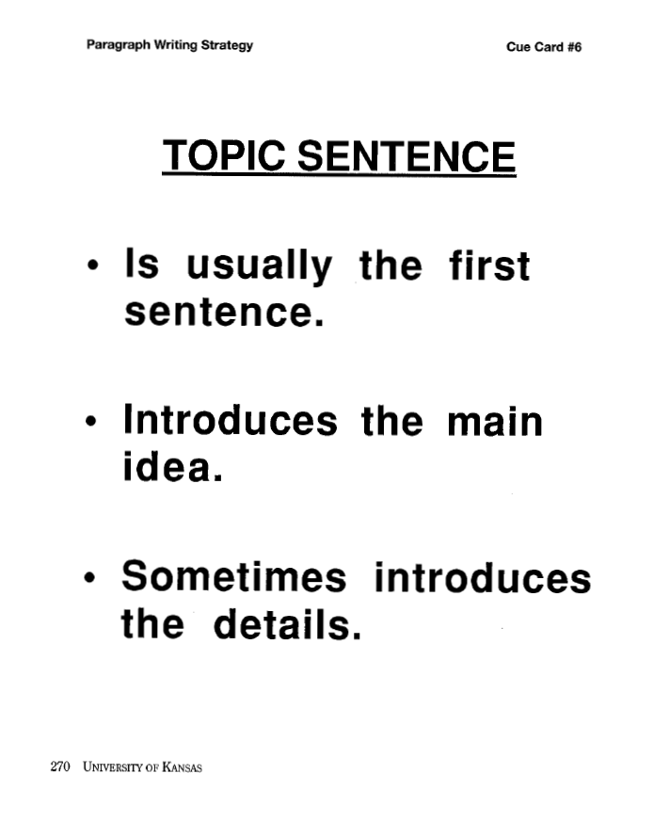
Notes:
Instructor Manual pg. 25

Slide 20
Main ideas and details are like…
Main Idea
Details
Car
Things about a car that would make it different (describe the car)
Notes:
Instructor manual pg. 26

Slide 21
A topic sentence is like…
A coming attraction
A topic sentence
Notes:
Instructor manual pg. 26

Slide 22
Review
Where does the Topic Sentence appear in the paragraph?
What does a Topic Sentence introduce?
What should a reader want to do after reading the Topic Sentence?

Slide 23
Exit Ticket
What was the main idea of today’s lesson?
What did you learn today?
What confused you about the lesson?
What do you still need to know?
How will this lesson help you in your future life?
Notes:
Instructor manual pg. 27

Slide 24
Review of Previous Content
What are the parts of a paragraph?
What is the definition of a Topic Sentence?
What is the job of a Topic Sentence?
What are the benefits of knowing a strategy for writing paragraphs?
Notes:
Instructor Manual pg. 28

Slide 25
Lesson 2 Essential Questions
What are the three types of Topic Sentences?
What is a strategy for writing Topic Sentences?
What are my goals related to how fast I will learn to write Topic Sentences?

Slide 26
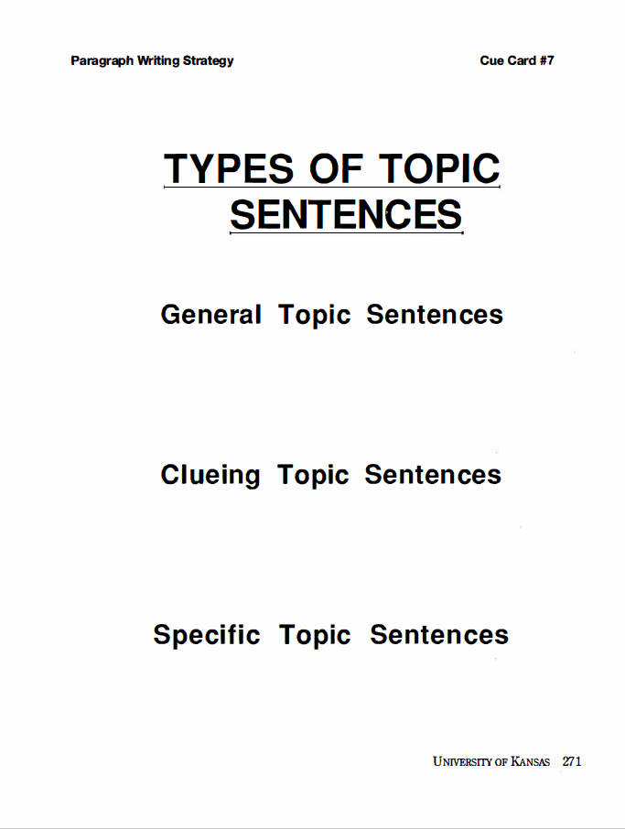
Notes:
Pg. 28

Slide 27
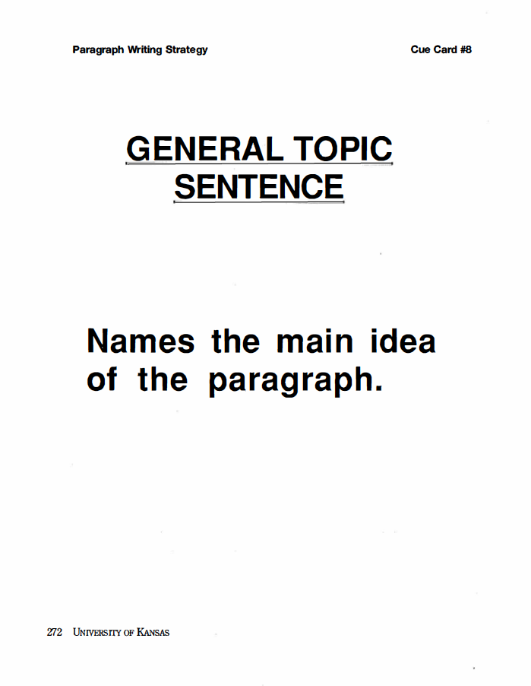
Notes:
Pg. 28

Slide 28
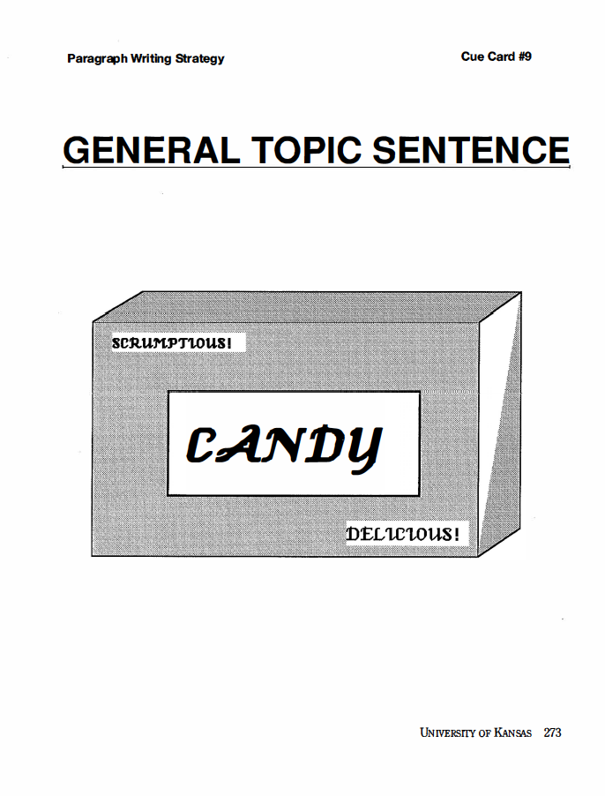
Notes:
Pg. 29

Slide 29
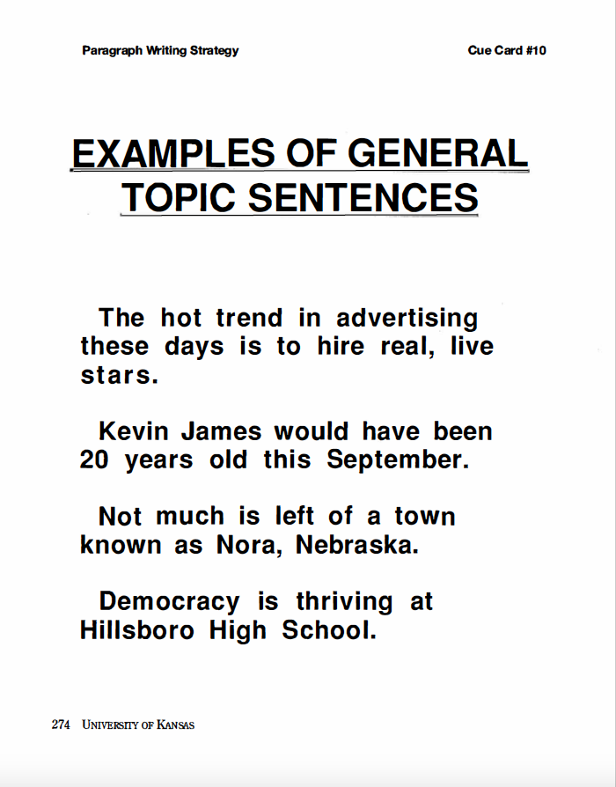

Slide 30
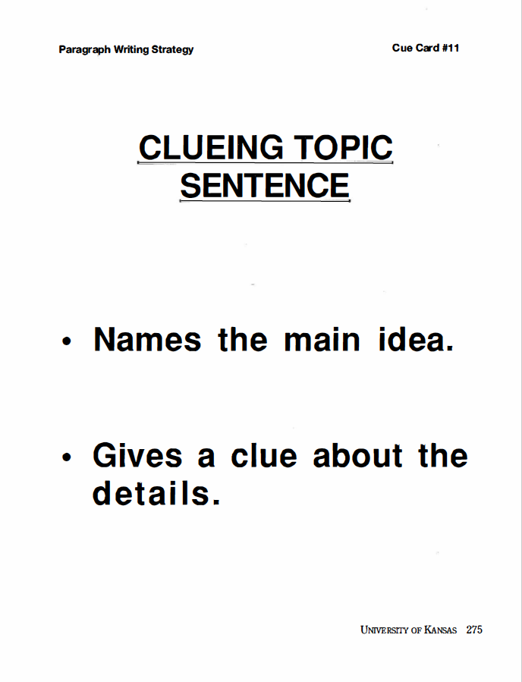
Notes:
Pg.29

Slide 31
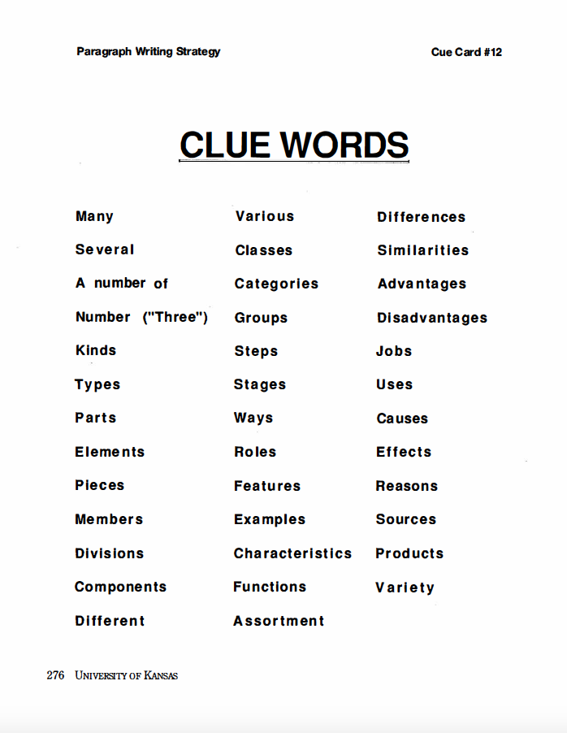
Notes:
Pg. 30

Slide 32
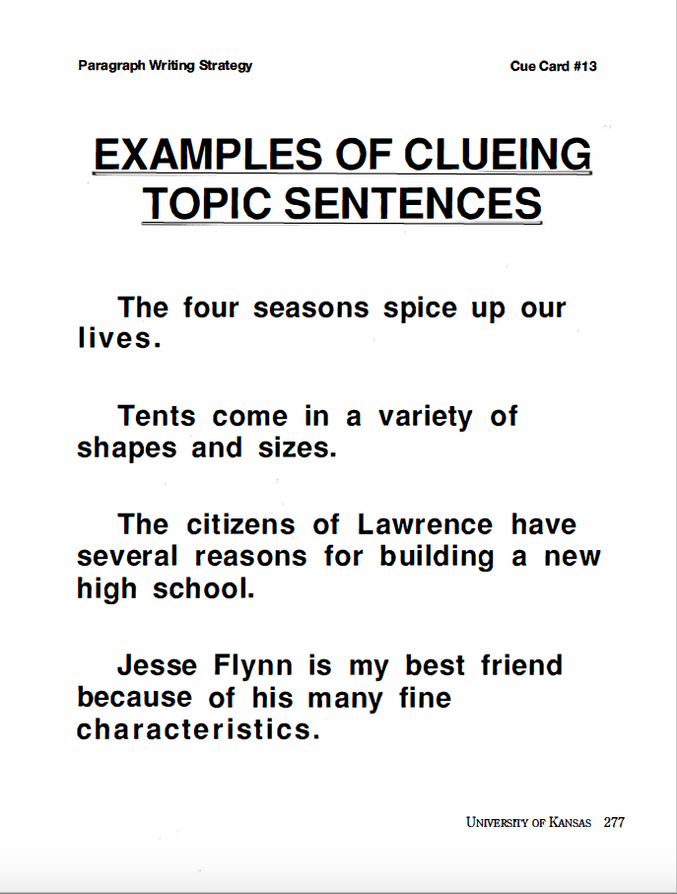
Notes:
Pg 30

Slide 33
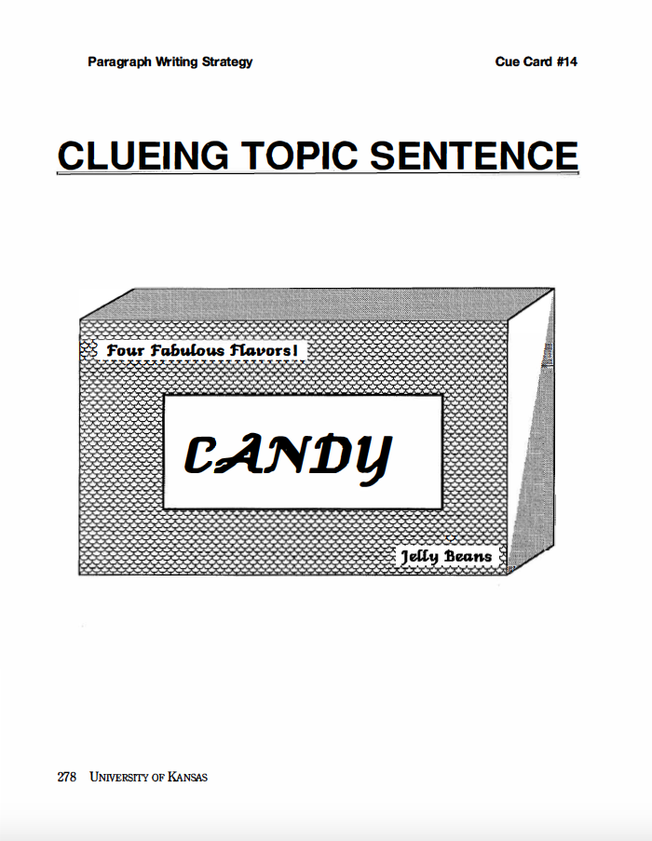
Notes:
Pg. 30

Slide 34
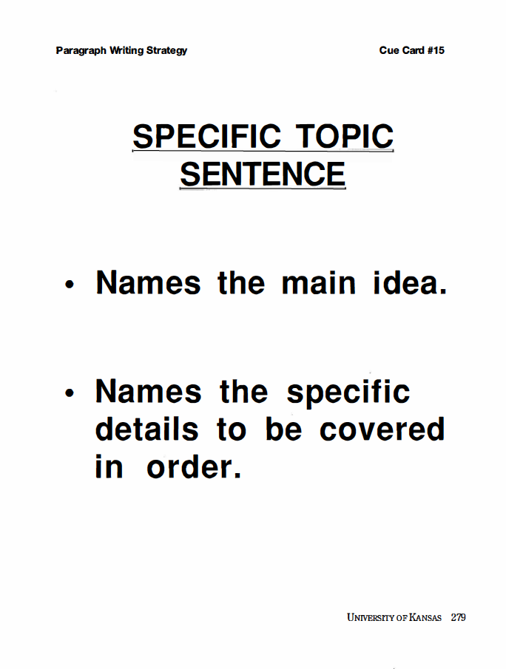
Notes:
Pg. 31

Slide 35
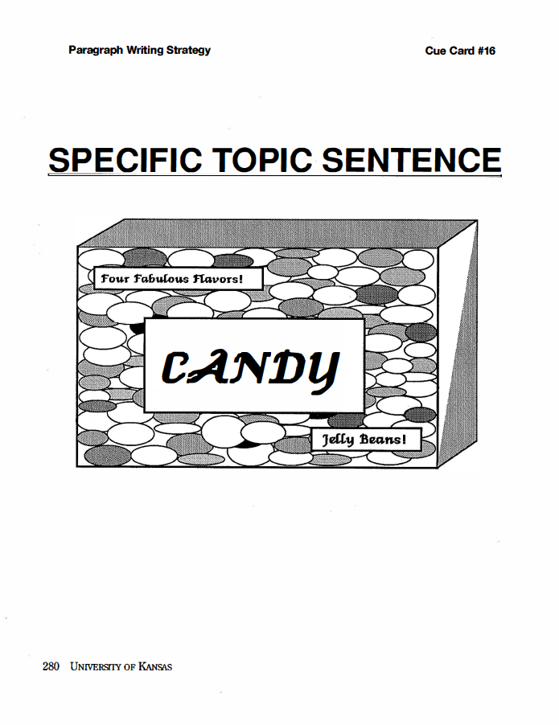
Notes:
Pg. 31

Slide 36
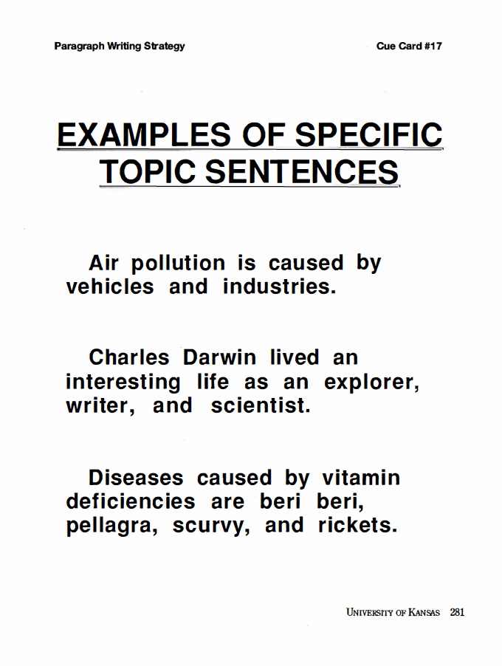
Notes:
Pg. 32

Slide 37
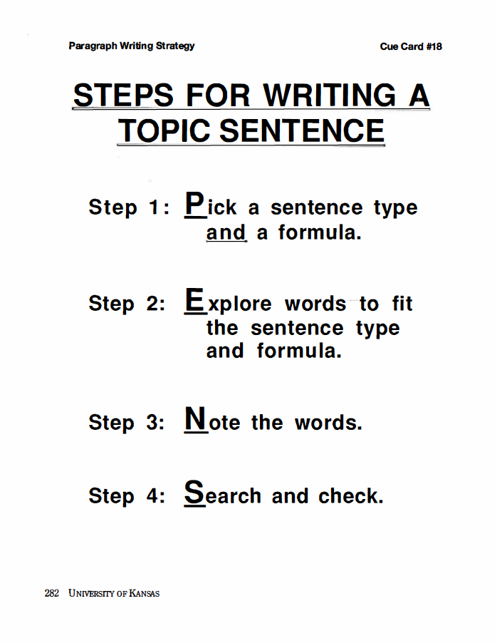
Notes:
Pg. 32

Slide 38
Review
What is the job a Topic Sentence must do?
In what type of Topic Sentence is only the main idea of the paragraph introduced and nothing else?
In what type of Topic Sentence are the main points or details named?
What type of Topic Sentences gives a hint about the details to be covered?
What is the mnemonic we will use to remember the four steps for writing Topic Sentences?
What are the new PENS steps?

Slide 39
Notes:
Pg. 35

Slide 40
Exit Ticket
What was the main idea of today’s lesson?
What did you learn today?
What confused you about the lesson?
What do you still need to know?
How will this lesson help you in your future life?
Notes:
Instructor manual pg. 35

Slide 41
Topic Sentences
Stage 3: Model
Notes:
Instructor Manual pg. 37

Slide 42
Review of previous information
What are the parts of a paragraph?
What is the definition of a Topic Sentence?
What are the three types of Topic Sentences?
What is the job a Topic Sentence must do?
What is the definition for a General Topic Sentence?
What is the definition for a Clueing Topic Sentence?
What is the definition for a Specific Topic Sentence?
What are the new PENS steps?
What are the sentence formulas?
What are the benefits of approaching a paragraph writing task strategically?
Notes:
Pg. 38

Slide 43
Write a paragraph about your favorite sports figure.
Notes:
Pg. 39

Slide 44
Write a paragraph about a movie you have seen recently.
Notes:
Pg. 40

Slide 45
Write a paragraph about why students should graduate from high school.
Notes:
Pg. 40

Slide 46
I purchased a new __________, but it did not work and I have to send it back to the company with a letter explaining what is wrong with it.
Notes:
Pg. 42….Insert something other than a tape recorder…SMART watch, wireless headphones, etc.

Slide 47
Write an article for the school newspaper about a star player on the school’s football team.
Notes:
Pg. 43

Slide 48
Exit Ticket
What did you witness today?
What did you learn today?
What confused you about the lesson?
What do you still need to know?
How will this lesson help you in your future life?
Notes:
Instructor manual pg. 44

Slide 49
Notes:
Pg. 45

Slide 50
Topic Sentences
Stage 4: Verbal Practice

Slide 51
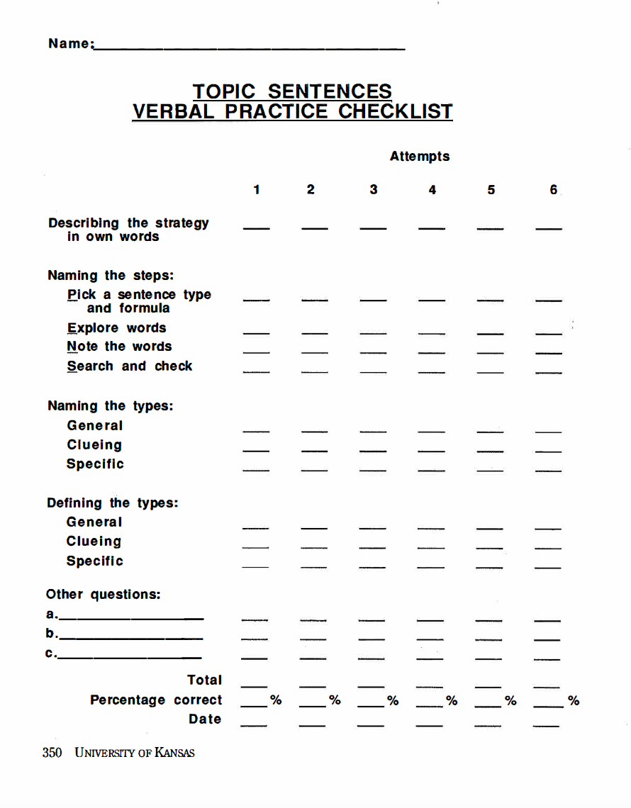

Slide 52
Notes:
Pg. 52

Slide 53
Topic Sentences
Stage 5:
Controlled Practice

Slide 54
Review of previous information
What is the purpose for writing
What are the parts of a paragraph?
What is the definition of a Topic Sentence?
What are the three types of Topic Sentences?
What is the job a Topic Sentence must do?
What is the definition for a General Topic Sentence?
What is the definition for a Clueing Topic Sentence?
What is the definition for a Specific Topic Sentence?
What are the new PENS steps?
What are the sentence formulas?
What are the benefits of approaching a paragraph writing task strategically?
What are the benefits for having three types of Topic Sentences to choose among?
Notes:
Pg. 55

Slide 55
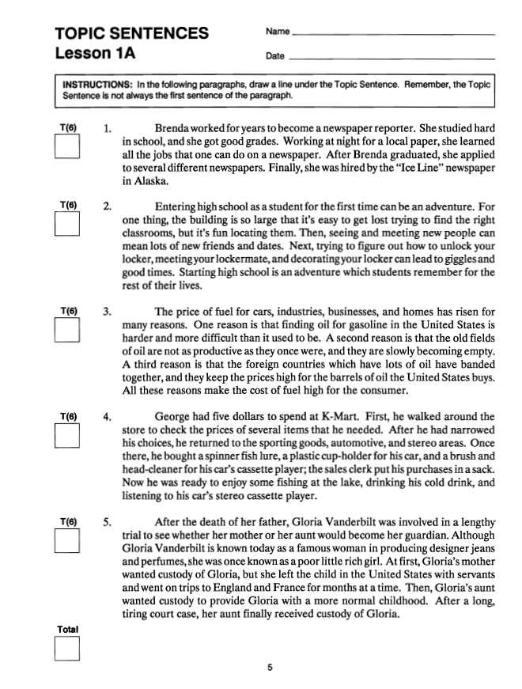
Notes:
Instructor Manual Pg. 56

Slide 56
Notes:
Pg. 60

Slide 57
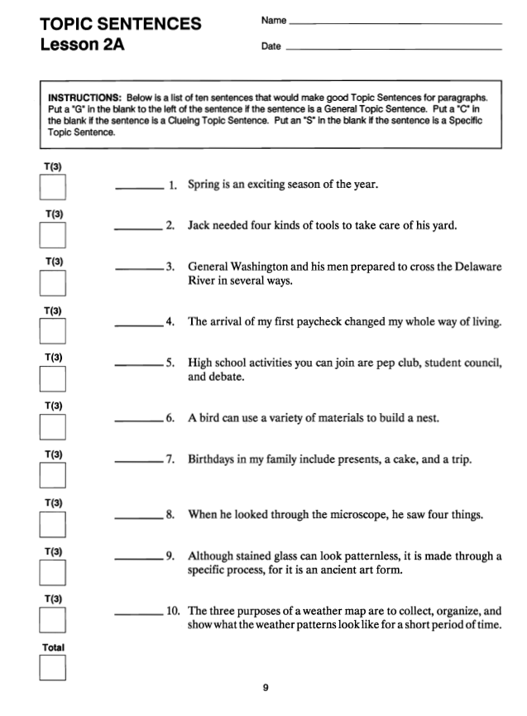

Slide 58
Notes:
Pg. 60

Slide 59
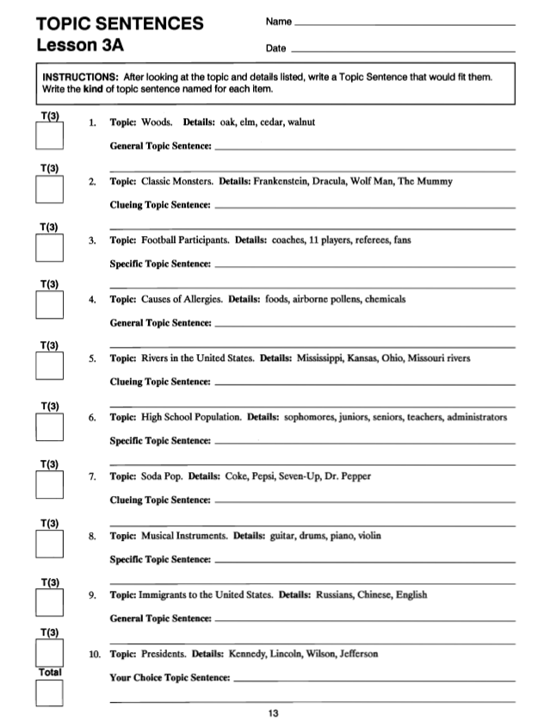

Slide 60
Notes:
Pg. 60

Slide 61
Notes:
Pg. 60

Slide 62
Detail Sentences
Stage 2: Describe
Notes:
Pg. 63

Slide 63
Review of previous information
What is the purpose for writing
What are the parts of a paragraph?
What is the definition of a Topic Sentence?
What are the three types of Topic Sentences?
What is the job a Topic Sentence must do?
What is the definition for a General Topic Sentence?
What is the definition for a Clueing Topic Sentence?
What is the definition for a Specific Topic Sentence?
What are the new PENS steps?
What are the sentence formulas?
What are the benefits of approaching a paragraph writing task strategically?
What are the benefits for having three types of Topic Sentences to choose among?
Notes:
Pg. 64

Slide 64
Lesson 1 – Essential Questions
What are Detail Sentences?
What are the two types of Detail Sentences?
How do you use a Paragraph Diagram to plan paragraphs?
Notes:
Pg. 64

Slide 65
Notes:
Pg. 65

Slide 66
You can study several subjects in school.
Transitions
Notes:
Pg. 65 & 66

Slide 67
Notes:
Pg. 67

Slide 68
Notes:
Pg. 68

Slide 69
Notes:
Pg. 69

Slide 73
Notes:
Pg. 70

Slide 74
Exit Ticket
What was the main idea of today’s lesson?
What did you learn today?
What confused you about the lesson?
What do you still need to know?
How will this lesson help you in your future life?
Notes:
Instructor manual pg. 71

Slide 75
Review of previous information
What is the definition of a Detail Sentence?
What are the two types of Detail Sentences?
What is the definition of a Lead-off Sentence?
What is the definition for a Follow-up Sentence?
Notes:
Pg. 72

Slide 76
Lesson 2 – Essential Questions
What are the five requirements for a good Detail Sentence?
Notes:
Pg. 64

Slide 77
I see many kinds of animals in the park.
Notes:
Pg.72

Slide 78
Notes:
Pg. 73

Slide 79
Notes:
Pg. 76

Slide 80
Notes:
Pg. 79

Slide 81
Class examples:
Notes:
Pg. 79

Slide 82
Class examples:
Notes:
Pg. 80

Slide 83
Class examples:
Notes:
Pg. 81

Slide 84
Notes:
Pg. 81

Slide 85
Notes:
Pg. 82

Slide 86
Notes:
Pg. 83

Slide 87
Notes:
Pg. 84

Slide 88
Class examples:
Notes:
Pg. 84

Slide 89
Exit Ticket
What was the main idea of today’s lesson?
What did you learn today?
What confused you about the lesson?
What do you still need to know?
How will this lesson help you in your future life?
Notes:
Instructor manual pg. 85

Slide 90
Review of previous information
What is the first requirement for a Detail Sentence?
What is the second requirement for a Detail Sentence?
What is the name of one sequence we can use to order the Detail Sentences?
What do we call the words we use to introduce a new detail?
What is the third requirement for a Detail Sentence?
What are some example transition words?
Notes:
Pg. 86

Slide 91
Review of previous information (pt. 2)
What do you have to remember to do when you use many transitions?
What is the Detail Sentence called that contains a transition?
What is the Detail Sentence called that does not contain a transition?
What is the fourth requirement for a Detail Sentence?
About whom are you speaking when you use the first person point of view?
Notes:
Pg. 86

Slide 92
Review of previous information (pt. 3)
About whom are you speaking when you use the second person point of view?
About whom are you speaking when you use the third person point of view?
What is the fifth requirement for a Detail Sentence?
What are the three tenses that you can use?
Notes:
Pg. 86

Slide 93
Lesson 3 – Essential Questions
How do you use a Paragraph Diagram to help plan the details you will discuss in your paragraph, as well as the sequence, transitions, point of view, and tense you will use?
How can you adapt the PENS steps for writing Detail Sentences?
Notes:
Pg. 87

Slide 94
Notes:
Pg. 87

Slide 95
Notes:
Pg. 89

Slide 96
Review
What is the job a Detail Sentence must do?
What is the memory device that you’re going to use to remember the three requirements you will be fulfilling as you write Detail Sentences?
What is the memory device you’ll be using to remember the steps for writing Detail Sentences?

Slide 97
Notes:
Pg. 35

Slide 98
Exit Ticket
What was the main idea of today’s lesson?
What did you learn today?
What confused you about the lesson?
What do you still need to know?
How will this lesson help you in your future life?
Notes:
Instructor manual pg. 85

Slide 99
Detail Sentences
Stage 3: Model
Notes:
Instructor Manual pg. 37

Slide 100
Review of previous information
What are the parts of a paragraph?
What is the definition of a Topic Sentence?
Why should you write a Topic Sentence?
What is the definition of a Detail Sentence?
What are the two types of Detail Sentences?
What are the five requirements for Detail Sentences?
What are the PENS steps for writing Detail Sentences?
Notes:
Pg. 96

Slide 101
Review of previous information Pt. 2
What are the sentence formulas?
How can using a Paragraph Diagram help you?
Why would you want to become a master paragraph writer?
Notes:
Pg. 96

Slide 102
Assignment
Write a paragraph describing this classroom.
Notes:
Pg. 97

Slide 103
Notes:
Pg. 97

Slide 104
Exit Ticket
What did you witness today?
What did you learn today?
What confused you about the lesson?
What do you still need to know?
How will this lesson help you in your future life?
Notes:
Instructor manual pg. 44

Slide 105
Notes:
Pg. 104

Slide 106
Detail Sentences
Stage 4: Verbal Practice

Slide 108
Notes:
Pg. 104

Slide 109
Detail Sentences
Stage 5:
Controlled Practice

Slide 110
Review of previous information
What is the purpose of writing?
What is the definition of a Topic Sentence?
What are the three types of Topic Sentences?
What is the definition for a General Topic Sentence?
What is the definition for a Clueing Topic Sentence?
What is the definition for a Specific Topic Sentence?
What are the new PENS steps?
What are the two types of Detail Sentences?
Notes:
Pg. 113

Slide 111
Review of previous information Pt. 2
What is the definition for a Lead-Off Sentence?
What is the definition for a Follow-up Sentence?
What is the definition for a Transition?
What are the different points of view?
What are the types of tenses?
What are the benefits of writing strategically?
Notes:
Pg. 113

Slide 113
Notes:
Pg. 60

Slide 115
Notes:
Pg. 60

Slide 117
Notes:
Pg. 60

Slide 119
Notes:
Pg. 60

Slide 121
Notes:
Pg. 60

Slide 122
Notes:
Pg. 120

Slide 123
Clincher Sentences
Stage 2: Describe
Notes:
Pg. 124

Slide 124
Review of previous information
Where can the Paragraph Writing Strategy be used?
What are the benefits to knowing how to write strategically?
What is the definition of a Topic Sentence?
What are the three types of Topic Sentences?
What is the definition for a Detail Sentence?
What are the two types of Detail Sentences?
What are the three tenses?
What are the three points of view?
What are the new PENS steps?
Notes:
Pg. 64

Slide 125
Notes:
Instructor Manual pg. 125

Slide 126
Notes:
Instructor Manual pg. 125

Slide 127
Lesson Essential Questions
What are Clincher Sentences?
What are the types of Clincher Sentences?
How do you use the PENS steps to write Clincher Sentences?
Notes:
Pg. 64

Slide 128
Notes:
Pg. 125

Slide 129
Paragraphs are like meals because…
Topic Sentences = Appetizer
Detail Sentences = Main Course
Clincher Sentences = Dessert
Notes:
Pg. 126

Slide 131
Notes:
Pg. 126

Slide 132
Notes:
Pg. 126

Slide 133
Notes:
Pg. 127

Slide 134
Notes:
Pg. 128

Slide 135
Notes:
Pg 128

Slide 136
Notes:
Pg.128

Slide 137
Notes:
Pg. 128

Slide 138
Notes:
Pg. 129

Slide 139
Notes:
Pg. 129

Slide 140
Notes:
Pg.130

Slide 141
Notes:
Pg. 130

Slide 142
Notes:
Pg. 130

Slide 143
Notes:
Pg. 131

Slide 144
Notes:
Pg. 131

Slide 145
Notes:
Pg. 131

Slide 146
Notes:
Pg. 132

Slide 147
Review
What is the job that a Clincher Sentence must do?
What can you include in a Clincher Sentence that will enable you to create a graceful flow from your last Detail Sentence to your Clincher Sentence?
What type of Clincher Sentence includes only the main idea and nothing else?
What type of Clincher Sentence names the main points or details of the paragraph?
In what type of Clincher Sentence are the details of the paragraph tied together?

Slide 148
Notes:
Pg. 120

Slide 149
Clincher Sentences
Stage 3: Model
Notes:
Instructor Manual pg. 137

Slide 150
Review of previous information
What are the benefits of being able to write well?
What are the benefits of using a strategy to write?
What are the parts of a paragraph?
What is the definition of a Clincher Sentence?
What are the three types of Clincher Sentences?
What is the definition for a General Clincher Sentence?
What is the definition for a Clueing Clincher Sentence?
Notes:
Pg. 138

Slide 151
Review of previous information (pt. 2)
What is the definition for a Specific Clincher Sentence?
What are the new PENS steps?
What are the sentence formulas?
What are the benefits of knowing three types of Clincher Sentences?
What are the benefits of using the Paragraph Writing Strategy?
Notes:
Pg. 138

Slide 152
Notes:
Pg. 139

Slide 153
Notes:
Pg. 140

Slide 154
Notes:
Pg. 141

Slide 155
Exit Ticket
What did you witness today?
What did you learn today?
What confused you about the lesson?
What do you still need to know?
How will this lesson help you in your future life?
Notes:
Instructor manual pg. pg. 141

Slide 156
Notes:
Pg. 142

Slide 157
Clincher Sentences
Stage 4: Verbal Practice

Slide 159
Notes:
Pg. 149

Slide 160
Clincher Sentences
Stage 5:
Controlled Practice
Notes:
Pg. 150

Slide 161
Review of previous information
What are the benefits of being able to write well?
What are the benefits of using a strategy to write?
What are the parts of a paragraph?
What is the definition of a Topic Sentence?
What is the definition of a Detail Sentence?
What is the definition of a Clincher Sentence?
What are the three types of Clincher Sentences?
What is the definition for a General Clincher Sentence?
What is the definition for a Clueing Clincher Sentence?
Notes:
Pg. 138

Slide 162
Review of previous information (pt. 2)
What is the definition for a Specific Clincher Sentence?
What are the new PENS steps?
What are the sentence formulas?
What are the benefits of knowing three types of Clincher Sentences?
What are the benefits of using the Paragraph Writing Strategy?
Notes:
Pg. 138

Slide 166
Notes:
Pg. 156

