Slide 1
The Star Writer Program: COMPUTERIZED
PARAGRAPH and Theme Writing INSTRUCTION
Jean Schumaker
SIM Conference
July, 2014

Slide 2
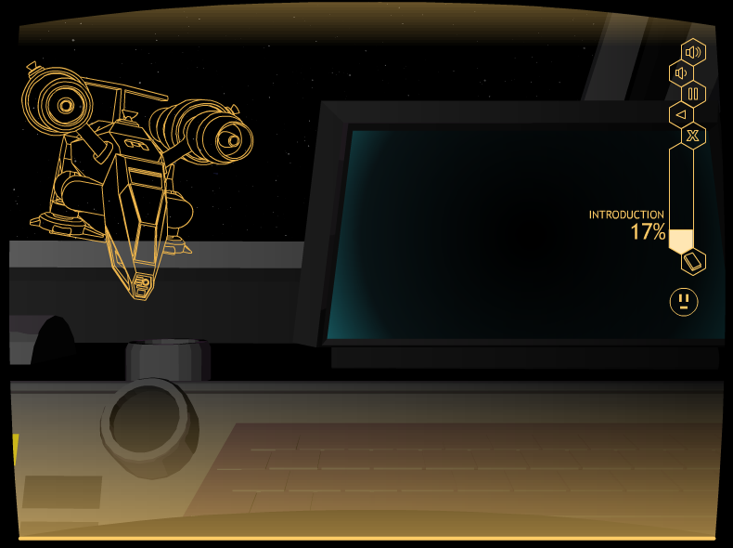
Matt: Insert a cool slide of the space ship or something showing the space theme

Slide 3
Parts of the program
The Basic Paragraph Program
The Advanced Paragraph Program
The Basic Theme Program
The Advanced Theme Program

Slide 4
Authors
Jean Schumaker
Karen Lyerla
Audio/visual: Matt Kappenman
Computer programming: Daran Chapman

Slide 5
Basic Paragraph-writing Program
Introduction
Lesson 1: Complete Sentences
Lesson 2: Topic Sentences
Lesson 3: Planning Diagram
Lesson 4: Detail Sentences
Lesson 5: Clincher Sentences

Slide 6
CONTENT OF THE PROGRAM
Parts I, II, III of the Paragraph Writing Strategy Program
The program builds across the lessons so that students are writing whole paragraphs in Lesson 5

Slide 7
INTRODUCTION
Introduces the purpose
Provides navigation instructions
Begins the plot
Provides an overview of the lessons

Slide 8
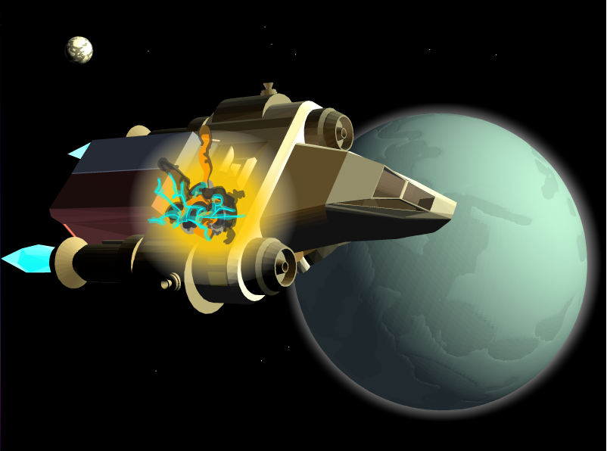

Slide 9
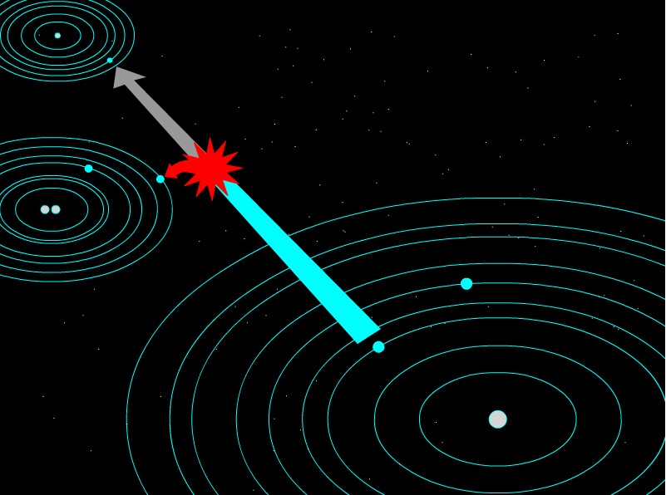

Slide 10
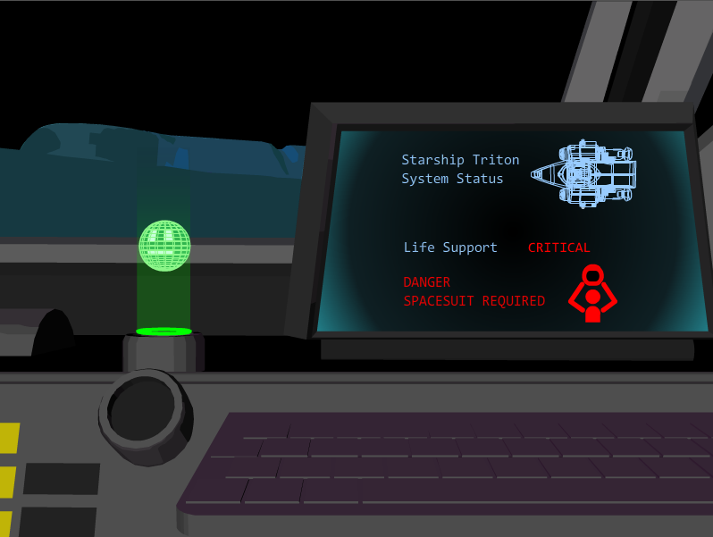

Slide 11
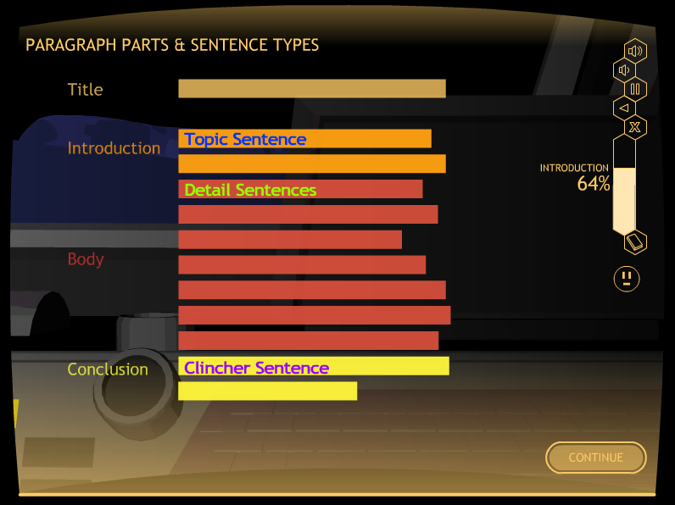

Slide 12
The Lessons
Lesson 1: Complete Sentences
Lesson 2: Topic Sentence
Lesson 3: Planning a Paragraph
Lesson 4: Detail Sentences
Lesson 5: Clincher Sentences

Slide 13
LESSON STRUCTURE
            Learn It
            Watch It
            Study It
            Practice It

Slide 14
End Goal: Mastery of basic paragraph-writing skills

Slide 15
Parts of the program
The Basic Paragraph Program
The Advanced Paragraph Program
The Basic Theme Program
The Advanced Theme Program

Slide 16
aDVANCED Paragraph-writing Program
Introduction
Lesson 1: Instructive Paragraphs
Lesson 2: Narrative Paragraphs
Lesson 3: Persuasive Paragraphs
Lesson 4: Informative Paragraphs
Lesson 5: Descriptive Paragraphs

Slide 17
CONTENT OF THE PROGRAM
Part IV of the Paragraph Writing Strategy Program

Slide 18
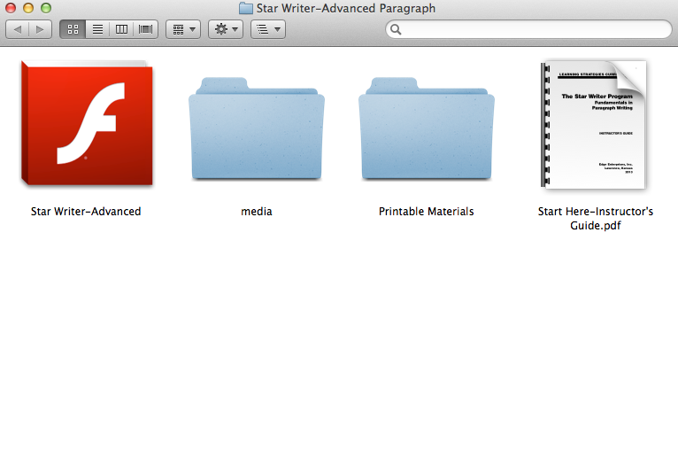

Slide 19
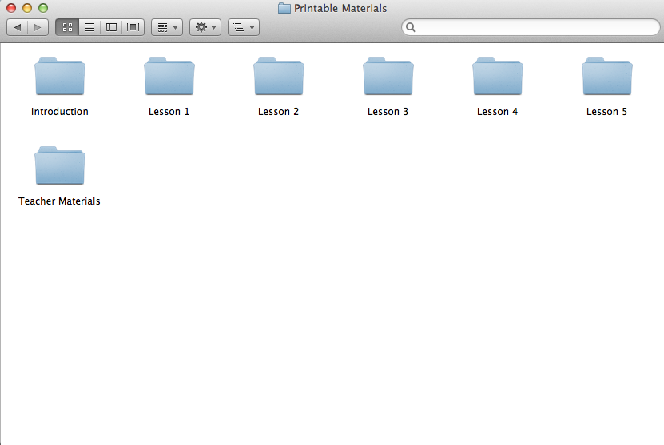

Slide 20
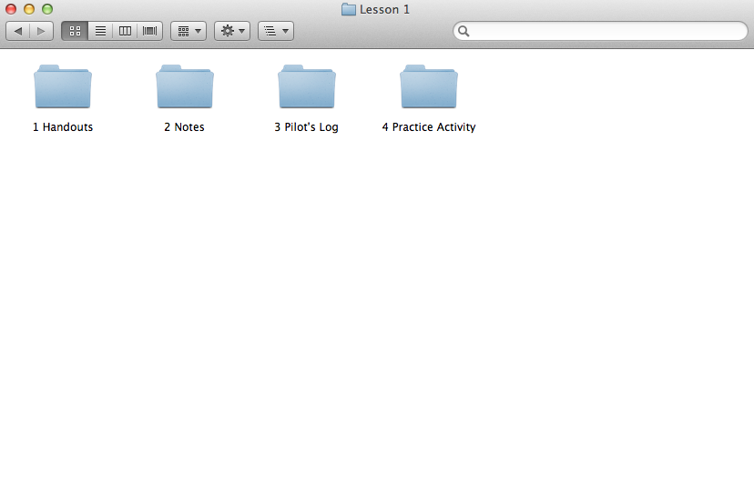

Slide 22
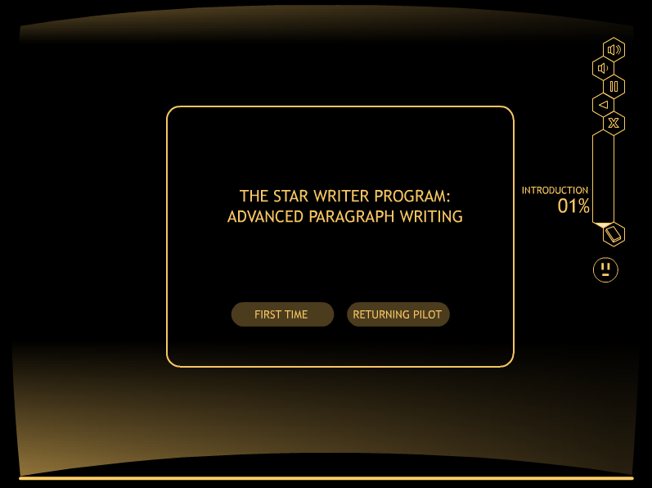
ADD second round of slides

Slide 23
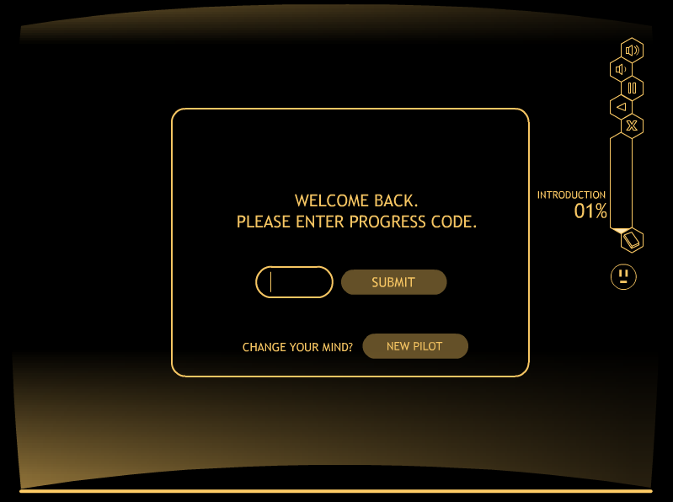
ADD second round of slides

Slide 24
INTRODUCTION
Introduces the purpose
Provides navigation instructions
Begins the plot
Provides an overview of the lessons

Slide 25
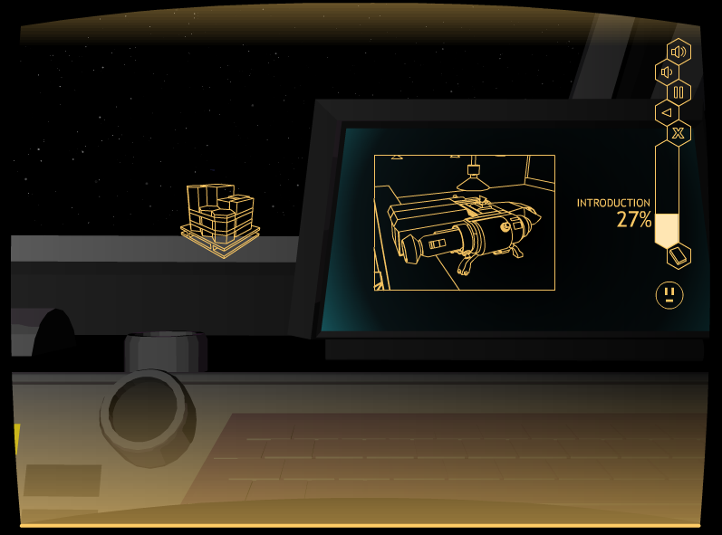
ADD second round of slides

Slide 26
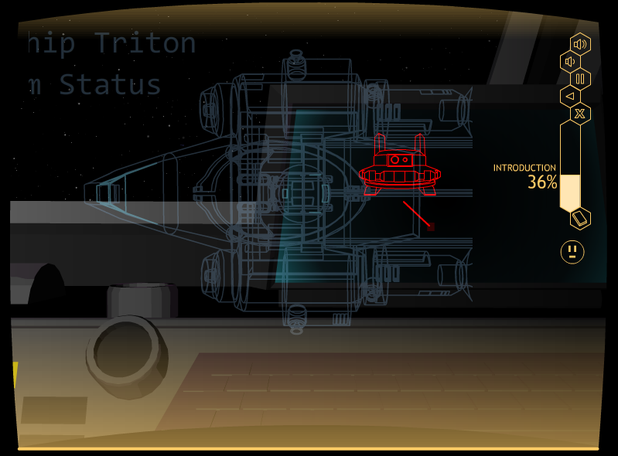
Matt: Insert a slide showing the space theme

Slide 27
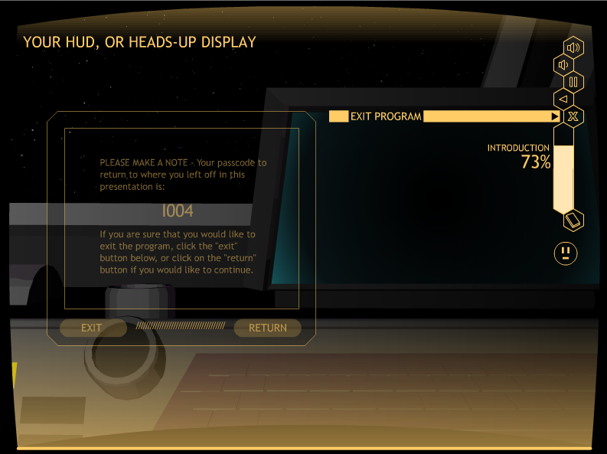

Slide 28
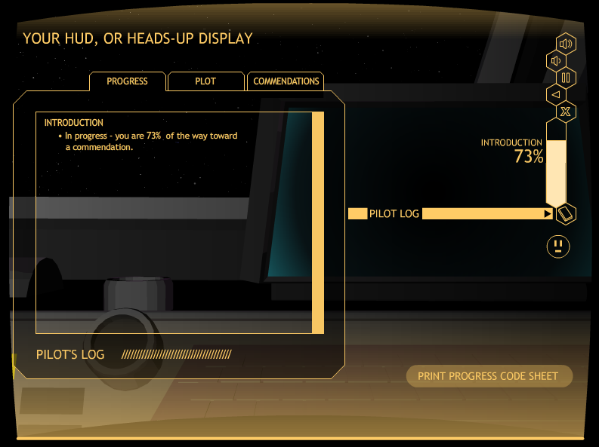

Slide 29
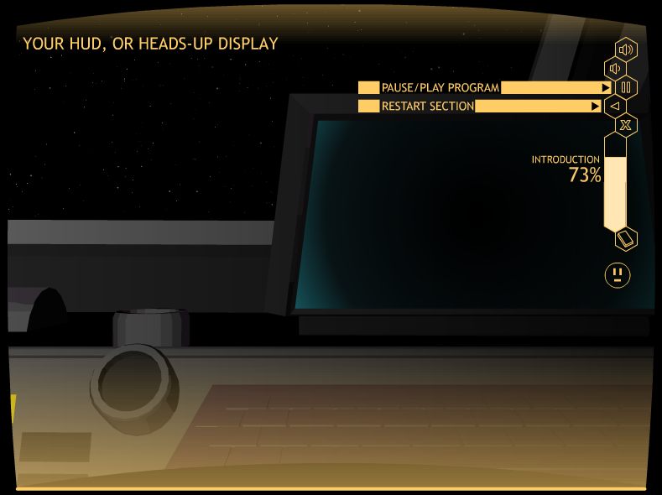

Slide 30
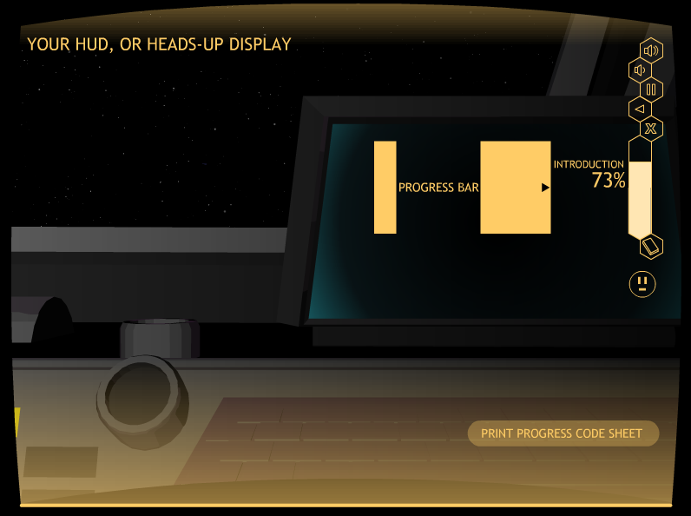

Slide 31
Lesson 1: instructive paragraphs

Slide 32
LESSON STRUCTURE
            Learn It
            Watch It
            Study It
            Practice It

Slide 33
EACH LESSON
Parts of the paragraph
Specifics about the paragraph type
Demonstration of filling in a Paragraph Diagram
Demonstration of writing the type of paragraph
Verbal Practice activities
Practice activities

Slide 34
EXAMPLE LEARN IT SCREEN

Slide 35
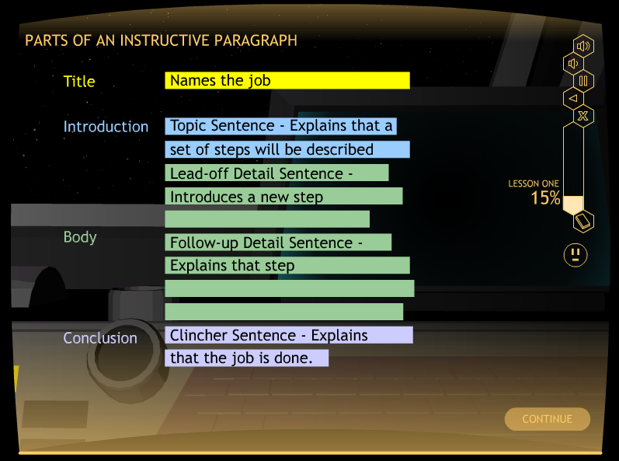
Matt: Add the slide from LS 1, Row 5
Matt: Insert

Slide 36
INstructive PARAGRAPH
Title: Names the job to be explained
Topic Sentence: Explains that a set of steps will be explained
Lead-off Detail Sentences: Each introduces a new step
Follow-up Detail Sentences: Each provides more information about the step
Clincher Sentence: Sums up the steps and tells that the job is done

Slide 37
EXAMPLE WATCH IT SCREEN

Slide 38
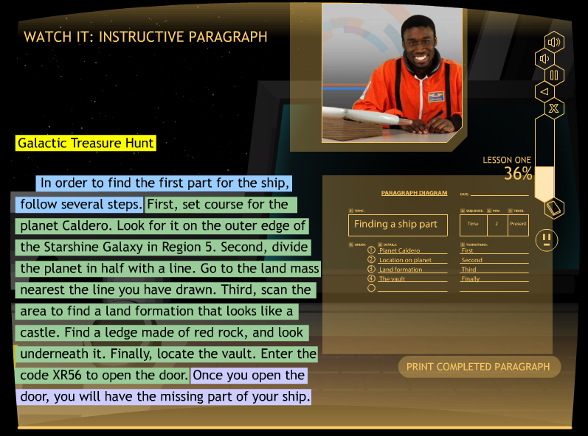
Matt: Insert the Watch It screen that shows the Instructive paragraph

Slide 39
EXAMPLE STUDY IT SCREEN

Slide 40
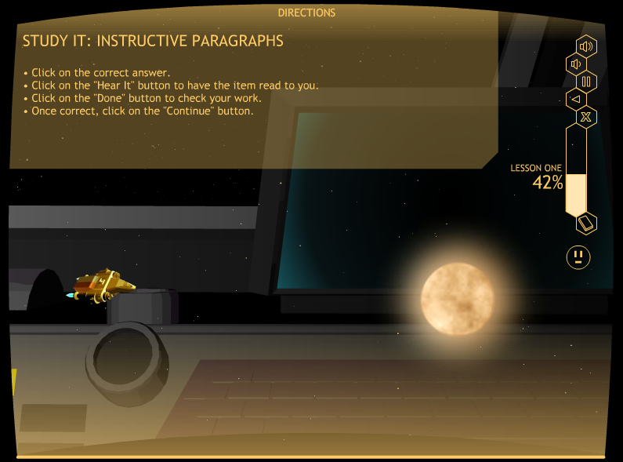
Matt: Add a picturesque Study it screen Here

Slide 41
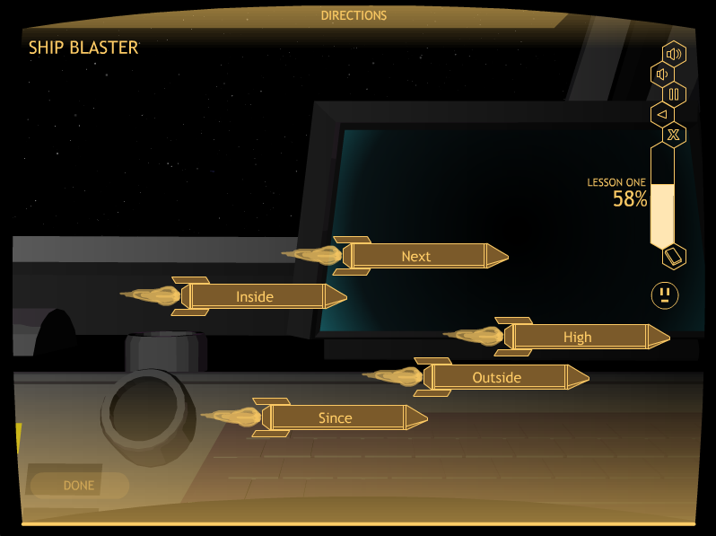
Matt: Insert a space slide

Slide 42
The practice sequence
Student practices planning a paragraph
Teacher scores paragraph diagram
Student practices writing a paragraph with prompts
Teacher scores paragraph
Student practices writing a paragraph independently (no prompts)
Teacher scores paragraph
Student reaches mastery and progresses to the next lesson

Slide 43
EXAMPLE PRACTICE IT SCREENS

Slide 44
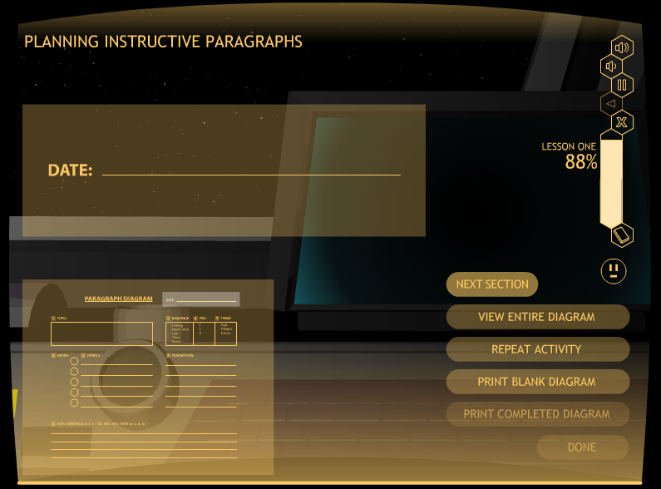
Matt: Add the paragraph diagram screen here

Slide 45
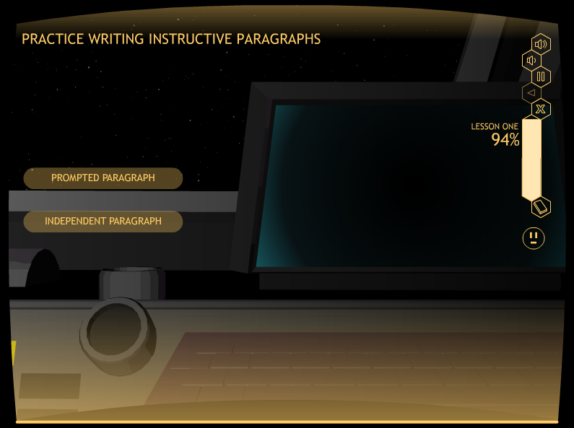
Matt: add the prompted and independent button screen here

Slide 46
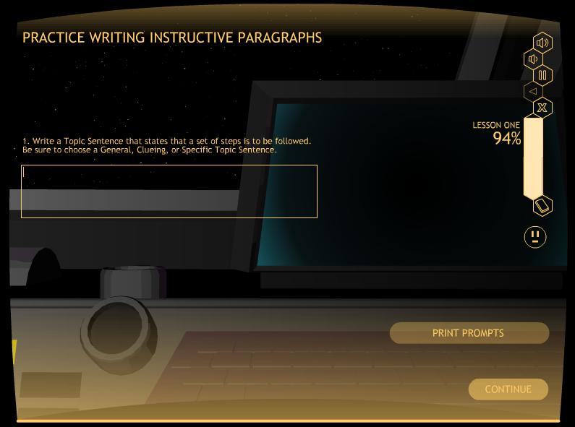
Matt: Add a Prompt screen here—Topic sentence

Slide 47
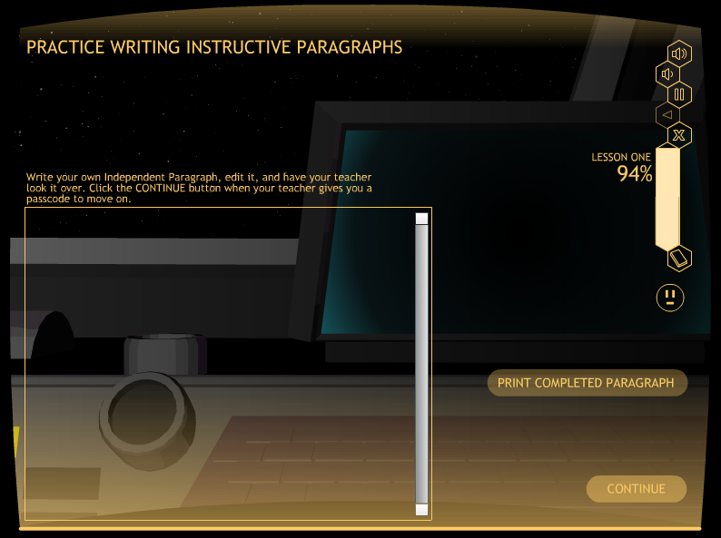
Matt: Add the independent paragraph screen here

Slide 48
Narrative paragraphs

Slide 49
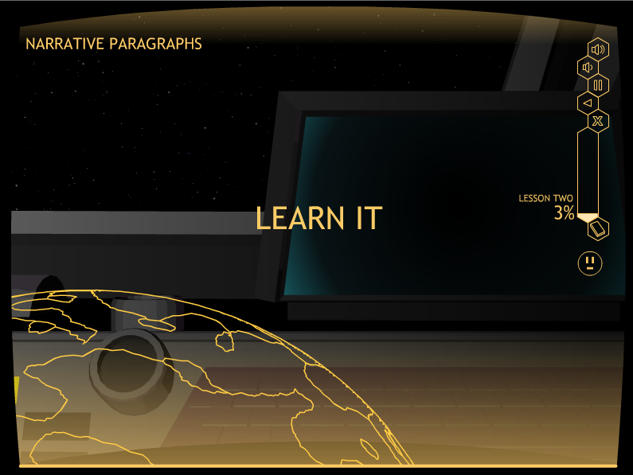
Matt: Add a good picture from Narrative lesson here

Slide 50
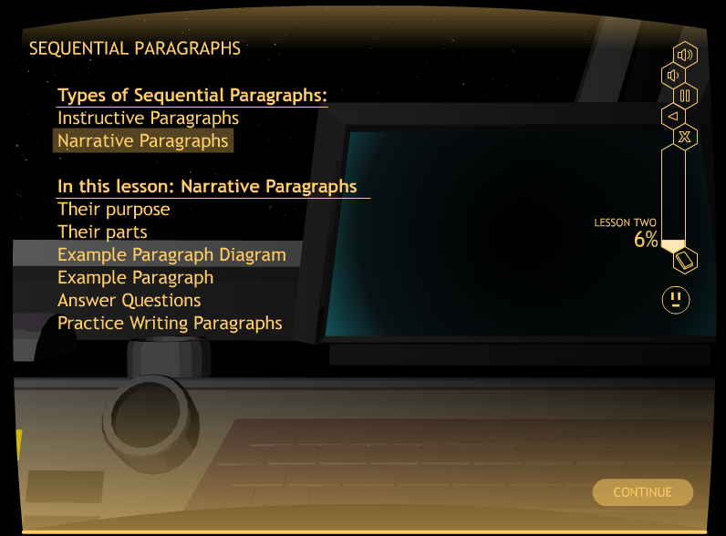
Matt: Add a good picture from Narrative lesson here

Slide 51
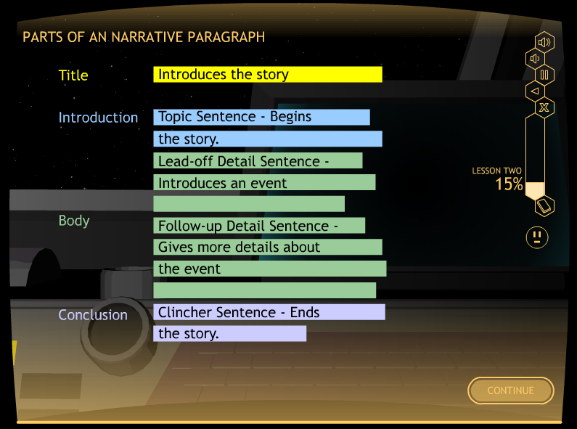
Matt: Add a good picture from Narrative lesson here

Slide 52
narrative PARAGRAPH
Title: Introduces the story
Topic Sentence: Begins the story
Lead-off Detail Sentences: Each introduces a new event
Follow-up Detail Sentences: Each provides more information about the event
Clincher Sentence: Ends the story

Slide 53
Persuasive paragraphs

Slide 54
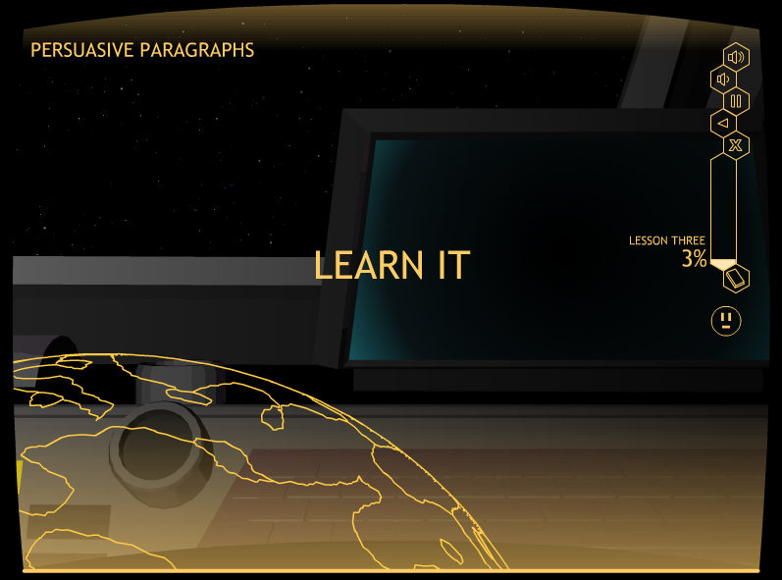
Matt: Add a good picture from Persuasive lesson here

Slide 55
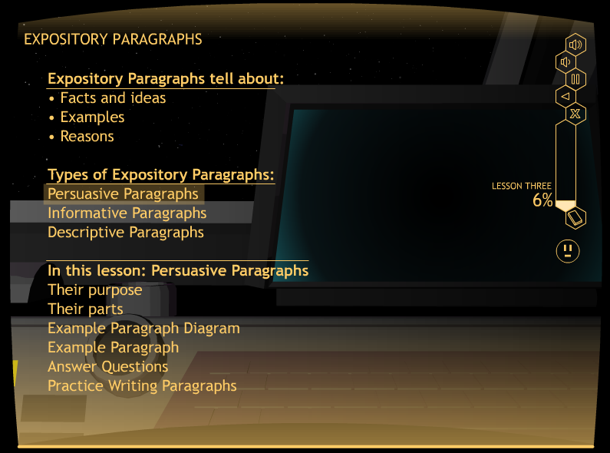
Matt: Add a good picture from Persuasive lesson here

Slide 56
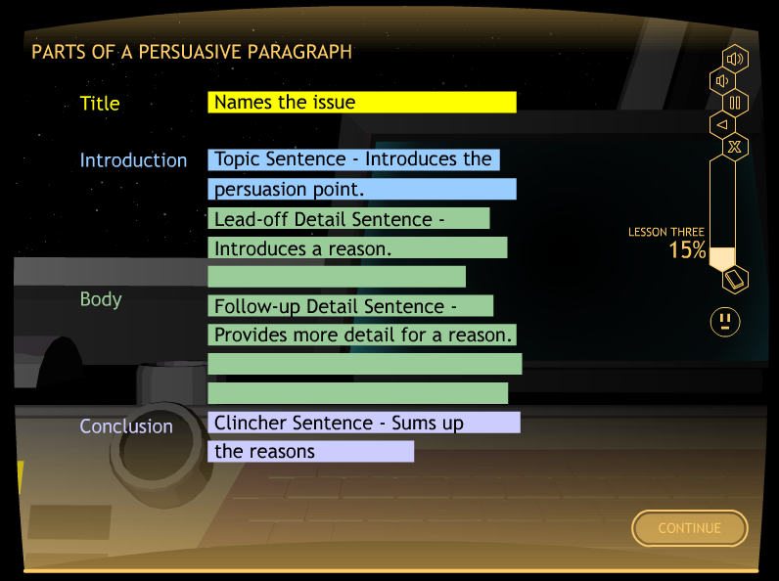
Matt: Add a good picture from Persuasive lesson here

Slide 57
PERSUASIVE PARAGRAPH
Title: Names the issue
Topic Sentence: Introduces the persuasion point
Lead-off Detail Sentences: Each introduces a new reason
Follow-up Detail Sentences: Each provides more information about the reason
Clincher Sentence: Sums up the reasons

Slide 58
Informative paragraphs

Slide 59
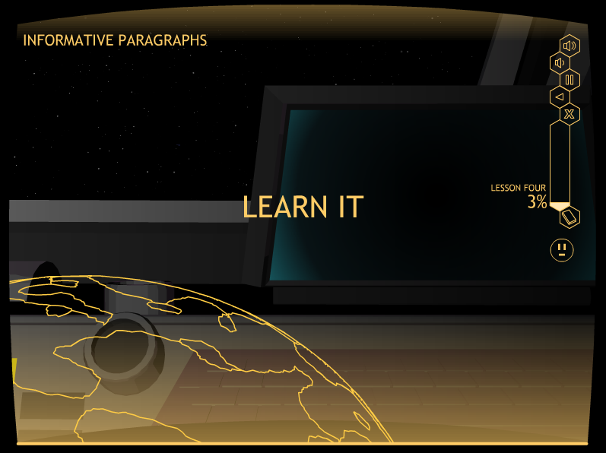
Matt: Add a good picture from Informative lesson here

Slide 60
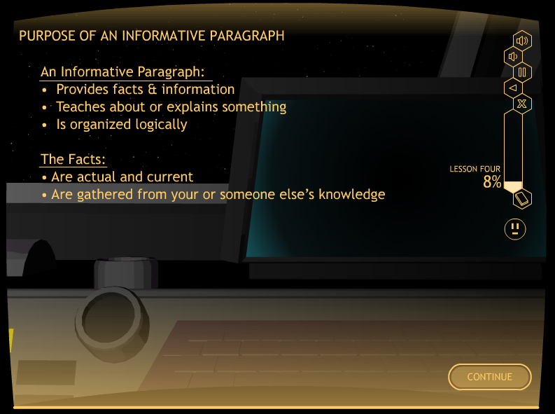
Matt: Add a good picture from Informative lesson here

Slide 61
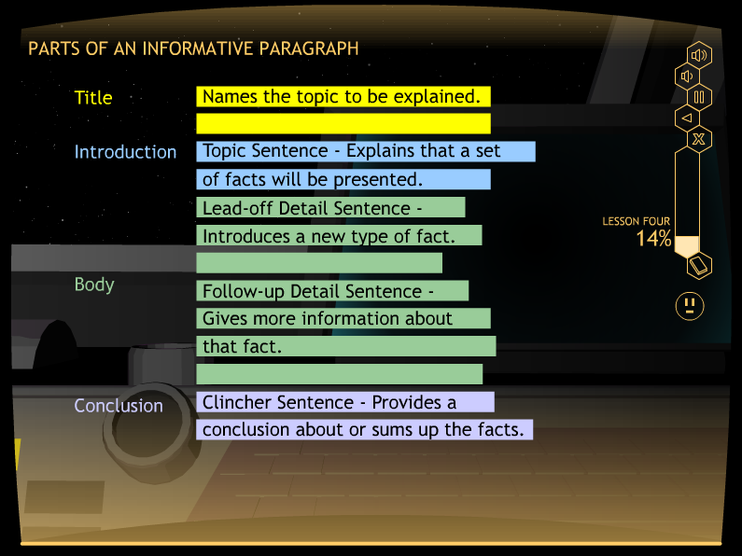
Matt: Add a good picture from Informative lesson here

Slide 62
INFORMATIVE PARAGRAPH
Title: Names the topic to be explained
Topic Sentence: Explains that a set of facts will be presented
Lead-off Detail Sentences: Each introduces a new fact
Follow-up Detail Sentences: Each provides more information about the fact
Clincher Sentence: Sums up the facts

Slide 63
What’s special about this lesson?
Students need content about which they can write an Informative Paragraph.
We provided video clips that they can watch and use for writing their paragraphs.
Four video clips are included.

Slide 64
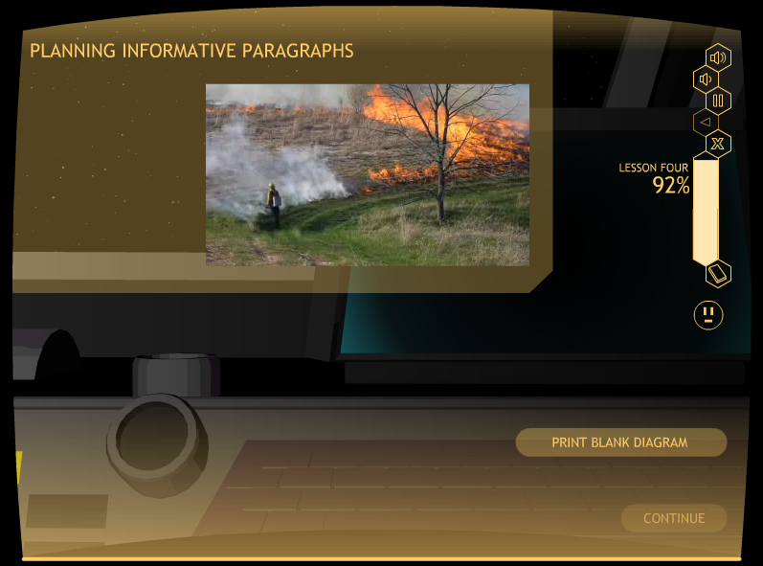
Matt: Insert a good slide showing the video clip playing in the video box

Slide 65
Descriptive paragraphs

Slide 66

Matt; Add a good picture from the descriptive lesson here

Slide 67
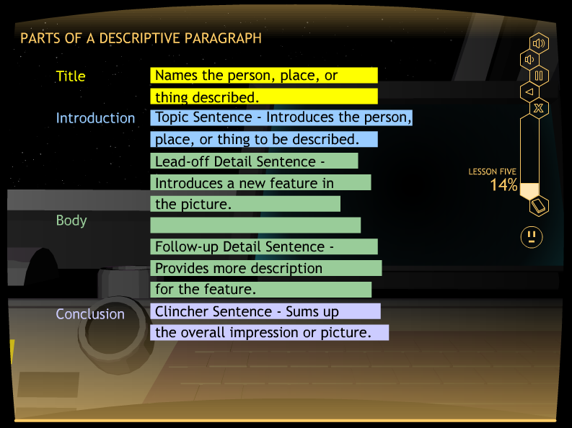
Matt; Add a good picture from the descriptive lesson here

Slide 68
DESCRIPTIVE PARAGRAPH
Title: Names the person, place, or thing to be described
Topic Sentence: Introduces the person, place, or thing
Lead-off Detail Sentences: Each introduces a new feature of the person, place, or thing
Follow-up Detail Sentences: Each provides more information about the feature
Clincher Sentence: Sums up the features and gives and overall impression

Slide 69
Study DETAILS
Control-group design with randomly selected groups
Plus a normative group

Slide 70
More Study Details
STRUGGLING WRITERS
Junior high writing group = 24 students
Junior high reading group = 17 students
Senior-high writing group = 18 students
Senior-high reading group = 18 students
NORMAL LEARNERS
• Junior-high group = 24 students
• Senior-high group = 21 students

Slide 71
Percent Correct
Strategy knowledge test

Slide 72
Percent Points earned
Paragraph skills test

Slide 73
SENTENCE COMPLETENESS:
Narrative PARAGRAPH

Slide 74
PARAGRAPH PLANNING:
Narrative PARAGRAPH

Slide 75
Paragraph organization:
Narrative PARAGRAPH

Slide 76
SENTENCE COMPLETENESS: persuasive PARAGRAPH

Slide 77
PARAGRAPH PLANNING:
Persuasive PARAGRAPH

Slide 78
Paragraph organization:
Persuasive PARAGRAPH

Slide 79
Parts of the star writer program
The Basic Paragraph Program
The Advanced Paragraph Program
The Basic Theme Program
The Advanced Theme Program

Slide 80
CONTENT OF THE PROGRAM
The Fundamentals of the Theme Writing Strategy
The program builds across the lessons so that students are writing whole themes at the end of Lesson 3

Slide 81
Basic theme-writing Program
Introduction
Lesson 1: Introductory Paragraphs
Lesson 2: Detail Paragraphs
Lesson 3: Concluding Paragraphs

Slide 82
INTRODUCTION
Introduces the purpose
Provides navigation instructions
Begins the plot
Provides an overview of the lessons

Slide 83
The Lessons
Lesson 1: Introductory Paragraphs
Lesson 2: Detail Paragraphs
Lesson 3: Concluding Paragraphs

Slide 84
Matt: Add the screen with the TOWER Diagram on it here.

Slide 85
INTRODUCTORY PARAGRAPHS
Purpose
Parts

Slide 86
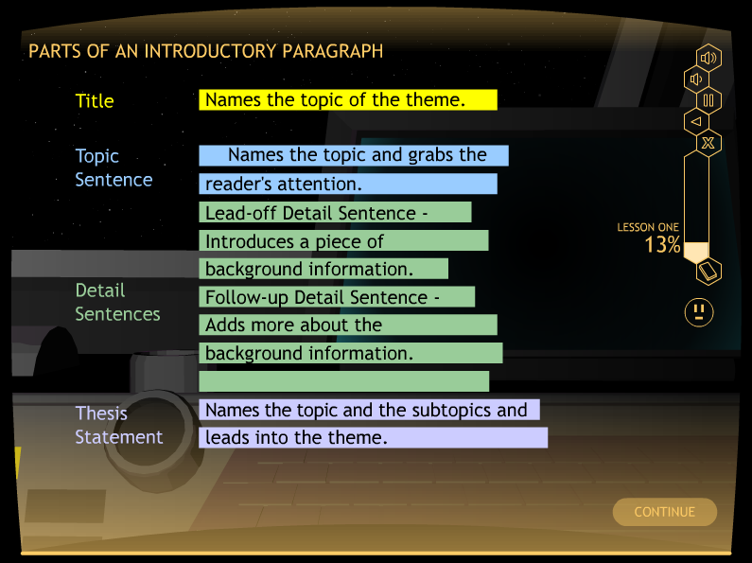
Matt: Put the parts slide here. I think it’s Lesson 1, row 5

Slide 87
Highlighting a key sentence
The Thesis Statement
Defined:
• Introduces the main message of the theme
• Introduces the subtopics of the theme

Slide 88
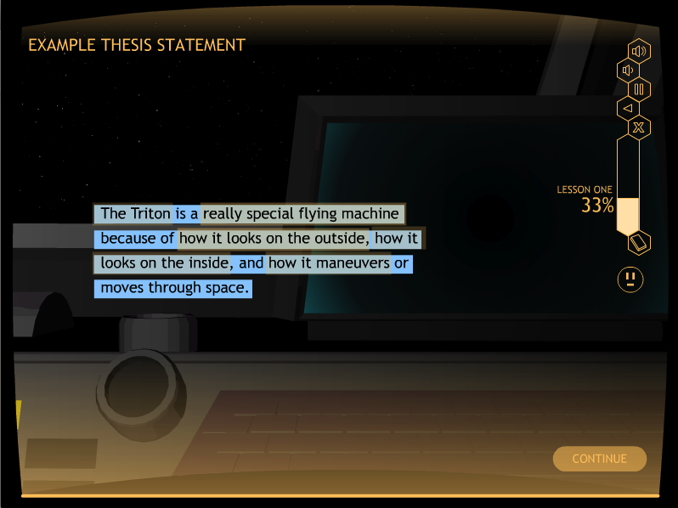
Matt: Add the Example Thesis Statement slide here - Row 13

Slide 89
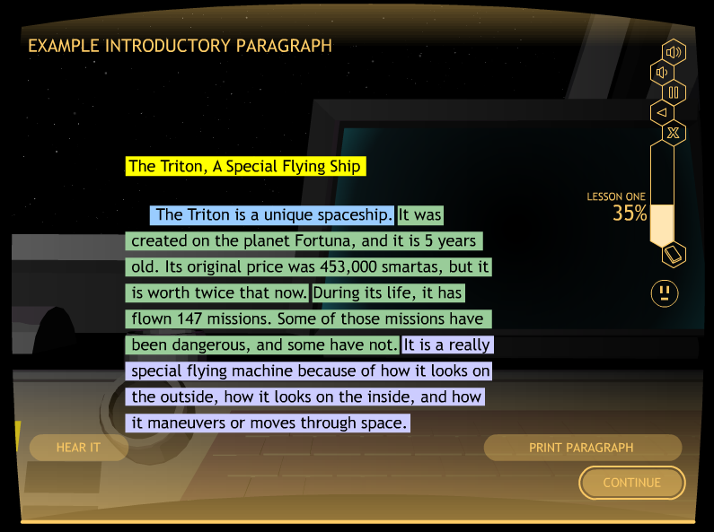
Matt: Add the Example Paragraph slide here - Row 14

Slide 90
Watch It

Slide 91
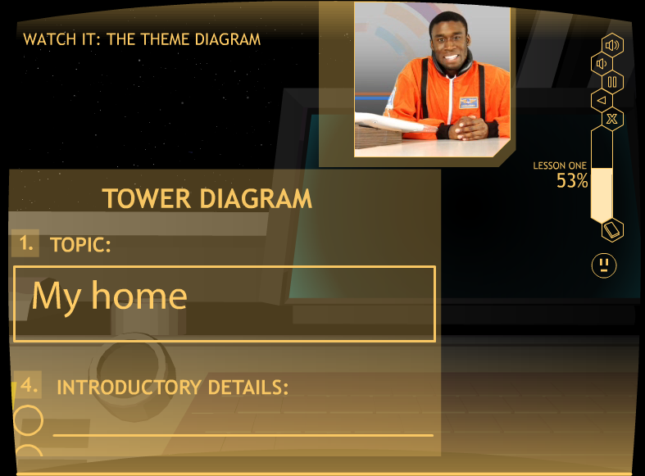
Matt: Please insert a watch it screen where the paragraph is planned-showing the diagram

Slide 92
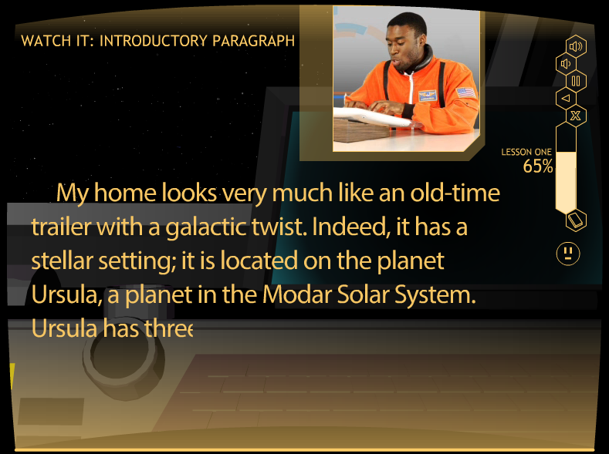
Matt: Please insert a watch it slide where the paragraph is written on the screen with the pilot shown in the corner.

Slide 93
Study it

Slide 94
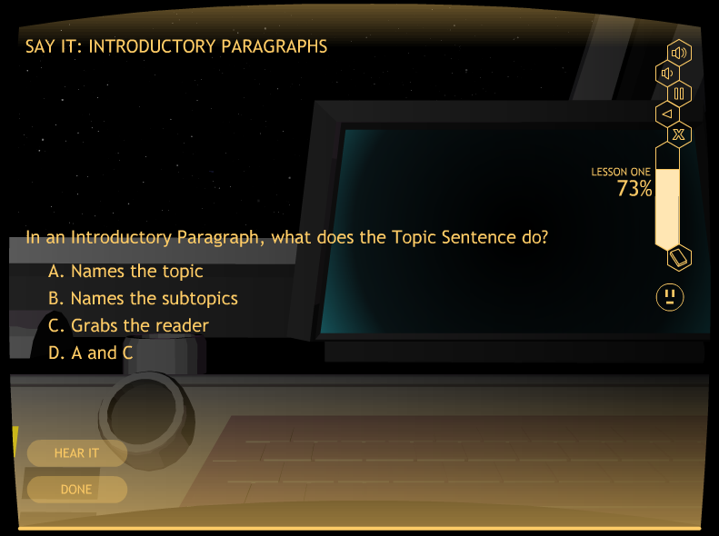
Matt: Please insert a multiple choice slide from study it here

Slide 95
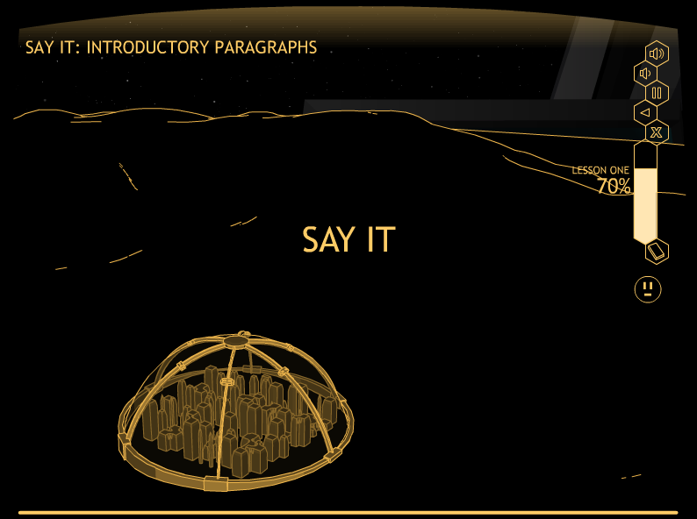
Matt: Please insert best study it slide here

Slide 96
Practice it
Activity 1: Write Thesis Statements
Activity 2: Plan an Instructive Paragraph
Activity 3: Write an Instructive Paragraph
• Prompted paragraph
• Independent paragraph

Slide 97
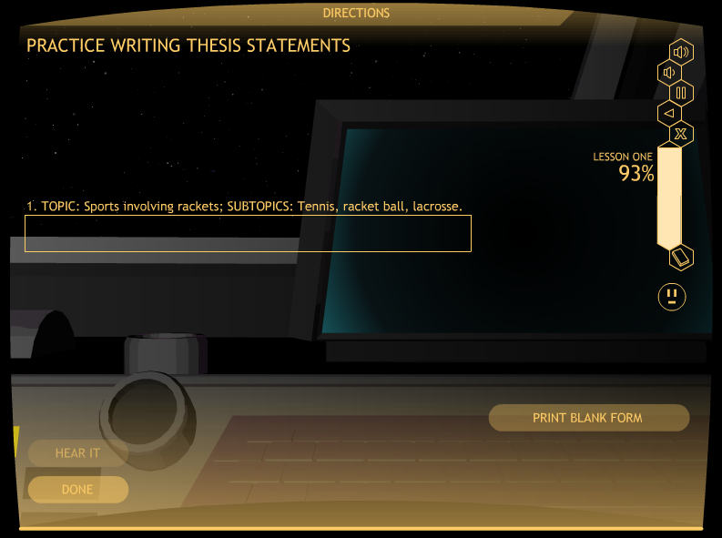
Matt: Put a thesis statement slide in here where they have to write one in the box.

Slide 98
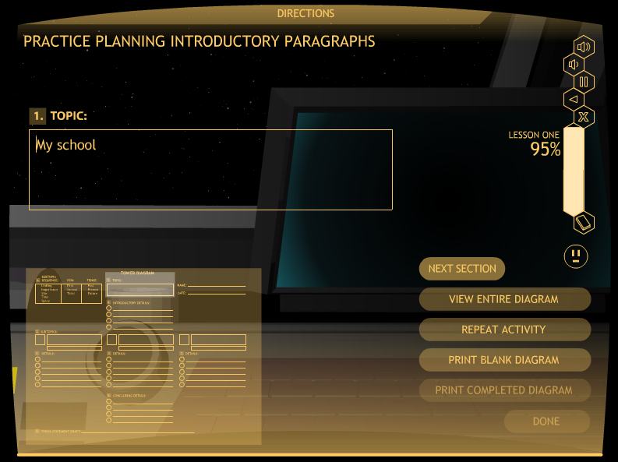
Matt: Please put the paragraph diagram slide in here

Slide 99
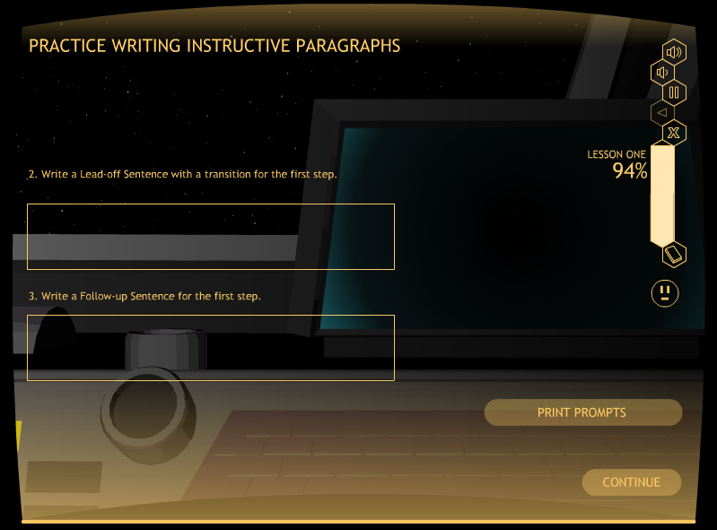
Matt: Please put a prompted slide here. Maybe the first lead-off sentence slide

Slide 100
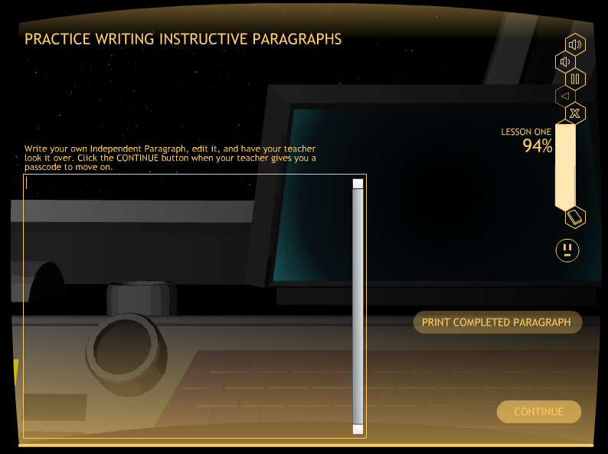
Matt: Please insert an independent paragraph slide in here

Slide 101
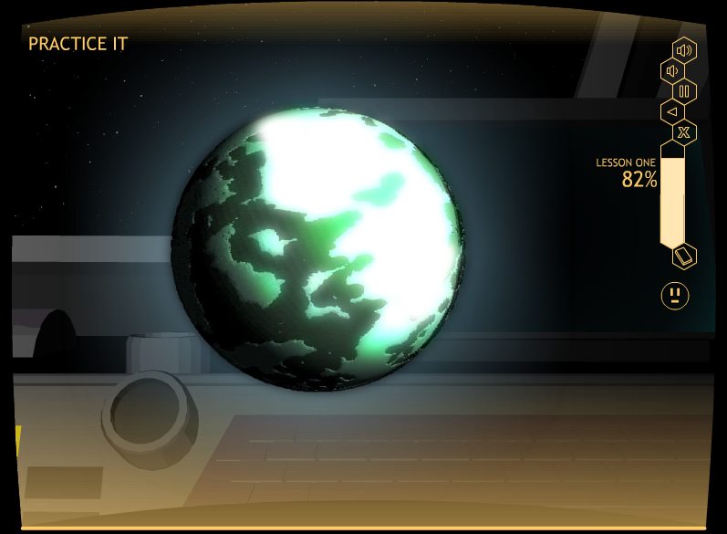
Matt: Please put a cool space picture here

Slide 102
The practice sequence
Student practices planning a paragraph
Teacher scores paragraph diagram
Student practices writing a paragraph with prompts
Teacher scores paragraph
Student practices writing a paragraph independently (no prompts)
Teacher scores paragraph
Student reaches mastery and progresses to the next lesson

Slide 103
Practice during other lessons
Lesson 2: Detail Paragraphs
Writing Topic Transition Sentences
Planning Detail Paragraphs
Writing Detail Paragraphs: Prompted and unprompted
Lesson 3: Concluding Paragraphs
Writing Concluding Transition Sentences
Planning Concluding Paragraphs
Writing Concluding Paragraphs
Planning a whole theme
Writing a whole theme: Prompted and unprompted

Slide 104
Theme Writing Study
Junior-high Students:
• 8th Graders (n=26)
• 9th Graders (n=15)
Senior-high Students (n=48):
• 12th-graders - AP students) (n=21)

Slide 105
Percent of points theme writing test

