Slide 1
The Star Writer Program: fundamentals of
PARAGRAPH WRITING
Jean Schumaker
January, 2015

Slide 2
TODAY’S GOALS
To familiarize you with:
The Star Writer Program content for teaching beginning paragraph writing skills
The program structure
Your role as a teacher
The instructor’s guide
How to get organized
The research

Slide 3
Lessons in the Program
Introduction
Lesson 1: Complete Sentences
Lesson 2: Topic Sentences
Lesson 3: Planning Diagram
Lesson 4: Detail Sentences
Lesson 5: Clincher Sentences

Slide 4
The program is based on strategic instruction
  The Paragraph Writing Strategy
  Instructional Methods for teaching strategies

Slide 5
CONTENT OF THE PROGRAM
Parts I, II, III of the Paragraph Writing Strategy Program
The program builds across the lessons so that students are writing whole paragraphs in Lesson 5

Slide 6
Basic Instructional Methods for Teaching Strategies
Describe
Model
Verbal Practice
Controlled Practice
Advanced Practice

Slide 7
LESSON FORMAT
Learn It
(Describe)
Watch It
(Model)
Study It
(Verbal Practice)
Practice It
(Controlled Practice)
(Advanced Practice)

Slide 8
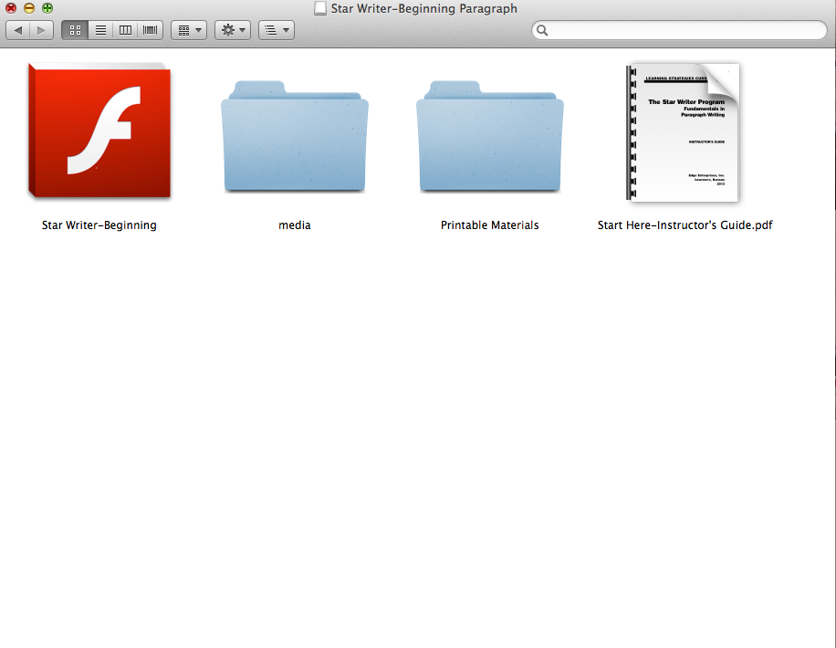
Matt: Please insert in here several slides showing the icons and folders they will see when they open the program, open the printable materials, open the instructor’s guide, etc.

Slide 9
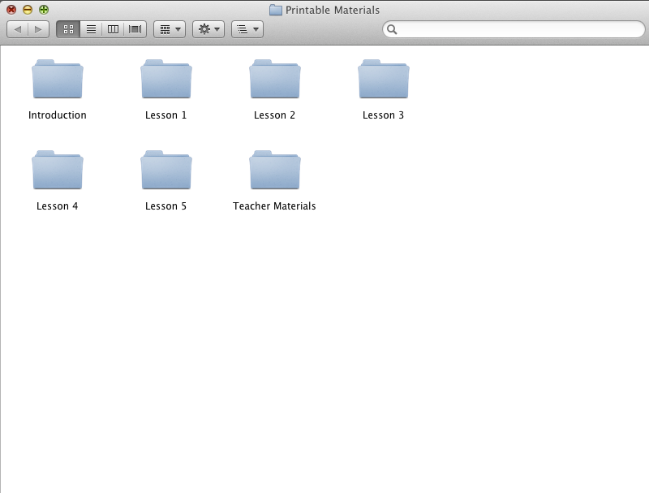

Slide 10
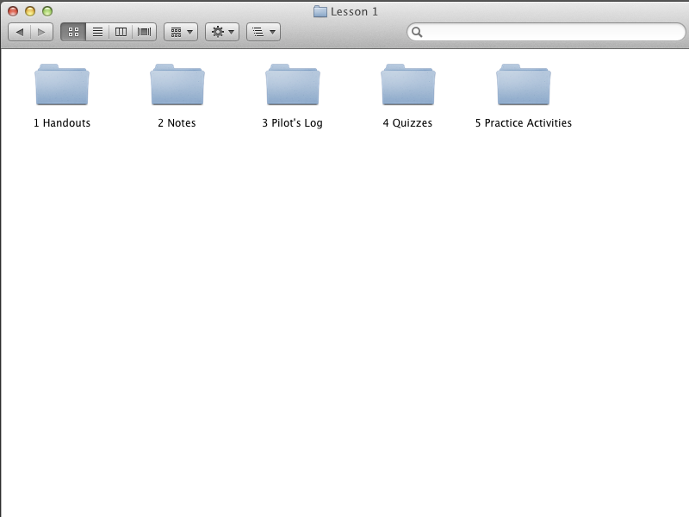

Slide 11
Matt: Please insert in here several slides showing the icons and folders they will see when they open the program, open the printable materials, open the instructor’s guide, etc.

Slide 12
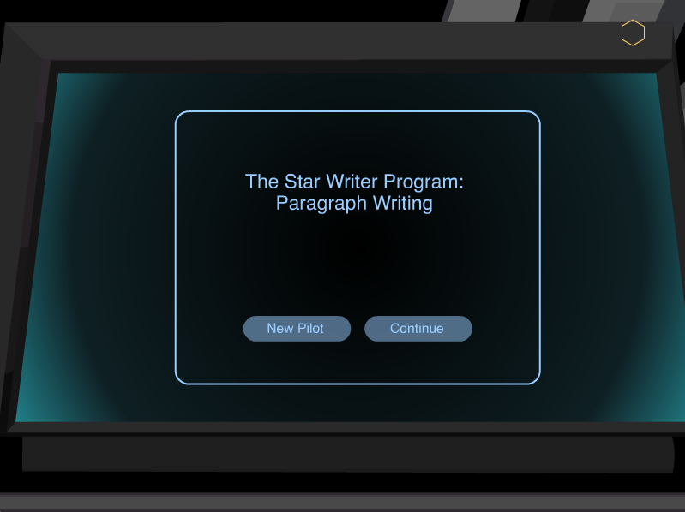

Slide 13
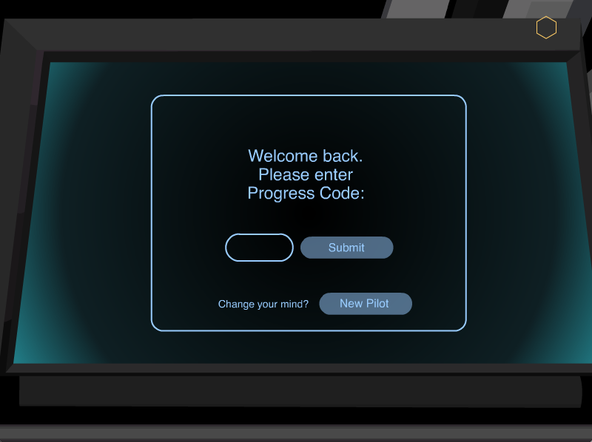

Slide 14
INTRODUCTION

Slide 15
INTRODUCTION
Introduces the purpose of the program
Provides navigation instructions
Begins the plot
Provides an overview of the lessons
a

Slide 16
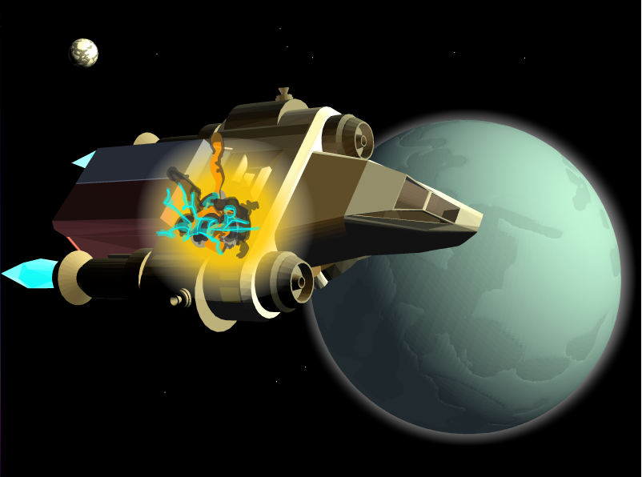

Slide 17
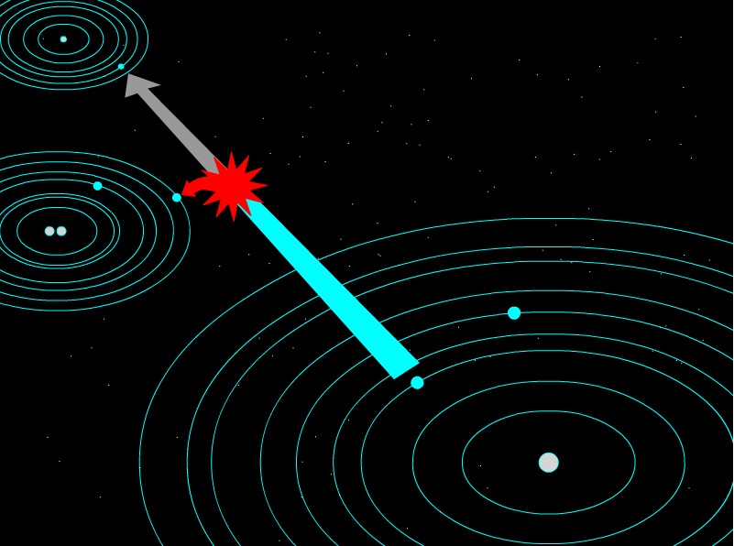

Slide 18
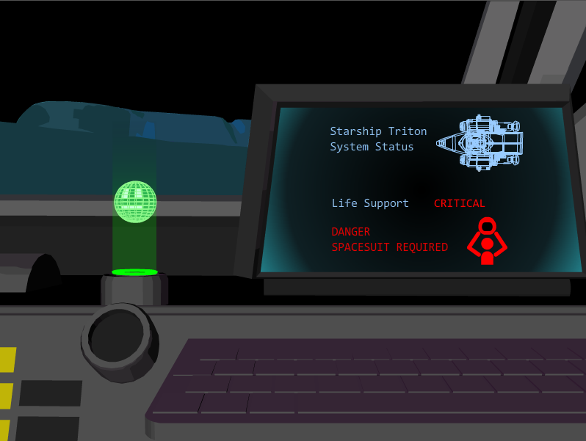

Slide 19
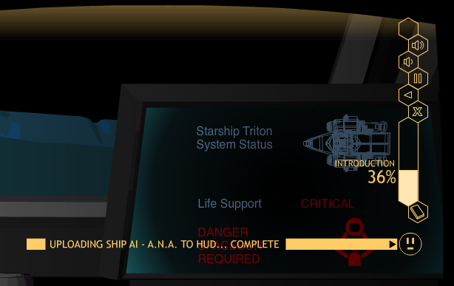
Matt: Put a screen shot in here of Row 4 with the navigation buttons enlarged.

Slide 20
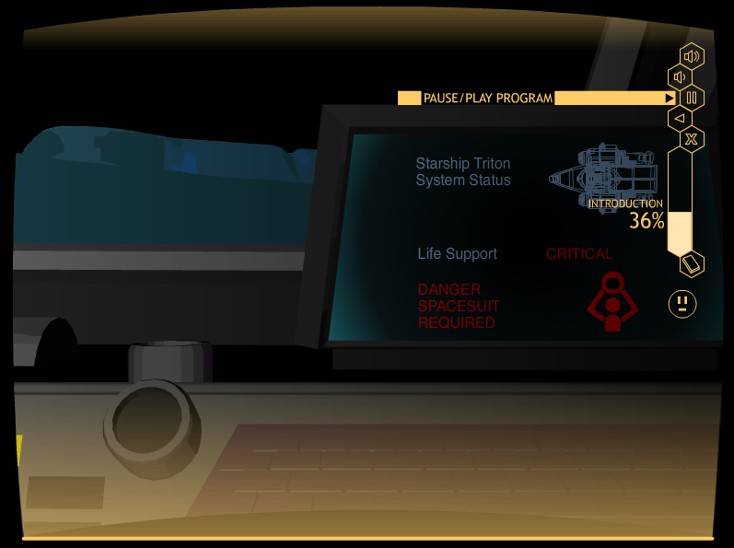
Matt: Please insert in here several slides showing the
Navigation buttons, like exit, restart, etc.

Slide 21
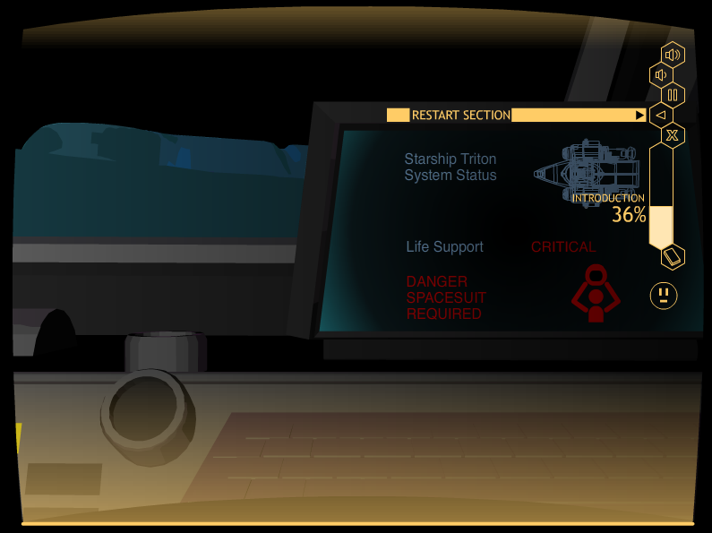
Matt: Please insert in here several slides showing the
Navigation buttons, like exit, restart, etc.

Slide 22
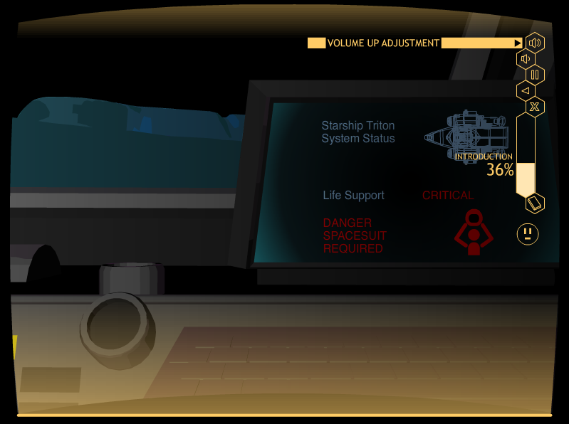
Matt: Please insert in here several slides showing the
Navigation buttons, like exit, restart, etc.

Slide 23
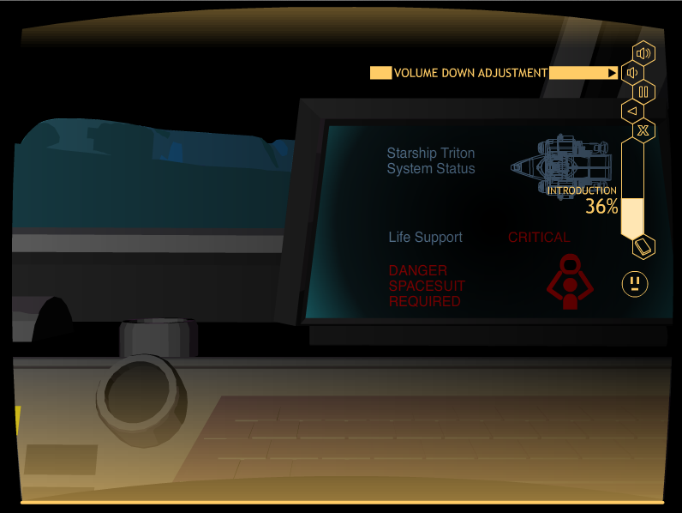
Matt: Please insert in here several slides showing the
Navigation buttons, like exit, restart, etc.

Slide 24
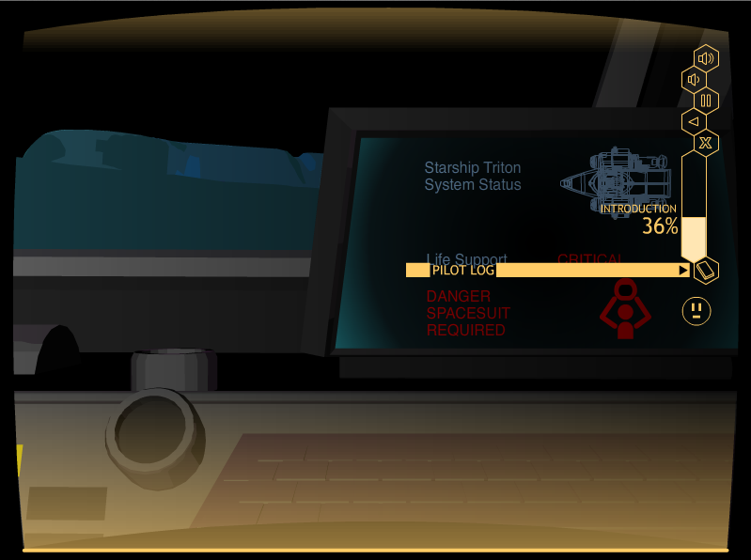
Matt: Please insert in here several slides showing the
Navigation buttons, like exit, restart, etc.

Slide 25
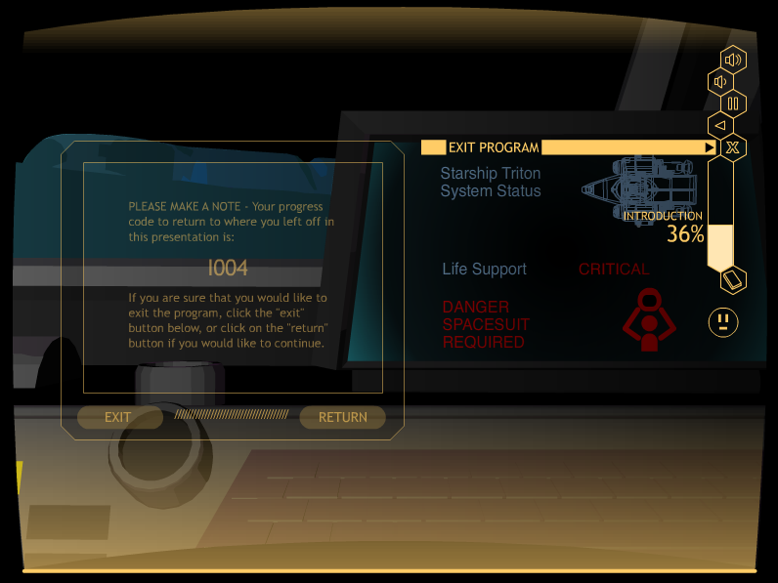
Matt: Please insert in here several slides showing the
Navigation buttons, like exit, restart, etc.

Slide 27
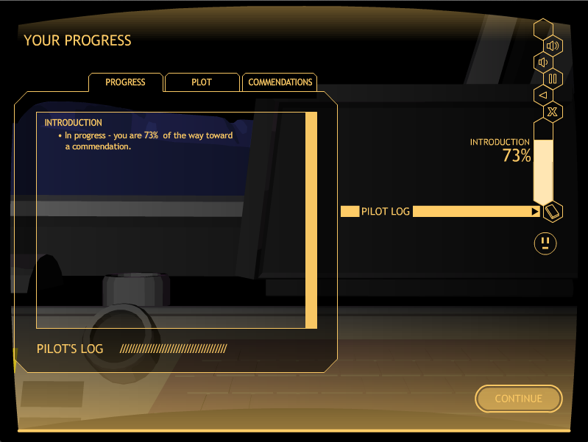
Matt: Please put a screen shot of the Pilot’s log in here at the point of the last screen of the intro.

Slide 28
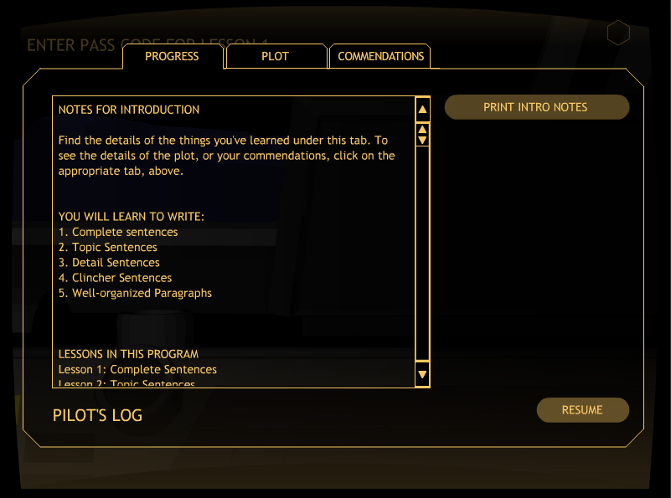

Slide 29
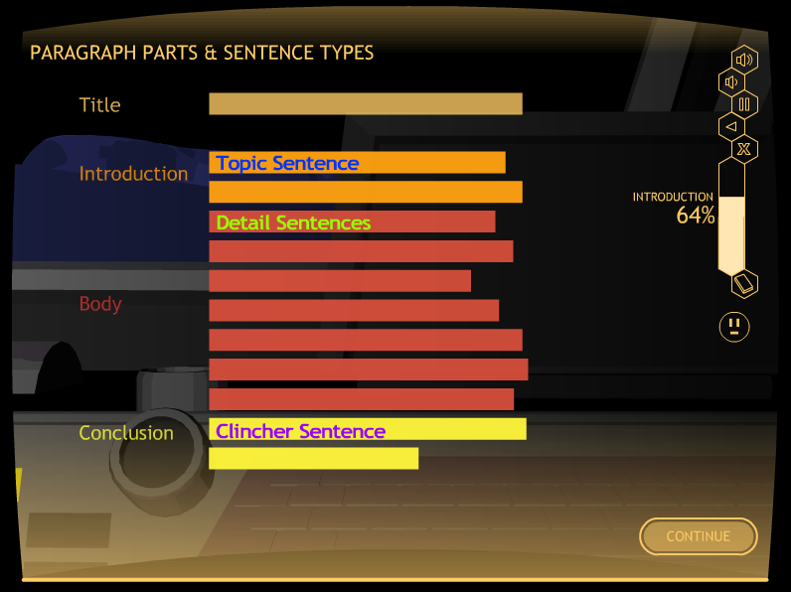

Slide 30
Let’s Look at the instructor’s guide

Slide 31
Matt: Please insert in here several slides showing the icons and folders they will see when they open the program, open the printable materials, open the instructor’s guide, etc.

Slide 33
Notice the Pass Codes!

Slide 34
Three types of Pass Codes
Pass Codes for Entering a lesson
Pass Codes for passing a quiz
Pass Codes for progressing to a new level of practice

Slide 35
The Lessons
Lesson 1: Complete Sentences
Lesson 2: Topic Sentence
Lesson 3: Planning a Paragraph
Lesson 4: Detail Sentences
Lesson 5: Clincher Sentences

Slide 36
LESSON STRUCTURE
            Learn It
            Watch It
            Study It
            Practice It

Slide 37
Lesson 1

Slide 38
LESSON 1: COMPLETE SENTENCES
Major Concepts:
Complete sentence
Subjects and verbs
Simple Sentences
Compound Sentences

Slide 39
Lesson 1: Learn it

Slide 40
Lesson Format FOR Learn It
Introduction
Concept #1
Definition
Examples
Practice Activity
Concept #2
Definition
Examples
Practice Activity
Concept #N
Definition
Examples
Practice Activity
Closing
Notes:
Lesson format: Learn It [Does this look okay??? Shall I change it to one column, even thought it will be much smaller font?]

Slide 41
EXAMPLE LEARN IT SCREEN

Slide 42
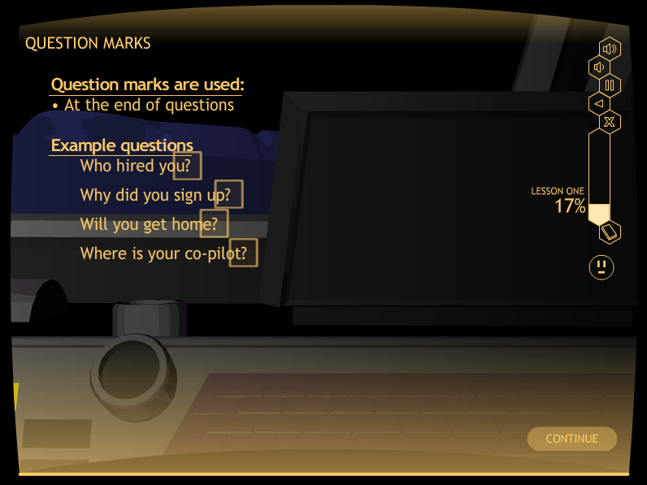
Matt: Please add a slide in here showing the instruction for end punctuation. I’m thinking screen A018

Slide 43
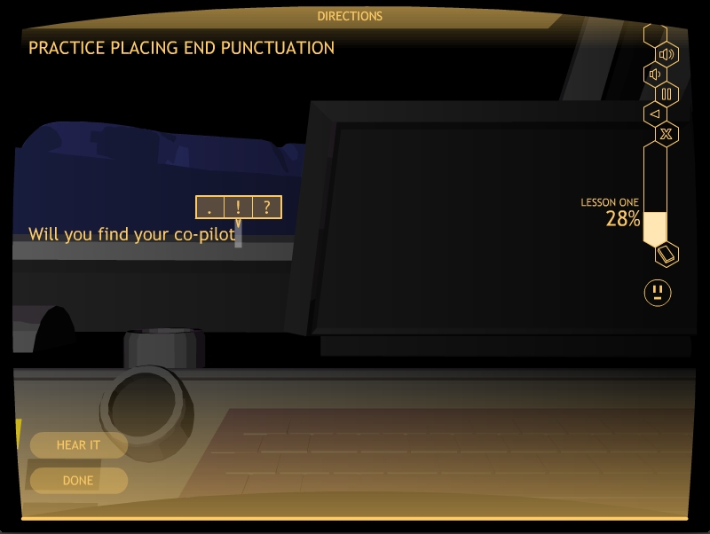
Matt: Please put a screen shot from A029 in here showing the three option choices for punctuation

Slide 44
Let’s Look at A simple Activity
Go to A029
Stop when you have completed 3 sentences

Slide 45
Subjects and verbs

Slide 46
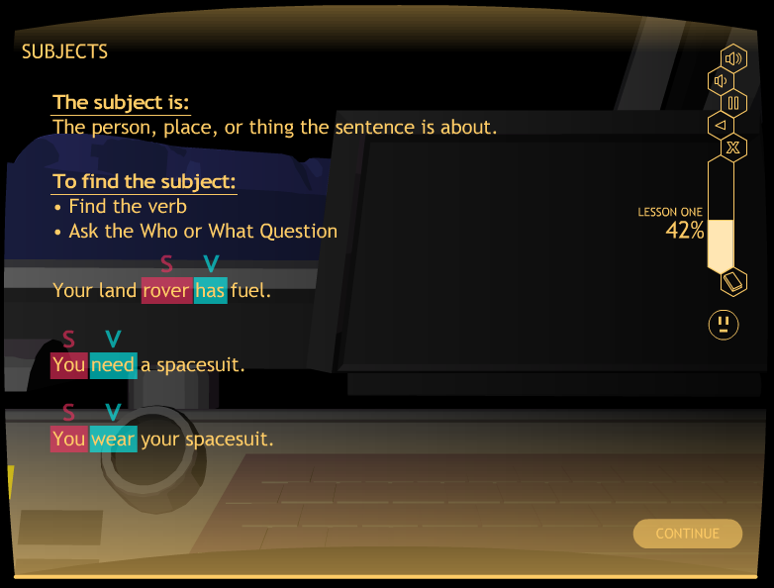

Slide 47
Let’s look at another learn it section
Go to A034
Stop at “Subjects”
Click on “Exit”

Slide 48
Lesson 1: Watch It

Slide 49
EXAMPLE WATCH IT SCREEN

Slide 50
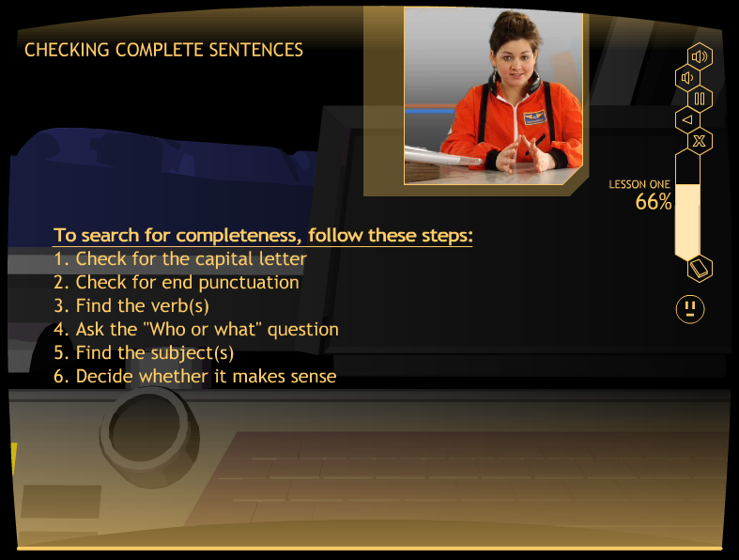

Slide 51
Let’s Look at “watch It”
Go to A074
Stop at “Example Sentence 2”
Click on “Exit”

Slide 52
Lesson 1: Study It

Slide 53
EXAMPLE STUDY IT SCREEN

Slide 54
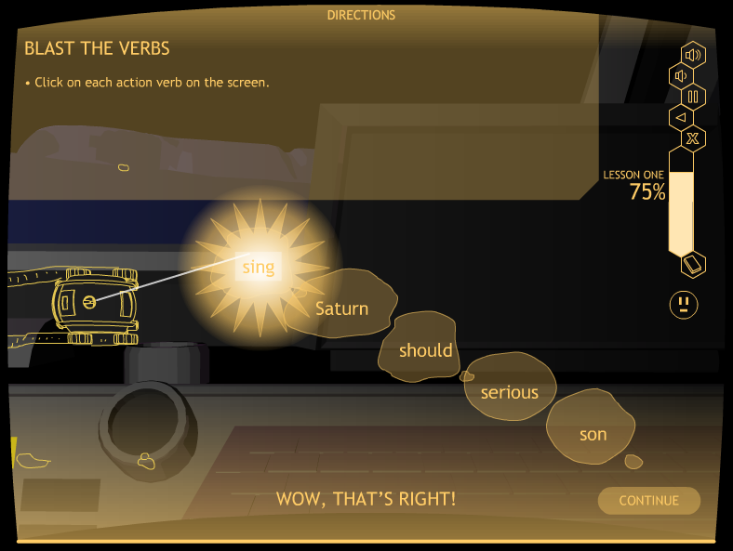

Slide 55
Let’s Look at Study It
Go to A083 “Blast the Verbs”
Stop at “Blast the Subjects”
Click on “Exit”

Slide 56
QUIZ TIME!
At the end of Study It, students take a quiz.
They can print it out, or you can give them a paper copy.
This replaces the Verbal Practice Quiz in the strategy programs.
Mastery is 100%
First time, a short oral quiz of one or two questions is recommended to see if the student is ready.
If not, have the student repeat Study It.

Slide 58
A Caution about the first quiz!!
Briefly quiz (one or two oral questions) to make sure the student is ready to take the quiz.
Have the student repeat Study It when not ready.
Next time, the student will be ready.

Slide 59
Lesson 1: Practice It

Slide 60
Practice It Levels 1-6
Level 1: Identifying a subject and a verb
Level 2: Identifying more subjects and verbs
Level 3: Finishing simple sentences
Level 4: Writing simple sentences
Level 5: Finishing compound sentences
Level 6: Writing compound sentences

Slide 61
EXAMPLE PRACTICE IT SCREENS

Slide 62
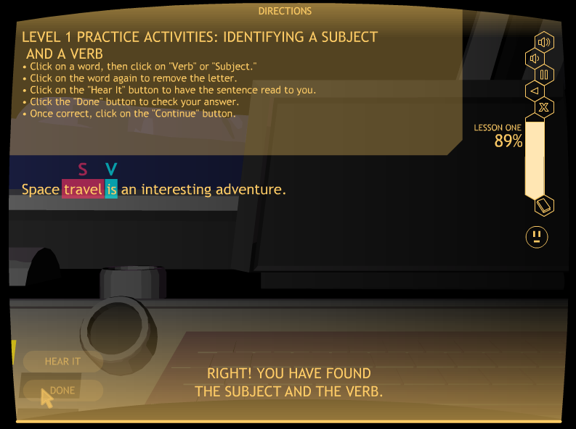

Slide 63
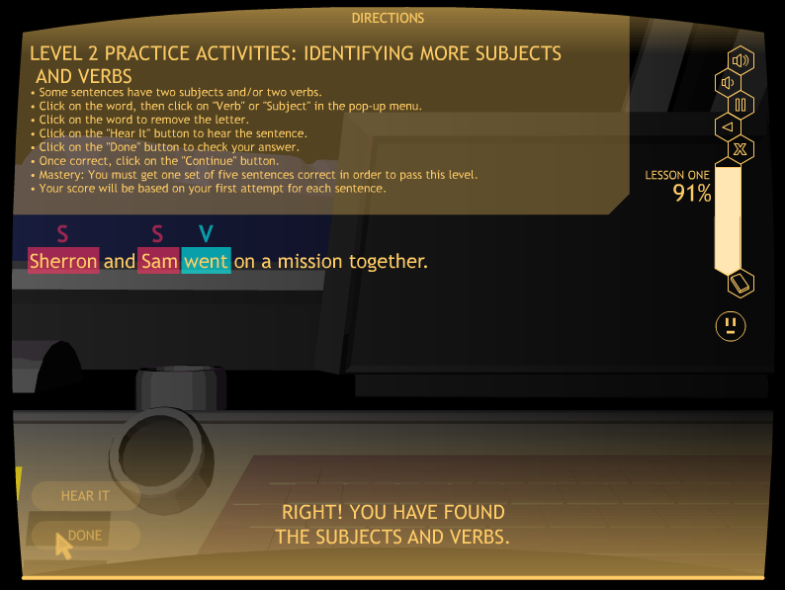
Matt: Please insert a Level 2 slide in here showing the
Little subject
Verb screen.

Slide 64
Let’s look at practice It
Level 2
Go to A098 (Level 2)
Click on “subject” or “verb” for each subject and verb
Click on the “Hear It,” “Done,” & “Continue” buttons
Stop after one set of five sentences
Click on the “Exit” button

Slide 65
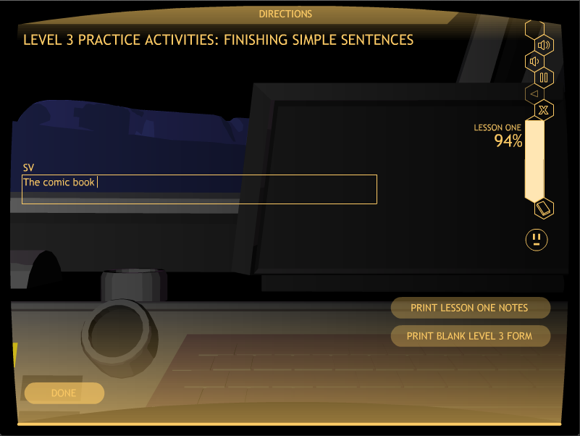
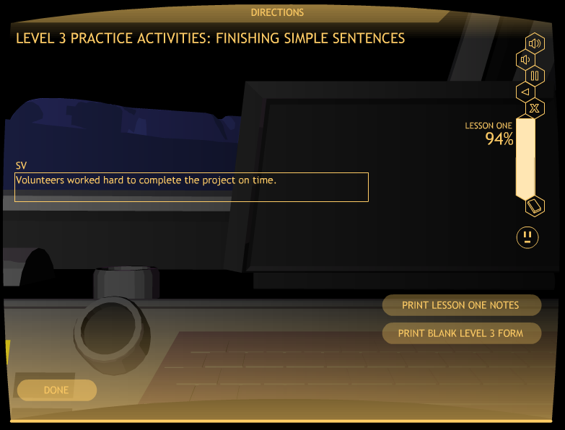

Slide 66
Look at practice It
Level 3
Go to A099 (Level 3)
Finish five simple sentences
Stop after editing one set of five sentences
Click on the “Exit” button

Slide 67
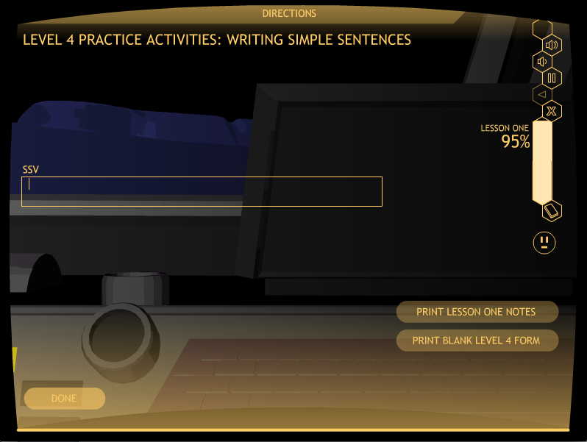

Slide 68
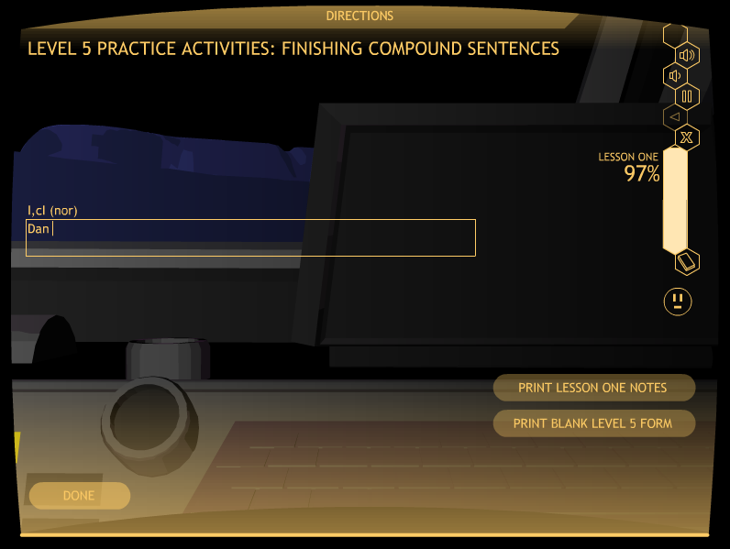

Slide 69


Slide 70
Lesson 1 practice It
Mastery
Level 1: 100%, two sets
Level 2: 100%, one set
Level 3: 80%, one set
Level 4, 80%, one set
Level 5: 80%, one set
Level 6: 80%, one set

Slide 71
Let’s Look at the printable materials folder
Go to the program folder
Click on the Printable Materials Folder

Slide 72
Matt: Please insert in here several slides showing the icons and folders they will see when they open the program, open the printable materials, open the instructor’s guide, etc.

Slide 75
Lesson 2

Slide 76
LESSON 2: TOPIC SENTENCES
The Concepts:
Three types of Topic Sentences
          General
          Clueing
          Specific

Slide 77
Lesson 2: Learn It

Slide 78
Lesson Format FOR Learn It
Introduction
Concept #1
Definition
Examples
Practice Activity
Concept #2
Definition
Examples
Practice Activity
Concept #N
Definition
Examples
Practice Activity
Closing
Notes:
Lesson format: Learn It [Does this look okay??? Shall I change it to one column, even thought it will be much smaller font?]

Slide 79
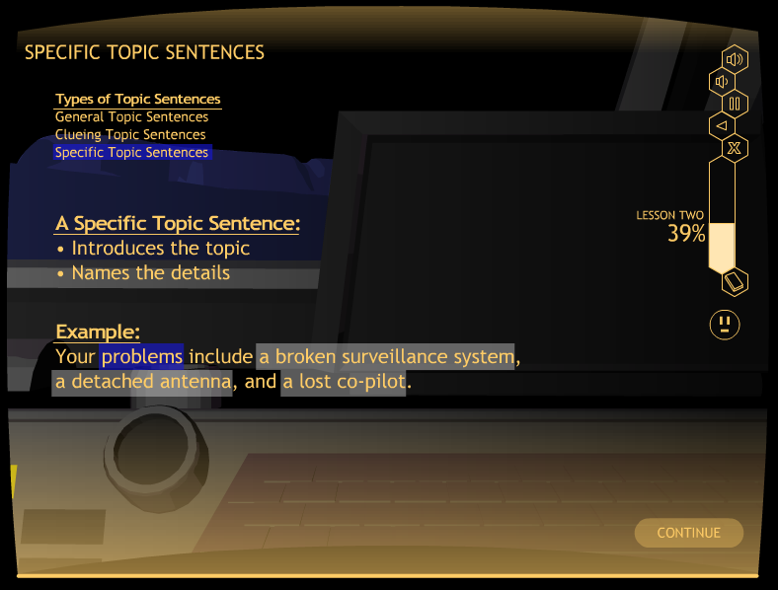

Slide 80
Let’s Look at Learn It
Go to B020
Stop at “Summary”
Click on “Exit”

Slide 81
Lesson 2: WATCH IT

Slide 82
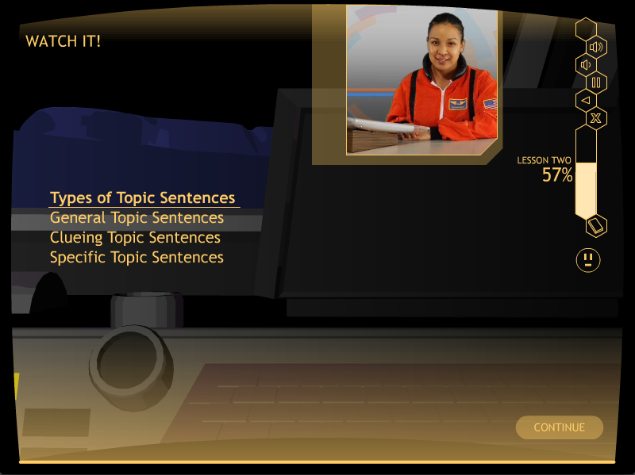
Matt: Please put a Watch It slide in here

Slide 83
Look at Watch It
Go to B033
Stop at “Moving On”
Click on “Exit”

Slide 84
Lesson 2: Study it

Slide 85
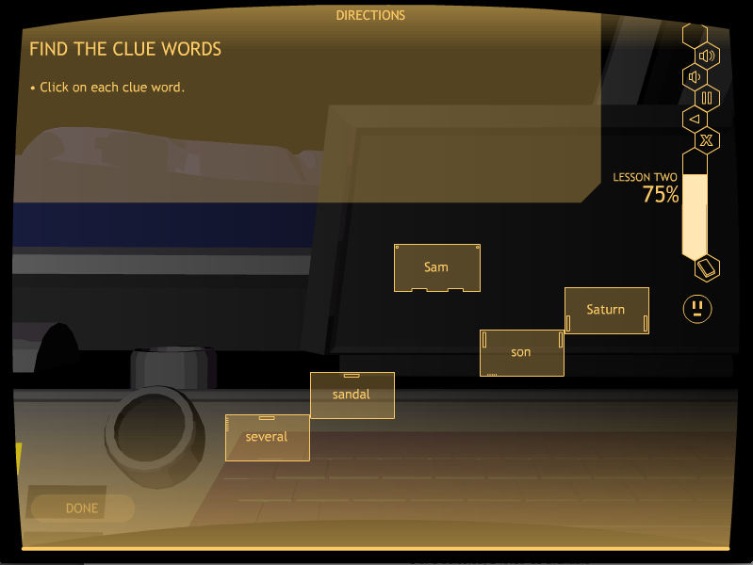
Matt: put a screen shot of Bo38 in here

Slide 86
Let’s look at Study It
Go to B038
Stop at “The Writing Steps”
Click on “Exit”

Slide 87
QUIZ TIME!
At the end of Study It, students take a quiz.
They can print it out, or you can give them a paper copy.
This replaces the Verbal Practice Quiz in the strategy programs.
Mastery is 100%
First time, recommend a short oral quiz of one or two questions to see if the student is ready.
If not, have the student repeat Study It.

Slide 89
Lesson 2: PRACTICE IT

Slide 90
Lesson 2: Practice it levels
Level 1: Identifying types of Topic Sentences
Level 2: Finishing Topic Sentences
Level 3: Writing Topic Sentences

Slide 91
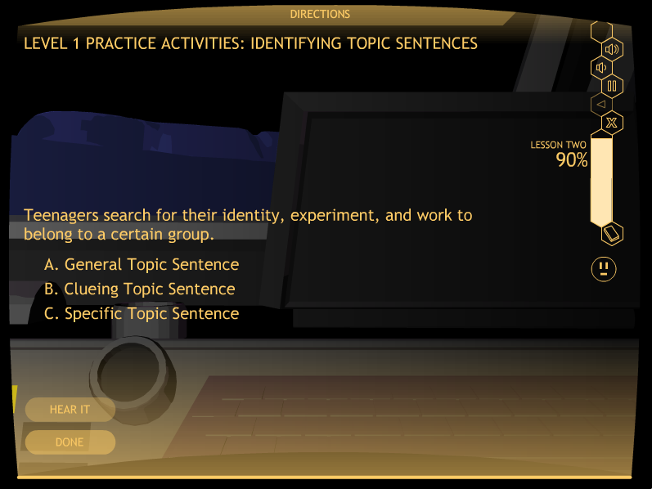
Matt: Please put a Level 1 screen shot in here

Slide 92
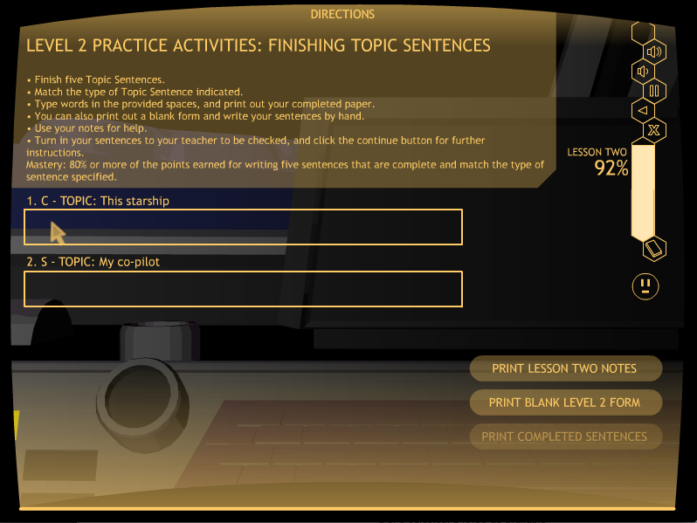
Matt: Put a screen shot of a B047 activity in here: Level 2 Practice It Activity
There should be part of a sentence in the box.

Slide 93
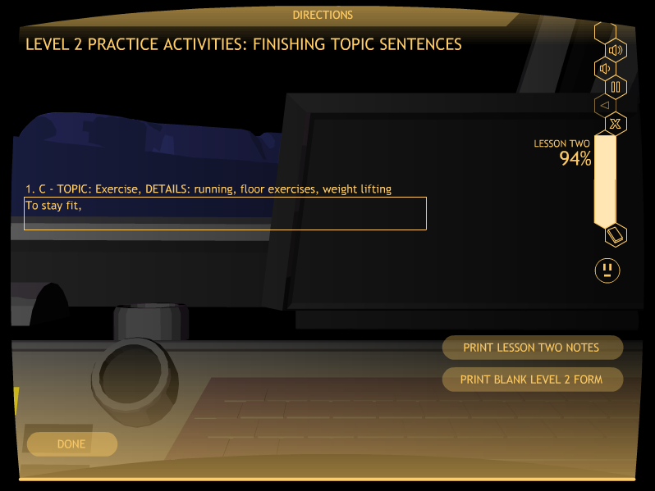

Slide 94
Look at Practice It
Go to B047: Level 2
Stop at “Level 3 Practice Activity”
Click on “Exit”

Slide 95

Matt: Please add in here the Level 3 slide showing the box where they write their own Topic sentence.

Slide 96

Matt: Please add in here the Level 3 slide showing the box where they write their own Topic sentence.

Slide 97
Lesson 2 practice It
Mastery
Level 1: 100%, two sets
Level 2: 80%, one set
Level 3: 80%, one set

Slide 98
Lesson 3

Slide 99
LESSON 3: PLANNING DIAGRAM
The Concepts taught:
The topic
The details
The sequences and transitions
The points of view
The tenses
The order of the details
The Topic Sentence (reviewed)

Slide 100
Lesson 3: learn it

Slide 101
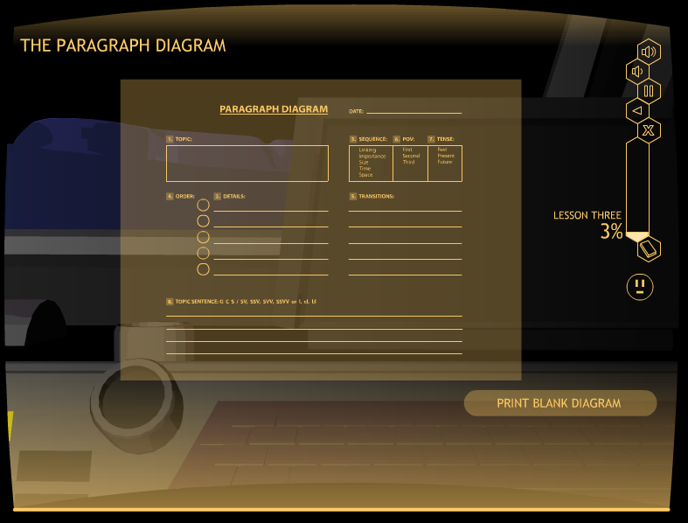

Slide 102
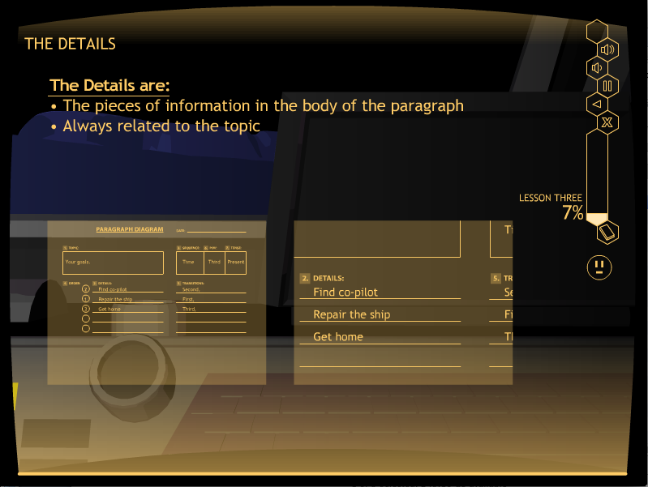
Matt: Please put a screen shot in here from
Learn it that shows a major section of the Paragraph
Diagram being explained.

Slide 103
Let’s Look at Learn It
Go to C005
Stop at “Order”
Click on “Exit”

Slide 104
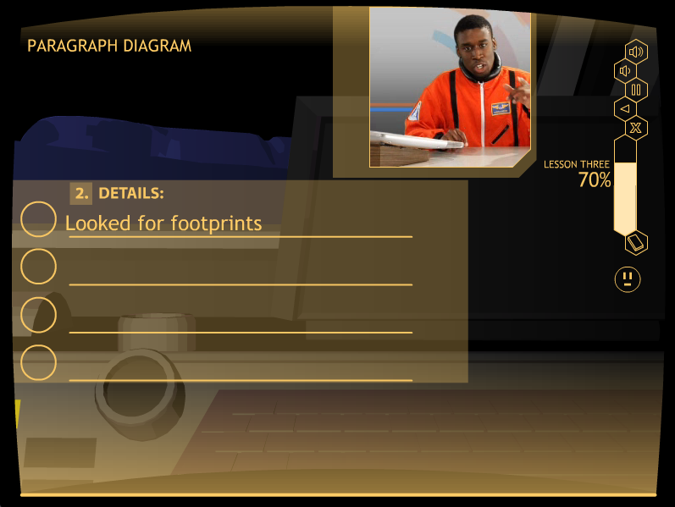
Lesson 3: Watch it
Matt: Please replace the next screen with a Watch it Screen that spells all the words correctly on the first line of details.

Slide 105
Look at Watch It
Go to C048
Stop at “Moving On”
Click on “Exit”

Slide 106
Lesson 3: Study It

Slide 107
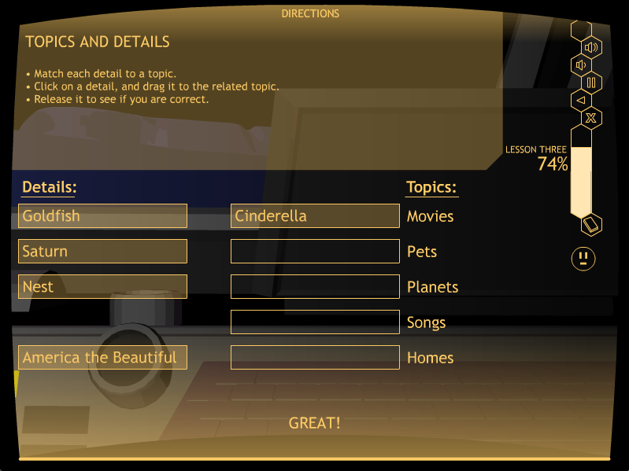
Matt: put a screen shot of Bo38 in here

Slide 108
Let’s Look at Study It
Go to C051
Stop at “Blast the Past Tense Words”
Click on “Exit”

Slide 109
QUIZ TIME!
At the end of Study It, students take a quiz.
They can print it out, or you can give them a paper copy.
This replaces the Verbal Practice Quiz in the strategy programs.
Mastery is 100%
A short oral quiz of one or two questions is recommended to see if the student is ready.
If not, have the student repeat Study It.

Slide 111
Lesson 3: Practice It
Level 1: Identifying point of view
Level 2: Identifying tense
Level 3: Identifying sequence
Level 4: Planning a paragraph

Slide 112
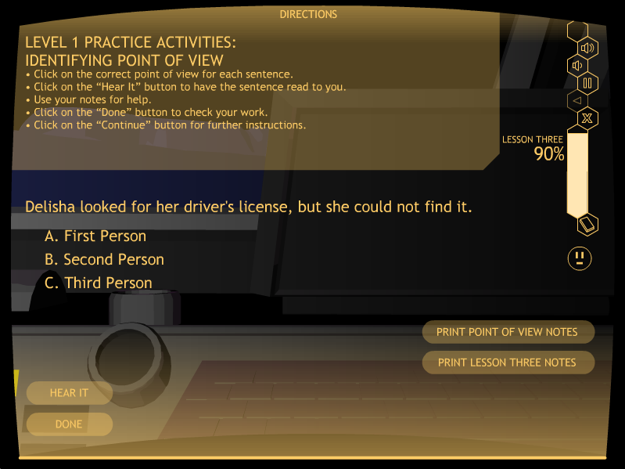
Matt: Please put a Level 1 screen shot in here

Slide 113
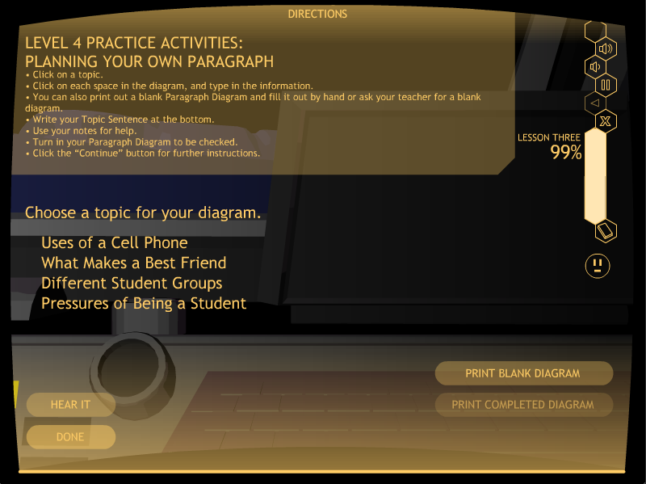
Matt: Put a screen shot of the Level 4 Practice It Activity in here
The topics should show here.

Slide 114
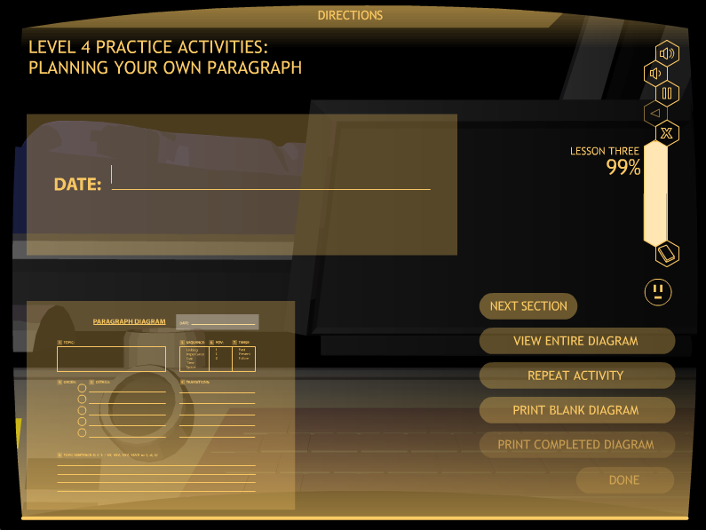
Matt: Please put in here a screen shot of the paragraph diagram that is to be filled out, with all the buttons on the right-hand side so they can be explained.

Slide 115
Look at Practice It
Go to C068
Stop when you have planned a paragraph
Click on “Exit”

Slide 116
Lesson 3 practice It
Mastery
Level 1: 80%, two sets
Level 2: 80%, two sets
Level 3: 80%, two sets
Level 4: 90%, one diagram

Slide 117
Lesson 4

Slide 118
LESSON 4: DETAIL SENTENCES
The concepts taught:
Two types of Detail Sentences
Lead-off Sentences
Follow-up Sentences

Slide 119
Lesson 4: Learn it

Slide 120
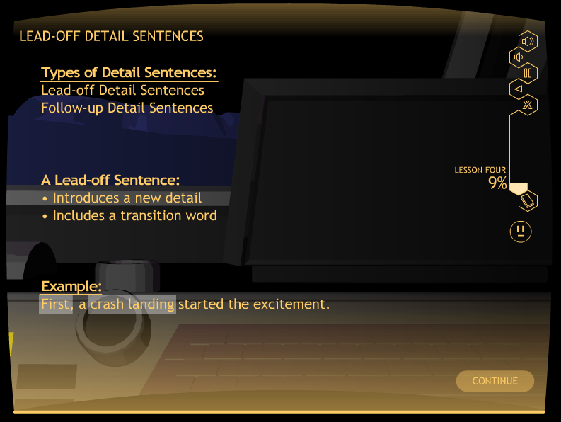

Slide 121
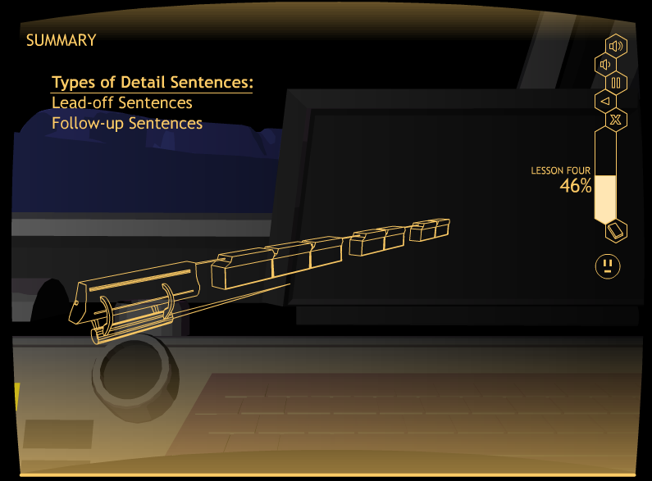
Matt: Please put in here the slide with the galactic train on it from the beginning paragraph CD. It should have all the cars.

Slide 122
Let’s Look at Learn It
Go to D012
Stop at “Summary”
Click on “Exit”

Slide 123
Lesson 4: Watch it

Slide 124
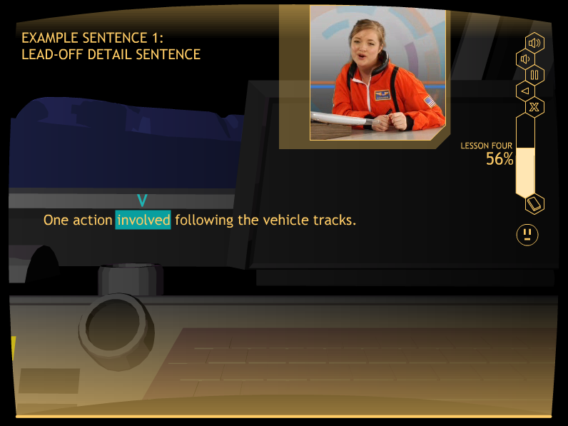
Matt: Please put a Watch It slide in here: Maybe D027 where you can see the
Lead-off sentence that she has written

Slide 125
Let’s Look at Watch It
Go to D027
Stop at “Example Sentence 2”
Click on “Exit”

Slide 126
Lesson 4: Study it

Slide 127
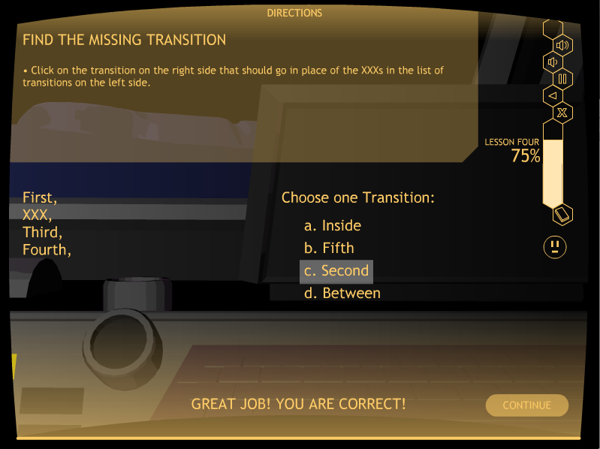
Matt: put a screen shot of D036 in here

Slide 128
Let’s Look at Study It
Go to D036
Stop at “Quiz Time”
Click on “Exit”

Slide 129
QUIZ TIME!
At the end of Study It, students take a quiz.
They can print it out, or you can give them a paper copy.
This replaces the Verbal Practice Quiz in the strategy programs.
Mastery is 100%

Slide 131
Lesson 4:
The practice Activities
Level 1: Identifying Lead-off and Follow-up Sentences
Level 2: Completing Lead-off and Follow-up Sentences
Level 3: Writing Lead-off and Follow-up Sentences
Level 4: Creating a Paragraph Diagram
Level 5: Writing a partial paragraph:
Topic Sentence and Detail Sentences

Slide 132
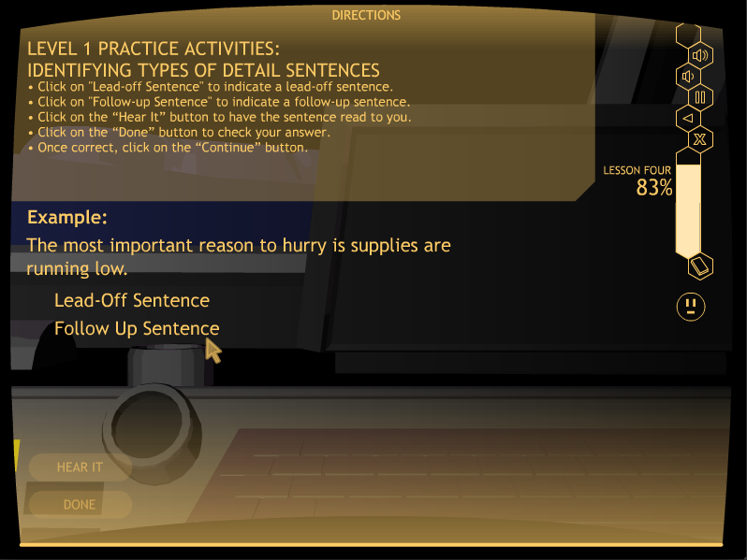
Matt: Please put a Level 1 screen shot in here for Lesson 4

Slide 133
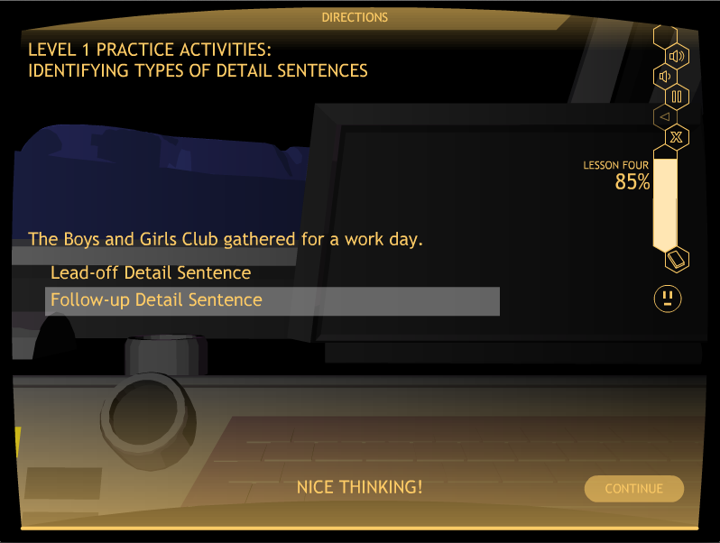

Slide 134
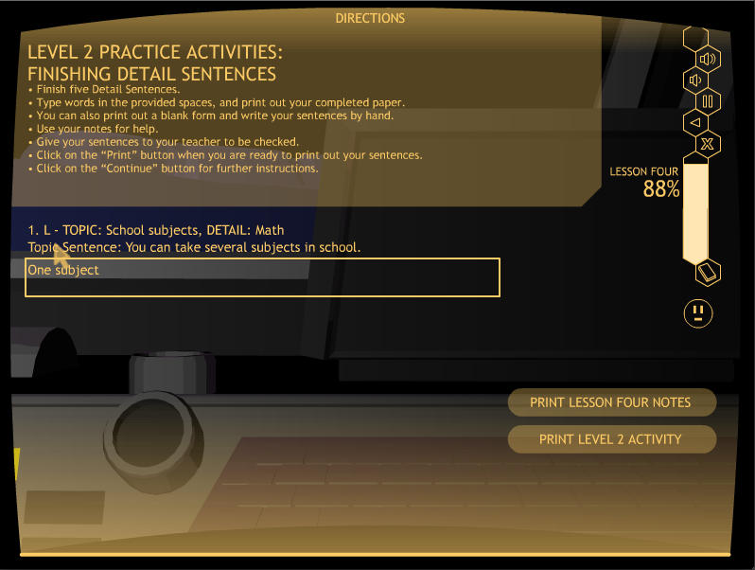
Matt: Put a screen shot of a D042 activity in here: Level 2 Practice It Activity
There should be part of a sentence in the box.

Slide 135
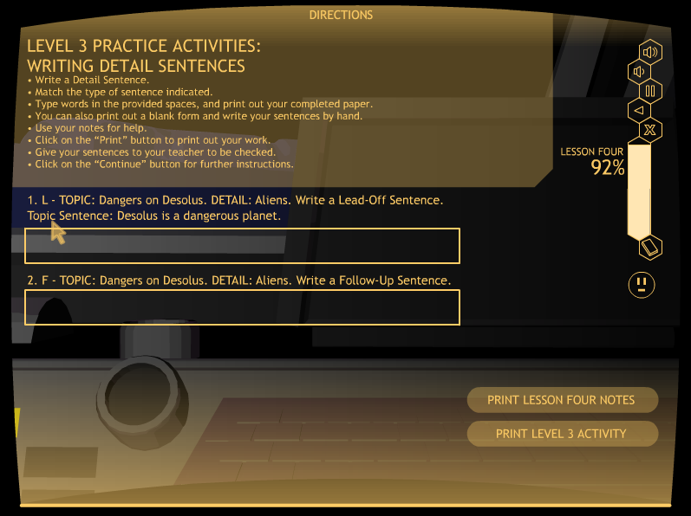
Matt: Please put in here slides for levels 3 & 4

Slide 136

Matt: Please put in here slides for levels 3 & 4

Slide 137

Matt: Please put a screen shot in here of the Level 4 screen where the two buttons are shown: Prompted, Indep.

Slide 138

Matt: Put a screen shot in here of a Prompted sentence, Like first Lead-off

Slide 139
Let’s Look at Practice It
Go to D047
Click on the “Prompted Activity” button
Stop at the end of this activity
Click on “Exit”

Slide 140
Lesson 4 practice It
Mastery
Level 1: 100%, two sets
Level 2: 80%, one set
Level 3: 80%, one set
Level 4: 90%, one diagram
Level 5: 80%, one paragraph

Slide 141
Lesson 5

Slide 142
LESSON 5: CLINCHER SENTENCES
    Concepts taught:
    Three types of Clincher Sentences
    General
    Clueing
    Specific

Slide 143
Lesson 5: Learn It

Slide 144


Slide 145

Matt: Please put in here the slide with the galactic train on it from the beginning paragraph CD. It should have all the cars.

Slide 146
Let’s Look at Learn It
Go to E025
Stop at “Moving On”
Click on “Exit”

Slide 147
Lesson 5: watch It

Slide 148

Matt: Please put a Watch It slide in here. E038 It should show the
Clincher Sentence that the pilot has written.

Slide 149
Let’s look at Watch It
Go to E038
Stop at “Moving On”
Click on “Exit”

Slide 150
Lesson 5: Study It

Slide 151

Matt: put a screen shot of E047 in here

Slide 152
Look at Study It
Go to E047
Stop at “Quiz Time”
Click on “Exit”

Slide 153
QUIZ TIME!
At the end of Study It, students take a quiz.
They can print it out, or you can give them a paper copy.
This replaces the Verbal Practice Quiz in the strategy programs.
Mastery is 100%

Slide 155
Lesson 5:
The practice Activities
Level 1: Identifying Clincher Sentences
Level 2: Completing Clincher Sentences
Level 3: Writing Clincher Sentences
Level 4: Creating a Paragraph Diagram
Level 5: Writing a whole paragraph

Slide 156

Matt: Please put a Level 1 screen shot in here- E052

Slide 157

Matt: Put a screen shot of a E054 activity in here: Level 2 Practice It Activity
There should be part of a sentence in the box.

Slide 158

Matt: Please add in here the slides for Levels 3 and 4 for Lesson 5

Slide 159

Matt: Please add in here the slides for Levels 3 and 4 for Lesson 5

Slide 160

Matt: Please add in here the slides for Levels 3 and 4 for Lesson 5

Slide 161

Matt: Please put a screen shot in here of the Level 4 screen where the two buttons are shown: Prompted, Indep.

Slide 162

Matt: Put a screen shot in here of a Prompted sentence, Like Clincher sentence

Slide 163

Matt: Please insert the screen for the Independent paragraph here where the kid writes the paragraph in the box.

Slide 164
Look at Practice It
Go to E059
Click on the “Independent Activity” button
Stop at the end of this activity
Click on “Exit”

Slide 165
Lesson 5 practice It
Mastery
Level 1: 100%, two sets
Level 2: 80%, one set
Level 3: 80%, one set
Level 4: 90%, one diagram
Level 5: 80%, one paragraph

Slide 166

Matt: Please insert in here a colorful slide as a transition slide

Slide 167
Study DETAILS
Control-group design with randomly selected groups (experimental and control groups)
Plus a normative group

Slide 168
More Study Details
STRUGGLING WRITERS
Junior high writing group = 24 students
Junior high reading group = 17 students
Senior-high writing group = 18 students
Senior-high reading group = 18 students
NORMAL LEARNERS
• Junior-high group = 24 students
• Senior-high group = 21 students

Slide 169
Paragraph strategy Knowledge
• Experimental students made statistically significant gains on a test of Paragraph Strategy Knowledge:
Junior High – 15% to 94% of the points
Senior High – 17% to 98% of the points
• Control Students made no gains

Slide 170
Sentence completeness
• On a Paragraph Writing Test, experimental students made statistically significant gains on a measure of sentence completeness:
Junior High – 61% to 94% sentences complete
Senior High – 59% to 98% sentences complete
• Control Students made no gains

Slide 171
Paragraph writing skills
• Experimental students made statistically significant gains on a test of Paragraph Writing Skills:
Junior High – 26% to 88% of the points
Senior High – 17% to 96% of the points
• Control Students made no gains

Slide 172
Results summary
All experimental group students met mastery on the sentence writing and paragraph writing skills.
All experimental group students made statistically significant and socially significant gains on all measures of sentence writing, paragraph planning, and paragraph organization.
The control students made no gains on any measures of writing.

Slide 173
Results summary (continued)
There were no significant differences between the experimental junior-high and senior-high students’ scores on the posttests while controlling for the pretest scores. (Junior-high and senior-high students learned equally well from the program.)
There were significant differences between the experimental and control students’ posttest scores while controlling for the pretest scores, with very large effect sizes for each measure.
The experimental students’ mean posttest scores exceeded the mean end-of-year scores of the normal students.

Slide 174
For more information about the writing strategy programs, contact:
Edge Enterprises, Inc.
708 W. 9th St.
Lawrence, KS 66044
785-749-1473
www.edgeenterprisesinc.com

