Slide 1
The Star Writer Program: COMPUTERIZED
PARAGRAPH-WRITING STRATEGY INSTRUCTION
Jean Schumaker
October, 2015

Slide 2
TODAY’S GOALS
To familiarize you with:
The Star Writer Program content for beginning Paragraph Writing
The program structure
Your role as a teacher
The instructor’s guide
Other materials
The research

Slide 3
Lessons in the Program
Introduction
Lesson 1: Complete Sentences
Lesson 2: Topic Sentences
Lesson 3: Planning Diagram
Lesson 4: Detail Sentences
Lesson 5: Clincher Sentences

Slide 4
The program is based on strategic instruction
  The Paragraph Writing Strategy
  Instructional Methods for teaching strategies

Slide 5
CONTENT OF THE PROGRAM
Parts I, II, III of the Paragraph Writing Strategy Program
The program builds across the lessons so that students are writing whole paragraphs in Lesson 5

Slide 6
Basic Instructional Methods for Teaching Strategies
Describe
Model
Verbal Practice
Controlled Practice
Advanced Practice

Slide 7
LESSON FORMAT
Learn It
(Describe)
Watch It
(Model)
Study It
(Verbal Practice)
Practice It
(Controlled Practice)
(Advanced Practice)

Slide 8
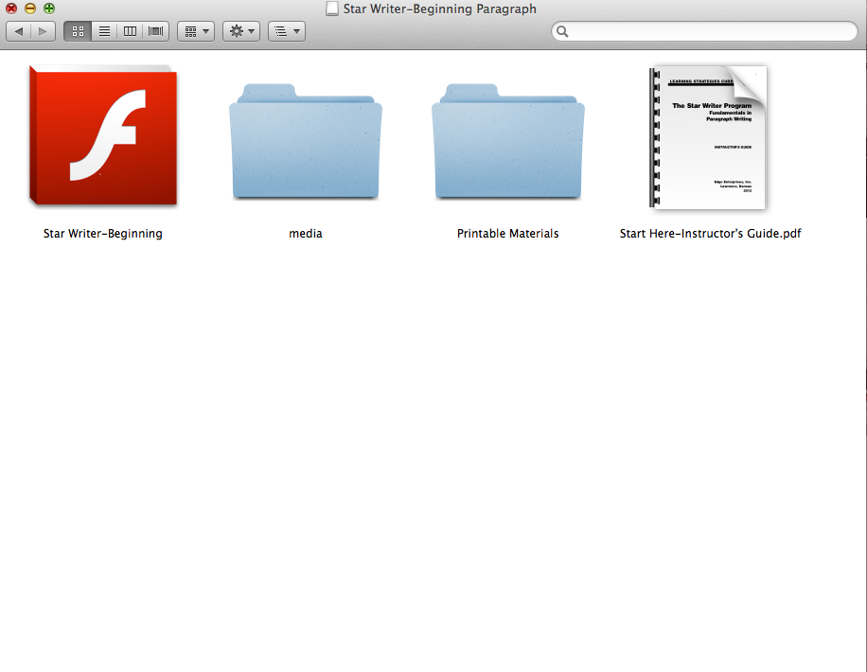
Matt: Please insert in here several slides showing the icons and folders they will see when they open the program, open the printable materials, open the instructor’s guide, etc.

Slide 9
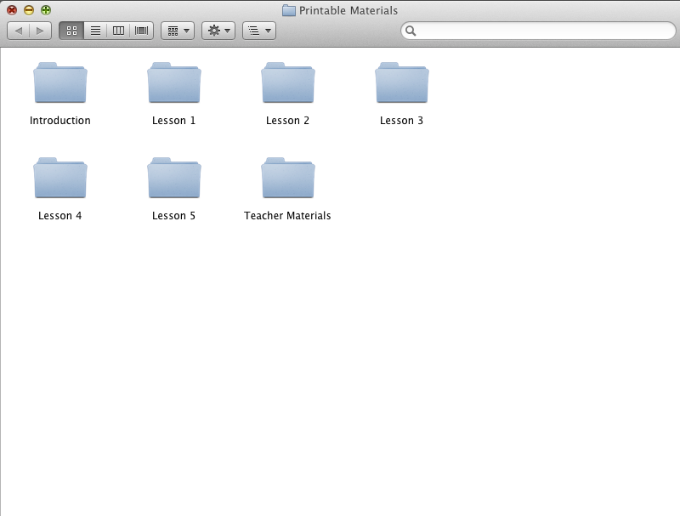

Slide 10
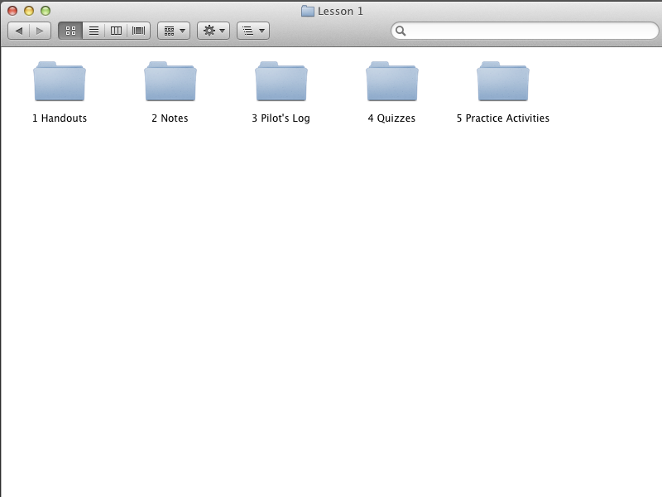

Slide 11
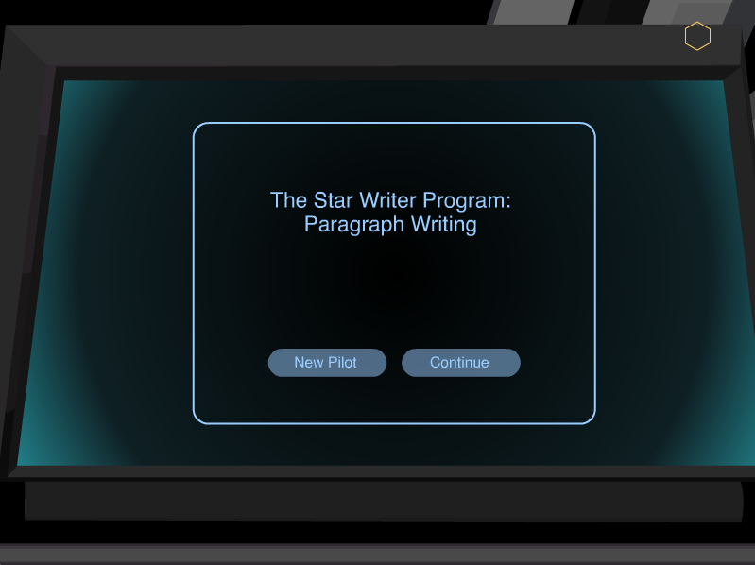

Slide 12
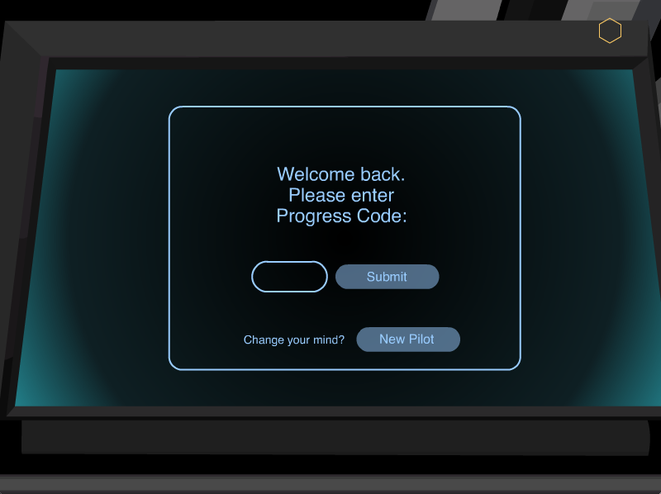

Slide 13
INTRODUCTION

Slide 14
INTRODUCTION
Begins the plot
Provides the navigation instructions
Introduces the purpose of the program
Provides an overview of the lessons
a

Slide 15
The Plot

Slide 16
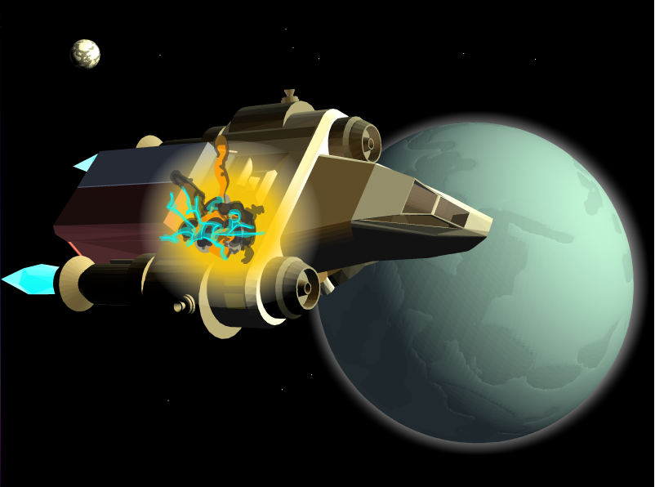

Slide 17
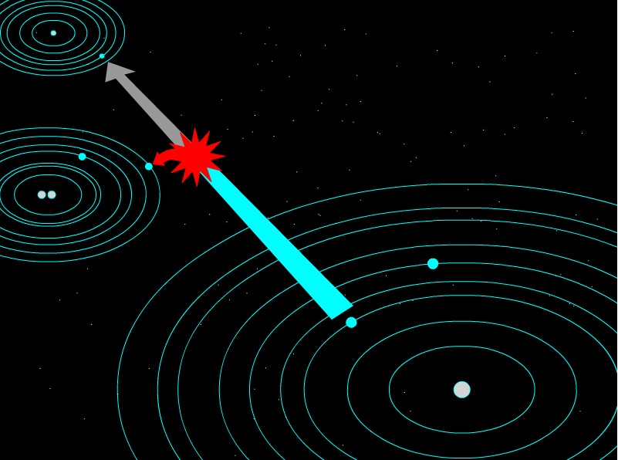

Slide 18
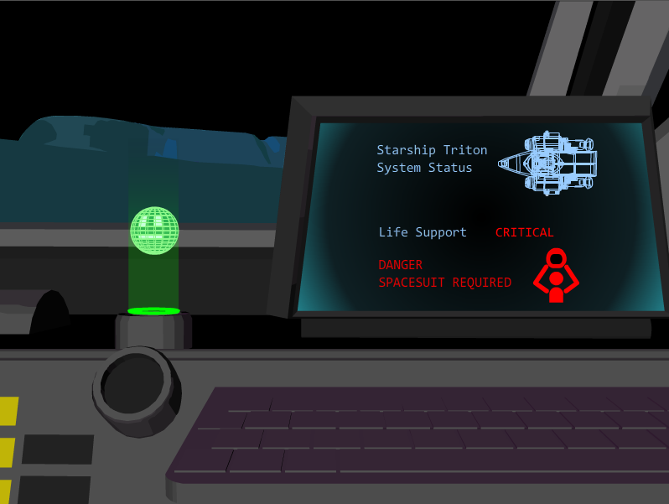

Slide 19
THE NAVIGATION

Slide 20
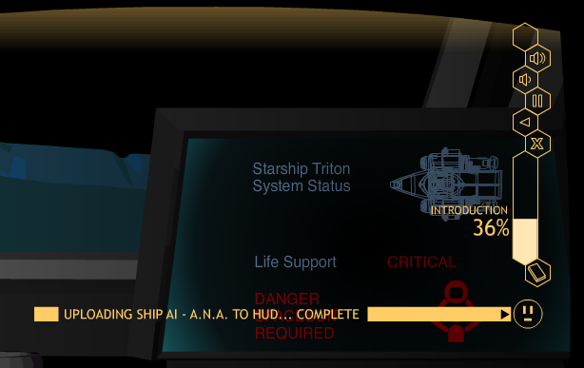
Matt: Put a screen shot in here of Row 4 with the navigation buttons enlarged.

Slide 21
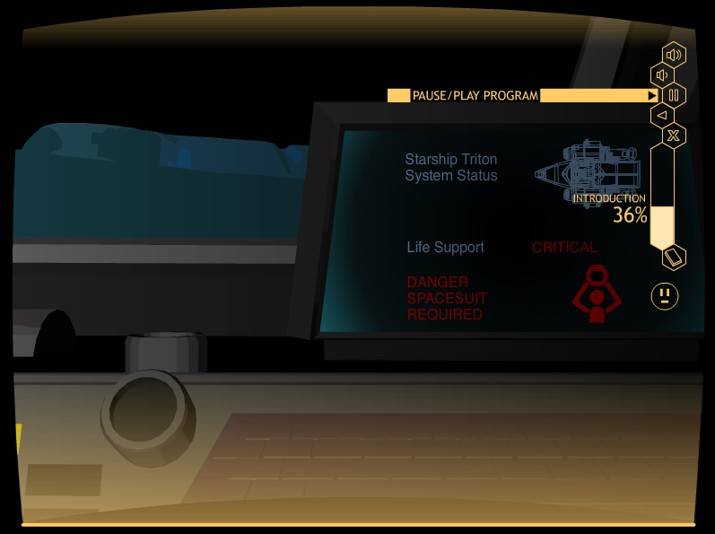
Matt: Please insert in here several slides showing the
Navigation buttons, like exit, restart, etc.

Slide 22
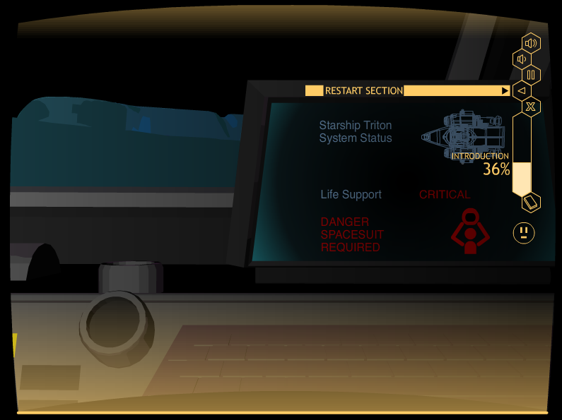
Matt: Please insert in here several slides showing the
Navigation buttons, like exit, restart, etc.

Slide 23
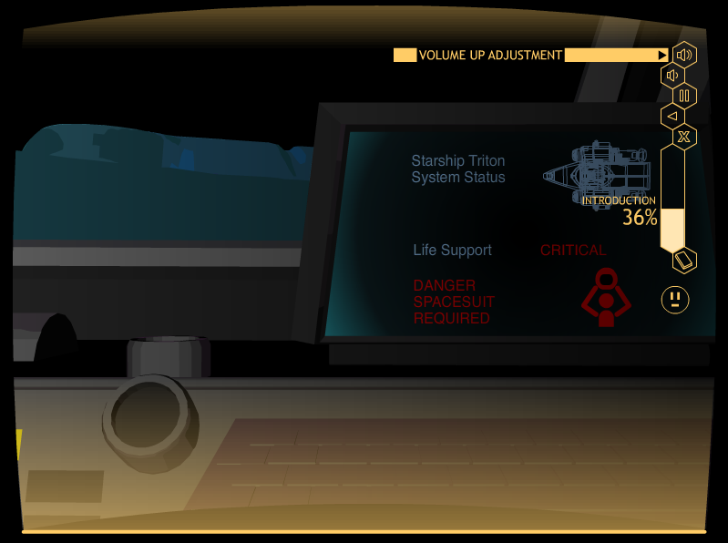
Matt: Please insert in here several slides showing the
Navigation buttons, like exit, restart, etc.

Slide 24
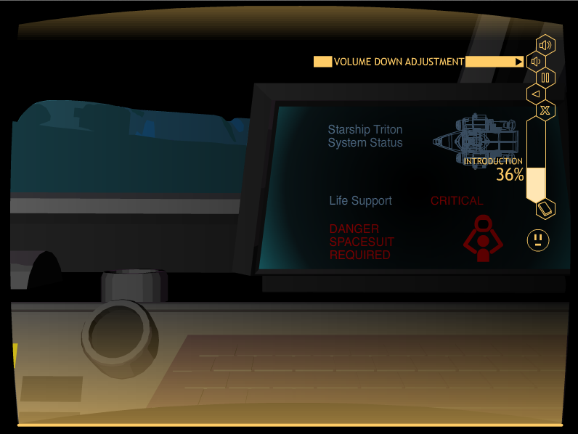
Matt: Please insert in here several slides showing the
Navigation buttons, like exit, restart, etc.

Slide 25
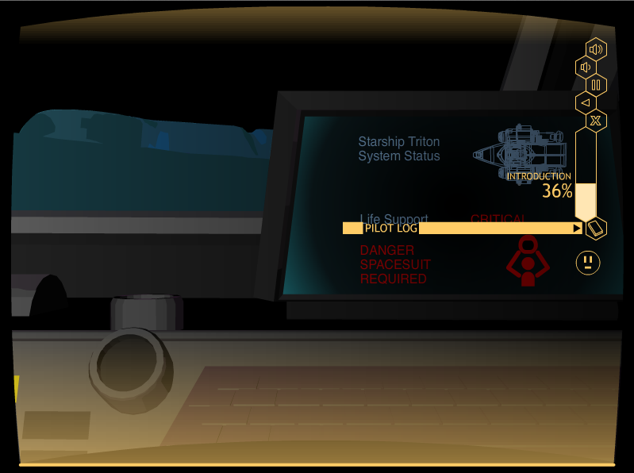
Matt: Please insert in here several slides showing the
Navigation buttons, like exit, restart, etc.

Slide 26
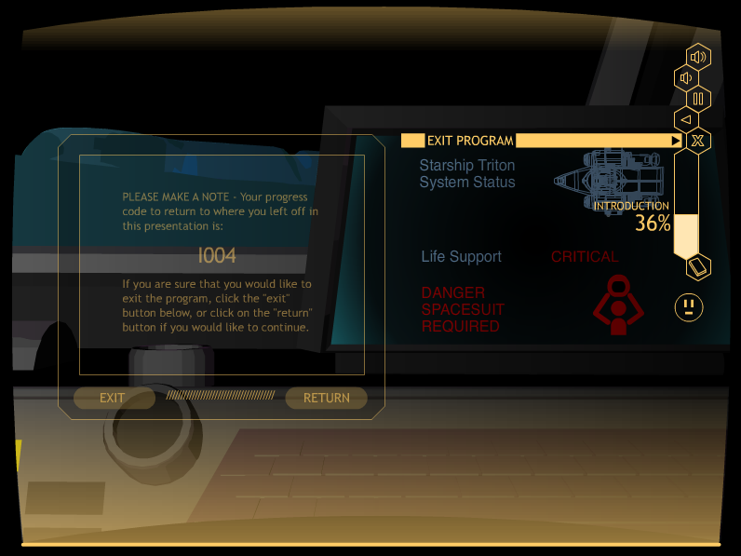
Matt: Please insert in here several slides showing the
Navigation buttons, like exit, restart, etc.

Slide 27
Matt: Please put a photo of the Pass Code sheet in here.

Slide 28
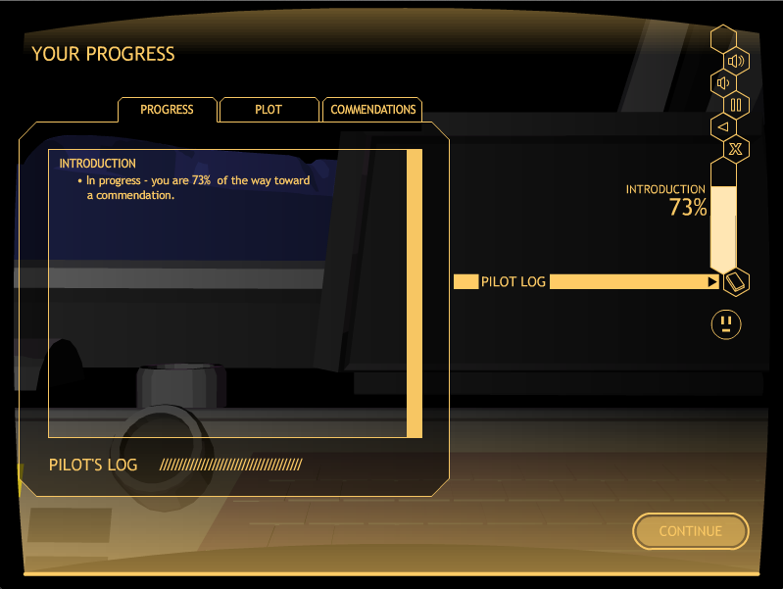
Matt: Please put a screen shot of the Pilot’s log in here at the point of the last screen of the intro.

Slide 29
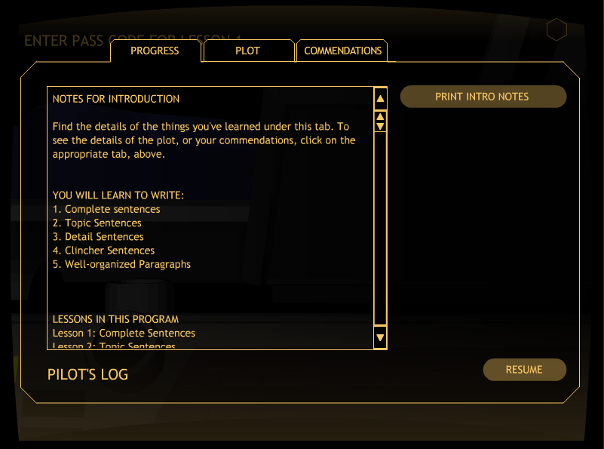

Slide 30
THE PURPOSE

Slide 31
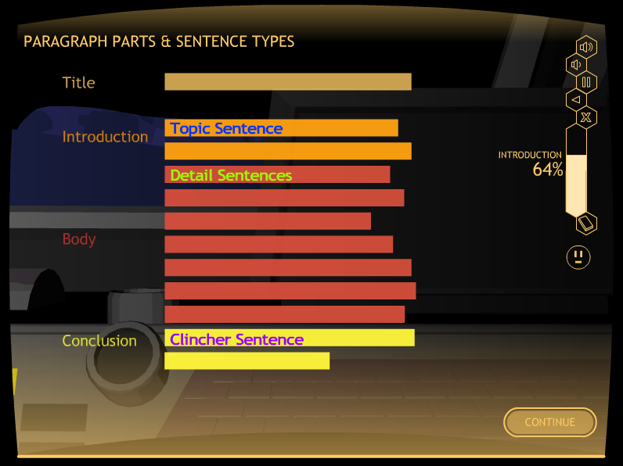

Slide 32
OVERVIEW OF THE PROGRAM

Slide 33
The Lessons
Lesson 1: Complete Sentences
Lesson 2: Topic Sentence
Lesson 3: Planning a Paragraph
Lesson 4: Detail Sentences
Lesson 5: Clincher Sentences

Slide 34
LESSON STRUCTURE
            Learn It
            Watch It
            Study It
            Practice It

Slide 35
Let’s Look at the instructor’s guide

Slide 36
Matt: Please insert in here several slides showing the icons and folders they will see when they open the program, open the printable materials, open the instructor’s guide, etc.

Slide 38
Notice the Pass Codes!

Slide 39
Lesson 1

Slide 40
LESSON 1: COMPLETE SENTENCES
Major Concepts:
Complete sentence
Subjects and verbs
Simple Sentences
Compound Sentences

Slide 41
Lesson 1: Learn it

Slide 42
Lesson Format FOR Learn It
Introduction
Concept #1
Definition
Examples
Practice Activity
Concept #2
Definition
Examples
Practice Activity
Concept #N
Definition
Examples
Practice Activity
Closing
Notes:
Lesson format: Learn It [Does this look okay??? Shall I change it to one column, even thought it will be much smaller font?]

Slide 43
EXAMPLE LEARN IT SCREEN

Slide 44
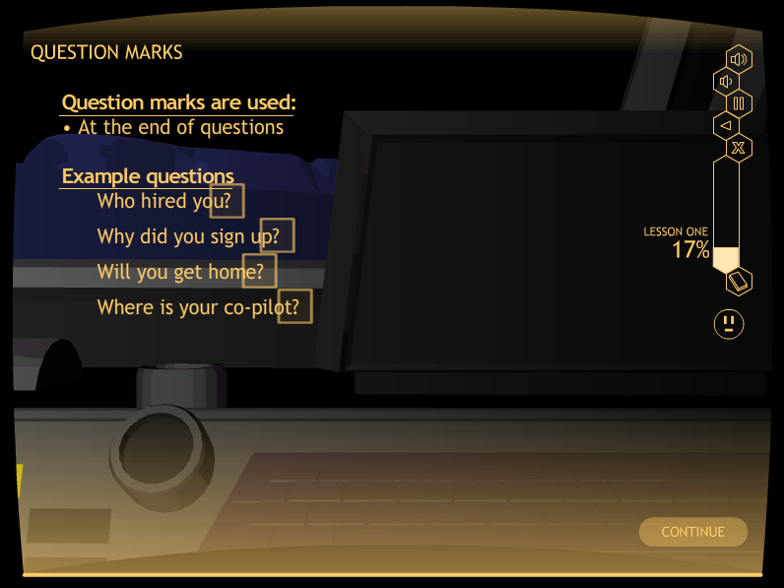
Matt: Please add a slide in here showing the instruction for end punctuation. I’m thinking screen A018

Slide 45
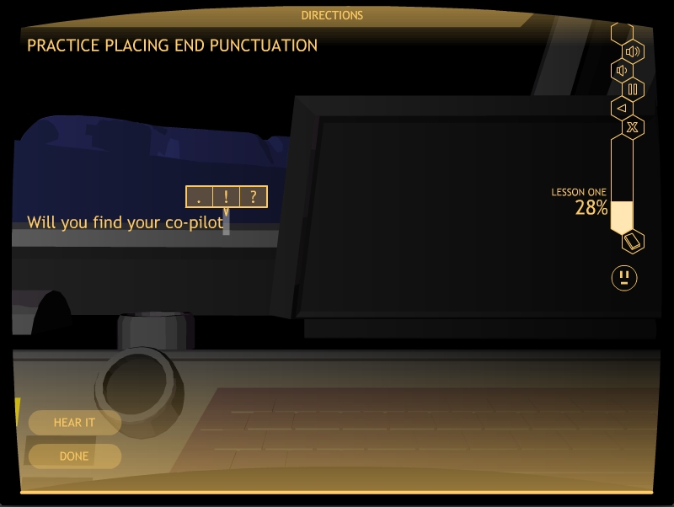
Matt: Please put a screen shot from A029 in here showing the three option choices for punctuation

Slide 46
Let’s Look at A simple Activity
• Go to A029
• Stop after 3 sentences
• Click on “Exit”

Slide 49
Subjects and verbs

Slide 50
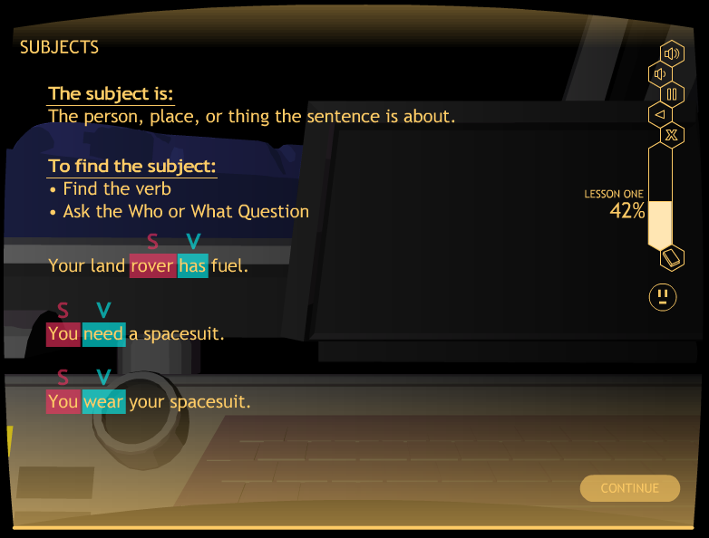

Slide 51
Let’s look at another learn it section
Go to A034
Stop at “Subjects”
Click on “Exit”

Slide 52
Lesson 1: Watch It

Slide 53
EXAMPLE WATCH IT SCREEN

Slide 54
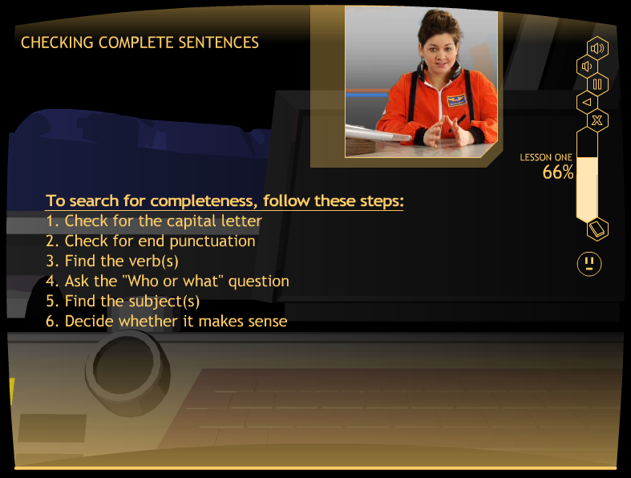

Slide 55
Let’s “watch It”
Go to A074
Stop at “Example Sentence 2”
Click on “Exit”

Slide 56
Lesson 1: Study It

Slide 57
EXAMPLE STUDY IT SCREEN

Slide 58
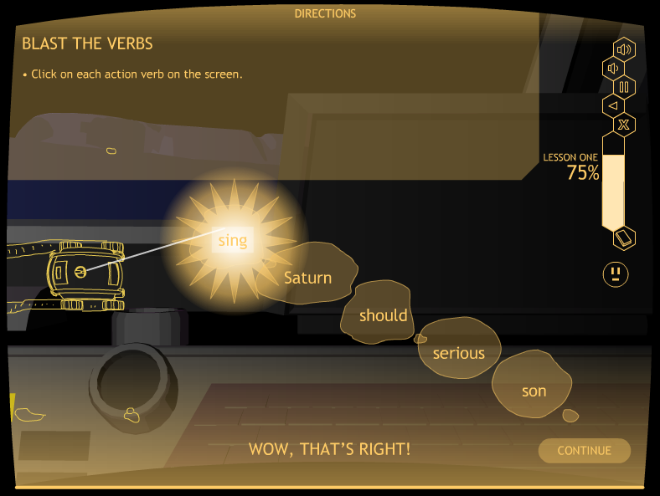

Slide 59
Let’s Look at “Study It”
Go to A083 “Blast the Verbs”
Stop at “Blast the Subjects”
Click on “Exit”

Slide 60
QUIZ TIME!
At the end of Study It, students take a quiz.
They can print it out, or you can give them a paper copy.
This replaces the Verbal Practice Quiz in the strategy programs.
Mastery is 100%
First time, a short oral quiz of one or two questions is recommended to see if the student is ready.
If not, have the student repeat Study It.

Slide 62
A Caution about the first quiz!!
Briefly quiz (one or two oral questions) to make sure the student is ready to take the quiz.
Have the student repeat Study It when not ready.
Next time, the student will be ready.

Slide 63
Lesson 1: Practice It

Slide 64
Practice It Levels 1-6
Level 1: Identifying a subject and a verb
Level 2: Identifying more subjects and verbs
Level 3: Finishing simple sentences
Level 4: Writing simple sentences
Level 5: Finishing compound sentences
Level 6: Writing compound sentences

Slide 65
EXAMPLE PRACTICE IT SCREENS

Slide 66
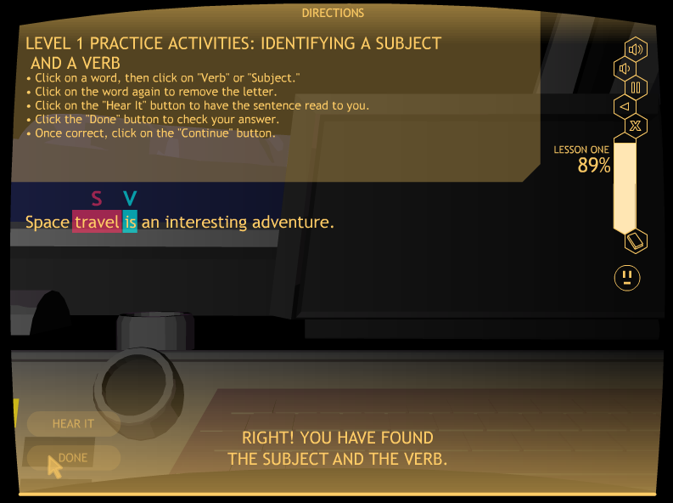

Slide 67
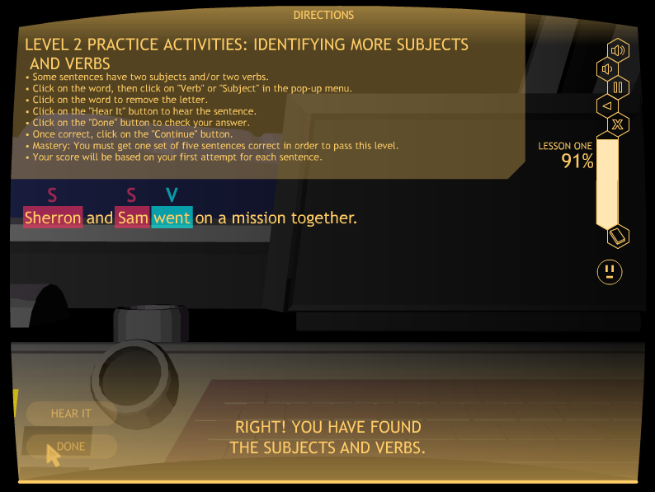
Matt: Please insert a Level 2 slide in here showing the
Little subject
Verb screen.

Slide 68
Let’s look at “practice It,
Level 2”
Go to A098 (Level 2)
Click on “subject” or “verb” for each subject and verb
Click on the “Hear It,” “Done,” & “Continue” buttons
Stop after one set of five sentences
Click on the “Exit” button

Slide 69
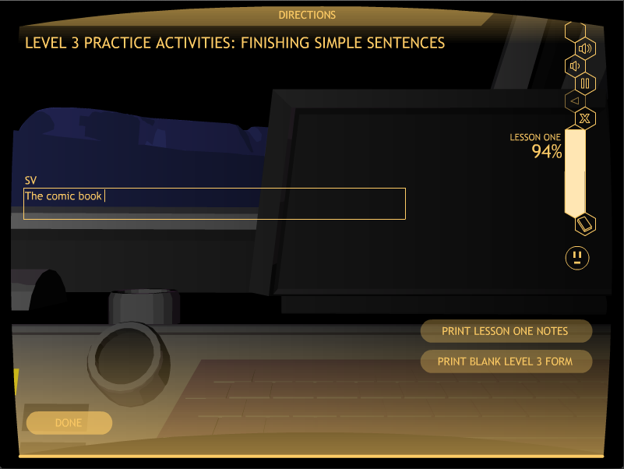
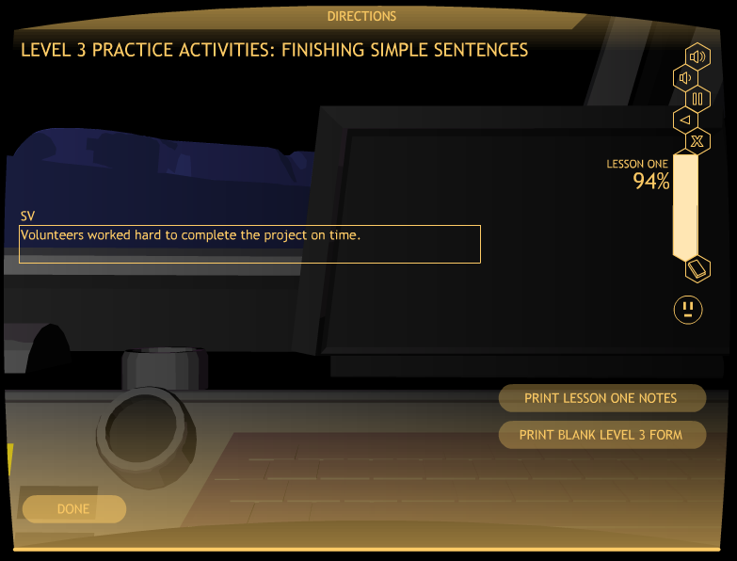

Slide 70
Let’s Look at practice It
Level 3
Go to A099 (Level 3)
Finish five simple sentences
Stop after editing one set of five sentences
Click on the “Exit” button

Slide 71
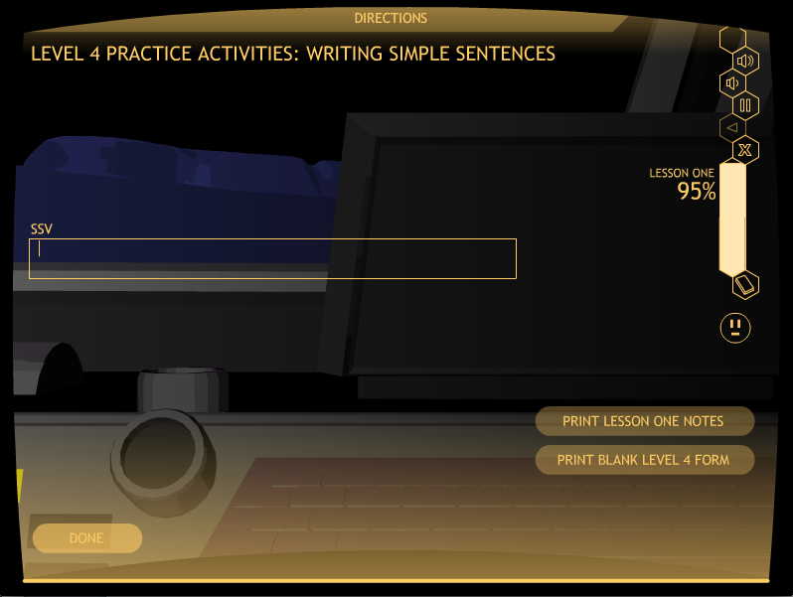

Slide 72
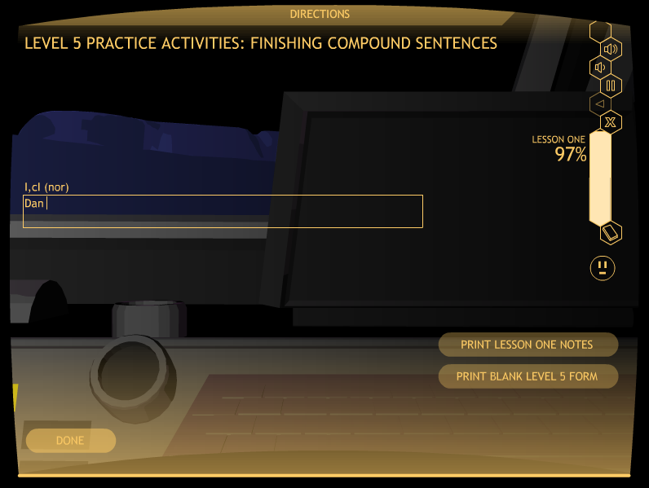

Slide 73


Slide 74
Lesson 1 practice It
Mastery
Level 1: 100%, two sets
(Computer scored)
Level 2: 100%, one set
(Computer scored)
Level 3: 80%, one set
(Teacher scored)

Slide 75
Lesson 1 practice It
Mastery
Level 4, 80%, one set
(Teacher scored)
Level 5: 80%, one set
(Teacher scored)
Level 6: 80%, one set
(Teacher scored)

Slide 76
Let’s Look at the printable materials folder
Go to the program folder
Click on the Printable Materials Folder

Slide 77
Matt: Please insert in here several slides showing the icons and folders they will see when they open the program, open the printable materials, open the instructor’s guide, etc.

Slide 80
Lesson 2

Slide 81
LESSON 2: TOPIC SENTENCES
The Concepts:
Three types of Topic Sentences
          General
          Clueing
          Specific

Slide 82
Lesson 2: Learn It

Slide 83
Lesson Format FOR Learn It
Introduction
Concept #1
Definition
Examples
Practice Activity
Concept #2
Definition
Examples
Practice Activity
Concept #N
Definition
Examples
Practice Activity
Closing
Notes:
Lesson format: Learn It [Does this look okay??? Shall I change it to one column, even thought it will be much smaller font?]

Slide 84
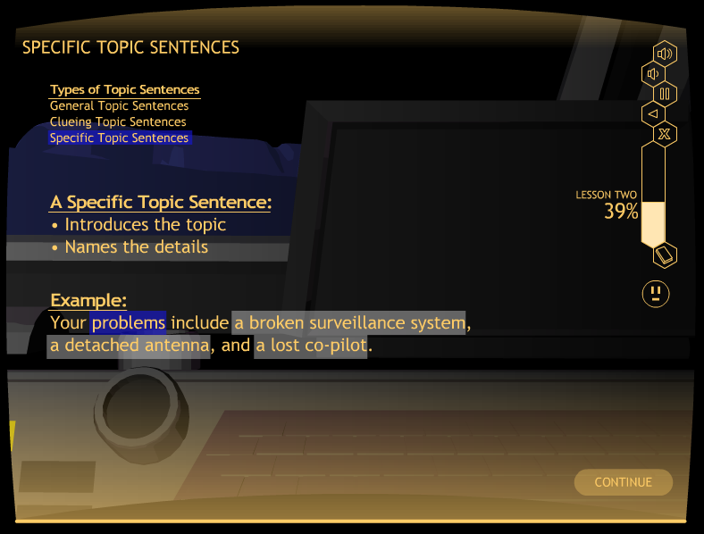

Slide 85
Let’s Look at Learn It
Go to B020
Stop at “Summary”
Click on “Exit”

Slide 86
Lesson 2: WATCH IT

Slide 87
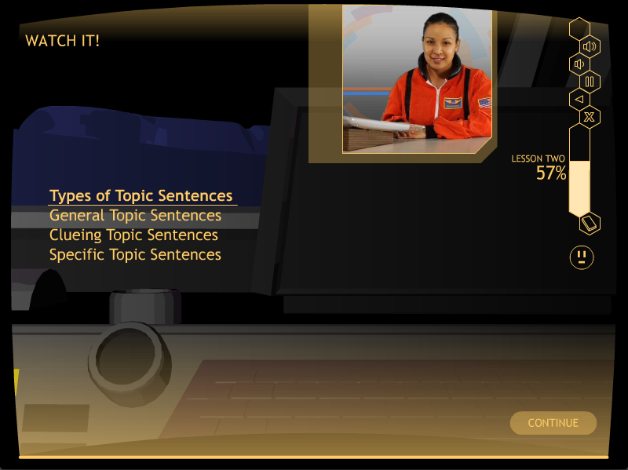
Matt: Please put a Watch It slide in here

Slide 88
Look at Watch It
Go to B033
Stop at “Moving On”
Click on “Exit”

Slide 89
Lesson 2: Study it

Slide 90
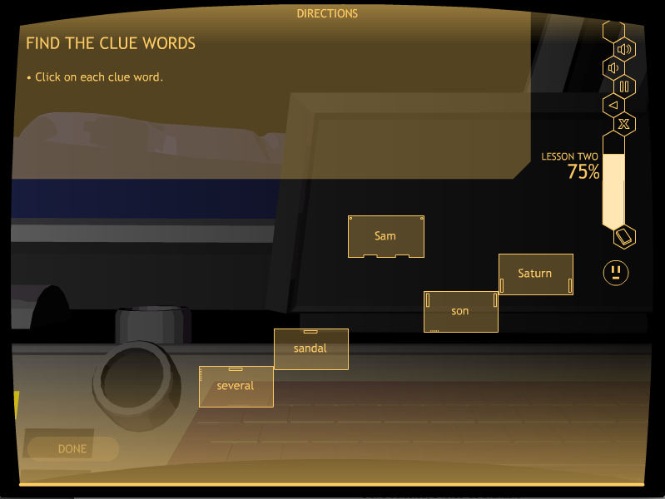
Matt: put a screen shot of Bo38 in here

Slide 91
Let’s look at Study It
Go to B038
Stop at “The Writing Steps”
Click on “Exit”

Slide 92
QUIZ TIME!
At the end of Study It, students take a quiz.
They can print it out, or you can give them a paper copy.
This replaces the Verbal Practice Quiz in the strategy programs.
Mastery is 100%
First time, recommend a short oral quiz of one or two questions to see if the student is ready.
If not, have the student repeat Study It.

Slide 94
Lesson 2: PRACTICE IT

Slide 95
Lesson 2: Practice it levels
Level 1: Identifying types of Topic Sentences
Level 2: Finishing Topic Sentences
Level 3: Writing Topic Sentences

Slide 96
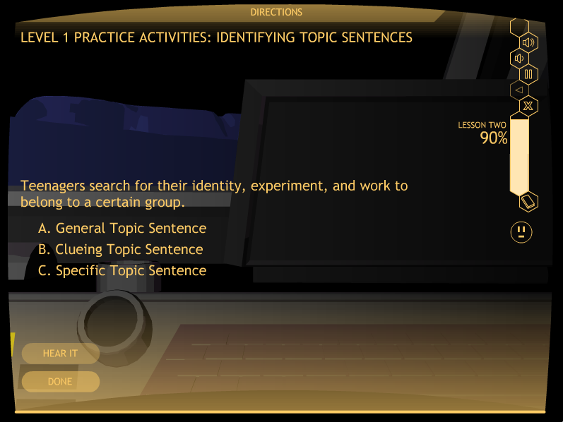
Matt: Please put a Level 1 screen shot in here

Slide 97
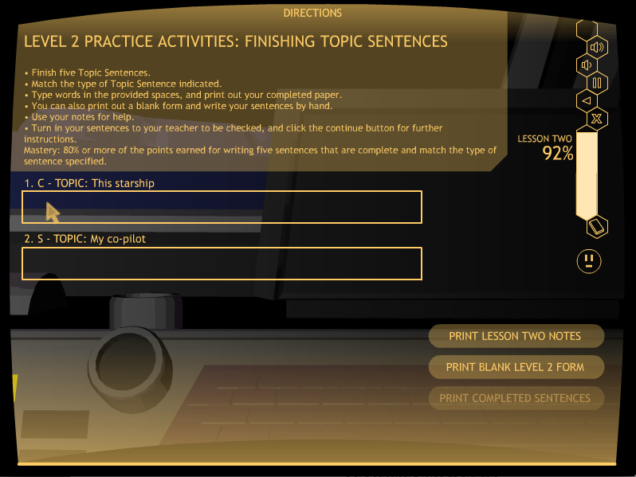
Matt: Put a screen shot of a B047 activity in here: Level 2 Practice It Activity
There should be part of a sentence in the box.

Slide 98
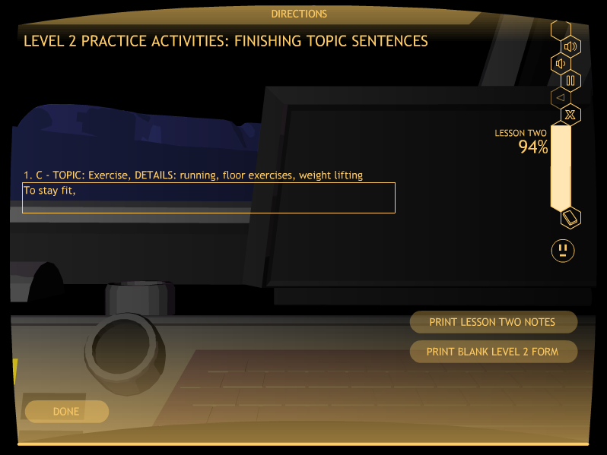
LET’

Slide 99
LET’S Look at Practice It
Go to B047: Level 2
Stop at “Level 3 Practice Activity”
Click on “Exit”

Slide 100

Matt: Please add in here the Level 3 slide showing the box where they write their own Topic sentence.

Slide 101

Matt: Please add in here the Level 3 slide showing the box where they write their own Topic sentence.

Slide 102
Lesson 2 practice It
Mastery
Level 1: 100%, two sets
(Computer scored)
Level 2: 80%, one set
(Teacher scored)
Level 3: 80%, one set
(Teacher scored)

Slide 103
Lesson 3

Slide 104
LESSON 3: PLANNING DIAGRAM
The Concepts taught:
The topic
The details
The sequences and transitions
The points of view
The tenses
The order of the details
The Topic Sentence (reviewed)

Slide 105
Lesson 3: learn it

Slide 106
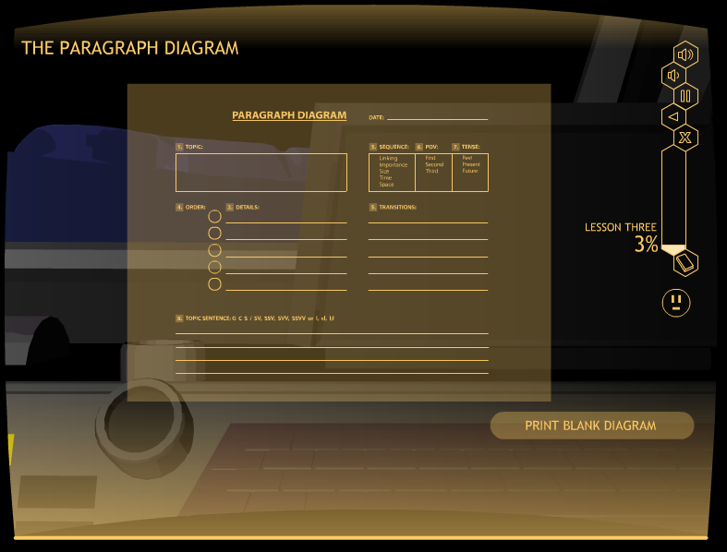

Slide 107
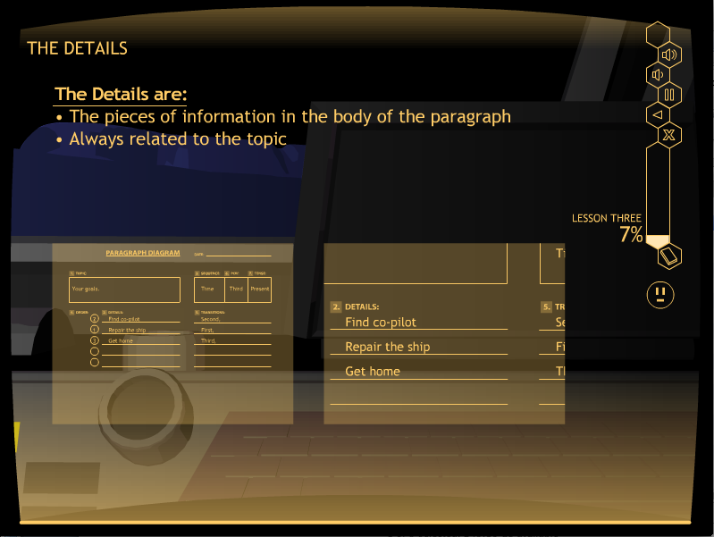
Matt: Please put a screen shot in here from
Learn it that shows a major section of the Paragraph
Diagram being explained.

Slide 108
Let’s Look at Learn It
Go to C005
Stop at “Order”
Click on “Exit”

Slide 109
LESSON 3: WATCH IT

Slide 110
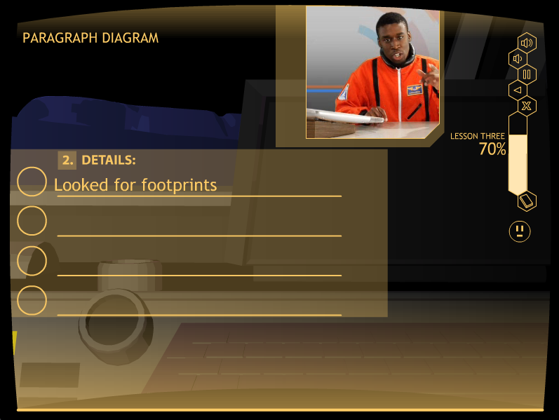
Lesson 3: Watch it
Matt: Please replace the next screen with a Watch it Screen that spells all the words correctly on the first line of details.

Slide 111
LET’S Look at Watch It
Go to C048
Stop at “Moving On”
Click on “Exit”

Slide 112
Lesson 3: Study It

Slide 113
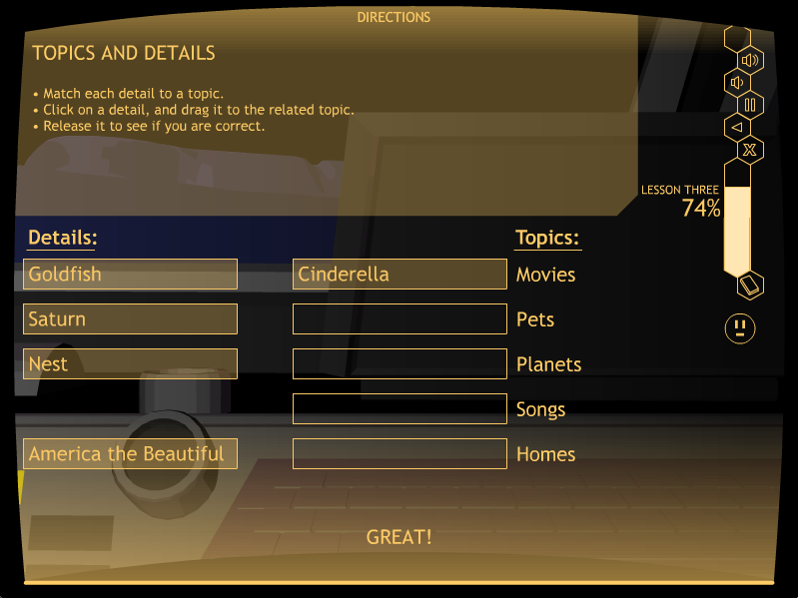
Matt: put a screen shot of Bo38 in here

Slide 114
Let’s Look at Study It
Go to C051
Stop at “Blast the Past Tense Words”
Click on “Exit”

Slide 115
QUIZ TIME!
At the end of Study It, students take a quiz.
They can print it out, or you can give them a paper copy.
This replaces the Verbal Practice Quiz in the strategy programs.
Mastery is 100%
A short oral quiz of one or two questions is recommended to see if the student is ready.
If not, have the student repeat Study It.

Slide 117
Lesson 3: Practice It
Level 1: Identifying point of view
Level 2: Identifying tense
Level 3: Identifying sequence
Level 4: Planning a paragraph

Slide 118
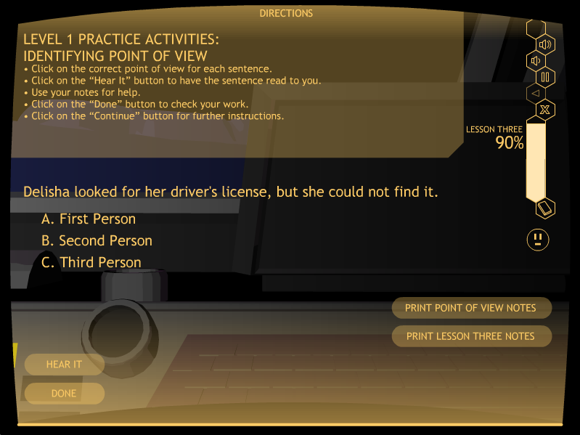
Matt: Please put a Level 1 screen shot in here

Slide 119
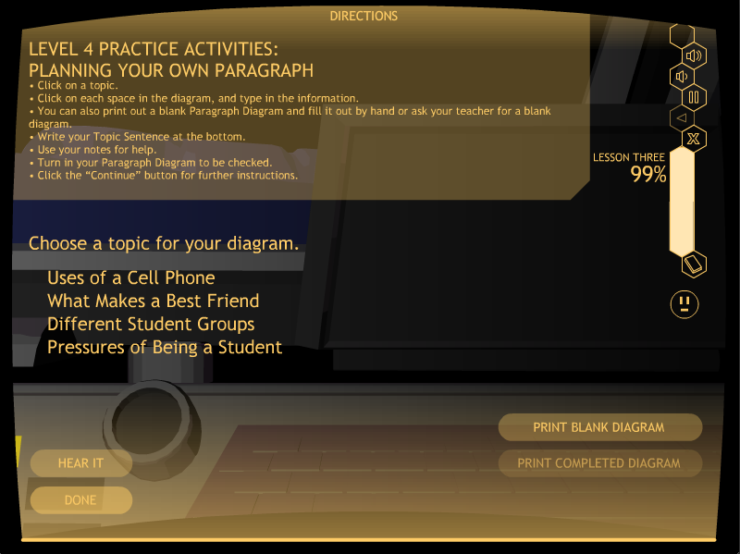
Matt: Put a screen shot of the Level 4 Practice It Activity in here
The topics should show here.

Slide 120
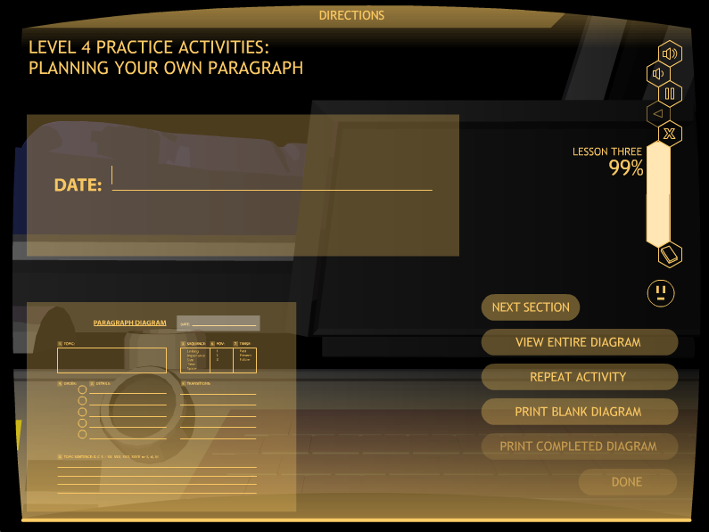
Matt: Please put in here a screen shot of the paragraph diagram that is to be filled out, with all the buttons on the right-hand side so they can be explained.

Slide 121
LET’S Look at Practice It
Go to C068
Stop when you have planned a paragraph
Click on “Exit”

Slide 122
Lesson 3 practice It
Mastery
Level 1: 80%, two sets
(Computer scored)
Level 2: 80%, two sets
(Computer scored)
Level 3: 80%, two sets
(Computer scored)
Level 4: 90%, one diagram
(Computer scored)

Slide 123
Lesson 4

Slide 124
LESSON 4: DETAIL SENTENCES
Two types of Detail Sentences
Lead-off Sentences
Follow-up Sentences

Slide 125
Lesson 4: Learn it

Slide 126
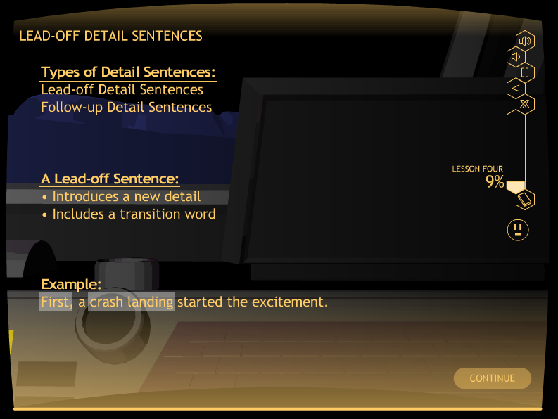

Slide 127
Let’s Look at Learn It
Go to D012
Stop at “Summary”
Click on “Exit”

Slide 128
Lesson 4: Watch it

Slide 129
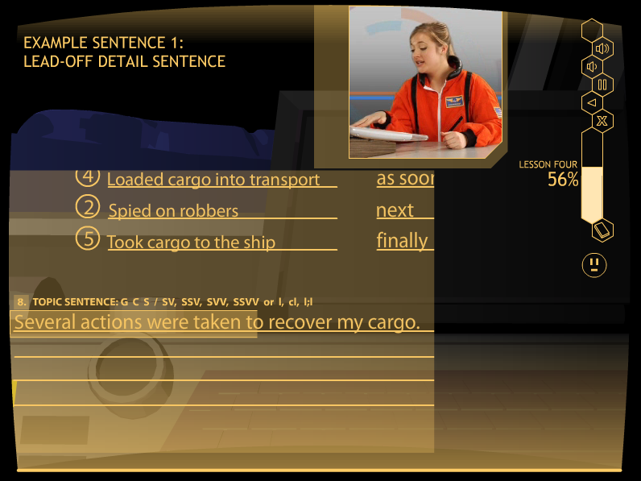
Matt: Please put a Watch It slide in here: Maybe D027 where you can see the
Lead-off sentence that she has written

Slide 130
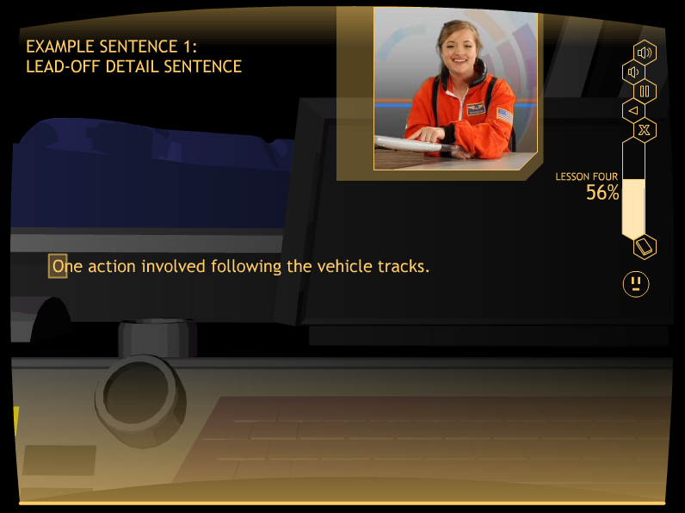
Matt: Please put a Watch It slide in here: Maybe D027 where you can see the
Lead-off sentence that she has written

Slide 131
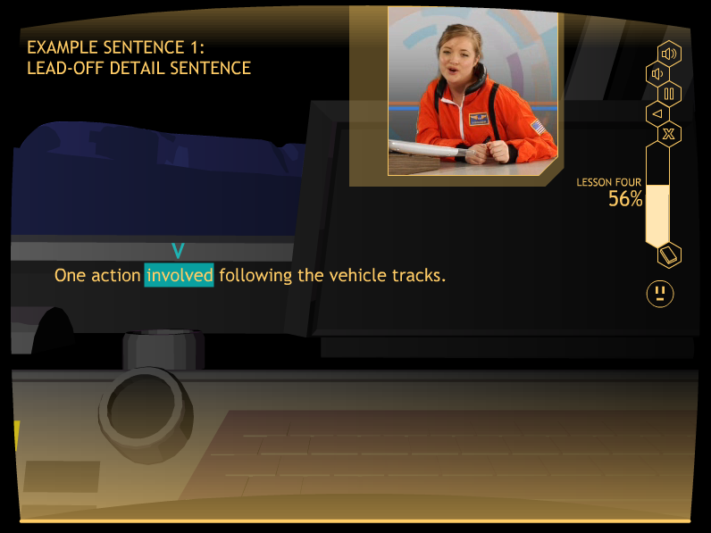
Matt: Please put a Watch It slide in here: Maybe D027 where you can see the
Lead-off sentence that she has written

Slide 132
Let’s Look at Watch It
Go to D027
Stop at “Example Sentence 2”
Click on “Exit”

Slide 133
Lesson 4: Study it

Slide 134
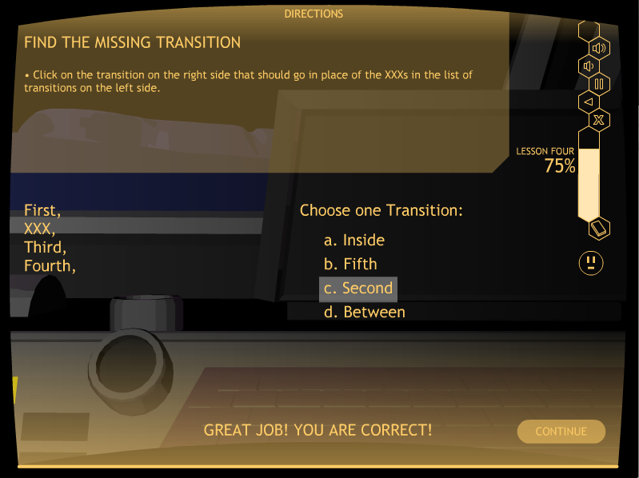
Matt: put a screen shot of D036 in here

Slide 135
Let’s Look at Study It
Go to D036
Stop at “Quiz Time”
Click on “Exit”

Slide 136
QUIZ TIME!
At the end of Study It, students take a quiz.
They can print it out, or you can give them a paper copy.
This replaces the Verbal Practice Quiz in the strategy programs.
Mastery is 100%

Slide 138
Lesson 4:
The practice Activities
Level 1: Identifying Lead-off and Follow-up Sentences
Level 2: Completing Lead-off and Follow-up Sentences
Level 3: Writing Lead-off and Follow-up Sentences
Level 4: Creating a Paragraph Diagram
Level 5: Writing a partial paragraph:
Topic Sentence and Detail Sentences

Slide 139
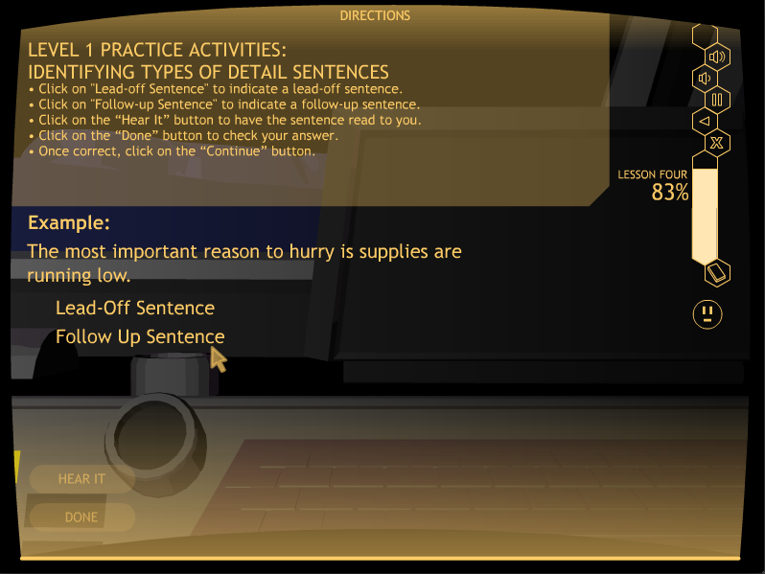
Matt: Please put a Level 1 screen shot in here for Lesson 4

Slide 140
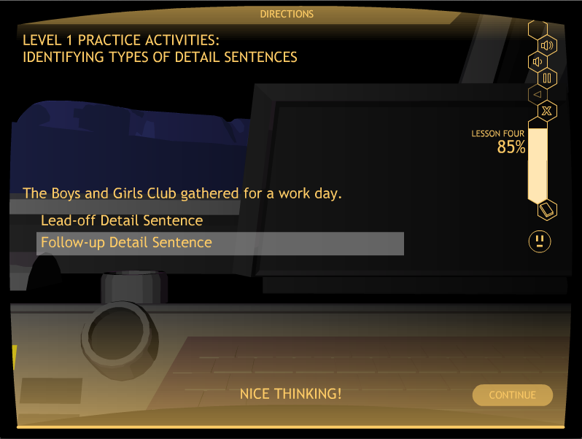

Slide 141
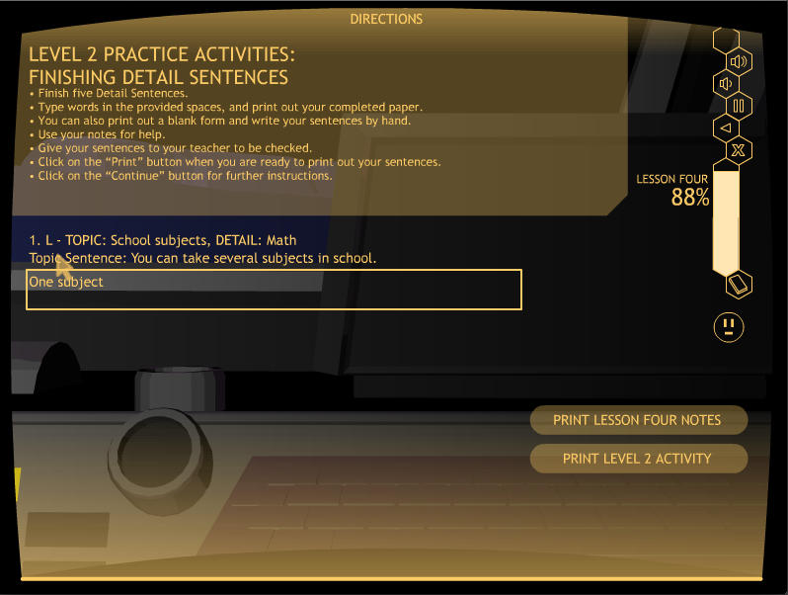
Matt: Put a screen shot of a D042 activity in here: Level 2 Practice It Activity
There should be part of a sentence in the box.

Slide 142

Matt: Please put in here slides for levels 3 & 4

Slide 143

Matt: Please put in here slides for levels 3 & 4

Slide 144

Matt: Please put a screen shot in here of the Level 4 screen where the two buttons are shown: Prompted, Indep.

Slide 145

Matt: Put a screen shot in here of a Prompted sentence, Like first Lead-off

Slide 146
Let’s Look at Practice It
Go to D047
Click on the “Prompted Activity” button
Stop at the end of this activity
Click on “Exit”

Slide 147
Lesson 4 practice It
Mastery
Level 1: 100%, two sets
(Computer scored)
Level 2: 80%, one set
(Teacher scored)
Level 3: 80%, one set
(Teacher scored)

Slide 148
Lesson 4 practice It
Mastery
Level 4: 90%, one diagram
(Teacher scored)
Level 5: 80%, one paragraph
(Teacher scored)

Slide 149
Lesson 5

Slide 150
LESSON 5: CLINCHER SENTENCES
    Three types of Clincher Sentences:
    General
    Clueing
    Specific

Slide 151
Lesson 5: Learn It

Slide 152


Slide 153
Let’s Look at Learn It
Go to E025
Stop at “Moving On”
Click on “Exit”

Slide 154
Lesson 5: watch It

Slide 155

Matt: Please put a Watch It slide in here. E038 It should show the
Clincher Sentence that the pilot has written.

Slide 156
Let’s look at Watch It
Go to E038
Stop at “Moving On”
Click on “Exit”

Slide 157
Lesson 5: Study It

Slide 158

Matt: put a screen shot of E047 in here

Slide 159
LET’S Look at Study It
Go to E047
Stop at “Quiz Time”
Click on “Exit”

Slide 160
QUIZ TIME!
At the end of Study It, students take a quiz.
They can print it out, or you can give them a paper copy.
This replaces the Verbal Practice Quiz in the strategy programs.
Mastery is 100%

Slide 162
Lesson 5:
The practice Activities
Level 1: Identifying Clincher Sentences
Level 2: Completing Clincher Sentences
Level 3: Writing Clincher Sentences
Level 4: Creating a Paragraph Diagram
Level 5: Writing a whole paragraph

Slide 163

Matt: Please put a Level 1 screen shot in here- E052

Slide 164

Matt: Put a screen shot of a E054 activity in here: Level 2 Practice It Activity
There should be part of a sentence in the box.

Slide 165

Matt: Please add in here the slides for Levels 3 and 4 for Lesson 5

Slide 166

Matt: Please add in here the slides for Levels 3 and 4 for Lesson 5

Slide 167

Matt: Please add in here the slides for Levels 3 and 4 for Lesson 5

Slide 168

Matt: Please add in here the slides for Levels 3 and 4 for Lesson 5

Slide 169

Matt: Please put a screen shot in here of the Level 4 screen where the two buttons are shown: Prompted, Indep.

Slide 170

Matt: Put a screen shot in here of a Prompted sentence, Like Clincher sentence

Slide 171

Matt: Please insert the screen for the Independent paragraph here where the kid writes the paragraph in the box.

Slide 172
LET’S Look at Practice It
Go to E059
Click on the “Independent Activity” button
Stop at the end of this activity
Click on “Exit”

Slide 173
Lesson 5 practice It
Mastery
Level 1: 100%, two sets
(Computer scored)
Level 2: 80%, one set
(Teacher scored)
Level 3: 80%, one set
(Teacher scored)

Slide 174
Lesson 5 practice It
Mastery
Level 4: 90%, one diagram
(Teacher scored)
Level 5: 80%, one paragraph
(Teacher scored)

Slide 175

Matt: Please insert in here a colorful slide as a transition slide

Slide 176
Study DETAILS
Control-group design with randomly selected groups (experimental and control groups)
Plus a normative group

Slide 177
More Study Details
STRUGGLING WRITERS
Junior high writing group = 24 students
Junior high reading group = 17 students
Senior-high writing group = 18 students
Senior-high reading group = 18 students
NORMAL LEARNERS
• Junior-high group = 24 students
• Senior-high group = 21 students

Slide 178
Results summary
All experimental group students met mastery on the sentence writing and paragraph writing skills.
All experimental group students made statistically significant and socially significant gains on all measures of sentence writing, paragraph planning, and paragraph organization.
The control students made no gains on any measures of writing.

Slide 179
Results summary (continued)
There were no significant differences between the experimental junior-high and senior-high students’ scores on the posttests while controlling for the pretest scores. (Junior-high and senior-high students learned equally well from the program.)
There were significant differences between the experimental and control students’ posttest scores while controlling for the pretest scores, with very large effect sizes for each measure.
The experimental students’ mean posttest scores exceeded the mean end-of-year scores of the normal students.

Slide 180
For more information about the writing strategy programs, contact Edge Enterprises, Inc. at 785-749-1473 or go to www.edgeenterprisesinc.com .

