Slide 1
Fundamentals in the Sentence Writing Strategy
By Jean Schumaker with Jan Sheldon
Teaching powerpoint developed by FL SPDG SIM Project to support teachers in implementing The Fundamentals in Sentence Writing Strategy
***Please note, this presentation is intentionally very plain, so that teachers can add their own design to the slides.

Slide 2
Lesson 1
Requirements of a complete sentence
Notes:
Instructor Manual pg. 9

Slide 3
Lesson 1 Essential Questions
What are the 5 requirements of a complete sentence?
What is the definition of a subject?
What is the definition of a verb?
Notes:
Pg. 9 Instructor Manual – student objectives have been translated into questions.

Slide 4
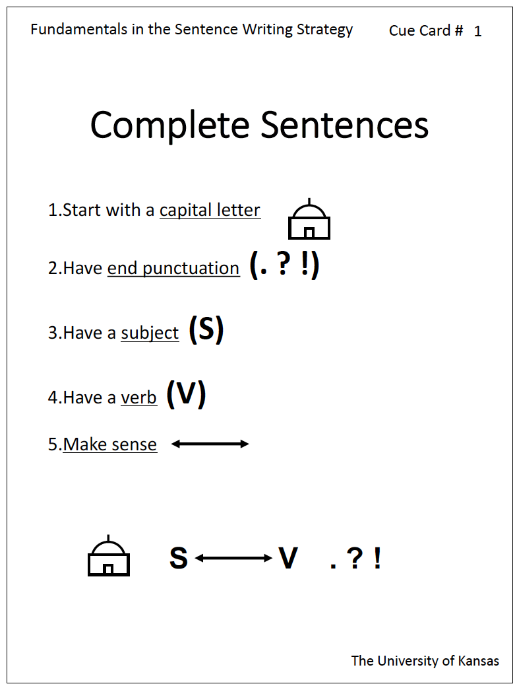
Notes:
Pg. 10

Slide 5
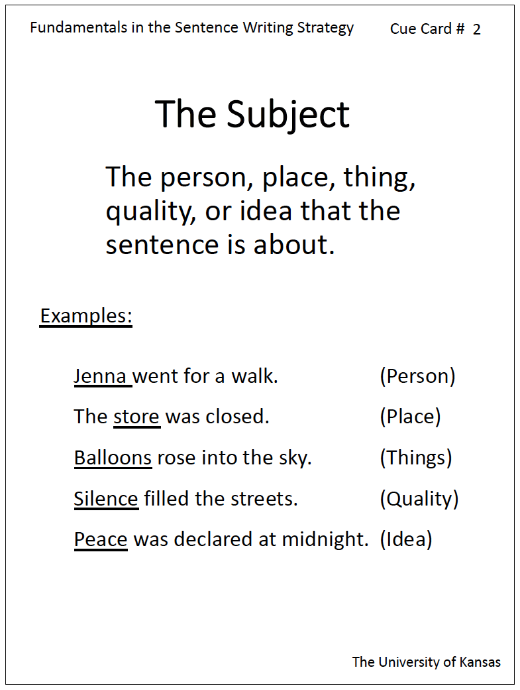
Notes:
Pg. 12

Slide 6
Person
Place
Thing
Quality
Idea
Notes:
Pg. 12-13

Slide 7
Notes:
Pg. 13

Slide 8
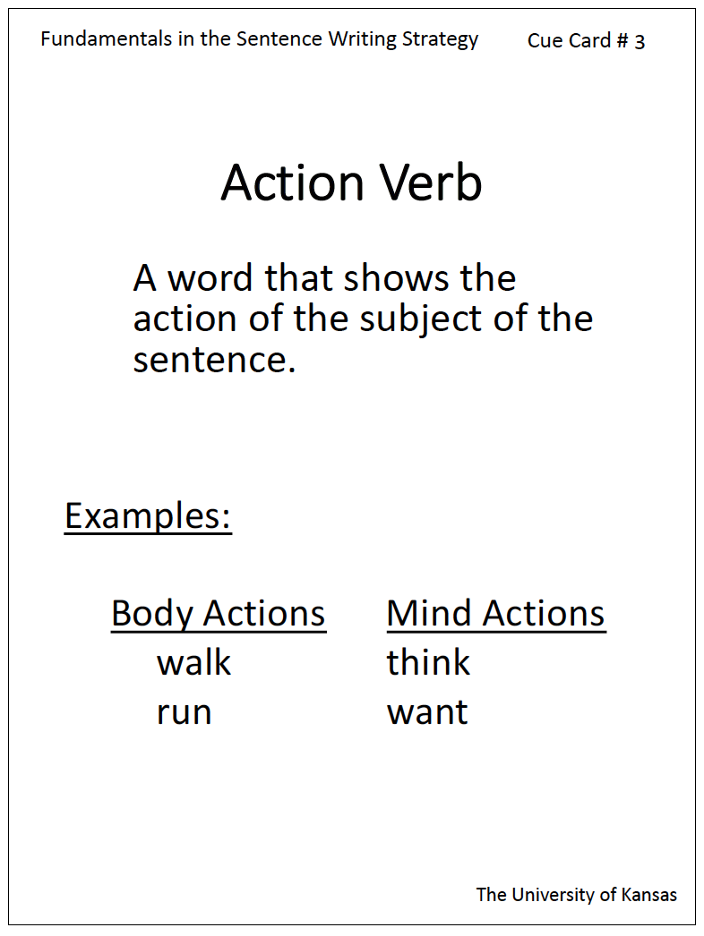
Notes:
Pg. 13

Slide 9
Notes:
Pg. 14

Slide 10
The boy jumped.
The book smiled.

Slide 11





Notes:
Pg. 14

Slide 12
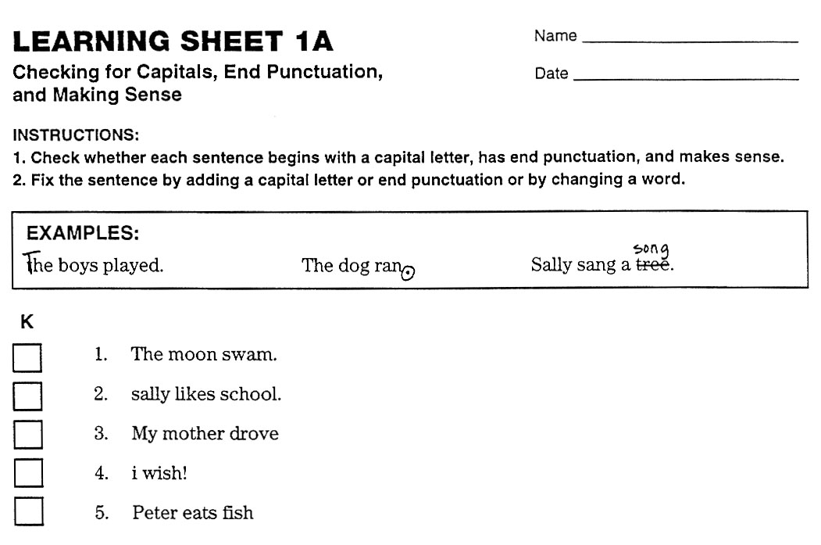
Notes:
Pg. 15

Slide 13
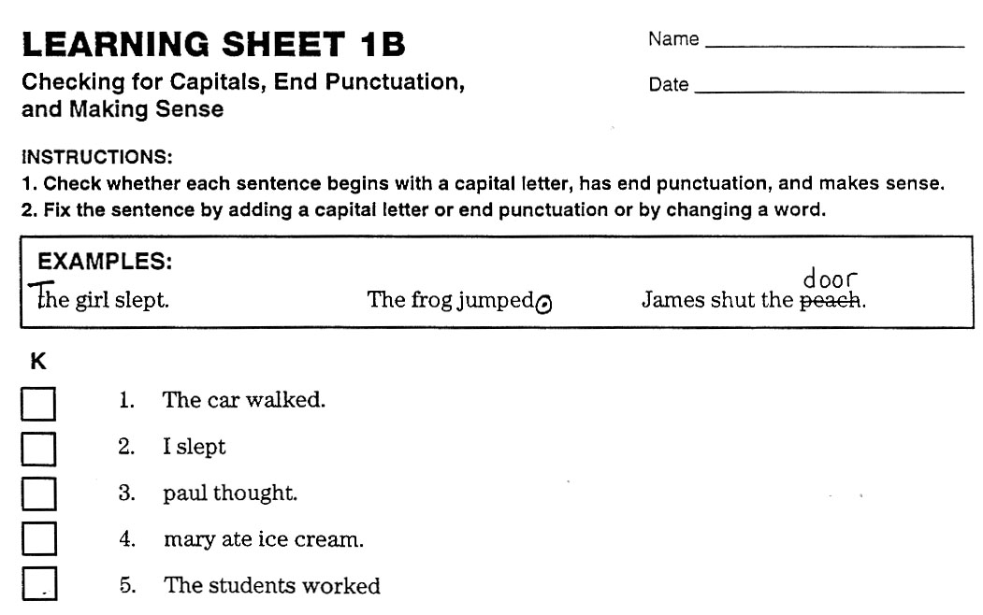

Slide 14
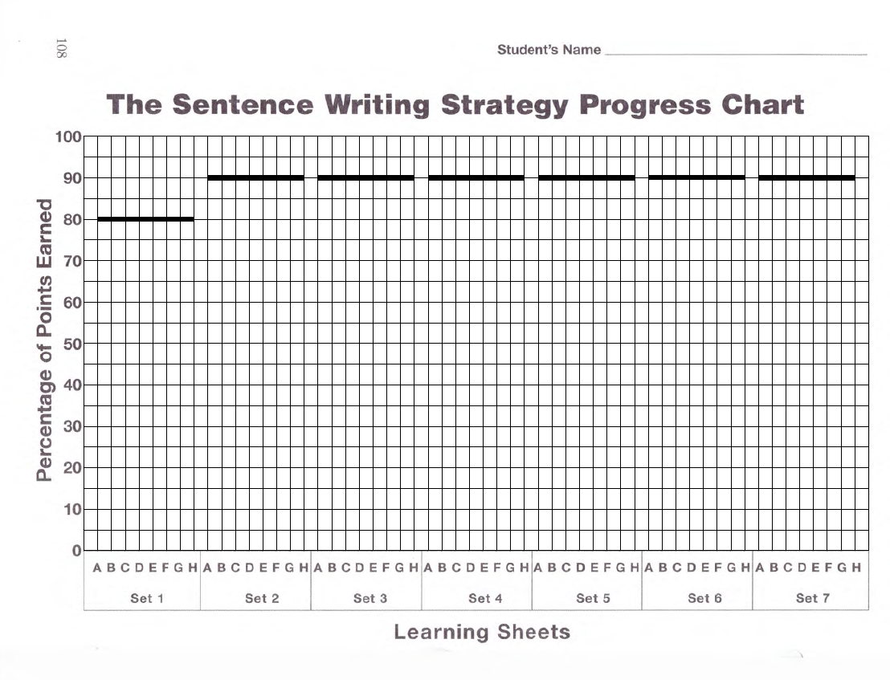
Plot Learning Sheet 1 scores here

Slide 15
Lesson 2
The PENS Steps
Notes:
Instructor Manual pg. 16

Slide 16
Lesson 2 Essential Questions
What are the steps of the Sentence Writing Strategy?
What are the three parts of the Search and Check Step?
How can I use the steps to write a complete sentence?
Notes:
Pg. 16 Instructor Manual – student objectives have been translated into questions.

Slide 17
Review of Previous Information
What is at the beginning of a complete sentence?
What is at the end?
What is in the middle?
What does the sentence have to do?
Notes:
Pg. 16

Slide 18
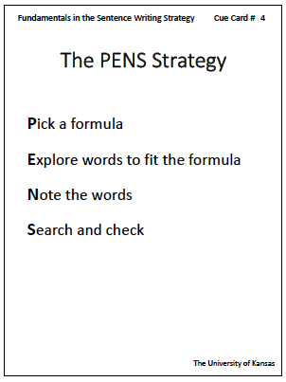
Notes:
Pg. 17

Slide 19
S V
Notes:
Pg. 17

Slide 20
S V
Notes:
Pg. 17 & 18

Slide 21
Notes:
Pg. 18

Slide 22
Notes:
Pg. 18

Slide 23
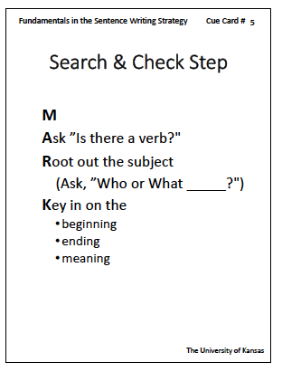
Notes:
Pg. 19

Slide 24
Notes:
Pg. 19

Slide 25
Notes:
Pg. 19

Slide 26
Notes:
Pg. 20

Slide 27
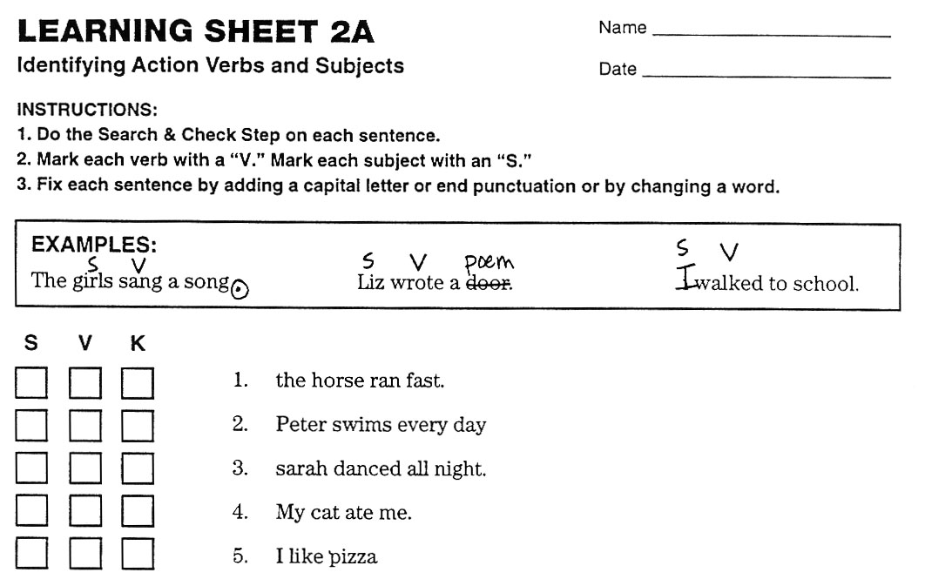
Notes:
Pg. 21

Slide 28
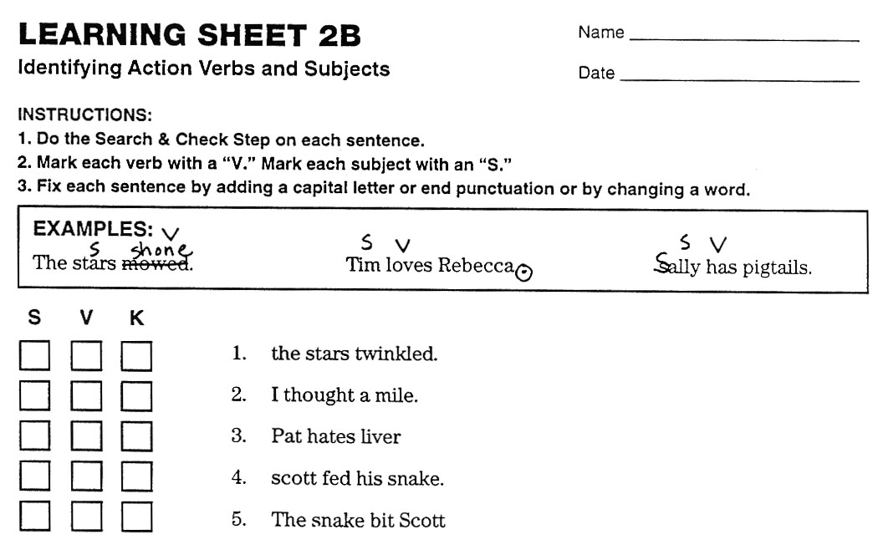
Notes:
Pg. 22

Slide 29
Plot Learning Sheet 2 scores here

Slide 30
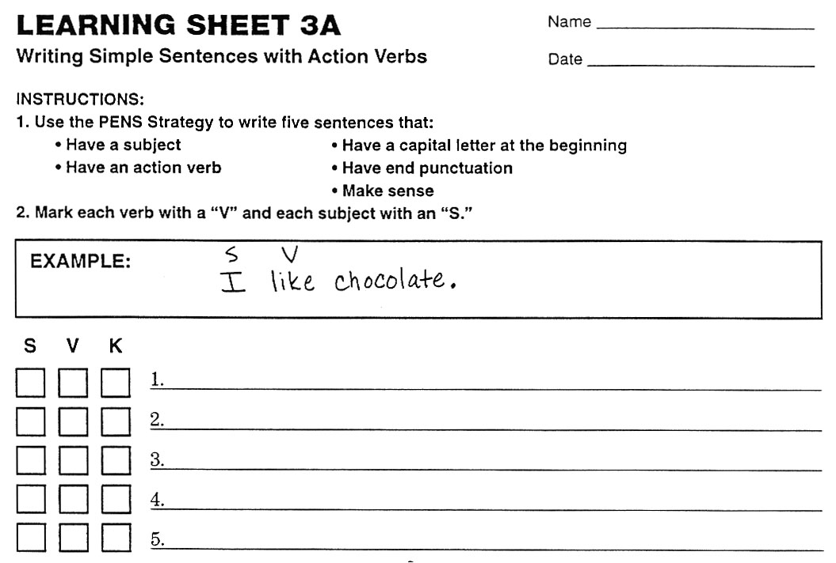
Notes:
Pg. 22

Slide 31
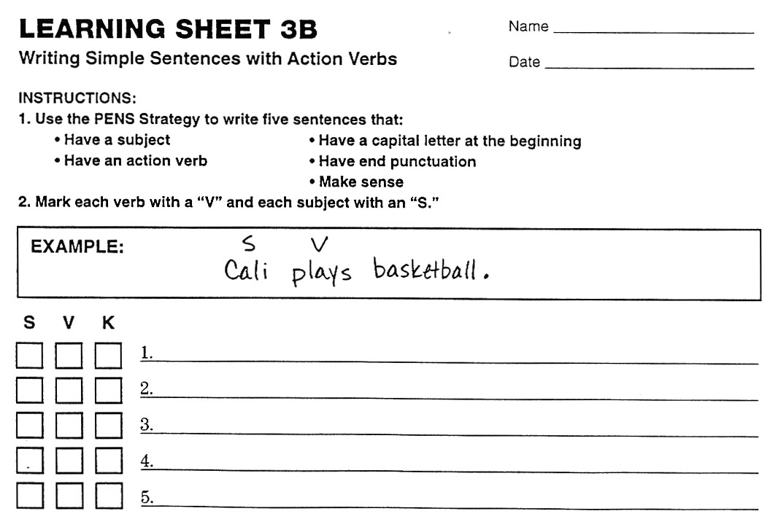
Notes:
Pg. 23

Slide 32
Plot Learning Sheet 3 scores here

Slide 33
Lesson 3
Linking Verbs
Notes:
Instructor Manual pg. 24

Slide 34
Lesson 3 Essential Questions
What are linking verbs?
How can I use the “PENS” Strategy with sentences that have linking verbs?
Notes:
Pg. 24 Instructor Manual – student objectives have been translated into questions.

Slide 35
Review of Previous Information
What is the “P” step?
What is the “E” step?
What is the “N” step?
What is the “S” step?
What is the “A” step?
What is the “R” step?
What is the “K” step?
Notes:
Pg. 24

Slide 36
Review of Action Verbs
Notes:
Pg. 25

Slide 37
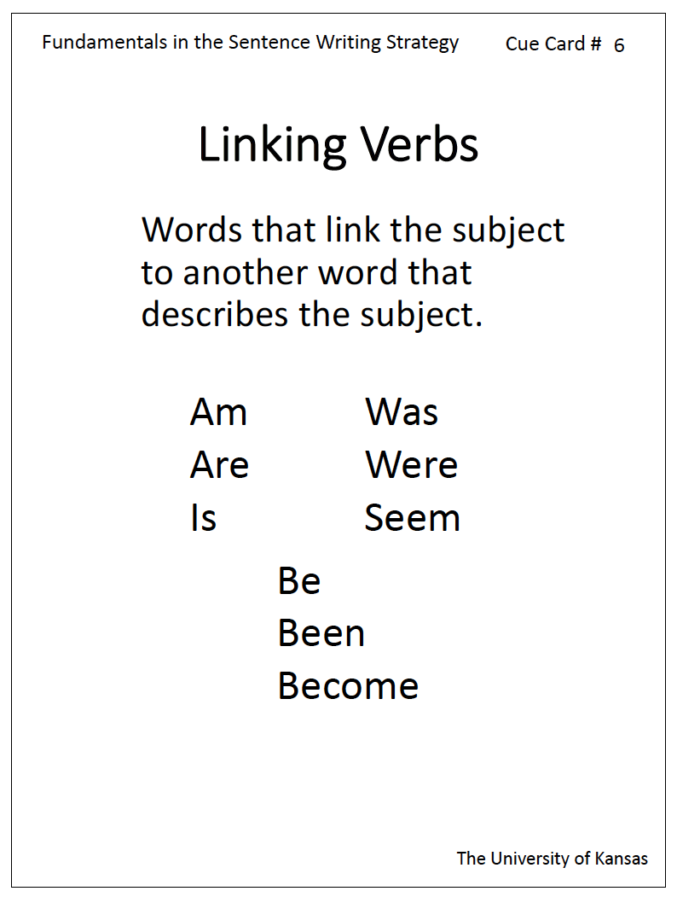
Notes:
Pg. 25

Slide 38
Simon was old.

Slide 39
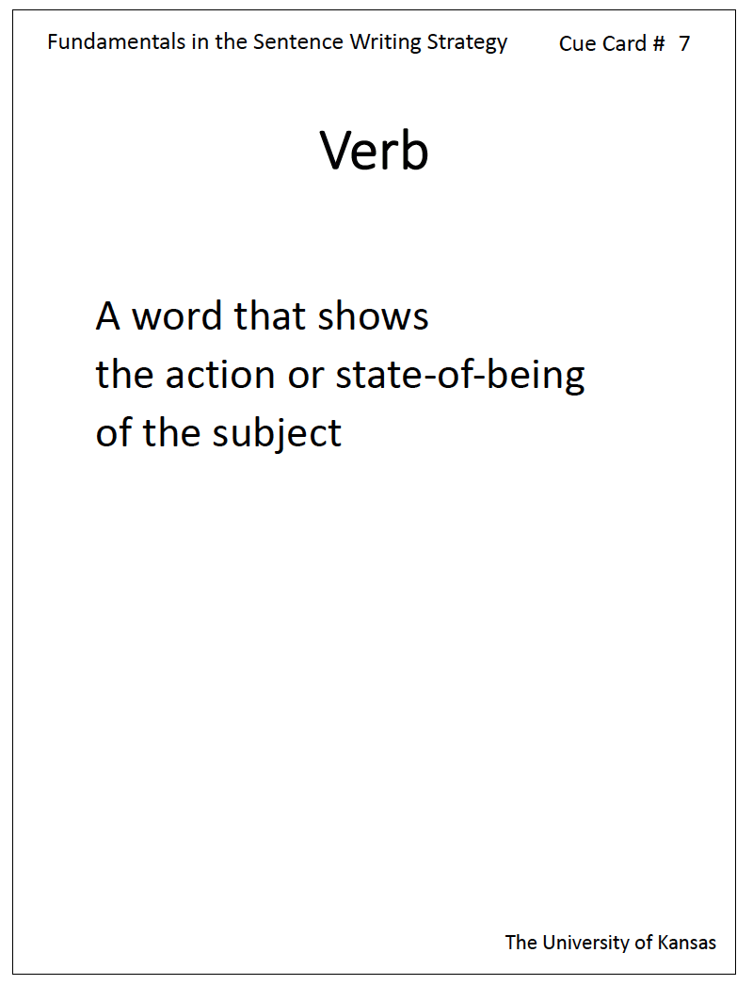
Notes:
Pg. 26

Slide 40
Is there an action or linking verb?
Jennifer is very beautiful.
Notes:
Pg. 27

Slide 41
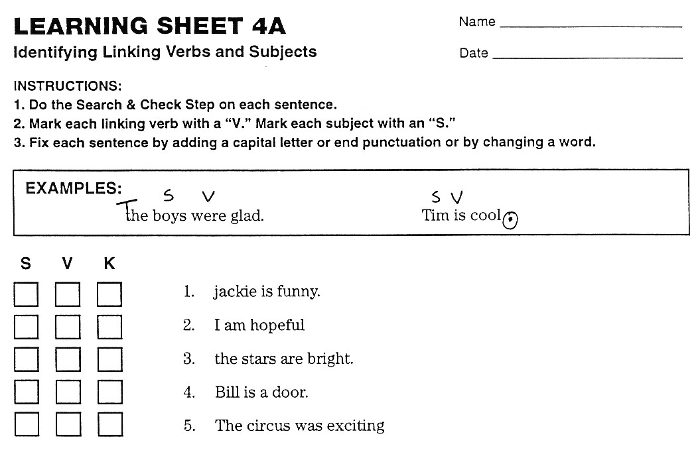
Notes:
Pg. 27

Slide 42
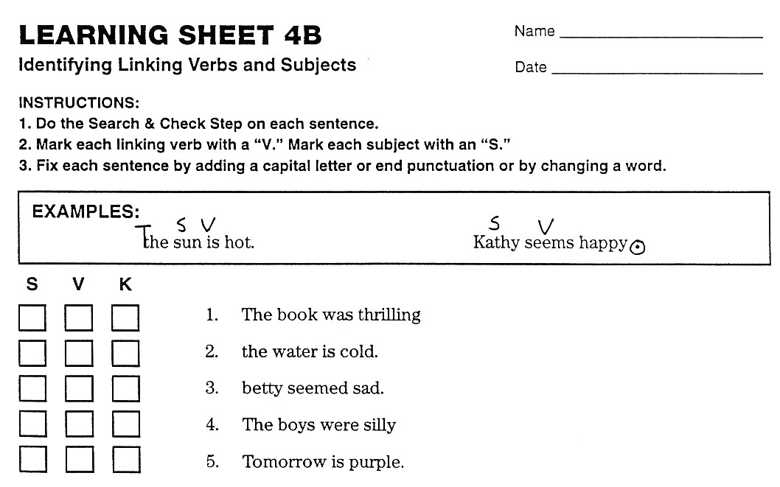
Notes:
Pg. 28

Slide 43
Plot Learning Sheet 4 scores here

Slide 44
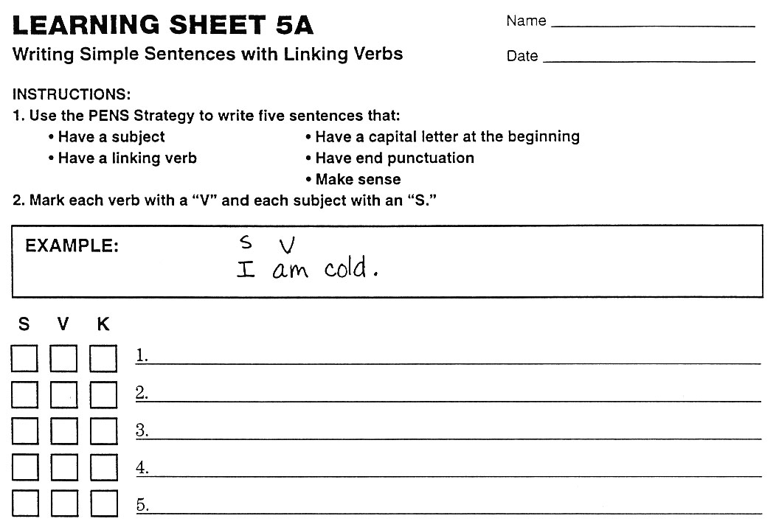
Notes:
Pg. 29

Slide 45

Notes:
Pg. 29

Slide 46
Plot Learning Sheet 5 scores here

Slide 47
Lesson 4
Infinitives
Notes:
Instructor Manual pg. 30

Slide 48
Lesson 4 Essential Questions
What are infinitives?
What is the “M” part of the Search and Check step?
How do I use the Search and Check step with sentences that have infinitives?
How do I write and check sentences that have infinitives?
Notes:
Pg. 30 Instructor Manual – student objectives have been translated into questions.

Slide 49
Review of Previous Information
What are the five requirements for a complete sentence?
What is the definition for a verb?
What is the definition for an action verb?
What is the definition for a linking verb?
What are some examples of linking verbs?
What is the definition for a subject?
What are some examples of subjects?
Notes:
Pg. 30

Slide 50
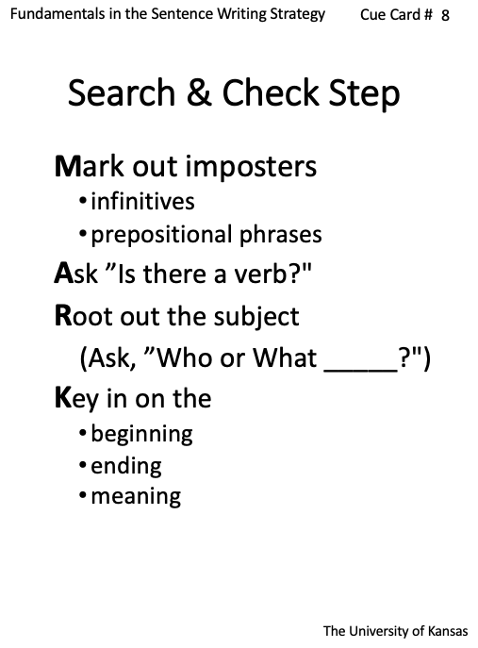
Notes:
Pg. 31

Slide 51
Madonna likes to sing.
Notes:
Pg. 32

Slide 52
Notes:
Pg. 32

Slide 53
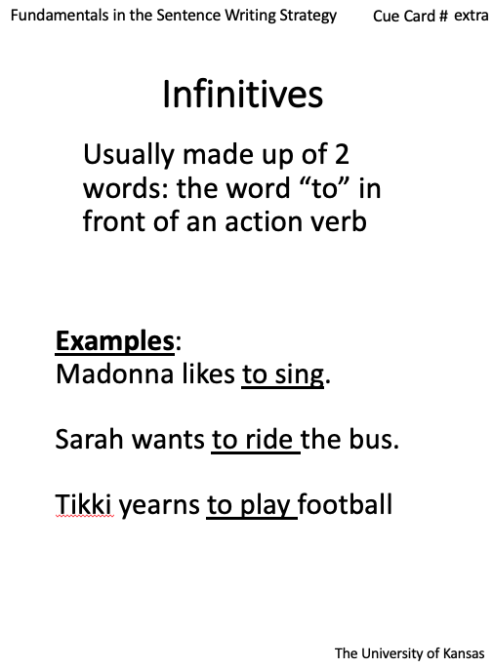
Notes:
Pg. 33

Slide 54
to
two
too
Notes:
Pg. 33

Slide 55
Emily likes to ride horses
Notes:
Pg. 33

Slide 56
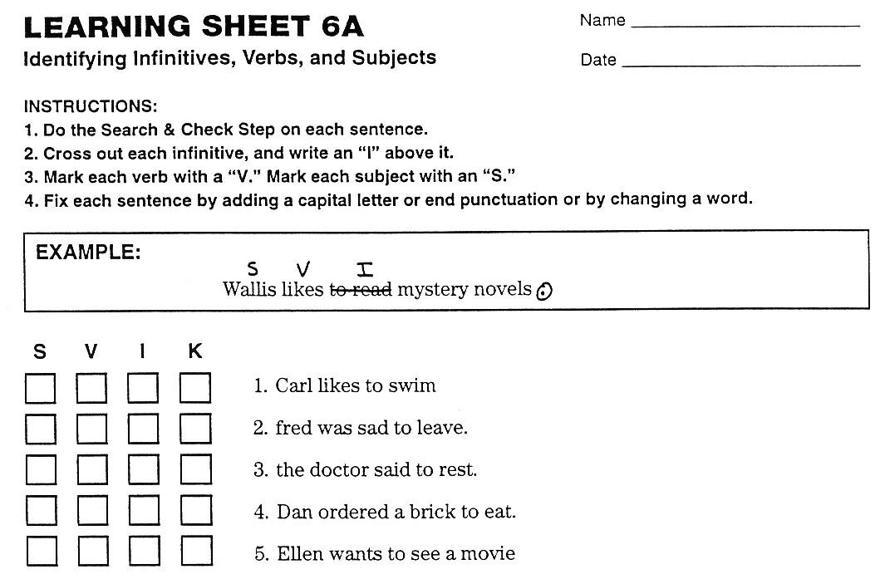
Notes:
Pg. 35

Slide 57
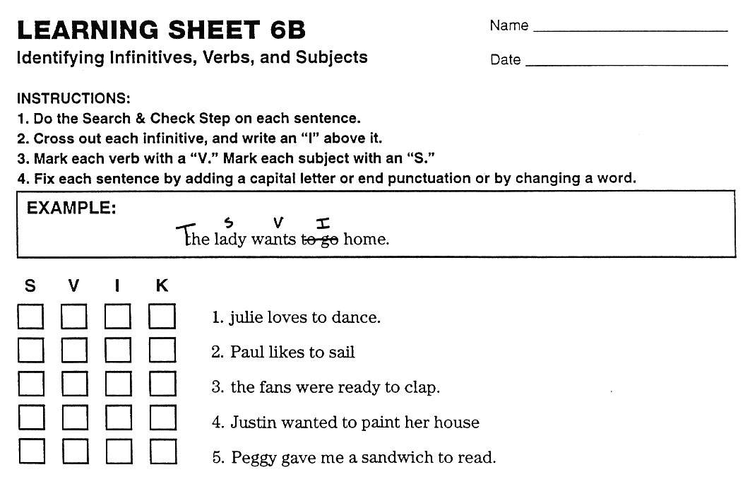
Notes:
Pg. 37

Slide 58
Plot Learning Sheet 6 scores here

Slide 59
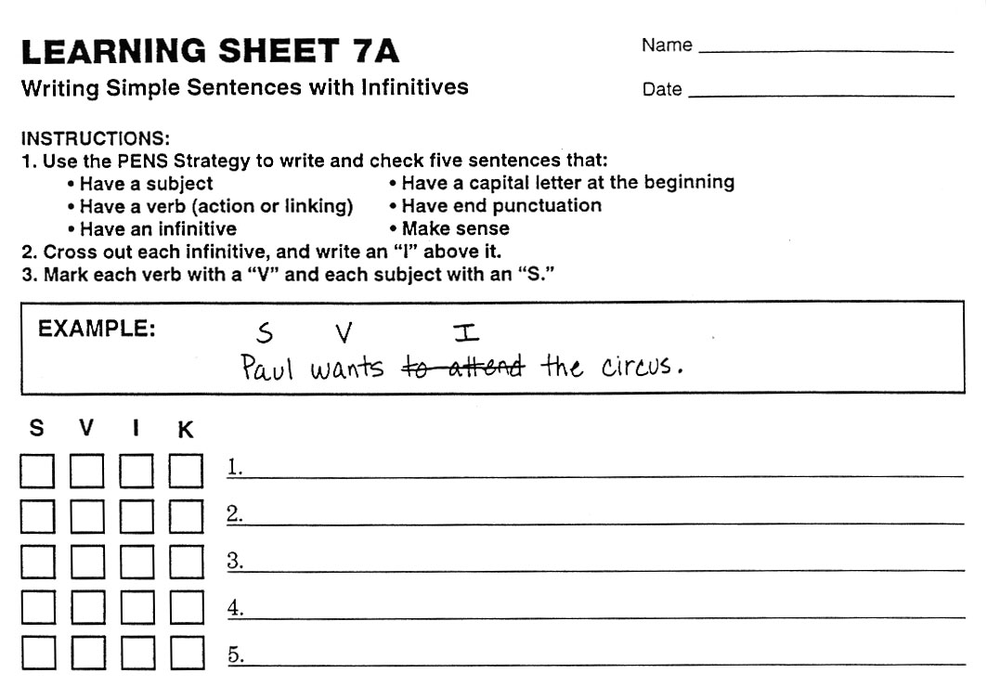
Notes:
Pg. 37

Slide 60
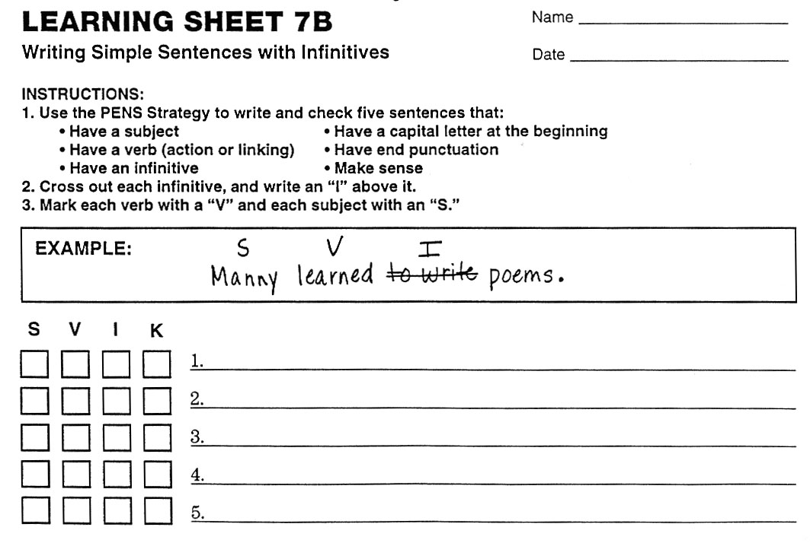
Notes:
Pg. 37

Slide 61
Plot Learning Sheet 7 scores here

Slide 62
Lesson 5
Prepositional Phrases
Notes:
Instructor Manual pg. 38

Slide 63
Lesson 5 Essential Questions
What are prepositions?
What are prepositional phrases?
How do I use the Search and Check step with sentences that have prepositional phrases?
How do I write and check sentences that have prepositional phrases?
Notes:
Pg. 38 Instructor Manual – student objectives have been translated into questions.

Slide 64
Review of Previous Information
What are the five requirements for a complete sentence?
What is the definition for a verb?
What is the definition for an action verb?
What are some examples of action verbs?
What is the definition for a linking verb?
What are some examples of linking verbs?
What is the definition for a subject?
What are some examples of subjects?
What is the definition for an infinitive?
What are some examples of infinitives?
Why do we need to eliminate infinitives before we look for the verb?
Notes:
Pg. 38

Slide 65
Notes:
Pg. 39

Slide 66
The ball rolled into the street.
Notes:
Pg. 39

Slide 67
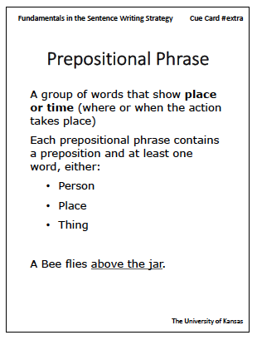
Notes:
Pg. 40

Slide 68
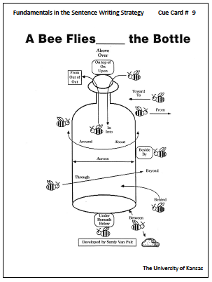
Notes:
Pg. 40

Slide 69
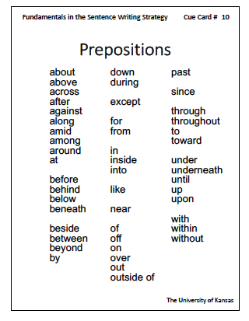
Notes:
Pg. 41

Slide 70
joe swam in the lake.
Notes:
Pg. 41

Slide 71
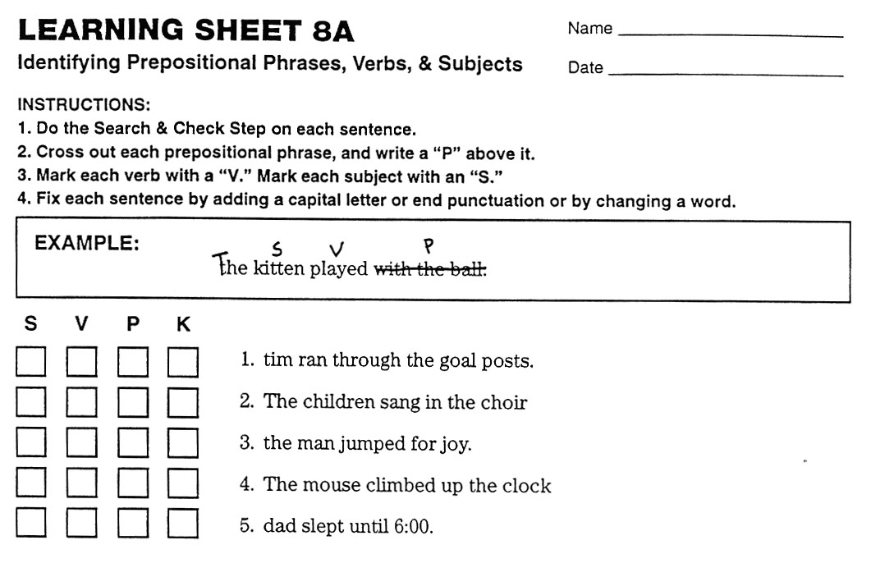
Notes:
Pg. 42

Slide 72
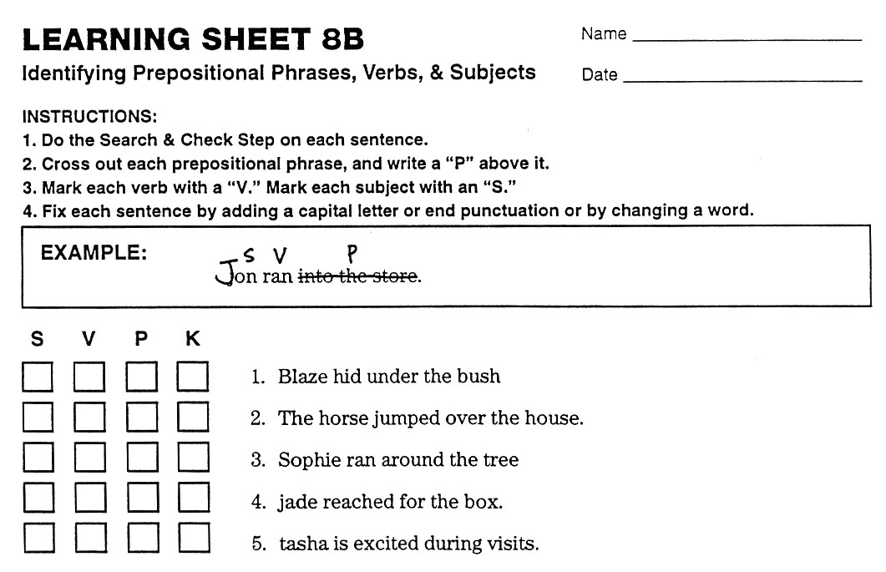
Notes:
Pg. 44

Slide 73
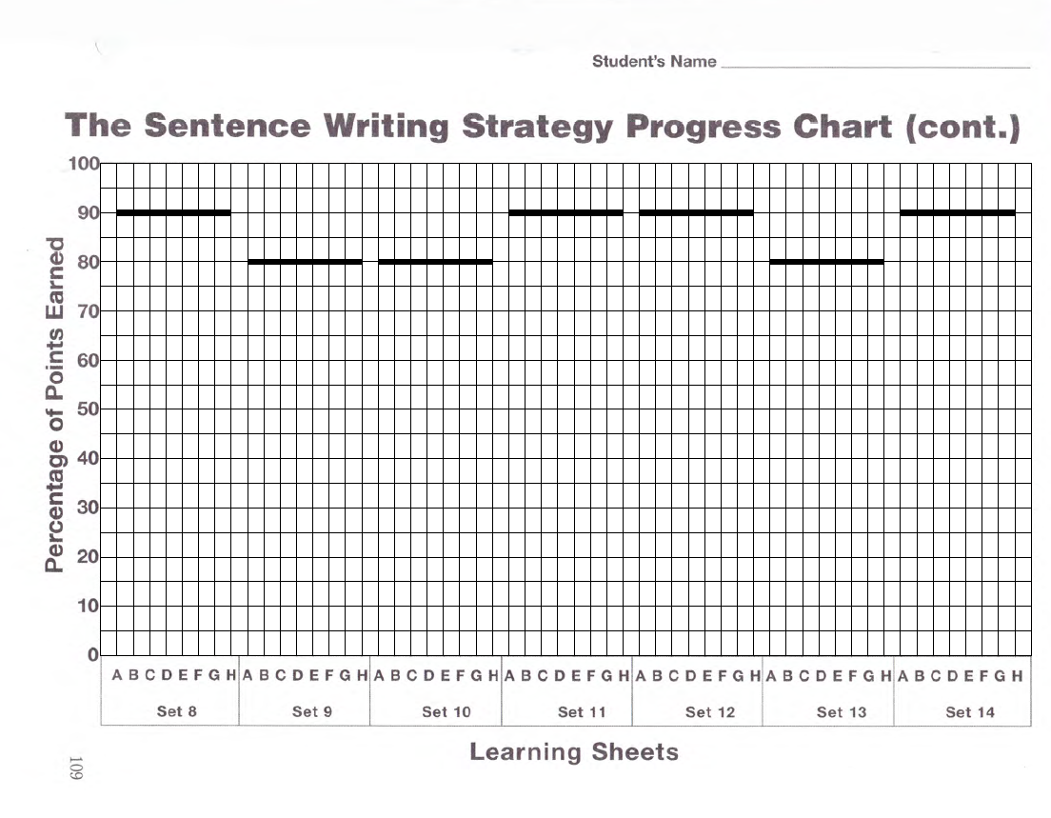
Plot Learning Sheet 8 scores here

Slide 74
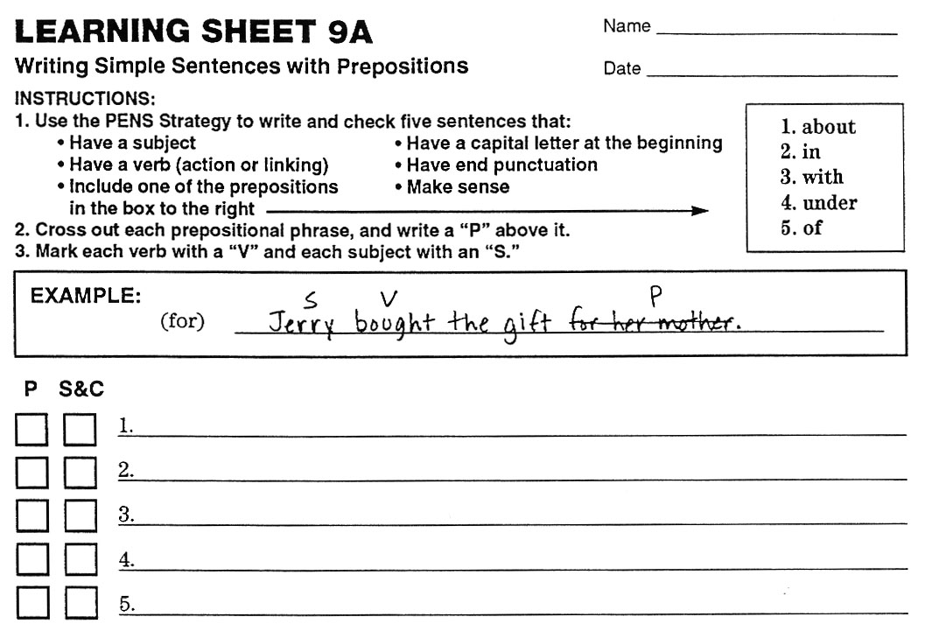
Notes:
Pg. 45

Slide 75
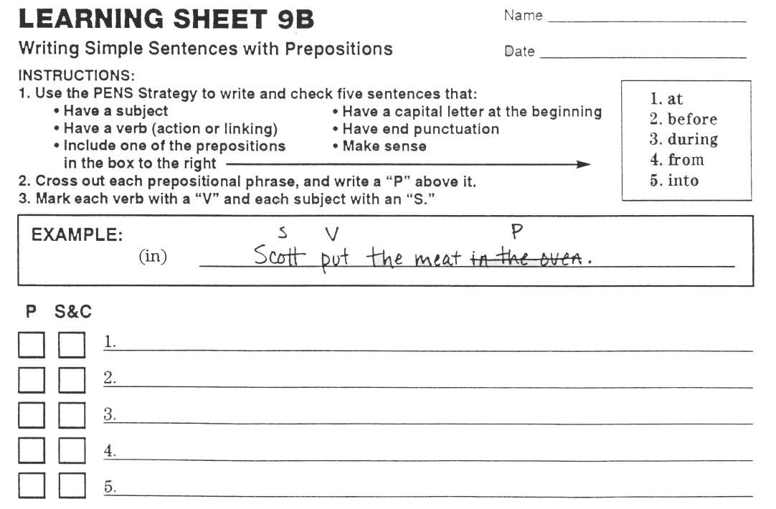
Notes:
Pg. 45

Slide 76
Plot Learning Sheet 9 scores here

Slide 77
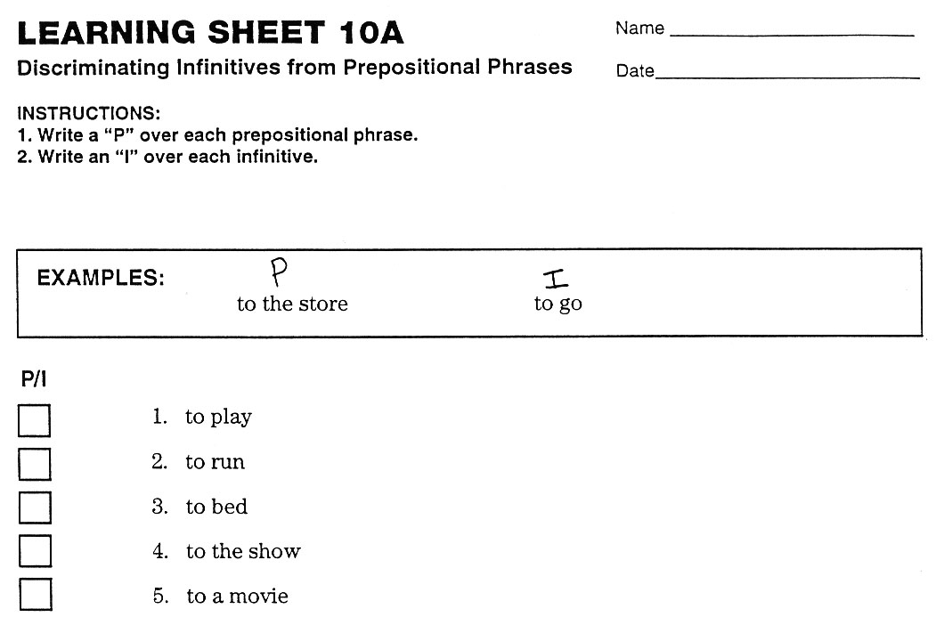
Notes:
Pg. 45

Slide 78
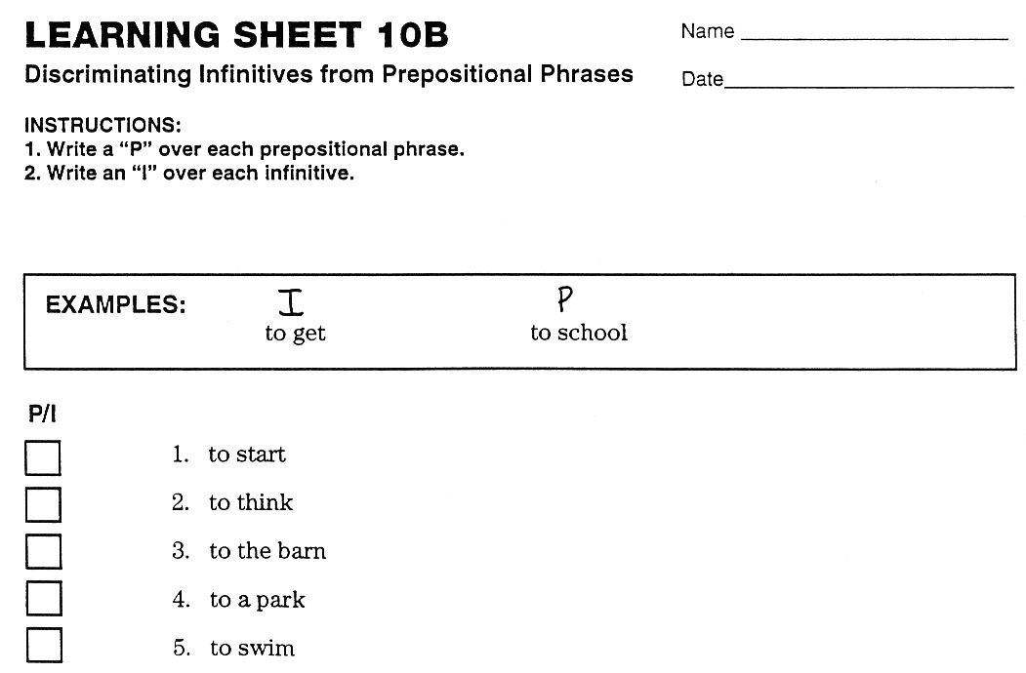
Notes:
Pg. 46

Slide 79
Plot Learning Sheet 10 scores here

Slide 80
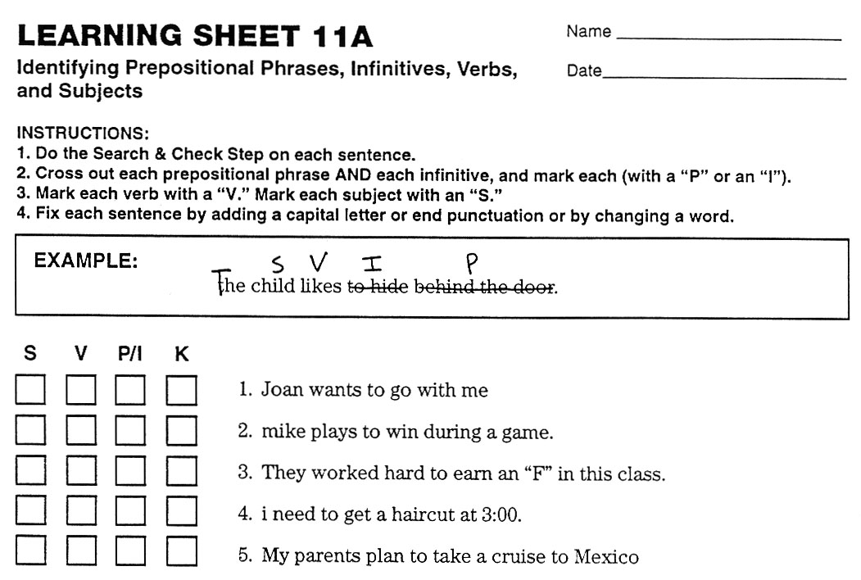
Notes:
Pg. 46

Slide 81
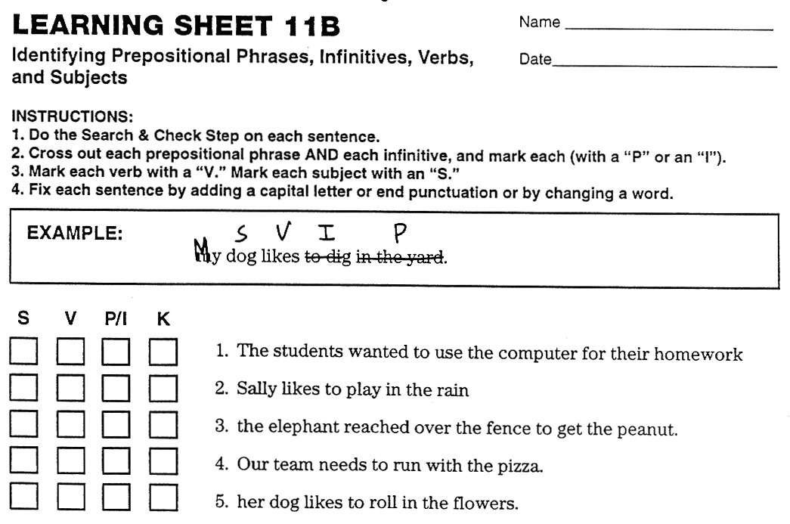
Notes:
Pg. 46

Slide 82
Plot Learning Sheet 11 scores here

Slide 83
Lesson 6
SS V Sentences
Notes:
Instructor Manual pg. 47

Slide 84
Lesson 6 Essential Questions
How do I use the Search and Check step with sentences that have two subjects and one verb?
How do I write and check sentences that have two subjects and one verb using the PENS and MARK steps?
Notes:
Pg. 47 Instructor Manual – student objectives have been translated into questions.

Slide 85
Review of Previous Information
What is the definition for a verb?
What is the definition for an action verb?
What are some examples of action verbs?
What is the definition for a linking verb?
What are some examples of linking verbs?
What is the definition for a subject?
What are some examples of subjects?
What is the definition of a prepositional phrase?
What are some examples of prepositions and prepositional phrases?
What is the definition for an infinitive?
What are some examples of infinitives?
What are the PENS steps?
What are the four parts of the Search and Check step?
Notes:
Pg. 48

Slide 86
Simple Sentences
One subject and one verb SV
  One person doing one thing
Two subjects and one verb SS V
Notes:
Pg. 48

Slide 87
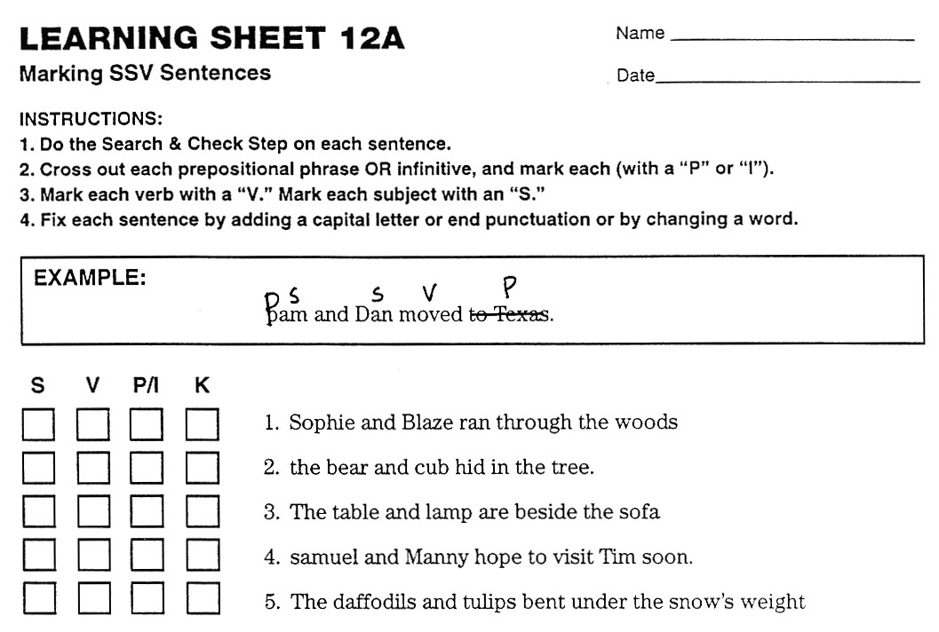
Notes:
Pg. 51

Slide 88
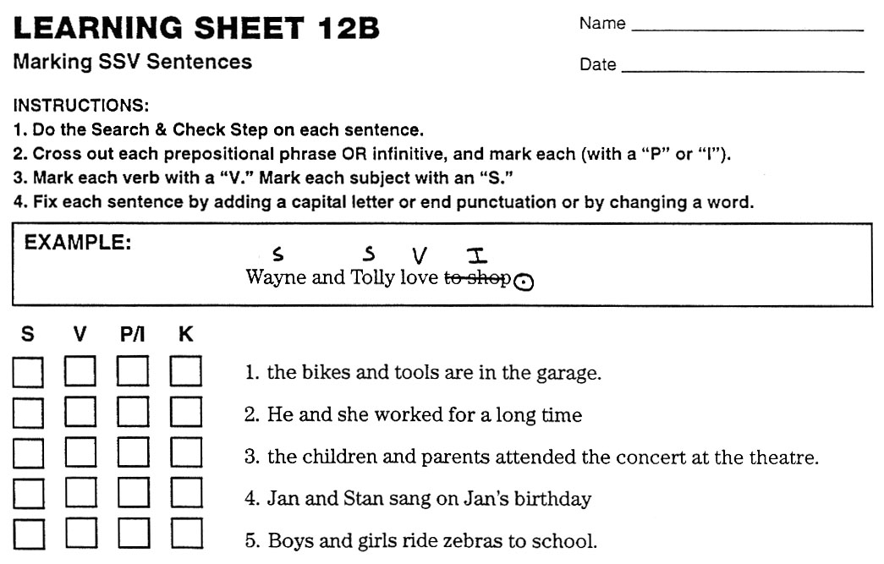
Notes:
Pg. 53

Slide 89
Plot Learning Sheet 12 scores here

Slide 90
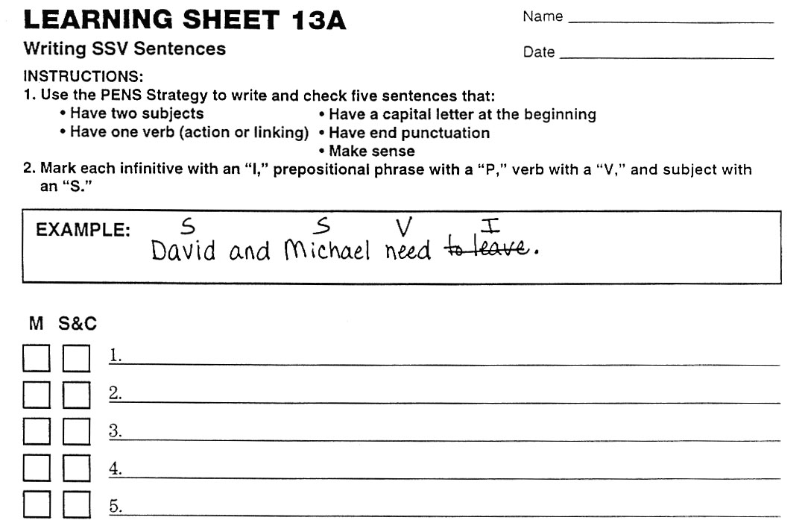
Notes:
Pg. 53

Slide 91
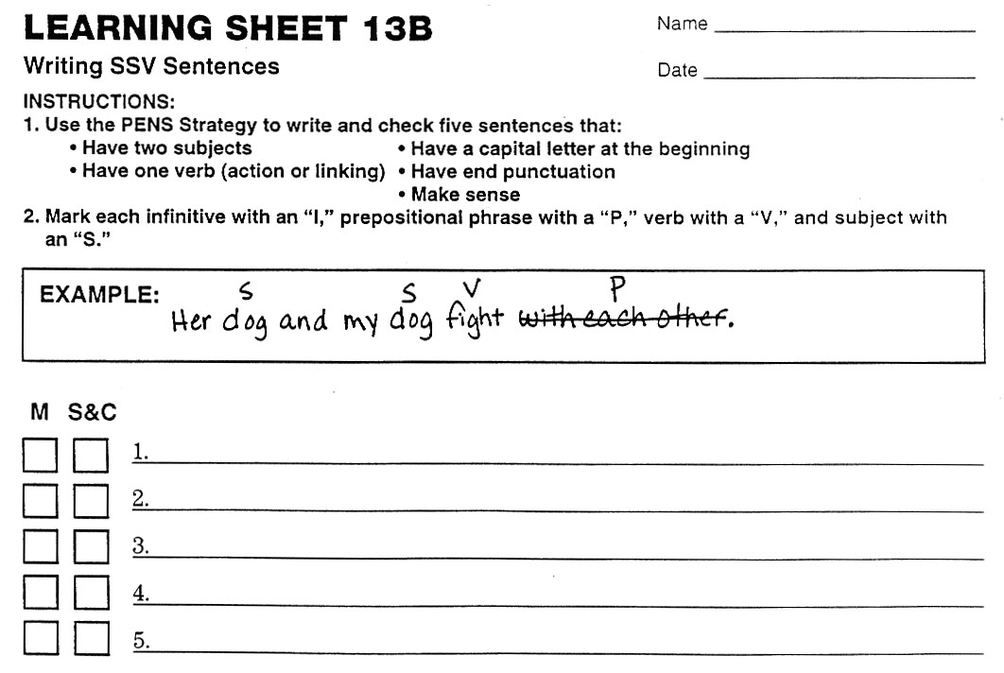
Notes:
Pg. 54

Slide 92
Plot Learning Sheet 13 scores here

Slide 93
Lesson 7
S VV Sentences
Notes:
Instructor Manual pg. 55

Slide 94
Lesson 7 Essential Questions
What is the formula for a simple sentence with one subject and two verbs?
How do I use the Search and Check step with sentences that have one subject and two verbs?
How do I write and check sentences that have one subject and two verbs using the PENS and MARK steps?
Notes:
Pg. 55 Instructor Manual – student objectives have been translated into questions.

Slide 95
Review of Previous Information
What is the definition for a verb?
What is the definition for an action verb?
What are some examples of action verbs?
What is the definition for a linking verb?
What are some examples of linking verbs?
What is the definition for a subject?
What are some examples of subjects?
What is the definition of a prepositional phrase?
What are some examples of prepositions and prepositional phrases?
What is the definition for an infinitive?
What are some examples of infinitives?
What is the formula for Simple Sentences with one subject and one verb?
What is the formula for Simple Sentences with two subjects and one verb?
What are the PENS steps?
What are the four parts of the Search and Check step?
Notes:
Pg. 56

Slide 96
Simple Sentences
One subject and one verb SV
  One person doing one thing
Two subjects and one verb SS V
  Two people doing one thing
One subject and two verbs S VV
  One person doing two things
Notes:
Pg. 56

Slide 97
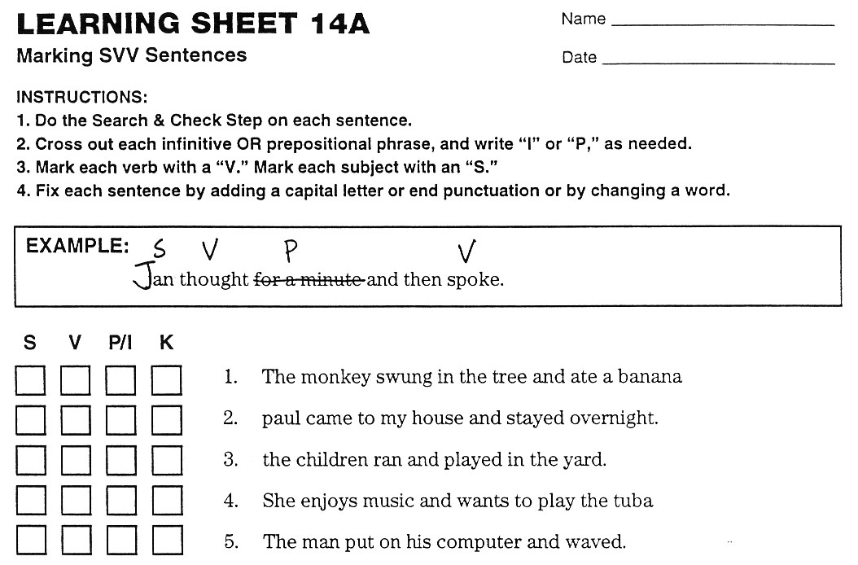
Notes:
Pg. 59

Slide 98
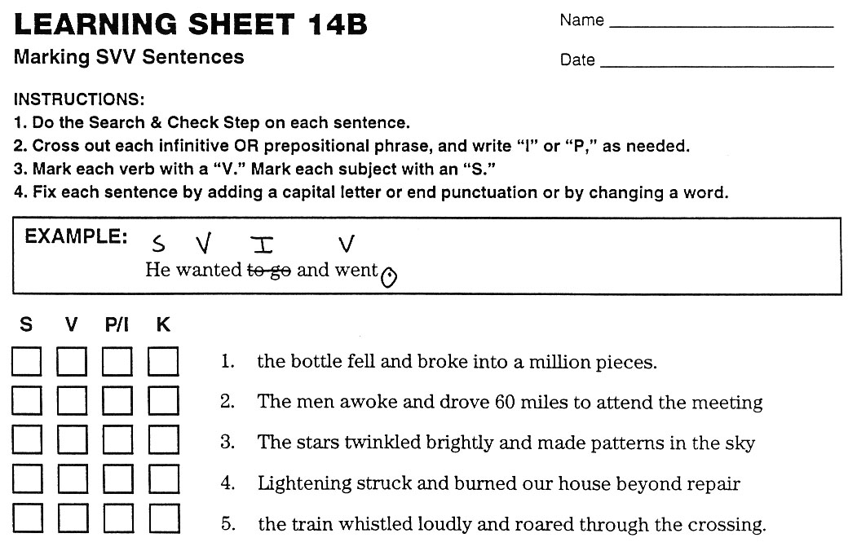
Notes:
Pg. 61

Slide 99
Plot Learning Sheet 14 scores here

Slide 100
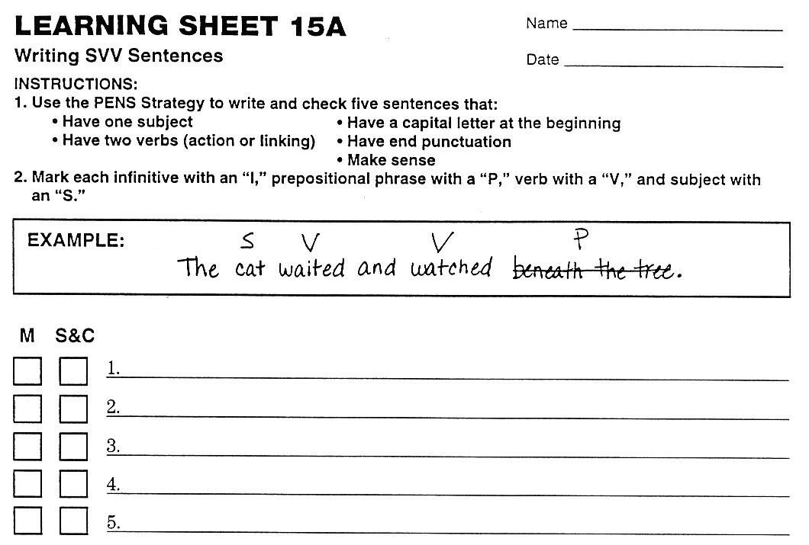
Notes:
Pg. 61

Slide 101
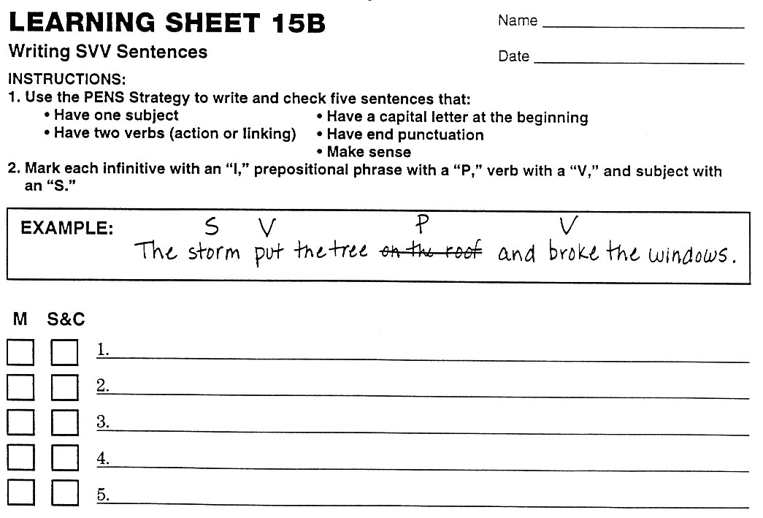

Slide 102
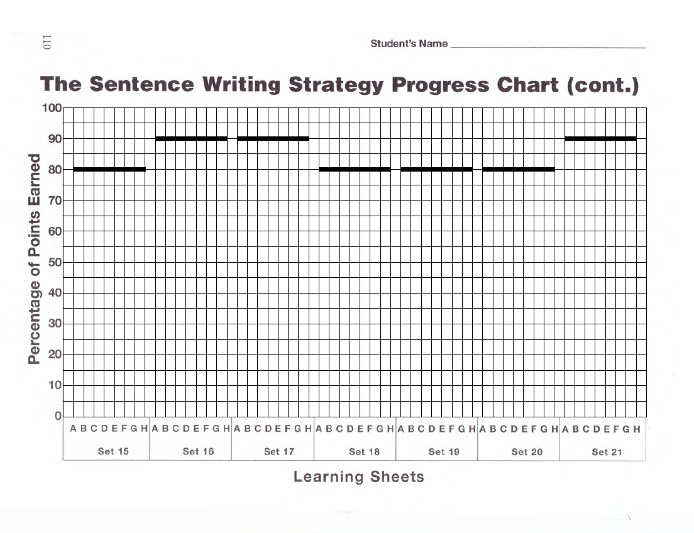
Plot Learning Sheet 15 scores here

Slide 103
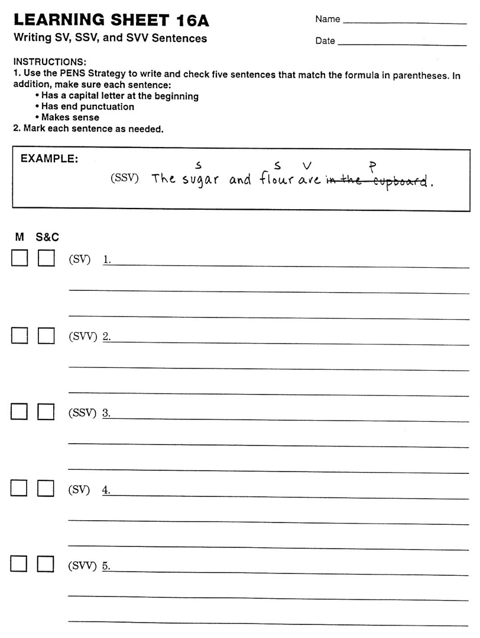

Slide 104
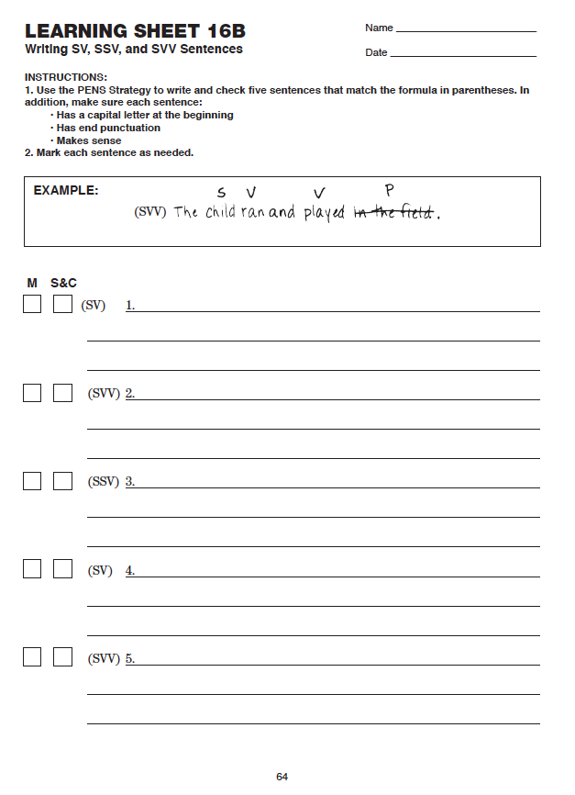
Notes:
Pg. 62

Slide 105
Plot Learning Sheet 16 scores here

Slide 106
Lesson 8
SS VV Sentences
Notes:
Instructor Manual pg. 63

Slide 107
Lesson 8 Essential Questions
What is the formula for a simple sentence with two subjects and two verbs?
How do I use the Search and Check step with sentences that have two subjects and two verbs?
How do I write and check sentences that have two subjects and two verbs using the PENS and MARK steps?
Notes:
Pg. 63 Instructor Manual – student objectives have been translated into questions.

Slide 108
Review of Previous Information
What is the definition for a verb?
What is the definition for an action verb?
What are some examples of action verbs?
What is the definition for a linking verb?
What are some examples of linking verbs?
What is the definition for a subject?
What are some examples of subjects?
What is the definition of a prepositional phrase?
What are some examples of prepositions and prepositional phrases?
What is the definition for an infinitive?
What are some examples of infinitives?
What are the PENS steps?
What are the four parts of the Search and Check step?
Notes:
Pg. 56

Slide 109
Simple Sentences
One subject and one verb SV
  One person doing one thing
Two subjects and one verb SS V
  Two people doing one thing
One subject and two verbs S VV
  One person doing two things
Two subjects and two verbs SS VV
  Two people doing two things
Notes:
Pg. 64

Slide 110
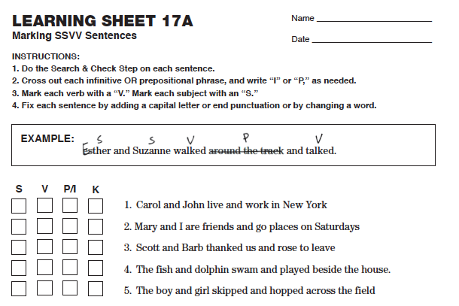
Notes:
Pg. 67

Slide 111
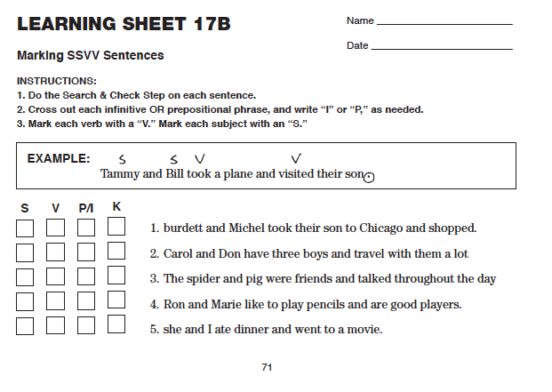
Notes:
Pg 68

Slide 112
Plot Learning Sheet 17 scores here

Slide 113
Notes:
Pg. 69

Slide 114
Notes:
Pg. 69

Slide 115
Plot Learning Sheet 18 scores here

Slide 116
Notes:
Pg. 69

Slide 117
Notes:
Pg. 70

Slide 118
Plot Learning Sheet 19 scores here

Slide 119
Lesson 9
Adjectives and Main Subjects
Notes:
Instructor Manual pg. 71

Slide 120
Lesson 9 Essential Questions
What is an adjective?
What is a main subject?
How do I use the PENS Steps to write sentences with complex subjects?
How do I use the Search and Check step to find infinitives, prepositional phrases, verbs and main subjects?
How do I write a variety of Simple Sentences that have adjectives?
Notes:
Pg. 71 Instructor Manual – student objectives have been translated into questions.

Slide 121
Review of Previous Information
What is the definition for a verb?
What is the definition for an action verb?
What are some examples of action verbs?
What is the definition for a linking verb?
What are some examples of linking verbs?
What is the definition for a subject?
What are some examples of subjects?
What is the definition of a prepositional phrase?
What are some examples of prepositions and prepositional phrases?
What is the definition for an infinitive?
What are some examples of infinitives?
What are the four types of Simple Sentences and their formulas?
What are the PENS steps?
What are the four parts of the Search and Check step?
Notes:
Pg. 72

Slide 122
The long, white limousine carried the singers to their hotel.

Slide 123
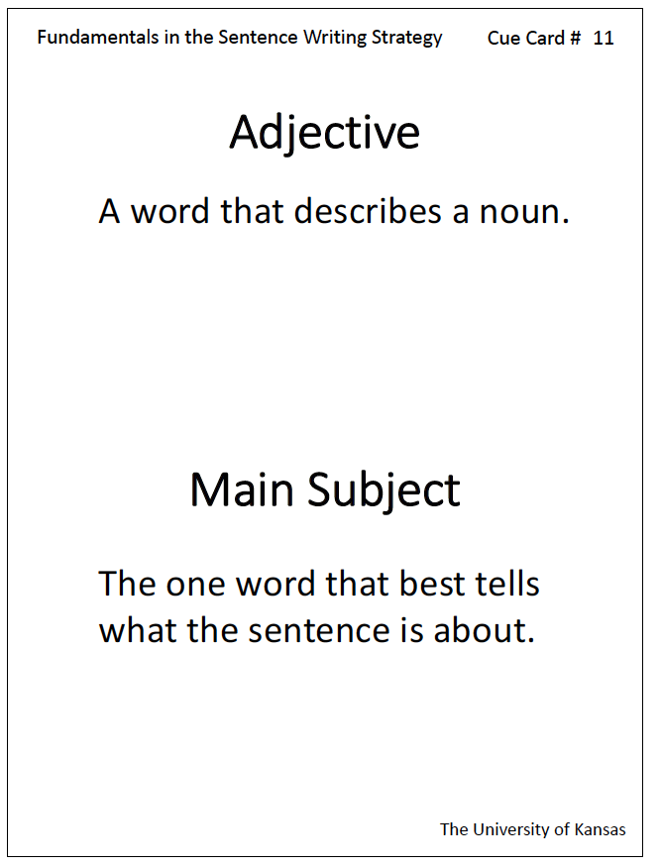
Notes:
Pg. 72

Slide 124
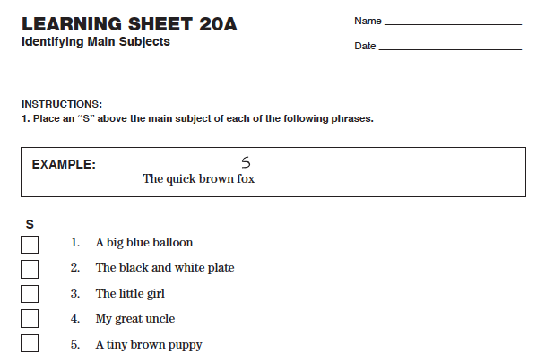
Notes:
Pg. 74

Slide 125

Notes:
Pg. 74

Slide 126
Plot Learning Sheet 20 scores here

Slide 127

Notes:
Pg. 75

Slide 128

Notes:
Pg. 76

Slide 129
Plot Learning Sheet 21 scores here

Slide 130

Notes:
Pg. 77

Slide 131

Notes:
Pg. 77

Slide 132

Plot Learning Sheet 22 scores here

Slide 133
Lesson 10
Helping Verbs and Complete Verbs
Notes:
Instructor Manual pg. 78

Slide 134
Lesson 10 Essential Questions
What is a complete verb?
What is a helping verb?
How can I remember the helping verbs?
How do I use the PENS Steps to write sentences with helping verbs?
How do I use the Search and Check step with sentences that have helping verbs?
How do I write sentences that have helping verbs?
Notes:
Pg. 78 Instructor Manual – student objectives have been translated into questions.

Slide 135
Review of Previous Information
What is the definition for a verb?
What is the definition for an action verb?
What are some examples of action verbs?
What is the definition for a linking verb?
What are some examples of linking verbs?
What is the definition for a subject?
What are some examples of subjects?
What is the definition of an adjective?
What are some examples of adjectives?
What is the definition of a prepositional phrase?
What are some examples of prepositions and prepositional phrases?
What is the definition for an infinitive?
What are some examples of infinitives?
What are the PENS steps?
What are the four parts of the Search and Check step?
Notes:
Pg. 79

Slide 136
The players must have practiced for weeks.
Notes:
Pg. 79

Slide 137

Notes:
Pg. 79

Slide 138

Notes:
Pg. 79

Slide 139
I am going to the store.
Notes:
Pg. 80

Slide 140
Notes:
Pg. 80

Slide 141
Louis has been playing the violin.
Notes:
Pg. 80

Slide 142


Notes:
Pg. 81

Slide 143


More options for remembering the helping verbs

Slide 144

Notes:
Pg. 82

Slide 145

Notes:
Pg. 84

Slide 146
Plot Learning Sheet 23 scores here

Slide 147

Notes:
Pg. 85

Slide 148

Notes:
Pg. 85

Slide 149
Plot Learning Sheet 24 scores here

Slide 151
Plot Learning Sheet 25 scores here

Slide 152
Lesson 11 (optional)
Adverbs
Notes:
Instructor Manual pg. 87

Slide 153
Lesson 11 Essential Questions
What is an adverb?
How do I use the PENS Steps to write sentences with adverbs?
How do I use the Search and Check step with sentences that have adverbs?
How do I write sentences that have adverbs?
Notes:
Pg. 87 Instructor Manual – student objectives have been translated into questions.

Slide 154
Review of Previous Information
What is the definition for a verb?
What is the definition for an action verb?
What are some examples of action verbs?
What is the definition for a linking verb?
What are some examples of linking verbs?
What is the definition for a subject?
What are some examples of subjects?
What is the definition of an adjective?
What are some examples of adjectives?
What is the definition of a prepositional phrase?
What are some examples of prepositions and prepositional phrases?
What is the definition for an infinitive?
What are some examples of infinitives?
What are the PENS steps?
What are the four parts of the Search and Check step?
Notes:
Pg. 88

Slide 155

Notes:
Pg. 88

Slide 156
Kathy sang.
Notes:
Pg. 88

Slide 157

Notes:
Pg. 89

Slide 158

Notes:
Pg. 89

Slide 159
Plot Learning Sheet 26 scores here

Slide 160

Notes:
Pg. 91

Slide 161

Notes:
Pg. 91

Slide 162
Plot Learning Sheet 27 scores here

