Slide 1
A Problem!

Slide 2
Uh…oh…I am writing my paragraph and I have soooooo much I want to say!
Let’s look at an example…

Slide 3
How can we use our Paragraph Diagram to plan and write an essay?
How can we find details from reading social studies text?

Slide 4
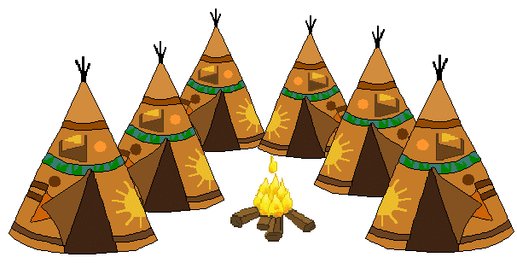
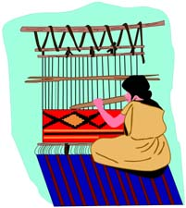
Choose three groups of Native Americans.
Write an essay about these three groups. Explain how each group obtained food, clothing, and shelter.

Slide 6
Native Americans
C-L
1
Kwakiutls - Northwest
First
2
Sioux – Great Plains
Another
3
Hopi - Southwest
Finally

Slide 7
The Native Americans of the Northwest lived on a narrow strip of land along the Pacific Coast. There was plenty of wildlife in the area. Fish, especially salmon, filled the streams. Whales swam up and down the coast. Deer, elk, mountain goats, and wolves lived in the forest.
The Kwakiutls used wood from the forest for housing. They built huge wooden structures that served as homes for several families. Outside each home they placed totem poles. On these poles, they carved figures of animals, humans, and spirits. These carvings told about important events in the family’s history.
Clothes made from cedar bark protected Kwakiutls from the wet climate. Women wove the bark’s soft inner core into warm waterproof coats and hats.

Slide 8
Native Americans
C-L
1
Kwakiutls - Northwest
First
Hunted and fished
Wood houses
Clothes – cedar bark
2
Sioux – Great Plains
Another
Hunt buffalo - food
Tepees – buffalo hide
Clothes – buffalo hide
3
Hopi - Southwest
Finally
Farmed
Adobe pueblos
Cotton clothing

Slide 10
Native Americans
There were three groups of Native Americans that each had a very different way of life.
One group was the Kwakiutls who lived in the Northwest. They hunted and fished for their food. Their houses were made out of wood with totem poles in front. They made their clothes out of cedar bark.
Another group was the Sioux who lived on the Great Plains. The Sioux hunted the buffalo to provide food. The also used the buffalo hides to make their homes called tepees. They even used the buffalo hides to make warm clothing.

Slide 11
Native Americans
Finally, the Hopi lived in the Southwest. They were farmers and grew corn, beans, and squash. Their houses were called adobes and were made from mud. They grew cotton and made it into clothing.
In conclusion, the Kwakiutls, Sioux, and Hopi all had different ways of finding food, clothing, and shelter.

