Slide 1
The Essay Test-Taking Strategy
By Charles A. Hughes, Jean B. Schumaker, & Donald D. Deshler
July 2006
University of Kansas
Center for Research on Learning
Lawrence, Kansas

Slide 2
Essay Test-Taking Strategy Pretest Questions List
INSTRUCTIONS:
Choose one of the questions from the following list.
Write an essay answer to the question using any and all strategies that you know.
Identify a career you might like to have. Explain why you’re interested in this career. Then, outline the major steps you’ll need to take to obtain it.
Choose a sport you like to watch or play. Describe who plays it, where they play it, and how it is played.
Describe the pros and cons of having a job while going to school.
Critique the lunch food in the school cafeteria. Explain what you consider good and bad.
Define “work ethic”. Give an example of someone who has a good work ethic. Justify your answer.

Slide 3
Pretest Reading Passage, Page 126
Essay question
Define a food chain, and draw an example of one. Explain the levels of the food chain that you have drawn.

Slide 4
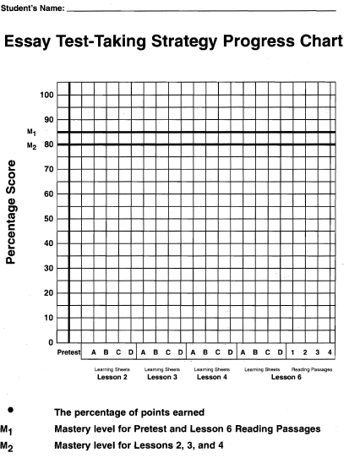

Slide 5
The Steps of the Essay Test-Taking Strategy
Cue Card #2
Step 1: Analyze the Action Words
Step 2: Notice the Requirements
Step 3: Set Up an Outline
Step 4: Work in Details
Step 5: Engineer Your Answer
Step 6: Review Your Answer

Slide 6
The Steps of the Essay Test-Taking Strategy
Cue Card #2
Step 1: Analyze the Action Words
Step 2: Notice the Requirements
Step 3: Set Up an Outline
Step 4: Work in Details
Step 5: Engineer Your Answer
Step 6: Review Your Answer
Focuses on the essay question
Focuses on developing an outline to organize your answer
Focuses on actually writing the response to the essay question

Slide 7
Results of the Essay Test-Taking Strategy
The percentage of points available for essay test-taking behaviors:
Before instruction
5%
After instruction
85%

Slide 8
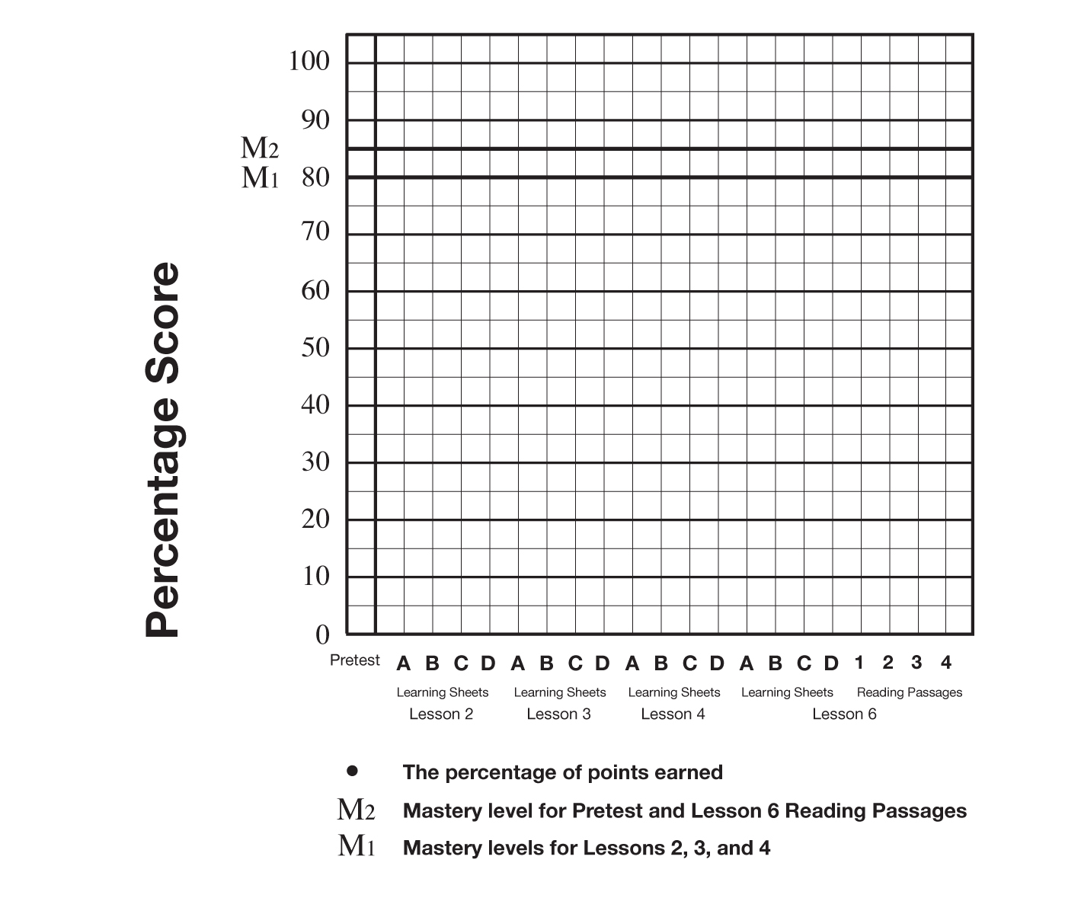
Progress Chart

Slide 9
Step 1: Analyze the Action Words
Cue Card #3
Read the question carefully.
Underline key action words.

Slide 10
Examples of Key Action Words
Cue Card #4
Compare
To show how two or more things are the same or similar. “Compare rap and hip-hop.”
Contrast
To show how two or more things are different. “Contrast socialism and capitalism.”
Critique/Criticize
To point out both the good points and bad points of something. “Critique the public welfare system.”
Define
To give a clear meaning of something. This usually involves naming the class it belongs to and how it is different from other things in that class. “Define the term ‘mammal.”
Notes:
The Challenge

Slide 11
Examples of Key Action Words (cont.)
Cue Card #4
Describe
To provide a “word picture” of something. “Describe the events related to the Alamo.”
Diagram
To organize information in a pictorial or graphic manner, such as a chart, table, map, or diagram. “Diagram the water cycle.”
Discuss
To write about all sides or points of view related to an issue. This may include writing about the advantages and disadvantages of something.
“Discuss environmental issues related to the timber industry.”
Evaluate
To make a value judgment (positive or negative) based on facts or evidence.
“Evaluate the overall impact of the welfare system.”

Slide 12
Cue Card #4
Examples of Key Action Words (cont.)
Justify
To argue in writing why something is good or bad. This involves giving reasons for why something is good or bad and/or writing about the advantages and disadvantages of something. “What is your position on capital punishment? Justify your position.”
List
To write sentences about specific elements or examples. This sometimes requires some form of order or sequencing.
“List the stages of butterfly metamorphosis.”
Summarize
To present the main ideas of an issue or topic in a shortened way by providing a few examples or details.
“Summarize the steps of the Essay Test-Taking Strategy.”

Slide 13
Example Essay Questions
Cue Card #5
Describe the inside of the eye. Be sure to include all five major parts in your description
List at least three types of pollution. Select one of the types and describe it.
Choose two literary styles and contrast them.
Are you warm-blooded or cold-blooded? Explain what that means.

Slide 14
Example Essay Questions, cont.
Cue Card #5
Select one of the following simple machines (pulley, lever, or wheel), and write how you would explain it to a first-grade student.
Consider these two contrasting statements: “Look before you leap” and “He who hesitates is lost.” Select the one you believe to be generally the best advice. Persuade the reader by using an example from your own life as well as an example from historical or current events.

Slide 15
Step 2: Notice the Requirements
Cue Card #6
Scan and mark
Change it into your own words
Arrange the times
Name your goal

Slide 16
Scan and Mark
This means that you look for and mark the question’s requirements
Draw 2 lines under each requirement
For every action word you underline, you will probably underline at least 1 requirement

Slide 17
Change it into Your Own Words
This means that you paraphrase the question into your own words.
Paraphrasing makes you think carefully about the question
Paraphrasing helps you better understand the question

Slide 18
Arrange the Times
This means that you figure out how much time you can spend answering the question
Factors to consider:
Total test time
Number of test parts
Number of points/part
Number of essay questions

Slide 19
Name Your Goals
This means that you state a positive goal for the test.
“I am going to do well on this part of the test.”
“I am going to do a quality job.”
“I am going to earn all the points I can on this question.”

Slide 20
Parts of an Outline
Cue Card #7
Main ideas
Details
Numbers

Slide 21
Step 3: Set Up an Outline
Cue Card #8
List main ideas
Leave space underneath
each main idea

Slide 22
Step 4: Work in Details
Cue Card #9
Indent details under main ideas
Add numbers

Slide 23
General Rules for Abbreviations
Cue Card #10
Rule 1: Use typical abbreviations
Examples: + for “and”
w/ for “with”
w/o for “without”
Rule 2: Omit vowels
Example: Lgsltr for “legislature”
Rule 3: Use initials
Example: B.O.G. for “Branches of Government”
Rule 4: Use first two or three letters
Example: Eng. for “English”

Slide 24
Step 5: Engineer Your Answer
Cue Card #11
Write an Introductory Paragraph (or sentences
Write a Detail Paragraph (or a sentence) about each main idea

Slide 25
Examples Introductory Paragraphs for Essay Answers
Cue Card #12
Question 1: Explain at least four reasons why people have difficulty remembering information.
People have difficulty remembering information for a variety of reasons. These reasons include lack of motivation, too much new information has been presented, information has been presented too fast, and people do not use memory strategies.

Slide 26
Examples Introductory Paragraphs for Essay Answers
Cue Card #12
Question 2: Describe three factors or issues that led to the Civil War.
The Civil War was caused by three major factors. First, the Northerners and Southerners disagreed over the issue of slavery. Second, the nature of their land led to economic differences between them. Third, they had different cultures.

Slide 27
Examples Introductory Paragraphs for Essay Answers
Cue Card #12
Question 3: What are the major functions of the three branches of government?
The three branches of the federal government have separate responsibilities. These branches are the executive, legislative, and judicial branches. Responsibilities for each relate to particular powers of governing citizens.

Slide 28
Example of an Outline
What are the major functions of the three branches of government?
I. Exec. Branch: Pres
1. can declare war
2. starts legislation
3. appt jdges
4. can veto legis.
II. Jud. branch: Sup Crt.
1. decides if laws are const.
2. hears leg. cases from low. cts.
III. Legis. branch
Hse. of Rep
1. proposes legis
2. accuses in impeach. Cases
3. passes legis.
4. overrides pres. Veto
Senate
1. pass legis.
2. confirm pres. appoint.
3. try impeach. cases
4. overrides pres. veto
Cue Card #13

Slide 29
Parts of a Detail Paragraph for Essay Answers
Cue Card #14
TOPIC SENTENCE that gives a preview of the rest of the paragraph. It should relate to a main idea from the outline.
DETAIL SENTENCES that provide details about the Topic Sentence.

Slide 30
Example Detail Paragraph
Cue Card #15
Question: What are the major functions of the three branches of government?
The three branches of the federal government have separate responsibilities. These branches are the executive, legislative, and judicial branches. Responsibilities for each relate to particular powers for governing citizens.
The executive branch, which is headed by the President of the United States, has many different responsibilities and powers. One of the President’s most important powers is the ability to declare war on another country, although he must have the Senate’s approval to do this. The President also has a lot of legislative authority. He can propose any law that he thinks the county needs. He can approve laws made by Congress, or he can veto any law that he does not like. The President is also able to appoint Supreme Court judges, ambassadors, and other top-ranking officers of the federal government. He supervises the members of his Cabinet who run the various departments of the federal government.

Slide 31
Step 6: Review Your Answer
Cue Card #16
Check that all parts of the question are answered
Check that outlined items are included
Polish your answer

Slide 32
Sample Essay Question for Demonstration and Guided Practice
Cue Card #17
Define “natural resources” and list several examples. Select the natural resource you think is the most precious. Justify your answer.

