Slide 1
Janis A. Bulgren, Ph.D.
Higher Order
Thinking & Reasoning
(HOTR)
Content Enhancement Routines
2023

Slide 2
Professional Development Materials: Higher Order Thinking and Reasoning Routines (HOTR)
A1 HOTR: Introduction to Higher Order Thinking and Reasoning (HOTR) Routines
A2 HOTR: Alignment of HOTR routines with reasoning standards across content standards
A3 HOTR: Similarities across HOTR routines to facilitate teaching and learning
B1 CCAR: Introduction to the Cross Curricular Argumentation Routine (CCAR)
B2 CCAR: Alignment of CCAR with standards across content areas
B3 CCAR: Expanding Learning with the CCAR Routine
C1 Demystifying Reasoning and Deconstructing Complex Questions
C2 Building Bridges from other Content Enhancement Routines (CERs) to HOTR routines
C3 Scaffolds for gradual introduction of complex HOTR routines
© Janis Bulgren 2023

Slide 3
Janis A. Bulgren, Ph.D.
HOTR Slide Set B1:
Introduction to the Cross Curricular Argumentation Routine (CCAR)
2023

Slide 4
Cross-Curricular Argumentation Guide A
Name: | Date: | Class: | Topic:
1. Clarify the claim with any qualifier and define key terms.
2. List the evidence. | 3. Analyze the reasoning.
4. Identify other arguments for or against the claim.
5. Make a judgment about the quality of evidence, the reasoning, and other arguments.
6. State why you accept or reject the claim.

Slide 5
Janis A. Bulgren, Ph.D.
HOW do
Higher Order Thinking and Reasoning (HOTR) Routines
such as CCAR
align with other
Content Enhancement Routines
developed at the
University of Kansas Center for Research on Learning?
© Janis Bulgren 2023
Notes:
2022

Slide 7
Janis A. Bulgren, Ph.D.
HOW does the CCAR
respond to the needs of
STUDENTS and TEACHERS facing increasingly rigorous STANDARDS?
© Janis Bulgren 2023
Notes:
2022

Slide 8
The CCAR guides responses to standards requiring Reasoning
Reasoning is the process of
thinking about a CLAIM,
analyzing the EVIDENCE presented to support the claim, and
thinking and REASONING to explain HOW the evidence is strong enough and is well connected to the claim (or not) to support the claim. See Chapter 1 of Teaching Cross-Curricular Argumentation (2021) The University of Kanas Center for Research on Learning
© Janis Bulgren 2023

Slide 9
Rationales for using the Cross Curricular Argumentation Routine
Building on factual information to engage in reasoning
Responding to rigorous standards across content areas
Responding to school and real-world issues and needs
© Janis Bulgren 2023

Slide 10
The Heart of
Teaching Cross-Curricular Argumentation: understanding arguments and argumentation
Argument: a claim* backed by reasons that are supported by evidence
Argumentation: the process of making a claim, presenting evidence, and producing reasons
how and why the evidence supports the claim
* A claim is sometimes presented as a statement, conclusion, finding, or assertion.
© Janis Bulgren 2023

Slide 11
DISCUSSION
What are examples of questions that ask students to consider claims, evidence or reasoning?
Which content areas present these types of questions?
Give Examples.

Slide 12
Use the Cross-Curricular Argumentation Routine to guide
Arguments about Claims using Evidence and Reasoning with:
Graphic Devices designed to support Argumentation
Cognitive Strategic Steps: Steps on the Device
Instructional Procedures: Cue-Do-Review
See Chapter 2: of Teaching Cross-Curricular Argumentation (2021) The University of Kanas Center for Research on Learning
© Janis Bulgren 2023

Slide 13
The Cross-Curricular Argumentation Routine contains three main components.
Visual Devices: Guides A & B
A Cognitive Reasoning Strategy
Instructional Procedures
See Chapter 2 of Teaching Cross-Curricular Argumentation (2021) The University of Kanas Center for Research on Learning

Slide 14
There are two
Cross-Curricular Argumentation Guides:
Guide A
Guide B with additional terms
See Chapter 2 of Teaching Cross-Curricular Argumentation (2021) The University of Kanas Center for Research on Learning

Slide 15
Cross-Curricular Argumentation Guide A
Name: | Date: | Class: | Topic:
1. Clarify the claim with any qualifier and define key terms.
2. List the evidence. | 3. Analyze the reasoning.
4. Identify other arguments for or against the claim.
5. Make a judgment about the quality of evidence, the reasoning, and other arguments.
6. State why you accept or reject the claim.

Slide 16
Claim: A statement that something is true
Cross-Curricular Argumentation Guide A
Name: | Date: | Class: | Topic:
1. Clarify the claim with any qualifier and define key terms.
2. List the evidence. | 3. Analyze the reasoning.
4. Identify other arguments for or against the claim.
5. Make a judgment about the quality of evidence, the reasoning, and other arguments.
6. State why you accept or reject the claim.
Reasoning: Thinking process used
to show how the evidence supports
or proves the claim
Evidence: Information used to support claim
© Janis Bulgren 2023

Slide 17
Cross-Curricular Argumentation Guide A
Name: | Date: | Class: | Topic:
1. Clarify the claim with any qualifier and define key terms.
2. List the evidence. | 3. Analyze the reasoning.
4. Identify other arguments for or against the claim.
5. Make a judgment about the quality of evidence, the reasoning, and other arguments.
6. State why you accept or reject the claim.
Other arguments, rebuttals, counterarguments, corroboration
Decision
Explanation
© Janis Bulgren 2023

Slide 18
Examples of Version A of the
Cross Curricular Thinking and Reasoning Guide across Content Areas
© Janis Bulgren 2023

Slide 19
Cross-Curricular Argumentation Guide A – Science
Clarify the claim with any qualifier and key terms. Some changes caused by heating or cooling can be reversed and some cannot. Reversed – changed back to original form
2. List the evidence. When butter, chocolate and ice are heated, they melt. When they are cooled, they go back to their original form. When an egg is cooked, paper is burned, or bread is toasted they do not their original form when they are cooled. | 3. Analyze the reasoning. Some changes caused by heating or cooling can be reversed. Some changes caused by heating or cooling cannot be reversed.
4. Identify other arguments for or against the claim. I have seen when plants freeze in the winter, they do not go back to their original form when it warms up.
5. Make a judgment about quality of evidence reasoning, and other arguments. The evidence is good because we can give examples changes caused be heating that can be reversed. We can also give examples of changes caused by heating that cannot be reversed.
6. State why you accept or reject the claim. I accept the claim because I observed the evidence in an experiment.
Name: | Date: | Class: | Topic: Reversible and not reversible changes
© Janis Bulgren 2023

Slide 20
Cross-Curricular Argumentation Guide A - English Language Arts.
Name: | Date: | Class: | Topic: American Literary Novel: Mark Twain
Mark Twain’s Huckleberry Finn is an example of a great American literary novel.
1. Clarify the claim and define key terms. å
2. List the evidence. | 3. Analyze the reasoning.
4. Identify other arguments for or against the claim.
5. Make judgements about the quality of evidence, reasoning and other arguments.
6. State why you accept or reject the claim.
Literary novel: Work of fiction that explores social themes, uses figurative language (e.g., symbolism, explores character growth, & contains a message.
American novel: A novel that uses uniquely American settings or cultural beliefs and often uses colloquial language.
Literary novel characteristics include:
an important social theme
uses symbolism
shows growth in character’s understanding
contains a message for the reader
American novel characteristics include:
set in a specific American time and culture
uses colloquial language of the time
Huckleberry Finn:
addresses the social theme of slavery.
uses the Mississippi River as a symbol of Huck’s journey.
Huck grows in his understanding of the immorality of slavery.
has the message: worth of each human.
Huckleberry Finn:
is set in the American pre-Civil War Southern culture.
characters in the novel use colloquial language of the time.
Throughout the novel, Huck moves from accepting the cultural belief of slaves as property and feeling guilty about helping Jim escape to recognizing Jim was a human being who showed kindness to all, loyalty and love of family and deserved to be free.
The quality of evidence is good because it is a list of characteristics of both a literary novel and American novel. The reasoning is logical because there is a point-by-point correlation showing that all characteristics of both a literary novel and American novel are found in Huckleberry Finn. The additional argument is a good example of the cultural beliefs addressed in this novel.
I agree with the claim because there is a point-by-point correlation between good quality evidence and reasoning.
© Janis Bulgren 2023

Slide 21
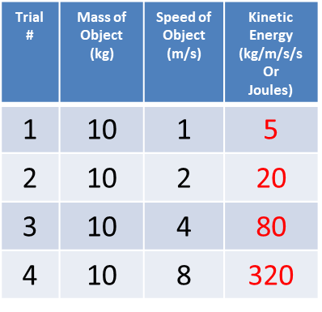
Cross-Curricular Argumentation Guide A - Mathematics
Name: | Date: | Class: | Topic: Kinetic Energy and Speed
1. Clarify the claim with any qualifier and define key terms. The amount of kinetic energy increases with the square of an object’s speed. Kinetic energy is the energy in a moving object that is calculated using the formula KE = ½ mass X speed². When you square a number, you multiply it by itself. For example, 2²= 2 x 2 = 4 or 3² = 3 x 3 = 9.
2. List the evidence. The experimental data provided shows the following relationships between mass and kinetic energy for an object moving at a speed of 10m/s: | 3. Analyze the reasoning. When the speed of the moving object was multiplied by 2, the kinetic energy was multiplied by 4 which is 2². When the speed of the moving object was multiplied by 4, the kinetic energy was multiplied by 16 which is 4². When the speed of the moving object was multiplied by 8, the kinetic energy was multiplied by 64 which is 8².
4. Identify other arguments for or against the claim. I know that in a wreck, the faster the cars are going, the greater the damage. That must mean there is more energy involved at greater speeds.
5. Make a judgment about the quality of evidence, the reasoning, and other arguments. The evidence is good because it is based on experimental data. The reasoning is logical because it uses math to make cause-and-effect connections. The additional argument based on personal observation is also logical.
6. State why you accept or reject the claim. I accept the claim that the amount of kinetic energy increases with the square of an object’s speed because it is based on experimental evidence and logical reasoning.
Comparing Trial 1 to Trial 2, the speed of the moving object was multiplied by 2.
Comparing Trial 1 to Trial 3, the speed of the moving object was multiplied by 4.
Comparing Trial 1 to Trial 4, the speed of the moving object was multiplied by 8.

Slide 22
Cross-Curricular Argumentation Guide A – Social Studies/History
Name: | Date: | Class: | Topic:
1. Clarify the claim and define key terms.
2. List the evidence. Roman system of government Separation of powers Checks and Balances Vetoes Term limits 5. Regular elections. | 3. Analyze the reasoning. American system of government
5. Make judgements about the quality of evidence, reasoning and other arguments.
6. State why you accept or reject the claim.
The American system of government has precedents in the Roman system of government.
*precedent - earlier action that is a guide to be considered in other similar circumstances.
*system of government – the ways a group of people governing a nation or state are organized
1. Separation of powers: Executive, Legislative, Judicial
2. Checks and balances, three branches of government with power to overrule decisions by another branch
3. President can veto Congressional bills; Congress can override a presidential veto; Supreme court can intervene
4. Presidents can serve only two terms
5. Regular elections held every two to four years.
4. Identify other arguments for or against the claim. There seems to be few arguments against this claim, but it would be
Interesting to explore how the two are different.
The quality of evidence is good because it clearly lists five aspects of the Roman system of government.
The reasoning is good because it shows a one-to-one correlations between all five of those aspects.
I agree with the claim because of good quality evidence and how the reasoning uses the evidence to show a point-by-point correlation between the Roman and American systems.
© Janis Bulgren 2023

Slide 23
Cross-Curricular Argumentation Guide A – Social Studies/History: Example Guide A used to Argue an Issue
Name: | Date: | Class: | Topic: Term Limits
Clarify the claim with any qualifier and define key terms. Term limits should be established for members of the United States Congress. term limits - mandatory restrictions on how long members of the House of Representatives and Senate can serve in office
2. List the evidence. Members of Congress now spend much of their time campaigning and raising money for their reelection. Special interest groups invest a lot of money in reelection campaigns of individuals who push legislation that favors them. Members of Congress have millions of dollars of federal money and staff available to help get them reelected. Senior members of Congress can campaign by emphasizing their ability to get special projects for their states or districts. Career politicians do not know what day-to-day life is for their constituents because they live in the artificial world of Congress. | 3. Analyze the reasoning. Time - If members of Congress spent less time time trying to get reelected, then they could spend more time doing their job. Money - If members of Congress get money from special interest groups, then they could be considering those groups’ interests over the interests of the people. Support - If members of Congress have money and staff to run a campaign, then they have an advantage for continued reelection. Favoritism - If members of Congress who have seniority get special projects for their own states or districts, then government funds may be used improperly. Point of View - If members of Congress had limited time in office, then frequent turnover would bring fresh, new perspectives to Congress.
4. Identify other arguments for or against the claim. Two counterarguments against this claim are: 1. Elections are already a form of term limits, and 2. Term limits would prevent a person who was doing a really good job from continuing to serve.
5. Make a judgment about the quality of evidence, the reasoning, and other arguments. The evidence applies to the claim, but since no sources are given, I would say the quality is fair. The reasoning used to show how the evidence supports the claim is logical. The counterarguments do not seem very strong to me.
6. State why you accept or reject the claim. Based on the evidence and reasoning, I accept the claim that term limits should be established. I think the idea of having fresh faces and new perspectives is important even if it prevents effective members of Congress from continuing to serve.

Slide 24
Cross-Curricular Argumentation Guide A: Mathematics
Name: | Date: | Class: | Topic: Order of Operations
1. Clarify the claim with any qualifier and define key terms. When solving the equation 24 – 6 ÷ 2 + 3² =? the correct answer is 30. the order of operations – an agreed-upon set of rules that determines which operation should be done before or after others when solving an equation
2. List the evidence. When solving an equation using the order of operations: Actions in parentheses should be solved first. Exponents should be solved second. Multiplication or division (from left to right, as found in the problem) should be solved third. Addition or subtraction (from left to right, as found in the problem) should be solved fourth. | 3. Analyze the reasoning. Since there are no parentheses in this equation, we should move to step. If exponents are solved second, then the equation becomes 24 – 6 ÷ 2 + 9 =? If division is solved third, then the equation becomes 24 – 3 + 9 =? If addition or subtraction from left to right is solved fourth, the equation becomes 24 – 3 + 9 = 30
4. Identify other arguments for or against the claim. The order of operations must be used to correctly solve an equation because, in this example, if you simply complete the operations from left to right you would get an answer of 18.
5. Make a judgment about the quality of evidence, the reasoning, and other arguments. The evidence is good because the order of operations is a set of rules that should always be used to solve an equation. The reasoning is good because it correctly applies the order of operations to the equation in the claim.
6. State why you accept or reject the claim. I accept the claim based on the quality of the evidence and reasoning.
© Janis Bulgren 2023

Slide 25
An Example of Version A with a model of the Sun-Earth-Moon system to respond to the claim on the previous slide “The cyclic pattern of lunar phases can be observed and predicted”.
© Janis Bulgren 2023

Slide 26
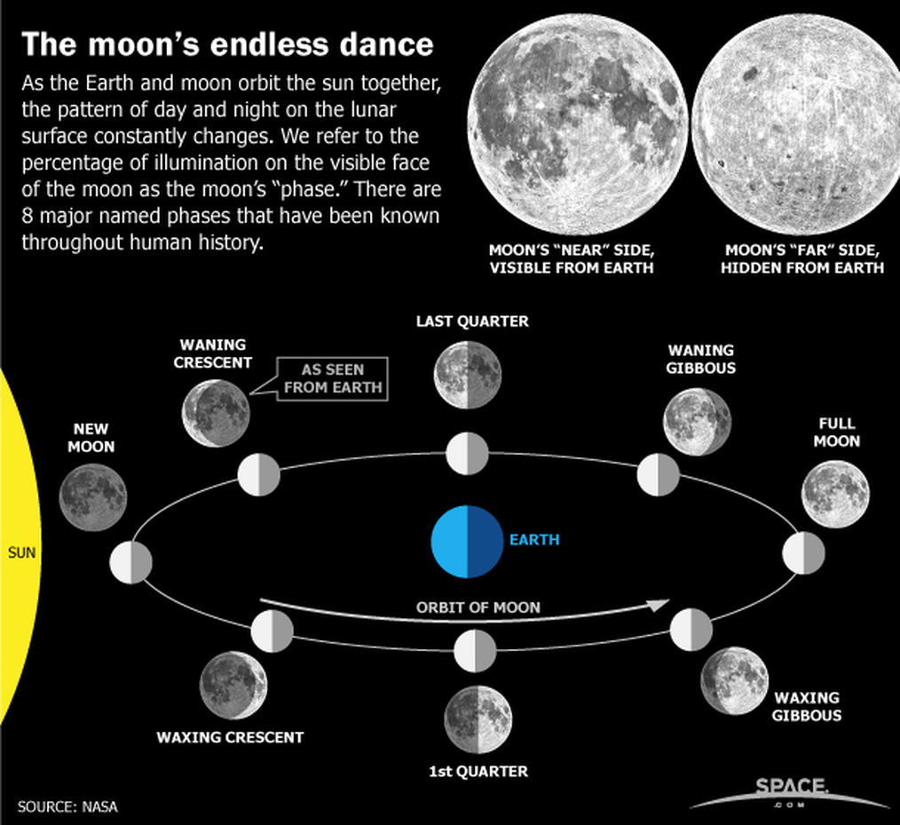
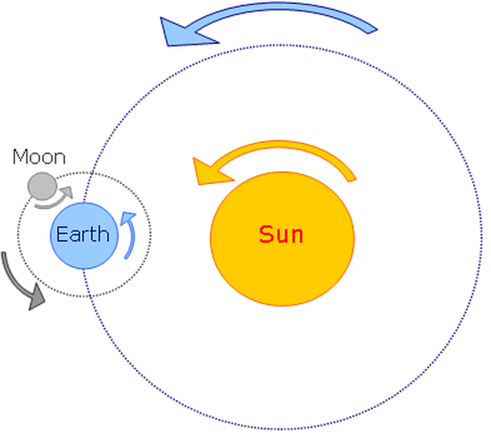
Use these models of the Sun-Earth-Moon system to respond to the claim on the previous slide “The cyclic pattern of lunar phases can be observed and predicted”.
As the Moon orbits around the Earth, the half of the moon that faces the sun is lit up. As a result, different shapes of the lit portion of the Moon that can be seen from the Earth each night.
Day 25
Day 21
Day 18
Day 0
Day 14
Model 1. Motion of the Earth-Moon-Sun System
Earth rotates (spins) on its axis in about 24 hours
Moon revolves (orbits) around the Earth in about 29.5 days
The Earth-Moon System revolves around the Sun.
Day 3
Day 11
Day 7
Model 2. Lunar Phases
© Janis Bulgren 2023

Slide 27
Cross-Curricular Argumentation Guide A
Name: | Date: | Class: | Topic: Lunar phases (sample background on following slide)
1. Clarify the claim with any qualifier and define key terms. The cyclic pattern of lunar phases can be observed and predicted. cyclic pattern - a pattern that recurs at regular intervals lunar phases - the shapes of the directly sunlit portion of the Moon as viewed from Earth
2. List the evidence. The Earth rotates on its axis in approximately 24 hours. The Moon revolves around the Earth in approximately 29 days. During the Moon’s revolution around the Earth, light from the sun is reflected off the Moon’s surface. The portion of the Moon’s surface that is visible from Earth depends on the relative position of the Moon, the Earth, and the Sun. | 3. Analyze the reasoning. Since the Earth rotates on its axis in approximately 24 hours, there is the cyclic pattern of day and night. Since the Moon revolves around the Earth in approximately 29 days, the position of the Moon relative to the Earth and the Sun changes daily. Because the light from the sun reflects off the Moon, we can see the Moon’s shape which is a lunar phase. Since the position of the Moon relative to the Earth and the Sun changes daily, then the portion of the Moon visible from the Earth also changes daily; this results in a cyclic pattern of lunar phases.
4. Identify other arguments for or against the claim. I have observed different lunar phases when looking at the night sky. I can predict that I will see a full moon about once a month.
5. Make a judgment about the quality of evidence, the reasoning, and other arguments. The evidence presented is good because it is based on scientific facts and personal observation. The reasoning that ties the evidence to the claim is logical.
6. State why you accept or reject the claim. I accept this claim because the evidence is based on scientific facts, the reasoning is logical, and I have observed it myself.
Claim Evidence Reasoning
© Janis Bulgren 2023

Slide 28
Guide B contains the same basic steps as Guide A with additional prompts to support deeper analysis at each step.
© Janis Bulgren 2023

Slide 29
Examples of Version B of the
Cross Curricular Thinking and Reasoning Guide across Content Areas
© Janis Bulgren 2023

Slide 30
Cross Curricular Argumentation Guide B
Name: | Date: | Class: | Topic: Masks prevent spread of a virus.
Clarify the claim with any qualifiers, key terms and citations (author, date, source).
2. List the evidence (fact/data, authority, theory, precedent). | 3. Analyze the reasoning (cause-effect, correlation, generalization).
4. Identify other arguments for or against the claim (rebuttal, counterargument, corroboration). .
5. Make judgments about the quality of and other arguments. (relevant, accurate, adequate, objective), reasoning (type of logic), and other argumennts.
6. State why you accept or reject the claim.

Slide 31
∙ Qualifier in claim: a word that limits the strength of the claim (sometimes, may, often, etc.) ∙ Claim: author, date, source) ∙ Evidence: fact/data, authority, theory, precedent ∙ Reasoning: cause-effect, correlation, generalization ∙ Other: considering counterarguments and rebuttals, and corroborations of the claim ∙ Judging evidence: relevant, accurate, adequate, objective ∙ Judging type of logic: cause effect, correlation, generalization See Chapter 2 of Teaching Cross-Curricular Argumentation (2021) The University of Kanas Center for Research on Learning. © Janis Bulgren 2023
Use the Cross-Curricular Argumentation Routine B to analyze expanded components of Argumentation:
© Janis Bulgren 2023

Slide 32
Cross-Curricular Argumentation Guide B: Science
Name: | Date: | Class: | Topic: Dinosaurs in the Arctic
Clarify the claim with any qualifier and key terms (including author, date, source, era Some species of dinosaurs lived in the Arctic year around. https://www.sciencejournalforkids.org/articles/how-could-baby-dinosaurs-live-in-the-arctic/ (summary of research) Species - a group of animals or plants that can reproduce with one another and produce offspring (babies) Sediment – fragments of rocks and minerals broken down by erosion and moved to a new location Fossil - the remains or traces of plants and animals that lived a long time (even millions of years) ago Migration - the seasonal movement of animals from one place to another
2. List the evidence (facts, data, authority, theory, precedent). In the Arctic, researchers found fossils of dinosaur eggs. (fact) Researchers found fossil teeth of very young dinosaurs from both small and large dinosaur species. (fact) | 3. Analyze the reasoning (cause-effect, correlation, generalization). Since fossil remains of eggs were found, therefore, some species of dinosaurs must have nested in the Arctic. (cause-effect) Since the baby dinosaurs wouldn’t have been big enough to migrate South before the cold winter months, therefore some species of dinosaurs in the Arctic must have lived there year around. (cause-effect)
4. Identify other arguments for or against the claim (rebuttal, counterargument, corroboration). Scientists don’t know how dinosaurs survived the cold, lack of sunlight, and shortage of food so maybe it wasn’t cold when dinosaurs lived there. (counterargument)
5. Make a judgment about quality of evidence (accurate, adequate, objective, relevant), reasoning, (type of reasoning), and other arguments. The method for collecting evidence was carefully done and relevant to the claim so the quality of the evidence is good. The reasoning explains how the evidence supports the claim. The article stated the researchers collected rock samples and looked for clues about what the environment was like there millions of years ago but didn’t say what they found so the report may be incomplete.
6. State why you accept or reject the claim. I reject this claim because of the missing information about environmental conditions in the Arctic millions of years ago. More information is needed.

Slide 33
Cross-Curricular Argumentation Guide B – Social Studies/History
Name: | Date: | Class: | Topic: Civil Disobedience: Letter from Birmingham Jail
1. Clarify the claim with any qualifier and key terms (including author, date, source, era). Use of civil disobedience to change unjust segregation laws through non-violent protests is justified. Author: Rev. Martin Luther King, Jr. Date: 1963 Source: Letter written by MLK while in jail in Birmingham Era: Civil Rights movement with marches and protests King’s letter was in response to an open letter from 8 white clergymen who argued for peaceful negotiation rather than demonstrations against segregation.
2. List the evidence (facts, data, authority, theory, precedent). Martin Luther King, Jr. stated: A local law that preserves segregation and denies citizens the right of assembly is an unjust law and contrary to Constitutional rights. Natural law and Christian moral codes supporting equality have higher status and take precedent over man-made laws. White business and Christian church leaders who say they believe in equality but do not support it with actions create barriers to economic, financial, and social equality for African Americans. Historically, some authorities defended protesting and disobeying unjust laws. (Jefferson, St. Augustine, Paul, Biblical figures). Segregation laws that cause humiliation, brutality, poverty and psychological problems are unjust. African Americans have repeatedly sought their constitutional and God-given rights for over 340 years. | 3. Analyze the reasoning (cause-effect, correlation, generalization). If a law denies people constitutional rights, then they should engage in direct action to achieve political change even if it means arrest. Given that natural law and Christian moral codes supporting equality take precedent over man-made laws, those laws should be changed. If leaders say one thing and do another, that is contrary to Christian principles and creates social, financial, and economic barriers for African Americans. Since historical figures supported protest of unjust laws, therefore there is an historical and theoretical correlation to the 1963 protests. Segregation that results in humiliation, brutality, poverty, and psychological damage harms African American citizens. If justice is delayed, the effect is that justice is denied.
4. Identify other arguments for or against the claim (rebuttal, counterargument, corroboration). The 8 clergymen’s claim argued that adhering to principles of law requires addressing violations of rights in the courts and negotiations, not in provocative street demonstrations.
5. Make a judgment about quality of evidence (accurate, adequate, objective, relevant), reasoning, (type of reasoning), and other arguments. The evidence seems accurate, adequate, and relevant. King uses cause-and-effect, correlation, and generalization reasoning to connect his evidence to political, moral, ethical, theoretical, and psychological results. The clergymen’s statement is not strong because negotiations to end racism had been ineffective for 340 years.
6. State why you accept or reject the claim. I accept King’s claim. The evidence is based on fact, authority, theory, and precedent. It is well-supported with good cause-and-effect reasoning, and the argument against it is not persuasive.

Slide 34
Cross-Curricular Argumentation Guide B: Science
Name: | Date: | Class: | Topic: Finding planets in other solar systems
Clarify the claim with any qualifier and key terms (including author, date, source, era). Scientists have discovered a new planet outside of our Milky Way Galaxy. https://www.sciencejournalforkids.org/articles/how-do-we-find-a-planet-in-another-galaxy/ (summary of research done by Di Stefano, Berndtsson, Urquhart, et al., (2021) A possible planet candidate in an external galaxy detected through X-ray transit. Reported in Nature Astro.) Galaxy – A large group of stars, each of them with its own solar system. Light-year –the distance that light travels during one year (which is around 9.5 trillion kilometers). X-rays – a form of radiation with high energy. They can pass through matter, but they get weaker or even blocked depending on the material they try to go through. Solar system – a term to describe everything that is gravitationally bound to a central star and orbits around it.
2. List the evidence (facts, data, authority, theory, precedent). The researchers used telescopes to study a galaxy ( M51 31) a million light years from Earth; that source that gave off both x-rays and visible light. It is called M51-ULS-1. (data - see Figure 2) Data collected over several years showed there was a repeating time frame of 3 hours in which the x-rays from M51-ULS-1 did not get through to their telescopes. (data) | 3. Analyze the reasoning (cause-effect, correlation, generalization). Since the light source in the M51 galaxy gave off both x-rays and visible light, therefore, it must be similar to our sun and could be the center of a solar system with orbiting planets. (generalization) If the x-rays from M51-ULS1 were being blocked in a repeating patten, then there must be a planet orbiting the light source in the M51 galaxy. (cause-effect)
4. Identify other arguments for or against the claim (rebuttal, counterargument, corroboration). The researchers’ data also showed the signal blockage was not due to dust found in the universe or a change of M51-ULS-1 itself. (corroboration)
5. Make a judgment about quality of evidence (accurate, adequate, objective, relevant), reasoning, (type of reasoning), and other arguments. The evidence is objective and relevant data collected by the researchers, so it is good. The reasoning uses generalization and cause-effect thinking to explain how the evidence supports the claim, so it is good.
6. State why you accept or reject the claim. I accept the claim based on the quality of the evidence and reasoning that there is anew planet outside the Milky Way system..

Slide 35
Use the Cross-Curricular Argumentation Routine to guide
Higher Order Thinking and Reasoning
with an embedded strategy:
The Cognitive Reasoning Strategy: CLAIMS
See Chapter 3: of Teaching Cross-Curricular Argumentation (2021) The University of Kanas Center for Research on Learning
© Janis Bulgren 2023

Slide 36
The Cognitive Reasoning Strategy: CLAIMS
Step 1: Clarify the claim with any qualifier and define key terms (including author, date, source, era).
Step 2: List the evidence (facts, data, authority, theory, precedent).
Step 3: Analyze the reasoning (cause-effect, correlation, generalization).
Step 4: Identify other arguments for or against the claim (rebuttal, counterargument, corroboration).
Step 5: Make a judgment about quality of evidence (accurate, adequate, objective, relevant), reasoning (type of reasoning), and other arguments.
Step 6: State why you accept or reject the claim.
Acronym: CLAIMS
© Janis Bulgren 2023

Slide 37
Use the Cross-Curricular Argumentation Routine
with instructional procedures:
The Cue-Do-Review Instructional Sequence
See Chapter 3: of Teaching Cross-Curricular Argumentation (2021) The University of Kanas Center for Research on Learning
© Janis Bulgren 2023

Slide 38
Instructional Procedures:
The Cue-Do-Review Instructional Sequence
Cue – Teacher introduces the Cross Curricular Guide and explains expectations for student participation.
Do - Teacher and class collaboratively construct the device using the strategy steps cued by CLAIMS.
Review – Confirm
knowledge gained from using the guide,
process and steps of using the guide, and
generalization of use of the strategy
See Chapter 3zw: of Teaching Cross-Curricular Argumentation (2021) The University of Kanas Center for Research on Learning
© Janis Bulgren 2023

Slide 39
DISCUSSION
How can we help students understand that they already use parts of argumentation in daily conversation?
Which Parts
Give Examples
© Janis Bulgren 2023
Notes:
?

Slide 40
What we hear everyday: Competing Claims
Claim A: We should go to the ball game
Friday night.
Claim B: We should go to the concert Friday night.
© Janis Bulgren 2023
Notes:
?

Slide 41
Claim A as a Complete Argument
Claim A: We should go to the ball game Friday night.
Evidence:
It is an important game. If we win, we go to the finals.
The team needs our support.
The weather is supposed to be great!
Reasoning: Since the game is so important, and since the team
represents our school spirit, and since the weather will be
good, therefore we should go to the game based on importance, school support, and weather.
Counterargument: We can see this band next year.
© Janis Bulgren 2023
Notes:
?

Slide 42
Claim B as a Complete Argument
Claim B: We should go to the concert Friday night.
Evidence:
We really like this band.
It is a one-night only show
We have discounted tickets
Reasoning: Because this is a favorite group (preference) with our only chance (timing) and the good price (cost),
as a result, we should go to the concert because of preference, timing and cost.
Counterargument: We can go to the final game when we
win the game tonight.
© Janis Bulgren 2023
Notes:
?

Slide 43
DISCUSSION
Which components of the Argumentation Routine did each student use?
What are other claims students make to each other (or teachers) that can be used to familiarize students ith the components of Argumentation?
© Janis Bulgren 2023
Notes:
?

Slide 44
EXTRAS !!!!
Additional supports in the
Cross Curricular Argumentation Routine Instructional Guidebook
© Janis Bulgren 2023
Notes:
?

Slide 45
The Cross-Curricular Argumentation Guides and Examples: Appendices A & B
Use Blank Guides A and B to prepare your own Guides
Use Sample Guides B to teach in Classes
See Teaching Cross-Curricular Argumentation (2021) Appendix A & B The University of Kanas Center for Research on Learning
© Janis Bulgren 2023

Slide 46
Cross-Curricular Argumentation Appendix C Supports for Instruction and Implementation
Steps for Guide A Strategy Cue Card – p. 43
Steps for Guide B Strategy Cue Card - p. 44
Definitions List for Guide A - p. 45
Definition List for Guide B - p. 46
Teacher Implementation Cue Card – p. 47

Slide 47
Cross-Curricular Argumentation Appendix C for Instructional Material
Strategy Steps
These pages contain the steps of the Cross-Curricular Argumentation Strategy for Guides A and B. The steps can be copied and given to students the first time you teach the routine. Additionally, they can be turned into a classroom poster that students can then refer to throughout the year.
Definitions Lists
These pages contain definitions for the terms used on Guides A and B. Students using Guide A will only need the list for Guide A. Students using Guide B will need both of the lists. The appropriate list(s) should be copied and given to students the first time you teach the routine.
Teacher Implementation Process
This page contains an overview of the basic instructional process you will use each time you teach the routine (the Cue-Do-Review process). Once you are familiar with the routine, you can copy this page and refer to it as a one-page outline instead of referring to Chapter 3.
See Teaching Cross-Curricular Argumentation (2021) Appendix C The University of Kanas Center for Research on Learning
© Janis Bulgren 2023

Slide 48
Cross-Curricular Argumentation
Appendix D for Evaluating Student Learning
Checklists
Stem Prompts
Short Answer
Essay Outline from Graphic Sample Essay
See Teaching Cross-Curricular Argumentation (2021) Appendix D The University of Kanas Center for Research on Learning
© Janis Bulgren 2023

Slide 49
Use Appendix D to Evaluate Learning
Evaluate:
Knowledge of Cognitive Strategy
A Variety of Knowledge Assessments
Use the Guide to support Essay Writing
See Chapter 4: of Teaching Cross-Curricular Argumentation (2021) The University of Kanas Center for Research on Learning
© Janis Bulgren 2023

Slide 50
DISCUSSION
What are types of argumentation questions that are useful in initially introducing the CCAR?
How insightful could it be to ask teachers and administrators to engage in “backward design,” that is, to start with analyzing required learning outcomes based on assessments and standards – and then aligning those with the appropriate HOTRs?
© Janis Bulgren 2023
Notes:
?

Slide 51
ADDITIONAL PROFESSIONAL DEVELOPMENT RESOURCES
Refer to the Professional Developer slides in SIMville for Cross Curricular Argumentation Routine that provide guidance on using that guidebook and descriptions of different chapters and appendices.
Also refer to
B2 for Alignment of CCAR with standards across content areas, and
B3 for Expanding Learning with the CCAR
© Janis Bulgren 2023

