Slide 1
Learning to Read with KUCRL
Fusion Reading :: Xtreme Reading
Irma Brasseur-Hock, Ph.D.
Patty Graner, Ph.D.
July 14, 2016

Slide 2
OUR GOAL
It doesn't matter how much we know. What matters is how clearly others can understand what we know.
-Simon Sinek

Slide 3
Outcomes
Overall: To gain knowledge regarding Fusion Reading and Xtreme Reading in order to inform others.
To understand the development and rationale for each program
To understand the elements of each program
To understand the expected outcomes for students
To recognize the similarities and differences between the programs

Slide 4
Xtreme Development
IES funded project
Enhanced Reading Opportunity Study
Year-long
Replace 9th grade elective to Student motivation & engagement
Reading Fluency
Vocabulary, Comprehension
Phonics
Writing
SIM: Reading Programs

Slide 5
Fusion Development
Descriptive Study
Assessing the reading skill profile of adolescent proficient and non proficient readers = 400 students
Development Study
Designed a comprehensive multi-component reading program for struggling adolescent readers = Increase student engagement, motivation and reading outcomes (Phonics, Word Recognition, Fluency, Vocabulary, Comprehension) = Fusion Reading Program
Randomized Control Trial
Key outcome was to respond to the struggling reader profile= close the reading gap

Slide 6
Xtreme Rationale
Respond to the IES Grant
Integrate current KUCRL strategies
In a one year program
Minimum of 225 minutes of instruction per week
12-15 students/class
Improved school behaviors
Improved academic performance
Progress toward graduation
ELA or SS teacher-2 yrs.
Notes:
Change the way teachers teach
Students are successful in core classes

Slide 7
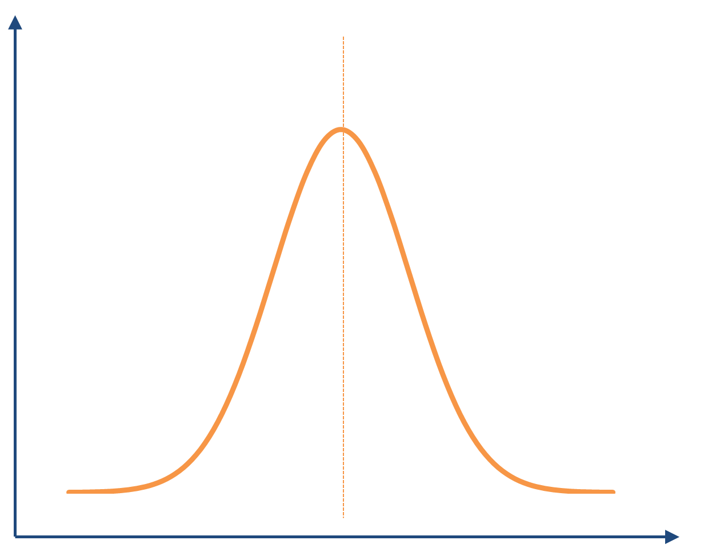
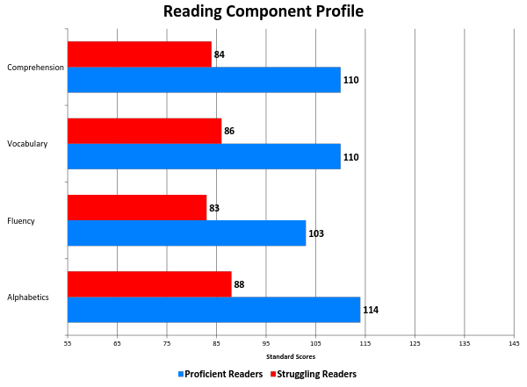
Notes:
Can keep or hide-got from Sue and I liked this visual for this audience-but totally up to you which to use slide (or both)

Slide 8
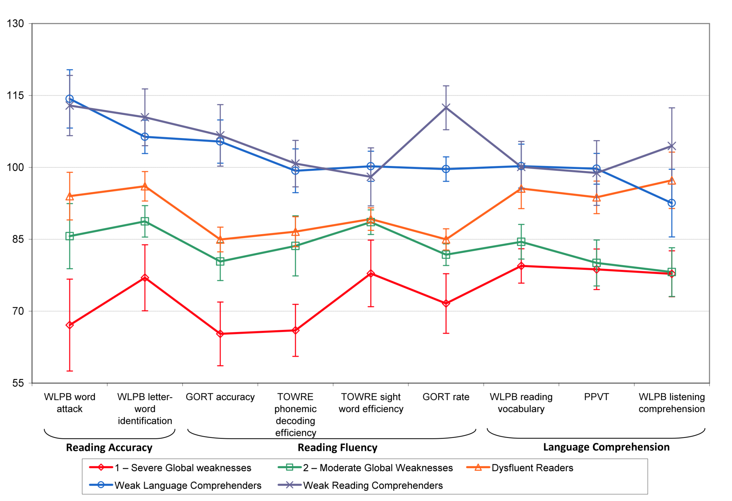
“Clusters” of Poor Comprehenders
80%
Notes:
Purpose: “Struggling Reader” is a broad category. That is, there is diversity in the reading skill profile of sub groups within the category. Our purpose is to more clearly define these subgroups and think about what this diversity means for instruction.
Comment: We conducted a latent class analysis on the struggling readers in the previous data set. Latent class analysis is a way to analyze date to see if clusters emerge from the data. That is, are there groups of students with similar scores that are significantly different from other groups of students in the data set. We found 5 distinct reader groups (see graph). Three groups, making up 80%of the struggling reader total group, had word level deficits. Thus, reading programs should address word level AND comprehension skill deficits in a significant way if we wish to improve student achievement.
WLPB Woodcock Language Proficiency Battery

Slide 9
Fusion Rationale
Respond to the IES Grant
Use descriptive study data
Design new reading strategies
Two year program
Flexible implementation
12-15 students/class
Grades 6-12
Teacher outcomes
Student outcomes

Slide 10
How are they alike
Designed and Developed with funded IES Grants
Reading, Listening, Speaking, and Writing
Explicit instruction for teachers and students
Utilizes a Course Organizer and all of its elements
Embeds a daily lesson format
Daily reading and vocabulary with time
Devoted to explicit instruction in Close reading strategies
Embeds social emotional learning
Lesson plans with detailed objectives and scripts that support the plan
Pacing guides are provided
Data collection system built in
Daily practice using novels

Slide 11
Appropriate for students with:
Fusion Reading
Reading at the 3rd-4th grade levels
Low word level skills and strategies
Lack comprehension skills and strategies
Need re-engagement and motivation to read
Need on-going feedback and assessment to increase outcomes
Xtreme Reading
Poor reading fluency,
Small sight vocabularies,
Limited understanding of words and multiple word meanings,
Limited background and conceptual knowledge,
Few skills in using strategies that enhance understanding and remembering of oral and written language.

Slide 12
How is it delivered? (scheduling)
Fusion Reading
Flexible
60 min. daily
90 min. every other day
90 min. daily
One to three
12-15 students
Xtreme Reading
45 min. day/ 5 days/week
One year
12-15 students

Slide 13
SEQUENCE OF INSTRUCTION: XTREME READING

Slide 14
The Xtreme Reading Model
Reading Core
Metacognition
Class Management
OUTCOMES
• Improved reading
comprehension
• Motivation for reading
• Increased hope
• Success in academically challenging classes
Decoding
Vocabulary
Word Recognition
=
Comprehension
Fluency
Community Learning Skills
Motivation

Slide 15
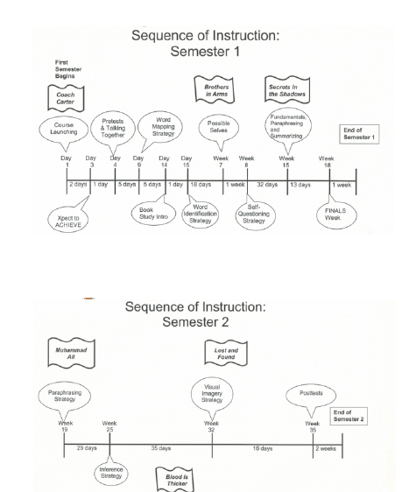
Xtreme Reading

Slide 16
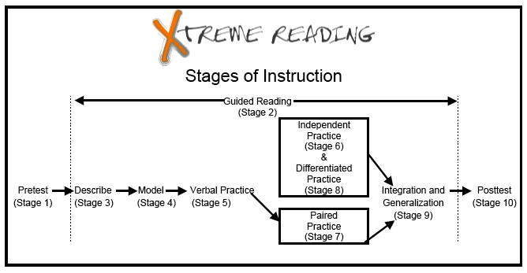

Slide 17
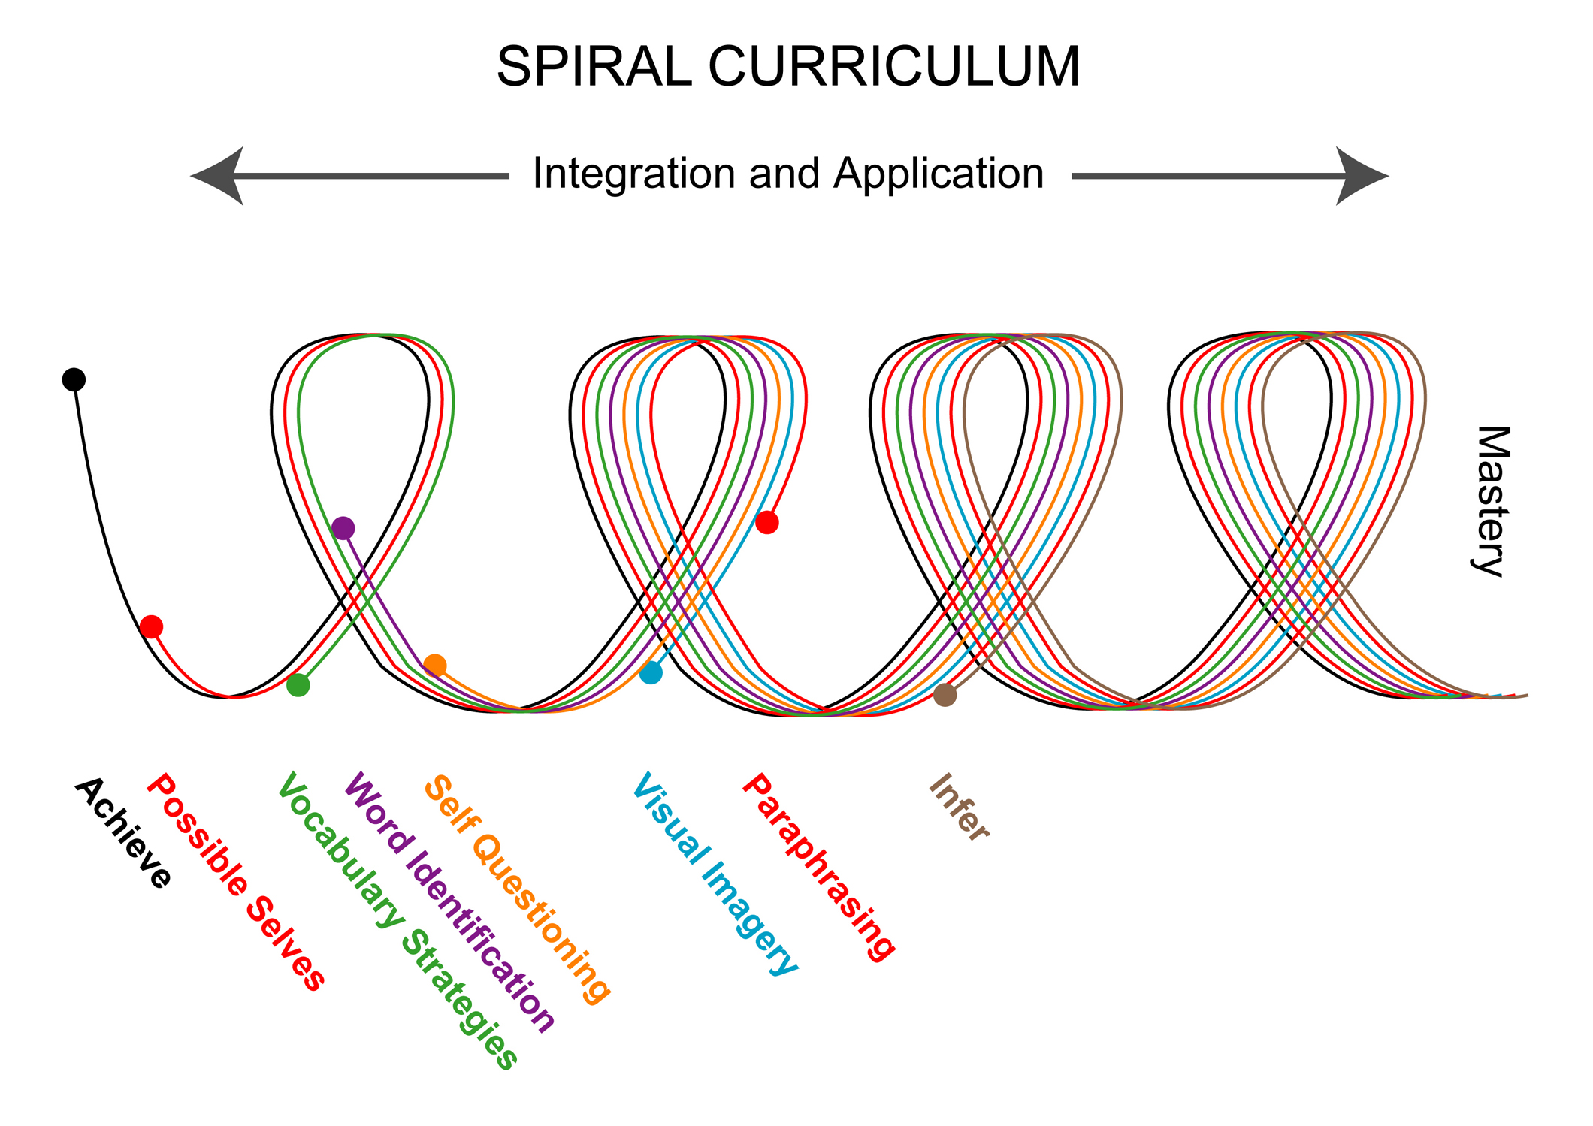

Slide 18
Sequence of Instruction Fusion

Slide 19
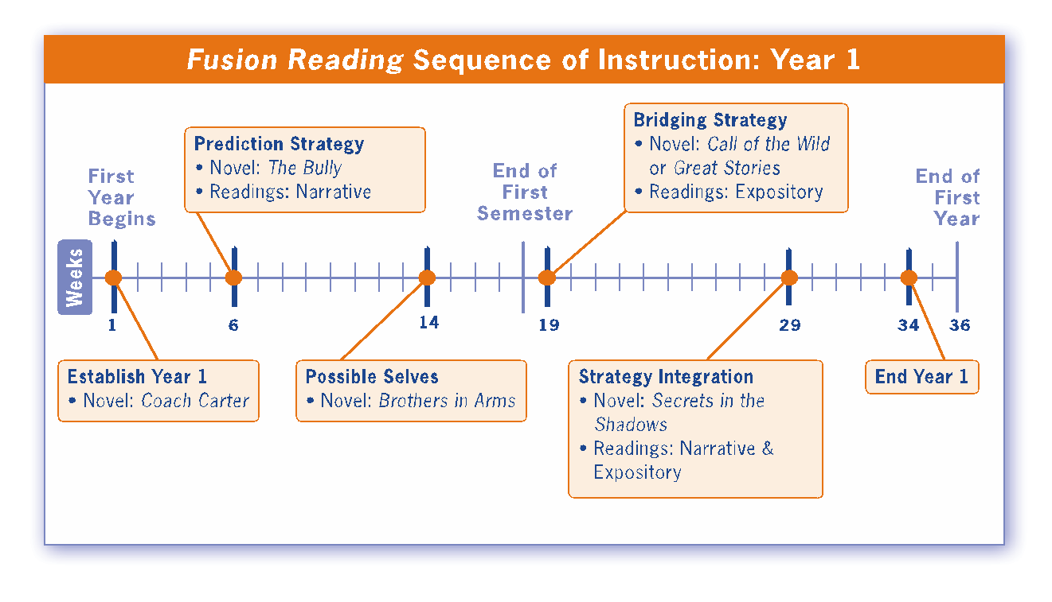
Notes:
Another way to look at the course is with this timeline. Here you will see how long each unit typically lasts along with the novel read and types of other readings covered during that unit. This timeline represents a 90 minute every other day or 60 minutes every day delivering of the Fusion Reading Program. Notice that time has been allocated to Establish the Course at the beginning of the year, as well, as time to wrap up the year.

Slide 20
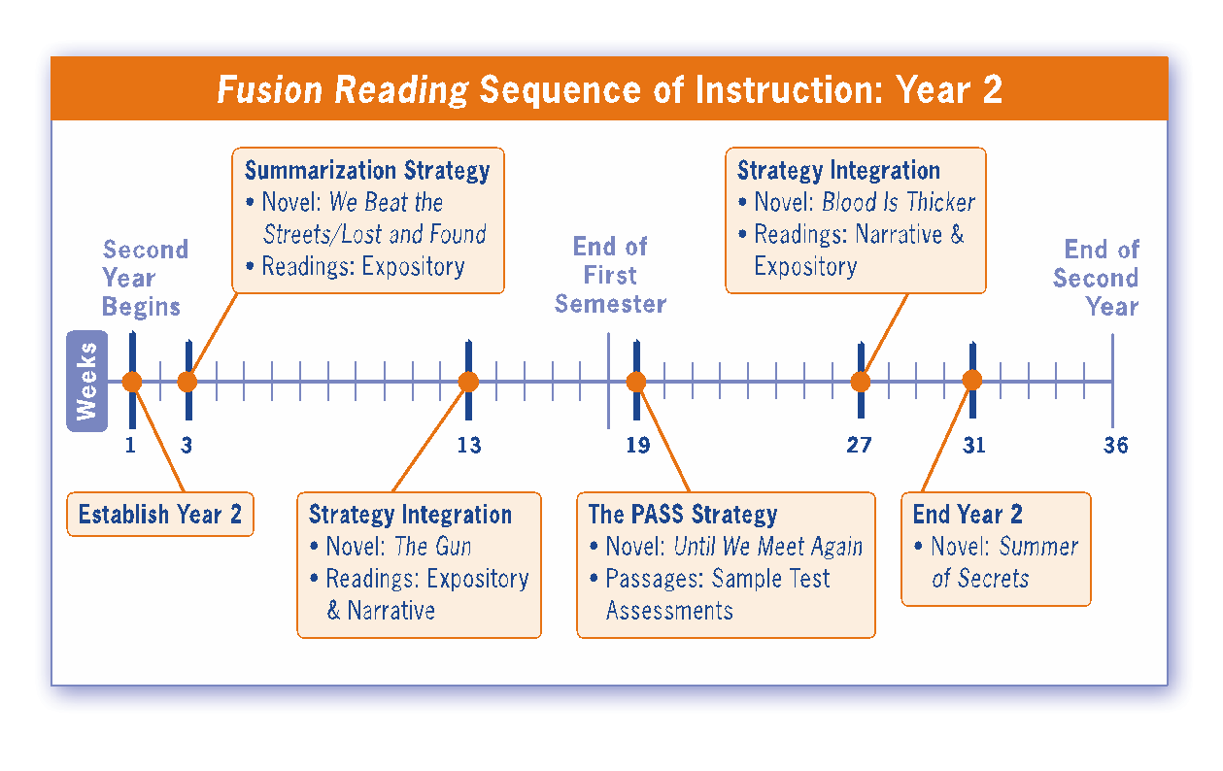
Notes:
There are a number of delivery options for the Fusion Reading program.
For example, if you want to accelerate Fusion Reading from a two-year program to a one-year program…you can do that by offering Fusion Reading everyday for 90 minutes. The timeline information that you’ve just seen is based on the two-year model…with 90-minute reading classes taking place every other day.

Slide 21
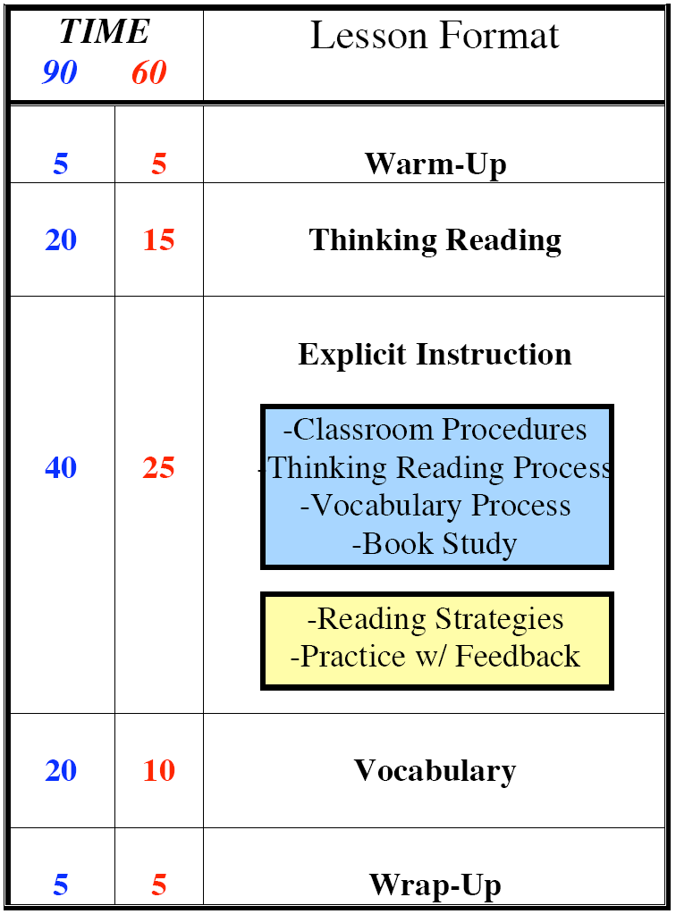
The Fusion Reading System
Units of Study
Reading Strategies
Explain
Model
Practice w/feedback
- Integrate and Apply
Establishing The Course
Classroom Procedures
Thinking Reading
Vocabulary Process
Book Study
Assessment
Year One
Year Two

Slide 22
Results of Implementation

Slide 23
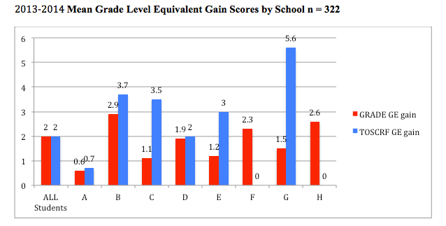
Xtreme – NC Data (2013-14)

Slide 24
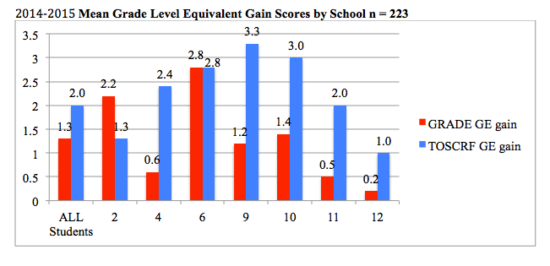
Xtreme – NC Data (2014-15)

Slide 25
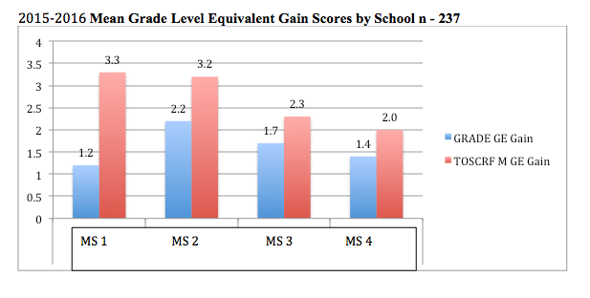
Xtreme – NC Data (2015-2016)

Slide 26
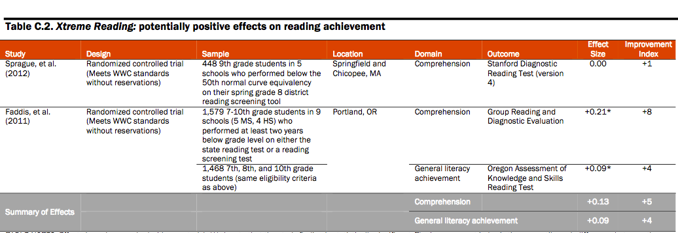
Xtreme
Source: https://www2.ed.gov/programs/strivingreaders/performance.html

Slide 27
Fusion Reading Quasi-Experimental Study: GRADE Total Test Score
40 Special Education Students in Grade 6
7
6
5
4
3
2
1
+1.5 Yrs. in
5 1/2 months
Statistically significant at the
.000 level
Effect Size =1.36
6.25
Grade Level
4.75
3.25
3.33
3.26
Comparison Pretest
YR. 1
Comparison Posttest
Yr. 1
Fusion Pretest
Yr. 1
Fusion Posttest
Yr. 1
Fusion Projected
Yr. 2
Notes:
Matched Sample Groups on GRADE Total Test Pretest Scores
Fusion Reading = 20; Corrective Reading = 20
3 middle Schools
Independent Samples t-Test
22 teachers- 3 middle schools
Middle school students grades 6 & 7
Meet every day for about 45 minutes
40 students (20 Fusion and 20 comparison)
Design: quasi experimental; comparison group
Measures: MAP Reading & GRADE
Analysis: Independent Samples t-test
There was a statistically significant difference between the Experimental and Comparison groups fall to spring MAP mean scores (.007) in favor of Fusion students.
The magnitude of the difference was .78, a large effect.
Started in late November, ended in June (5 ½ months

Slide 28
2012-2013 Year 1 NC Students
Fusion Reading
Beginning of year 1 average grade equivalency September 2012 TOSCRF | End of year 1 average grade equivalency April 2014 | Grade equivalency growth 2012-2013
3.6 | 5.3 | +1.7

Slide 29
2013-2014 Year 1 NC Students
Fusion Reading
Beginning of year average grade equivalency TOSCRF | End of year average grade equivalency TOSCRF | Average grade equivalency growth TOSCRF
3.0 | 5.2 | +2.2
MAP | Met growth projection | Did not meet growth projection
Number of Students | 113 | 75
Percentage of Students | 60% | 40%
Notes:
264

Slide 30
What are the differences in the programs?

Slide 31
How do we get this into districts
Fusion Reading
McGraw-Hill Sales Representative
McGraw-Hill Website
1 Day PD over ETC
Options:
Purchase remaining PD modules
Work with a Fusion Reading Leader
In time PD based on district calendar
Building Capacity and Sustainability through….
Xtreme Reading
SIM Professional Developer will order product from KUCRL & conduct PD
Three day PD with the teachers - summer
Two day PD based – about 9 weeks in
Monthly Coaching
Micro-credential Specialists for sustainability

Slide 32
2014-2015
Fusion PD & Coaching
Year 1 Professional Development | Date(s)
Establish the Course Year 1 | 8/4, 8/5
The Prediction Strategy | 9/16
Possible Selves | 12/9
The Bridging Strategy | 1/28, 1/29
Year 2 Professional Development | Date(s)
Establish the Course Year 2, Strategy Integration | 8/6, 8/7
The Summarization Strategy | 12/11
The PASS Strategy | 2/24
Coaching from Mike, Irma & Sue | Dates
ETC1, ETC2 | 9/16, 9/17, 9/18
Prediction, Strategy Integration | 10/14, 10/15, 10/16
Bridging, Summarization | 2/24, 2/25, 2/26
Bridging, PASS | 3/24, 3/25, 3/26
Notes:
ETC Year 2

Slide 33
How can you help!
Engage in Single Case Design Research
Engage in Action Research – see SIMville (Cache)
https://www.surveymonkey.com/mp/likert-scale/

