Slide 1
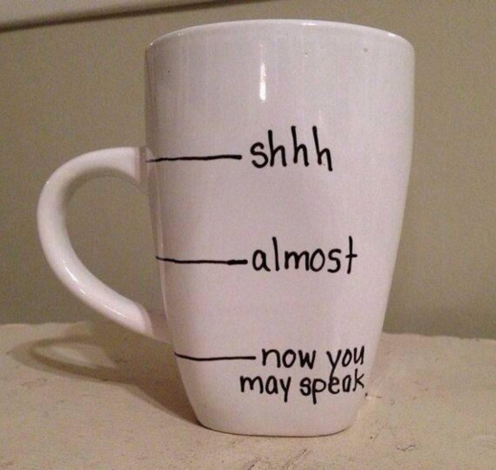
Welcome Back!
Please review the Course Questions on the Course Organizer and and think through how you would answer each one.
Where are you in your understanding?
Notes:
Also address any misconceptions from yesterday’s exit ticket questions. Hold tight on that homework, we will be using it this afternoon.

Slide 2
Our Schedule Today
Course Questions check-in
Unit Organizer of the Unit Organizer
Drafting another Unit Organizer
Cue-Do-Review “Review”
Option…learn the Framing Routine

Slide 3
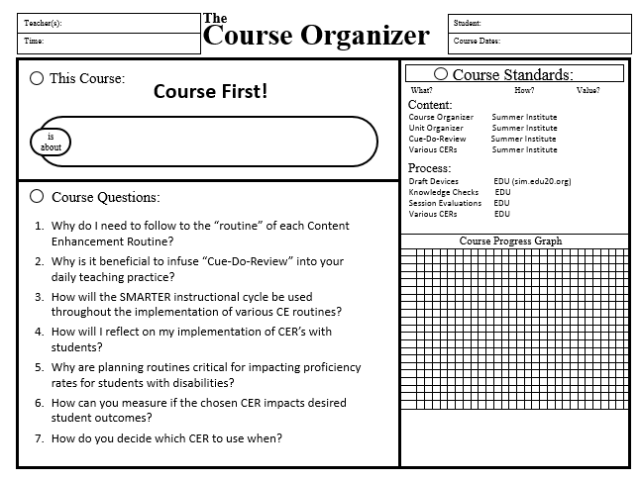
Course First! Course Organizer
Review the Course Questions. Which ones can you answer – all or part?
What questions do you have about the questions?
Notes:
(wait to revisit when they have data to graph?) Revisit Pink sheet Tab 4. 1. Have participants self evaluate the course questions with arrows(Up=I know it, sideways = kinda, down=haven’t heard it yet or I don’t know). 2. Graph. 3. Revisit community principles and add to it if needed.

Slide 4
Barriers to Student Success
Skill gaps – reading, problem solving, research
Knowledge gaps (from previous courses)
Won’t ask questions/for help
Mindset (I can’t…)
Social acceptance
Don’t value education, disengaged, or only care about the “A”
Lazy, do it later mentality
Struggle to focus (distractions, cell phones)
Attendance
Afraid to stretch because of too much support
Cheating
Lack of support at home
Struggle with “big picture”

Slide 5
Unit Organizer of the Unit Organizer
Notes:
Tab 5, first page. Be sure to take a trainers time out and ask participants how you co-constructed device with them. What type of questions did I ask?

Slide 6
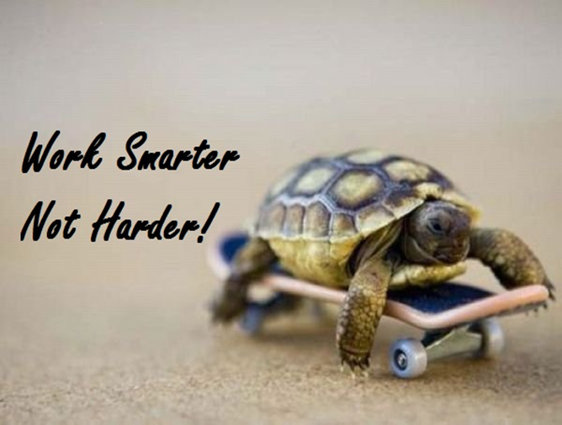
SMARTER Planning
Shape the Critical Questions
Map the Critical Content
Analyze for Learning Difficulties
Reach Enhancement Decisions
Teach Strategically
Evaluate Mastery
Re-evaluate Critical Questions
Notes:
K - Review. Focus on ARTER. We’ve already covered the S & M

Slide 7
Self Test Questions
Do you have any questions to add to box 10?
Notes:
To be used with advanced UO

Slide 8
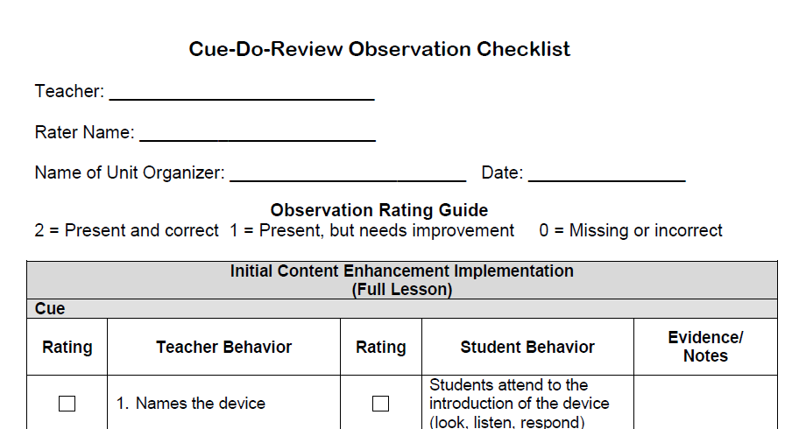
Notes:
Find this document you will need it in a min….
Participants will take cue do review checklist out of binder and rate the co-construction of the cue do review frame. This will be a reflective activity to see if they can identify the PDer and their role in this.

Slide 9
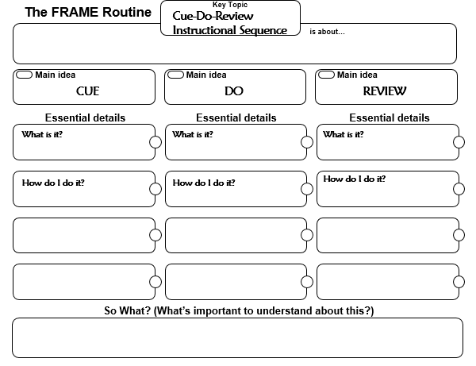
Notes:
Tab 2, yellow handout. Facilitator will co-construct the CUE Column Only.

Slide 10
Work Time!!
Draft a second (and maybe 3rd) UO…
The Unit Organizer
4
NAME
BIGGER PICTURE
DATE
2
LAST UNIT
/Experience
CURRENT UNIT
3
NEXT UNIT
/Experience
1
CURRENT UNIT
8
UNIT SCHEDULE
5
UNIT MAP
is about...
6
UNIT SELF-TEST QUESTIONS
RELATIONSHIPS
UNIT
7

Slide 11
Reaching Enhancement Decisions
Each Content Enhancement Routine (CER)is designed to scaffold and teach a strategy for approaching a particular learning task.
The more CERs you learn, the more tools you have for meeting the demands of your standards and the needs of your students.
Notes:
Tab 3, second to last page

Slide 12
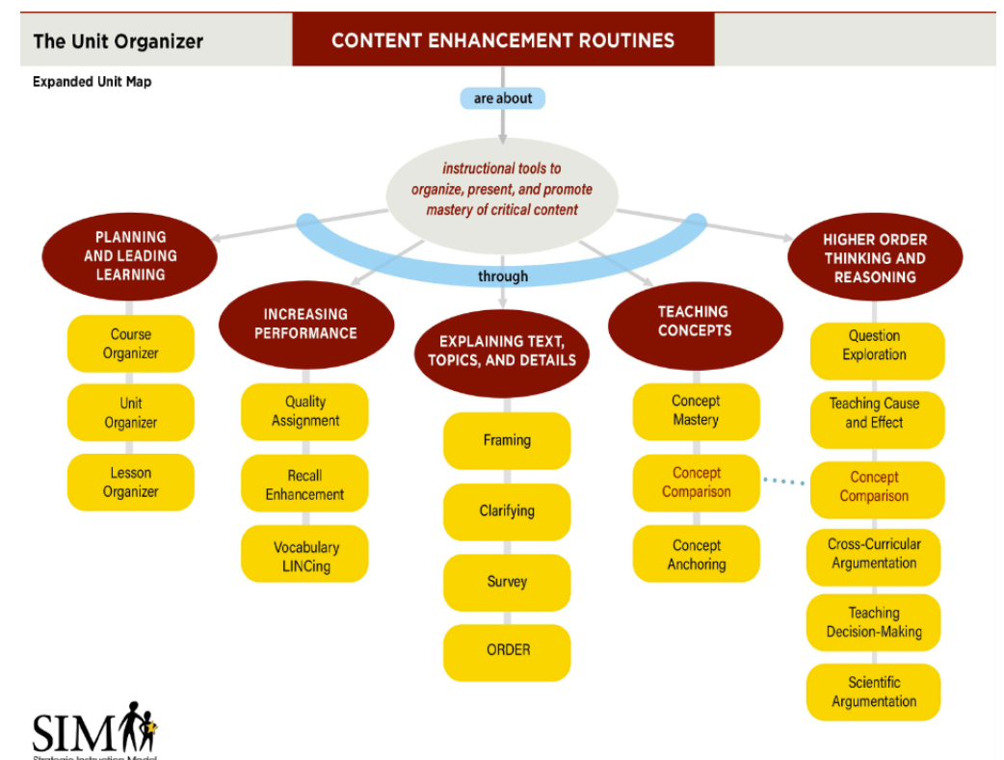
Notes:
Tab 3, second to last page

Slide 13
The Framing Routine
for organizing main ideas and details in a way that supports application of the content in learning tasks…

Slide 14
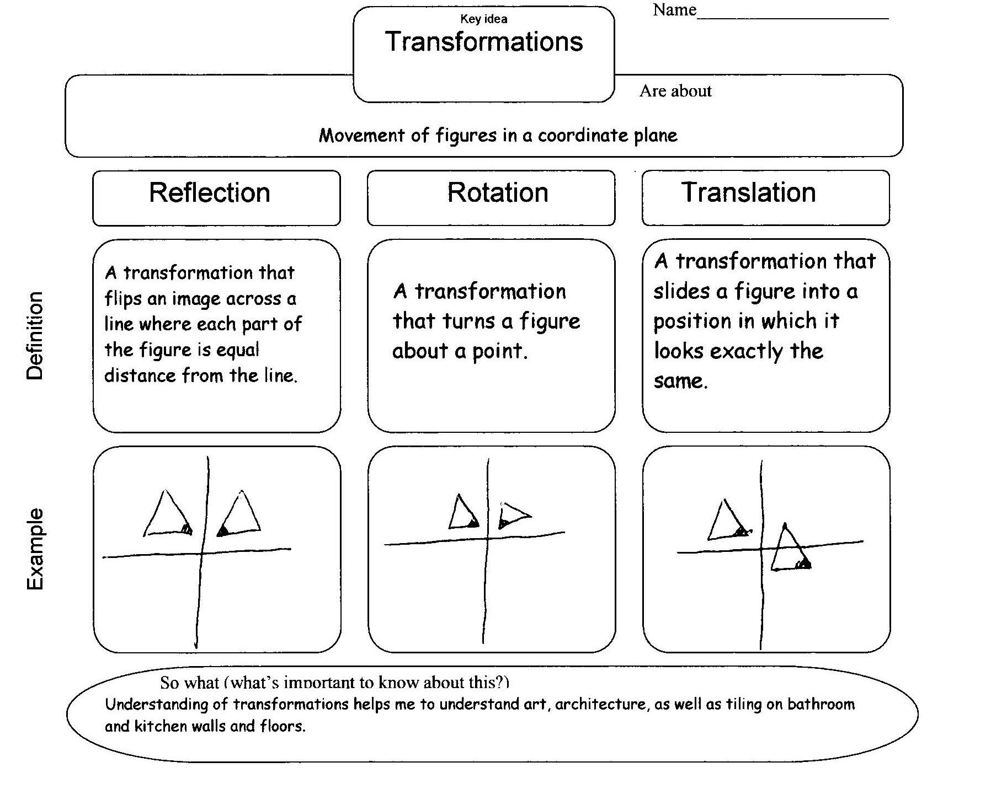

Slide 15
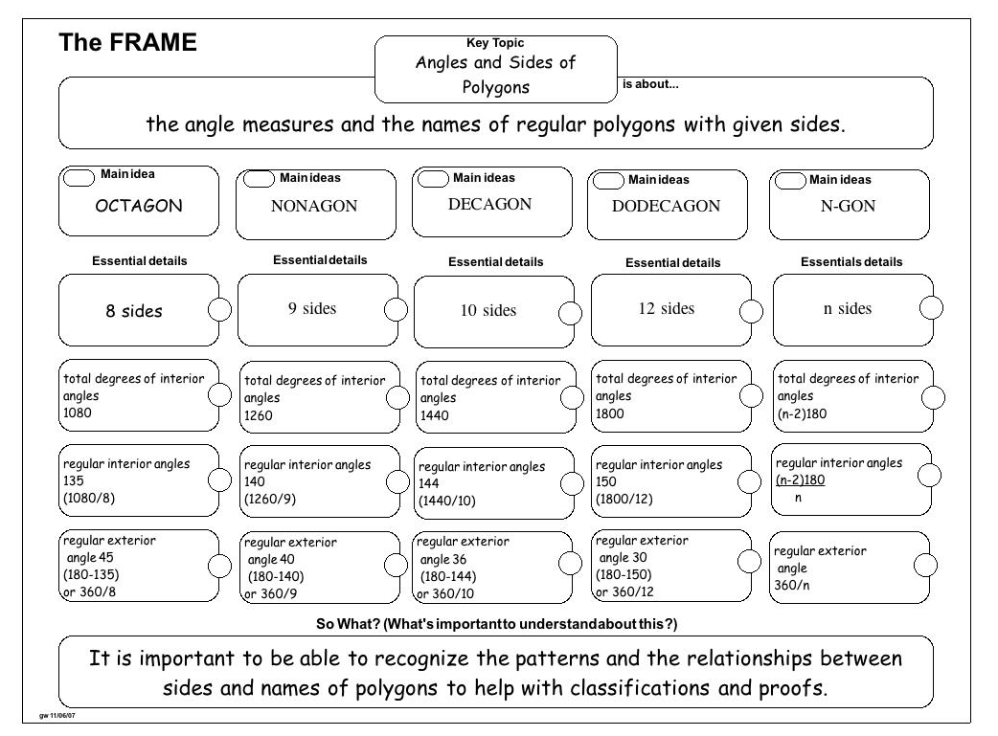

Slide 17
The FRAME Routine
Key Topic
Using Verb Phrases
is about…
words in a sentence or statement that express an action or a state of being
Main idea
Main idea
Main idea
Verb
Linking Verb
Verb Phrase
Essential details
Essential details
Essential details
What it does: expresses an action or state of being (is, am, etc.)
What it does: Joins the subject with a noun, pronoun or adjective that describes the subject
What it is: part of the sentence with a main verb and all its linking verbs
Look for forms of “be”:
am, is, are, was, were, being, been
Different tenses :
past (watched)
present (watch)
future (will watch)
How it is used: as clue for finding verb phrase
Look for forms of “have”: has, have, had, having
Examples: is, was, am, be, have, had, look, stay, seem, feel
Examples: ride, walk, talk, eat, danced, played, is, looks, feels
Example: If I hadn’t been texting and driving , I wouldn’t have had an accident.
So What? (What’s important to understand about this?)
To be a good communicator (and to pass the Reading FCAT), you need to identify and be able to write quality sentences which must have verb phrases.

Slide 18
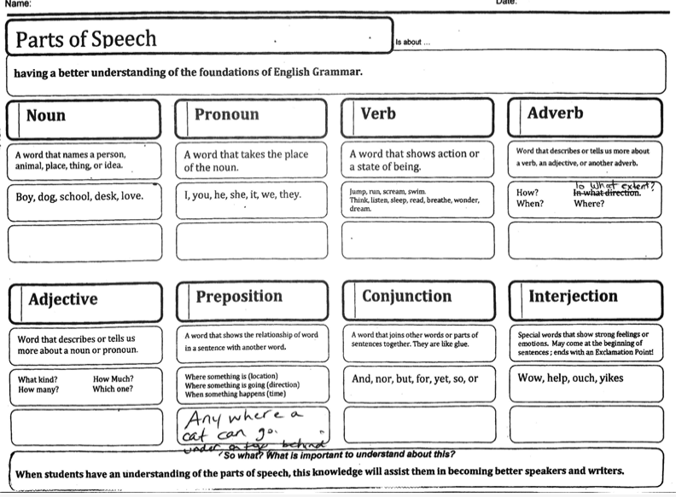

Slide 19
Sentence 1 – Topic Sentence
Sentence 2
Sentence 3
Sentence 4
Sentence 5
Sentence 6 – Closing Sentence

Slide 20
Opening Paragraph
Body Paragraph 1
Body Paragraph 2
Body Paragraph 3
Closing Paragraph

Slide 21
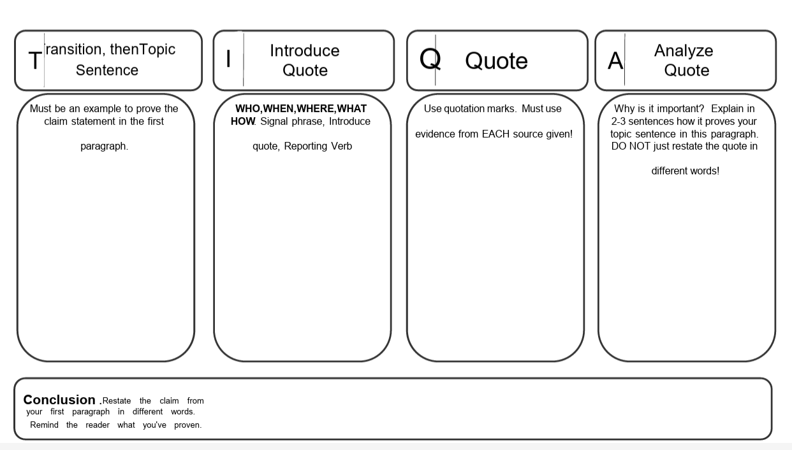

Slide 23
Key Topic
The FRAME Routine
Photosynthesis
is about…
Plants using the sun’s energy to make food for animals
Main idea
Main idea
Main idea
Reactants
(what goes in)
Products
(what comes out)
How plants do this
Essential details
Essential details
Essential details
Sunlight = catalyst
Sugar (glucose, C⁶H¹²O⁶)
trap sun’s energy in chlorophyll
chlorophyll is found in chloroplasts in plant cells
Water (H²O)
Oxygen gas (O²)
Carbon Dioxide (CO²)
2 reactions: Light-
dependent & Calvin Cycle
Works best between 0° and 35°
So What? (What’s important to understand about this?)
Humans (and all animals) need oxygen to breathe and sugar to eat and burn for energy to stay alive. Plants produce these so humans (and animals) need plants.

Slide 25
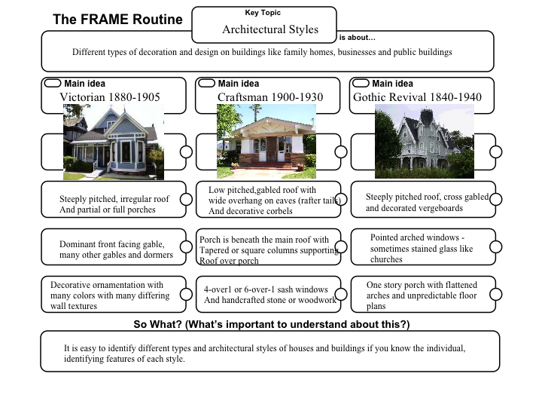

Slide 26
The Concept Mastery Routine
for exploring characteristics and examples of a critical concept in a way that supports application of the concept in learning tasks…

Slide 27
CONCEPT DIAGRAM
3
1
CONVEY CONCEPT
1
2
Key Words
Like Terms
Parts of an Algebraic Expression
2
OFFER OVERALL
same
variable
exponent
X
Y
simplify
CONCEPT
3
NOTE KEY WORDS
4
CLASSIFY
have fractions
have the same coefficient
have no variables
have negative signs
CHARACTERISTICS
Always Present
Sometimes Present
Never Present
have all the same variables
have like variables raised to the same power
must be combined with each other to simplify the expression
a variable that is in one term but not the other
same variable with different exponents
5
EXPLORE EXAMPLES
Examples:
Nonexamples:
3x, 3x
¼y², 8y²
-2xy, 6xy
3, 9
2x, x²
7a²b, 4ab
-17xy, 10xy
4x, 4y
5a², 3a
2x, 3
8x³, 8y³
6
PRACTICE WITH NEW EXAMPLE
7
TIE DOWN A
DEFINITION
Like Terms are parts of an algebraic expressions that have the same variables, have like variables raised to the same power and must be combined with each other to simplify the expression.

Slide 28
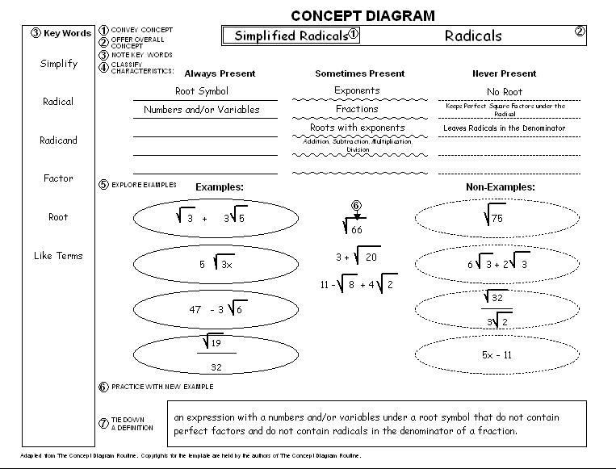

Slide 29
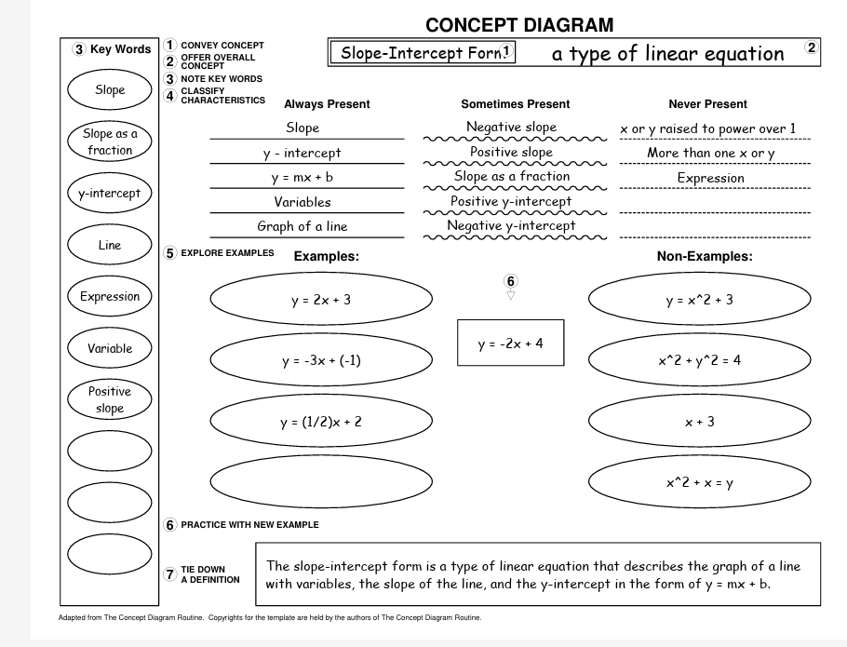

Slide 30
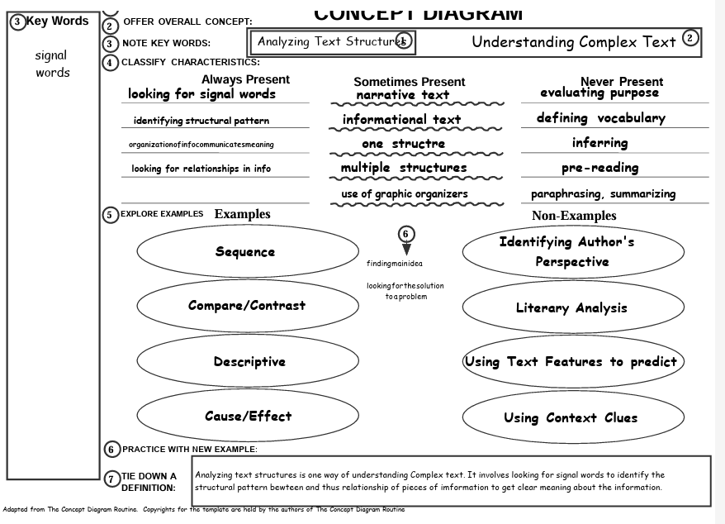

Slide 31
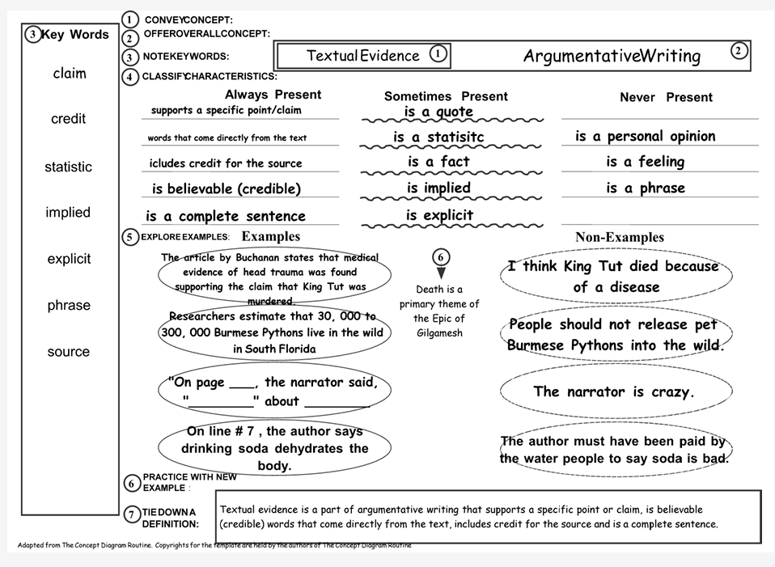

Slide 32
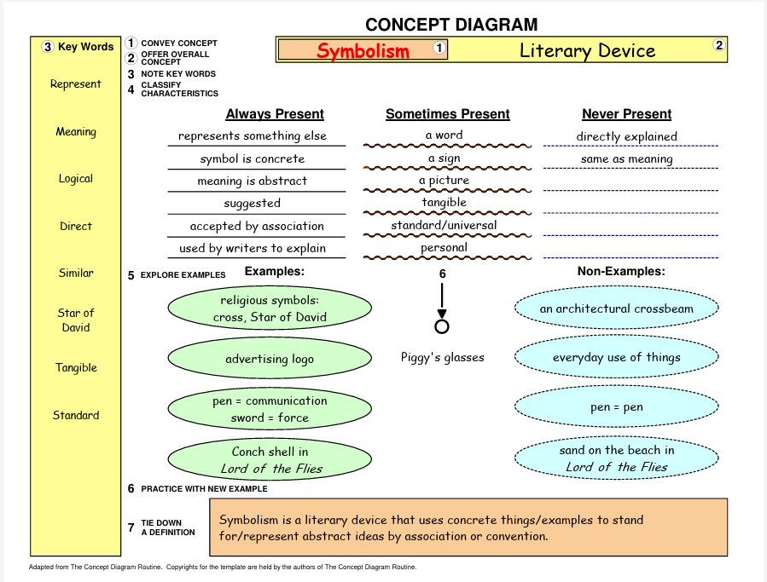

Slide 33
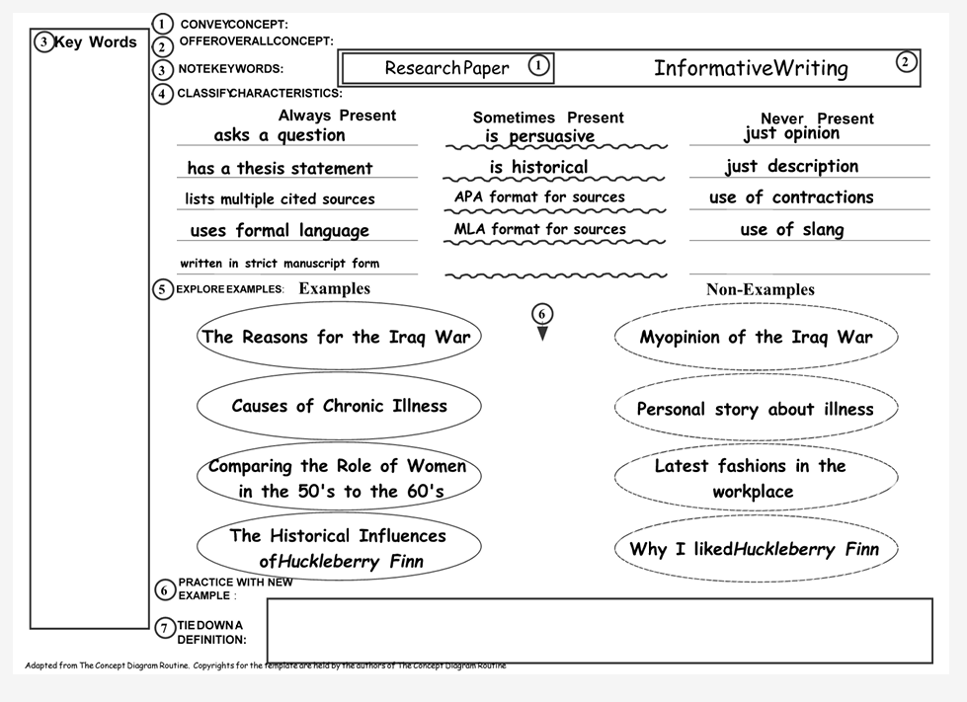

Slide 34
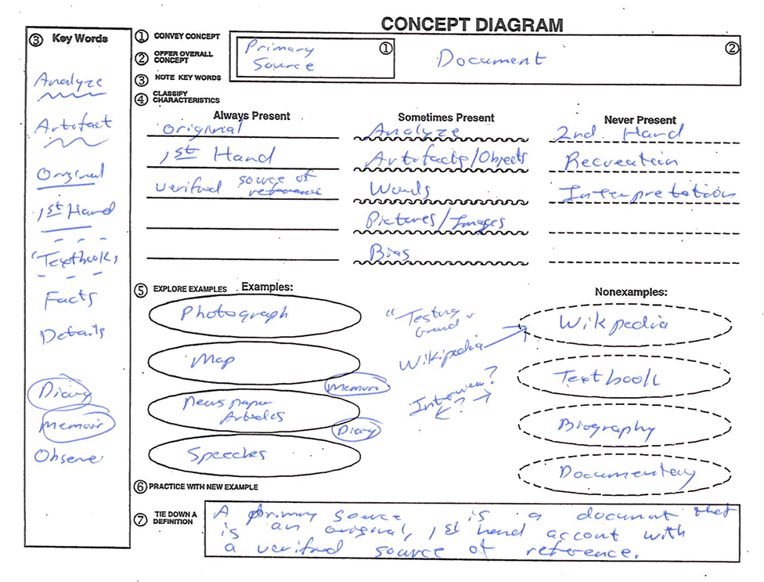

Slide 35
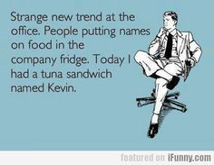
Lunch
When you return from lunch:
Review feedback and make edits on your second Unit Organizer

Slide 36
As you return from lunch, please prepare to share with a partner…
Grab your review page from behind Tab 2.
Brainstorm and write content questions
AND process questions for the U.O. you drafted this morning.
Write out how you might model use of the Unit Organizer as test review or prep for some other learning task…

Slide 37
Let’s practice the “Review”
Notes:
Participants partner with another person that does not teach the content area and ask probing questions to co-construct a UO that was created on day 2.

Slide 38
Cue-Do-Review
Think it.. Ink it
Which part of the Cue-Do-Review sequence feels easy to incorporate in your teaching? Why?
Which part of the Cue-Do-Review sequence might be challenging to include? Why?
What plan do you have to overcome your potential struggle?
Share with a friend….

Slide 39
Coaching for Implementation
Virtual
Individual or Small Group
During or after contract hours
Funded by FDLRS

Slide 40
Exit Ticket
Discuss with your team how you would like to integrate and schedule coaching for the upcoming school year.
Email your plan to Janice, janicecreneti@gmail.com and cc: Toyka Holden, toyka.holden@paec.org

Slide 41
DAY 4 - Woohoo! You made it!
Options for today…
Learn the Concept Mastery Routine
Draft more Unit Organizers
As you are settling in, think about how you’d like to use your time today…

Slide 42
Janice’s current list for leadership video…
(In no particular order…)
How do other teachers learn these SIM routines?
How do I support implementers?
LET them implement
Recognition for their implementation
Provide them with protected planning and reflection time
Provide adequate resources (colored paper, sheet protectors, extra copies)
What else?

Slide 43
Course First! Course Organizer
Let’s take a final look at the course questions.
What do you know now?
What questions do you have?
Notes:
(wait to revisit when they have data to graph?) Revisit Pink sheet Tab 4. 1. Have participants self evaluate the course questions with arrows(Up=I know it, sideways = kinda, down=haven’t heard it yet or I don’t know). 2. Graph. 3. Revisit community principles and add to it if needed.

Slide 44
Exit Ticket
Complete the green evaluation and put on the front table.
On a post it note (or a few), reflect on our time together:
Anything that could have improved the experience for you?
Anything you want me to be sure to share with your school leadership?
Thank you for a great week!
Notes:
Add tasks for EDU
Don’t forget to add the units to their CO on Hot Pink

Slide 45
Day 4
Please review and revise your draft devices from yesterday.
Graph your data on the course progress graph of your PINK course organizer.
Unit Organizer knowledge Check
Unit Organizer Draft Devices (2 scores)
Knowledge Check and Draft Device score for chosen breakout session
Notes:
Reminder to speak with LS participants to look at quick reference guide and signup for sessions.

Slide 46
Debrief on the Process
What has been challenging so far?
Any questions?
Notes:
Use this time to address the exit ticket questions, comments, and concerns.

Slide 47
Your Questions
Insert exit ticket questions from day 3

Slide 48
Gallery Walk with Feedback
Notes:
Done next door. Participants leave feedback on a sticky note while gallery walking and viewing peer’s CO drafts. Presenters all give feedback. If time allows, allow participants to get into like content groups to discuss final drafts and share ideas. Move participants into content groups. Assign a Pder to sit with each group.
If needed have conversations regarding the different types of questions and their relationships

Slide 49
Breakout Session
Reminder: You must submit a draft device for each routine you learn.
1:30-2:30
Notes:
edit time

Slide 50
Breakout Session
Reminder: You must submit a draft device and complete the knowledge check for each routine you learn.
10:30-11:30
Lunch 11:45-1:00

Slide 51
Lunch

Slide 52
Breakout Session
Reminder: You must submit a draft device for each routine you learn.
1:30-2:30

Slide 53
Let’s add our progress to the Course First!Course Organizer
Notes:
Graph feedback score for UO on progress graph, color in units complete
Knowledge check data for Course and Unit

Slide 54
Unit Organizer Gallery Walk

Slide 55
Notes:
Co-construct the “DO” with participants. Handout behind tab 2. Highlight where teachers struggle in “do”: crickets and wrong answers from students. Reference the probing questions handout.

Slide 56
Notes:
Co-construct the “DO” with participants. Handout in tab 2. Highlight where teachers struggle in “do”: crickets and wrong answers from students. Reference the probing questions handout.

Slide 57
INSIDE OUTSIDE CIRCLES
Read a script for “Review”
Notes:
Have participants find homefun in tab 2. Inside outside circles.

Slide 58
Notes:
Co-construct the “DO” with participants. Yellow Handout in tab 2 in binder. Highlight where teachers struggle in “do”: crickets and wrong answers from students. Reference the probing questions handout.

Slide 59
Debrief on the Process
What has been challenging so far?
Any questions?
Notes:
Facilitator should stress the importance of collaboration and continuous editing.
Questions on the Parking Lot

Slide 60
Reaching Enhancement Decisions UO
Notes:
Tab 3, pink handout. Co-construct

Slide 61
Brainstorm Time Barriers
Notes:
Pder will select an activity.

Slide 62
Reaching Enhancement Decisions
Think of an area that you know students struggle with.
Take out the KUCRL CE brochure and look at the different CERs offered.
Locate one of the routines that will help support students with that struggle.
Notes:
Tab 3, second to last page

Slide 63
Before the Breakout Sessions
Finalize both Unit Organizers and submit for scoring
Verify that you’ve earned an 80% or higher on both knowledge checks

Slide 64
Exit Ticket
What is working for you?
What do you need more support on before you leave tomorrow?

Slide 65
Exit Ticket
What supports do you need during the school year?
(Provide name & email)

