Slide 1


Content Enhancement Routines:
Course First!
Summer Institute
2019
Day 2

Slide 2

Welcome Back!
Please check for an email from Canvas and see if you can access the CO for PAEC course
Please review the feedback on Your Draft Course Device and edit if needed
And don’t forget to sign in…
Notes:
Also address any misconceptions from yesterday’s exit ticket questions. Hold tight on that homework, we will be using it this afternoon.

Slide 3
Barriers to Student Success
Skill gaps – reading, problem solving, research
Knowledge gaps (from previous courses)
Won’t ask questions/for help
Mindset (I can’t…)
Social acceptance
Don’t value education, disengaged, or only care about the “A”
Lazy, do it later mentality
Struggle to focus (distractions, cell phones)
Attendance
Afraid to stretch because of too much support
Cheating
Lack of support at home
Struggle with “big picture”

Slide 4
Linking Steps for the Course Organizer
Cue Course Questions.
Outline Critical Concepts and Units.
Uncover Community Principles.
Reveal Learning Rituals.
Share Performance Options.
Explain Course Standards

Slide 5
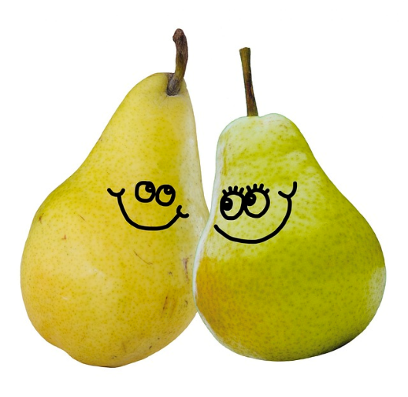
How Would You Define a Unit?
Notes:
Write answer to question on a sticky note. Pair Discussion

Slide 6
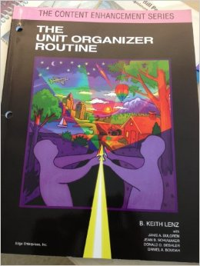
How Similar Was Your Thinking?
Please go to page 18 of your guidebook and read the definition of “unit” on the top of column 2.

Slide 7
Unit Organizer Routine
Notes:
Tab 5. Have participants get out the guidebook and blank devices. May have participants tab sections in guidebooks.

Slide 8
Tab it
In the Unit Organizer Guidebook:
Research (page 3)
Overview of the Sections (pages 6-9)
Linking Steps (pages 10-11)
Cue Do Review Sequence (pages 12-15)
Constructing a Draft (pages 21-26)
Unit Relationships (page 53)

Slide 9
Supporting Research
Positive results were achieved when teachers:
  received 2-3 hours of instruction in the routine
  discussed the routine with colleagues
  spent the necessary time to plan use of the routine
Positive results were achieved when students:
  were taught how to participate in and use the routine
  used the routine regularly over time
  were held the highest expectations for student learning
University of Kansas Center for Research on Learning 2002

Slide 10
Components of
The Unit Organizer Routine
The
Unit Organizer
Teaching Device
Craft
Linking Steps
Cue-Do-Review
Sequence
University of Kansas Center for Research on Learning 2002

Slide 11
The Unit Organizer Teaching Device
Is a visual device that is designed to enhance student…
    ...organization
    ...understanding
    ...remembering
    ...responses
    ...belief in the value of the content
University of Kansas Center for Research on Learning 2002

Slide 12
Rationale
Makes the curriculum “conceptually transparent”
Makes abstract…concrete
Helps make new connections
Isolated bits of information are too difficult to learn; students lose interest and attention
“Chunking” leads to better understanding and retention of new knowledge
University of Kansas Center for Research on Learning 2002

Slide 13
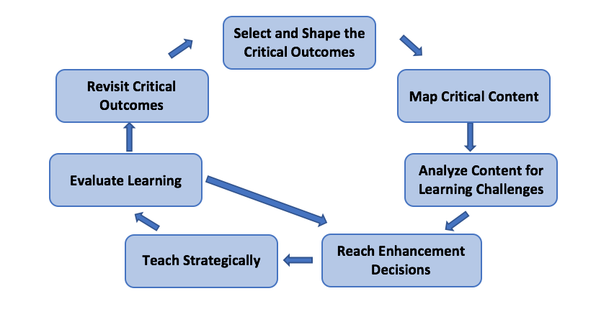
SMARTER Planning & Instruction
Notes:
Reference Handout in Binder. Review components of SMARTER

Slide 14
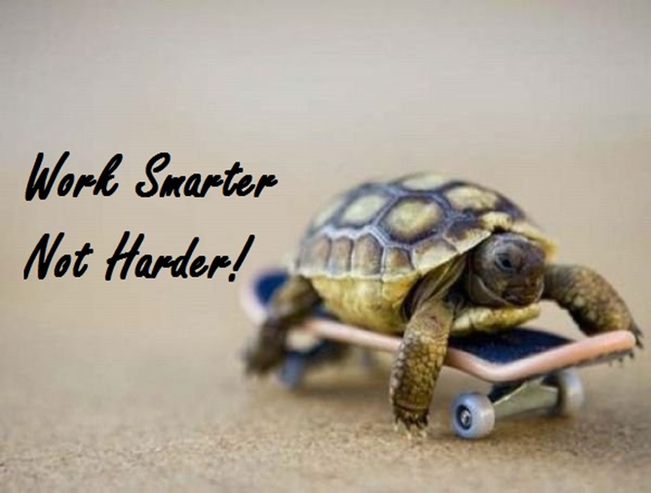
SMARTER
Select and shape the critical questions
Map critical content
Analyze Content for Learning Challenges
Reach Instructional Enhancement Decisions
Teach Strategically
Evaluate Learning
Revisit Critical Outcomes
Notes:
Reference handout in binder Tab 3. Facilitator will go over S & M at this point.

Slide 15
FRONT
The Unit Organizer
4
BIGGER PICTURE
NAME
DATE
2
LAST UNIT
/Experience
CURRENT UNIT
3
NEXT UNIT
/Experience
1
CURRENT UNIT
8
UNIT SCHEDULE
5
UNIT MAP
is about...
6
UNIT SELF-TEST QUESTIONS
RELATIONSHIPS
UNIT
7
Notes:
Tab 5. Teach a piece, build a piece. Have participants use single sided copy of UO to draft. Write “front” on paper.

Slide 16
The Unit Organizer
NAME
DATE
9
Expanded Unit Map
is about...
Back
10
NEW
UNIT
SELF-TEST
QUESTIONS
Notes:
Write “back” on paper.

Slide 17
Teacher(s):
The
Course Organizer
Student:
Time:
Course Dates:
…
This Course:
Biology
Course Standards:
What?
How?
Value?
Content:
Tests/Quiz 40%
Labs/Project 40%
interactive
Notebook 20%
is
about
studying life (the structure, function, growth, origin, evolution and distribution of living organisms).
Understanding Essential Content
Applying Concepts
Providing examples and details
Process:
Course Questions:
Why is it critical to apply the strict standards of science when assessing the reliability of sources, data and scientific claims?
How are the four major macromolecules (including enzymes) each involved in various cellular processes in living things?
How do living things grow and heal?
How do living things reproduce and pass on their traits to their offspring?
How has the variety of life on this planet come into existence?
How are living things related to each other?
How do organisms on this planet interact?
Course Progress Graph
100
90
80
70
60
50
40
30
20
10
Cycle 1 Q1 Grade Cycle 2 Q2 Cycle 3 Q3 Q4
A=100-90 B=89-80 C=79-70
D=69-60 F=59 and below
Notes:
Example: find this example under tab 4, 9th page.
Have participants pick up integrated units
Record Fawnia

Slide 18
Course Map
This Course:
Biology
Student:
includes
Community
Principles
Learning Rituals
Performance
Options
Be Respectful
Be Engaged
Be Solution Oriented
…
Course Organizer Unit Organizers
Frames Lab reports
Interactive Notebooks Concept Comparison Routine
Clickers Kahoot
Exit Tickets Foldables
Card Sorts Stations
Mastery check
Extended work time
Alternative work areas
Structured reviews
Product Choice
Critical Concepts
Macromolecules
Scientific Theory
Scientific Law
Evidence
Enzymes
Cellular Processes
Cellular Functions
Body
Heredity
Mechanisms of Evolutionary Change
Classification
Biogeochemical Cycles
Ecosystem Changes
Body
Organization
Learned in these
Units
Human
Health
Study of Biology
Study of the Biosphere
Cell Biology
Cycling of Matter & Energy
Genetics
Evolution
Notes:
Example: use the CO to identify the Unit you are to draft a UO (Cell Biology)

Slide 19
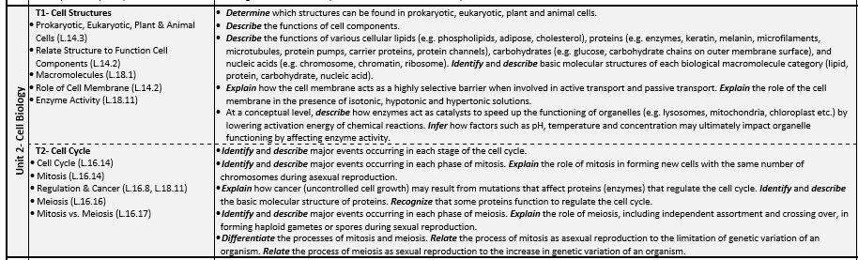
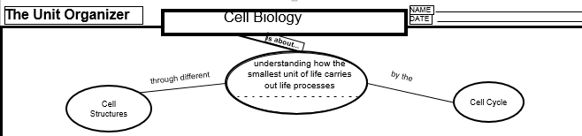
Notes:
Show how topics and standards given in curriculum guide can be used to set-up EUM

Slide 20
SC.912.L.14.3
Compare and contrast the general structures of plant and animal cells. Compare and contrast the general structures of prokaryotic and eukaryotic cells.
Content Limits:
Items referring to prokaryotic structures are limited to the cell wall, cell membrane (plasma membrane), cytoplasm, plasmid, ribosomes, and flagella.
Items referring to eukaryotic structures are limited to the cell wall, cell membrane (plasma membrane), cytoplasm, nucleus, nuclear envelope, nucleolus, chromatin, ribosomes, endoplasmic reticulum, microtubules, microfilaments, vacuoles, mitochondria, Golgi apparatus, chloroplasts, lysosomes, cilia, and flagella.
Notes:
Discuss unpacking with this example

Slide 21
The Unit Organizer
Cell Biology
NAME
DATE
proteins
carbohydrates
lipids
nucleic acids
Cell Cycle
is about...
by the
understanding how the smallest unit of life carries out life processes
Which produces
through different
Which produces
which includes
which can contain
Cell Structures
somatic
cells
G1, S, G2, M, cytokinesis
gametes
found in
which are
and is regulated by
found in
which are
prokaryotic cells
eukaryotic cells
haploid
Proteins (enzymes)
diploid
such as
such as
through
Nucleus
Nuclear envelope
Nucleolus
Chromatin
Cell membrane
ribosomes
Cytoplasm
Microtubules
microfilaments
Endoplasmic reticulum
Mitochondria
Golgi Apparatus
lysosomes
through
Cell wall
Cell membrane
Cytoplasm
Plasmid
Ribosomes
flagella
Cell Wall
Chloroplast
Large Central Vacuole
which can also
and
only found in
plant cells
mitosis
meiosis
Disrupt regulation
and
Which is a form of
Which is a form of
One or more small vacuoles
Cilia
flagella
only found in
animal cells
due to
Mutations
asexual
reproduction
sexual
reproduction
which can result in
cancer
10
Teacher Notes: May want to have students highlight macromolecules that appear throughout the unit.
NEW
UNIT
SELF-TEST
QUESTIONS
Notes:
Show how the unpack benchmark on previous slide transcends onto EUM. Point out Line labels. Have participants read aloud the sentence.

Slide 22
Backwards (or Forwards) Design
OR

Slide 23
Think about a Unit you have on your Course Organizer
What standards are included in that Unit?
What should students know, understand, and be able to do by the end of the Unit?
What content/skills are necessary to get students to the level of rigor in the standard?
Notes:
Give participants time to identify a unit, list standards for that unit. Take a break during this time.

Slide 24
The Unit Organizer
NAME
Elida Cordora
The Causes of the Civil War
DATE
1/22
9
Expanded Unit Map
is about...
Sectionalism
was based on the
was influenced by
Areas of the
pp. 201-236
Leaders of
U.S.
change
developed because of
became greater with
such as
-Henry Clay
Differences
Events in the
-Stephen Douglas
between the
U.S.
-Zachary Taylor
which included the
areas
-Harriet Beecher Stowe
and included
and included
and included
such as
-Douglas Filmore
which included the
-John Brown
which included the
Social
Political
Economic
-1820 Missouri Compromise
-Jefferson Davis
Differences
Differences
Differences
-1846 Mexican War
-Abraham Lincoln
-1850 Compromise of 1850
West
-1850 Fugitive Slave Law of 1850
-1852
Uncle Tom's Cabin
-1854 Kansas-Nebraska Act
Page 25-26
-1854 Republican Party formed
South
9. EXPANDED UNIT MAP
-1854 Bleeding Kansas
-1857 Dred Scott Case
-1858 Lincoln Douglas Debates
-1859 John Brown's Raid
As the unit progresses, the basic UNIT
-1860 Lincoln Elected
North
-1860 South Carolina Secedes
MAP from the first page of the Unit
-1861 Confederacy formed
Organizer is expanded with key summary
10
information about the
NEW
UNIT
SELF-TEST
QUESTIONS
How did national events and leaders pull the different sections of the U.S. apart?
content of the unit.
Notes:
Pg 9

Slide 25
Connectors
are
line labels stating the relationship between two or more ideas
Linked bubbles can be read as a series of sentences
Represent clearest and most accurate picture of relationships between key ideas/concepts
See the purple sheet…
University of Kansas Center for Research on Learning 2002
Notes:
Tab 5, 3rd page. Reference Handout

Slide 26
Practice
Work on drafting your extended unit map:
Identify the Standards that you will be addressing (you may need to unpack more)
Use curriculum guides to help identify appropriate sub-bubbles(topics) and critical content within your unit.
Map out the pieces and connections between them
Make sure that the language from your standard is included in the content of your unit map
University of Kansas Center for Research on Learning 2002
Notes:
Use the one on the next slide or at this point put in one of your own.

Slide 27
Connector Check
Try reading your Extended Unit Map from the unit title through the “is about” bubble, through each sub-bubble through the chain under each sub-bubble. Does each chain read as a complete, grammatically correct sentence?
If not, adjust the language in the sub-bubble and/or on the line labels until the sentences are grammatically correct.

Slide 28
The “Big Idea” Paraphrase
Page 22
Captures the major point of learning
Translated for students
Understandable
Inclusive
Is about
pp.
University of Kansas Center for Research on Learning 2002
Notes:
Construct on the back first.

Slide 29
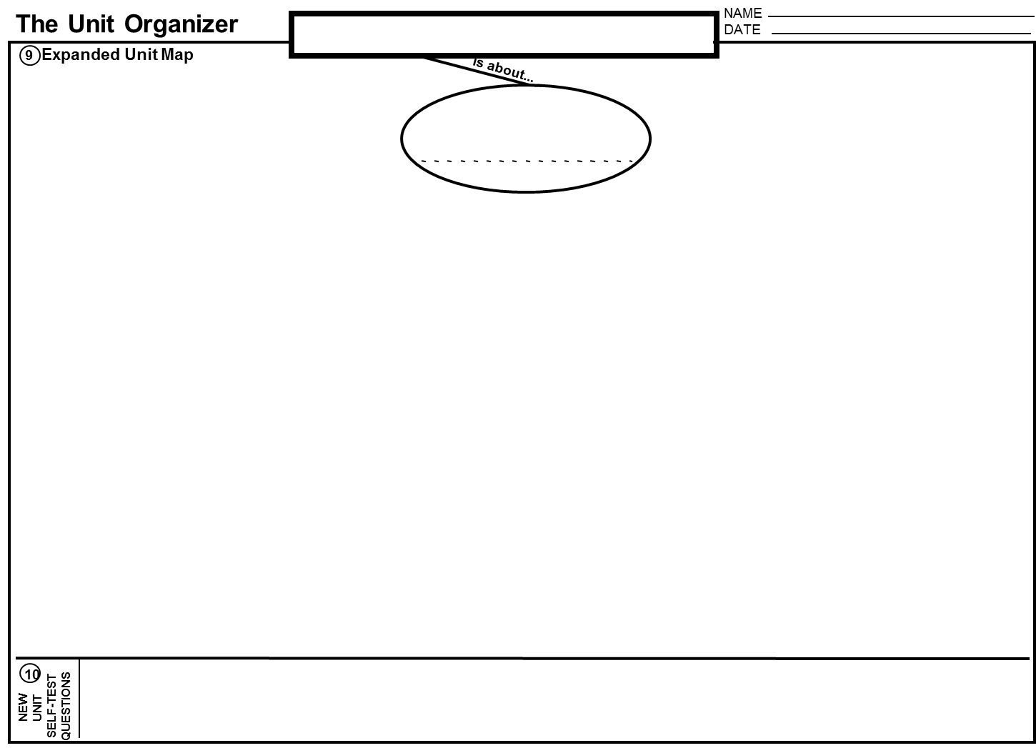
Practice
Do your “is about” bubble on your expanded map.
University of Kansas Center for Research on Learning 2002

Slide 30
Mixed Pair-Share
Get with someone in a different content then you and share your “is about” statements.
Are they clear and understandable?
If not, discuss how to reword these.
Notes:
Pair Discussion

Slide 31
The Unit Organizer
4
BIGGER PICTURE
NAME
Elida Cordora
DATE
1/22
The roots and consequences of civil unrest.
2
LAST UNIT
/Experience
1
CURRENT UNIT
3
NEXT UNIT
/Experience
CURRENT UNIT
The Civil War
Growth of the Nation
The Causes of the Civil War
8
UNIT SCHEDULE
5
UNIT MAP
is about...
1/22 Cooperative groups -
over pp. 201-210
Sectionalism
1/28 Quiz
was based on
was influenced by
1/29 Cooperative groups -
pp. 201-236
Leaders
over pp. 210-225
Areas of
across the
the U.S.
emerged because of
became greater with
Pg 21
"Influential Personalities"
1. CURRENT UNIT
U.S.
projectdue
Differences
Events in
1/30 Quiz
2. LAST UNIT
between
the U.S.
2/2 Cooperative groups -
the areas
over pp. 228-234
3. NEXT UNIT
4. BIGGER PICTURE
2/6 Review for test
2/7 Review for test
Information is listed to help students see how the current unit is related to other units
an to course ideas.
2/6 Test
What was sectionalism as it existed in the U. S. of 1860?
descriptive
6
UNIT SELF-TEST
QUESTIONS
How did the differences in the sections of the U.S. in 1860 contribute to the start of the Civil War?
compare/contrast
UNIT
RELATIONSHIPS
cause/effect
7
What examples of sectionalism exist in the world today?

Slide 32

Practice
Complete boxes 1-4 on your draft.

Slide 33
The Unit Organizer
NAME
Elida Cordora
The Causes of the Civil War
DATE
1/22
9
Expanded Unit Map
is about...
Sectionalism
was based on the
was influenced by
Areas of the
pp. 201-236
Leaders of
U.S.
change
developed because of
became greater with
such as
-Henry Clay
Differences
Events in the
-Stephen Douglas
between the
U.S.
-Zachary Taylor
which included the
areas
-Harriet Beecher Stowe
and included
and included
and included
such as
-Douglas Filmore
which included the
-John Brown
which included the
Social
Political
Economic
-1820 Missouri Compromise
-Jefferson Davis
Differences
Differences
Differences
-1846 Mexican War
-Abraham Lincoln
-1850 Compromise of 1850
West
-1850 Fugitive Slave Law of 1850
-1852
Uncle Tom's Cabin
-1854 Kansas-Nebraska Act
-1854 Republican Party formed
South
-1854 Bleeding Kansas
-1857 Dred Scott Case
-1858 Lincoln Douglas Debates
-1859 John Brown's Raid
-1860 Lincoln Elected
North
-1860 South Carolina Secedes
-1861 Confederacy formed
10
NEW
UNIT
SELF-TEST
QUESTIONS
How did national events and leaders pull the different sections of the U.S. apart?
Notes:
Pg 9. reference examples in back of guidebook. Use for discussion on structure of sub-bubble.

Slide 34

Leave your Draft of the Unit Organizer for some feedback.

Slide 35
The Unit Organizer
4
BIGGER PICTURE
NAME
Elida Cordora
DATE
1/22
The roots and consequences of civil unrest.
2
LAST UNIT
/Experience
1
CURRENT UNIT
3
NEXT UNIT
/Experience
CURRENT UNIT
The Civil War
Growth of the Nation
The Causes of the Civil War
8
UNIT SCHEDULE
5
UNIT MAP
is about...
1/22 Cooperative groups -
over pp. 201-210
Sectionalism
1/28 Quiz
was based on
was influenced by
1/29 Cooperative groups -
pp. 201-236
Leaders
over pp. 210-225
Areas of
across the
the U.S.
emerged because of
became greater with
U.S.
"Influential Personalities"
projectdue
Differences
Events in
1/30 Quiz
between
the U.S.
2/2 Cooperative groups -
the areas
over pp. 228-234
2/6 Review for test
Page 22-23
2/7 Review for test
5. UNIT MAP
2/6 Test
What was sectionalism as it existed in the U. S. of 1860?
descriptive
6
A Unit Paraphrase of the big idea of the unit and a Content Map are used to show students how to think about and structure the information in the unit.
UNIT SELF-TEST
QUESTIONS
How did the differences in the sections of the U.S. in 1860 contribute to the start of the Civil War?
compare/contrast
UNIT
RELATIONSHIPS
cause/effect
7
What examples of sectionalism exist in the world today?

Slide 36
The Unit Organizer
4
BIGGER PICTURE
NAME
Elida Cordora
DATE
1/22
The roots and consequences of civil unrest.
2
LAST UNIT
/Experience
1
CURRENT UNIT
3
NEXT UNIT
/Experience
CURRENT UNIT
The Civil War
Growth of the Nation
The Causes of the Civil War
8
UNIT SCHEDULE
5
UNIT MAP
is about...
1/22 Cooperative groups -
over pp. 201-210
Sectionalism
7. UNIT SELF-TEST QUESTIONS
Page 24
1/28 Quiz
was based on
was influenced by
1/29 Cooperative groups -
pp. 201-236
Leaders
over pp. 210-225
Areas of
across the
became greater with
Questions that students can use to
the U.S.
emerged because of
U.S.
"Influential Personalities"
projectdue
Differences
Events in
1/30 Quiz
check understanding of the big ideas
between
the U.S.
2/2 Cooperative groups -
the areas
over pp. 228-234
and relationships in the unit are listed.
2/6 Review for test
2/7 Review for test
2/6 Test
What was sectionalism as it existed in the U. S. of 1860?
descriptive
6
UNIT SELF-TEST
QUESTIONS
How did the differences in the sections of the U.S. in 1860 contribute to the start of the Civil War?
compare/contrast
UNIT
RELATIONSHIPS
cause/effect
7
What examples of sectionalism exist in the world today?
Notes:
Have conversation about the types of questions in this box. Are these good examples of questions that match the rigor of the standard? (level 1, 2, 3).

Slide 37
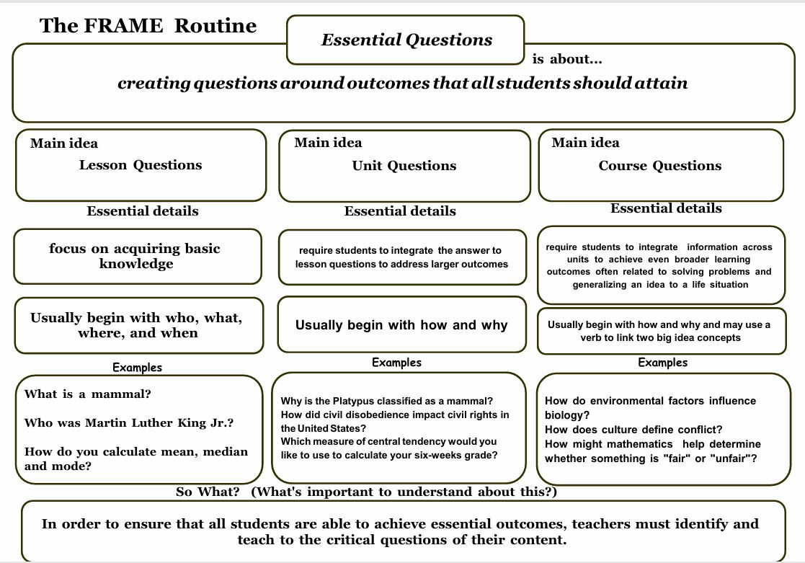

Slide 38
The Unit Organizer
4
BIGGER PICTURE
NAME
Elida Cordora
DATE
1/22
The roots and consequences of civil unrest.
2
LAST UNIT
/Experience
1
CURRENT UNIT
3
NEXT UNIT
/Experience
6. UNIT RELATIONSHIPS
CURRENT UNIT
The Civil War
Growth of the Nation
The Causes of the Civil War
Page 23-24
8
UNIT SCHEDULE
5
UNIT MAP
is about...
1/22 Cooperative groups -
over pp. 201-210
A list of relationships that reflect
Sectionalism
was based on
was influenced by
the central ideas of the unit are
1/28 Quiz
1/29 Cooperative groups -
pp. 201-236
Leaders
over pp. 210-225
provided so that students can look for
Areas of
emerged because of
became greater with
across the
the U.S.
U.S.
these relationships as the content of
"Influential Personalities"
projectdue
Differences
Events in
1/30 Quiz
between
the unit is learned.
the areas
the U.S.
2/2 Cooperative groups -
over pp. 228-234
2/6 Review for test
2/7 Review for test
2/6 Test
What was sectionalism as it existed in the U. S. of 1860?
descriptive
6
UNIT SELF-TEST
QUESTIONS
How did the differences in the sections of the U.S. in 1860 contribute to the start of the Civil War?
compare/contrast
UNIT
RELATIONSHIPS
cause/effect
7
What examples of sectionalism exist in the world today?
Notes:
These relationships can be used to guide other enhancement decisions

Slide 39
The Unit Organizer
4
BIGGER PICTURE
NAME
Elida Cordora
DATE
1/22
The roots and consequences of civil unrest.
LAST UNIT
/Experience
8. UNIT SCHEDULE
NEXT UNIT
/Experience
2
1
CURRENT UNIT
3
CURRENT UNIT
The Civil War
Growth of the Nation
The Causes of the Civil War
8
UNIT SCHEDULE
5
UNIT MAP
is about...
1/22 Cooperative groups -
To help students organize
over pp. 201-210
Sectionalism
task management and
1/28 Quiz
was based on
was influenced by
completion, experiences that
1/29 Cooperative groups -
pp. 201-236
Leaders
over pp. 210-225
Areas of
across the
promote learning and show
the U.S.
emerged because of
became greater with
U.S.
"Influential Personalities"
students what they have
projectdue
Differences
Events in
1/30 Quiz
between
the U.S.
learned are listed.
Pages 24-25
2/2 Cooperative groups -
the areas
over pp. 228-234
2/6 Review for test
2/7 Review for test
2/6 Test
What was sectionalism as it existed in the U. S. of 1860?
descriptive
6
UNIT SELF-TEST
QUESTIONS
How did the differences in the sections of the U.S. in 1860 contribute to the start of the Civil War?
compare/contrast
UNIT
RELATIONSHIPS
cause/effect
7
What examples of sectionalism exist in the world today?

Slide 40
Practice
Complete boxes 5, 6, 7, 8 on your draft device.
University of Kansas Center for Research on Learning 2002
Notes:
Tab 3, third and fourth page. Reference Handouts Marzano Taxonomy Cross-walk question stems & Question Stems FRAME to be used in constructing questions for their own UO. Use the one on the next slide or at this point put in one of your own.

Slide 41
The Unit Organizer
NAME
Elida Cordora
The Causes of the Civil War
DATE
1/22
9
Expanded Unit Map
is about...
Sectionalism
was based on the
was influenced by
10. NEW UNIT SELF-TEST QUESTIONS
Areas of the
pp. 201-236
Leaders of
U.S.
change
developed because of
became greater with
such as
As the unit progresses, new questions
-Henry Clay
Differences
Events in the
-Stephen Douglas
between the
U.S.
-Zachary Taylor
that seem important about the content of
which included the
areas
-Harriet Beecher Stowe
and included
and included
and included
such as
-Douglas Filmore
the unit are listed or old questions can be
-John Brown
which included the
which included the
Social
Political
Economic
-1820 Missouri Compromise
-Jefferson Davis
Differences
Differences
Differences
-1846 Mexican War
-Abraham Lincoln
modified.
-1850 Compromise of 1850
Pages 26-27
West
-1850 Fugitive Slave Law of 1850
-1852
Uncle Tom's Cabin
-1854 Kansas-Nebraska Act
-1854 Republican Party formed
South
-1854 Bleeding Kansas
-1857 Dred Scott Case
-1858 Lincoln Douglas Debates
-1859 John Brown's Raid
-1860 Lincoln Elected
North
-1860 South Carolina Secedes
-1861 Confederacy formed
10
NEW
UNIT
SELF-TEST
QUESTIONS
How did national events and leaders pull the different sections of the U.S. apart?
Notes:
Left blank in teacher draft

Slide 42
How Much Do Students Write?
You can give them a partially completed unit organizer to help in this area.
Why might we want to do this?
University of Kansas Center for Research on Learning 2002
Notes:
Show examples

Slide 43
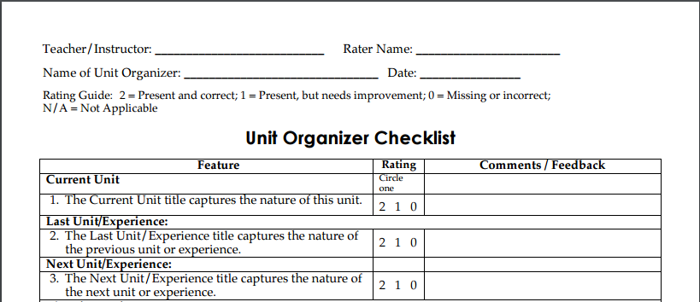
As you are coming back from lunch, grab the Unit Organizer checklist (Tab 5). Where are you with your Unit Organizer draft?
Notes:
Tab 5, second to last page. Have participants use the UO device checklist to ID all parts on Unit Organizer.

Slide 44

Time Out for Sharing
Find a partner.
Share one thing you were wondering about with your Expanded Unit Map and describe how you addressed it.
Switch roles.
Find a new partner and repeat.
Notes:
Essential Questions Sort Card Activity if needed.

Slide 45
Cue: before constructing the device
Name the Routine
Explain to students how this will help them with learning goals
Explain to students how they will participate
such as:
  “Make your paper look like mine”
  “We will turn and talk with a partner before we write on the device”

Slide 46
Do: while constructing the device
Follow the linking steps (unique to each routine)
Ask probing questions to co-construct the device (GOAL: students talk as much as the teacher)
Provide positive and corrective feedback to shape students’ contributions for the device

Slide 47
CRAFT Linking Steps
Page 42
Create a context
  Explore how the information in this unit fits with previous, future, and bigger learning
Recognize Content Structures
  Identify how to think about and structure the information to be learned in the unit
Acknowledge Unit Relationships
  Explore relationships that are or might be important in the unit
University of Kansas Center for Research on Learning 2002

Slide 48
CRAFT Linking Steps
  Frame Unit Questions
    Generate and discuss the types of questions that reflect what the unit is really about.
  Tie Content to Tasks
    Identify a schedule of tasks to be completed and how these tasks connect to learning the content.

Slide 49
Pg. 42
Implementing the Unit Organizer Routine
Launching the Unit
Floating the Unit
Tying Up the Unit
GOAL
The new unit is introduced to
Attention is drawn to unit ideas
The Unit Organizer is used to
students using the Unit
as each unit section is
review unit content and promote
Organizer Routine.
completed or introduced.
student confidence.
C
The CURRENT UNIT is related
Each unit section is reviewed
The UNIT MAP, the
to the LAST UNIT, the NEXT
and in conjunction with the
EXPANDED UNIT MAP, and
UNIT, and to a BIGGER IDEA in
UNIT MAP.
relationships to other units and
the course.
ideas are reviewed.
R
The UNIT MAP is revealed
Key information is added to the
Students construct personal unit
through a Unit Paraphrase
EXPANDED UNIT MAP as part
maps without looking at the Unit
and a Content Map.
of section review or introduction.
Organizer and then check
accuracy.
A
The UNIT MAP is explored
UNIT RELATIONSHIPS are
Students explain, edit, and
and UNIT RELATIONSHIPS
confirmed and highlighted on
revise personal content maps
are identified.
the EXPANDED UNIT MAP.
with others.
F
UNIT QUESTIONS reflecting
UNIT QUESTIONS are answered
Students answer the UNIT
central ideas of the unit are
and answers to previously
QUESTIONS and generate
constructed.
answered questions are
new self-test questions.
improved.
T
The UNIT SCHEDULE is
Status of task progress,
Class discusses how unit tasks
constructed and explained.
completion, and student
promoted learning and how
satisfaction with learning is
learning could have been
checked.
improved.
Notes:
Tab 5, third to last page. Reference Handout

Slide 50

Launch
Float
Tie-up
Notes:
Chalk Talk: Write down how you would use the unit organizer the participants drafted to launch, float, tie up in your class. Include the boxes on the unit organizer next to your ideas. Visit each poster.

Slide 51
Let’s take a break…

Slide 52
Co-Construction in a Science Class
Unit Organizer Overview on Vimeo

Slide 53
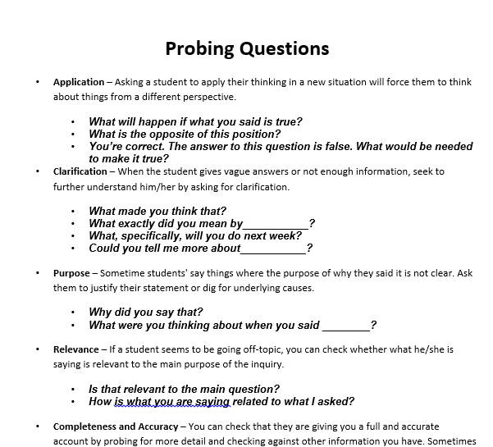
Stand Up, Sit Down
Tab 3
found in
Everyone stands
Select a person to go first
Share 1 question with your table group and explain why you selected that question.
Sit down after you share
*We will know when everyone is done when you are all seated.
University of Kansas Center for Research on Learning 2006
Notes:
Home Fun Reminder - Why did you pick the questions you selected.

Slide 54
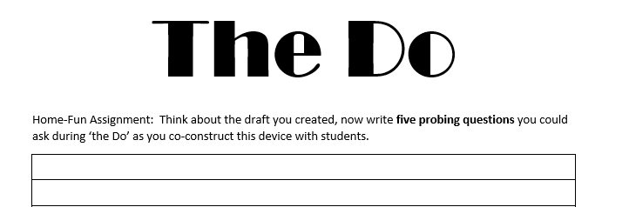
Take out home fun.
Notes:
Use Kagen strategy here.

Slide 55
Review: after constructing the device
Ask questions about content on the device
Ask questions about the learning process and how the device works
MODEL how to use the device as a study tool, support for in class assignments or homework

Slide 56
Jay Walking Video
Notes:
Facilitator stop video periodically to ask the audience what questions could he have asked in order to elicit the desired response?

Slide 57
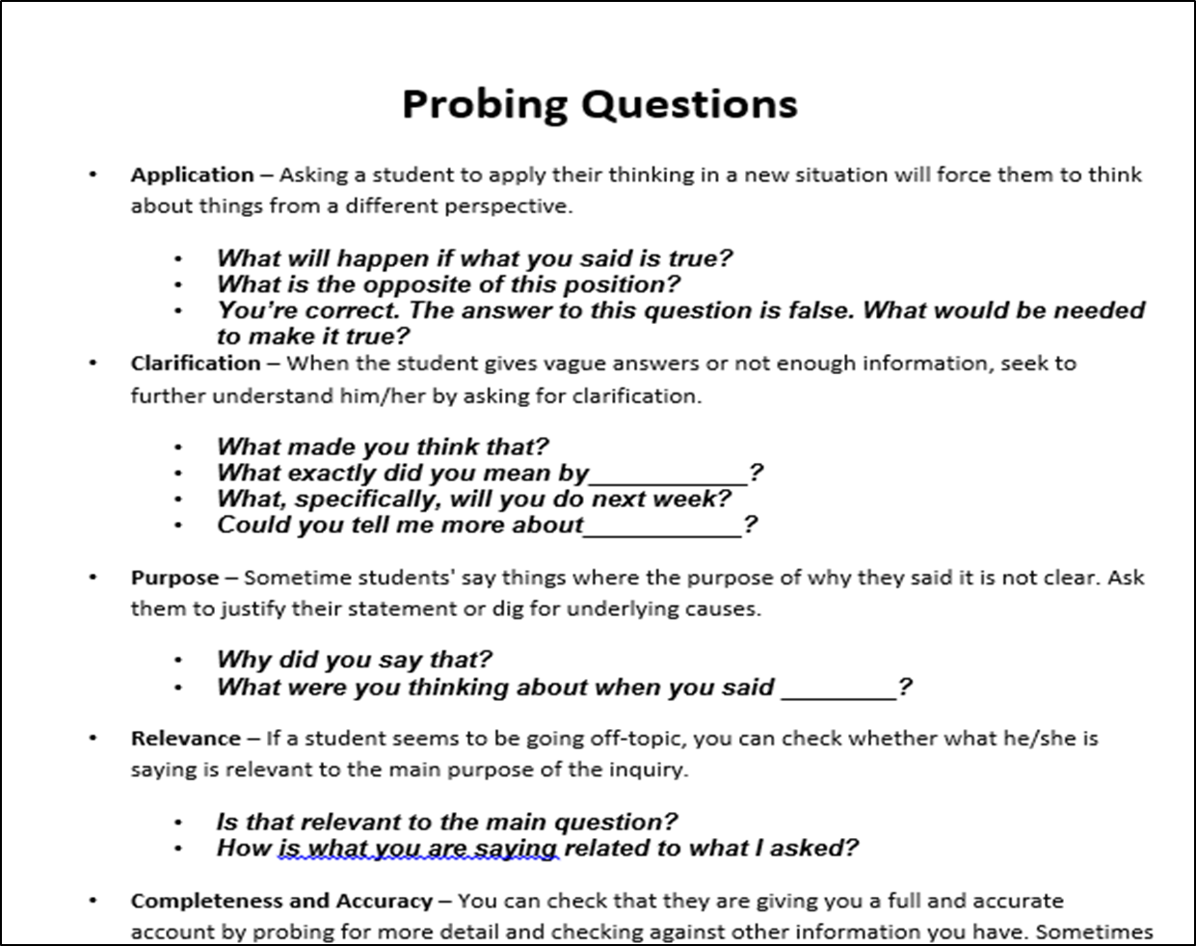

Time to Practice the “DO” with Emphasis on Co-Construction
Notes:
Participants partner with another person that does not teach the content area and ask probing questions to co-construct a UO that was created on day 2.

Slide 58
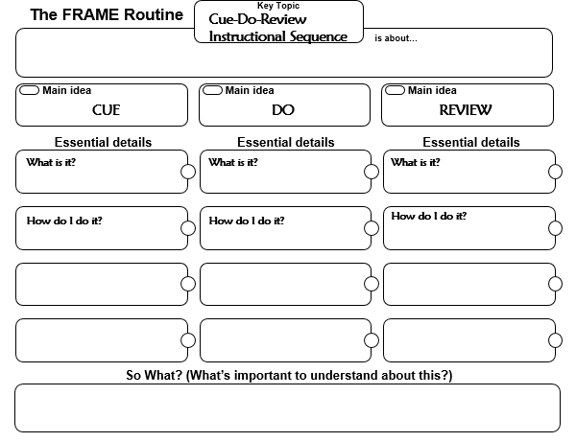
Notes:
Co-construct the “DO” with participants. Handout in tab 2. Highlight where teachers struggle in “do”: crickets and wrong answers from students. Reference the probing questions handout.

Slide 59

Unit Organizer for Families
How might this be helpful for struggling learners and their families?
Notes:
Tab 5, last page. Reference Handout and play video for participants after lunch. Video to play in the background as they work on draft. http://www.fdlrs.org/statewidepd/florida-s-state-personnel-development-grant.html
https://www.screencast.com/t/ATYAOCDkyHgl

Slide 60
Canvas Course
Tip: Bookmark and save your password
Let’s take a tour…
You’ve been added to a course for the Unit Organizer.
Please see if you can access it.
Notes:
Introduce SIM EDU. (groups, classes, assignments, etc.) Participants will take the 1. Baseline Survey 2. knowledge check for course organizer 3. complete the session evaluation.

Slide 61
Exit Ticket
Leave your draft Unit Organizer for review (or send Janice a picture, janicecreneti@gmail.com)
On a post it note (or a few), reflect on today:
  What are you feeling good about?
  What are you concerned about?
  What are you wondering?
Notes:
Add tasks for EDU
Don’t forget to add the units to their CO on Hot Pink

Slide 62
Home Fun
Complete “The Do” and “The Review” handouts under tab 2.
01
Take a look at the Quick Reference Guide under Planning Tab 3.
02
Choose 2 devices you think you would like to learn more about.

Slide 63
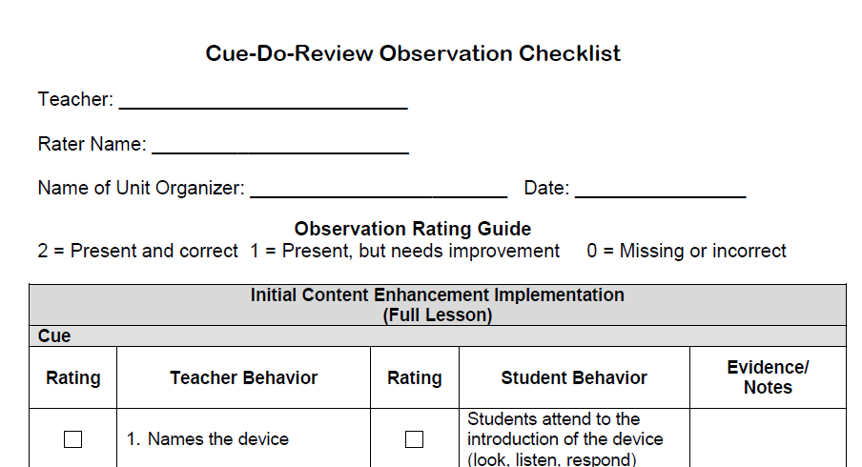
Notes:
Find this document you will need it in a min….
Participants will take cue do review checklist out of binder and rate the co-construction of the cue do review frame. This will be a reflective activity to see if they can identify the PDer and their role in this.

Slide 64
Notes:
Tab 2, yellow handout. Facilitator will co-construct the CUE Column Only.

Slide 65
The Unit Organizer
4
BIGGER PICTURE
NAME
DATE
Understanding relationships
2
LAST UNIT
/Experience
CURRENT UNIT
3
NEXT UNIT
/Experience
1
CURRENT UNIT
Functions
Linear Equations in 1 Variable
Linear Equations in 2 Variables
8
UNIT SCHEDULE
5
UNIT MAP
is about...
Comparing linear relationships
To determine
That are
Proportional
Solutions
using
Similar triangles
6
UNIT SELF-TEST QUESTIONS
RELATIONSHIPS
UNIT
7
Notes:
Teacher Version
Presenter's Choice for device of comfort

Slide 66
The Unit Organizer
Linear Equations in 2 Variables
NAME
DATE
9
Expanded Unit Map
is about...
Points of intersection
graphing
Comparing linear relationships
That are
To determine
by
Which are
Proportional
Solutions
Inspection
(common sense)
using
using
Similar triangles
By interpreting
Displayed in
in
Algebraically using
Unit Rate
Different Ways
On a
That are
substitution
situations
Coordinate Plane
Proportional
Such as
Verbal Expressions
Table
Graph
Equation
That are
That look like
Non-Proportional
Y = mx
That look like
y = mx+b
10
NEW
UNIT
SELF-TEST
QUESTIONS
Notes:
Teacher Version

Slide 67
The Unit Organizer
4
BIGGER PICTURE
NAME
DATE
Understanding relationships
2
LAST UNIT
/Experience
CURRENT UNIT
3
NEXT UNIT
/Experience
1
CURRENT UNIT
Functions
Linear Equations in 1 Variable
Linear Equations in 2 Variables
8
UNIT SCHEDULE
5
UNIT MAP
is about...
Comparing ______ relationships
To determine
That are
___________
________
using
_______ triangles
6
UNIT SELF-TEST QUESTIONS
RELATIONSHIPS
UNIT
7
Notes:
Presenter's Choice for device of comfort

Slide 68
The Unit Organizer
Linear Equations in 2 Variables
NAME
DATE
9
Expanded Unit Map
is about...
_________of intersection
________
Comparing linear relationships
That are
To determine
by
Which are
Proportional
Solutions
________
(common sense)
using
using
Similar triangles
By interpreting
Displayed in
in
Algebraically using
_______Rate
Different _______
On a
That are
__________
________
________ Plane
_________
Such as
Verbal Expressions
__________
__________
__________
That are
That look like
Non-_________
Y = ____
That look like
y = ____
10
NEW
UNIT
SELF-TEST
QUESTIONS
Notes:
Presenter's Choice for device of comfort

Slide 69
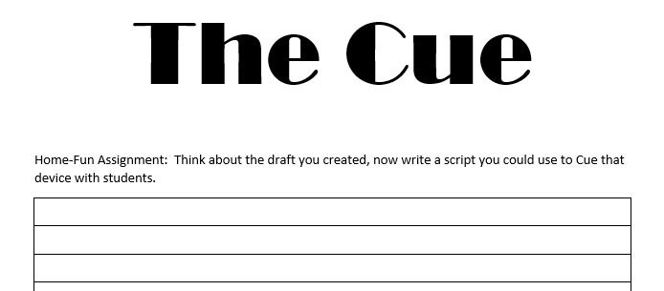
Take out your home fun

Slide 70
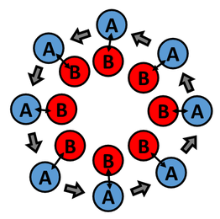
INSIDE OUTSIDE CIRCLES
Read the “cue” script you created for homework
Or
Read a “cue” script for the unit organizer
Notes:
Participants will use inside outside circles to practice the “cue” only. Inside=delivery of cue. Outside=listen and provide feedback. (30 sec for cue, 30 sec for feedback) Switch roles. Rotate. Reference Handout: cue do review checklist.

Slide 71
Exit Ticket: Self-Reflection
What aspects of cue do review are already integrated into your teaching practice and where?
Which are not? Over the next three days think about how you might integrate those missing pieces.

Slide 72
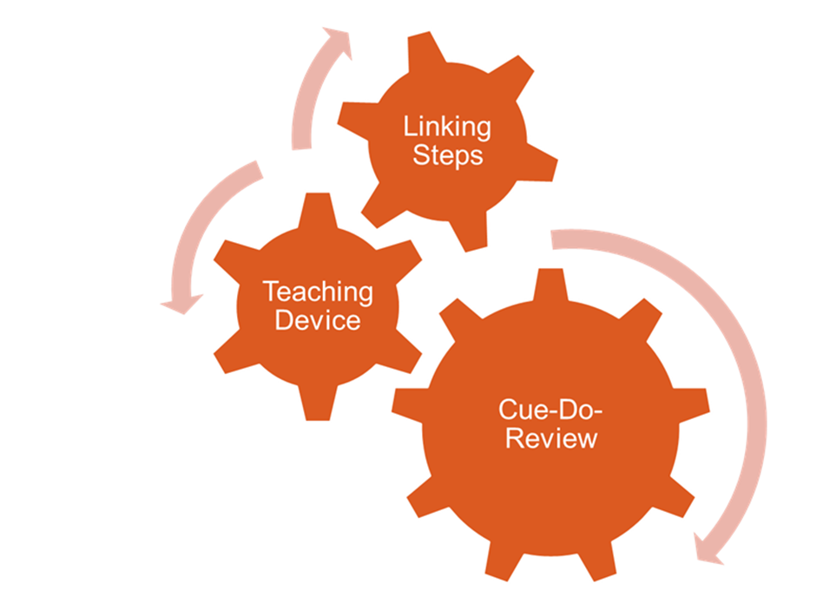
How Do I Teach the Unit Organizer?
Notes:
Reinforce the importance of Cue, Do, Review and Co-construction.

Slide 73
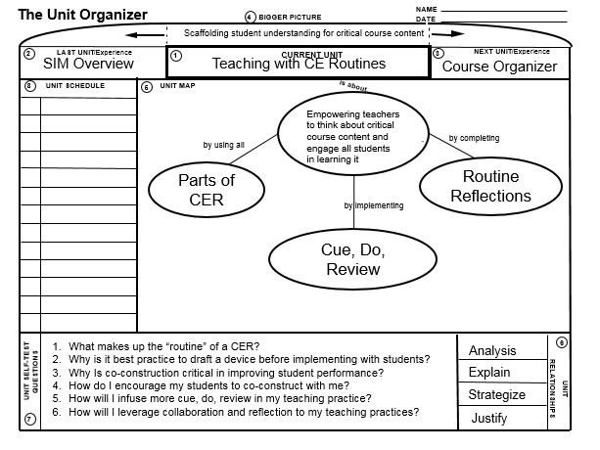
What Do You Notice?
Notes:
Participants will take out the student version of the “teaching with CERs” UO from their binder. Give a minute for participants to make initial observations and share out.

Slide 74
Review of “CUE DO REVIEW”
Cue: teacher announces the CE routine and explains its use, how it will help students and expectations for student participation
Do: teacher and class collaboratively construct the device using the Linking Steps that “connect” the content to the needs and goals of students
Review: Information presented in the device is reviewed and confirmed, use of the device is reviewed and confirmed, use of the device as a learning and study tool is modeled
Notes:
Review if needed

Slide 75
Time to Draft Your Own Unit Organizer
Menu of Options for Learning:
Small group led by facilitator.
View the PowerPoint for unit organizer
Read the guidebook for unit organizer
Review online resources (Livebinders and SIM EDU)
Work in small content groups
Notes:
Explain how to build unit organizer from standard (Jane/Fawnia)
Sort participants (new to UO/Go make UO)

Slide 76

Self Assess with Device Checklist
Notes:
Remind them to use the UO device checklist to assist

Slide 77
Debrief on the Process
What has been challenging so far?
Any questions?
Notes:
Facilitator should stress the importance of collaboration and continuous editing.

Slide 78
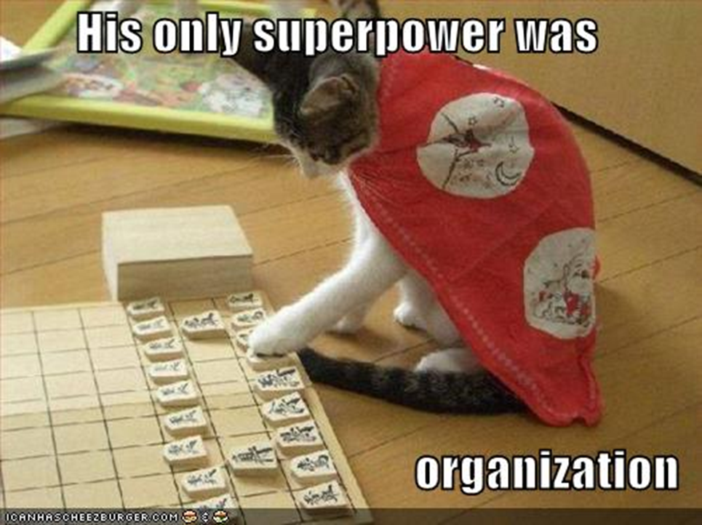
Finish Drafting Your Unit Organizers

Slide 79
To Do…
Take the Unit Organizer knowledge check in EDU
Take the Unit Organizer Evaluation in EDU
Upload an electronic course organizer draft device into EDU
Notes:
K.O.

Slide 80
Question types – Jay Walking

Slide 81
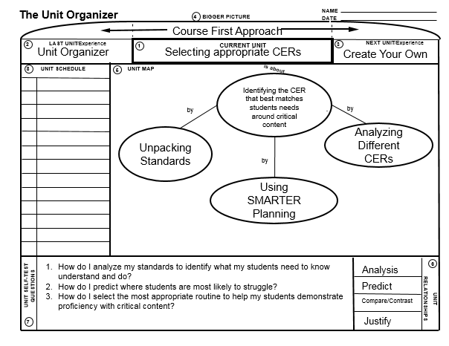
Notes:
A - Swap to ELMO and put up UNIT ORGANIZER UO and review this routine and device with participants.

Slide 82
SMARTER Planning
Shape the Critical Questions
Map the Critical Content
Analyze for Learning Difficulties
Reach Enhancement Decisions
Teach Strategically
Evaluate Mastery
Re-evaluate Critical Questions
Notes:
K - Review. Focus on ARTER. We’ve already covered the S & M

Slide 83
Example of Co-Construction in a Math Classroom
https://edpuzzle.com/assignments/59305df310a91d6c026c04e8/watch
Notes:
Facilitator will call attention to JUST Co-CONSTRUCTION Participants will use a notecard or sticky to tally Teacher Talk vs. Student Talk

Slide 84

Time to Work
Notes:
Two sessions before lunch
Review expectations with participants

Slide 85

Time to Practice the “DO”
Notes:
Participants will rotate so that each person acts as a teacher to do the “Do” a routine they have created. The observer makes sure that all components of do are covered.
Reflect after activity: What did you find to be challenging? What did you learn? Revisit the cue do review frame if needed.

Slide 86
Time to Practice the “Review”
Notes:
Participants will rotate so that each person acts as a teacher to do the “Review” of a routine they have created. The observer makes sure that all components of do are covered. Student will co-construct with teacher.
Reflect after activity: What did you find to be challenging? What did you learn? Revisit the cue do review frame if needed.

Slide 87
Ticket out the door
What is 1 thing you learned today?
What is 1 question you still have?

Slide 88

Gallery Walk with Feedback
Notes:
Participants leave feedback on a sticky note while gallery walking and viewing peer’s CO drafts. Presenters all give feedback. If time allows, allow participants to get into like content groups to discuss final drafts and share ideas. Move participants into content groups. Assign a Pder to sit with each group.

Slide 89
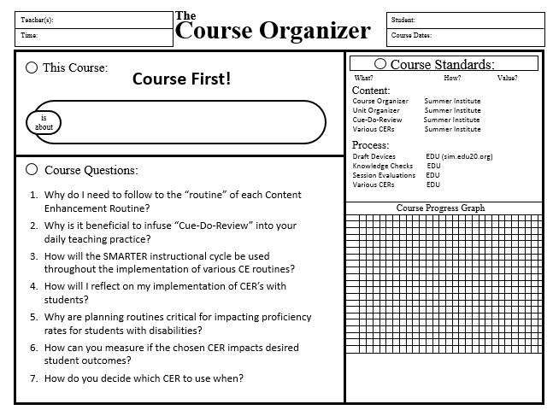
Course First! Course Organizer
Review the Course Questions. Which ones can you answer – all or part?
What are you wondering about today?
Notes:
(wait to revisit when they have data to graph?) Revisit Pink sheet Tab 4. 1. Have participants self evaluate the course questions with arrows(Up=I know it, sideways = kinda, down=haven’t heard it yet or I don’t know). 2. Graph. 3. Revisit community principles and add to it if needed.

Slide 90

The Strategic Instruction ModelTM (SIM)
is about
_______________________________practices
for _____________________________________planning and
__________________________teaching
developed by
website:
organized through the
Instructional Cycle
and may include intervention for academic skills with
and may include co-construction of learning with
Curriculum (LS)
Routines (CERs)
that include
(#’s on device)
that have a
chosen based on
Instructional Sequence
to provide a strategy for
Mastery-based
drafted by the teacher and driven by
with embedded
that is
and engages students
Notes:
Revisit from day 1? Complete this instead of revisiting course organizer on previous slide?

Slide 91

Turn and Talk
  How do you already implement the SMARTER planning steps when planning your own curriculum and devices?
  How are the SMARTER planning steps connected to a Course Organizer?
Notes:
Only if needed.

Slide 92
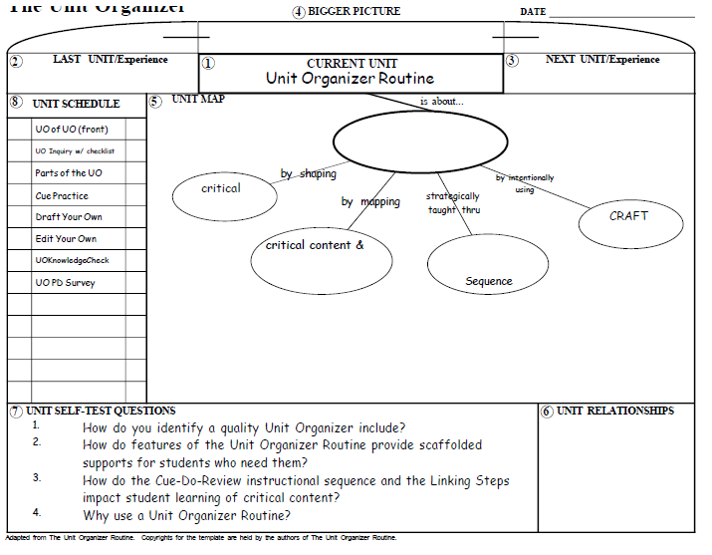
Unit Organizer of the
Unit Organizer
Notes:
Tab 5, first page. Be sure to take a trainers time out and ask participants how you co-constructed device with them. What type of questions did I ask?

Slide 93
Self Test Questions
Do you have any questions to add to box 10?
Notes:
To be used with advanced UO

Slide 94
Time Out for Sharing
Find a partner that does not teach the same content as you.
Each person share one unit question.
Provide feedback.
Find a new partner and repeat.
Notes:
Essential Questions Sort Card Activity if needed.

Slide 95

Think-Pair-Share
How and when are you thinking that you might use the Unit Organizer in your instruction?
Notes:
Pair Discussion

