Slide 1
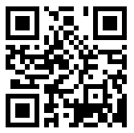
Modifications suggested or made.
Add “Tab it”slide before starting the parts of the C.O.
  tab for research
  tab for overview of sections
  tab for linking steps
  tab for cue do review
  tab for details to draft
After first co-construction of SIM flow chart stop for a turn and talk (How did the professional developer co-construct this chart with you? Etc.)
Add an arrow to the SIM flow chart after the sharks data slide to point to CER box
Copy slide mentioned in bullet above to after the SMARTER slide referenced after Concept Mastery example
Animate boxes and bullets underneath on the SIM flow chart
Add slide for padlet-QR code
Course First
https://padlet.com/crenetij/m2skquezutvt
Do unit map before critical concepts
At lunch ask participants to put any questions they may have on
If participants are ready give allow them to make an attempt at the course questions
If the participants have time cue the CO for course First and model the home fun before they are dismissed.
Password for Padlet: Course First

Slide 2
Welcome to Content
Enhancement Course First!
Welcome to Course First!
Professional learning on SIM Content Enhancement
As you come in:
Please fill out a name tent using the guide below.
If you haven’t had a chance to review the SIM Overview, check that out from the Course First email from Ms. Holden or review the first 3 pages of the SIM Brochure (last document behind Tab 1 in your binder.
In 2025-26 my role will be …
(include Content area, grade level)
School District
First Name (large print, please)
Favorite thing about teaching
Favorite place
Notes:
Pders set up: “other structures/strategies” chart & Consensogram Questions:
Rate your familiarity with
… unpacking your standards and grouping them into units
… Cue Do Review
… Course Organizer
… Unit Organizer
… SIM as an organization.
1 Never seen or heard of 2 have Heard of and seen a bit
3 starting to use
4 Very comfortable 5 I could teach it

Slide 3
Introductions
Why we’re here
What you want to get out of the week
What you need as a learner
How I came to SIM

Slide 4
Our week together
Schedule for each day
Schedule for the week
Canvas

Slide 5
How we’ll work together (Community Principles )
Choice
Voice
Praxis
Equality
Reflection
Dialogue
Stretching
Notes:
CP on Chart paper. This should be co-constructed. Pders can each pick one and share. Open to the group if any more should be added.

Slide 6

Think about a student who is disengaged, who has an IEP, and/or who struggles…
Identify a barrier to that student’s success.
Put each barrier on a separate sticky note.
Notes:
Compelling Why-Participants will complete post-its and then turn and talk with their table.
***Personal story of at least one presenter.
They will stick them on the table parking lot. Pders will group the post-it notes and will reference back to at slide #__ (Keisha).

Slide 7

Do you ever feel like this?

Slide 8

Or this?

Slide 9
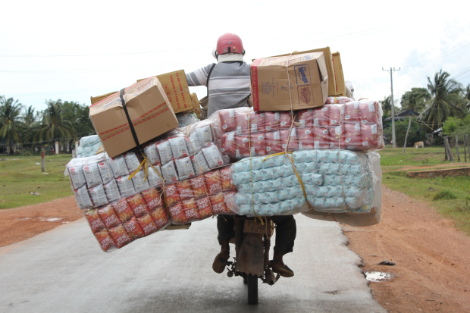
Or this?

Slide 10

Where we are with teaching & learning…
More rigorous expectations of students
Reveals Student Misconceptions, Gaps in knowledge, strategies or skills
Need for instructional approaches that do more in less time
How can you expand your toolbox?

Slide 11

We’re gonna need _______________?

Slide 12
So what if you could…
Identify the content that is most critical for all learners
Learn tools proven to increase instructional effectiveness for all learners including students with disabilities
Receive one-on-one assistance in implementing
Meet the requirements of your evaluation, growth plans, and all other initiative with ONE set of tools

Slide 13
And what if your students could…
Increase their proficiency rates on rigorous tasks as measured by classroom tests, benchmark assessments, and state tests
Increase their level of engagement
Get supports to enable their increased participation in more rigorous learning activities (e.g. AVID strategies, DBQ's)
Better self-assess and monitor their own learning
Increase their confidence levels as students and their belief in the value of the school curriculum.

Slide 14
Content
Enhancement Routines
(CERs)
Content
Use is based on demands in the standards and student need
Enhancement
Graphic devices are used
Language needed to talk about the content is explicitly stated
“how to” steps are embedded
Routine
Follows a specific instructional routine each time used (Cue-Do-Review)
Meant to become routinely used in the classroom

Slide 15

Every Content Enhancement Routine (CER) consists of 3 parts.
Each part is critical to the successful implementation of the routine.
The Teaching Device (e.g. the Unit Organizer, the Frame, the Concept Diagram, the Comparison Table)
The Linking Steps (CRAFT for Unit Organizer, FRAME for Framing)
The CUE-DO-REVIEW
Instructional Sequence

Slide 16

The Strategic Instruction ModelTM (SIM)
is about
_______________________________practices
for _____________________________________planning and
__________________________teaching
developed by
website:
organized through the
Instructional Cycle
and may include intervention for academic skills with
and may include co-construction of learning with
Curriculum (LS)
Routines (CERs)
that include
(#’s on device)
that have a
chosen based on
Instructional Sequence
to provide a strategy for
Mastery-based
drafted by the teacher and driven by
with embedded
that is
and engages students
Notes:
Tab 1, second page. Have participants reference handout the unit map for SIM. Co-construct under Elmo. They will be completing this map through out the overview. Presenter must stop and discuss how all routines are research validated and where they can find that research. Presenter must also focus on “standards-aligned planning.” Highlight that CERs are standards based routintes.

Slide 17
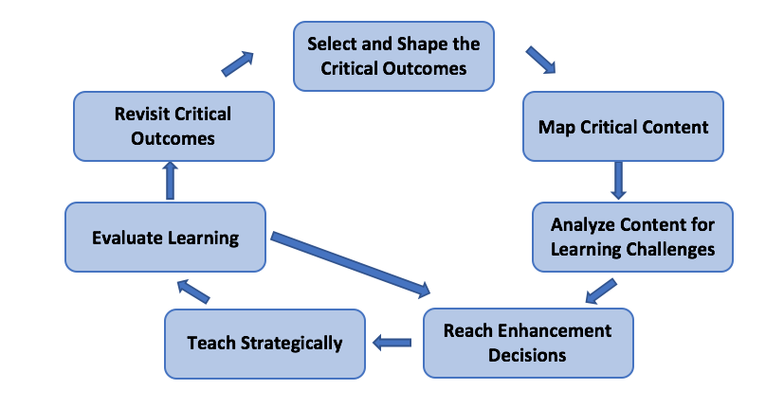
SMARTER Planning and Instructional Cycle
Notes:
Keisha
Tab 3 first and fifth pages, Reference Handout in Binder. Review components of SMARTER

Slide 18
Cue
Do
Review
How do we support students in meeting learning expectations?

Slide 19
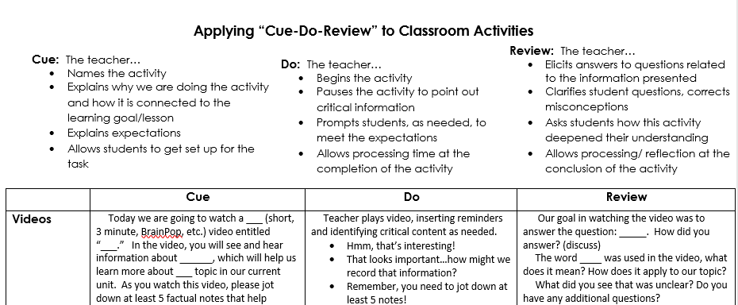
Think of a lesson you taught toward the end of school year. Find the type of lesson you taught and read over the Cue, Do, Review of that activity.
Notes:
Tab 2, first handout. Reference handout. Participants read and then Turn Talk.
Introduce CDR is examples of how they do it across all activities.
Point out HUGE gains in student understanding in use of CDR alone.

Slide 20

Student talk is critical…
Co-construction = Facilitating learning through conversation

Slide 21
Cue: before constructing the device
Name the Routine
Explain to students how this will help them with learning goals
Explain to students how they will participate
such as:
  “Make your paper look like mine”
  “We will turn and talk with a partner before we write on the device”

Slide 22
Do: while constructing the device
Follow the linking steps (unique to each routine)
Ask probing questions to co-construct the device (GOAL: students talk as much as the teacher)
Provide positive and corrective feedback to shape students’ contributions for the device

Slide 23
Review: after constructing the device
Ask questions about content on the device
Ask questions about the learning process and how the device works
MODEL how to use the device as a study tool, support for in class assignments or homework

Slide 24

How might Cue - Do - Review positively impact student participation?
Notes:
Add questions here to help participants process Cue Do Review and Smarter.

Slide 25
Break Time!

Slide 26


Slide 27
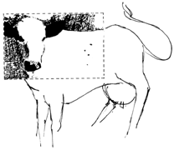

Slide 28
Think About A
Syllabus You Have Created
  What is the purpose for creating one?
  What content is include?
  How do you use it throughout the semester?
  What is the return on your investment of time?
Notes:
Turn and talk (timer 1 min). Intro to the Course Organizer Routine.

Slide 29


The Course Organizer Routine gives students the view from the helicopter, so they can see the trees in relation to the forest and landscape.

Slide 30
The Value of Course Planning
  Communicate course expectations about how content, learning, and social interactions will be organized during the first weeks of a course.
  Define how the learning community will be created and maintained.

Slide 31
Teacher(s):
The
Course Organizer
Student:
Time:
Course Dates:
This Course:
Course Standards:
Course First!
What?
How?
Content:
Course Organizer Summer Institute
Unit Organizer Summer Institute
Cue-Do-Review Summer Institute
Various CERs Summer Institute
is
about
Process:
Draft Devices EDU (sim.edu20.org)
Knowledge Checks EDU
Session Evaluations EDU
Various CERs EDU
Course Questions:
Why do I need to follow to the “routine” of each Content Enhancement Routine, particularly for students with disabilities?
Why is it beneficial to infuse “Cue-Do-Review” into your daily teaching practice?
How will the SMARTER instructional cycle be used throughout the implementation of various CE routines?
How will I reflect on my implementation of CER’s with students?
Why are planning routines critical for impacting proficiency rates for students with disabilities?
How can you measure if the chosen CER impacts desired student outcomes, particularly students with disabilities?
How do you decide which CER to use and when?
Course Progress Graph
100
90
80
70
Score (%)
60
50
40
30
20
10
0
Key
KC=knowledge Check
DD=Draft Device
Routines

Slide 32
Course Map
This Course:
Course First!
Student:
includes
Community
Principles
Learning Rituals
Performance
Options
During this week: During the year:
Cue-Do-Review Dialogue Implementation
Course Organizer Videos Coaching
Data review EDU Groups Reflection Questions
Co-construction LiveBinders
Drafting/Editing Use of Guidebooks
Role Play WIN!” Reflection questions
Facilitated Planning
Lesson Study
Virtual Support
Observing/Modeling
PLC Support
Critical Concepts
Learned in these
Units

Slide 33
Tab it
In the Course Organizer Guidebook:
Research (pages 2-3)
Overview of the Sections (pages 6-9)
Linking Steps (pages 10-13)
Cue Do Review Sequence (pages 14-18)
Constructing a Draft (pages 21-35)
Notes:
Reference resources: (guidebooks, tab 4-blanks, examples, and checklist)

Slide 34
Research on Course Planning
When teachers use a Course Organizer Routine:
  Students considered at risk for school failure answered more course content questions correctly.
  All students either improved or maintained steady progress.
  Teachers reported that it provided focus for unit and lesson planning.
Page 3

Slide 35
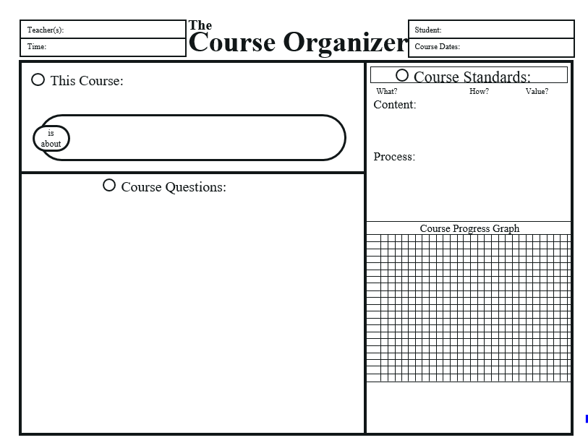
Grab a blank device

Slide 36
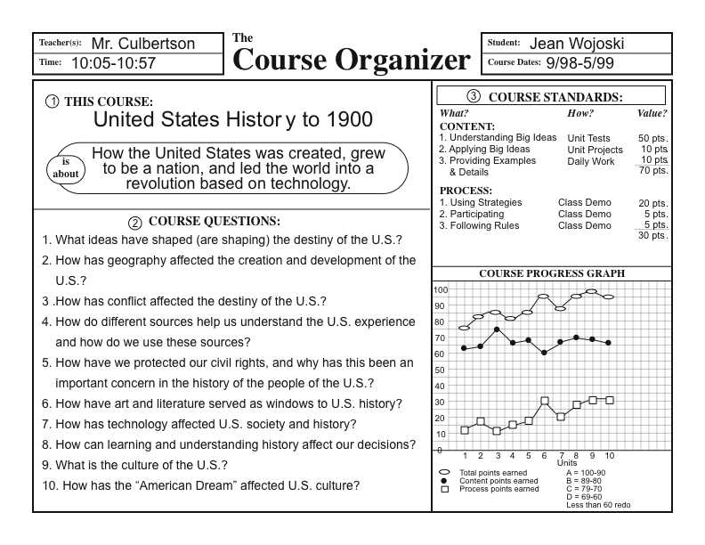
This Course
The name of the course
and a summary or
paraphrase of what the
course is about

Slide 37
The Course Paraphrase
Pg. 21-22
Should:
Capture the main idea of the course.
Distinguish the course from similar courses.
Clearly and meaningfully communicate course content.
Provide an umbrella for all learning.

Slide 38
Course Standards
The standards that will be
emphasized and used
for feedback and determination
of grades
Also, a graph that students
can use to monitor
individual progress across
units in the course

Slide 39
Course Progress Graph
Examples of Assessment Methods to be Graphed:
  Tests
  Quizzes
  Homework
  Projects
  Demonstrations
  Observation

Slide 40
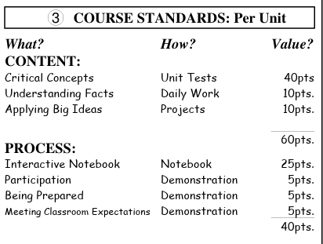
How do you differentiate between Content, Process, What, How & Value
Pg. 35
Notes:
Discuss how the Course standards may be reflected in the Course Progress Graph

Slide 41
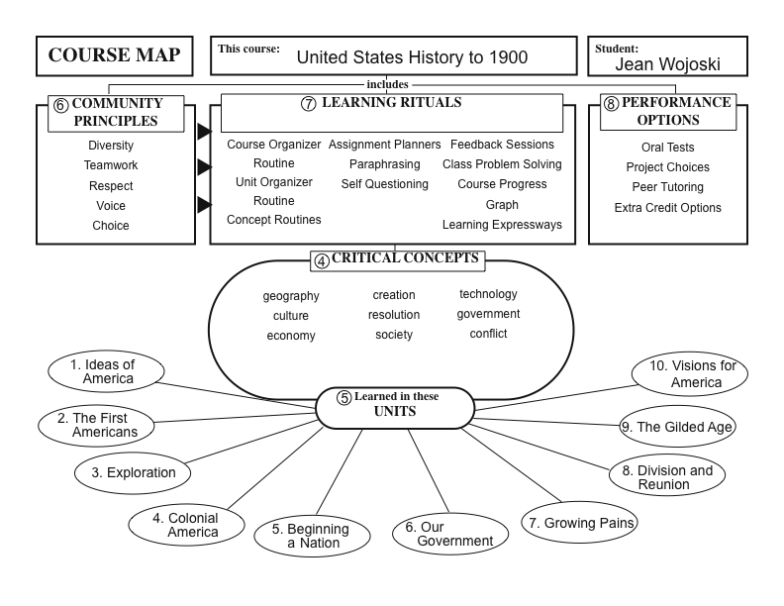
Course Map
A graphic depiction showing
how the course information
has been organized for learning
Pg. 26
Notes:
Can use annual overview or other district guides to fill in the units.

Slide 42
Critical Concepts
The critical concepts that will be emphasized
throughout the course, that relate to course questions,
and that cut across more than one unit. There should be 10 or fewer concepts.

Slide 43
Critical Concepts
Pg. 25
A concept is a category or group of members that share the same characteristics
  Fraction
  Novel
  Mammal
  Democracy
  Can I think of 3 examples of __________?
  If yes, it may be an example of a concept.
Notes:
See handouts regarding concepts in the binder for each course

Slide 44

Concept or Example?
Culture
Economy
Conflict
Martin Luther King Jr.
USA
Energy
Invertebrate
Meiosis
Species
Genre
The Road Less Traveled
Essay
Ratio
Right Triangle
Variable
Percent
Square
Notes:
Formative Assessment: Have participants respond to each term with a “c” or “e” sign language hand gesture

Slide 45
Characteristics of a Learning Community
When you visualize the “perfect” class, how would they interact with each other and with you?
How would they deal with difference?
How would they work together?
What would they value?
Generate a list of characteristics
Come to agreement on your top 5

Slide 46
Turning Characteristics → Principles
Pg. 27-30, 67-68
For each characteristic, identify the underlying principle, value, or quality that is needed to nurture the characteristic.
  Show respect for each other and the teacher = Respect others
  Tolerate differences among people = Tolerate diversity
  Work with others to solve problems = Teamwork

Slide 47
Learning Rituals
The teaching routines, learning strategies,
and communication systems related to
learning. Are used throughout the course
to enhance learning.
Notes:
Take a moment to have teachers preview examples of the learning rituals

Slide 48
Learning Rituals
Pg. 30 – 34 & 61 - 63
Must always:
  Consist of a set of concrete steps that define how something important related to learning is done;
  Be known, taught, or learned by each member of the group;
  Be performed in relatively the same way each time it is performed;
  Focus on how the following guide learning: teaching, learning, and connecting to others.

Slide 49
Learning Rituals
How Students…
…knowledge
Acquire
Practice
Deepen

Slide 50
Performance Options
The adaptations that will be built into
the course to accommodate the needs of
diverse learners.

Slide 51
Performance Options
Pg. 34, 65 - 66
Examples:
  extended work time
  peer readers/tutors
  copies of presentation notes
  presenting assignments orally and in writing
  study partners/peer study teams
  audiotaped responding or drawing answers
  project choices

Slide 52
Performance Options
How will you differentiate….
Summative
Assessments
Formative
Assessments
So that all students can demonstrate mastery

Slide 53
Course Questions
The critical
questions that every
student in the class
will be able to
answer by the
end of the course
Notes:
No who or what

Slide 54
Writing Course Questions
Ask yourself:
What is really critical for all students to understand about the information in this course?
What would I want all students to remember and be able to use and discuss if I met them on the street next year and had an opportunity to visit with them?
What are the underlying ideas and concepts that capture the essence of the critical content represented in this course?

Slide 55
Writing Course Questions
Start with the Essential Learnings that have been developed from the course standards
Translate these into a useable set of questions for students
Incorporate multiple levels of higher order questioning (avoid questions that can be answered with one word or a list)
We want questions that cross unit with overarching themes and connections

Slide 56
Example Course Questions
Biology – How are living things related and organized? What ideas and discoveries have shaped the study of life?
Math – How do we use data to solve every day problems? How can data be used in multiple forms? How can I write and simplify algebraic equations? How do you determine how many solutions an equation has?

Slide 57
Example Course Questions
History – How has conflict shaped the course of history? Where do we get our knowledge of what happened in the past? How reliable are these sources? What is the culture of the US? How has the economy of the US changed over time? How has geography affected the growth and development of the United States?
Language Arts – How can I use reflective strategies to improve my reading and writing? How can I use different styles of writing to communicate my purpose?

Slide 58
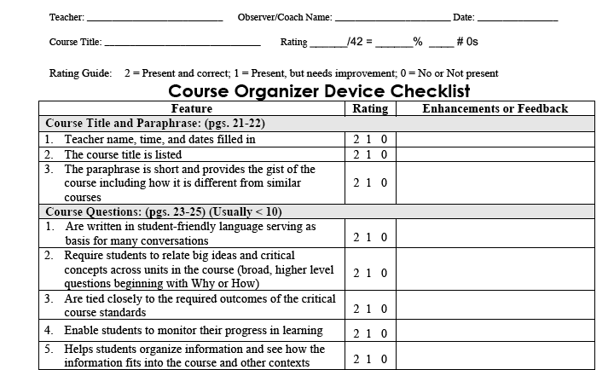
How would you rate your Course Organizer?
Notes:
Have participants use the CO device checklist to self evaluate all parts on their course Organizer.

Slide 59

Welcome Back From Lunch!
Review examples of course organizers in your guidebook
If you received an email, please accept the invitation to EDU

Slide 60
Linking Steps for the Course Organizer
Cue Course Questions.
Outline Critical Concepts and Units.
Uncover Community Principles.
Reveal Learning Rituals.
Share Performance Options.
Explain Course Standards

Slide 61
The Linking Steps in Action
Implementing the Course Organizer with Students

Slide 62
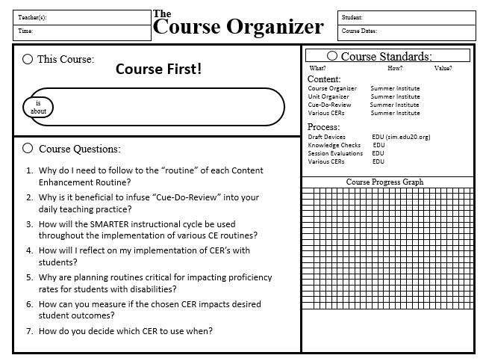
Course Organizer
Notes:
Tab 4, first page. (pink handout.) Co-Construct Course First! Course organizer with participants before they draft their own.
Is about
Star course questions
Add community principles
Question 5

Slide 63
Course Map
This Course:
Course First!
Student:
includes
Community
Principles
Learning Rituals
Performance
Options
During this week: During the year:
Cue-Do-Review Dialogue Implementation
Course Organizer Videos Coaching
Data review EDU Groups Reflection Questions
Co-construction LiveBinders
Drafting/Editing Use of Guidebooks
Role Play WIN!” Reflection questions
Facilitated Planning
Lesson Study
Virtual Support
Observing/Modeling
PLC Support
Critical Concepts
Learned in these
Units

Slide 64

Submit your course organizer draft device and checklist to a professional developer for feedback before you leave today.

Slide 65
Home Fun
Review pages 14-18 in the Course Organizer Guidebook
Write a script to “Cue” the course organizer you created today.
Be prepared to share your “Cue” tomorrow.
Notes:
Tab 2, second handout is the homefun sheet.

Slide 66

Time to Create your Own Course Organizer
1. Content Area Groups
2. Support is Available
Notes:
Tab 4-blanks and device checklist. Consider putting participants into similar content groups to draft together.

Slide 67
Exit Ticket
  To be answered on Index Card:
    Describe what worked well for you today
    Describe what you would change for the rest of the week
    Number 2 & 3 from the Course First Course Organizer (Pink Paper)
Notes:
Do we want to use number 2 and 3? Maybe a specific question about the application of the course organizer instead?

Slide 68
SIM Overview
Notes:
Sarah Swoch will use her own ppt.

Slide 69
Things To Do:
  Submit your course organizer draft device and checklist to a professional developer for feedback
  Exit Ticket Questions to be answered on Index Card:
Notes:
Create Exit Ticket

Slide 70
Things To Do:
  Submit your course organizer draft device to a professional developer for feedback
  In EDU complete the following:
    the CER Baseline 2018-19 (Your School’s Class)
    the Course Organizer knowledge Check (SPC Class) 80%
    The Course Organizer Session Evaluation (SPC Class)

Slide 71
Things To Do:
  Submit your course organizer draft device to a professional developer for feedback
  In EDU, complete the following:
    Course Organizer Knowledge Check
    Workshop Evaluation
    Baseline Survey

Slide 72
Problem
Solution
Results
Notes:
Donna

Slide 73

SIM EDU
http://sim.edu20.org/
Notes:
Day 2: Introduce SIM EDU. (groups, classes, assignments, etc.) Participants will take the 1. Baseline Survey 2. knowledge check for course organizer 3. complete the session evaluation.

Slide 74

Problem
Math and Science Teachers
New to building and teaching
New administration
Identifying areas of struggle for students
Notes:
Donna
Work with 3 math teachers –

Slide 75

Slow and Steady (2 Years)
Implemented Content Enhancement Routines gradually over time
Instructional coach learned along with the teachers and gradually moved to supporting them
Used PLC team to support planning for using CERs
Solution
Notes:
Donna

Slide 76
Ranked 49th out of 565 middle schools for improvement in Mathematics Achievement from 2015-16 to 2016-17
Results
Notes:
Donna
Received a letter from the governor recognizing that they were in the top 10% of the state for math gains. The three new teachers out performed the experienced teachers as they used SIM.

Slide 77

Problem
Algebra 1 EOC Pass Rates
Looking for instructional procedures to support all students, but specifically students who have struggled with math
Notes:
Donna
Sean should present this.

Slide 78
PD and Planning Time
Regular and remedial math classes teachers participated in Content Enhancement Routines professional development
Principal ensured teachers had time to plan together by providing one full day each semester
Teachers attended district facilitated planning sessions
Solution
Notes:
Donna
Great planning time given.

Slide 79
Results
Notes:
Donna

Slide 80
High School Science
Problem
Biology EOC
Increase pass rates for all students
Notes:
Donna

Slide 81
High School Science
CERs
Provided PD and facilitated planning sessions for interested Biology teachers
Instructional coaches supported implementation and provided “just-in-time” professional development
Solution
Notes:
Donna

Slide 82
High School Science
Common Assessment
Results
Notes:
Donna

Slide 83
High School Science
EOC
Results
Notes:
Donna

Slide 84
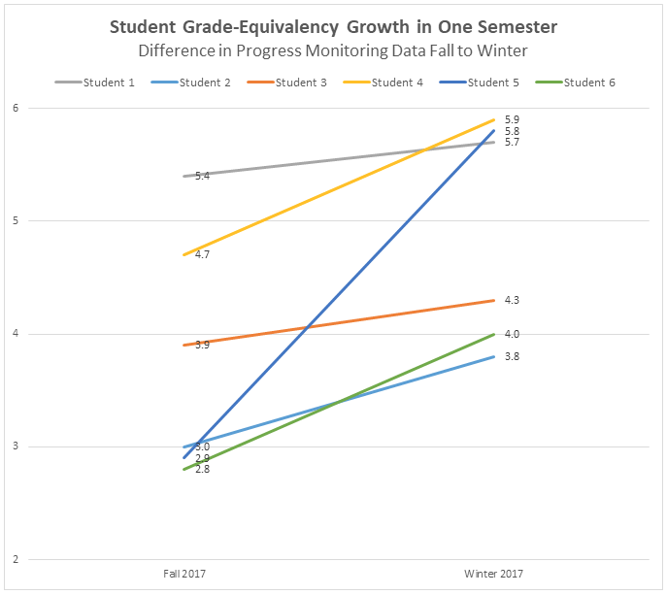
Learning Strategies Curriculum in MS Reading Classes
Fundamentals in Paraphrasing & Summarizing and the Inference Strategy
STAR Reading Assessment Progress Monitoring Data
Notes:
Donna
Emphasize STAR assessment

Slide 85

Notes:
EDUCATION SCIENCES' WHAT WORKS CLEARINGHOUSE
A new report adds two Strategic Instruction Model™ programs to an influential national database of education interventions that have been proven effective in the classroom. The report found that Xtreme Reading and SIM Learning Strategies Curriculum, separately, have shown evidence of—in the parlance of the Institute of Education Sciences’ What Works Clearinghouse—“potentially positive effects” on achievement for struggling adolescents. The WWC rating means at least one study of each program reported statistically significant positive effects. In both cases, the level of evidence met criteria to allow the programs to be included in the What Works Clearinghouse, a first for both interventions.

Slide 86
Strategic Instruction Model
is about
research-validated
practices for standards-aligned
planning and data-driven
teaching
developed by
organized through the
SMARTER
Instructional Cycle
may include co-construction of learning with
and may include intervention for academic skills with
Content Enhancement
Routines
Learning Strategies
Curriculum
Notes:
Keisha
Have participants reference handout the unit map for SIM. They will be completing this map through out the overview.

Slide 87
Strategic Instruction Model
Is about
research-validated
practices for standards-aligned
planning and data-driven
teaching
developed by
organized through the
SMARTER
Instructional Cycle
and may include intervention for academic skills with
and may include co-construction of learning with
Content Enhancement
Routines
Learning Strategies
Curriculum
that include
Linking Steps (#’s on device)
chosen based on
that includes
that have a
that follow a
Device
Cue-Do-Review
Instructional Sequence
to provide a strategy for approaching the learning task
Individual Student need
Mastery-based gradual release instructional sequence
drafted by the teacher and driven by content complexity
with embedded learning scaffolds
that is explicit and engages students
Notes:
Keisha
Participants with fill in the unit map. Have participants highlight the 3 parts of CERs-let them know that this will be the focus for the institute.
Strong tier 1 instruction reduces the need for MTSS

Slide 88
How do you see the three components of SIM supporting all students, especially those who struggle?
Think it
Ink it
Stand up and walk around until the music stops
When the music stops, find 2 other people to form a triad.
Discuss your responses to the question above.
Notes:
Have participants get into triads. Play music and have people move around. When the music stops find two people to form and group of three for this discussion.

Slide 89
Let’s Discuss the Pre-Institute Work
What is the Strategic Instructional Model (SIM)?
  Read about SIM and Content Enhancement Routines:
  https://sim.drupal.ku.edu/sim-curricula
What does a Content Enhancement Routine look and sound like in a classroom?
  Preview the video below:
  https://vimeo.com/simnetwork/review/87086441/4715a315fc
What is the Course First institute?
  Read the attached document: “Course First Overview”
I like….
I wonder…
Notes:
“I like..I wonder” post-it activity for homefun.

Slide 90
Strategic Instruction Model Project
Intentionally planning and structuring learning so all students become proficient and graduate

Slide 91

What is the concern you want to address?
< 80% of students are proficient in the “core”?
Rigor?
Standards Aligned?
Active Engagement?
Data-driven Differentiation?
Remediation for kids who didn’t get it?
Data-driven Interventions?
Progress monitoring?
Teacher Evaluations?
Notes:
Return of the Post-its
Here are common concerns and here is what you said.

Slide 92
Strategic Instruction Model
is about
research-validated
practices for standards-aligned
planning and data-driven
teaching
developed by
organized through the
SMARTER
Instructional Cycle
may include co-construction of learning with
and may include intervention for academic skills with
Content Enhancement
Routines
Learning Strategies
Curriculum

Slide 93
Strategic Instruction Model
Is about
research-validated
practices for standards-aligned
planning and data-driven
teaching
developed by
organized through the
SMARTER
Instructional Cycle
and may include intervention for academic skills with
and may include co-construction of learning with
Content Enhancement
Routines
Learning Strategies
Curriculum
that include
Linking Steps (#’s on device)
that have a
that follow a
Device
Cue-Do-Review
Instructional Sequence
to provide a strategy for approaching the learning task
drafted by the teacher and driven by content complexity
with embedded learning scaffolds
that is explicit and engages students
Notes:
Keisha
Participants with fill in the unit map. Have participants highlight the 3 parts of CERs-let them know that this will be the focus for the institute.

Slide 94
Teacher Decisions and behaviors around the
Concept Mastery Routine
Teacher uses a Concept Diagram on “Like Terms” to support students in solving linear equations.
  Interprets standards to determine that students need to be able to solve real-world problems with linear equations
  Problem: students are not able to solve one-step equations fluently
  Further investigates to determine that students struggle to identify like terms, a foundational skill for solving linear equations
  Teacher is able to identify like terms as a concept that needs to be applied which includes identifying examples and non-examples of like terms.
  Selects the Concept Mastery Routine as the appropriate CER to remediate the foundational skill
  Drafts a device which accurately identifies the characteristics of like terms that are always and sometimes present
  Uses formative assessment accurately to identify the misconceptions, misunderstandings students have around like terms – critical to building a draft that addresses them all
  Co-construct the Concept Diagram with students following the Cue-Do-Review Instructional Sequence in a way that cements student understanding.
  Follows all Linking Steps including the step where students engage in guided practice with the concept so teacher can assess if students now understand the concept enough to correctly identify like terms to assist in solving linear equations
Notes:
Information for Presenter, not to be shown to participants. This ties in with the R in smarter. Teacher interprets standards to determine that students need to be able to solve real-world problems with linear equations
Teacher determines that students are not able to solve one-step equations fluently
Teacher further investigates to determine that students struggle to identify like terms, a foundational skill for solving linear equations
Teacher is able to identify like terms as a concept that needs to be applied which includes identifying examples and non-examples of like terms.
Teacher is able to select the Concept Mastery Routine as the appropriate CER to remediate the foundational skill
Teacher is able to draft a device which accurately identifies the characteristics of like terms that are always and sometimes present
Teacher is able to use formative assessment accurately identify the misconceptions, misunderstandings students have around like terms to identify never present characteristics and non-examples that effectively address the misconceptions, misunderstandings
Teacher is able to co-construct the Concept Diagram with students following the Cue-Do-Review Instructional Sequence in a way that cements student understanding.
Teacher follows all Linking Steps including the step where students engage in guided practice with the concept so teacher can assess if students now understand the concept enough to correctly identify like terms to assist in solving linear equations

Slide 95
CONCEPT DIAGRAM
l
Key Words
j
CONVEY CONCEPT
j
k
k
OFFER OVERALL
like terms
parts of an algebraic expression
CONCEPT
Same
Variable
exponent
l
NOTE KEY WORDS
m
CLASSIFY
CHARACTERISTICS
Always Present
Sometimes Present
Never Present
Have the same variable(s)
have fractions
Have the same variable with different exponents
have same coefficient
have no variables
have negative signs
n
EXPLORE EXAMPLES
Examples:
Nonexamples:
3x, 3x
2x, x²
4x, 4y
¼ y², 8 y²
7a²b, 4ab
5a², 3a
-2xy, 6xy
2x, 3
-17xy, 10xy
3, 9
8x³, 8y³
o
PRACTICE WITH NEW EXAMPLE
p
TIE DOWN A
Like terms are part of an algebraic expression that always have the same variable
DEFINITION
Notes:
Keisha
This is an example of a teacher making a content enhancement decision. Linking steps embedded, strategy embedded. Intro Device.

Slide 96
What behaviors are we trying to increase with Content Enhancement Routines?
Planning is grounded in course standards and takes time
Teachers plan units, lessons, and assignments that are coherent with connections made explicit
Common misconceptions, gaps in background knowledge, and challenging content are determined and addressed pro-actively
Formative assessment drives changes to instruction and supports student learning
Teachers use explicit instructional routinely (Cue-Do-Review) with all classroom activities
Devices are created in collaboration with students (students talk as much as the teachers)
Notes:
Keisha

Slide 97
SMARTER Planning and Instructional Cycle
Notes:
Keisha
Analyze Content for Learning Challenges-might need more intensive intervention due to academic or social skill deficit. Enhancement decision=learning strategy intervention. (not for entire class, for the individual) 30 min/day.

Slide 98
Barriers
Skill gaps – reading, problem solving, research
Knowledge gaps (from previous courses)
Won’t ask questions/for help
Mindset (I can’t…)
Social acceptance
Don’t value education, disengaged, or only care about the “A”
Lazy, do it later mentality
Struggle to focus (distractions, cell phones)
Attendance
Afraid to stretch because of too much support
Cheating
Lack of support at home
Struggle with “big picture”

