Slide 1

The Vocabulary LINCing Routine
The University of Kansas
Center for Research on Learning

Slide 2
Content Enhancement Series
Routines for
Planning & Leading Learning
Course Organizer
Unit Organizer
Teaching Concepts
Concept Anchoring
Concept Comparison
Exploring Text, Topics and Details
Clarifying
Framing
Lesson Organizer
Concept Mastery
Survey
ORDER
Higher Order Reasoning & Thinking
Decision-Making
Question Exploration
Scientific Argumentation
Teaching Cause & Effect
Enhancing Performance
Recall Enhancement
Vocabulary LINCing
Quality Assignment
University of Kansas Center for Research on Learning 2019

Slide 3
The Results of the LINCing Routine on Student in Inclusive
General Education Classrooms
6th Grade Social Studies Class
9th Grade English Class
Page 3 of The Vocabulary LINCing Routine (6th grade Social Studies study)
https://sim.drupal.ku.edu/sites/sim.ku.edu/files/images/general/ResearchSlides/LinkRout.pdf (9th grade ELA Class study)
University of Kansas Center for Research on Learning 2019
Notes:
https://sim.drupal.ku.edu/sites/sim.ku.edu/files/images/general/ResearchSlides/LinkRout.pdf

Slide 4
More Research
4th graders with LDs show significant improvement in vocabulary and appreciable improvement in reading comprehension. https://eric.ed.gov/?id=ED578184
Secondary students with disabilities showed improvement in vocabulary acquisition, especially academically vocabulary. Students were asked if their friends should be taught the strategy and the overall average response was 3.92 out of a possible 5. https://digitalcommons.odu.edu/cdse_etds/4/
University of Kansas Center for Research on Learning 2019

Slide 5
The Vocabulary LINCing Routine is …
A visual and auditory way to help students remember the meaning of important words.
A way to “revisit” and solidify student knowledge of terms introduced or taught in a lesson.
University of Kansas Center for Research on Learning 2019

Slide 6
The Relationship Between the LINCing
Routine and the LINCS Strategy
The LINCing Routine is based heavily on the LINCS Strategy.
The LINCS Steps are the same in both books.
Primary difference: Where each should be used and by whom.
University of Kansas Center for Research on Learning 2019

Slide 7
Where the LINCing Routine
Should Be Used and by Whom
Within the context of a general education classroom in which a diverse group of students is enrolled (e.g., biology or history).
Teachers of subject-area classes.
University of Kansas Center for Research on Learning 2019

Slide 8
Where the LINCS Strategy
Should Be Taught and by Whom
In small classes where intensive types of instruction can take place.
Support teachers (e.g., special education teachers, study skills teachers).
University of Kansas Center for Research on Learning 2019

Slide 9
Components of the LINCing Routine
The LINCS Table
The LINCS Steps*
The Cue-Do-Review Sequence
*In all other Content Enhancement manuals, these instructional procedures are referred to as the “LINCing Steps.” This name has been changed for this manual to eliminate any confusion that might arise between the instructional procedures themselves (the LINCS Steps) and the name of this routine, the LINCing Routine.
University of Kansas Center for Research on Learning 2019

Slide 10
The Cue-Do-Review Sequence
Cue
Name the routine or the LINCS Table.
Explain benefits of the routine.
Specify expectations.

Slide 11
The Cue-Do-Review Sequence (cont.)
Do
List the parts.
Identify a Reminding Word.
Note a LINCing Story.
Create a LINCing Picture.
Supervise practice.

Slide 12
The Cue-Do-Review Sequence (cont.)
Review
Ask questions about the information.
Ask questions about the process.

Slide 13
SMARTER Planning and Instructional Cycle
Shape the critical questions
Map the critical content and relationships
Analyze how learning might be difficult, made apparent, and measured
      Students have difficulty remembering critical terms
Reach instructional enhancement decisions
Teach strategically
Evaluate learning
Revisit learning outcomes and critical questions
University of Kansas Center for Research on Learning 2019
Notes:
What are some CERs that deal with teaching vocabulary?
Memorizing vocabulary

Slide 14
The LINCS Table
Is a device that
Can be used in place of traditional flash cards.
Is used initially under teacher guidance to help students understand the meaning of important vocabulary words.
Focuses attention on the most important aspects of a term’s definition.
Uses auditory and visual memory devices to promote recall of a term.
Links learning to previous knowledge connections.
University of Kansas Center for Research on Learning 2019

Slide 15
The LINCS Table
Term LINCing Story LINCing Picture Definition
Reminding Term
1
4
5
2
3
Term LINCing Story LINCing Picture Definition
Reminding Term
1
4
5
2
3
4
5
Term LINCing Story LINCing Picture Definition
Reminding Term
1
2
3
1
4
5
2
Term LINCing Story LINCing Picture Definition
Reminding Term
3
List the parts of the story Identify a reminding word Note a LINCing Story Create a LINCing picture Self-test

Slide 16
The LINCS Table
1
Term
4
LINCing Story
5
LINCing Picture
2
Definition
3
Reminding Word
1
Term
4
LINCing Story
5
LINCing Picture
2
Definition
3
Reminding Word
1
Term
4
LINCing Story
5
LINCing Picture
2
Definition
3
Reminding Word
1
Term
4
LINCing Story
5
LINCing Picture
2
Definition
3
Reminding Word
List the parts
Identify a reminding word
Note a LINCing story
Create a LINCing picture
Self-test

Slide 17
Section 1 of the LINCS Table
The Term
An important word that all students are expected to understand and remember
1
Term
4
LINCing Story
5
LINCing Picture
2
Definition
palisades
My pal, Joe, dove from the cliff into the ocean.
A line of steep cliffs a long a river or ocean.
3
Reminding Word
pal
University of Kansas Center for Research on Learning 2019

Slide 18
Section 2 of the LINCS Table
The Definition
A brief statement of the term’s definition in student-friendly language
1
Term
4
LINCing Story
5
LINCing Picture
2
Definition
palisades
My pal, Joe, dove from the cliff into the ocean.
A line of steep cliffs a long a river or ocean.
3
Reminding Word
pal
University of Kansas Center for Research on Learning 2019

Slide 19
Section 3 of the LINCS Table
The Reminding Word
A real word that sounds similar to the new term and is know to all the students.
1
Term
4
LINCing Story
5
LINCing Picture
2
Definition
palisades
My pal, Joe, dove from the cliff into the ocean.
A line of steep cliffs a long a river or ocean.
3
Reminding Word
pal
University of Kansas Center for Research on Learning 2019

Slide 20
An Effective Reminding Word
Always
Sounds like part or all of the new word.
Is a real word. (Cannot be a nonsense word.)
Has a meaning that you already know.
Helps you remember what the new word means.
University of Kansas Center for Research on Learning 2019

Slide 21
An Effective Reminding Word (cont.)
Sometimes
Sounds like the beginning of the new word.
Sounds like the end of the new word.
Rhymes with the new word or sounds like almost all of the new word.
Has a meaning that is very similar to the new word’s meaning.
Can be two or more words that sound like the new word.
University of Kansas Center for Research on Learning 2019

Slide 22
An Effective Reminding Word (cont.)
Never
Sounds completely different from the new word.
Is a nonsense word.
Has a meaning that you don’t know.
University of Kansas Center for Research on Learning 2019

Slide 23
Reminding Words
Examples |  |  |  | Nonexamples
New Word (Vocabulary Term) |  | Example |  | New Word (Vocabulary Term) |  | Nonexample
paramecium |  | parachute |  | paramecium |  | parapet
Put a reason in the chat why this is a nonexample.
University of Kansas Center for Research on Learning 2019

Slide 24
Reminding Words
Examples |  |  |  | Nonexamples
New Word (Vocabulary Term) |  | Example |  | New Word (Vocabulary Term) |  | Nonexample
paramecium |  | parachute |  | paramecium |  | parapet
crinoline |  | crinkle |  | crinoline |  | crinium
Put a reason in the chat why this is a nonexample.
University of Kansas Center for Research on Learning 2019

Slide 25
Reminding Words
Examples |  |  |  | Nonexamples
New Word (Vocabulary Term) |  | Example |  | New Word (Vocabulary Term) |  | Nonexample
paramecium |  | parachute |  | paramecium |  | parapet
crinoline |  | crinkle |  | crinoline |  | crinium
flourite |  | floor |  | flourite |  | zorite
Put a reason in the chat why this is a nonexample.
University of Kansas Center for Research on Learning 2019

Slide 26
Reminding Words
Examples |  |  |  | Nonexamples
New Word (Vocabulary Term) |  | Example |  | New Word (Vocabulary Term) |  | Nonexample
paramecium |  | parachute |  | paramecium |  | parapet
crinoline |  | crinkle |  | crinoline |  | crinium
flourite |  | floor |  | flourite |  | zorite
serf |  | servant |  | serf |  | wharf
Put a reason in the chat why this is a nonexample.
University of Kansas Center for Research on Learning 2019

Slide 27
Reminding Words
Examples |  |  |  | Nonexamples
New Word (Vocabulary Term) |  | Example |  | New Word (Vocabulary Term) |  | Nonexample
paramecium |  | parachute |  | paramecium |  | parapet
crinoline |  | crinkle |  | crinoline |  | crinium
flourite |  | floor |  | flourite |  | zorite
serf |  | servant |  | serf |  | wharf
parrafin |  | pair of fins |  | parrafin |  | wax
Put a reason in the chat why this is a nonexample.
University of Kansas Center for Research on Learning 2019

Slide 28
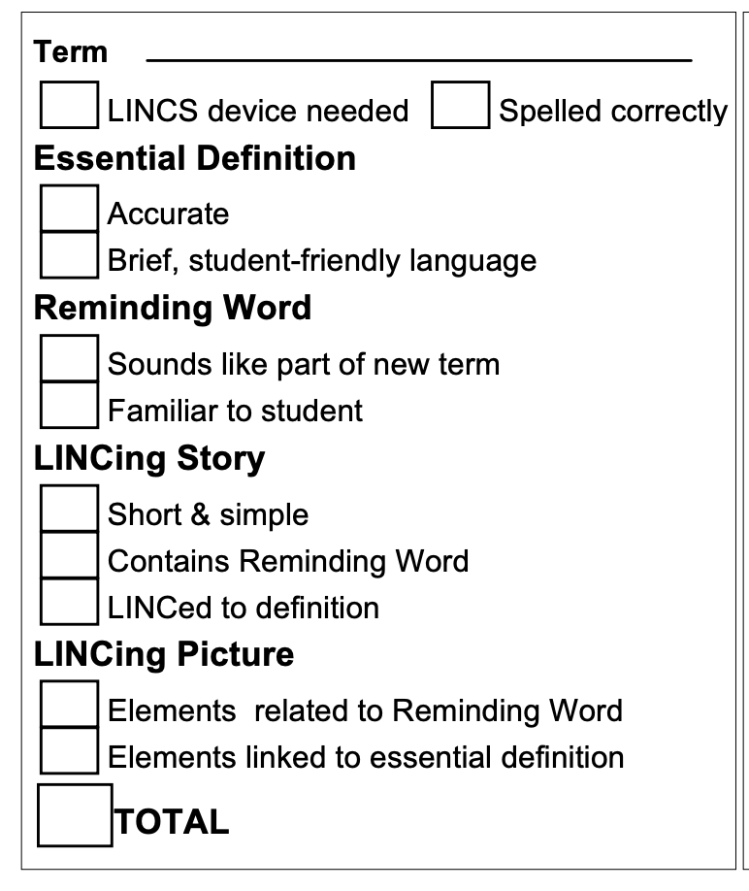
Reminding Words – Example or Nonexample?
Poll – Example/Non-Example
New word:
shivearee
Reminding word:
cacophony
shiver
University of Kansas Center for Research on Learning 2019

Slide 29
Reminding Words – Example or Nonexample?
Poll – Example/Non-Example
New word:
theocracy
Reminding word:
democracy
theocrat
University of Kansas Center for Research on Learning 2019

Slide 30
Reminding Words – Example or Nonexample?
Poll – Example/Non-Example
New word:
reparations
Reminding word:
repair
nations

Slide 31
Reminding Words – Example or Nonexample?
Poll – Example/Non-Example
New word:
bauble
Reminding word:
beautiful
bull
University of Kansas Center for Research on Learning 2019

Slide 32
Reminding Words – Your Turn
Please take a screenshot of this page
With a partner, come up with a reminding word for each of these words (or generate a list related to your content area):
eradicate
nationalism
unilateral
oppose
denominator
You will be sharing these with the whole group!
University of Kansas Center for Research on Learning 2019

Slide 33
Section 4 of the LINCS Table
The LINCing Story
A phrase or sentence that connects—or links—the definition of the new term to the Reminding Word.
1
Term
4
LINCing Story
5
LINCing Picture
2
Definition
palisades
My pal, Joe, dove from the cliff into the ocean.
A line of steep cliffs a long a river or ocean.
3
Reminding Word
pal
University of Kansas Center for Research on Learning 2019

Slide 34
An Effective LINCing Story
Always
Includes the Reminding Word or some form of the Reminding Word.
Links the Reminding Word to the meaning of the new word.
Is short and simple.
University of Kansas Center for Research on Learning 2019

Slide 35
An Effective LINCing Story (cont.)
Sometimes
Includes both the Reminding Word and the new word.
Is funny or bizarre.
University of Kansas Center for Research on Learning 2019

Slide 36
An Effective LINCing Story (cont.)
Never
Includes only the new word.
Is so complex that it takes a lot of mental energy to remember it.
Is long like a paragraph.
Includes words you don’t understand.
University of Kansas Center for Research on Learning 2019

Slide 37
LINCing Story Examples & Nonexample
Flourite: A purple mineral used to make steel hard
Reminding Word: floor
Example LINCing Story: "My knee turned purple when it hit the hard, steel floor." (Story helps you think of steel and the color purple.)
Nonexample LINCing Story: "The floor was messy." (Story does not help you think of steel or the color purple.)
University of Kansas Center for Research on Learning 2019

Slide 38
LINCing Story Examples & Nonexample
Decree: To make a decision and force it on others
Reminding Word: decide
Example LINCing Story: "The dictator decided to force everyone to pay higher taxes." (Story helps you think of a decision being forced on others.)
NonExample LINCing Story: "He decided to go to town." (Story does not help you think of forcing a decision on others.)
University of Kansas Center for Research on Learning 2019

Slide 39
LINCing Story Examples & Nonexample?
Poll – Example/Non-Example
wholesale: The price that a store pays for an item before they sell it; usually less than the selling price.
Reminding Word: hole
LINCing Story: “The store owner buried the money he made in a hole.”
Better LINCing Story: “The store owner buried the money he made from buying low and selling high in a hole.”
University of Kansas Center for Research on Learning 2019

Slide 40
LINCing Story Examples & Nonexample?
Poll – Example/Non-Example
charitable: giving, generous.
Reminding Word: table
LINCing Story: “He gave lots of food for the table.”
University of Kansas Center for Research on Learning 2019

Slide 41
LINCing Story – Your Turn
With a Partner, develop a LINCing story for this vocabulary term: shivaree
Please take a screenshot of this page
Shivaree: A noisy song sung to a newly married couple
Reminding Word: Shiver
LINCing Story:
LINCing Story: The married couple shivered when the guests sang outside their window.
University of Kansas Center for Research on Learning 2019
Notes:
The married couple shivered when the guests sang the shivaree outside their open window

Slide 42
Section 5 of the LINCS Table
The LINCing Picture
A memory device that provides a
visual link for the new term.
1
Term
4
LINCing Story
5
LINCing Picture
2
Definition
palisades
My pal, Joe, dove from the cliff into the ocean.
A line of steep cliffs a long a river or ocean.
3
Reminding Word
pal

Slide 43
An Effective LINCing Picture
Contains a part related to the Reminding Word
Contains parts related to the important ideas in the definition.
Helps you remember the new term’s definition.
University of Kansas Center for Research on Learning 2019

Slide 44
An Effective LINCing Picture (cont.)
Example term: palisades
Definition: A line of steep cliffs that rise along a river or ocean
Reminding Word: pal
LINCing Story: My pal, Joe, dove from the cliff into the ocean.
Poor Better Best
LINCing Picture LINCing Picture LINCing Picture
University of Kansas Center for Research on Learning 2019

Slide 45
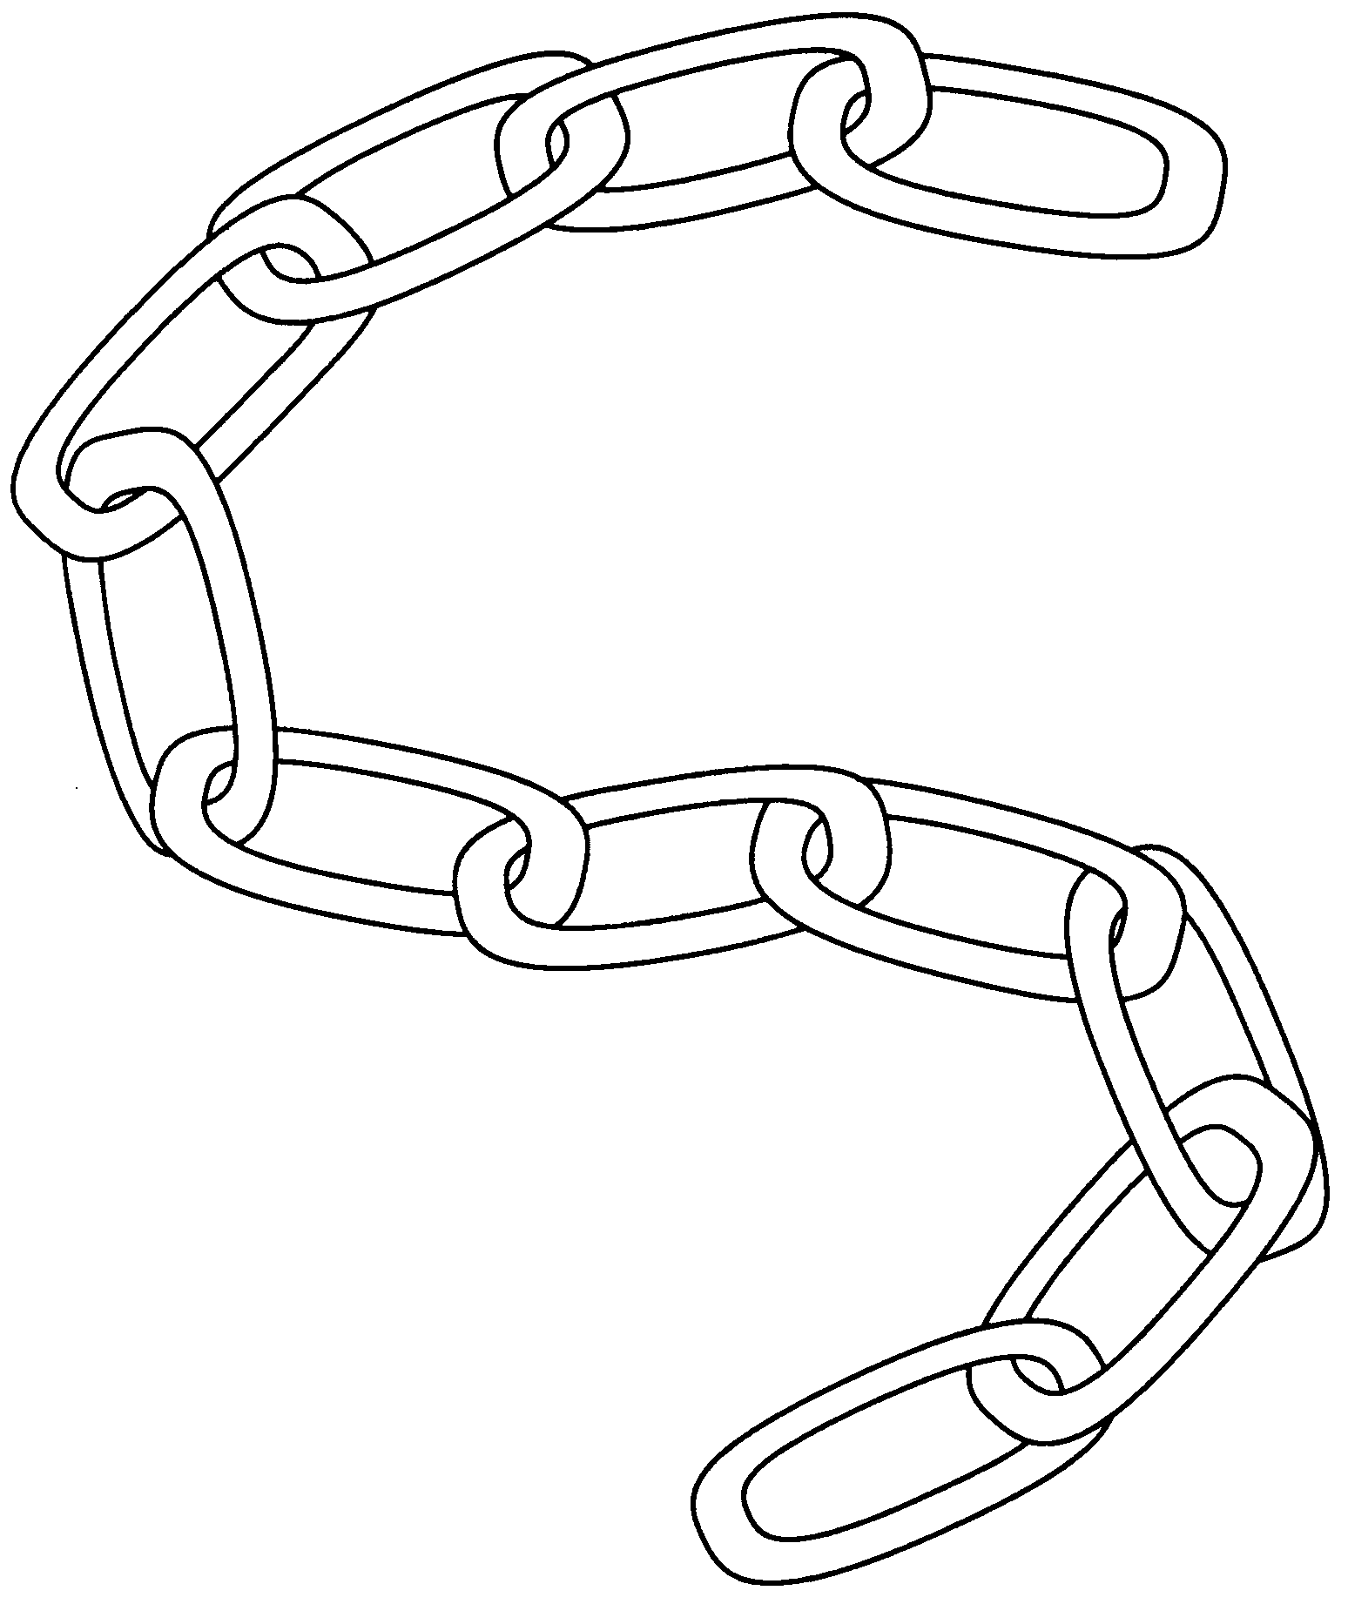
Chain Analogy
Different pieces of
knowledge are
linked together
like a chain.
Many times, if you can remember the information in one of the links in a chain, you will remember information in many of the other links.
When you apply the LINCS devices to a word you need to remember, you create a strong chain between the word and its meaning.
The stronger the links
between pieces of
information, the easier you
can remember them. The
weaker the links, the more
difficulty you'll have remembering them.

Slide 46
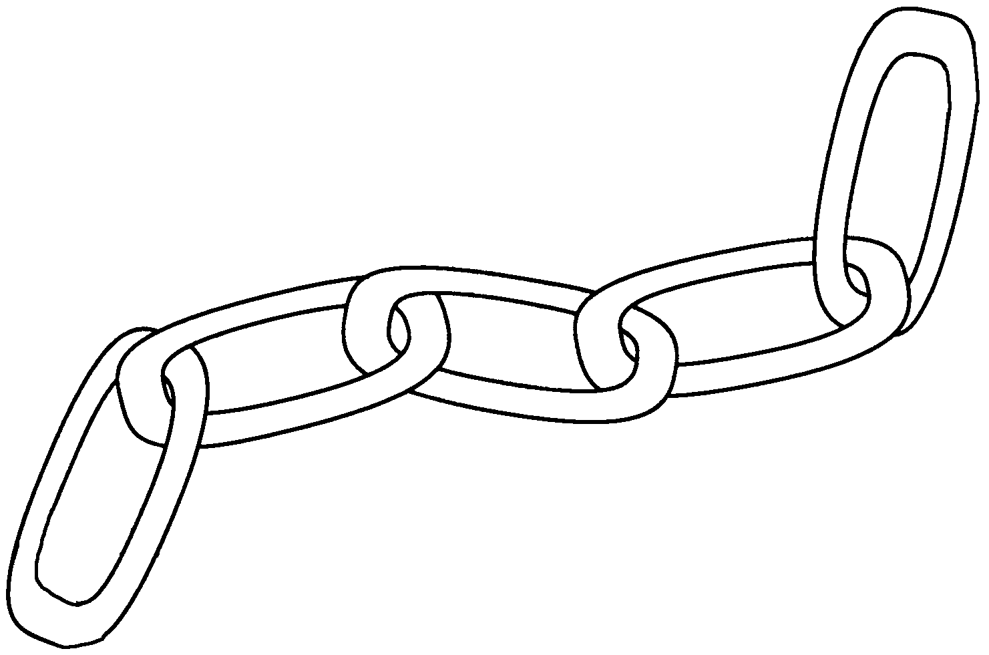
The LINCS Memory Chain
Definition
LINCing
Story
Image
Reminding
Word
Word
Using the LINCS devices transforms
a potentially weak link between a word and its definition into a chain of very strong links.

Slide 47
The LINCS Steps
List the parts (the term & definition)
Identify a Reminding Word
Note a LINCing Story
Create a LINCing Picture
Supervise practice/Self-test

Slide 48
Student Practice
Self-test forward
  Say the new word.
  Say the Reminding Word.
  Think of the LINCing Story.
  Think of the image.
  Say the meaning of the new word.
  Check to see whether you're correct.

Slide 49
Student Practice (cont.)
Self-test backward
  Say the meaning of the new word.
  Think of the image.
  Think of the LINCing Story.
  Think of the Reminding Word.
  Say the new word.
  Check to see whether you're correct.

Slide 50
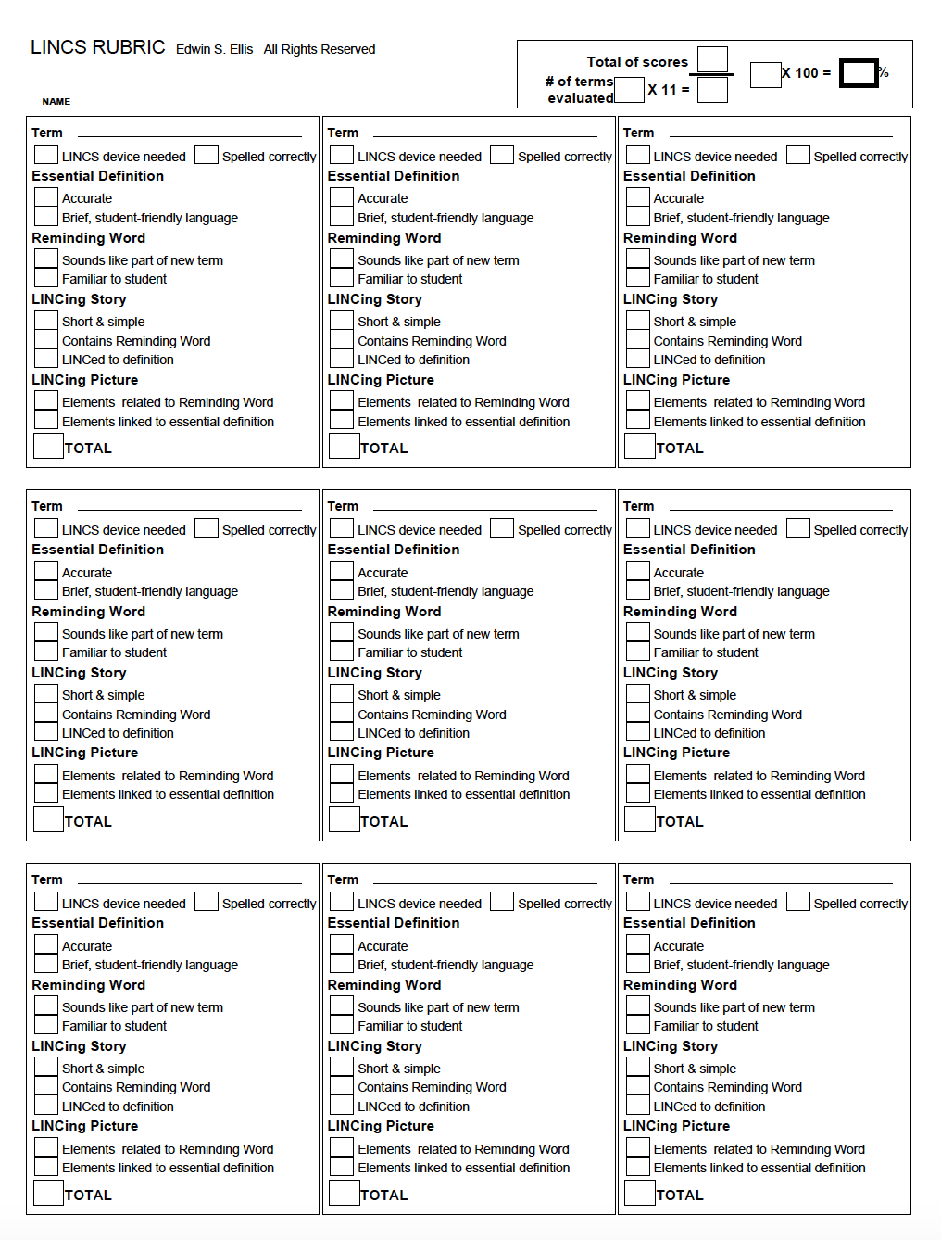
Mastery = 90% on 3 consecutive words

Slide 51
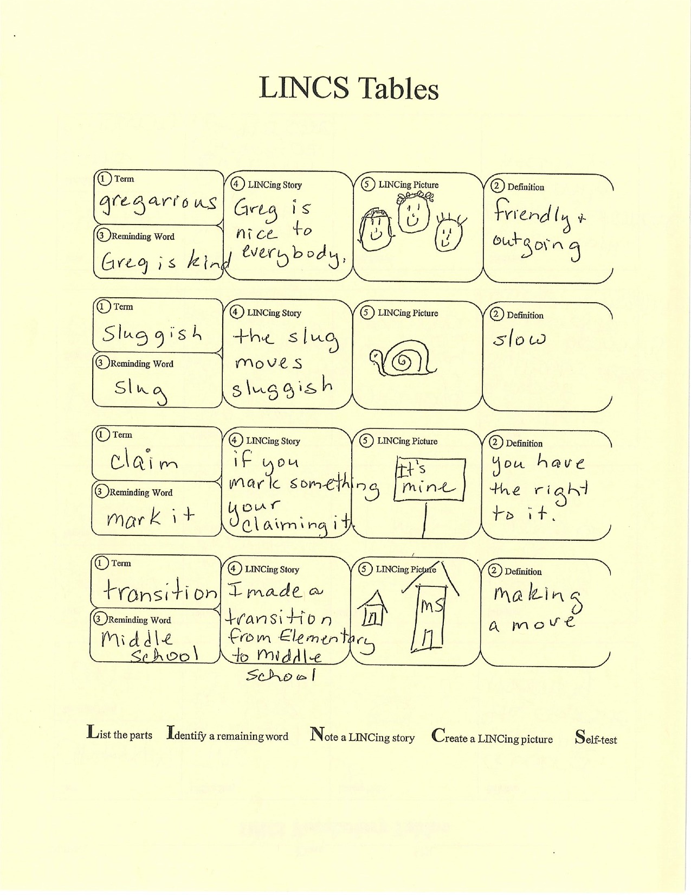
Let’s look at some LINCS Tables!
In small groups, please score these Tables

Slide 52
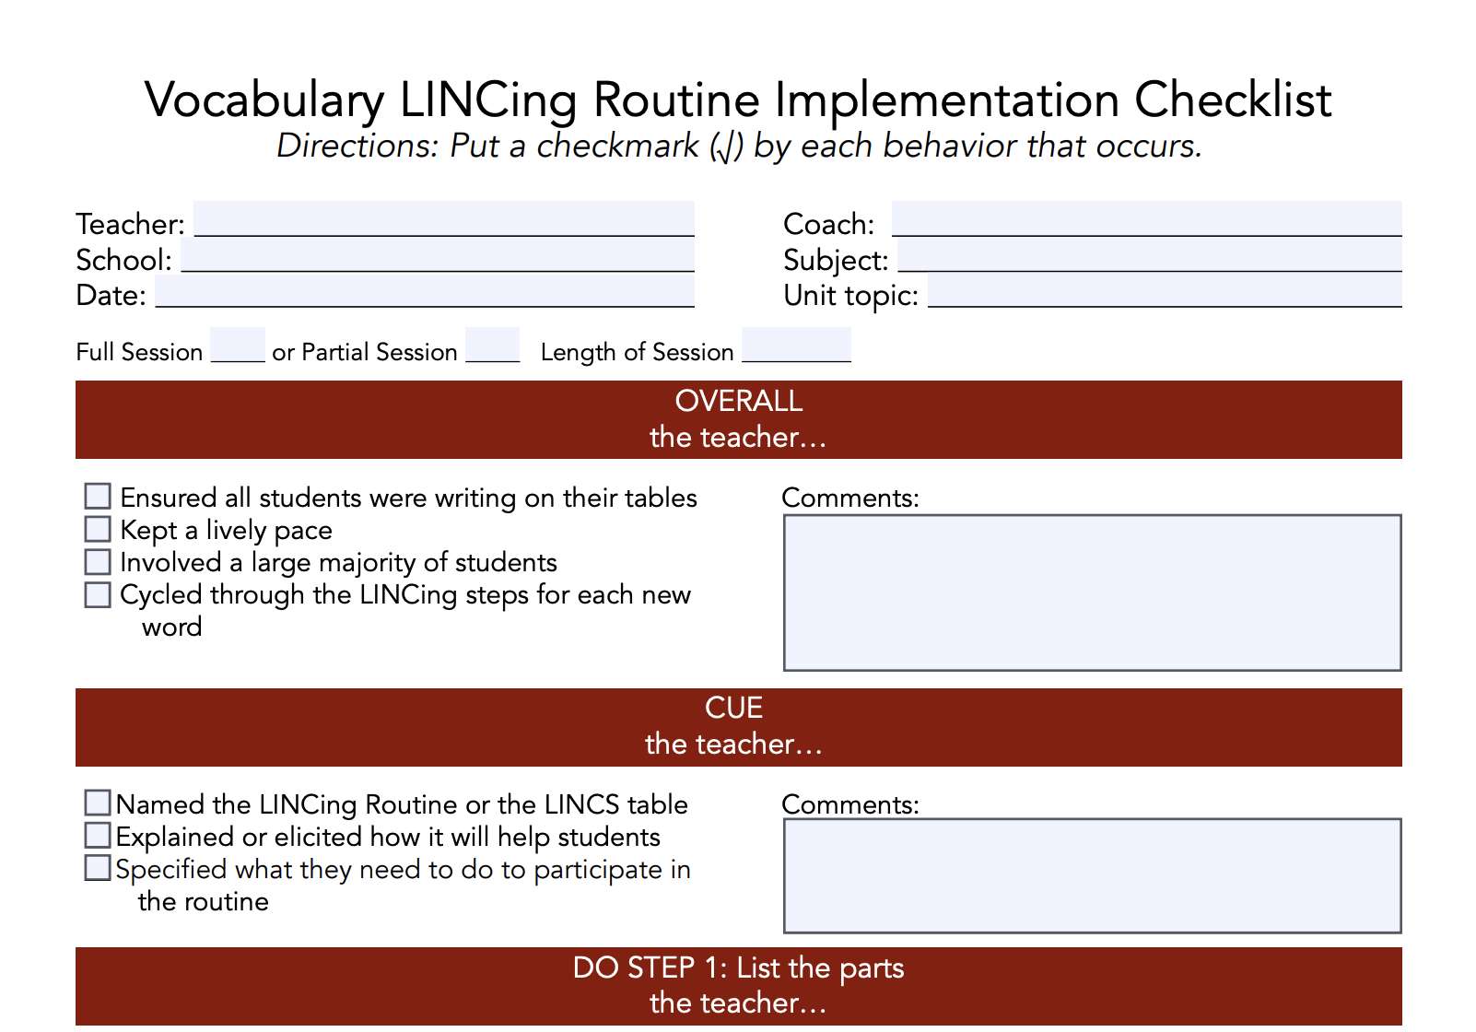
Checklist
Notes:
https://www.youtube.com/watch?v=G-vza_gfUK4

Slide 53
Video
Notes:
https://www.youtube.com/watch?v=G-vza_gfUK4

Slide 54
The LINCS Table
Term LINCing Story LINCing Picture Definition
Reminding Term
1
4
5
2
3
Term LINCing Story LINCing Picture Definition
Reminding Term
1
4
5
2
Let’s co-construct!
3
4
5
Term LINCing Story LINCing Picture Definition
Reminding Term
1
2
3
1
4
5
2
Term LINCing Story LINCing Picture Definition
Reminding Term
3
List the parts of the story Identify a reminding word Note a LINCing Story Create a LINCing picture Self-test

Slide 55
The LINCS Table
Term LINCing Story LINCing Picture Definition
Reminding Term
1
4
5
2
3
Term LINCing Story LINCing Picture Definition
Reminding Term
1
4
5
2
3
4
5
Term LINCing Story LINCing Picture Definition
Reminding Term
1
2
3
1
4
5
2
Term LINCing Story LINCing Picture Definition
Reminding Term
3
List the parts of the story Identify a reminding word Note a LINCing Story Create a LINCing picture Self-test

Slide 56
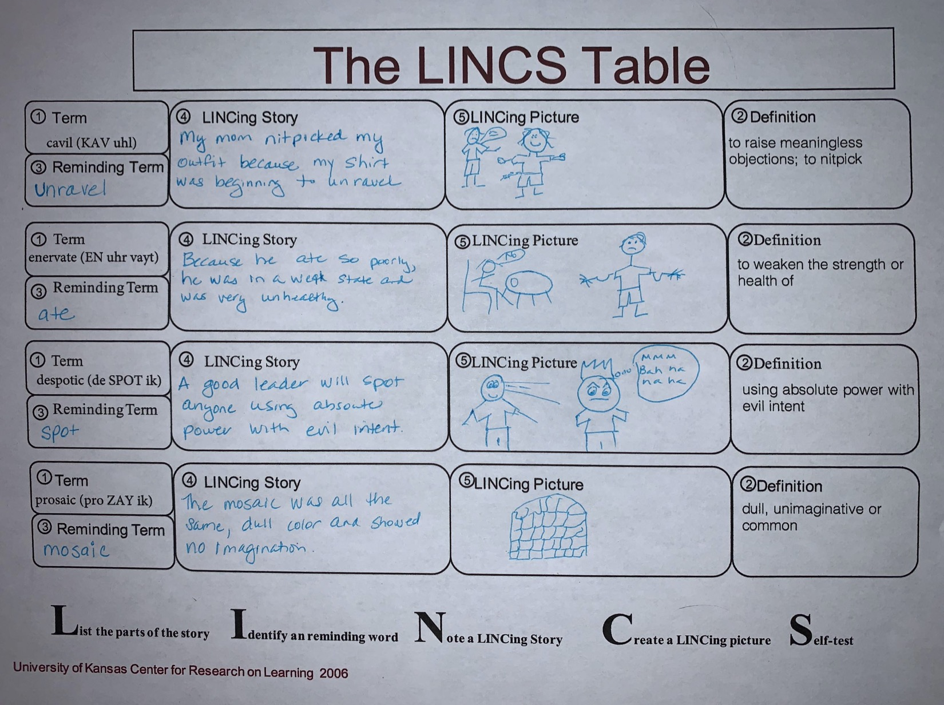
Draft

Slide 57
Device for EDU
groat: A British fourpence piece used from the 14th to 17th century
pityriasis: Skin diseases of humans and animals that result in shedding of flaky scales
suffrutescent: Having a woody stem or base
greenockite: A yellowish brown to red mineral
chlamydate: Having a mantle as in mollusks
affricate: A speech sound produced by stopping the breath and releasing it at articulation

Slide 59
Get Ready!
Decide when to use the LINCing Routine.
Collect materials and ideas.
Construct a draft of the LINCS Table.
Plan for the presentation.

Slide 60
Get Set!
Choose material.
Preview the lesson.
Introduce the LINCS Tables.
Explain and show how you will cue the routine.
Explain and show how you will do the routine.
Explain and show how you will review and debrief.

Slide 61
Go!
Use the routine explicitly.
Build thinking skills.
Build in continuity by referring to LINCS Tables.
Evaluate your use of the routine.
Teach students to construct their own LINCS Tables.
Vary your use of the routine.

Slide 62
Go!
The Instructional Sequence
We do It
Ya’ll do It (in small groups)
You do It (independently)

Slide 63
Go!
Vary your use of the Routine
Fame LINCS
Gotcha!
Bright ideas
Double-dip bonuses
Shareware LINCS
LINCS Portfolios
Student-LINCed-to-students

Slide 64
Students Win!
Check whether students are learning what they’re supposed to be learning.
Check whether students are personally satisfied with what and how they are learning.
Check whether students’ grades reflect how much they have learned.

Slide 65
You Win!
Select a growth target.
Choose a way to learn.
Choose a support system.
Plan for confidence building.
Debug.
Maximize the challenge.
Take ownership of the routine.

Slide 67
Assignments for EDU
Upload a Teacher Draft Table with at least 4 terms.
  You can use terms from your content area or terms on the next slide
  You can work with a partner or individually, but all participants must upload a Draft Device
Knowledge Check
  You can work with a partner or individually. This is OPEN notes… Feel free to use the PowerPoint (which I will drop in the chat box) and is in the LiveBinder
  Master is 80% or higher.

