Slide 1
Equations in two Variables
Device Adapted From Port Charlotte Middle School Team
MAFS.8.EE.2.5 Graph proportional relationships, interpreting the unit rate as the slope of the graph. Compare two different proportional relationships represented in different ways. For example, compare a distance-time graph to a distance-time equation to determine which of two moving objects has greater speed.
MAFS.8.EE.2.6 Use similar triangles to explain why the slope m is the same distance between two distinct points on a non-vertical line in the coordinate plane; derive the equation 𝑦𝑦=𝑚𝑚𝑚𝑚 for a line through the origin and the equation 𝑦=𝑚x+𝑏 for a line intercepting the vertical axis at b.
MAFS.8.EE.3.8 Analyze and solve pairs of simultaneous linear equations.
Understand that solutions to a system of two linear equations in two variables correspond to points of intersection of their graphs, because points of intersection satisfy both equations simultaneously.
Solve systems of two linear equations in two variables algebraically, and estimate solutions by graphing the equations. Solve simple cases by inspection. For example, 3𝑥+2𝑦=5 and 3𝑥+2𝑦=6 have no solution because 3𝑥+2𝑦 cannot simultaneously be 5 and 6.
Solve real-world and mathematical problems leading to two linear equations in two variables. For example, given coordinates for two pairs of points, determine whether the line through the first pair of points intersects the line through the second pair.

Slide 2
The Unit Organizer
4
BIGGER PICTURE
NAME
Equations
DATE
2
LAST UNIT
/Experience
CURRENT UNIT
3
NEXT UNIT
/Experience
1
CURRENT UNIT
Linear Equations
Equations in two variables
Functions
8
Vocabulary
5
UNIT MAP
is about...
by finding
determining if a functional relationship exists
by solving
slope
system of equations
slope-intercept form
1) How do I solve and represent solutions to systems of equations? 2) How do you determine if the relationship between two quantities is linear? 3) How do you determine if a relationship is proportional? 4) What are three ways you can find slope? 5) Describe the relationship between unit rate and slope? 6) If you had to define slope and y-intercept, what would you say?
6
UNIT SELF-TEST QUESTIONS
CHECK-IN
SELF
7

Slide 3
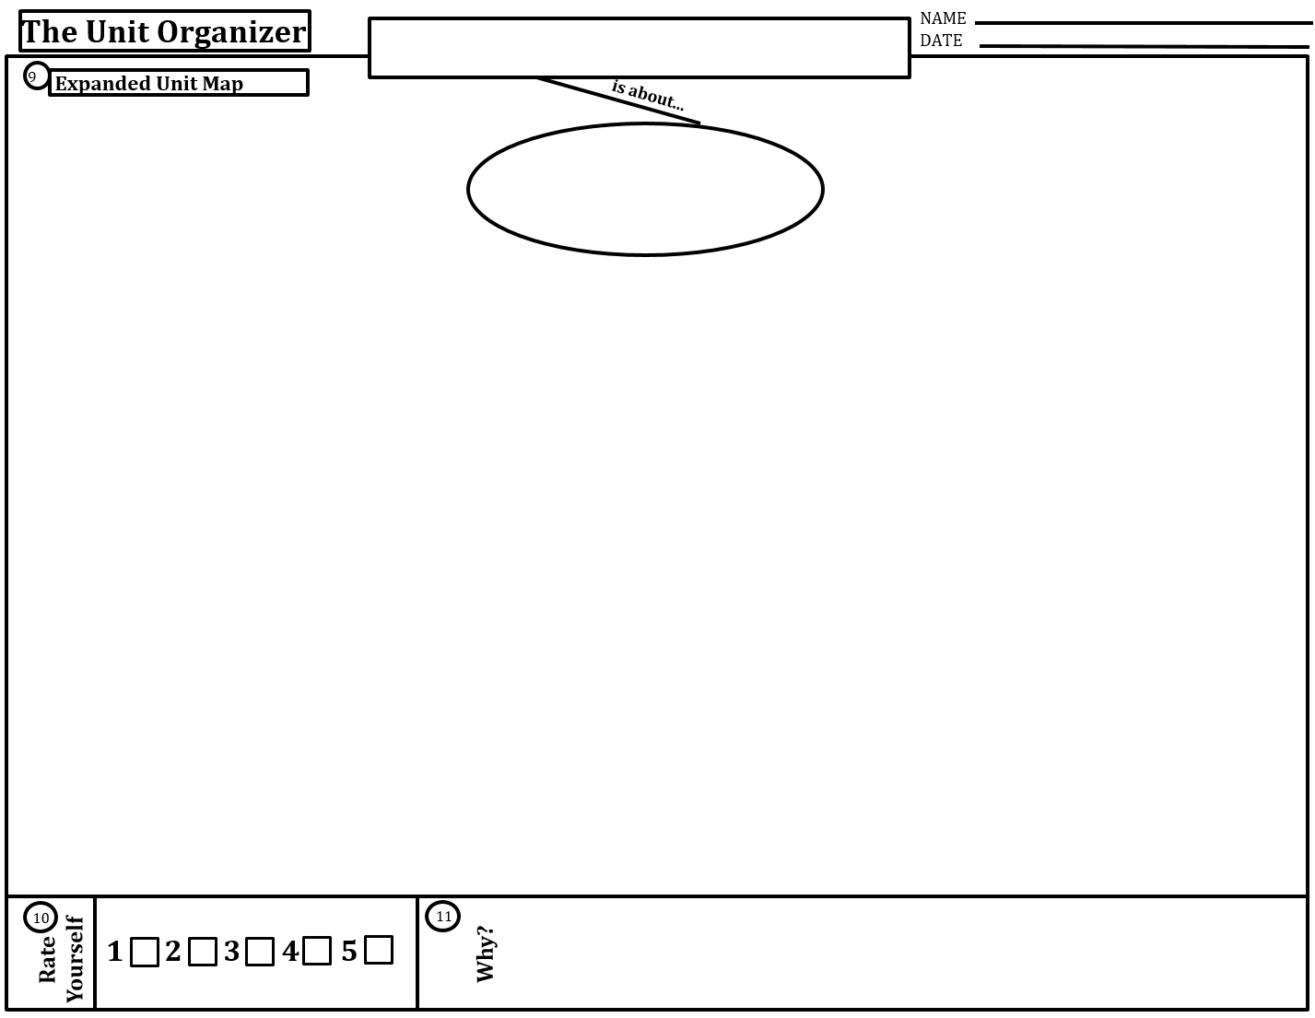




Equations in two variables
slope
(rate of change)
determining if a functional relationship exists
systems of
equations
by finding
by solving
By finding the
using the
Shared Point
Slope formula
$$m=\frac{y_{2}−y_{1}}{x_{2}−x_{1}}$$
which
is
With the equation
in a
using a
on a graph
using a
by using
graphically
algebraically
graph
knowing
$$\frac{rise}{run}$$
such as those on the
the solutions are
frame
slope-intercept form
- one solution
- no solution
- infinite solutions
table
knowing
$$\frac{change in y}{change in x}$$
$$y=mx+b$$
which includes
slope = m
y-intercept (0,b)
Word problem
looking for
per or each
represents
represents
change
start

Slide 4
The Unit Organizer
4
BIGGER PICTURE
NAME
DATE
2
LAST UNIT
/Experience
CURRENT UNIT
3
NEXT UNIT
/Experience
1
CURRENT UNIT
8
Vocabulary
5
UNIT MAP
is about...
1) How do I solve and represent solutions to systems of equations? 2) How do you determine if the relationship between two quantities is linear? 3) How do you determine if a relationship is proportional? 4) What are three ways you can find slope? 5) Describe the relationship between unit rate and slope? 6) If you had to define slope and y-intercept, what would you say?
6
UNIT SELF-TEST QUESTIONS
CHECK-IN
SELF
7

Slide 6




Equations in two variables
per or each
slope
(rate of change)
graph
algebraically
table
$$\frac{rise}{run}$$
systems of
equations
$$m=\frac{y_{2}−y_{1}}{x_{2}−x_{1}}$$
Slope formula
slope-intercept form
frame
$$y=mx+b$$
slope = m
- one solution
- no solution
- infinite solutions
Shared Point
Word problem
$$\frac{change in y}{change in x}$$
y-intercept (0,b)
graphically
start
change

