Slide 1
Examples of Recall Study Cards

Slide 2
Illustrations of Study Cards for Pairs of Items
"The Confederacy won the Battle of Bull Run."
front
What battle did
THE CONFEDERACY
win?

Slide 3
Illustrations of Study Cards for Pairs of Items
"The Confederacy won the Battle of Bull Run."
back
Who won
THE BATTLE OF BULL RUN?

Slide 4
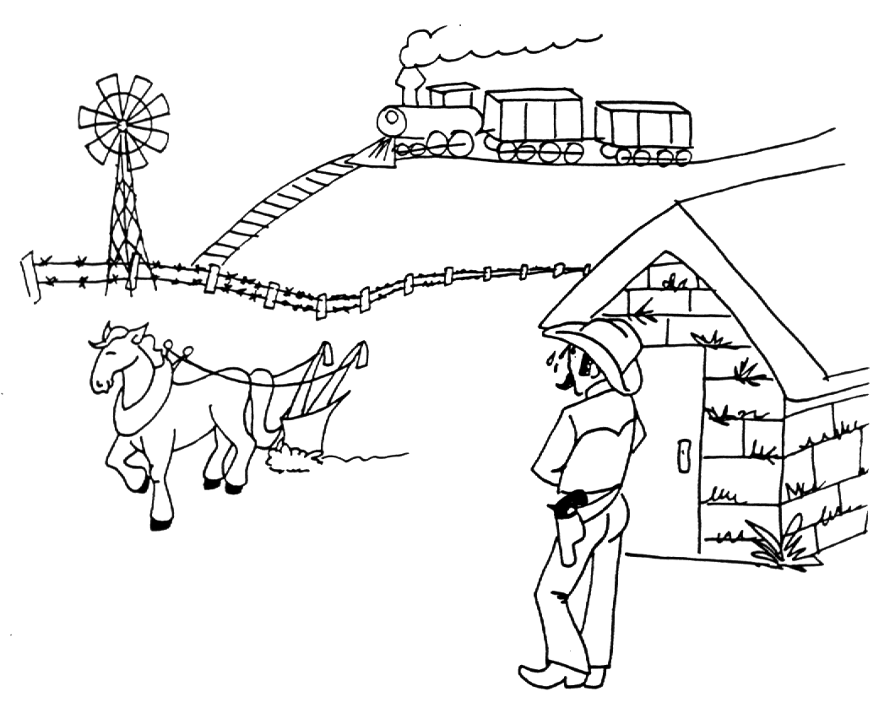
Illustrations of Study Cards for Lists of Items
"Six inventions that helped to settle the West were: the sod house, the six shooter, the windmill, the plow, the locomotive, and barbed wire.”
front
What
Six Inventions Helped Settle The West?

Slide 5
Illustrations of Study Cards for Lists of Items
"Six inventions that helped to settle the West were: the sod house, the six shooter, the windmill, the plow, the locomotive, and barbed wire.”
back
What are these?
Sod House
Six Shooter
Windmill
Plow
Locomotive
Barbed Wire

Slide 6
Illustrations of Study Cards for a Definition
"Greenockite is a yellow mineral in crystal form."
front
What is
GREENOCKITE?

Slide 7
Illustrations of Study Cards for a Definition
"Greenockite is a yellow mineral in crystal form."
back
What is the name of
A Yellow Mineral In Crystal Form?

