Slide 1
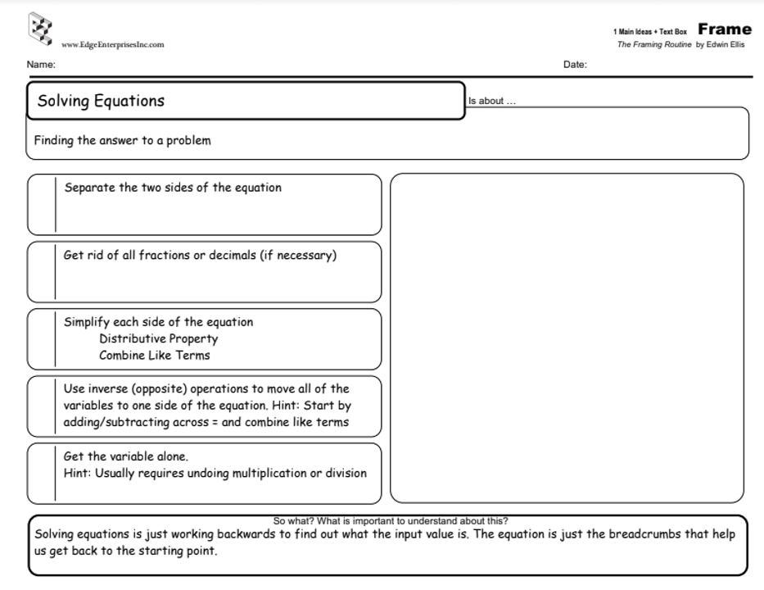
4n – 2n = 4
2n
= 4
2
2
n = 4

Slide 2





-3 (4r-8) = -36

Slide 3
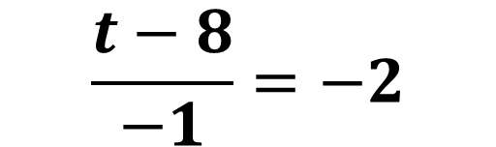



$$\frac{t−8}{−1}=−2$$

