Slide 1
Professional Developer’s Guide developed by Janis A. Bulgren
Teaching
Cross-Curricular Argumentation:
Overview of the
Guides, Cognitive Strategy & Instruction
2021
The University of Kansas
Center for Research on Learning
Lawrence, Kansas 66045
© J. Bulgren 2021
Notes:
Advance Organizer
The Unit Organizer Routine: Title Page

Slide 2
HOTR CADRE Questions
As you go through these slides and consider how you and other PDers will use them, consider:
When, where and how would you use these slides with teachers?
What activities would be useful to insert (and where)?
Provide feedback on the flow and sequence of the slides (and recommendations)

Slide 3
Cross-Curricular Argumentation Guide A
Name: | Date: | Class: | Topic:
1. Clarify the claim with any qualifier and define key terms.
2. List the evidence. | 3. Analyze the reasoning.
4. Identify other arguments for or against the claim.
5. Make a judgment about the quality of evidence, the reasoning, and other arguments.
6. State why you accept or reject the claim.

Slide 4
The Heart of
Teaching Cross-Curricular Argumentation: understanding arguments and argumentation
Argument: a claim backed by reasons that are supported by evidence
Argumentation: the process of making a claim, presenting evidence, and producing reasons why the evidence supports the acceptance of the claim
© J. Bulgren 2021

Slide 5
The Cross-Curricular Argumentation Routine contains three main components.
Two Visual Devices: Graphics/Guides
A Cognitive Reasoning Strategy
Instructional Procedures
© J. Bulgren 2021

Slide 6
Two
Cross-Curricular Argumentation Guides:
Guide A : Basic
Guide B: Basic with additional terms
© J. Bulgren 2021

Slide 7
Cross-Curricular Argumentation Guide A
Name: | Date: | Class: | Topic:
1. Clarify the claim with any qualifier and define key terms.
2. List the evidence. | 3. Analyze the reasoning.
4. Identify other arguments for or against the claim.
5. Make a judgment about the quality of evidence, the reasoning, and other arguments.
6. State why you accept or reject the claim.
Claim: A statement that something is true
Evidence: Information used to support the claim
© J. Bulgren 2021

Slide 8
Cross-Curricular Argumentation Guide A
Name: | Date: | Class: | Topic:
1. Clarify the claim with any qualifier and define key terms.
2. List the evidence. | 3. Analyze the reasoning.
4. Identify other arguments for or against the claim.
5. Make a judgment about the quality of evidence, the reasoning, and other arguments.
6. State why you accept or reject the claim.
Reasoning: The thinking process used to show how the evidence supports or proves the claim
Other arguments
© J. Bulgren 2021

Slide 9
Cross-Curricular Argumentation Guide A
Name: | Date: | Class: | Topic:
1. Clarify the claim with any qualifier and define key terms.
2. List the evidence. | 3. Analyze the reasoning.
4. Identify other arguments for or against the claim.
5. Make a judgment about the quality of evidence, the reasoning, and other arguments.
6. State why you accept or reject the claim.
Judgments: The process of forming decision through careful evaluation
Decision & Explanation
© J. Bulgren 2021

Slide 10
Example of a Cross-Curricular Argumentation Guide and Model
The Guide with a claim to analyze: The cyclic pattern of lunar phases can be observed and predicted.
Model for students to use: Model of the Sun-Earth-Moon system to use to develop the Guide.
© J. Bulgren 2021

Slide 11
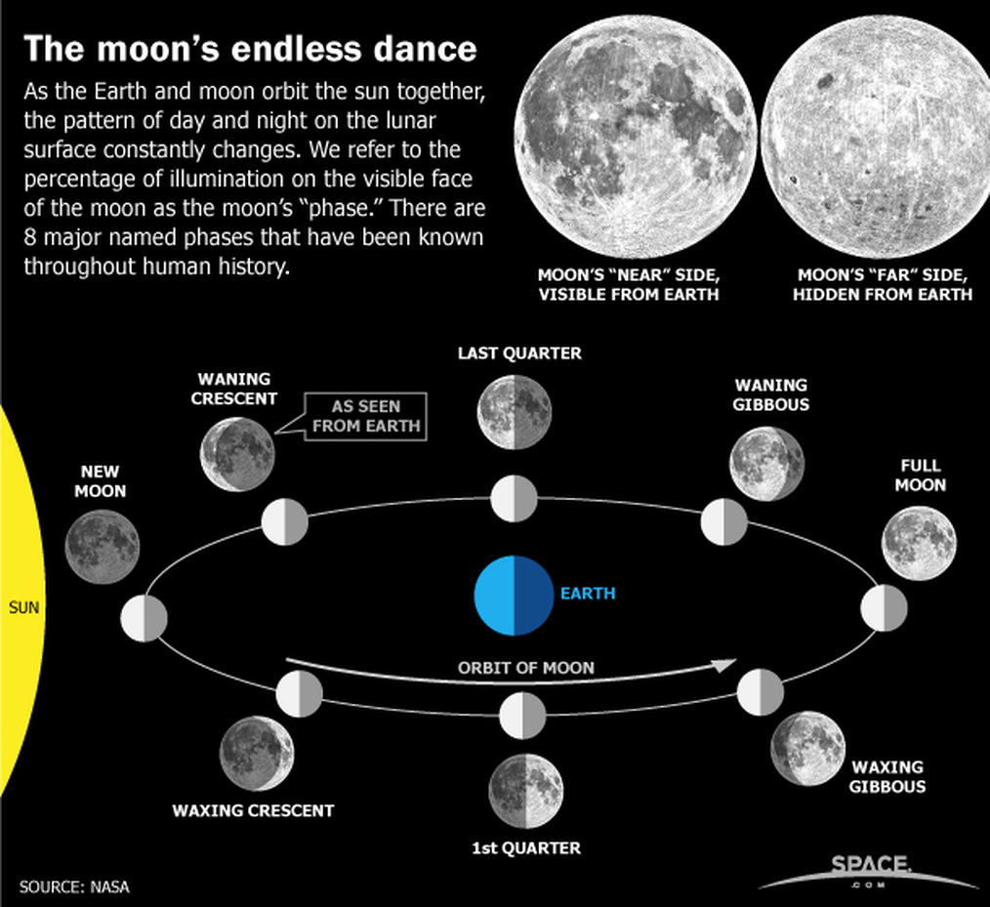
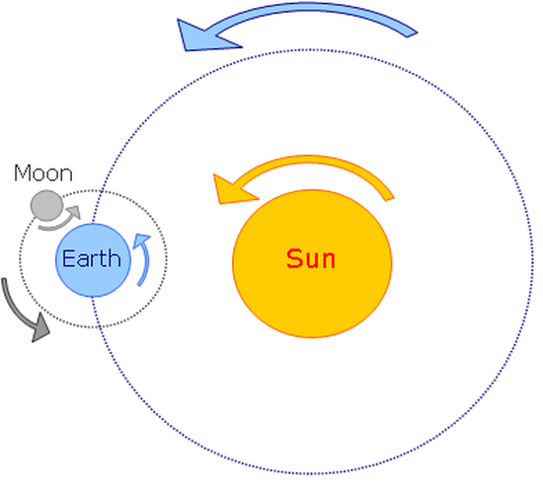
Use these models of the Sun-Earth-Moon system to respond to the claim on the previous slide “The cyclic pattern of lunar phases can be observed and predicted”.
As the Moon orbits around the Earth, the half of the moon that faces the sun is lit up. As a result, different shapes of the lit portion of the Moon that can be seen from the Earth each night.
Day 25
Day 21
Day 18
Day 0
Day 14
Model 1. Motion of the Earth-Moon-Sun System
Earth rotates (spins) on its axis in about 24 hours
Moon revolves (orbits) around the Earth in about 29.5 days
The Earth-Moon System revolves around the Sun.
Day 3
Day 11
Day 7
Model 2. Lunar Phases
© J. Bulgren 2021

Slide 12
Cross-Curricular Argumentation Guide A
Name: | Date: | Class: | Topic: Lunar phases (sample background on following slide)
1. Clarify the claim with any qualifier and define key terms. The cyclic pattern of lunar phases can be observed and predicted. cyclic pattern - a pattern that recurs at regular intervals lunar phases - the shapes of the directly sunlit portion of the Moon as viewed from Earth
2. List the evidence. The Earth rotates on its axis in approximately 24 hours. The Moon revolves around the Earth in approximately 29 days. During the Moon’s revolution around the Earth, light from the sun is reflected off the Moon’s surface. The portion of the Moon’s surface that is visible from Earth depends on the relative position of the Moon, the Earth, and the Sun. | 3. Analyze the reasoning. Since the Earth rotates on its axis in approximately 24 hours, there is the cyclic pattern of day and night. Since the Moon revolves around the Earth in approximately 29 days, the position of the Moon relative to the Earth and the Sun changes daily. Because the light from the sun reflects off the Moon, we can see the Moon’s shape which is a lunar phase. Since the position of the Moon relative to the Earth and the Sun changes daily, then the portion of the Moon visible from the Earth also changes daily; this results in a cyclic pattern of lunar phases.
4. Identify other arguments for or against the claim. I have observed different lunar phases when looking at the night sky. I can predict that I will see a full moon about once a month.
5. Make a judgment about the quality of evidence, the reasoning, and other arguments. The evidence presented is good because it is based on scientific facts and personal observation. The reasoning that ties the evidence to the claim is logical.
6. State why you accept or reject the claim. I accept this claim because the evidence is based on scientific facts, the reasoning is logical, and I have observed it myself.
© J. Bulgren 2021

Slide 13
Guide B contains the same basic steps as Guide A with additional prompts to support deeper analysis at each step.
© J. Bulgren 2021

Slide 14
Cross Curricular Argumentation Guide B
Name: | Date: | Class: | Topic: Masks prevent spread of a virus.
Clarify the claim with any qualifiers, key terms and citations (author, date, source). Community use of multi-layer cloth masks will prevent spread of a virus. The source is the CDC website from 11.10.2020 citing information from 42 scientific studies. CDC – Center for Disease Control and Prevention – a government agency asymptomatic or presymptomatic - infected people who feel well and may be unaware of their ability to infect others
2. List the evidence (fact/data, authority, theory, precedent). The CDC cited the following data from multiple scientific authorities: Data from 4 studies showed that multi-layer cloth masks block release of exhaled respiratory particles carrying a virus. Data from 2 studies showed that 50% of virus spread is due to asymptomatic or presymptomatic people. Data from 14 studies showed that up to 50% of virus particle can be filtered from inhaled air by an effective mask and 1 study showed that some masks materials repel droplets. | 3. Analyze the reasoning (cause-effect, correlation, generalization). Since studies show a cause-and-effect relationship between the quality of masks and effectiveness of blocking virus particles, everyone should use a multi-layer cloth mask at minimum to protect others. Since studies show a cause-and-effect relationship between virus spread and people who don’t have symptoms, we can generalize that everyone needs to wear a mask to protect others. Since studies show a cause-and-effect relationship between wearing a mask and the filtering or repelling of virus particles, we can generalize everyone need to wear a mask to protect themselves.
4. Identify other arguments for or against the claim (rebuttal, counterargument, corroboration). A study of an outbreak aboard the USS Theodore Roosevelt aircraft carrier where people work and live close together found that use of face coverings on-board was associated with a 70% reduced risk of getting a virus. This corroborates the claim.
5. Make judgments about the quality of evidence (relevant, accurate, adequate, objective), reasoning (type of logic), and other arguments. The evidence was excellent since the CDC cited data from multiple scientific authorities. The reasoning shows a cause-and-effect relationship between wearing an effective face mask and reducing the spread of an infection. Since this was true for the studies, we can generalize that mask wearing would protect the public from the spread of a virus. The USS Theodore Roosevelt case study provides corroboration for the claim.
6. State why you accept or reject the claim. Based on the excellent scientific evidence that shows a cause-and-effect relationship between mask wearing and preventing the spread of a virus, I accept this claim.

Slide 15
The Cognitive Reasoning Strategy: CLAIMS
Step 1: Clarify the claim with any qualifier and define key terms (including author, date, source, era).
Step 2: List the evidence (facts, data, authority, theory, precedent).
Step 3: Analyze the reasoning (cause-effect, correlation, generalization).
Step 4: Identify other arguments for or against the claim (rebuttal, counterargument, corroboration).
Step 5: Make a judgment about quality of evidence (accurate, adequate, objective, relevant), reasoning (type of reasoning), and other arguments.
Step 6: State why you accept or reject the claim.
Acronym: CLAIMS
© J. Bulgren 2021

Slide 16
Instructional Procedures:
The Cue-Do-Review Instructional Sequence
Cue - Introduces the Cross Curricular Guide and explains expectations for student participation.
Do - Teacher and class collaboratively construct the device using the Strategy steps cued by CLAIMS.
Review – Confirm
knowledge gained from using the Guide,
process and steps of using the guide, and
generalization of use of the strategy
© J. Bulgren 2021

