Slide 1
SC.912.L.16.14
Describe the cell cycle, including the process of mitosis. Explain the role of mitosis in the formation of new cells and its importance in maintaining chromosome number during asexual reproduction.
Clarifications:
Students will describe specific events occurring in each of the stages of the cell cycle and/or phases of mitosis.
Students will explain how mitosis forms new cells and its role in maintaining chromosome number during asexual reproduction.

Slide 2
The FRAME Routine
Key Topic
Mitosis
is about…
Step
Description
Interphase
Prophase
Metaphase
Anaphase
Telophase
Cytokinesis
So What? (What’s important to know about this?)

Slide 3
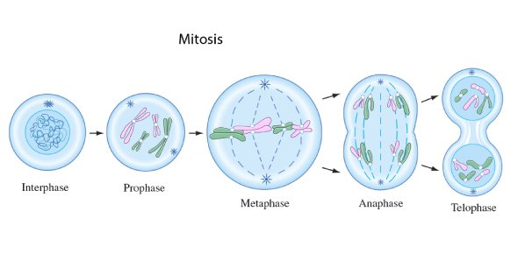
Extend Understanding
Directions: Label the diagram below by drawing a line to the structure within the cell and label using the letters in the key below. Some terms will be used multiple times. See the example below.
Key: A = DNA, B = nucleus, C = centriole, D = chromosomes, E = spindle fibers, F = chromatids, G = nuclear membrane
A

Slide 4
The FRAME Routine
Key Topic
Mitosis
is about…
how cells in our body go through reproduction to make new cells that are exactly like the old cells.
Step
Description
1
Interphase
Cell gets ready to start dividing, DNA makes a copy of itself so there is enough for the 2 new cells that will be created when the old cell divides
2
Prophase
Strands of DNA called chromatin compact or coil up to form chromosomes
Membrane around the nucleus dissolves
3
Metaphase
Chromosomes line up in the middle of the cell
4
Anaphase
Chromosomes are pulled apart into individual chromatids
Sister chromatids (halves of the same chromosome) are pulled to opposite ends of the cell
5
Telophase
Membrane s forms around each group of chromatids making 2 nucleii
Chromosomes unwind into chromatin
So What? (What’s important to know about this?)
Our body’s cell have to go through mitosis for our hair and nails to grow, for cuts in our skin to heal, and for our body to work properly. If something goes wrong in mitosis, it can lead to problems like cancer.

