Slide 1
SC.912.L.17.2 Explain the general distribution of life in aquatic systems as a function of chemistry, geography, light, depth, salinity, and temperature.
Clarification :
Students will explain that different types of organisms exist within aquatic systems due to chemistry, geography, light, depth, salinity, and/or temperature.
Content Limits : Items referring to chemical factors in aquatic systems are limited to pH, oxygen, carbon dioxide, nitrogen, phosphorous, and salinity.
Items referring to geography in aquatic systems are limited to water depth, latitude, temperature, underwater topography, and proximity to land.
Items will not require the identification of oceanic zones.

Slide 2
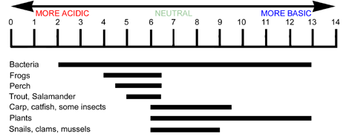
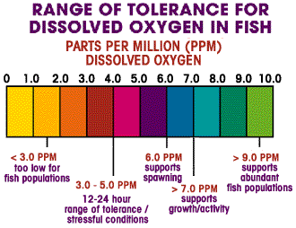
The FRAME Routine
Key Topic
Chemical Factors
is about…
Main idea
Main idea
Main idea
Main idea
Main idea
Phosphorus
Main idea
Salinity
So What? (What’s important to understand about this?)

Slide 3
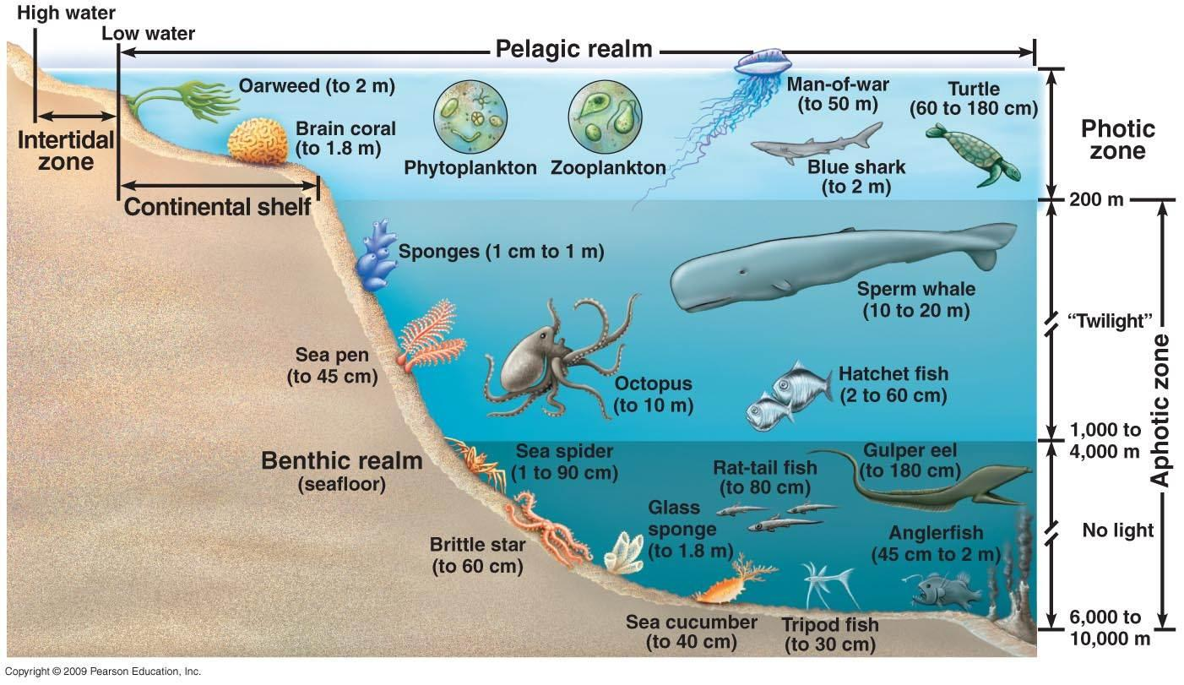
The FRAME Routine
Key Topic
Physical Factors
is about…
Main idea
Main idea
Main idea
Main idea
Main idea
So What? (What’s important to understand about this?)

Slide 4
Extend Understanding
Answer these follow up questions:
Which factors may contribute to high biodiversity?
Which factors may contribute to a decrease in biodiversity?
Explain which factors can influence the carrying capacity of a population.
Are all of these limiting factors? Explain.
OR
Research the chemical and physical factors required for an aquatic species of your choosing. Be sure to discuss all factors present on these frames.

Slide 5
The FRAME Routine
Key Topic
Chemical Factors
is about…
how various abiotic factors affect the distribution of life in aquatic systems
Main idea
pH
Main idea
Oxygen
Main idea
Carbon Dioxide
1. Carbon dioxide reacts with water to form a weak acid called carbonic acid
2. Impact of the pH of water
3. Ocean Acidification can damage coral reefs
Dissolved Oxygen
Main idea
Nitrogen
Main idea
Phosphorus
Main idea
Salinity
1. Source= runoff of fertilizers, detergents, animal waste, and sewage
2. Required for plant growth
3. Too much can cause artificial Eutrophication
1. Source= runoff of fertilizers, detergents, animal waste, and sewage
2. Required for plant growth
3. Too much can cause artificial Eutrophication
1. measure of the amount of salt in dissolved water
2. Oceans have a salinity of 35 ppt
3. Fresh water (lakes, rivers) 0.5 ppt
4. Brackish (estuary like Tampa Bay) 0.5 – 30 ppt
So What? (What’s important to understand about this?)
Each aquatic species (plants and animals) have specific requirements for pH, Oxygen, carbon dioxide, nitrogen, phosphorus, and salinity that must be maintained in order to live and reproduce. Humans can impact these values!

Slide 6
The FRAME Routine
Key Topic
Physical Factors
is about…
how various abiotic factors affect the distribution of life in aquatic systems
Main idea
Temperature
Main idea
Latitude
Main idea
Water Depth
1. Affects amount of gasses dissolved in water
2. Colder=more gasses (oxygen/carbon dioxide)
3. As oceans get warmer: Can’t hold as much oxygen they release Carbon dioxide into the atmosphere
Areas closest to the equator Receive greatest amount of sunlight
warmer
High biodiversity
Photic zone=depth of sunlight penetrating water
(Higher biodiversity closer to the surface)
2. Pressure increases with depth
Main idea
Underwater Topography
Main idea
Proximity to Land
1. Can impact ocean currents
2. Can impact availability of nutrients (upwelling)
3. Can impact temperature (deep sea thermal vents)
1.Rivers move materials from land to water
Nutrients, Sediment, & pollution
2.Human activities are concentrated closest to land
So What? (What’s important to understand about this?)
Aquatic species (plants and animals) live in different locations in the world and within bodies of water due to factors like water temperature, available sunlight, proximity to land, underwater topography, latitude, etc.

