Slide 1
Professional Developer’s Guide developed by Janis A. Bulgren
Teaching
Cross-Curricular Argumentation
Lawrence, Kansas 66045
2021
Notes:
Advance Organizer
The Unit Organizer Routine: Title Page

Slide 2
Cross-Curricular Argumentation Guide A
Name: | Date: | Class: | Topic:
1. Clarify the claim with any qualifier and define key terms.
2. List the evidence. | 3. Analyze the reasoning.
4. Identify other arguments for or against the claim.
5. Make a judgment about the quality of evidence, the reasoning, and other arguments.
6. State why you sthe claim.

Slide 3
Chapter 1: Introduction - p. 4
Content Enhancement Routines:
principles and introduction
Higher Order Thinking Routines
The Cross-Curricular Argumentation Routine

Slide 4
Content Enhancement Routines Principles
A way of teaching an academically diverse group of students in which:
Both group and individual needs are valued and met
The integrity of the content is maintained
Critical features of the content are selected and transformed in a manner that promotes student learning
Instruction is carried out in a partnership with students

Slide 5
Cross-Curricular Argumentation
The
Cross-Curricular Argumentation Routine (CCAR) is one of the
Higher Order Thinking and Reasoning
Routines
within the Content Enhancement the Routines.

Slide 6
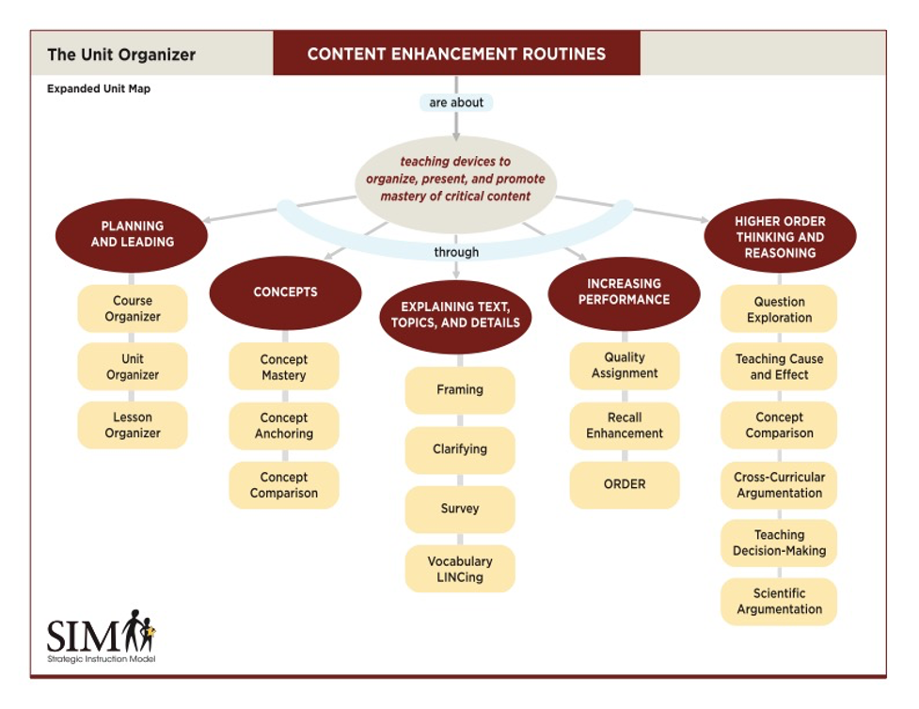
Content Enhancement Routines

Slide 7
Purpose of
Cross-Curricular Argumentation
The Cross-Curricular Argumentation Routine is designed to enhance students’ abilities to identify, analyze and evaluate:
claims
evidence
reasoning
other arguments
judgments about evidence, reasoning, arguments, and
come to a decision and explain it.

Slide 8
Rationales & Needs Based on Standards and Diversity
Standards: In addition to the importance of organization and facts as necessary foundations for learning, standards require students to focus on higher order thinking and reasoning.
Diversity: Students with a wide range of achievement and ability levels are taught in inclusive content area classes and require instructional procedures responsive to diverse needs of all students.

Slide 9
Chapter 2: The CCAR Guide - p. 6
An overview of the graphic organizers (the Cross-Curricular Argumentation Guides A and B)
Detailed descriptions of six parts of the guide with definitions and suggestions
Information about what you should think about or do prior to using a guide in your class

Slide 10
Two
Cross-Curricular Argumentation Guides:
Guide A : Basic
Guide B: Basic with additional terms

Slide 11
Cross-Curricular Argumentation Guide A
Name: | Date: | Class: | Topic:
1. Clarify the claim with any qualifier and define key terms.
2. List the evidence. | 3. Analyze the reasoning.
4. Identify other arguments for or against the claim.
5. Make a judgment about the quality of evidence, the reasoning, and other arguments.
6. State why you accept or reject the claim.
Name: | Date: | Class: | Topic:

Slide 12
Cross-Curricular Argumentation Guide B
Name: | Date: | Class: | Topic:
1. Clarify the claim with any qualifier and key terms (including author, date, source, era).
2. List the evidence (facts, data, authority, theory, precedent). | 3. Analyze the reasoning (cause-effect, correlation, generalization).
4. Identify other arguments for or against the claim (rebuttal, counterargument, corroboration).
5. Make a judgment about quality of evidence (accurate, adequate, objective, relevant), reasoning, (type of reasoning), and other arguments.
6. State why you accept or reject the claim.

Slide 13
The Heart of
Teaching Cross-Curricular Argumentation: Understanding Arguments and Argumentation
Argument: a claim backed by reasons that are supported by evidence
Argumentation: the process of making a claim, presenting evidence, and producing reasons why the evidence supports the acceptance of the claim

Slide 14
Cross-Curricular Argumentation Guide A
Name: | Date: | Class: | Topic:
1. Clarify the claim with any qualifier and define key terms.
2. List the evidence. | 3. Analyze the reasoning.
4. Identify other arguments for or against the claim.
5. Make a judgment about the quality of evidence, the reasoning, and other arguments.
6. State why you accept or reject the claim.
Claim: A statement that something is true

Slide 15
Cross-Curricular Argumentation Guide B
Name: | Date: | Class: | Topic:
1. Clarify the claim with any qualifier and key terms (including author, date, source, era).
2. List the evidence (facts, data, authority, theory, precedent). | 3. Analyze the reasoning (cause-effect, correlation, generalization).
4. Identify other arguments for or against the claim (rebuttal, counterargument, corroboration).
5. Make a judgment about quality of evidence (accurate, adequate, objective, relevant), reasoning, (type of reasoning), and other arguments.
6. State why you accept or reject the claim.
Guide B: Also includes
Author: the person or group making the claim
Date: when the claim was originally made or printed
Source: where the claim was found (e.g., a student report, a lecture, a research study, online information, verbal presentation, or other source)
Era: distinct period of history

Slide 16
Cross-Curricular Argumentation Guide A
Name: | Date: | Class: | Topic:
1. Clarify the claim with any qualifier and define key terms.
2. List the evidence. | 3. Analyze the reasoning.
4. Identify other arguments for or against the claim.
5. Make a judgment about the quality of evidence, the reasoning, and other arguments.
6. State why you accept or reject the claim.
Evidence: Information used to support the claim

Slide 17
Cross-Curricular Argumentation Guide B
Name: | Date: | Class: | Topic:
1. Clarify the claim with any qualifier and key terms (including author, date, source, era).
2. List the evidence (facts, data, authority, theory, precedent). | 3. Analyze the reasoning (cause-effect, correlation, generalization).
4. Identify other arguments for or against the claim (rebuttal, counterargument, corroboration).
5. Make a judgment about quality of evidence (accurate, adequate, objective, relevant), reasoning, (type of reasoning), and other arguments.
6. State why you accept or reject the claim.
Guide B: includes facts, data, authority, precedent
Facts: things that are known, observable, or proven to be true by research
Data: information usually in the form of numbers or statistics
Authority: individuals or groups with a high level of knowledge in a field
Theory: formal ideas that are intended to explain something
Precedent: laws, rules, customs, or other guidelines that are set up by social institutions to govern behavior

Slide 18
Cross-Curricular Argumentation Guide A
Name: | Date: | Class: | Topic:
1. Clarify the claim with any qualifier and define key terms.
2. List the evidence. | 3. Analyze the reasoning.
4. Identify other arguments for or against the claim.
5. Make a judgment about the quality of evidence, the reasoning, and other arguments.
6. State why you accept or reject the claim.
Reasoning: The thinking process used to show how the evidence supports the claim

Slide 19
Cross-Curricular Argumentation Guide B
Name: | Date: | Class: | Topic:
1. Clarify the claim with any qualifier and key terms (including author, date, source, era).
2. List the evidence (facts, data, authority, theory, precedent). | 3. Analyze the reasoning (cause-effect, correlation, generalization).
4. Identify other arguments for or against the claim (rebuttal, counterargument, corroboration).
5. Make a judgment about quality of evidence (accurate, adequate, objective, relevant), reasoning, (type of reasoning), and other arguments.
6. State why you accept or reject the claim.
Guide B: Reasoning: Cause-effect, correlation, generalization
Cause-effect: a relationship in which one thing is responsible for another happening or that provides support for or proof of a claim
Correlation: a relationship exists that cannot be due to chance alone, but cause and effect cannot be established
Generalization: a statement that if something is true for one situation, then it is likely to be true for a similar situation

Slide 20
Cross-Curricular Argumentation Guide A
Name: | Date: | Class: | Topic:
1. Clarify the claim with any qualifier and define key terms.
2. List the evidence. | 3. Analyze the reasoning.
4. Identify other arguments for or against the claim.
5. Make a judgment about the quality of evidence, the reasoning, and other arguments.
6. State why you accept or reject the claim.
Other arguments

Slide 21
Cross-Curricular Argumentation Guide B
Name: | Date: | Class: | Topic:
Guide B: Other Arguments
Rebuttal: a statement that a claim is wrong and why it is wrong
Counterargument: a statement based on evidence that supports a different claim
Corroboration: evidence that confirms or supports the original claim
1. Clarify the claim with any qualifier and key terms (including author, date, source, era).
2. List the evidence (facts, data, authority, theory, precedent). | 3. Analyze the reasoning (cause-effect, correlation, generalization).
4. Identify other arguments for or against the claim (rebuttal, counterargument, corroboration).
5. Make a judgment about quality of evidence (accurate, adequate, objective, relevant), reasoning, (type of reasoning), and other arguments.
6. State why you accept or reject the claim.

Slide 22
Cross-Curricular Argumentation Guide A
Name: | Date: | Class: | Topic:
1. Clarify the claim with any qualifier and define key terms.
2. List the evidence. | 3. Analyze the reasoning.
4. Identify other arguments for or against the claim.
5. Make a judgment about the quality of evidence, the reasoning, and other arguments.
6. State why you accept or reject the claim.
Judgments: The process of forming decision through careful evaluation

Slide 23
Cross-Curricular Argumentation Guide B
Name: | Date: | Class: | Topic:
2. List the evidence (facts, data, authority, theory, precedent).
4. Identify other arguments for or against the claim (rebuttal, counterargument, corroboration).
5. Make a judgment about quality of evidence (accurate, adequate, objective, relevant), reasoning, (type of reasoning), and other arguments.
6. State why you accept or reject the claim.
Judgments:
Quality of evidence (accurate, adequate, objective, relevant)
Reasoning (type of reasoning)
and Other Arguments

Slide 24
Cross-Curricular Argumentation Guide A
Name: | Date: | Class: | Topic:
1. Clarify the claim with any qualifier and define key terms.
2. List the evidence. | 3. Analyze the reasoning.
4. Identify other arguments for or against the claim.
5. Make a judgment about the quality of evidence, the reasoning, and other arguments.
6. State why you accept or reject the claim.
Decision

Slide 25
Cross-Curricular Argumentation Guide B
Name: | Date: | Class: | Topic:
1. Clarify the claim with any qualifier and key terms (including author, date, source, era).
2. List the evidence (facts, data, authority, theory, precedent). | 3. Analyze the reasoning (cause-effect, correlation, generalization).
4. Identify other arguments for or against the claim (rebuttal, counterargument, corroboration).
5. Make a judgment about quality of evidence (accurate, adequate, objective, relevant), reasoning, (type of reasoning), and other arguments.
6. State why you accept or reject the claim.
Guide B:
State whether to accept or reject the claim.
Explain your decision.

Slide 26
The Embedded Strategy: CLAIMS
Step 1: Clarify the claim with any qualifier and define key terms (including author, date, source, era).
Step 2: List the evidence (facts, data, authority, theory, precedent).
Step 3: Analyze the reasoning (cause-effect, correlation, generalization).
Step 4: Identify other arguments for or against the claim (rebuttal, counterargument, corroboration).
Step 5: Make a judgment about quality of evidence (accurate, adequate, objective, relevant), reasoning (type of reasoning), and other arguments.
Step 6: State why you accept or reject the claim.
Acronym: CLAIMS

Slide 27
Chapter 3: Using the
Cross-Curricular Argumentation Routine
with Students - p.11

Slide 28
Cue-Do-Review Instructional Sequence
Cue - Introduces the Cross Curricular Guide and explains expectations for student participation.
Do - Teacher and class collaboratively construct the device using the Linking Steps and the strategy steps cued by CLAIMS.
Review – Confirm knowledge gained from using the Guide, the process and steps of using the guide, and generalization of use of the strategy are confirmed.

Slide 29
Cue-Do-Review Instructional Sequence incorporating CLAIMS
CUE
Upon every subsequent use of the routine:
give all students a blank copy of the guide and prompt them to take notes on it,
provide an overview of the strategic steps found in each section of the guide,
explain the importance of the topic or issue, and
explain the importance of engaging in higher order thinking and reasoning associated with analyzing an argument.
DO
Clarify the claim and qualifier and define key terms.
List the evidence.
Analyze the reasoning.
Identify other arguments for or against the claim.
Make judgments about the quality of evidence, reasoning, and other arguments.
State why you accept or reject the claim.
REVIEW
Review content knowledge of guide.
Review process of learning.
Discuss generalization of the argumentation process to other areas

Slide 30
Cue – p. 11
The teacher introduces the Cross Curricular Argumentation Guide and explains expectations for student participation.

Slide 31
DO - p. 11
Teacher and students collaboratively construct the guide using the Linking Steps and the strategy steps cued by CLAIMS.

Slide 32
Step 1: Clarify the claim with any qualifier and define key terms - p. 11
A CLAIM focuses on
Understanding the claim
Identifying and underlining qualifiers
Providing adequate background knowledge of key terms
(if Guide B is selected, guidance on identifying author, data, source, era)

Slide 33
Where possible,
tie evidence to everyday usage:
“It’s going to rain this afternoon.”
(probably not important enough to explore)
“We need to buy solar panels today.”
(worth exploring pros and cons first
“Most people don’t believe in climate change so our
regulatory board doesn’t need to do anything.”
(worth exploring esp. for a regulatory board)

Slide 34
Step 2: List the evidence - p. 12
Evidence focuses on
Identifying evidence
Clearly re-stating evidence in short accurate statements
(if Guide B is selected, guidance on identifying facts, data, authority, theory, precedent)

Slide 35
Where possible,
tie evidence to everyday usage:
“I want to hear more details about your lab results”
(request for evidence as facts or data)
“Do many experts agree with what you said?”
(request for authority)
“I think we should plan the program the same way as
we always have.”
(reference to precedent)

Slide 36
Step 3: Analyze the reasoning - p. 13
Reasoning focuses on
Understanding how the author used the evidence to support or prove the claim
Explaining that connection in the students’ own words
(if Guide B is selected, guide students on identifying the author’s reasoning by cause-effect, correlation or generalization)

Slide 37
Where possible,
connect reasoning to everyday usage.
Explain that authors do not always (often) name the type of reasoning they use (reasoning is implicit).
Prompt student to ask: “Can the author’s reasoning be re-stated by completing one of the following sentence patterns that suggest cause-and-effect, correlation, or generalization”:
“As a result of …, the author reasons that …”
“Since …, then …”
“Because …, therefore …

Slide 38
Step 4: Identify other arguments for or against the claim p. 14
Other Arguments
Step 4 focuses on
presenting other arguments that may weaken or strengthen
Identifying source of other arguments, e.g., author’s reasoning or other outside sources
(if Guide B is selected, guide student students on identifying rebuttals, counterarguments, & corroboration.)

Slide 39
Where possible, connect arguments to everyday usage
Remind students that they often respond to claims everyday:
“That’s just wrong because the numbers prove the opposite.” Rebuttal
“Well, I think we could come to a different conclusion based on the information you provided.” Counterargument
“I totally agree with you because I saw the same thing.” Corroboration

Slide 40
Construct a Draft of the QEG Step 5: Make judgments about quality of evidence, reasoning and other arguments - p. 14
Judge evidence (if Guide B is selected, guide students on if claim is accurate adequate, objective, reliable)
Judge logic of reasoning (If Guide B is selected, guide students on logic of cause-effect, correlation, generalization)
Judge other arguments (If Guide B is selected, review counterarguments, arguments, corroboration)

Slide 41
Step 6: State why you accept or reject the claim - p. 15
Step 6 focuses on
A decision: Does student accept or reject the claim?
An explanation for the decision: Why? (based on the quality of the claim, evidence, reasoning and other arguments)

Slide 42
Review – p.16
REVIEW:
Knowledge of the Content gained from using the Guide,
Process and Steps of the guide, and
Generalization of use to other content and the real world

Slide 43
Appendix C- Instructional Supports for
Instruction and Implementation
Steps for Guide A Cue Card – p. 43
Steps for Guide Cue Card - p. 44
Definitions List for Guide A - p. 45
Definition List for Guide B - p. 46
Teacher Implementation Cue Card – p. 47

Slide 44
As you continue to use the
Cross-Curricular Argumentation Routine:
Always be flexible
Support use of additional strategies
Collaborate with teachers in co-taught classes
Share with teachers in other content areas
Encourage transfer and generalization to other classes and the real world
Vary groups structures
Encourage collaboration

Slide 45
Plan Integration of Cross-Curricular Argumentation
including on a Course, Unit, or Lesson Organizer.
by referring to recall or fact-gathering strategies
by reinforcing use of common components such as Key Terms and definitions across the routines
emphasizing patterns of thinking across and within routines

Slide 46
Emphasize thinking and reasoning across content areas
analysis, comparison, discrimination, points of view, causation, problem solving, evaluation, generalization, explanation, judgment, decision-making, synthesis

Slide 47
Chapter 4: Evaluating Student Learning p.18
Evaluate knowledge of the CLAIMS Strategy
Ask students to write the steps of the strategy from memory.
Assign Cross-Curricular Argumentation Checklist as self-check
Use scaffolded assessments
Argumentation Stem Prompts
Short Answer Test
Evaluate use of the CCAR Guide to write an essay
Steps in writing the essay
Sample essay

Slide 48
Appendix D –Supports for Chapter 4
Checklist – p. 49
Test with Stem Prompts - p.50
Test with questions only – p. 51
Essay Outline - p. 52
Essay Sample - p. 53

Slide 49
Chapter 5: Extending Student Learning p. 19
Introduce content-area and domain-specific vocabulary
For science classes, controlled studies, reliability or validity.
For social studies classes legislation, rulings, primary sources, founding documents.
For literature in English Language Arts classes, character, plot, setting, conflict, resolution, theme, symbols and metaphors
For mathematics, equations, tables, charts, diagrams, graphs, words, symbol
Use Guides to prepare for a debate
a debate, a claim, position, opinion, or statement
reasoning or type of logical thinking
conclusion
Introduce types of faulty reasoning
red herrings and more

Slide 50
Appendix A – Blank Guides- p. 20-22
Cross-Curricular Argumentation Guide A
Cross-Curricular Argumentation Guide B

Slide 51
Appendix B Examples p. 23
Cross-Curricular Argumentation Guide A
Changes to an Ecosystem – based on the California sea otter
Homeowners should install solar panels
Homeowners should NOT install solar panels
Term Limits
Rotation of a shape + background slide
Lunar Phases + background slide
American literary novel: Mark Twain
Flat Earth theory
Homologous Structures: Evidence of Common Ancestry
Order of Operations
Historical Cold Cases – the Chicago Fire of 1871
Face masks prevent spread of viruses
Kinetic Energy and Speed
Air Pollution in China – Industry Over Health
Cross-Curricular Argumentation Guide B
15. Face masks will prevent spread of a virus
16. Civil Disobedience: Letter from Birmingham Jail

Slide 52
Appendix C- Supports for Chapters 2 and 3
Steps for Guide A Cue Card – p. 43
Steps for Guide Cue Card - p. 44
Definitions List for Guide A - p. 45
Definition List for Guide B - p. 46
Teacher Implementation Cue Card – p. 47
Appendix D –Supports for Chapter 4
Checklist – p. 49
Stem Prompts p.50
Test – p. 51
Essay Outline p. 52
Essay Sample p. 53

Slide 53
Example
Cross-Curricular Argumentation Guides

Slide 54
Cross-Curricular Argumentation Guide A
Name: | Date: | Class: | Topic: Changes to an Ecosystem – based on the California Sea Otter
1. Clarify the claim with any qualifier and define key terms. The California sea otter is a good example of how changes to one biological component of a balanced ecosystem affects other populations. Balanced ecosystem - a biological community in which plants and animals coexist with other species and their environment
2. List the evidence. Off the coast of California, sea otters eat sea urchins, which eat kelp plants, among which fish lay eggs and raise young. Between 1700 and 1800, the sea otter was hunted almost to extinction for its fur. Following the decrease in the sea otter population, the sea urchin population grew quickly. With an increase in sea urchins, the kelp beds got smaller. Within a few years, the fishermen noticed that fish were disappearing. In 1911, the International Fur Seal Treaty was passed to protect the sea otters from being hunted. The sea otter population increased. | 3. Analyze the reasoning. Sea otters, urchins, kelp, and fish are populations that make up a balanced ecosystem. Humans caused a change in a biological component of the ecosystem by hunting and significantly decreasing the sea otter population. With fewer sea otters to eat them, more sea urchins survived, and their population increased. Since there were more sea urchins, they ate more kelp plants. Since the kelp population had decreased, the fish had no place to lay eggs and raise their young. With more sea otters there were fewer sea urchins, larger kelp beds, and more fish appeared i.e., a balanced ecosystem returned.
4. Identify other arguments for or against the claim. According to seaotters.com, the sea otter species is considered a keystone species because of their critical importance to the health and stability of the nearshore marine ecosystem. Their health reflects that of California’s coastal oceans.
5. Make a judgment about the quality of evidence, the reasoning, and other arguments. The quality of the evidence is good because it gives a factual timeline for changes in the ecosystem of the California sea otter. The reasoning ties the claim to the changes in a logical way showing causes and effects. The information from seaotters.com adds support from an authority.
6. State why you accept or reject the claim. I accept the claim based on the evidence, reasoning, and authority that supports the claim.

Slide 55
Cross-Curricular Argumentation Guide A
Name: | Date: | Class: | Topic: Homeowners should install solar panels.
1. Clarify the claim with any qualifier and define key terms. Installing solar panels in a home is a good energy decision. solar panel - a device designed to absorb the sun’s rays to generate electricity solar renewable energy credits - power companies buy credit for homeowners’ energy production to meet state green energy requirements net metering - a system in which homeowners are given future credit for energy that is produced but not used at the time
2. List the evidence. When you install solar panels on your home, you generate your own electricity. Recent studies found that property values increase after solar panels are installed. Solar renewable energy credits (SRECs) and net metering allow you to earn bill credits or cash. Over the last 10 years, the cost of solar panels has dropped by over 70% while the cost of electricity as risen by about 5%. Solar energy does not cause air or water pollution like fossils fuels or nuclear energy. | 3. Analyze the reasoning. Solar panels can reduce or eliminate your electric bills for their 25-35-year lifespan. Solar panels may improve the value of your home for resale. Solar panels can pay you money for the extra energy produced by your system. Solar panels give you control over rising energy costs. Solar panels protect the environment.
4. Identify other arguments for or against the claim. The Energy Independence and Security Act (Public Law 110-1400) passed in 2007 moves the United States to rely less on energy sources from other countries and to increase production of clean fuels. Use of solar panels helps meet these goals.
5. Make a judgment about the quality of evidence, the reasoning, and other arguments. The evidence is good quality because it gives facts about solar panels. The reasoning is good because it applies the evidence to the claim. The argument for energy independence is a great reason from more people to use solar panels.
6. State why you accept or reject the claim. I accept the claim based on the evidence and reasoning. The Energy Independence and Security Act corroborates the decision to install solar panels on homes.

Slide 56
Cross-Curricular Argumentation Guide A
Name: | Date: | Class: | Topic: Homeowners should NOT install solar panels
1. Clarify the claim with any qualifier and define key terms. Installing solar panels on a home is a bad energy decision. solar panel – a device designed to absorb the sun’s rays to generate electricity community solar project – allows residents, small businesses, and organizations to receive credit on electric bills for the power produced from their portion of a solar array
2. List the evidence. Homes with slate or cedar roofs, skylights or rooftop decks can make the solar installation process difficult or costly or impossible. Homeowners must pay up front for solar panel installation. The average solar panel payback period in the U.S. is around 7.5 years. In states like Louisiana the cost of electricity is 25% lower than the national average. Solar is one of the fastest growing markets in the world, and there are plenty of companies that are deploying aggressive sales tactics. | 3. Analyze the reasoning. Solar panels do not work for every type of roof. Initially, installing solar panels is quite expensive. Solar panels are not ideal if you are about to move. Solar panels may not save you money if your electricity costs are already low. Finding quality, local solar installers and easily comparing quotes can be stressful and confusing.
4. Identify other arguments for or against the claim. An alternative to homeowners installing their own solar panels is to participate in a community solar project which has the benefits of costing less per person, does not require having solar panels on your roof, and can even be used if you are renting or living in a shared building.
5. Make a judgment about the quality of evidence, the reasoning, and other arguments. The evidence is good quality because it gives facts about solar panels. The reasoning is good because it applies the evidence to the claim. Also, the other argument about community solar projects being a better option than solar panels on homes is good.
6. State why you accept or reject the claim. I accept the claim that installing solar panels in homes is a bad energy decision based on the evidence, reasoning, and the other argument.

Slide 57
Cross-Curricular Argumentation Guide A
Name: | Date: | Class: | Topic: Term Limits
1. Clarify the claim with any qualifier and define key terms. Term limits should be established for members of the United States Congress. term limits - mandatory restrictions on how long members of the House of Representatives and Senate can serve in office
2. List the evidence. Members of Congress now spend much of their time campaigning and raising money for their reelection. Special interest groups invest a lot of money in reelection campaigns of individuals who push legislation that favors them. Members of Congress have millions of dollars of federal money and staff available to help get them reelected. Senior members of Congress can campaign by emphasizing their ability to get special projects for their states or districts. Career politicians do not know what day-to-day life is for their constituents because they live in the artificial world of Congress. | 3. Analyze the reasoning. If members of Congress spent less time time trying to get reelected, then they could spend more time doing their job. If members of Congress get money from special interest groups, then they could be considering those groups’ interests over the interests of the people. If members of Congress have money and staff to run a campaign, then they have an advantage for continued reelection. If members of Congress who have seniority get special projects for their own states or districts, then government funds may be used improperly. If members of Congress had limited time in office, then frequent turnover would bring fresh, new perspectives to Congress.
4. Identify other arguments for or against the claim. Two counterarguments against this claim are: 1. Elections are already a form of term limits, and 2. Term limits would prevent a person who was doing a really good job from continuing to serve.
5. Make a judgment about the quality of evidence, the reasoning, and other arguments. The evidence applies to the claim, but since no sources are given, I would say the quality is fair. The reasoning used to show how the evidence supports the claim is logical. The counterarguments do not seem very strong to me.
6. State why you accept or reject the claim. Based on the evidence and reasoning, I accept the claim that term limits should be established. I think the idea of having fresh faces and new perspectives is important even if it prevents effective members of Congress from continuing to serve.

Slide 58
Cross-Curricular Argumentation Guide A
Name: | Date: | Class: | Topic: Rotation of a shape (use information on following slide)
1. Clarify the claim with any qualifier and define key terms. For triangle XYZ shown in Figure 2 to move to the position of triangle X’Y’Z’, it must be rotated counterclockwise 180°.
2. List the evidence. The table (Figure 1) shows the mathematical relationship of points of a triangle when rotated a set number of degrees in a set direction. The graph (Figure 2) provides the following information about rotated triangles XYZ and X’Y’Z’ : Coordinates of point X = (1,2) Coordinates of corresponding point X’ = (-1, -2) Coordinates of point Y = (3,5) Coordinates of corresponding point Y’ = (-3, -5) Coordinates of point Z = (-3,4) Coordinates of corresponding point Z’ = (3, -4) | 3. Analyze the reasoning. Because the table in Figure 2 shows Shape Rotation Rules, then identifying the relationships between corresponding points in triangles XYZ and X’Y’Z’ will tell us the number of degrees and the direction of rotation of the triangle. Because the pattern of points on the original triangle is always (x,y) and the pattern of points on the the triangle after rotation is always (-x,-y), according to the table in Figure 1, the image could have been rotated 180° in a counterclockwise direction as stated in the claim, but there is another possibility. The triangle also could have been rotated 180° in a clockwise direction.
4. Identify other arguments for or against the claim. Since the table for rotation shows that triangle XYZ could have been rotated 180° in either a clockwise or counterclockwise direction and gotten to the position of triangle X’Y’Z’, the qualifier must makes the claim inaccurate.
5. Make a judgment about the quality of evidence, the reasoning, and other arguments. The evidence is good because it is based on accepted mathematical rules and direct observation. The reasoning is logical because it links the observations to the math facts, but it is incomplete due to the qualifier must. The result could be found in another way.
6. State why you accept or reject the claim. I reject the claim because of the qualifier must. Triangle XYZ could have rotated 180° in a counterclockwise direction, but it could also have rotated 180° in a clockwise direction to get to the same position.

Slide 59
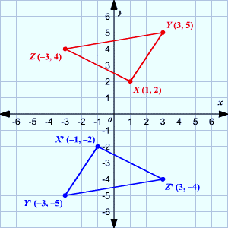
Background information to respond to question on previous slide:
For triangle XYZ shown in Figure 1. to move to the position of triangle X’Y’Z’, it must be rotated counterclockwise 180°.
Type of Rotation of image | Point on the pre-image | Point on the image after rotation
Rotation of 90$°$ clockwise | ( x , y ) | ( y , -x )
Rotation of 90$°$ counterclockwise | ( x , y ) | ( -y , x )
Rotation of 180$°$ clockwise or counterclockwise | ( x , y ) | ( -x , -y )
Rotation of 270$°$ clockwise | ( x , y ) | ( -y , x )
Rotation of 270$°$ counterclockwise | ( x , y ) | ( y , -x )
Figure 1.
Rotated Triangles
Figure 2.
Rotation Rules

Slide 60
Cross-Curricular Argumentation Guide A
Name: | Date: | Class: | Topic: Lunar phases (sample background on following slide)
1. Clarify the claim with any qualifier and define key terms. The cyclic pattern of lunar phases can be observed and predicted. cyclic pattern - a pattern that recurs at regular intervals lunar phases - the shapes of the directly sunlit portion of the Moon as viewed from Earth
2. List the evidence. The Earth rotates on its axis in approximately 24 hours. The Moon revolves around the Earth in approximately 29 days. During the Moon’s revolution around the Earth, light from the sun is reflected off the Moon’s surface. The portion of the Moon’s surface that is visible from Earth depends on the relative position of the Moon, the Earth, and the Sun. | 3. Analyze the reasoning. Since the Earth rotates on its axis in approximately 24 hours, there is the cyclic pattern of day and night. Since the Moon revolves around the Earth in approximately 29 days, the position of the Moon relative to the Earth and the Sun changes daily. Because the light from the sun reflects off the Moon, we can see the Moon’s shape which is a lunar phase. Since the position of the Moon relative to the Earth and the Sun changes daily, then the portion of the Moon visible from the Earth also changes daily; this results in a cyclic pattern of lunar phases.
4. Identify other arguments for or against the claim. I have observed different lunar phases when looking at the night sky. I can predict that I will see a full moon about once a month.
5. Make a judgment about the quality of evidence, the reasoning, and other arguments. The evidence presented is good because it is based on scientific facts and personal observation. The reasoning that ties the evidence to the claim is logical.
6. State why you accept or reject the claim. I accept this claim because the evidence is based on scientific facts, the reasoning is logical, and I have observed it myself.

Slide 61
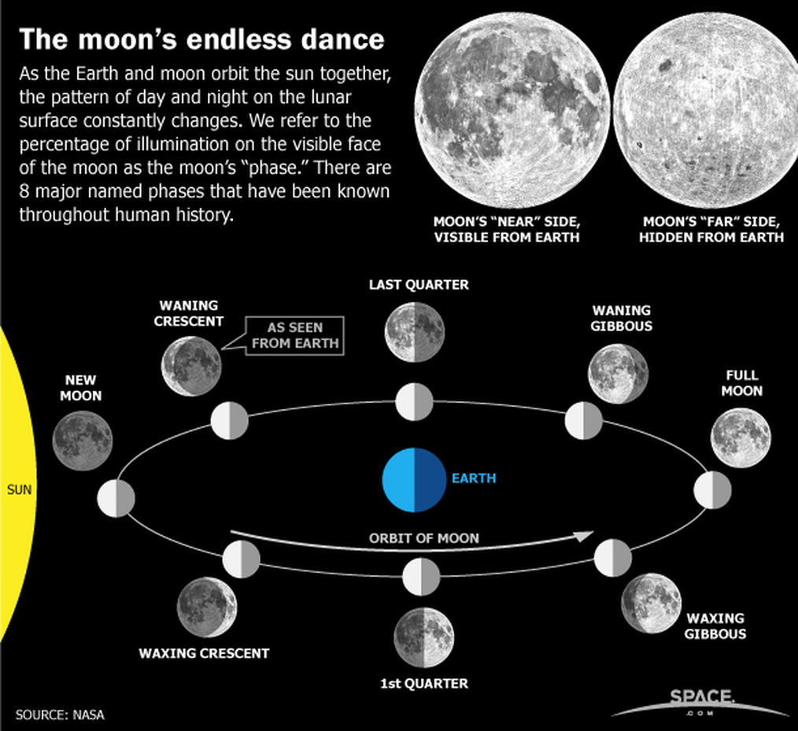
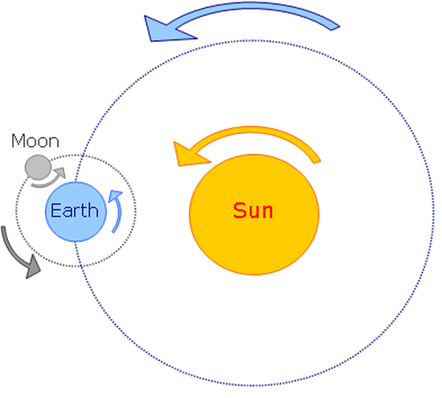
Use these models of the Sun-Earth-Moon system to respond to the claim on the previous slide “The cyclic pattern of lunar phases can be observed and predicted”.
As the Moon orbits around the Earth, the half of the moon that faces the sun is lit up. As a result, different shapes of the lit portion of the Moon that can be seen from the Earth each night.
Day 25
Day 21
Day 18
Day 0
Day 14
Model 1. Motion of the Earth-Moon-Sun System
Earth rotates (spins) on its axis in about 24 hours
Moon revolves (orbits) around the Earth in about 29.5 days
The Earth-Moon System revolves around the Sun.
Day 3
Day 11
Day 7
Model 2. Lunar Phases

Slide 62
Cross-Curricular Argumentation Guide A
Name: | Date: | Class: | Topic: American literary novel: Mark Twain
1. Clarify the claim with any qualifier and define key terms. Mark Twain’s Huckleberry Finn is an example of a great American literary novel. Literary novel: A work of fiction that explores social themes, uses figurative language such as symbolism, explores character growth, and contains a message. American novel: A novel that uses uniquely American settings or cultural beliefs and often uses colloquial language.
2. List the evidence. Literary novel characteristics include: contains an important social theme utilizes symbolism shows growth in character’s understanding contains a philosophical message for the reader American novel characteristics include: set in a specific American time and culture uses colloquial language of the time | 3. Analyze the reasoning. Huckleberry Finn: addresses the social theme of slavery. uses the Mississippi River as a symbol of Huck’s journey. Huck grows in his understanding of the immorality of slavery. has the message: worth of each human. Huckleberry Finn: is set in the American pre-Civil War Southern culture. characters in the novel use colloquial language of the time.
4. Identify other arguments for or against the claim. Throughout the novel, Huck moves from accepting the cultural belief of slaves as property and feeling guilty about helping Jim escape to recognizing Jim as a human being who showed kindness, loyalty and love of family, and deserved to be free.
5. Make a judgment about the quality of evidence, the reasoning, and other arguments. The quality of evidence is good because it lists characteristics of both a literary novel and American novel. The reasoning is logical because there is a point-by-point correlation showing all characteristics of both a literary novel and American novel are found in Huckleberry Finn. The additional argument is a good example of the cultural beliefs addressed in this novel.
6. State why you accept or reject the claim. I agree with the claim because there is a point-by-point correlation between good quality evidence and reasoning.

Slide 63
Cross-Curricular Argumentation Guide A
Name: | Date: | Class: | Topic: Flat Earth theory
1. Clarify the claim with any qualifier and define key terms. The Earth is flat and not a sphere. theory – a system of ideas intended to explain something empirical evidence – information received by means of observation and documentation of patterns and behavior through experimentation
2. List the evidence. In his 1881 book, Zetetic Astronomy, Samuel Birley Rowbotham states the Earth is a flat disc with the Arctic Circle in the center and Antarctica is a 150-foot-tall wall of ice around the rim that holds back the oceans. Zetetic Astronomy explains the sun and moon are spheres measuring 32 miles that move in circles 3,000 miles above the plane of the Earth. According to Zetetic Astronomy, the Earth disc is moving upward which makes objects appear to fall and there is no gravity. When you look out over the horizon, it always appears flat. When you watch a ship sail away, it does not drop out of sight. If you fly around the world on a plane looking at the bubble in a level, it remains in the center throughout the flight. | 3. Analyze the reasoning. If Samuel Rowbotham is an authority to be believed, his theory must be true. If the explanation of the moon and sun is part of the theory, then it must be true. If the explanation of lack of gravity is part of the theory, then it must be true. This personal observation is empirical evidence that would support a flat Earth theory. If Earth was a sphere, a ship’s path would curve, then the ship would drop out of sight as it moved around the curve (empirical evidence). If Earth was a sphere, a plane’s path would curve, then the bubble in the level would move as the plane flew around Earth (empirical evidence).
4. Identify other arguments for or against the claim. According to the NASA website, the ancient Greeks calculated Earth's circumference 2000 years ago. They could also see the Earth's round shadow on the moon during a lunar eclipse. We still can see this during lunar eclipses today. Today, scientists use geodesy, which is the science of measuring Earth's shape, gravity, and rotation. Geodesy provides accurate measurements that show Earth is round. Pictures from space also show Earth is round like the moon.
5. Make a judgment about the quality of evidence, the reasoning, and other arguments. The quality of the evidence is poor. Since no one had viewed Earth from space in 1881, Rowbotham’s theory is more of an opinion based on personal observations and weak authority. The reasoning seems to show a cause-and-effect relationship between the evidence and the claim, but since the evidence is faulty, the reasoning is poor. NASA is a respected authority and their evidence for a spherical Earth is strong.
6. State why you accept or reject the claim. I reject the claim that Earth is flat and not a sphere because it is supported by poor evidence and reasoning. Additionally, the theory is contradicted by well established scientific information from NASA.

Slide 64
Cross-Curricular Argumentation Guide A
Name: | Date: | Class: | Topic: Homologous Structures: Evidence of Common Ancestry
1. Clarify the claim with any qualifier and define key terms. Homologous structures observed in modern animals provide evidence of common ancestry, explain diversity of traits in species, and infer closeness of relationships on the evolutionary scale. homologous structures – anatomical features in different animals that have the same structure, but not necessarily the same function adaptation – process whereby organisms best suited to their environment survive to reproduce passing advantageous traits to offspring
2. List the evidence. Homologous structures are a result of a similar genetic makeup of different species. The differences in function of homologous structures of modern animals with common ancestry are a result of adaptation over many generations to survive in changing environments. Adaptation in species occurs slowly over time. | 3. Analyze the reasoning. If homologous structures indicate similar genetic make up, then animals with homologous structures must have a common ancestor. If adaptation results in a species’ traits changing over time, then over time, diversity of traits in a species increases. Since adaptations occur slowly over time, species with more similarities in their homologous structures have a closer relationship on the evolutionary scale. Also, species with greater differences in their homologous structures are farther apart on the evolutionary scale.
4. Identify other arguments for or against the claim. DNA comparisons can also show shared ancestry and how closely species are related on the evolutionary scale.
5. Make a judgment about the quality of evidence, the reasoning, and other arguments. The quality of evidence is good because it consists of accepted scientific fact. The quality of the reasoning is good because it supports the claim in logical cause-and-effect way. DNA comparison is a strong additional argument.
6. State why you accept or reject the claim. Based on the factual scientific evidence, logical reasoning, and the DNA argument, I accept the claim.

Slide 65
Cross-Curricular Argumentation Guide A
Name: | Date: | Class: | Topic: Order of Operations
1. Clarify the claim with any qualifier and define key terms. When solving the equation 24 – 6 ÷ 2 + 3² =? the correct answer is 30. the order of operations – an agreed-upon set of rules that determines which operation should be done before or after others when solving an equation
2. List the evidence. When solving an equation using the order of operations: Actions in parentheses should be solved first. Exponents should be solved second. Multiplication or division (from left to right, as found in the problem) should be solved third. Addition or subtraction (from left to right, as found in the problem) should be solved fourth. | 3. Analyze the reasoning. Since there are no parentheses in this equation, we should move to step. If exponents are solved second, then the equation becomes 24 – 6 ÷ 2 + 9 =? If division is solved third, then the equation becomes 24 – 3 + 9 =? If addition or subtraction from left to right is solved fourth, the equation becomes 24 – 3 + 9 = 30
4. Identify other arguments for or against the claim. The order of operations must be used to correctly solve an equation because, in this example, if you simply complete the operations from left to right you would get an answer of 18.
5. Make a judgment about the quality of evidence, the reasoning, and other arguments. The evidence is good because the order of operations is a set of rules that should always be used to solve an equation. The reasoning is good because it correctly applies the order of operations to the equation in the claim.
6. State why you accept or reject the claim. I accept the claim based on the quality of the evidence and reasoning.

Slide 66
Cross-Curricular Argumentation Guide A
Name: | Date: | Class: | Topic: Historical Cold Cases – The Chicago Fire of 1871
1. Clarify the claim with any qualifier and define key terms. The legend that the Great Chicago Fire of 1871 was started by a cow kicking over a lantern in a barn while being milked by Mrs. O’Leary is true.
2. List the evidence. The Chicago Evening Journal reported children stated the fire was started by a cow kicking over a lantern in a barn where a woman was milking. During an inquiry by the Board of Police and Fire Commissioners (BPFC), Mrs. O’Leary claimed to be asleep when flames first sparked in the barn. Mrs. White, a neighbor who had thrown a party the night of the fire, told Mrs. O’Leary that a male guest had slipped away and was milking cows in the O’Leary barn. At the inquiry held by the BPFC, a neighbor, Daniel Sullivan, said he left the party at 9:15, saw the fire, yelled for help, and ran into the barn to try to save the cows. After questioning 50 people, the BPFC issued an inconclusive report about the fire stating, “Whether it originated from a spark blown from a chimney on that windy night or was set on fire by human agency, we are unable to determine”. | 3. Analyze the reasoning. Since the story about how the fire started came from children, it might not be accurate. If Mrs. O’Leary were asleep when the fire started, she could not have been in the barn. Since Mrs. White’s guest left her party and was milking Mrs. O’Leary’s cows, we know someone was in the barn. Since Daniel Sullivan ran into the barn when he saw the fire, he would have seen Mrs. O’Leary if she were there. The Board of Police and Fire Commissioners was unable to conclusively report Mrs. O’Leary had anything to do with starting the fire.
4. Identify other arguments for or against the claim. Based on the evidence, a counterargument is the guest who left the party and Daniel Sullivan were the same man and that he may have started the fire when he was in the barn milking the cows.
5. Make a judgment about the quality of evidence, the reasoning, and other arguments. Much of the evidence was hearsay, but the Board of Police and Fire Commissioners is a credible source, so the evidence is pretty good. The reasoning that ties the evidence to the claim is logical. The other argument makes a possible case that someone else started the fire.
6. State why you accept or reject the claim. Based on the evidence, reasoning, and the other argument given, I reject the claim.

Slide 67
Cross-Curricular Argumentation Guide A
Name: | Date: | Class: | Topic: Face masks prevent spread of viruses
1. Clarify the claim with any qualifier and define key terms. Face masks are a critical tool in curbing the spread of a contagious virus. face mask - a protective mask covering the nose and mouth contagious virus - a submicroscopic organism that causes an infectious disease which spreads from person to person
2. List the evidence. A meta-analysis of 172 studies concluded wearing face masks significantly reduces the risk of viral transmission. (The Lancet, June 1, 2020) A study of people infected with the flu and coronaviruses found that even loose-fitting surgical masks blocked almost all contagious droplets the wearer breathed out. (Nature Medicine, April 3, 2020) In a study of Beijing households where everyone wore a facemask before a family member was even confirmed to have the coronavirus, the risk of transmission was cut by 79%. (BMJ Global Health, May 2020) A modeling study concluded that if the majority of people wore face masks in public, even homemade ones, this could dramatically reduce the spread of a contagious virus. (Proceedings of the Royal Society A, June 2020) | 3. Analyze the reasoning. Because all 4 of these published studies found that wearing masks significantly reduces the spread of a virus by blocking contagious droplets the wearer breathed out, face masks should be viewed as a critical tool in curbing the spread of a contagious virus.
4. Identify other arguments for or against the claim. WebMD says viruses spread mainly in droplets that fly out when you cough or sneeze. If those droplets enter the eyes, nose, or throat of another person, the other person is likely to become infected.
5. Make a judgment about the quality of evidence, the reasoning, and other arguments. The evidence is good because all of it is published in reputable journals. However, numbers of participants in the studies were not given. The reasoning is logical because evidence from multiple studies is used to support the claim. WebMD corroborates why a mask is effective.
6. State why you accept or reject the claim. Because of scientific evidence, logical reasoning, and corroboration, I accept the claim that face masks are a critical tool in curbing the spread of a contagious virus.

Slide 68
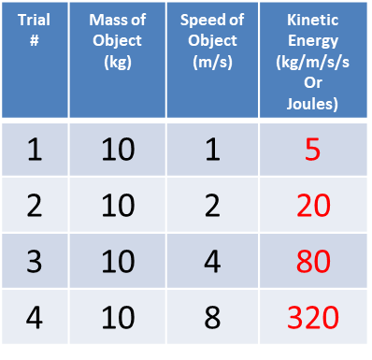
Cross-Curricular Argumentation Guide A
Name: | Date: | Class: | Topic: Kinetic Energy and Speed
1. Clarify the claim with any qualifier and define key terms. The amount of kinetic energy increases with the square of an object’s speed. Kinetic energy is the energy in a moving object that is calculated using the formula KE = ½ mass X speed². When you square a number, you multiply it by itself. For example, 2²= 2 x 2 = 4 or 3² = 3 x 3 = 9.
2. List the evidence. The experimental data provided shows the following relationships between mass and kinetic energy for an object moving at a speed of 10m/s: | 3. Analyze the reasoning. When the speed of the moving object was multiplied by 2, the kinetic energy was multiplied by 4 which is 2². When the speed of the moving object was multiplied by 4, the kinetic energy was multiplied by 16 which is 4². When the speed of the moving object was multiplied by 8, the kinetic energy was multiplied by 64 which is 8².
4. Identify other arguments for or against the claim. I know that in a wreck, the faster the cars are going, the greater the damage. That must mean there is more energy involved at greater speeds.
5. Make a judgment about the quality of evidence, the reasoning, and other arguments. The evidence is good because it is based on experimental data. The reasoning is logical because it uses math to make cause-and-effect connections. The additional argument based on personal observation is also logical.
6. State why you accept or reject the claim. I accept the claim that the amount of kinetic energy increases with the square of an object’s speed because it is based on experimental evidence and logical reasoning.
Comparing Trial 1 to Trial 2, the speed of the moving object was multiplied by 2.
Comparing Trial 1 to Trial 3, the speed of the moving object was multiplied by 4.
Comparing Trial 1 to Trial 4, the speed of the moving object was multiplied by 8.

Slide 69
Cross-Curricular Argumentation Guide A
Name: | Date: | Class: | Topic: Air Pollution in China – Industry Over Health
1. Clarify the claim with any qualifier and define key terms. Since 2011, the Chinese government has demonstrated a greater interest in industrial development than in public health. industrial development - building and growing industry within an economy public health - the health of a population subject to government regulations
2. List the evidence. In 2011, a Chinese deputy environment minister stated it was unrealistic for China to adopt health-based environmental standards because the economic loss would be too great. In 2014, China’s environmental protection law was revised to address better management of health risks from pollution. Nothing happened. Between 2015 and 2019, China reduced air pollution by 27% when it invested in coal fueled power plants in other countries - worsening pollution in those countries. In 2018, the Ministry of Environmental Protection laid out the government response to human health problems related to exposure to pollutants in the air, but only for trial use. | 3. Analyze the reasoning. If a Chinese official defended not adopting a health-based environmental policy because of economic losses, then the government chose industrial development over public health. If the Chinese environmental protection law was revised to address better management of health risks and nothing changed, then this is another example of choosing industrial development over public health. If China cut their air pollution by moving the cause of the pollution to other countries, then they are still creating a danger for public health. If the Ministry of Environmental Protection had a trial plan to respond to health problems related to exposure to air pollutants, then they acknowledged the problem, but still have not committed to solving it.
4. Identify other arguments for or against the claim. Edward Cunningham from Harvard University, a specialist on China and its energy markets, reported in 2019 that China was building or planning more than 300 coal plants in several other countries.
5. Make a judgment about the quality of evidence, the reasoning, and other arguments. The quality of the evidence is very good because it includes data and sources. The reasoning is good because it ties the evidence to the claim using cause-and-effect logic. The Harvard authority provides corroboration for the claim.
6. State why you accept or reject the claim. I accept this claim because the evidence includes data and sources, the reasoning is good cause-and-effect logic, and the information about coal plants is corroborated by an authority.

Slide 70
Cross-Curricular Argumentation Guide B
Name: | Date: | Class: | Topic: Face masks prevent spread of a virus
1. Clarify the claim with any qualifier and key terms (including author, date, source, era). Community use of multi-layer cloth face masks will prevent spread of a virus. Author: CDC website Date: 11.10.2020 Source: information from 42 scientific studies CDC - Center for Disease Control and Prevention – a government agency in charge of public health asymptomatic or pre-symptomatic - infected people who feel well and may be unaware of their ability to infect others
2. List the evidence (facts, data, authority, theory, precedent). The CDC cited the following data from multiple scientific authorities: Data from 4 studies showed that multi-layer cloth masks block release of exhaled respiratory particles carrying a virus. Data from 2 studies showed that 50% of virus spread is due to asymptomatic or pre-symptomatic people. Data from 14 studies showed that up to 50% of virus particles can be filtered from inhaled air by an effective mask and 1 study showed that some masks materials repel droplets. | 3. Analyze the reasoning (cause-effect, correlation, generalization). Since studies show a cause-and-effect relationship between the quality of masks and effectiveness of blocking virus particles, everyone should use a multi-layer cloth mask at minimum to protect others. Since studies show a cause-and-effect relationship between virus spread and people who do not have symptoms, we can generalize that everyone needs to wear a mask to protect others. Since studies show a cause-and-effect relationship between wearing a mask and the filtering or repelling of virus particles, we can generalize everyone needs to wear a mask to protect themselves.
4. Identify other arguments for or against the claim (rebuttal, counterargument, corroboration). A study of an outbreak aboard the USS Theodore Roosevelt aircraft carrier where people worked and lived close together found that use of face coverings on-board was associated with a 70% reduced risk of getting a virus. This corroborates the claim.
5. Make a judgment about quality of evidence (accurate, adequate, objective, relevant), reasoning, (type of reasoning), and other arguments. The evidence is excellent CDC-cited data from multiple scientific authorities. The reasoning shows a cause-and-effect relationship between wearing an effective face mask and reducing the spread of a virus. Since this was true for the studies, we can generalize that mask wearing would protect the public from the spread of a virus. The USS Theodore Roosevelt case study corroborates the claim.
6. State why you accept or reject the claim. Based on the excellent scientific evidence that shows a cause-and-effect relationship between mask wearing and preventing the spread of a virus, I accept this claim.

Slide 71
Cross-Curricular Argumentation Guide B
Name: | Date: | Class: | Topic: Civil Disobedience: Letter from Birmingham Jail
1. Clarify the claim with any qualifier and key terms (including author, date, source, era). Use of civil disobedience to change unjust segregation laws through non-violent protests is justified. Author: Rev. Martin Luther King, Jr. Date: 1963 Source: Letter written by MLK while in jail in Birmingham Era: Civil Rights movement with marches and protests King’s letter was in response to an open letter from 8 white clergymen who argued for peaceful negotiation rather than demonstrations against segregation.
2. List the evidence (facts, data, authority, theory, precedent). Martin Luther King, Jr. stated: A local law that preserves segregation and denies citizens the right of assembly is an unjust law and contrary to Constitutional rights. Natural law and Christian moral codes supporting equality have higher status and take precedent over man-made laws. White business and Christian church leaders who say they believe in equality but do not support it with actions create barriers to economic, financial, and social equality for African Americans. Historically, some authorities defended protesting and disobeying unjust laws. (Jefferson, St. Augustine, Paul, Biblical figures). Segregation laws that cause humiliation, brutality, poverty and psychological problems are unjust. African Americans have repeatedly sought their constitutional and God-given rights for over 340 years. | 3. Analyze the reasoning (cause-effect, correlation, generalization). If a law denies people constitutional rights, then they should engage in direct action to achieve political change even if it means arrest. Given that natural law and Christian moral codes supporting equality take precedent over man-made laws, those laws should be changed. If leaders say one thing and do another, that is contrary to Christian principles and creates social, financial, and economic barriers for African Americans. Since historical figures supported protest of unjust laws, therefore there is an historical and theoretical correlation to the 1963 protests. Segregation that results in humiliation, brutality, poverty, and psychological damage harms African American citizens. If justice is delayed, the effect is that justice is denied.
4. Identify other arguments for or against the claim (rebuttal, counterargument, corroboration). The 8 clergymen’s claim argued that adhering to principles of law requires addressing violations of rights in the courts and negotiations, not in provocative street demonstrations.
5. Make a judgment about quality of evidence (accurate, adequate, objective, relevant), reasoning, (type of reasoning), and other arguments. The evidence seems accurate, adequate, and relevant. King uses cause-and-effect, correlation, and generalization reasoning to connect his evidence to political, moral, ethical, theoretical, and psychological results. The clergymen’s statement is not strong because negotiations to end racism had been ineffective for 340 years.
6. State why you accept or reject the claim. I accept King’s claim. The evidence is based on fact, authority, theory, and precedent. It is well-supported with good cause-and-effect reasoning, and the argument against it is not persuasive.

