Slide 1
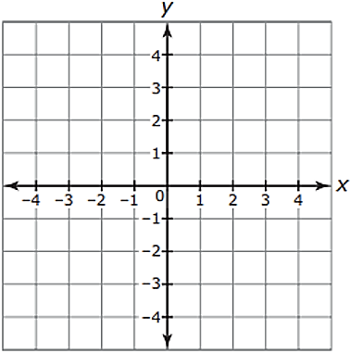
The FRAME Routine
Key Topic
is about…
Constructing Geometric Shapes
drawing 2-dimensional figures from given conditions
Example 1
Example 2
Example 3
Example 4
Conditions
Conditions
Conditions
Conditions
The shape has 3 sides.
Unique triangle.
The figure is a quadrilateral.
The figure is a quadrilateral.
Has one line of symmetry.
Has one line of symmetry.
Symmetric about the x-axis.
No lines of symmetry.
Only one pair of parallel sides.
Two pairs of parallel sides.
Line of symmetry is vertical.
Side length of 5 units.
Side lengths are 4 and 6 units.
Draw a triangle
Draw a triangle
Draw a 4-sided shape.
Draw a 4-sided shape.
Same length on each side of line of symmetry (x-axis).
Same length on each side of line of symmetry.
Same length on each side of line of symmetry.
If you fold the shape in any direction, it won’t match.
Only trapezoids have one pair of parallel sides.
Parallelograms have two pair of parallel sides.
Vertical mean up and down.
Base of triangle is 5 units.
Sides 6 and 4 units.

Slide 2
The FRAME Routine
Key Topic
is about…
Example 1
Example 2
Example 3
Example 4
Conditions
Conditions
Conditions
Conditions
The shape has 3 sides.
Unique triangle.
The figure is a quadrilateral.
The figure is a quadrilateral.
Has one line of symmetry.
Symmetric about the x-axis.
No lines of symmetry.
Has one line of symmetry.
Only one pair of parallel sides.
Two pairs of parallel sides.
Line of symmetry is vertical.
Side length of 5 units.
Side lengths are 4 and 6 units.

Slide 3
Example 5
Example 6
Example 7
Example 8
So What? (What’s important to understand about this?)

