Slide 1
The Teaching Cause-and-Effect Routine
By: Janis Bulgren, Ph.D.
University of Kansas Center for Research on Learning
Copyright 2014
Notes:
A routine that teachers can use to help students engage in Higher Order Reasoning.
Where is higher order reasoning showing up in your standards or courses?
What are challenges of students engaging in HOR?
What tools or methods have you been using to engage students in HOR?
Are these a regular part of your instruction? If so, how are they working? If not, you might try seeing how this squares with your teaching.

Slide 2
Thinking about Higher Order Reasoning
Where is higher order reasoning (HOR) in your standards or courses?
What are some challenges for engaging students in HOR?
What tools or methods have you been using to engage students in HOR?
Are these a regular part of your instruction? If so, how are they working? If not, how does this square with your teaching?
Notes:
Lead discussion about Higher Order Reasoning and Thinking skills.

Slide 3
Table of Contents
Chapter 1: Introduction
Chapter 2: The Guide
Chapter 3: Using the Routine w/ Students
Chapter 4 : Extend Student Learning
Appendix A: Instructional Materials
Appendix B: Example C&E Guides
Appendix C: An Example C&E Routine
Notes:
Let’s take a look at the organization of Teaching Cause and Effect

Slide 4
Cause-and-Effect Guide
Name:___________________ Date:___________________ Unit: ___________________Topic:________________________
1
2
Restated question:
Key Terms:
What causes farmers in South America to slash and burn the tropical rain forest, and what is the effect of that practice?
Tropical rain forest: dense forest, usually in hot, rainy area
Habitat: natural home
4
Causes & Connections:
3
Event & Background Information:
5
Effects & Connections:
Slashing and burning
the tropical rain forest
Plowing and grazing cause soil erosion
Land quickly loses all nutrients; plants and grass won’t grow
Land is abandoned, and new land has to be slashed and burned for growing more crops and grazing cattle
Unique habitat for plants and animals is lost
People need land for growing crops and raising cattle.
Leading to
Forest trees are cut down (slashed)
Remaining forest foliage is burned
Ashes provide short-term nutrients for growing crops and grazing cattle
Resulting in
6
Answer:
Farmers in South America slash and burn the tropical rain forest to obtain land for farming and cattle grazing. The land quickly becomes unusable, creating the need for slashing and burning more land. The practice destroys the habitat of many plants and animals.
TOOL BOX: Take one of these shapes and drag to use in your organizer.
You can drag, resize and place these shapes however you’d like.
Verb label box
Verb label box
Verb label box
Verb label box
Verb label box
Verb label box
Verb label box
© 2013 Janis Bulgren
Verb label box
Notes:
This Example Guide will be used throughout our discussion, so have a copy handy - physically or electronically.

Slide 5
Chapter 1: Introduction
Pages 1 & 2
Purpose
Supporting Research
Overview of Examples
Further Information

Slide 6
Higher Order Reasoning Defined
The Cause-and-Effect Routine is a package of instructional methods that teachers can use to help students engage in higher order reasoning. Although “reasoning” has many definitions, it is used here to describe thinking about a relationship in which one thing either leads to another or results from another.

Slide 7
Reasoning Process
Guide Students:
Begin with an event, action, idea, topic, or procedure.
Then think about its causes and effects.
The process enables students to acquire content knowledge and explore, analyze, and evaluate causal relationships within the content area.

Slide 8
How the Cause-and-Effect Routine Responds to Standards
Standards (including CCSS) challenge students as early as 3rd grade to describe the relationship between events, ideas, concepts or steps in terms of time, sequence and cause/effect.
This challenge is incorporated throughout Standards – sometimes with specific references to causes and effects and sometimes embedded within other terms.
Notes:
At 3rd grade standards

Slide 9
How the Cause-and-Effect Routine Responds to Next Generation Science Standards
The Next Generation Science Standards (NGSS) emphasize the importance of understanding causes and effects as a one of the seven Crosscutting Concepts of science.
Among the NGSS Dimensions of Science Framework, Cause and Effect is the second component of the Crosscutting Concepts and integrated into Science & Engineering Practices and the Core Ideas. https://www.nextgenscience.org/

Slide 10
Supporting Research
164 students
enrolled in seventh- and eighth-grade social studies and science classes.
HALO - students represented those identified as having learning disabilities, those who were low achieving, average achieving, and high achieving

Slide 11
Supporting Research
Findings from studies indicate that students in the experimental group:
Significantly outperformed students in the control group
Were able to learn the strategic steps designed to analyze a cause-and-effect relationship,
Were able to apply the steps as they analyzed a cause-and-effect relationship, and take better notes.
Were more motivated to do well in school and on tests
Were more confident in the correctness of their analysis of a cause and effect relationship

Slide 12
Chapter 2 – A Better Tool
The Guide begins with exploration of the critical event itself, not just the causes and effects.
The Guide provides a flexible template for examining a variety of relationships.
The Guide contains an embedded strategy to support student ownership of the steps and HO reasoning.

Slide 13
Chapter 2: Six Sections
Restated Question – include name of event or action, process or idea and type of answer required.
Key Terms – important words, phrases and their definitions
Event & Background Information – name event & list background info, details or facts, to set stage
Causes & Connections - only if causes are expected
Effects & Connections – only if effects expected
Answer – names critical event + type of causal relationship + explanation

Slide 14
Chapter 2: Overview of Examples
These examples represent different balances among the numbers of causes and the numbers of effects in various situations.

Slide 15
Cause-Effect Patterns
EVENT
CAUSE
EFFECT
Pattern of an event with one cause and one effect
EVENT
EFFECT
CAUSE
EFFECT
EFFECT
Pattern of an event with one cause and three (or more) effects
CAUSE
EVENT
CAUSE
EFFECT
CAUSE
Pattern of an event with three (or more) causes and one effect
CAUSE
EVENT
EFFECT
CAUSE
EFFECT
CAUSE
EFFECT
Pattern of an event with three (or more) causes and three (or more) effects

Slide 16
Chapter 2: The Cause-and-Effect Guide
Presents the 6 parts of the Cause-and-Effect Guide
Special emphasis is placed on
Restating Questions
and on
Key Terms
that signal cause-and-effect questions.

Slide 17
Original and Restated Questions
Original Question: Deforestation has reached levels of about 40 million acres each year. More than 50 percent of the rain forests have been cut. About 2% of the rest of the rain forests are destroyed in each succeeding year. What has caused this, and what could result?
Restated Question: What are the causes and effects of the destruction of the rain forest?

Slide 18
Words that can Signal Cause-and Effect
Cause
Lead to Bring about Create Generate Induce Make Produce Prompt Drive Instigate Support Set the stage Enable Promote
Effect
Result Ramification Outcome Denouement Development Repercussion Conclusion End By-product Consequence Outgrowth Product Upshot Impact
See p. 14

Slide 19
Chapter 2: An Activity
Review the CCSS or NGSS grade level demands and terms that signal a cause-and-effect thinking challenge to trace the continuity of higher order reasoning such as cause-and-effect in the standards.

Slide 20
Chapter 2: Before Using Guide
Select critical question to be analyzed.
Construct a draft.
Watch for synonyms (Appendix A).
Be aware of ways questions are asked.
Ensure students have general understanding of event being analyzed.

Slide 21
Chapter 3: Using the Routine with Students
iTunes Book: See Cue-Do-Review Sequence demonstrated with video
Read the demonstration in Appendix C

Slide 22
Chapter 4: Extend Student Learning
The Strategy: REASON
Group Structures
Assessments & Writing Supports
Notes:
A Strategy is built in to guide teachers through this and so that teachers can teach students how to use it independently.

Slide 23
Embedded Strategic Steps: Cause-and-Effect Guide
Steps of the Strategy
Restate the question
Define key terms
Identify critical event & background information
Explore causes & connections
Explore effects & connections
Answer the question
A Mnemonic
Restate the question
Examine key terms
Analyze critical event & background information
Specify causes & connections
Organize effects & connections
Nail down the answer

Slide 24
Chapter 4: Extend Student Learning
Vary Group Structures for Instruction:
Begin with entire class
Partner or small group practice
Notes:
Teachers should not hand these out to students to complete or hand out a completed devices for students to study. We recommend that the teacher guides students through the process a couple of times before turning it over to group practice. When possible, inform students about the underlying strategy and gradually release it to them.

Slide 25
Support for Writing
See page 10
Three parts:
Introductory Paragraph: Section 1 & 2
Body of Essay: Section 3, 4, & 5
Concluding Paragraph: Section 6
Let’s try it with our example Guide

Slide 26
Cause-and-Effect Guide
Name:___________________ Date:___________________ Unit: ___________________Topic:________________________
1
2
Restated question:
Key Terms:
What causes farmers in South America to slash and burn the tropical rain forest, and what is the effect of that practice?
Tropical rain forest: dense forest, usually in hot, rainy area
Habitat: natural home
4
Causes & Connections:
3
Event & Background Information:
5
Effects & Connections:
Slashing and burning
the tropical rain forest
Plowing and grazing cause soil erosion
Land quickly loses all nutrients; plants and grass won’t grow
Land is abandoned, and new land has to be slashed and burned for growing more crops and grazing cattle
Unique habitat for plants and animals is lost
People need land for growing crops and raising cattle.
Leading to
Forest trees are cut down (slashed)
Remaining forest foliage is burned
Ashes provide short-term nutrients for growing crops and grazing cattle
Resulting in
6
Answer:
Farmers in South America slash and burn the tropical rain forest to obtain land for farming and cattle grazing. The land quickly becomes unusable, creating the need for slashing and burning more land. The practice destroys the habitat of many plants and animals.
TOOL BOX: Take one of these shapes and drag to use in your organizer.
You can drag, resize and place these shapes however you’d like.
Verb label box
Verb label box
Verb label box
Verb label box
Verb label box
Verb label box
Verb label box
© 2013 Janis Bulgren
Verb label box

Slide 27
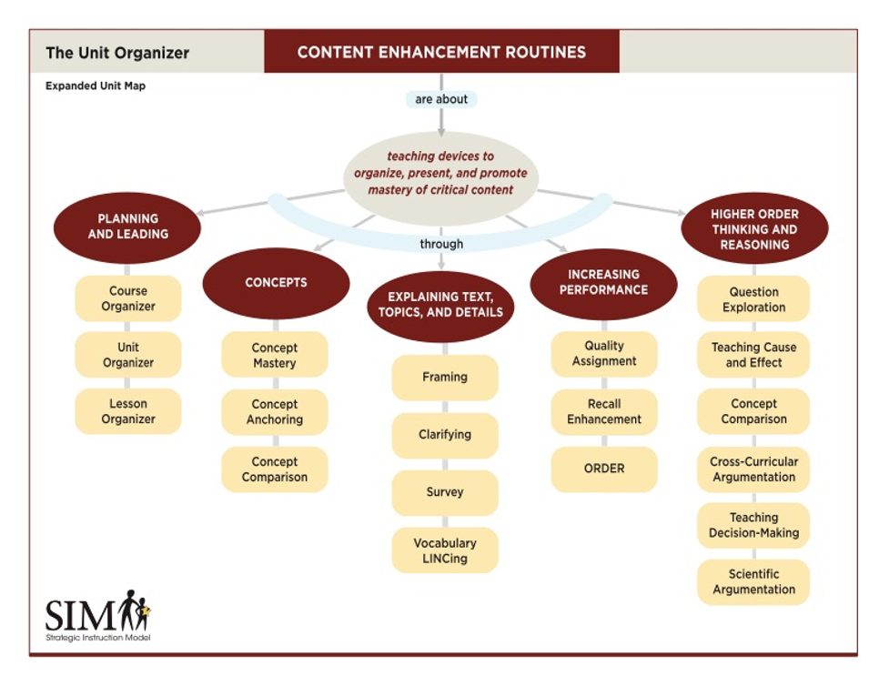
Content Enhancement Routines

Slide 28
To order Teaching Cause and Effect
www.shop.kucrl.ku.edu
For more information
https://sim.ku.edu/teaching-cause-and-effect

