Slide 1
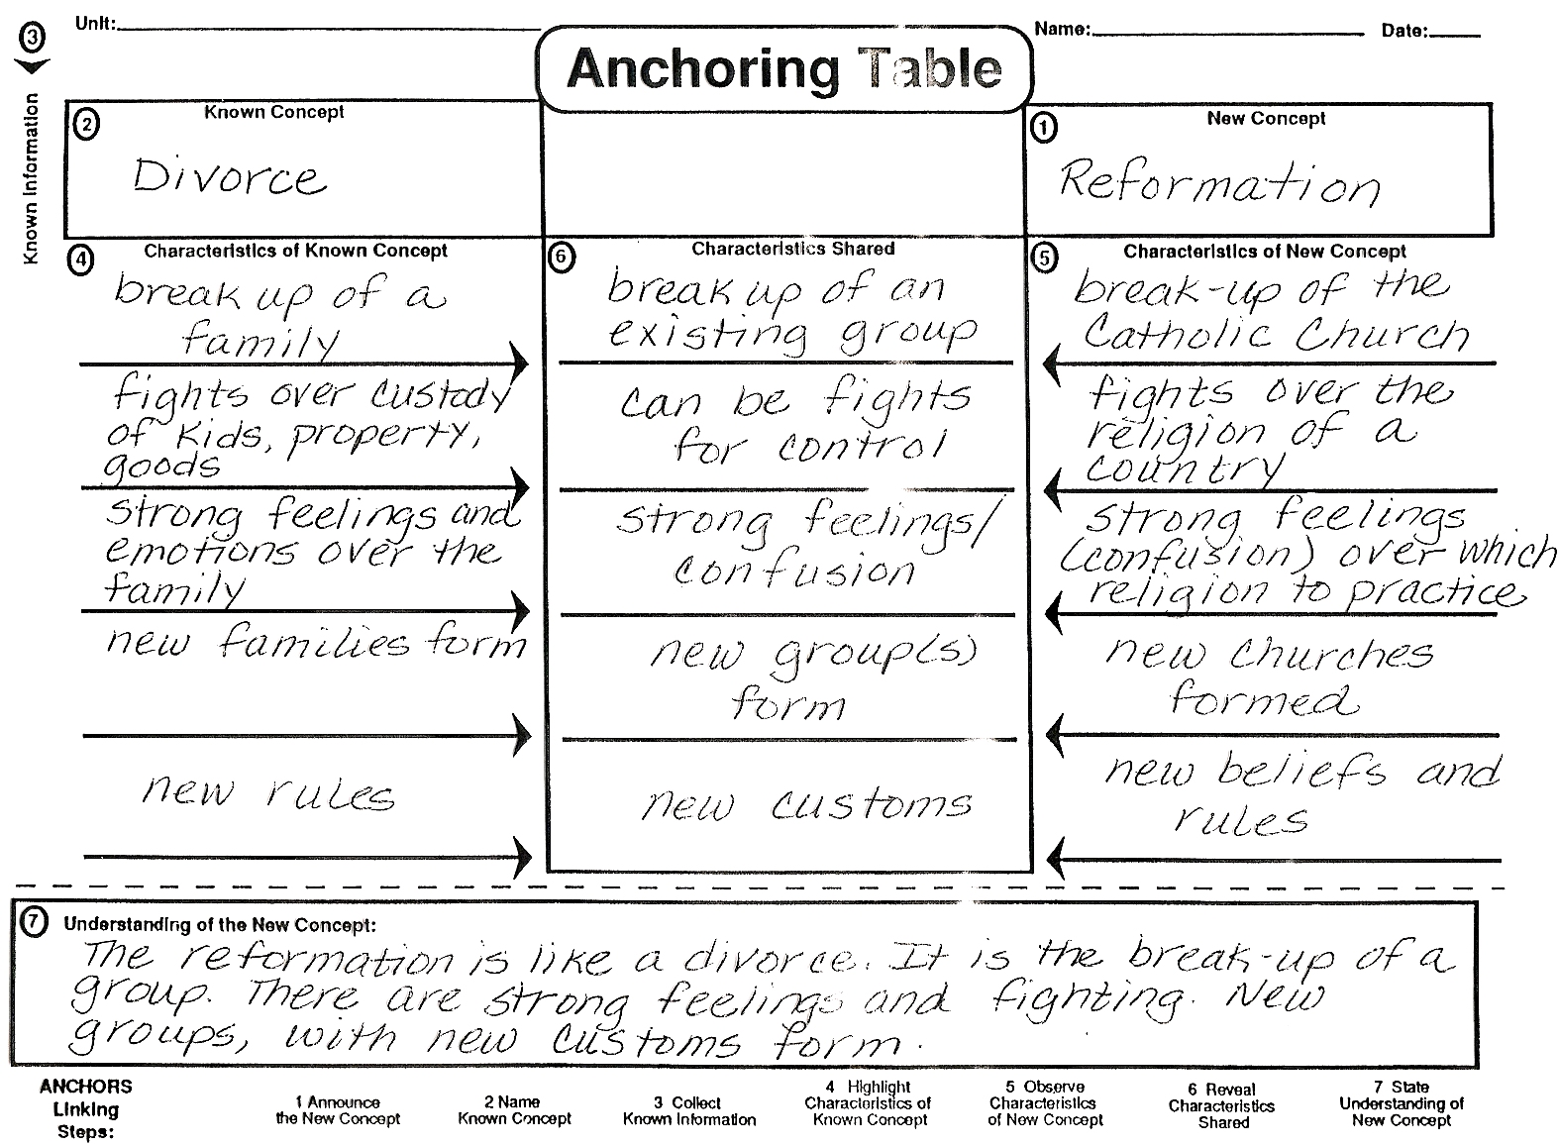
Notes:
Turlock Junior High
Peter Hamilton
Social Studies
1997

