Slide 1
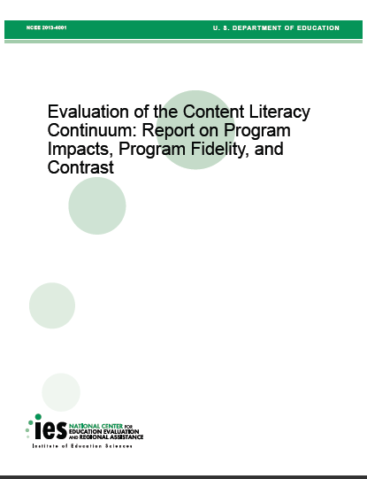
IES Report on the CLC
Click here to view the report
Click here to watch video of the 2013 SIM Conference session that accompanied this ppt discussing the IES Report
Notes:
The report is an opportunity to learn.

Slide 2
The Report on CLC
Analysis of a two-year randomized control trial (RCT) evaluation of CLC
  Impacts on 9th grade reading comprehension and credit accumulation?
  Impacts on outcomes for 10th grade students in second year of study.

Slide 3
Implementation
15 schools
Intent to Treat
Structural Fidelity – 9 components
Instructional Fidelity

Slide 4
Findings
Year 1: 22% of core class teachers used content enhancements or learning strategies
Year 2: 11% of core class teachers used content enhancements or learning strategies.
Reading Intervention: 64% of experimental schools implemented as prescribed by the developers.
Nine (9) Structural Components:
  11 of 15 schools implemented ≤ 4

Slide 5
Findings
No statistically significant differences in reading comprehension scores between the CLC condition and control schools.
No statistically significant impact on the students’ accumulation of core credits or student GPA in CLC condition school.
A statistically significant effect on student vocabulary scores in grade 9 but not in grade 10 in CLC condition schools.

Slide 6

Your Thoughts…

Slide 7
Implementation Science
Implementation is a process that will not occur “all at once or proceed smoothly” (p. 15).
Fixsen, D. L., Naoom, S. F., Blase, K. A., Friedman, R. M. & Wallace, F. (2005). Implementation Research: A Synthesis of the Literature. Tampa, FL: University of South Florida, Louis de la Parte Florida Mental Health Institute, The National Implementation Research Network (FMHI Publication #231).

Slide 8
Implementation Science
Evaluations of newly implemented innovations often take place before they are fully operational, hence,
evaluation of newly implemented programs may result in poor results (p. 18)
Fixsen, D. L., Naoom, S. F., Blase, K. A., Friedman, R. M. & Wallace, F. (2005). Implementation Research: A Synthesis of the Literature. Tampa, FL: University of South Florida, Louis de la Parte Florida Mental Health Institute, The National Implementation Research Network (FMHI Publication #231).

Slide 9

More to come as KUCRL reviews the data.
Notes:
We have petitioned for the data and will have more to say.

Slide 10
References
Corrin, W., Lindsay, J. J., Somers, M-A., Myers, N. E., Myers, C. V., Condon, C. A., & Smith, J. K. (2012). Evaluation of the Content Literacy Continuum: Report on Program Impacts, Program Fidelity, and Contrast.(NCEE2013-4001). Washington, DC: National Center for Education Evaluation and Regional Assistance, Institute of Education Sciences, U.S. Department of Education. Retrieved http://ies.ed.gov/ncee/edlabs/projects/project.asp?projectID=34
Fixsen, D. L., Naoom, S. F., Blase, K. A., Friedman, R. M. & Wallace, F. (2005). Implementation Research: A Synthesis of the Literature. Tampa, FL: University of South Florida, Louis de la Parte Florida Mental Health Institute, The National Implementation Research Network (FMHI Publication #231).

